Slide 1
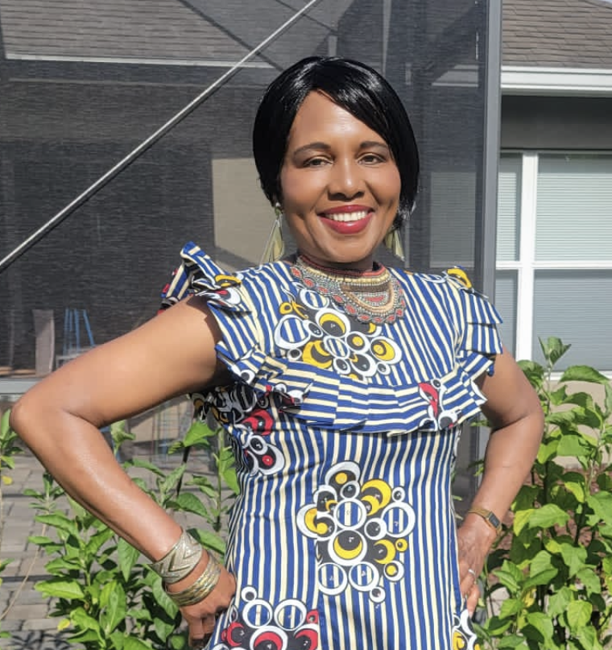
Ethics in Nursing : Upholding the VISION of the Founders
By: Mabel E. Okungbowa CRNA, MSN, BSN, RN
FOUNDER: SONUBTHA INTERNATIONAL.
FOUNDER: LOVE YOUR NEIGHBOR RESCUE MISSION INT.
FOUNDER: GRATITUDE REVOLUTION FOR LIFE

Slide 2
NURSING PHILOSOPHY
“Nursing is COMMITTED to, and ACCOUNTABLE for, safe, interprofessional practice as evidenced by CONSISTENT UTILIZATION of the NURSING PROCESS, collaboration with our colleagues and achievement of QUALITY OUTCOMES. We are ADVOCATES for people by promoting the delivery of the RIGHT CARE at the RIGHT TIME.”…..cedars-sinai.org

Slide 3
NURSING FOUNDERS’ VISION
Excellence in human caring

Slide 4
DEFINITION OF ETHICS
Derived from the Greek word “ethos.”
Which means “way of living.”
Ethics is a branch of philosophy that is concerned with human conduct, more specifically the behavior of individuals in society.
Ethics are moral principles that govern how the person or a group will behave or conduct themselves.
Ethics is what guides us to tell the truth, keep our promises, or help someone in need…..Mrs. Aghahowa

Slide 5
BRIEF HISTORY OF NURSING ETHICS
“The onset of nursing ethics can be traced back to the late 19th century. At that time, it was thought that ethics involved virtues such as physician loyalty, high moral character, and obedience. Since that early time, the nursing profession has evolved, and nurses are now part of the healthcare team and are patient advocates. The first formal Code of Ethics to guide the nursing profession was developed in the 1950’s.”

Slide 6
BRIEF HISTORY OF NURSING ETHICS
“Developed and published by the American Nurses Association (ANA), it guides nurses in their daily practice and sets primary goals and values for the profession. Its function is to provide a succinct statement of the ethical obligations and duties of every individual who enters the nursing profession. It provides a nonnegotiable ethical standard and is an expression of nursing’s own understanding of its commitment to society. The Code of Ethics has been revised over time. The current version represents advances in technology, societal changes, expansion of nursing practice into advanced practice roles, research, education, health policy, administration; builds and maintains healthy work environments.”

Slide 7
7 NURSING ETHICS MUST ADHERE TO
Justice, Beneficence, Nonmaleficence, Accountability, Fidelity, Autonomy, and Veracity.
JUSTICE: The right to be treated fairly and equally. Weigh if that decision is compatible with the law, the patient's rights, and if it's fair and balanced.
Beneficence: refrain from maltreatment, minimize harm, and promote good towards patients. An act of charity, mercy, and kindness with a strong connotation of doing good to others including moral obligation.

Slide 8
7 NURSING ETHICS MUST ADHERE TO Cont.
Nonmaleficence: Patient has the RIGHT TO NO HARM; requires that every medical action be weighed against all benefits, risks, and consequences, occasionally deeming no treatment to be the best treatment.
Accountability: To take responsibility for one's actions, decisions and their consequences.
Fidelity: defined as faithfulness to a person, belief, or cause. It is demonstrated by being loyal and supportive. Fidelity in nursing means nurses must remain true to professional promises, such as the promise to provide high-quality, competent, safe, and efficient patient care.

Slide 9
7 NURSING ETHICS MUST ADHERE TO Cont.
Autonomy: expressed as the right of competent adults to make informed decisions about their own medical care. Each patient has the right to make their own decisions based on their own beliefs and values.
Veracity: The principle of veracity, or truth telling, requires that healthcare providers be honest in their interactions with patients.

Slide 10


Slide 11
THE IMPORTANCE OF ETHICS WITHIN THE HEALTHCARE SETTING
workers must recognize healthcare dilemmas
make good judgments and decisions based on their values while keeping within the laws that govern them.
To practice competently with integrity. Therefore, nurses must have regulation and guidance within the profession.

Slide 12
ANA CODE OF ETHICS TO GUIDE THE NURSE: 9 PROVISIONS
Provision 1. The nurse practices with compassion and respect for the inherent dignity, worth, and unique attributes of every person.
The nurse must have a high level of respect for all individuals, and allow dignity in regards to dealings in care and communication.
It's important that patient's families are also treated with respect for their relationship to the patient.
Nurses must understand the professional guidelines in communications and work with colleagues and patient families.
It's important to understand the proper professional relationship that should be maintained with families and patients.
All individuals, whether patients or co-workers have the right to decide on their participation in care and work.

Slide 13
ANA CODE OF ETHICS TO GUIDE THE NURSE: 9 PROVISIONS Cont.
Provision 2. The nurse’s primary commitment is to the patient, whether an individual, family, group, community, or population.
The patient should always be a first and primary concern. The nurse must recognize the need for the patient to include their individual thought into care practices. Any conflict of interest, whether belonging to external organizations, or the nurse's habits or ideals that conflict

Slide 14
ANA CODE OF ETHICS TO GUIDE THE NURSE: 9 PROVISIONS Cont.
with the act of being a nurse, should be shared and addressed to not impact patient care.
Collaboration with internal and external teams to foster best patient care is a necessity.
Understanding professional boundaries and how they relate to patient care outcomes is important.

Slide 15
ANA CODE OF ETHICS TO GUIDE THE NURSE: 9 PROVISIONS Cont.
Provision 3. The nurse promotes, advocates for, and protects the rights, health, and safety of the patient.
It is important for the nurse to understand all privacy guidelines with regards to patient care and patient identifiers.
Nurses involved in research must understand all aspects of participation including informed consent and full disclosure to the patient of all aspects required to participate in the study.

Slide 16
ANA CODE OF ETHICS TO GUIDE THE NURSE: 9 PROVISIONS Cont.
The nurse must understand any institutional standards set in place to review his/her performance; this includes measurements of progress and the need for further review or study to meet performance standards. CONTINUING EDUCATION
To become a nurse, competence must be demonstrated in clinical and documentation prowess. Standards of competence will continue at institutions and academic organizations that employ the nurse.

Slide 17
ANA CODE OF ETHICS TO GUIDE THE NURSE: 9 PROVISIONS Cont.
If there is witness or recognition of questionable healthcare practice, it is important that the patient is protected by reporting any misconduct or potential safety concern. EMERGENCY ROOM EXPERIENCE IN UBTH THIS WEEK: PRIORITIZATION OF CARE
And finally, the nurse will not provide patient care while under the influence of any substance that may impair thought or action, this includes prescription medication.

Slide 18
ANA CODE OF ETHICS TO GUIDE THE NURSE: 9 PROVISIONS Cont.
Provision 4. The nurse has authority, accountability, and responsibility for nursing practice; makes decisions; and takes action consistent with the obligation to provide optimal patient care.
As a nurse, it's inherent that accountability for all aspects of care aligns with responsible decision making.
Use of authority must be professional and about all aspects of individualism and patient, ethical concerns.

Slide 19
ANA CODE OF ETHICS TO GUIDE THE NURSE: 9 PROVISIONS Cont.
Nursing decisions must be well thought, planned, and purposefully implemented responsibly.
Any delegation of nursing activities or functions must be done with respect for the action and the ultimate results to occur.

Slide 20
ANA CODE OF ETHICS TO GUIDE THE NURSE: 9 PROVISIONS Cont.
Provision 5. The nurse owes the same duties to self as to others, including the responsibility to promote health and safety, preserve wholeness of character and integrity, maintain competence, and continue personal and professional growth.
A nurse must also demonstrate care for self as well as others. An ideal nurse, will have self-regard towards healthcare practices and uphold safe practice within the care setting and at home.

Slide 21
ANA CODE OF ETHICS TO GUIDE THE NURSE: 9 PROVISIONS Cont.
It's important for a nurse to have a high regard for care as an overall inert ability once the profession is entered.
A character becoming a nurse would include integrity. Nurses should be concerned for personal growth in regards to continued learning of the profession. The ability to grow as a nurse with improvements to care, changes or trends in care should be adapted to maintain competence and allow growth of the profession.

Slide 22
ANA CODE OF ETHICS TO GUIDE THE NURSE: 9 PROVISIONS Cont.
Provision 6. The nurse, through individual and collective effort, establishes, maintains, and improves the ethical environment of the work setting and conditions of employment that are conducive to safe, quality health care.
As a nursing profession, standards should be outlined within and external to institutions of work that dictate ethical obligations of care and need to report any deviations from appropriateness.

Slide 23
ANA CODE OF ETHICS TO GUIDE THE NURSE: 9 PROVISIONS Cont.
It's important to iron mental considerations that are conducive to best patient care outcomes. understand safety, quality and environmental considerations that are conducive to best patient care outcomes.

Slide 24
ANA CODE OF ETHICS TO GUIDE THE NURSE: 9 PROVISIONS Cont.
Provision 7. The nurse, in all roles and settings, advances the profession through research and scholarly inquiry, professional standards development, and the generation of both nursing and health policy.
Nurse education should include principles of research, and each nurse should understand how to apply scholarly work and inquiry into practice standards.
Nurse committees and board memberships are encouraged to contribute to health policy and professional standards.
The ability to maintain professional practice standards should continue, changing and enhancing as developments in practice may over time.

Slide 25
ANA CODE OF ETHICS TO GUIDE THE NURSE: 9 PROVISIONS Cont.
Provision 8. The nurse collaborates with other health professionals and the public to protect human rights, promote health diplomacy, and reduce health disparities.
Through collaboration within the discipline, maintaining the concept that health is a right for all individuals will open the channels of best practice possibilities.
The nurse understands the obligation to continue to advance care possibilities by committing to constant learning and preparation.
The ability of the nurse to practice in various healthcare settings may include unusual situations that require continued acts of diplomacy and advocacy.

Slide 26
ANA CODE OF ETHICS TO GUIDE THE NURSE: 9 PROVISIONS Cont.
Provision 9. The profession of nursing, collectively through its professional organization, must articulate nursing values, maintain the integrity of the profession, and integrate principles of social justice into nursing and health policy.
Nurses must continue to gather for committees and organize groups where they may share and evaluate values for accuracy and continuation of the profession.
It is within these organizations that nurses may join in strength to voice for social justice.
There is a need for continued political awareness to maintain the integrity of the nursing profession. The ability of the nurse to contribute to health policy should be shared among the profession, joining nurses throughout the world for a unified voice.
American Nurses Association. (2015). Code of ethics with interpretative statements. Silver Spring, MD

Slide 27
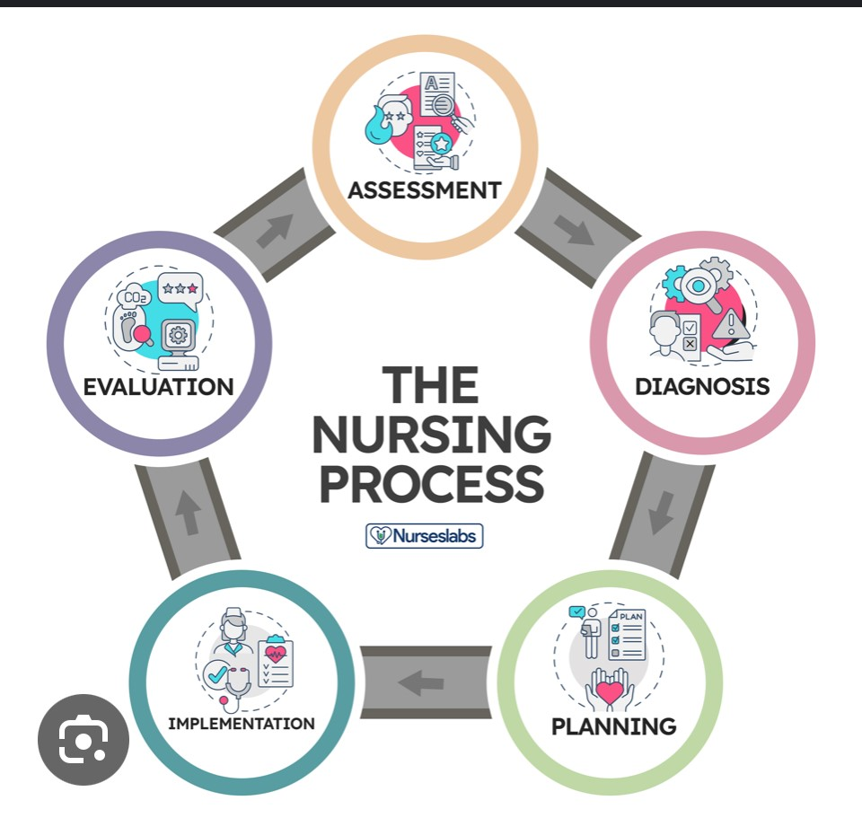
THE NURSING PROCESS

Slide 28
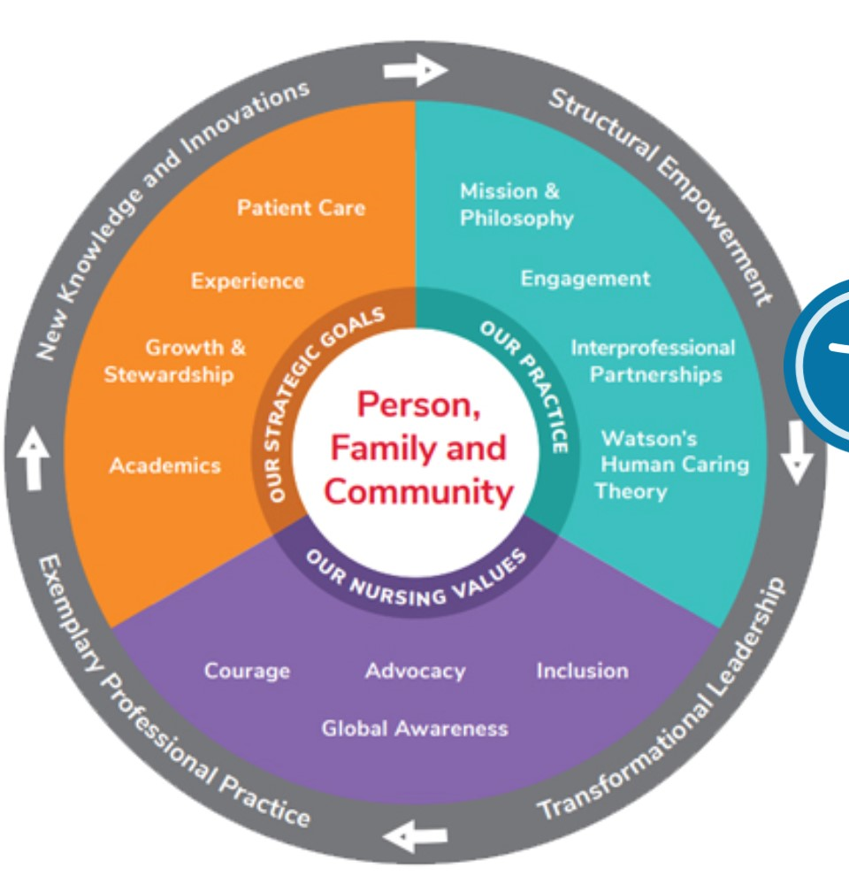
THE 3 C’s: CENTER, CENTRAL, CORE OF THE NURSING PROFESSION

Slide 29
PRACTICAL APPLICATIONS IN UBTH
SCENERIO #1: In 1983, a baby born at home under traditional birth attendant was brought to UBTH with severe jaundice. Because this mother was very poor, she couldn’t afford to pay for CONTINUOUS phototherapy or Exchange blood transfusion; rather she was asked to bring the baby from home to be exposed to phototherapy for few hours. Unfortunately, the child was complicated with kenicterus that resulted to developmental delay and seizures. In 2010, At the age of 26, he wondered away from home and never came back. His 79 years old mother (2023), perpetually lives with the pain and continues to look at that door entrance to their home that someday his son will come back home.

Slide 30
PRACTICAL APPLICATIONS IN UBTH
SCENERIO #2: A 77 years old woman was admitted to surgical ward with history of type 2 DM, HTN, and diabetic foot ulcer. She was scheduled for skin graft. She spent 10 days in UBTH with surgical treatment. Nurses were advising her to go and see the consultants privately and bribe him if she truly wanted her surgical treatment. She was never seen by the consultant. She got fed up, paid the hospital bills that she was not treated for and discharged herself to receive care from a private hospital.

Slide 31
PRACTICAL APPLICATIONS IN UBTH
SCENERIO #3: In 2021, an 86 years old man with no prior medical history collapsed in his home and was rushed to the hospital. They admitted him in coma and received a diagnosis of cerebrovascular accident (CVA or Stroke). Patient was in bed half naked, head of bed flat; initially no oxygen given; IV heplock without continuous iv infusion. His urinary output was very dark and concentrated like coffee. Few hours later, he was gasping for air and he was given oxygen via simple face mask and head of bed flat. At this time IV fluid was commenced. He later died 24 hours after admission. See his picture and video of patient.

Slide 32
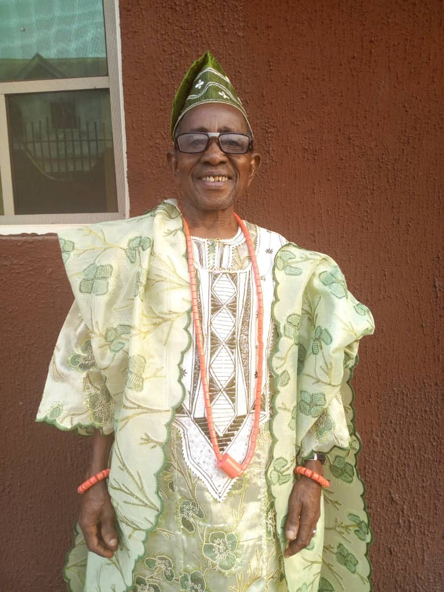
SCENERIO #3: 86 YEARS OLD MALE SUSTAINED ACUTE CVA

Slide 33
PRACTICAL APPLICATIONS IN UBTH
SCENERIO #4: A 79 years old female admitted for surgical removal of rod previously inserted in her hip 4 years ago following fracture. Her medical history included DM2, HTN, high cholesterol. She was charged for glucose control postop but the nurses would carry our her blood sugar checks but refused to tightly control with SQ insulin 70/30 and Humulin R; and her postop blood sugar rose to 200’s. Patient’s family member had to quickly complain and took over her glucose monitoring in order to prevent wound dehiscense. The IM pain medications administered to her were not preceded with any explanation….like working with robots. Patient was clueless about the names of the 9 pills dispensed TID without explanations. In addition, offering of bedpans and bed baths to their patients became the SOLE RESPONSIBILITIES of family members.

Slide 34
QUESTIONS FOR UBTH NURSING DEPARTMENT: RESEARCH WORK FOR ALL STUDENTS IN THE COLLEGES OF NURSING UBTH
Do we HONESTLY want to effect changes in nursing practice in UBTH to meet the international standard of nursing care?
This is a TRANSFORMATIVE LIFETIME JOURNEY that involves every nurse and at every level of the PYRAMID: nursing school at the base and the Chief Nursing Officer (CNO) at the peak of this pyramid.
Involves the UBTH management: their willingness to include the budget to establish a WORKING education department who designs MANDATORY ANNUAL COMPETENCIES.
A department that enforces policies and procedures: “POLICING” and ready to engage in CONSCIENTIOUS DISCIPLINARY ACTIONS irrespective of your position in the department and personal connections/influence with those in power.

Slide 35
ARE WE TRULY READY TO PRACTICE THIS KIND OF NURSING IN UBTH?
We practice HUMAN CARING.
We LISTEN to our patients and their loved ones.
We PLACE our patients at the center of ALL planning and decision-making.
We meet each patient where they are in the moment.
We CONNECT with each person by VALUING their unique needs, spiritual beliefs, and personal choices
We ALWAYS SEEK to earn person’s TRUST.

Slide 36
ARE WE TRULY READY TO PRACTICE THIS KIND OF NURSING IN UBTH? CONT.
Can we PURSUE and APPLY new Knowledge, evidence-driven practice and models of care as a means of providing services that EXCEED expectations?
Can we UTILIZE RESEARCH as the basis for our practice?
Can we ENGAGE in CONTINUOUS quality improvement?
Can we EMBRACE new technologies to promote the delivery of care?
Can we be COGNIZANT of the cost of care and ENGAGE in initiatives to enhance value?
Can we PARTNER with other department within the health sectors to provide a HOLISTIC CARE to our patient population?

Slide 37
BOTTOMLINE: VALUES ALLIGNMENT
OUTCOME: UBTH OVERALL VALUES WOULD HAVE TO ALLIGN WITH THE FOLLOWING VALUES:
Integrity
Compassion
Excellence
Innovation
Stewardship
Teamwork and Collaboration
Respect and Diversity

Slide 38
QUESTIONS ???
THANK YOU !
THANK YOU !!
AND THANK YOU SO MUCH !!!

Slide 39
BIBLIOGRAPHY
https://www.ncbi.nlm.nih.gov/books/NBK526054/
Epstein B, Turner M. The Nursing Code of Ethics: Its Value, Its History. Online J Issues Nurs. 2015 May 31;20(2):4. [PubMed
Morrell TJ, Konda S, Grant-Kels JM. Response to a letter to the editor regarding "The ethical issue of cherry picking patients". J Am Acad Dermatol. 2019 May;80(5):e127. [PubMed]
Suen KK. Ethical implications of population ageing in the intensive care unit. Ir J Med Sci. 2019 May;188(2):699-702. [PubMed]
Tiruneh MA, Ayele BT. Practice of code of ethics and associated factors among medical doctors in Addis Ababa, Ethiopia. PLoS One. 2018;13(8):e0201020. [PMC free article] [PubMed]
https://www.cedars-sinai.org/med-pros/nursing/mission.html#:~:text=Nursing%20is%20committed%20to%2C%20and,care%20at%20the%20right%20time

