Slide 1
The Urinary System: Comprehensive Overview, Nursing and Medical Management
Presented by:
Mabel Okungbowa, CRNA, APRN, MSN, BSN, RN
Notes:
AI-generated content may be incorrect. --- This presentation aims to provide a thorough understanding of the urinary system, its functions, anatomy, disorders, and management. We will explore the significance of the urinary system in maintaining homeostasis and the implications for nursing and medical practices.

Slide 2
Agenda for Today's Presentation
Introduction to the Urinary System
Anatomy and Physiology of the Urinary System
Functions of the Urinary System
Disorders of the Urinary System
Nursing and Medical Management of Urinary Disorders
Evidence-Based Nursing Practice in Urinary System Care
Notes:
We will begin with an introduction to the urinary system, discussing its definition and components. Next, we will explore the functions of the urinary system, followed by a detailed look at its anatomy and physiology. We will also cover common disorders, management strategies, and the integration of evidence-based practices in urinary care.

Slide 3
Overview of the Urinary System
Function of the Urinary System
Kidneys filter blood to produce urine, which helps expel waste from the body.
The kidneys filter ~200 Quarts/day (large bathtub size)
~2 Quarts filters as urine (1 QT=946.4 mL)
~198 Quarts reused by the body
Fluid Balance Regulation
Kidneys regulate body’s fluid balance and electrolyte levels (Mostly Na+ and K+)
Homeostasis Maintenance
The urinary system maintains homeostasis by regulating body temperature, pH, and hydration levels.
Notes:
The urinary system, also known as the renal system, is responsible for filtering blood, producing urine, and expelling waste from the body. It plays a vital role in regulating fluid balance and maintaining homeostasis.

Slide 4
Overview of the Urinary System
Function of the Urinary System Cont.
Gluconeogenesis: body converts non-carbohydrate molecules (like amino acids, glycerol, and lactate) into glucose.
(20-25% of total glucose released into the body.) Especially during fasting state
Makes protein called Renin that increases blood pressure
Produces Hormones: Calcitrol (form of Vit D that helps with calcium absorption); Erythropoietin (Red Blood Cells production)
Notes:
The urinary system, also known as the renal system, is responsible for filtering blood, producing urine, and expelling waste from the body. It plays a vital role in regulating fluid balance and maintaining homeostasis.

Slide 5
Anatomy and Physiology of the Kidneys
Notes:
The kidneys are the principal organs of the urinary system, responsible for filtering blood, producing urine, and regulating various bodily functions. Their structure is intricately designed to perform these tasks efficiently.

Slide 6
Gross Structure of the Kidneys
Kidney Location
The kidneys are bean-shaped organs positioned on either side of the spine, just below the ribcage
Outer Cortex
Each kidney has an outer cortex where the Nephron begins (filtering blood and producing urine.) Erythropoietin is produced in the cortex
Inner Medulla
Contains the renal pyramids (most Nephrons with glomeruli and renal tubules) plays a vital role in urine concentration.
Renal Pelvis and Ureter
The funnel shaped renal pelvis connects to the ureter, collects and transport of urine from the kidneys to the ureters >>>> urinary bladder
Notes:
The kidneys are bean-shaped organs located on either side of the spine. Each kidney is composed of an outer cortex and an inner medulla, with a renal pelvis leading to the ureter. Understanding their gross anatomy is fundamental to grasping their function.

Slide 7
Detailed Structure of the Nephron: the Functional Unit of the Kidneys
Components of the Nephron
The Glomerulus
Bowman’s Capsule
Proximal Convoluted Tubule
Loop of Henle
Distal Convoluted Tubule
Collecting Duct
Notes:
The nephron is the functional unit of the kidney responsible for filtering blood and producing urine. Each nephron consists of a glomerulus, proximal tubule, loop of Henle, distal tubule, and collecting duct, each playing a crucial role in urine formation.

Slide 8
Blood Supply and Filtration Process
Renal Blood Supply
The kidneys receive a rich oxygenated blood supply through the renal arteries.
~1.2L of blood pumped into kidneys per minute at rest
~5 liters (1.3 gallons or 10.5 pints of blood in human body)
Filtration in the Glomerulus
In the glomerulus, blood filtration occurs to begin urine formation.
Glomerular Capillary Endothelium ~70nM in diameter
Increased Glomerular pressure: difference in diameter of Afferent and Efferent Arterioles
Ultrafiltration: Large molecules (Large proteins, RBCs, Platelets remains). Small molecules (water, ions, glucose, amino acids, urea, various salts are filtered)
Notes:
The kidneys receive a rich blood supply through the renal arteries. Blood filtration occurs in the glomerulus, where water and solutes are filtered from the blood into the nephron, initiating the urine formation process.

Slide 9
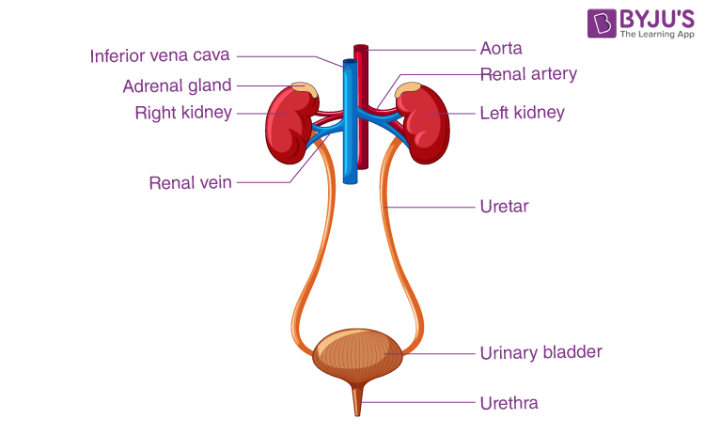
Ureters: Structure and Function
Notes:
The ureters are muscular tubes that transport urine from the kidneys to the urinary bladder. Their structure and function are essential for the effective movement of urine within the urinary system.

Slide 10
Anatomical Structure of the Ureters
Ureter Length
Each ureter measures approximately 25-30 cm in length
Three Layer Structure
The ureters are composed of three distinct layers: mucosa, muscularis, and adventitia, each serving a specific function as part of the peristaltic movement to propel urine to the urinary bladder.
Function of Layers
Contraction and Expansion, facilitating efficient urine transport from the kidneys to the urinary bladder.
Notes:
Each ureter is approximately 25-30 cm long and consists of three layers: mucosa, muscularis, and adventitia. This layered structure allows for the contraction and expansion needed to transport urine.

Slide 11
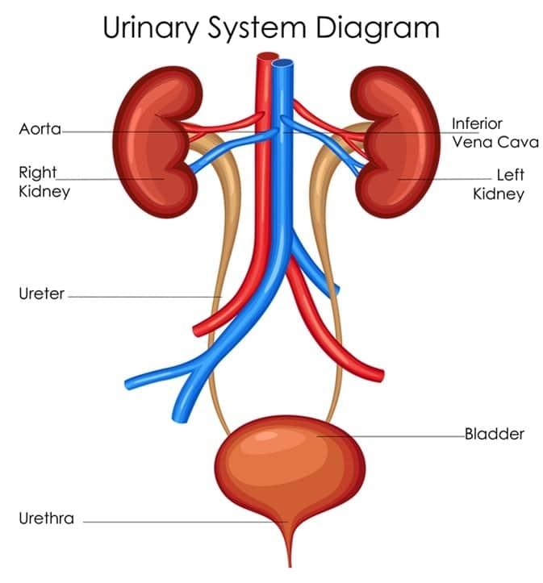
Urinary Bladder: Storage and Expulsion
Notes:
The urinary bladder serves as a temporary storage site for urine, allowing the body to control the timing of urination. Understanding its structure and function is vital for appreciating its role in the urinary system.

Slide 12
Anatomical Structure of the Bladder
Hollow Muscular Organ
The urinary bladder is a hollow, muscular organ that plays a crucial role in urine storage and elimination.
Transitional Epithelium
The inner lining of the bladder consists of transitional epithelium, which allows for stretching as the bladder fills.
Bladder Capacity
The average capacity of the urinary bladder ranges from 400 to 600 mL, accommodating varying volumes of urine.
Notes:
The urinary bladder is a hollow, muscular organ lined with transitional epithelium that allows it to stretch and accommodate varying volumes of urine. It has an average capacity of 400-600 mL.

Slide 13
TRIGONE of the Urinary Bladder
Triangular area at the base of the bladder
Formed by two ureteral openings and one urethral opening
Functions of Trigone:
Regulates urine flow from the ureters to the bladder
Prevents reflux (back flow of urine)
Trigone is richly innervated>>senses full bladder>>signals urge to urinate>>coordinates process of micturition
Notes:
The urinary bladder is a hollow, muscular organ lined with transitional epithelium that allows it to stretch and accommodate varying volumes of urine. It has an average capacity of 400-600 mL.

Slide 14
Physiology of Urine Storage
Bladder Function
The bladder serves as a storage reservoir for urine, allowing for controlled release during urination.
Detrusor Muscle Role
The detrusor muscle contracts and relaxes to regulate urine storage and release, playing a crucial role in bladder control.
Urethral Sphincters
The internal and external urethral sphincters work together to maintain continence until urination is initiated.
Notes:
The bladder's ability to store urine is regulated by the detrusor muscle and the internal and external urethral sphincters. These structures maintain continence until the time of urination.

Slide 15
Physiology of Urine Storage and Expulsion
Mechanism of Micturition (Urination): Two Phases
A reflex action responsible to expelling urine
Storage/continence phase: Urine stored in the Bladder (controlled by continence centers of the brain, relaxation of the detrusor muscle of the bladder, and simultaneous contraction of both the internal urethral sphincters (IUS) and external urethral sphincters (EUS).
Notes:
The bladder's ability to store urine is regulated by the detrusor muscle and the internal and external urethral sphincters. These structures maintain continence until the time of urination.

Slide 16
Physiology of Urine Storage and Expulsion
Voiding phase: Urine is released through the Urethra.
Coordinated contraction/ relaxation of the bladder and urethral sphincters
Nervous system control: sympathetic, parasympathetic and somatic nervous systems.
The bladder and IUS are under the control of the autonomic nervous system. The EUS is under the control of the somatic nervous system. This means only the EUS can be voluntarily opened or closed to control micturition, the others are controlled automatically
Notes:
The bladder's ability to store urine is regulated by the detrusor muscle and the internal and external urethral sphincters. These structures maintain continence until the time of urination.

Slide 17
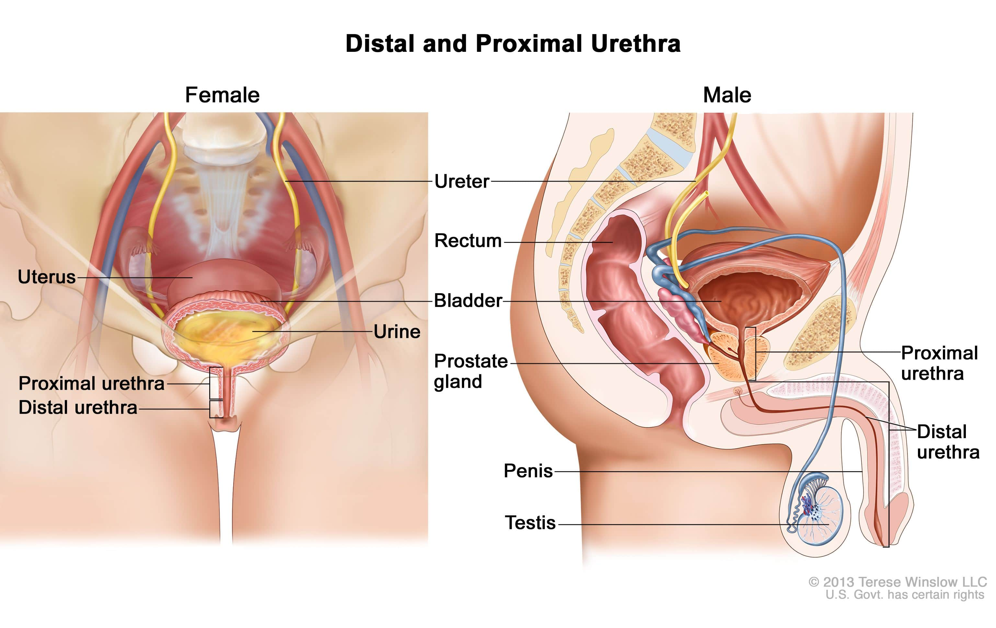
Urethra: Passageway for Urine
Notes:
The urethra is the final component of the urinary system, serving as a conduit for urine to exit the body. Its structure varies between genders and plays a crucial role in the expulsion of urine.

Slide 18
Anatomical Structure of the Urethra
Male Urethra Length
The male urethra is approximately 20 cm long, facilitating both urine and sperm transport.
Female Urethra Length
The female urethra measures around 4 cm and is responsible solely for urine transport. More prone to UTIs
Functional Differences
The male urethra has dual functions while the female urethra is dedicated to urination.
Notes:
The urethra differs in length and structure between males and females. The male urethra is about 20 cm long and functions in both urine and sperm transport, while the female urethra is about 4 cm long and solely transports urine.

Slide 19
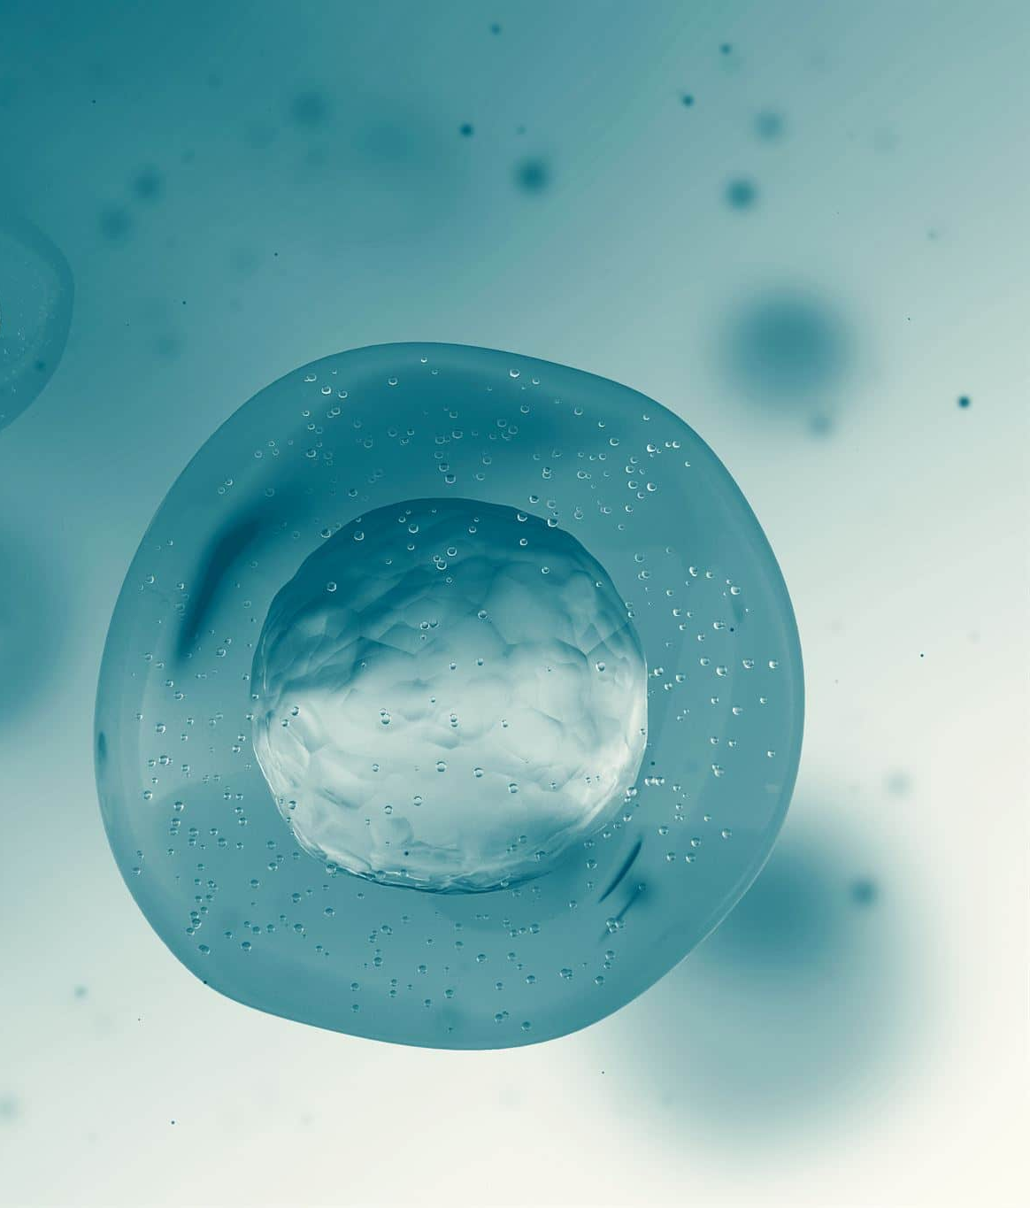
Physiology of the Urinary System: Processes, Balance, Regulation, and Hormonal Roles
Understanding homeostasis and kidney function
Notes:
AI-generated content may be incorrect. --- The urinary system plays a crucial role in maintaining homeostasis in the body. This presentation will explore the anatomy of the urinary system, the processes of urine formation, fluid and electrolyte balance, acid-base regulation, and the hormonal influences on kidney functions.

Slide 20
Physiology of the urinary system
Urine Formation (Filtration, Reabsorption, Secretion, and Excretion)
Fluid and Electrolyte Balance
Acid-Base Regulation
Role of Hormones (ADH, Aldosterone, ANP)

Slide 21
Urine Formation Processes
Filtration in the Glomerulus (Large proteins, RBCs, Platelets remains). Small molecules (water, ions, glucose, amino acids, urea, various salts are filtered
Reabsorption in the Renal Tubules
Secretion: removing excess substances
Excretion

Slide 22
Fluid and Electrolyte Balance
Notes:
The kidneys play a pivotal role in maintaining fluid and electrolyte balance in the body. They regulate the volume of fluids and the concentration of electrolytes, which is vital for cellular function.

Slide 23
Regulation of Water Balance
Average adult ~65% fluid mass slightly lower in females than males.
Our body fluids may subcategorize into intracellular and extracellular fluid compartments
Importance of Water Balance
Prevents both dehydration and overhydration
Kidney Function
Regulates water balance by adjusting urine output according to fluid intake.
Notes:
The regulation of water balance is crucial for preventing dehydration or overhydration. The kidneys adjust urine output based on hydration status and blood osmolarity through mechanisms involving hormones.

Slide 24
Regulation of Water Balance Cont.
Role of Hormones
Hormones such as antidiuretic hormone (ADH) regulate blood osmolarity and influence kidney function in water balance.
Fluid Intake Recommendations for healthy Adults:
Male: 15.5 cups (3.7 Liters) per day
Females: 11.5 cups (2.7 Liters) per day
Notes:
The regulation of water balance is crucial for preventing dehydration or overhydration. The kidneys adjust urine output based on hydration status and blood osmolarity through mechanisms involving hormones.

Slide 25
Electrolyte Homeostasis
Role of Kidneys
Maintain electrolyte balance by filtering blood and controlling ion levels.
Ions Involved
Key ions involved in electrolyte homeostasis include sodium, potassium, and calcium
Selective reabsorption and secretion processes in the kidneys help maintain stable electrolyte levels within the body.
Notes:
Electrolyte homeostasis is maintained by the kidneys through selective reabsorption and secretion of ions like sodium, potassium, and calcium, ensuring that the body's electrolyte levels remain stable.

Slide 26
Role of Kidneys in Osmoregulation
Osmoregulation Process:
Kidneys regulate the osmotic pressure of blood through extensive filtration and purification
Adjusts the concentration of urine based on the body's hydration status.
Osmotic Pressure and Hydrostatic Pressure help maintain fluid balance between blood and surrounding tissues.
Notes:
The kidneys play a vital role in osmoregulation by adjusting the concentration of urine. They respond to changes in blood osmolality by altering water reabsorption in the nephron.

Slide 27
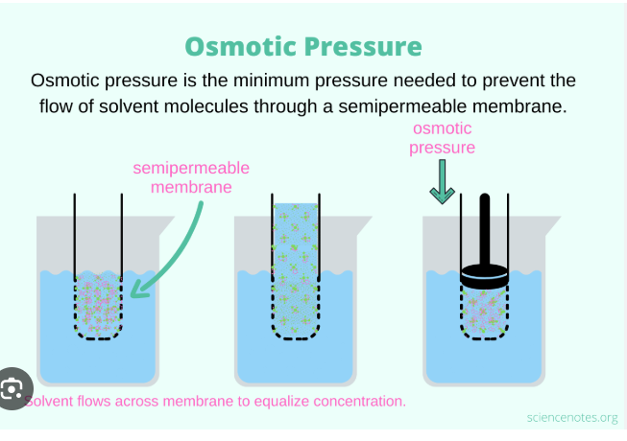
OSMOTIC PRESSURE VERSUS HYDROSTATIC PRESSURE

Slide 28
OSMOTIC PRESSURE OF BLOOD VERSUS HYDROSTATIC PRESSURE
Osmosis: the movement of water across a semi-permeable membrane from an area of low solute concentration to an area of high solute concentration.
Osmotic Pressure: ~7.9 BAR (~7.7 atm): the pressure that must be applied to a solution to prevent the net movement of water across a semi-permeable membrane due to osmosis. In essence, it's the pressure that opposes the flow of water into a solution.
Blood and Osmotic Pressure:
The osmotic pressure of blood is the force that pulls water into the blood vessels due to the concentration of solutes (like proteins, ions, and glucose) in the blood plasma. This pressure helps maintain fluid balance between blood and surrounding tissues.
Hydrostatic Pressure in the Blood: The force exerted by the blood within blood vessels against their walls. Capillaries HP 32 mmHg (arterial end) and 15 mmHg (venous end); mean capillary HP is 17 mmHg

Slide 29
OSMOTIC PRESSURE OF BLOOD VERSUS HYDROSTATIC PRESSURE CONT.
Osmotic Pressure is primarily driven by the presence of proteins (especially albumin) in the blood plasma. These proteins are too large to pass through the capillary walls, so their concentration in the blood plasma is higher than in the interstitial fluid (the fluid surrounding cells). This concentration difference creates an osmotic pressure that pulls water back into the blood vessels from the interstitial fluid.
Importance of Osmotic Pressure:
This pressure is crucial for maintaining fluid balance and preventing edema (swelling). The osmotic pressure in the capillaries counteracts the hydrostatic pressure (the pressure exerted by the blood itself), which pushes fluid out of the capillaries into the interstitial fluid.

Slide 30
Acid-Base Regulation
Notes:
The kidneys also participate in acid-base regulation, ensuring that the body's pH remains within a narrow range. This mechanism is critical for overall metabolic function and health.

Slide 31
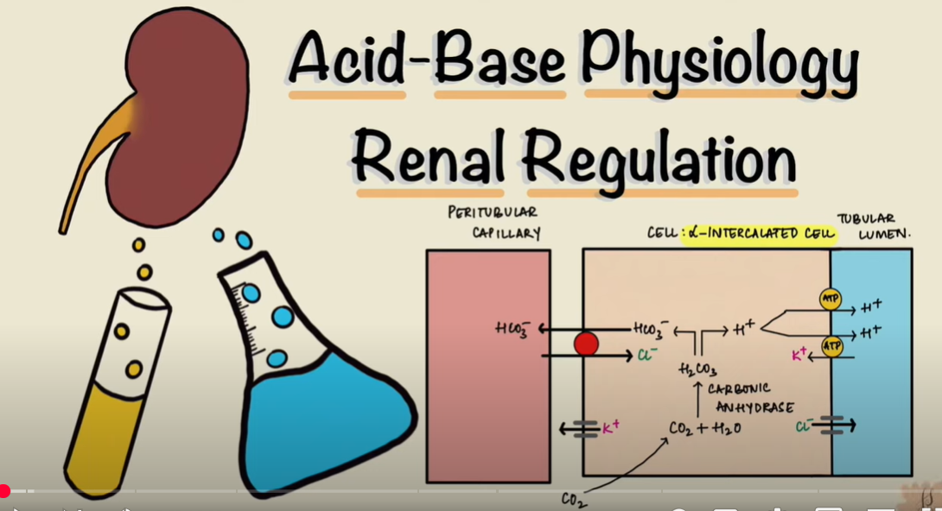
Mechanisms of Acid-Base Balance (pH Regulation)
Bicarbonate Reabsorption
The reabsorption of bicarbonate in the kidneys is crucial for maintaining acid-base balance by neutralizing excess acids.
Hydrogen Ion Secretion
The secretion of hydrogen ions in the kidneys helps regulate pH levels in the blood, counteracting acidity.
Neutralization Processes
These mechanisms work together to neutralize excess acids and bases, ensuring the body's pH remains balanced. pH 7.35-7.45

Slide 32
Buffer Systems in the Body
Role of Buffer Systems
Buffer systems like bicarbonate and phosphate are essential for regulating pH levels in the body, ensuring homeostasis.
Kidneys and pH Regulation
The kidneys work closely with buffer systems to maintain the body's acid-base balance by excreting excess acids or bases.
Notes:
Buffer systems, such as bicarbonate and phosphate buffers, play a crucial role in maintaining pH balance. These systems work in conjunction with the kidneys to stabilize the body's acidity and alkalinity.

Slide 33
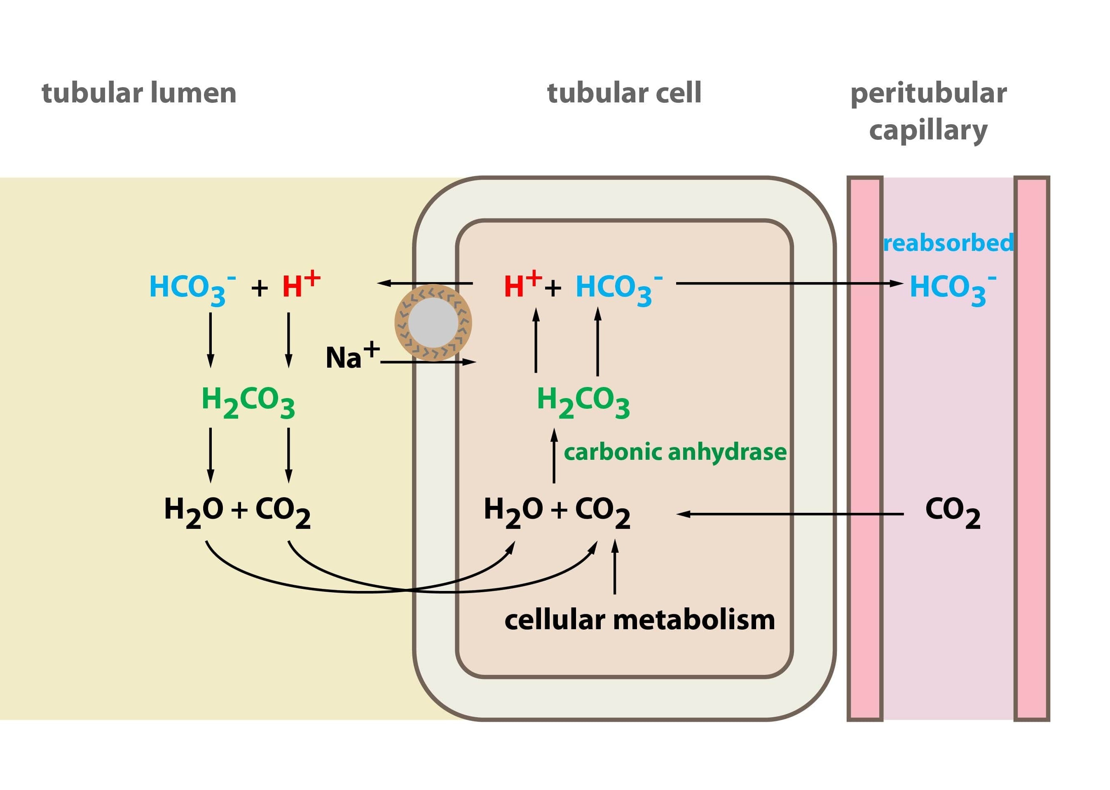
4 major Buffer Systems:
Bicarbonate Buffer System: This system, involving carbonic acid and bicarbonate ions, is crucial for maintaining the pH of the blood and other extracellular fluids.
Phosphate Buffer System: This system, primarily found in intracellular fluids and urine, uses phosphate ions to buffer against pH changes.
Protein Buffer System: Proteins, with their charged amino and carboxyl groups, can bind to hydrogen and hydroxyl ions, acting as buffers in both blood and cells.
Hemoglobin Buffer System: Hemoglobin, a protein in red blood cells, plays a vital role in buffering against pH changes, particularly in the blood.

Slide 34
Hormonal Regulation of Kidney Functions
Notes:
Several hormones regulate kidney functions, influencing processes such as water reabsorption, sodium retention, and blood pressure. Understanding these hormonal roles is key to comprehending kidney function.

Slide 35
Antidiuretic Hormone (ADH)
Regulates water balance by promoting water reabsorption in the kidneys.
Source of ADH
The posterior pituitary gland is responsible for the secretion of ADH
Mechanism of ADH Function
Hypothalamus>>Pituitary Gland>>Increased ADH release>>Kidneys Reabsorbs Water>> Concentrated Urine
Importance of Hydration
Maintains Homeostasis: proper bodily function and blood pressure
External Influences on ADH:
ALCOHOL: Inhibits the activity of ADH >> INCREASED Urine Excretion>> Dehydration >>Hangover
ECSTASY and similar substances: have same impact on ADH release.
Notes:
Antidiuretic hormone (ADH) is released by the posterior pituitary gland and promotes water reabsorption in the kidneys. This hormone is crucial for maintaining body hydration and blood pressure.

Slide 36
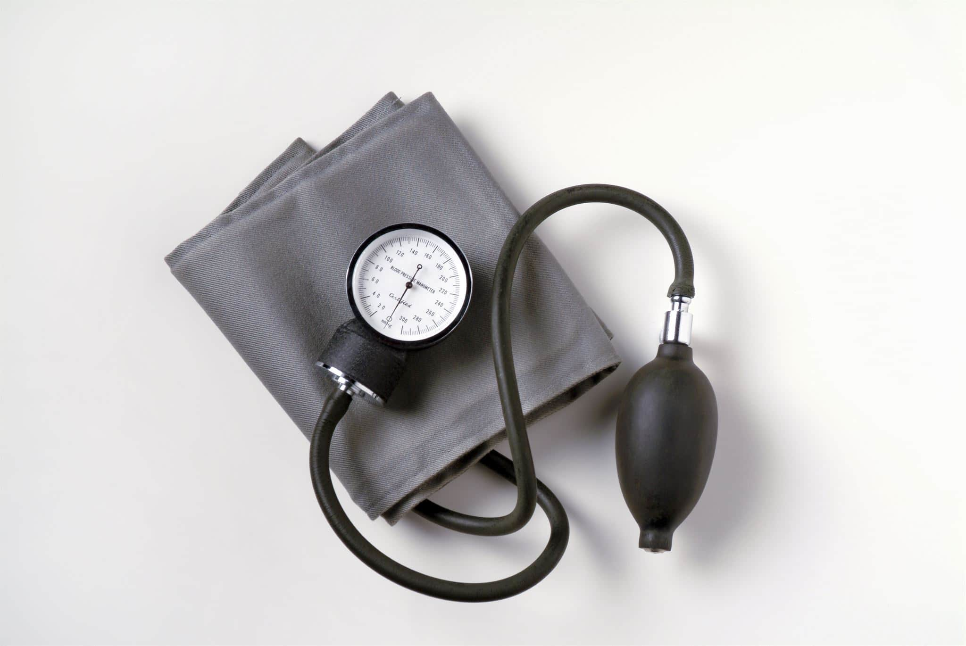
Aldosterone
Hormonal Role
Aldosterone is produced by the adrenal glands and regulates sodium and potassium levels in the body.
Blood Pressure Regulation
Through its effects on sodium reabsorption and fluid balance.
Fluid Balance
Regulates the reabsorption of water and electrolytes in the kidneys, affecting overall hydration.

Slide 37
Atrial Natriuretic Peptide (ANP)
Release Mechanism
ANP is released by the heart when there is an increase in blood volume, indicating a need for regulation.
Kidney Function
ANP prompts the kidneys to excrete more sodium and water, which helps regulate blood pressure.
Blood Pressure Regulation
The action of ANP contributes to lowering blood pressure and reducing fluid overload in the body.
Notes:
Atrial natriuretic peptide (ANP) is released by the heart in response to increased blood volume. It causes the kidneys to excrete more sodium and water, helping to lower blood pressure and reduce fluid overload.

Slide 38
RENAL PATHOLOGY

Slide 39
CAUSES OF RENAL PATHOLOGY
PRE-RENAL
INTRA-RENAL
POST-RENAL

Slide 40
PRE-RENAL CAUSES: Decreased Renal perfusion
Prerenal Causes (Before the Kidney) – Reduced Blood Flow to the Kidneys
These conditions affect renal perfusion, leading to decreased blood supply and potential ischemic injury.
Hypovolemia:
Hemorrhage
Severe dehydration (vomiting, diarrhea)
Burns
Decreased Cardiac Output:
Heart failure
Myocardial infarction
Cardiogenic shock
Systemic Vasodilation:
Sepsis
Anaphylaxis
Liver cirrhosis (hepatorenal syndrome)
Renal Artery Obstruction:
Renal artery stenosis
Embolism or thrombosis
Use of Drugs Affecting Renal Perfusion:
NSAIDs (reduce prostaglandin-mediated vasodilation)
ACE inhibitors/ARBs (reduce angiotensin II-mediated vasoconstriction)

Slide 41
INTRA-RENAL Causes (Within the Kidney): Direct Kidney Damage
These conditions involve damage to renal tissue, affecting nephrons and renal function.
Acute Tubular Necrosis (ATN):
Ischemia (prolonged prerenal causes)
Nephrotoxic drugs (aminoglycosides, contrast dye, NSAIDs, cisplatin)
Myoglobinuria (rhabdomyolysis)
Glomerular Disorders:
Glomerulonephritis (immune-mediated inflammation)
Lupus nephritis (autoimmune disease)
Interstitial Disorders:
Acute interstitial nephritis (due to drugs like
antibiotics, NSAIDs)
Infections (pyelonephritis)
Vascular Disorders:
Thrombotic microangiopathy (HUS, TTP)
Malignant hypertension

Slide 42
POST-RENAL Causes (After the Kidney): Obstruction of Urinary Flow
These conditions block urine outflow, leading to back pressure and kidney dysfunction.
Ureteral Obstruction:
Kidney stones (nephrolithiasis)
Ureteral strictures
Tumors compressing the ureters
Retroperitoneal fibrosis
Bladder Dysfunction or Obstruction:
Bladder tumors
Neurogenic bladder (spinal cord injury, diabetes)
Urethral Obstruction:
Benign prostatic hyperplasia (BPH)
Urethral strictures
Prostate cancer

Slide 43
Infections and Inflammatory Disorders
Notes:
Infections and inflammatory disorders of the urinary system can lead to significant morbidity. These conditions often present with painful symptoms and can affect kidney function if not addressed effectively.

Slide 44
Urinary Tract Infections (UTIs)
Common Infection
UTIs are among the MOST COMMON HOSPITAL ACQUIRED INFECTION, especially prevalent in women due to anatomical factors. WHY, WHY, WHY???
Symptoms of UTIs
Common symptoms include frequent urination, pain during urination, and the appearance of cloudy urine.
Importance of Treatment
Prompt diagnosis and treatment are crucial to prevent complications and ensure proper recovery from UTIs.
Notes:
Urinary tract infections are one of the most common infections, particularly among women. Symptoms include frequent urination, pain during urination, and cloudy urine. Prompt diagnosis and treatment are essential to prevent complications.

Slide 45
Pyelonephritis
Definition of Pyelonephritis
Pyelonephritis is a kidney infection caused by bacteria traveling from the bladder, affecting kidney function.
Symptoms
Common symptoms include fever, chills, and flank pain, indicating the presence of an infection in the kidneys.
Treatment Options
Treatment typically involves antibiotics; severe cases may require hospitalization for more intensive care.
Notes:
Pyelonephritis is a type of kidney infection that can occur when bacteria travel from the bladder to the kidneys. Symptoms may include fever, chills, and flank pain. Treatment typically involves antibiotics and, in severe cases, hospitalization.

Slide 46
Glomerulonephritis
Definition and Causes
Glomerulonephritis is an inflammation affecting the kidney's filtering units, caused by infections or autoimmune diseases.
Symptoms
Common symptoms include blood in urine, swelling in various parts of the body, and high blood pressure.
Importance of Early Diagnosis
Early diagnosis of glomerulonephritis is crucial for effective management and treatment of the condition.
Notes:
Glomerulonephritis is an inflammation of the kidney's filtering units. It can be caused by infections, autoimmune diseases, or other factors. Symptoms may include blood in urine, swelling, and high blood pressure. Early diagnosis is crucial for management.

Slide 47
Kidney Stones (Nephrolithiasis)
Formation of Kidney Stones
Kidney stones are hard deposits formed from minerals and salts that accumulate in the kidneys over time.
Symptoms
Kidney stones can cause excruciating pain and urinary obstruction, leading to serious discomfort for affected individuals.
Treatment Options
Treatment for kidney stones includes hydration, pain management, and surgical intervention when necessary.
Notes:
Kidney stones are hard deposits made of minerals and salts that form in the kidneys. They can cause severe pain and urinary obstruction. Treatment may include hydration, pain management, and in some cases, surgical intervention.

Slide 48
Hydronephrosis
Definition of Hydronephrosis
Hydronephrosis is characterized by the accumulation of urine in the kidneys due to a blockage.
Symptoms of Hydronephrosis
Symptoms can range from mild discomfort to severe pain and urinary difficulties.
Treatment Options
Treatment primarily focuses on relieving the obstruction to allow proper urine flow.
Notes:
Hydronephrosis occurs when urine builds up in the kidneys due to an obstruction in the urinary tract. Symptoms can range from mild to severe and may include pain and urinary difficulties. Treatment focuses on relieving the obstruction.

Slide 49
Benign Prostatic Hyperplasia (BPH)
Condition Overview
Benign Prostatic Hyperplasia (BPH) is a prevalent condition affecting older men, characterized by prostate gland enlargement.
Symptoms of BPH
Common symptoms of BPH include difficulty urinating and increased frequency of urination, especially at night.
Treatment Options
Treatment for BPH varies based on the severity of symptoms and may include medication or surgical options such as Prostatectomy
Notes:
Benign Prostatic Hyperplasia is a common condition in older men where the prostate gland enlarges, leading to urinary obstruction. Symptoms include difficulty urinating and frequent urination, especially at night. Treatment options vary based on severity.

Slide 50
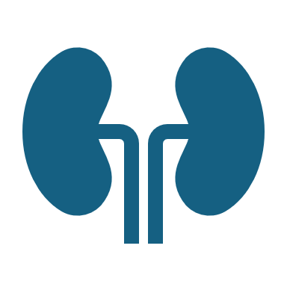
Renal Function Impairment: INTRA-RENAL
Notes:
Renal function impairment can lead to a progressive decline in kidney function and may result in serious health issues. Early detection and management are critical to improving outcomes.

Slide 51
Acute Kidney Injury (AKI)
Definition of AKI
Acute Kidney Injury (AKI) refers to a rapid decline in kidney function, often occurring suddenly due to various factors.
Causes of AKI
Common causes of AKI include dehydration, certain medications, and underlying health conditions that affect kidney function.
Symptoms of AKI
Symptoms may involve decreased urine output, swelling, fatigue, and in severe cases, confusion or shortness of breath.
Treatment Options
Prompt treatment for AKI can include hydration, medication adjustments, and in severe cases, dialysis to support kidney function.
Notes:
Acute Kidney Injury is a sudden decrease in kidney function that can occur due to various causes, including dehydration and medications. Symptoms may include decreased urine output and swelling. Prompt treatment can help reverse the condition.

Slide 52
Chronic Kidney Disease (CKD)
kidney damage or an estimated glomerular filtration rate (eGFR) of less than 60 mL/min/1.73 m², persisting for 3 months or more.
Progressive loss of kidney function, often leading to the need for renal replacement therapy, such as dialysis or transplantation.
Notes:
Chronic Kidney Disease is a gradual loss of kidney function over time, often caused by diabetes or hypertension. Early stages may be asymptomatic, making regular monitoring essential for early intervention.

Slide 53
Etiology of Chronic Kidney Disease (CKD)
Non-modifiable CKD risk factors:
Older age
male gender
Genetic factors: non-White ethnicity, including Black Americans, Afro-Caribbean individuals, Hispanics, and Asians (South Asians and Pacific Asians), all adversely affect CKD progression.
Modifiable CKD risk factors:
Systemic hypertension
Proteinuria
Metabolic factors:
Obesity
Dyslipedemia, hyperglycemia)
These can be addressed through lifestyle changes and medical interventions

Slide 54
Etiology of Chronic Kidney Disease (CKD)
Type 2 diabetes (30%-50%)
Type 1 diabetes (3.9%)
Hypertension (27.2%)
Primary glomerulonephritis (8.2%)
Chronic tubulointerstitial nephritis (3.6%)
Hereditary or cystic diseases (3.1%)
Secondary glomerulonephritis or vasculitis (2.1%)
Plasma cell dyscrasias or neoplasm (2.1%)
Sickle cell nephropathy, which accounts for less than 1% of ESRD
Notes:
Chronic Kidney Disease is a gradual loss of kidney function over time, often caused by diabetes or hypertension. Early stages may be asymptomatic, making regular monitoring essential for early intervention.

Slide 55
Staging CKD based on eGFR Cont.
Stage 1 (GFR ≥90 mL/min/1.73 m²)
Kidney damage with normal or high GFR
Asymptomatic, with possible proteinuria and hematuria
Stage 2 (GFR 60-89 mL/min/1.73 m²)
Mild kidney function decline
No significant symptoms, but early signs of nephron loss
Stage 3 (GFR 30-59 mL/min/1.73 m²)
Moderate kidney function decline
Increased waste buildup, possible fatigue, and swelling
3a (45-59 mL/min/1.73 m2)
3b (30-44 mL/min/1.73 m2).
Stage 4 (GFR 15-29 mL/min/1.73 m²)
Severe kidney function decline
Symptoms: Anemia, metabolic acidosis, electrolyte imbalances, worsening hypertension
Stage 5 (GFR <15 mL/min/1.73 m²) – ESRD
Severe loss of kidney function, requiring dialysis or kidney transplant
Symptoms: Uremia, fluid overload, severe electrolyte disturbances
Notes:
Chronic Kidney Disease is a gradual loss of kidney function over time, often caused by diabetes or hypertension. Early stages may be asymptomatic, making regular monitoring essential for early intervention.

Slide 56
Staging CKD based on GFR Cont.
The 3 levels of albuminuria include an Albumin-Creatinine Ratio (ACR):
A1: ACR less than 30 mg/g (<3.4 mg/mmol)
A2: ACR 30 to 299 mg/g (3.4-34 mg/mmol)
A3: ACR greater than 300 mg/g (>34 mg/mmol)
Notes:
Chronic Kidney Disease is a gradual loss of kidney function over time, often caused by diabetes or hypertension. Early stages may be asymptomatic, making regular monitoring essential for early intervention.

Slide 57
COMBINED CKD Staging Based on eGFR and Albuminuria:
A CKD stage is typically described as “G[ GFR stage ] A [Albuminuria stage ]”.
For example, a person with an eGFR of 25 mL/min/1.73 m² and an ACR of 15 mg/g would be classified as CKD G4A2.
Another example, a person with an eGFR of 50 mL/min/1.73 m² and an ACR of 35 mg/g would be classified as CKD G3aA3
Importance of Both eGFR
and ACR:
Both eGFR and ACR are crucial for accurately diagnosing and staging CKD.

Slide 58
End Stage Renal Disease (ESRD)
Definition of ESRD
End Stage Renal Disease is the last stage of chronic kidney disease when kidneys fail to function normally.
Need for Dialysis
Patients with ESRD often require dialysis as their kidneys can no longer filter waste from the blood effectively.
Kidney Transplantation
Kidney transplantation is another treatment option for ESRD, providing a potential cure for kidney failure.
Managing Complications
Effective management of complications is crucial for maintaining a good quality of life for ESRD patients.
Notes:
End Stage Renal Disease is the final stage of chronic kidney disease, where kidneys can no longer maintain normal function. Patients often require dialysis or kidney transplantation. Managing complications is vital for quality of life.

Slide 59
SIGNS AND SYMPTOMS OF ESRD
Early CKD stages are asymptomatic, and symptoms manifest in stages 4 or 5. Some common symptoms and signs at these stages of CKD include:
Nausea, Vomiting, Loss of appetite, Fatigue and weakness, Sleep disturbance, Oliguria, Decreased mental sharpness, Muscle cramps, Swelling of feet and ankles, Persistent pruritus, Chest pain due to uremic pericarditis, Shortness of breath due to pulmonary edema from fluid overload, Hypertension
Physical examination is often not helpful, but patients may demonstrate the following symptoms:
Skin pigmentation
Scratch marks from pruritus
Pericardial friction rub due to uremic pericarditis
Uremic frost, where high levels of blood urea nitrogen (BUN) cause urea in sweat to crystallize into fine, white powder on the skin: pruritic, confusion, N/V
Hyperreflexia or muscle twitches
Hypertensive fundal changes suggesting chronicity
Fluid retention ( edema, pulmonary congestion)

Slide 60
Congenital and Other Disorders
Notes:
Congenital disorders of the urinary system can lead to significant challenges from birth. Understanding these conditions is essential for appropriate management and care.

Slide 61
Polycystic Kidney Disease (PKD)
Genetic Disorder
Numerous cysts to develop in the kidneys.
Symptoms and Management
High blood pressure, Belly, side or back pain. Blood in the urine, A feeling of fullness in the belly.
Increased abdominal size due to enlarged kidneys, Headaches, Kidney stones.
Kidney failure, Urinary tract or kidney infections.
Management of PKD: Controlling symptoms and regularly monitoring kidney function to prevent complications.
Impact on Kidney Function
The growth of cysts leads to kidney enlargement and impaired function, affecting overall health.
Notes:
Polycystic Kidney Disease is a genetic disorder characterized by the growth of numerous cysts in the kidneys, leading to enlargement and impaired function. Management involves controlling symptoms and monitoring kidney health.

Slide 62
Nephrotic Syndrome
Kidney Disorder
Nephrotic Syndrome is a kidney disorder that leads to excessive protein loss in urine, impacting overall health.
Symptoms of Nephrotic Syndrome
Common symptoms include swelling in various body parts and fatigue, which can significantly affect quality of life.
Treatment Focus
Treatment for Nephrotic Syndrome aims to control symptoms and prevent complications through medication and lifestyle changes: Diuretics, steroids, antihypertensives, statins, Immunosuppressants
Notes:
Nephrotic Syndrome is a kidney disorder causing the body to excrete too much protein in urine. Symptoms include swelling and fatigue. Treatment focuses on controlling symptoms and preventing complications.

Slide 63
Prevalence of chronic kidney disease and risk factors in North-Central Nigeria: a population-based survey
One thousand three hundred and fifty-three adults ≥18 years (44% males)
Mean kidney lengths were: right, 93.5 ± 7.0 cm and left, 93.4 ± 7.5 cm.
The age-adjusted prevalence of hypertension was 24%; diabetes 4%; obesity 8.7%; albuminuria of > 30 mg/L 7%; and dipstick proteinuria 13%.
The age-adjusted prevalence of CKD by estimated GFR < 60 ml/min/1.73m² and/or Proteinuria was 12%.
Diabetes (aOR 6.41, 95%CI = 3.50-11.73, P = 0.001), obesity (aOR 1.50, 95%CI = 1.10-2.05, P = 0.011), proteinuria (aOR 2.07, 95%CI = 1.05-4.08, P = 0.035);
female sex (aOR 1.67, 95%CI = 1.47-1.89, P = 0.001); and age (aOR 1.89, 95%CI = 1.13-3.17, P = 0.015) were the identified predictors of CKD.
Conclusions: CKD and its risk factors are prevalent among middle-aged urban populations in North-Central Nigeria.
It is common among women, fueled by diabetes, ageing, obesity, and albuminuria. These data add to existing regional studies of burden of CKD that may serve as template for a national prevention framework for CKD in Nigeria.
One of the limitations of the study is that the participants were voluntary community dwellers and as such not representative for the community. The sample may thus have been subjected to selection bias possibly resulting in overestimation of CKD risk factors.

Slide 64
Many risk factors for CKD will not be addressed by targeting current WHO-recognized major Non-communicable Dxs (NCDs.)
Kidney disease is an increasing global problem that disproportionately affects poor, vulnerable and marginalized populations
Approximately 700 million people are estimated to have CKD worldwide.
AKI affects 7–18% of hospitalized patients and 20–200 per million individuals annually
the GBD study attributing ~3.1 million deaths in 2019 to kidney dysfunction.
The global population is rapidly ageing; the proportion of people aged >65 years is expected to rise from around 10% in 2024 to >16% by 2050.

Slide 65
World Health Organization’s Data on CKD Prevalence and Burden
Global Prevalence:
CKD is estimated to affect over 10% of the world's population, translating to over 800 million individuals.
Leading Cause of Death:
Kidney diseases are a leading cause of death, with CKD being the seventh most common cause of death from noncommunicable diseases (NCDs) worldwide.
Increasing Burden:
The global burden of CKD is increasing, with a rise in both the prevalence and mortality rates.
Underdiagnosis:
Many cases of CKD remain undiagnosed, particularly in low-income countries where robust primary care systems are lacking.

Slide 66
Nursing and Medical Management of Urinary Disorders
Notes:
Effective management of urinary disorders involves various nursing and medical strategies. Understanding diagnostic procedures and treatment options is essential for providing quality care.

Slide 67
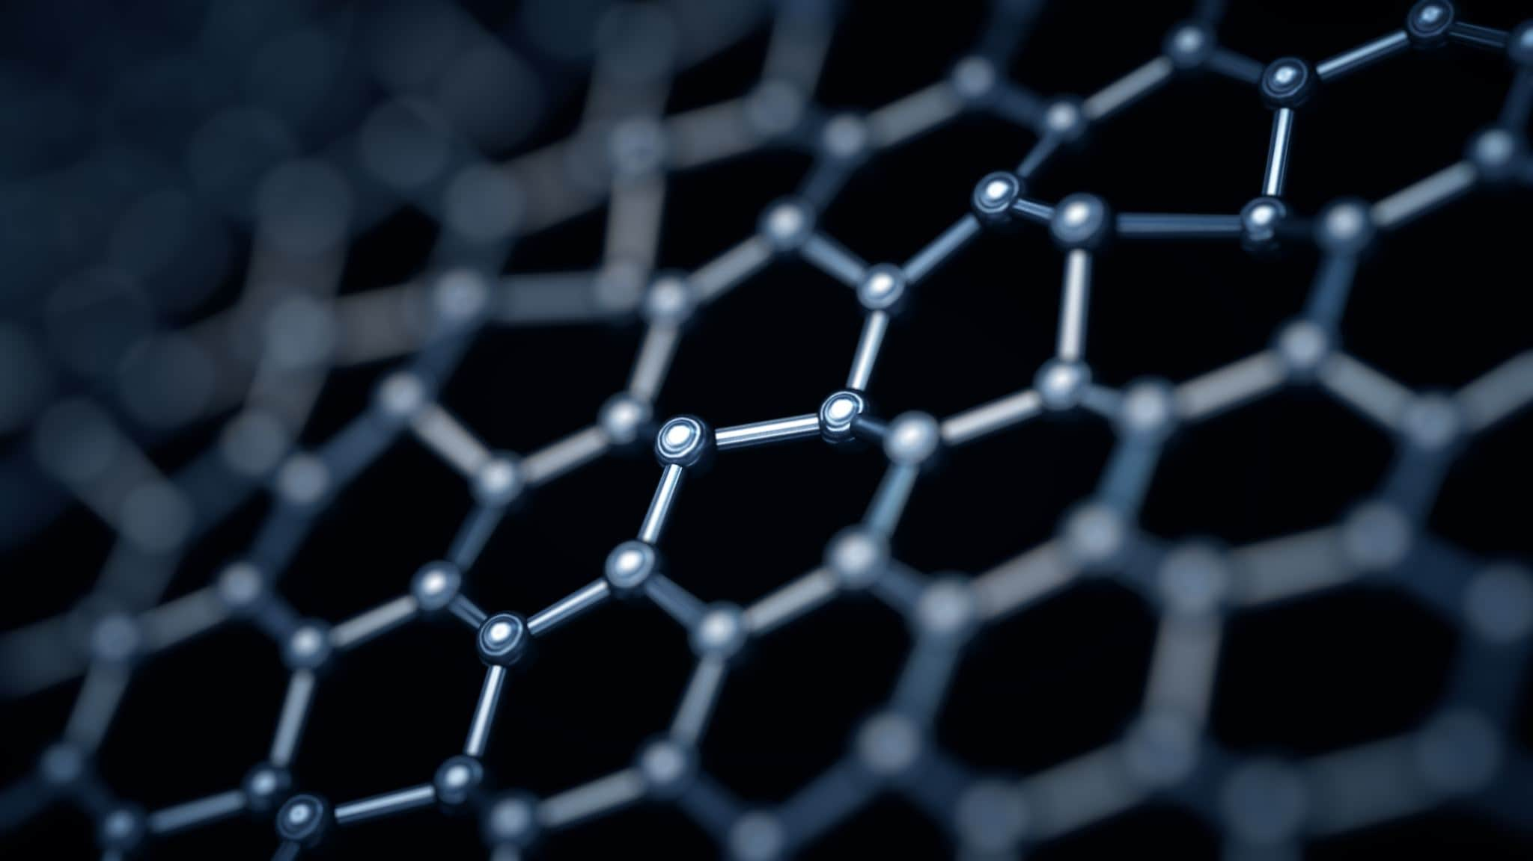
Medical Management
Assessment and Diagnosis
History Taking and Physical Examination
Diagnostic Tests (Urinalysis, Blood Tests, Imaging)
Medical Interventions
Pharmacologic Therapy (Diuretics, Antibiotics, Antihypertensives)
Renal Replacement Therapy (Hemodialysis, Peritoneal Dialysis and Kidney Transplant).
Surgical Interventions (Catheterization, Lithotripsy, Nephrectomy, Kidney Transplant)
Blood Test: BUN, Creatinine, GFR
Urinalysis: Proteinuria, Hematuria
Imaging Studies: CT scan, Ultrasound
Kidney Biopsy ( in some cases)
Anemia management ( Erythropoietin, Iron Supplement)
Dietary Modifications ( Low sodium, potassium, phosphorus).
Fluid Restriction

Slide 68
Nursing Management of Renal Disorders
Assessment and Monitoring
Monitor vital signs: Blood pressure, heart rate, respiratory rate, and temperature to detect hypertension, fluid overload, or signs of infection.
Assess urine output: Measure and record urine output (NORMAL 800-2,000ML/DAY) (oliguria, anuria, polyuria) and observe for abnormalities (color, odor, presence of blood or protein).
Monitor fluid and electrolyte balance: Check for signs of dehydration, fluid overload (edema, weight gain), and electrolyte imbalances (potassium, sodium, calcium, Phosphorus).
Assess for uremic symptoms: Look for nausea, vomiting, pruritus, confusion, or lethargy, which indicate worsening renal function.

Slide 69
Nursing Management of Renal Disorders Cont.
Monitor lab values:
Blood Urea Nitrogen (BUN) and Creatinine for kidney function
Glomerular Filtration Rate (GFR) to assess CKD staging
Electrolytes (Potassium, Sodium, Calcium, Phosphorus)
Hemoglobin and Hematocrit for anemia management

Slide 70
Nursing Management of Renal Disorders Cont.
Fluid and Dietary Management
Fluid restriction: Implement fluid intake limits as prescribed, especially in cases of fluid overload.
Sodium restriction: Educate on limiting salt intake to control blood pressure and prevent fluid retention.
Potassium management: Avoid high-potassium foods (bananas, oranges, potatoes) in hyperkalemia and encourage potassium-rich foods in hypokalemia.
Protein control: In CKD, limit protein intake to reduce nitrogenous waste buildup while ensuring adequate nutrition.
Phosphorus and calcium balance: Advise on phosphate binders and calcium supplements if needed.

Slide 71
Nursing Management of Renal Disorders Cont.
Medication Administration and Management
Diuretics: Administer loop diuretics (e.g., furosemide) to manage fluid overload if appropriate.
Antihypertensive medications: Administer ACE inhibitors, ARBs, or beta-blockers to control hypertension.
Erythropoietin therapy: Administer erythropoietin and iron supplements for anemia in CKD.
Phosphate binders: Administer calcium-based or non-calcium phosphate binders to control phosphate levels.
Avoid nephrotoxic drugs: Educate patients about avoiding NSAIDs, contrast dyes, and certain antibiotics that can worsen kidney function.

Slide 72
Nursing Management of Renal Disorders Cont.
Prevention of Complications
Prevent infections: Monitor for signs of urinary tract infections (UTIs) and educate on proper hygiene, catheter care, and fluid intake.
Manage metabolic acidosis: Administer sodium bicarbonate as prescribed to correct acid-base imbalance.
Monitor for signs of uremic complications: Such as pericarditis, neuropathy, or encephalopathy in ESRD patients.

Slide 73
Nursing Management of Renal Disorders Cont.
Dialysis and Renal Replacement Therapy Support
Hemodialysis Care:
Assess for signs of hypotension and electrolyte imbalances post-dialysis.
Monitor vascular access sites (AV fistula, graft) for signs of infection or clotting.
Peritoneal Dialysis Care:
Educate on proper technique to prevent peritonitis.
Monitor for cloudy dialysate, abdominal pain, or fever.

Slide 74
Nursing Management of Renal Disorders Cont.
Patient Education and Lifestyle Modifications
Diet and lifestyle: Encourage a renal-friendly diet, smoking cessation, and regular physical activity.
Medication adherence: Educate on proper medication use and the importance of compliance.
Fluid monitoring: Teach patients with CKD or ESRD how to track fluid intake and output.
Signs of worsening kidney disease: Educate on symptoms such as swelling, decreased urine output, fatigue, and mental confusion, prompting early medical intervention.

Slide 75
General Recommendations in Renal care
Treatment of Reversible Causes of Renal Failure
Potentially reversible causes of AKI, such as infection, drugs, hypotension, and hypovolemia, should be identified and addressed PROMPTLY
Patients with CKD should be carefully evaluated before undergoing intravenous contrast studies, and alternatives should be considered first.
Additionally, nephrotoxic agents, including aminoglycoside antibiotics and nonsteroidal anti-inflammatory drugs (NSAIDs), should be avoided
General Management
Drug dosages should be adjusted based on the patient's eGFR levels.
Preparation for renal replacement therapy should include making surgical referrals for the placement of hemodialysis or peritoneal dialysis access and for transplantation when appropriate.
Older patients with CKD require an integrated multidisciplinary approach to manage their multimorbidity, polypharmacy, high rates of adverse outcomes, cognitive dysfunction, frailty, fatigue and other age-related complications and symptoms.

Slide 76
Evidence-Based Nursing Practice (EBP) in Renal Disorders
Improves Patient Safety
Reduces Hospital Readmissions
Guides Effective Fluid and Electrolyte Management
Prevents and Manages Dialysis-Related Complications
Promotes Early Detection and Intervention
Enhances Nursing Competency and Decision-Making

Slide 77
5 Evidence-Based Nursing Practice (EBP) in Renal Disorders Cont.
Catheter-Associated Urinary Tract Infection (CAUTI) Prevention
Practice: Use of sterile technique during catheter insertion, maintaining a closed drainage system, and removing catheters as soon as clinically appropriate.
Evidence: CDC and WHO guidelines emphasize CAUTI prevention to reduce infection rates and hospital stays.
Bladder Training for Urinary Incontinence
Practice: Scheduled voiding and gradually increasing the interval between voids to improve bladder control.
Evidence: Proven effective in managing urge and mixed incontinence, as supported by Cochrane Reviews and urology clinical trials.
Monitoring and Maintaining Adequate Hydration
Practice: Encouraging regular fluid intake (unless contraindicated) to support kidney function and prevent urinary tract infections or stones.
Evidence: Studies show proper hydration reduces UTI incidence and supports renal health.
4. Perineal Hygiene and Infection Control
Practice: Cleaning from front to back, especially in females, and using antiseptic wipes during catheter care.
Evidence: Reduces the risk of ascending infections; supported by infection prevention protocols.
5. Assessment of Urinary Output and Characteristics
Practice: Regular monitoring of urine volume, color, clarity, and odor as part of routine assessment.
Evidence: Early detection of urinary tract dysfunction or systemic issues like dehydration or kidney disease is well-documented in nursing literature.

Slide 78
Evidence-based protocol on the urinary catheter cares in intensive care units…..UTIs
Urinary Tract Infections (UTIs) account for 24.92% of ICU nosocomial infections investigated.
Prevalence of UTI in ICU is directly related to the widespread use of urethral catheter (UC).
Increased morbidity and mortality, increased hospital stay and hospital costs, jeopardizing patient safety.
17% and 69% of UTIs associated with the UC can be prevented through an evidence-based prevention program.
The urinary system is the most common site for all hospital-acquired infections, accounting for approximately 40% of all nosocomial infections

Slide 79
Evidence-based protocol on the urinary catheter cares in intensive care units…..UTIs
Nursing actions for prevention of CAUTIs in patients with short- and long-term indwelling catheters:
01
Incorporation of antimicrobial substances into the urinary catheter
02
selection of catheter size.
03

Slide 80
Evidence-based protocol on the urinary catheter cares in intensive care units…..UTIs
CDC RECOMMENDATIONS
Use of packages with UC-related nursing care (technique of insertion, maintenance and drainage system).
To evaluate and compare the quality of care with other ICUs, quality indicators were established by the National Surveillance Study of Nosocomial Infection in Medical Services Intensive.
Rivero, M PA Et. al

Slide 81
References
Chen JS, Sabir S, Al Khalili Y. Physiology, Osmoregulation and Excretion. [Updated 2023 May 1]. In: StatPearls [Internet]. Treasure Island (FL): StatPearls Publishing; 2025 Jan-. Available from: https://www.ncbi.nlm.nih.gov/books/NBK541108/
Iveson-Iveson J. Anatomy and physiology: the urinary system. Nurs Mirror. 1979 Mar 15;148(11):31-2. PMID: 254175.
Márquez Rivero PA, Alvarez Pacheco I, Márquez Rivero A. Protocolo basado en la evidencia de los cuidados de los catéteres urinarios en unidades de cuidados intensivos [Evidence-based protocol on the urinary catheter cares in intensive care units]. Enferm Intensiva. 2012 Oct-Dec;23(4):171-8. Spanish. doi: 10.1016/j.enfi.2012.01.003. Epub 2012 Mar 14. PMID: 22420984.
Olanrewaju TO, Aderibigbe A, Popoola AA, Braimoh KT, Buhari MO, Adedoyin OT, Kuranga SA, Biliaminu SA, Chijioke A, Ajape AA, Grobbee DE, Blankestijn PJ, Klipstein-Grobusch K; Ilorin Renal Study Group. Prevalence of chronic kidney disease and risk factors in North-Central Nigeria: a population-based survey. BMC Nephrol. 2020 Nov 10;21(1):467. doi: 10.1186/s12882-020-02126-8. PMID: 33167899; PMCID: PMC7654149. https://pmc.ncbi.nlm.nih.gov/articles/PMC7654149/

Slide 82
References
Titsworth WL, Hester J, Correia T, Reed R, Williams M, Guin P, Layon AJ, Archibald LK, Mocco J. Reduction of catheter-associated urinary tract infections among patients in a neurological intensive care unit: a single institution's success. J Neurosurg. 2012 Apr;116(4):911-20. doi: 10.3171/2011.11.JNS11974. Epub 2012 Jan 6. PMID: 22224785.
Vaidya SR, Aeddula NR. Chronic Kidney Disease. [Updated 2024 Jul 31]. In: StatPearls [Internet]. Treasure Island (FL): StatPearls Publishing; 2025 Jan-. Available from: https://www.ncbi.nlm.nih.gov/books/NBK535404/
Willson M, Wilde M, Webb ML, Thompson D, Parker D, Harwood J, Callan L, Gray M. Nursing interventions to reduce the risk of catheter-associated urinary tract infection: part 2: staff education, monitoring, and care techniques. J Wound Ostomy Continence Nurs. 2009 Mar-Apr;36(2):137-54. doi: 10.1097/01.WON.0000347655.56851.04. PMID: 19287262.

Slide 83
THANK YOU
QUESTIONS AND ANSWERS ???

