Slide 1


NIF EXPRESSION OF INTEREST
SIRIUS DESIGN LABORATORY
ENGINEERING INC.
DESIGNS FOR EXCELLENCE
SIRIUS DESIGN LABORATORY
www.siriusdesignlab.com

Slide 2
Company Profile
25 + Years of expereince on autonomous vehicles especially on Defence Industry
Integration and Certification experience in Army, Navy and Air Platforms in National and International Projects including NATO systems
Knowledge of the system development process and system architecture for 15 different operational flying system
A complete know-how; from operational requirements on the field to design and validation
15 years of average experience with its highly educated working team

Slide 3
Company Expertises
Aerodynamic Design: Geometry Design, Database Derivation, Aerodynamic Analysis, Store Separation Analysis, Platform Integration
Navigation and Control Algorithms: Estimation Theory, Kalman Filter, EKF, Sensor Fusion, GPS/INS Integrated Navigation, Gimbal Control
Analog, Digital and Power Electronics: SMPS, AC/DC Converter, High Speed ​​Analog/Digital Electronics, EMI Filter, Motor Driver and Controller, MIL-STD-704 and MIL-STD-1760 Compliant Design
Embedded Software: Code Development for Real-Time OS, BSP, Baremetal, Military Systems
Systems Engineering: Process Management, Requirement Management, Functional Verification, Integration Tests, Validation to Military and Civil Standards

Slide 4
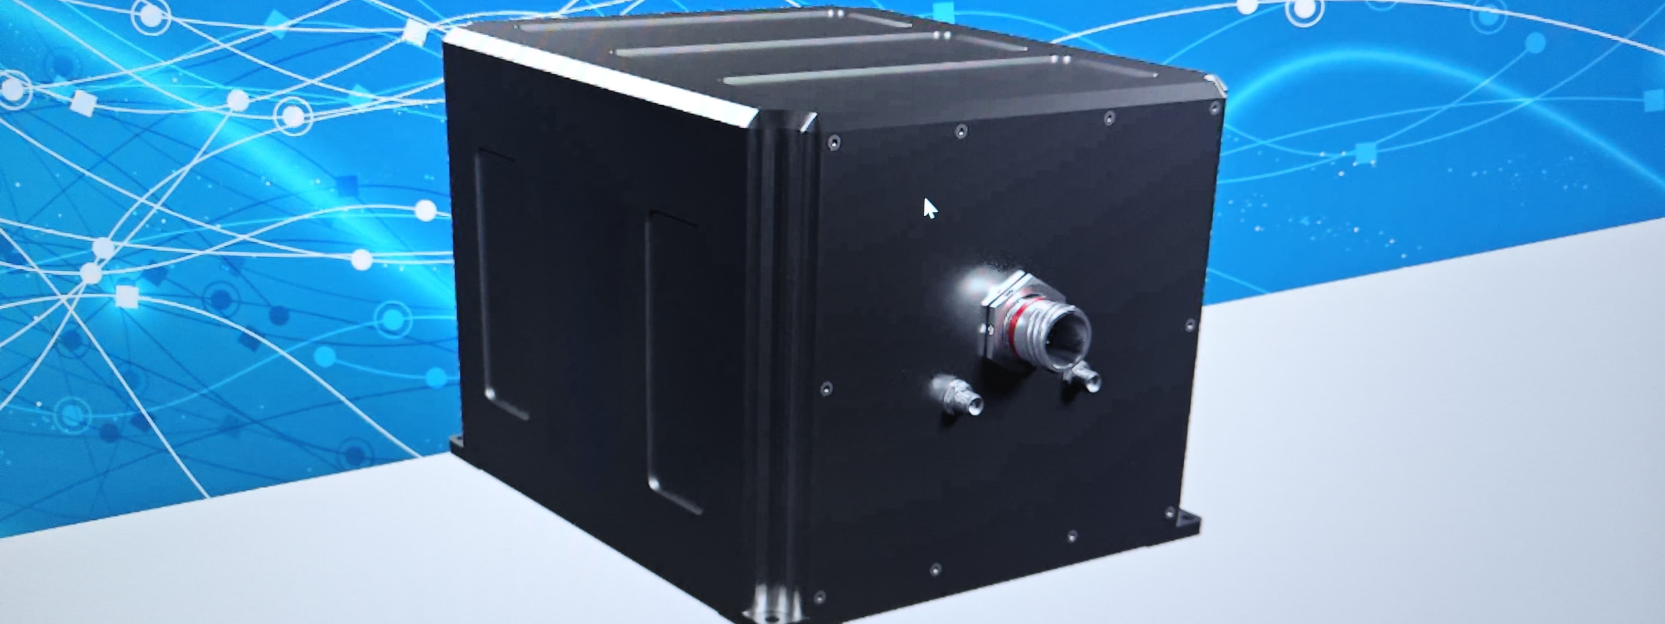
Development of A Hybrid FiberOptic INS
Cost Effective and Accurate Solution for Both Civil & Military Platforms

Slide 5
Hybrid INS Project
Today’s world, one of the most important issue for both civilian and military applications is navigation.
Especially, with the new generation cars on the Street, autonomy is the most growing topic.
On the military side, almost all platforms are heading to the unmanned vehicles.
Hence, all of these products must know their location very well in all conditions, where the magic solution of GNSS can be accured due to the tall buildings in a city or jammers on the fields.
An integrated GNSS/INS Navigation system which uses high accuracy Fiberoptic Inertial Sensor with high quality MEMS accelerometer will result in a good performance and affordable product, even if the GNSS signals are lost.

Slide 6
Development Phases
CONCEPT PHASE
DEVELOPMENT PHASE
PROTOTYPING
LABORATORY TESTS
FIELD TESTS
ENVIRONMENTAL CONDITION TESTS
VALIDATION OF THE PRODUCT
PREPARATION FOR SERIAL PRODUCTION
  2 YEARS OF HARD WORKING IS REQUIRED WITH 8 EXPERTS ON DIFFERENT TOPICS

Slide 7
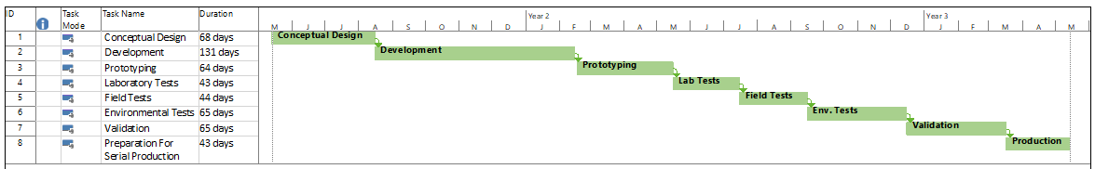
Development Timeline

Slide 8
Required Project Budget
LABOR: €400.000
COMPONENTS: €55.000
MECHANICS: €20.000
LABORATORY EQUIPMENT & INFRASTRUCTURE CONSTRUCTION : €500.000
ENVIRONMENTAL CONDITION TESTS: €100.000
FIELD TESTS: €40.000
  CITY TESTS
  FLIGHT TESTS
  NAVAL TESTS
  «TOTAL AMOUNT OF BUDGET REQUIRED IS €1.115.000»

Slide 9
Output of the Project
With the partial or full support of NATO, at the end of the Project,
There will be a multipurpose product that can be used for manned & unmanned vehicles, which is avaliable for both civilian and military applications, for accurate and reliable navigation output with an affordable price which may have dual use.

Slide 10



«DESIGNS FOR EXCELLENCE»
Thank you for Listening
www.siriusdesignlab.com
Tel : +90 312 235 14 23
Headquarters : Teknopark Ankara, Ostim Osb, No: 1/116 Yenimahalle/Ankara, TURKEY
Branch : Mutlukent Mahallesi , 1961. Cadde No:34/1, Çankaya/Ankara, TURKEY

