Slide 1

Living Way Summer Program
LIMITED SPACE AVAILABLE!!
MONDAY - FRIDAY
~ Summer Program + Day Care: 8am-6pm
~Half day Summer Program: 8am-12pm
~ Day Care: 12:30-6pm
~ $5 per hr after 12:30pm
WEEKLY THEMES
Week 3: (July 6th-10th) Under the Stars Week
Week 4: (July 13th-17th) Adventure Land Week
Week 5: (July 20th-24th) Under the Sea Week
Week 6: (July 27th-31st) It’s a Small World Week
16725 Valencia Ave. Fontana, Ca 92335
909-823-4405

Slide 2



Under The Stars Week
~Kids will do a Patriotic parade
~Make Homemade S'mores
~Glow in the dark play
~Camping in Classroom and much more

Slide 3


Imagination Week
~ Building things
~ Marshmallow Architecture
~ Fingerprint painting
~ Plays
~ Imagination Crafts and much more!

Slide 4
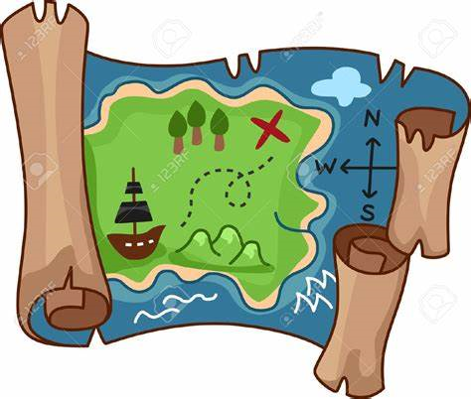


Adventure Land Week
~ Treasure Hunt
~ Scavenger Hunt
~Costume Day
~Pirate Hat crafts
~ And much more

Slide 5
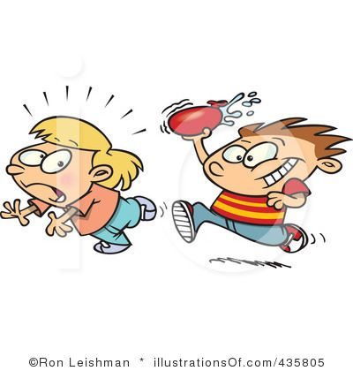


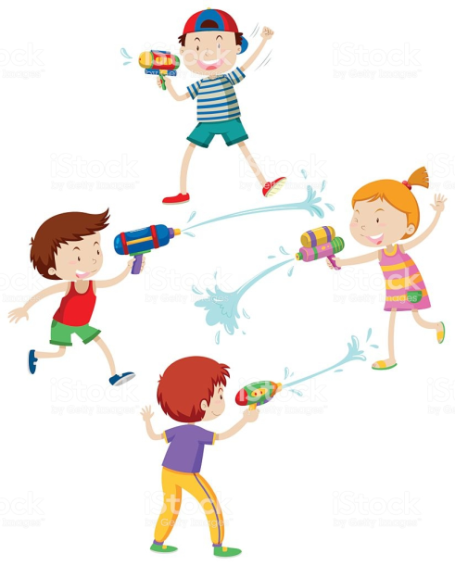

Under the Sea Week
~ Water Slide
~Water balloon toss
~Water gun play
~Jelly fish crafts
~Crab walk race and much more…!

Slide 6

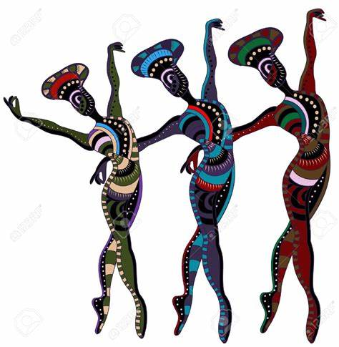

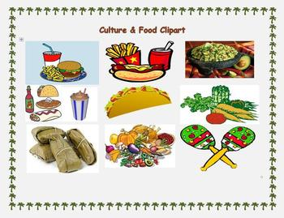
It’s A Small World Week
~ Puppet Theater
~ Performances
~Making different flags
~Bring in your culture food dish
~ Culture dances and much more!

Slide 7


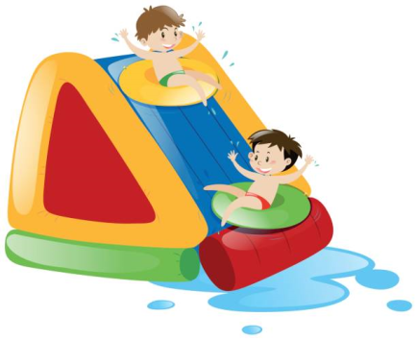


Last Day of SUMMER!
July 31st
Waterslide
Water balloon toss
Water gun play
Jelly fish craft
Crab walk race

Slide 8


See ya’ll in Fall

Slide 9




Living Way Summer Program and Extended Care 2020
JOIN US!
July 6th – 31st
Limited Spaces Available!!!
Summer Program:
Monday – Friday 8:00am – 12:00pm
Extended Care:
Monday - Friday
12:30pm – 6:00pm
Extended Care fee:
$20/daily

