Slide 1
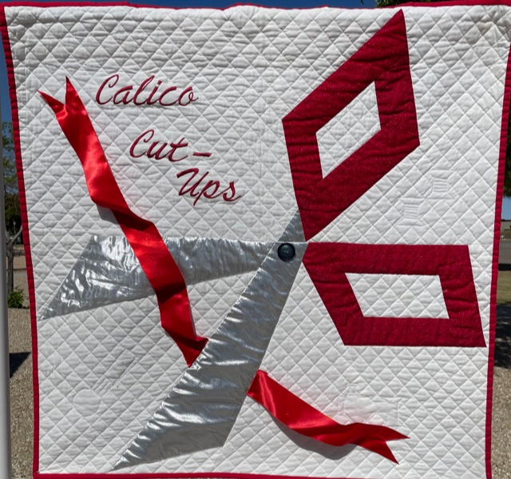
Calico Cut Ups
May 2021 Program
Log Cabin Binding Options

Slide 2
History of the Log Cabin Quilt
Wide-spread appearance in the United States in the 1860s during the time of the Civil War. The block name may very well have had a connection to the presidency of Abraham Lincoln.
The Log Cabin quilt became wildly popular and was identified with the pioneer spirit and values of America. Earlier version contained wool, satin, and other variety of fabric.
In traditional Log Cabin blocks, one half is made of dark fabrics and the other half light.
A red center symbolized the hearth of home and a yellow center represented a welcoming light in the window.
Anecdotal evidence, based on oral folklore, suggests that during the Civil War, a Log Cabin quilt with a black center hanging on a clothesline was meant to signal a stop for the Underground Railroad.
Now days there are numerous variations of the Log Cabin Block.

Slide 3
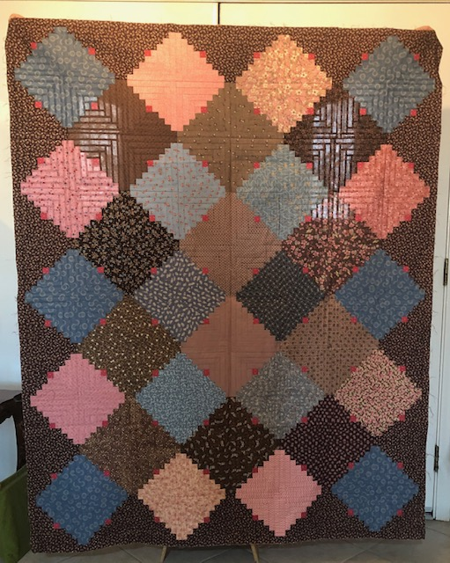
Show Us Your Log Cabin Quilts
Karen L.

Slide 4
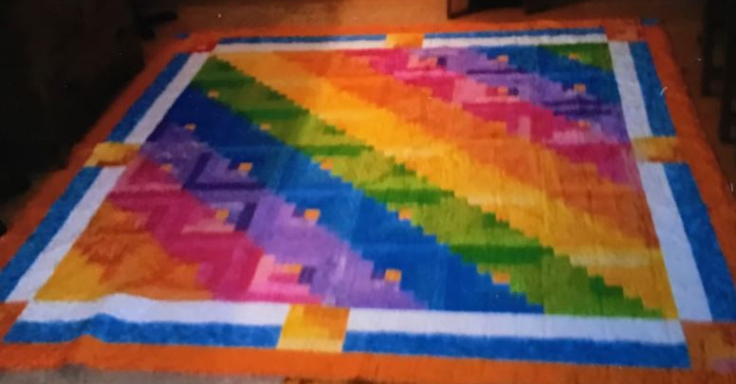
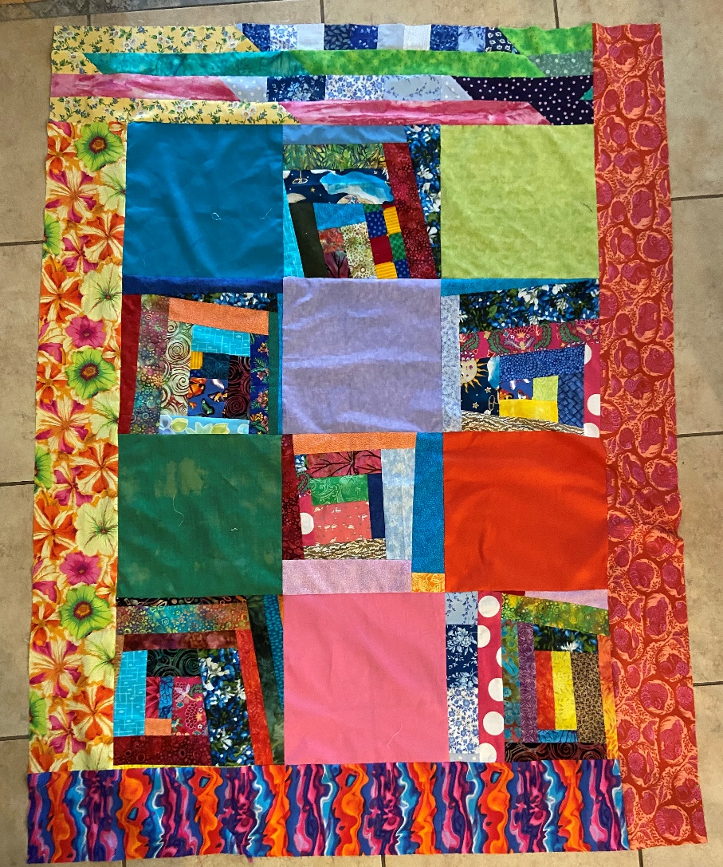
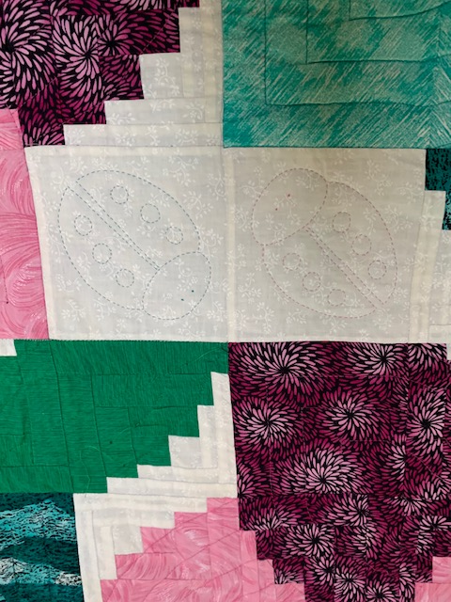
Show Us Your Log Cabin Quilts
Sandy H.
Fred Walker

Slide 5
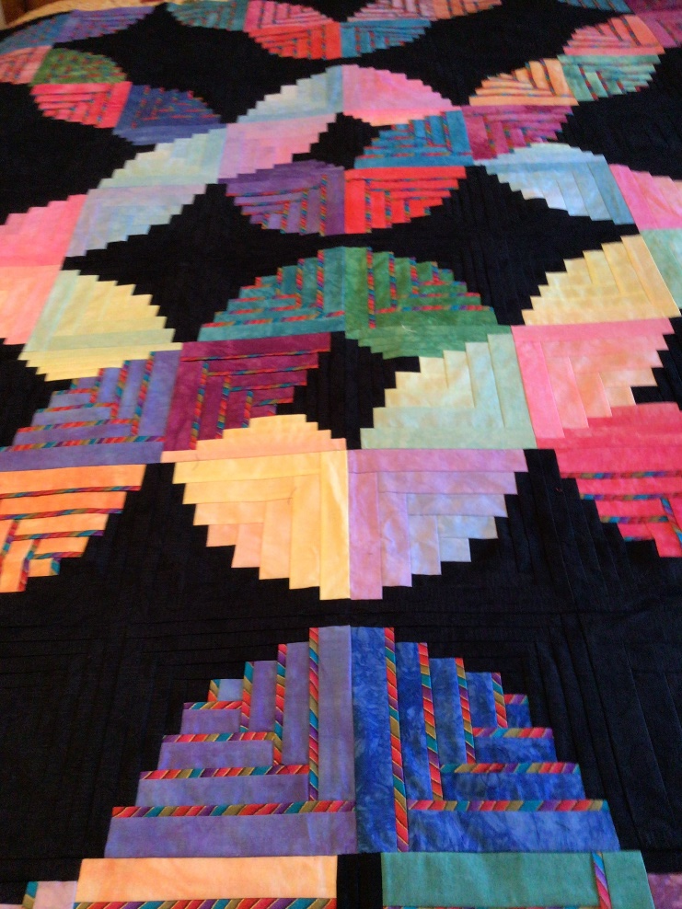
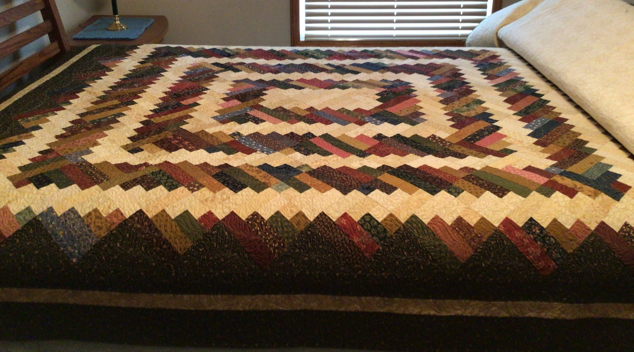
Show Us Your Log Cabin Quilts
Bev B.

Slide 6
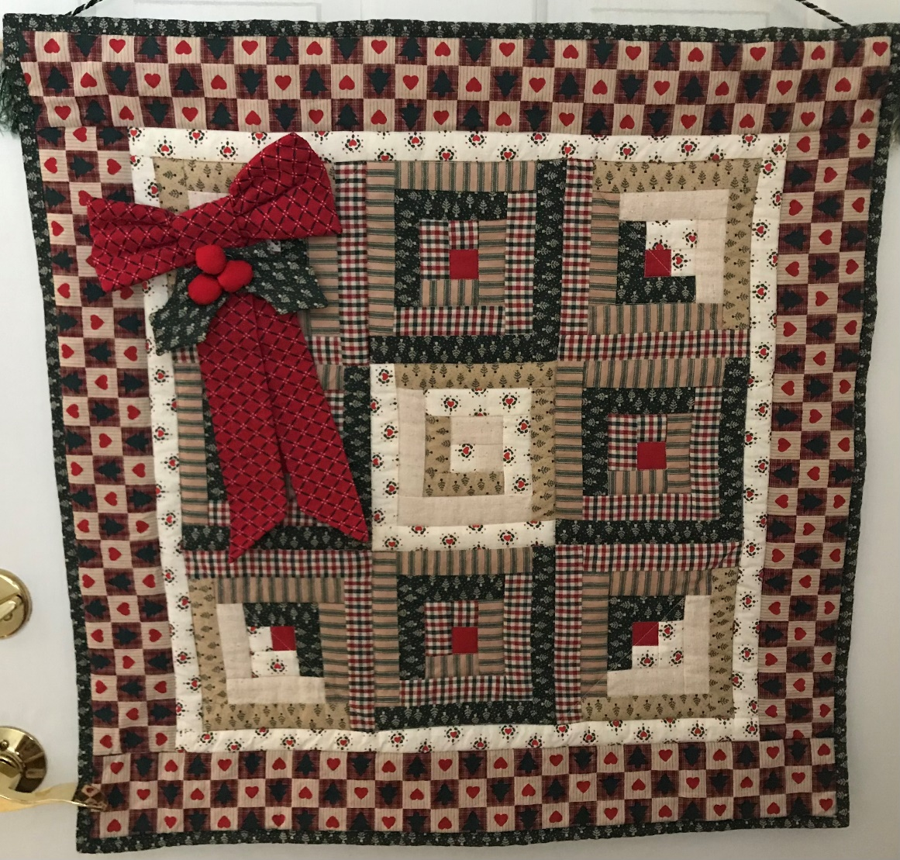
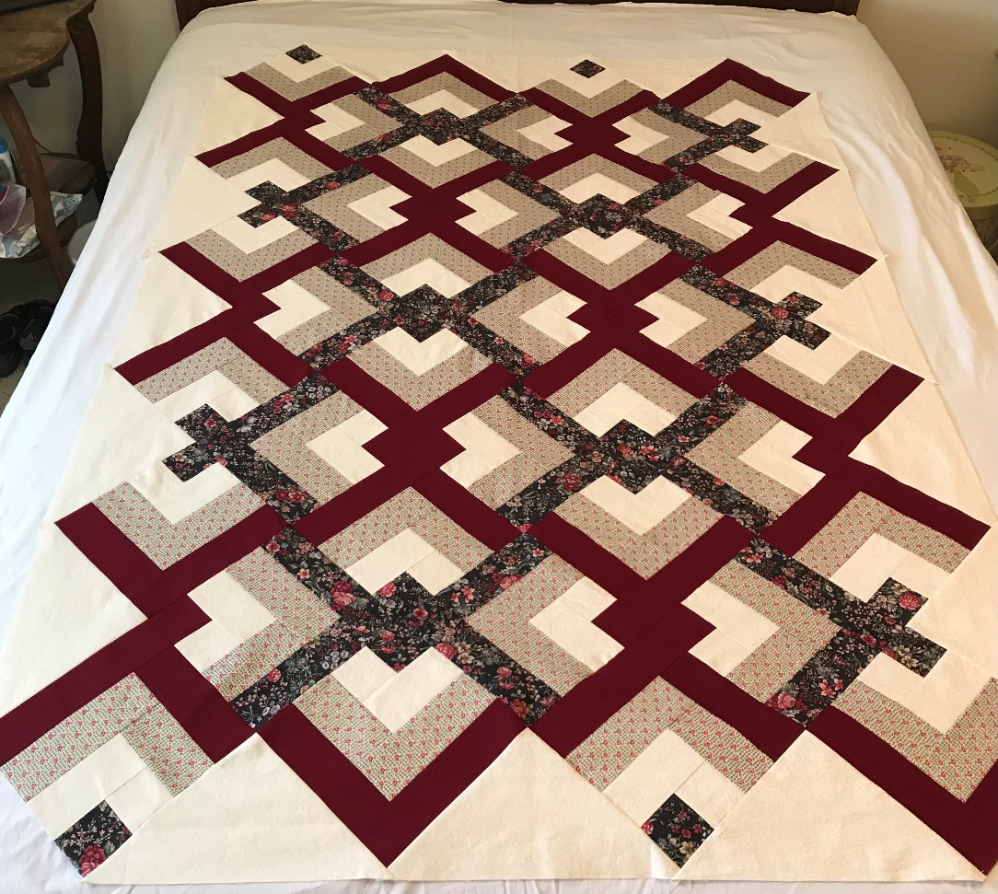
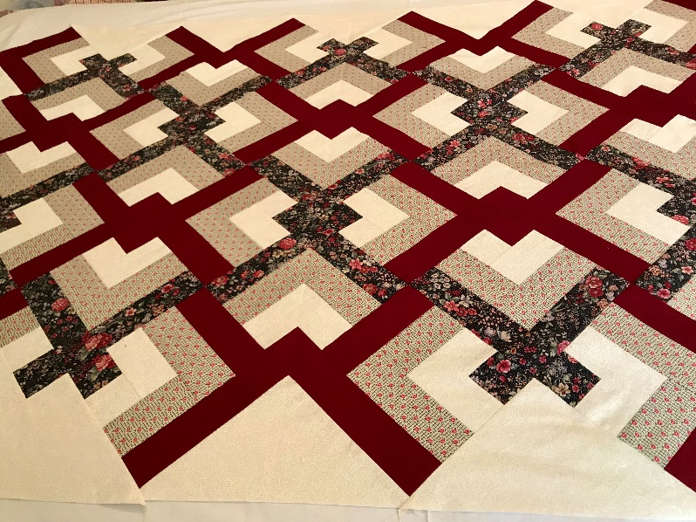
Show Us Your Log Cabin Quilts
Shirley
Helgeson

Slide 7
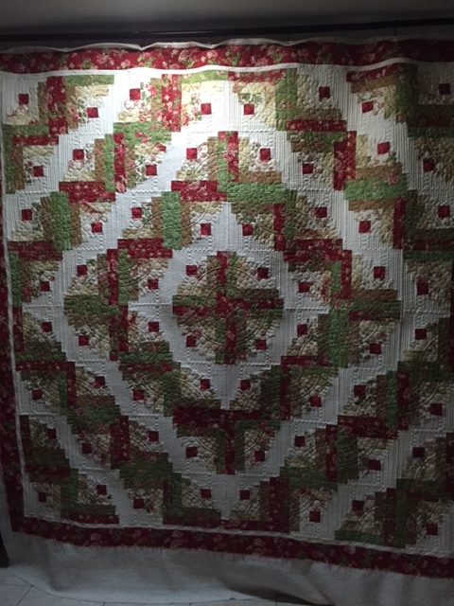
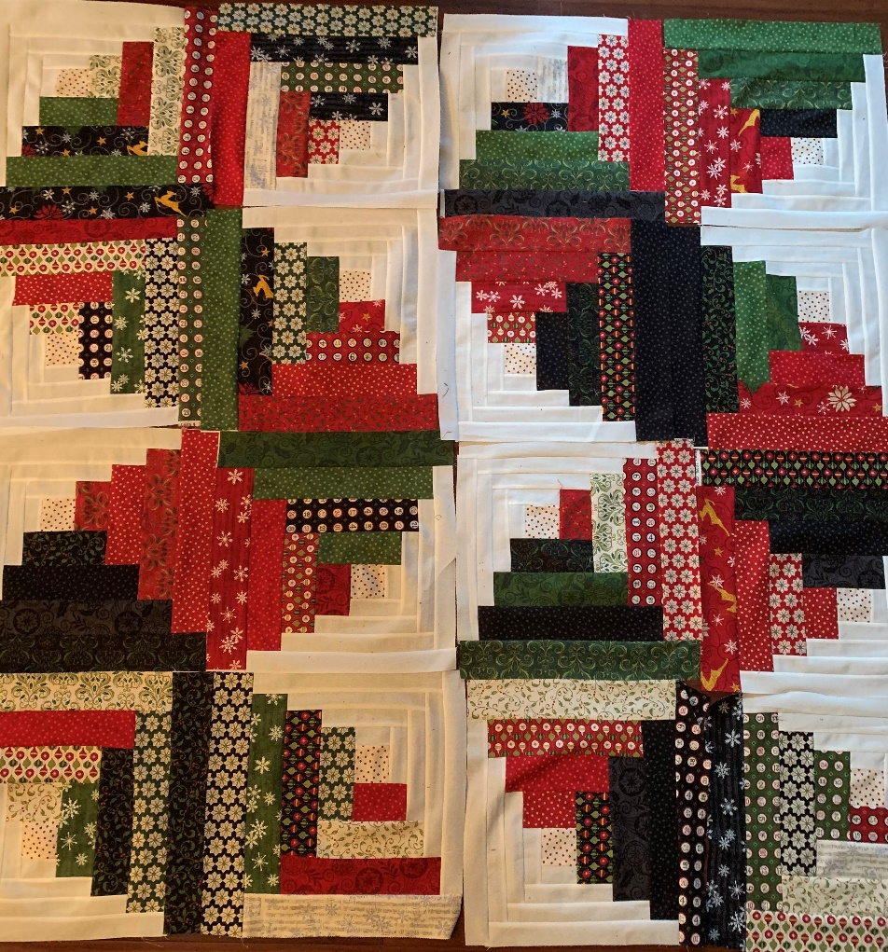
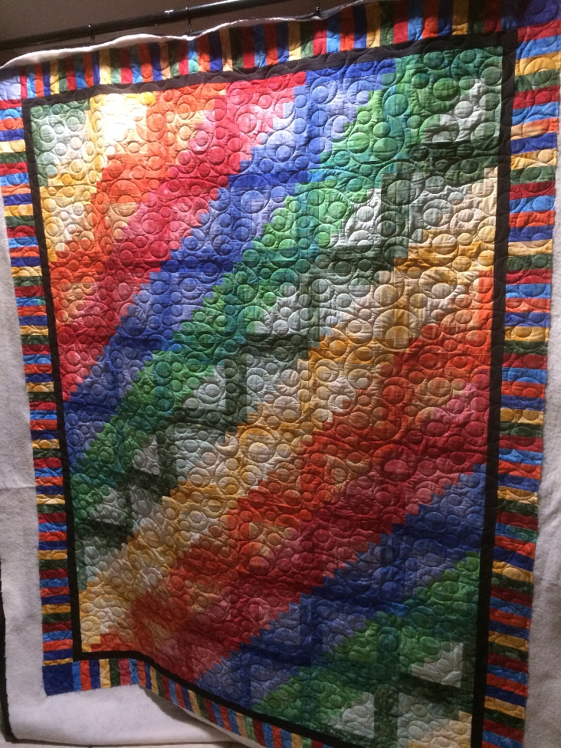
Show Us Your Log Cabin Quilts
Theresa F.

Slide 8
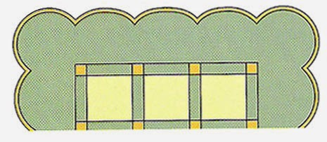
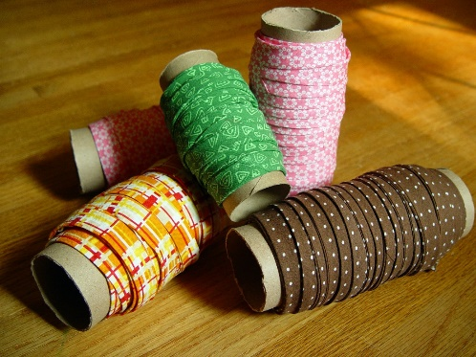
Scallop Quilt Border By Missouri Star Quilts
8 Inch Border
Quilt in a Day – Scallops, Vines & Wave Template
https://www.youtube.com/watch?v=rIHhTxTpMQ0
Continuous Bias Binding By Missouri Star Quilts
200 feet of binding from ½ yard of Fabric
https://www.youtube.com/watch?v=12VNavQleCM
EASIEST FANCY BORDERS FOR ANY QUILT!!!
Jordan Fabrics
https://www.youtube.com/watch?v=kvmDEefv31c

Slide 9
Calico Cut Ups
May 2021 Program
Log Cabin Binding Options

