Slide 1


2026-2027
Alonso High School Sports Information
WELCOME!
Please sit towards the from so you can see Slides

Slide 2
Alonso Awards
Our Coaches promote Experience, dedication, relationships, academics which yields success on the field, in the classroom, and off the field
Cheer State Champions
Regional Qualifiers Track
Regional qualifiers in Soccer, Lacrosse,
District Champions
National Recognized athletes
Students Signing with College to continue their Athletic career
Several Coaches of the Year winners
All County Team GPA’s Winners
Our athletes are in Student government, leadership, Academic top 10
Golden Ravens

Slide 3


Agenda
Welcome
Athletic Booster
Corecourse GPA
Review paperwork
Meet available Coaches

Slide 4
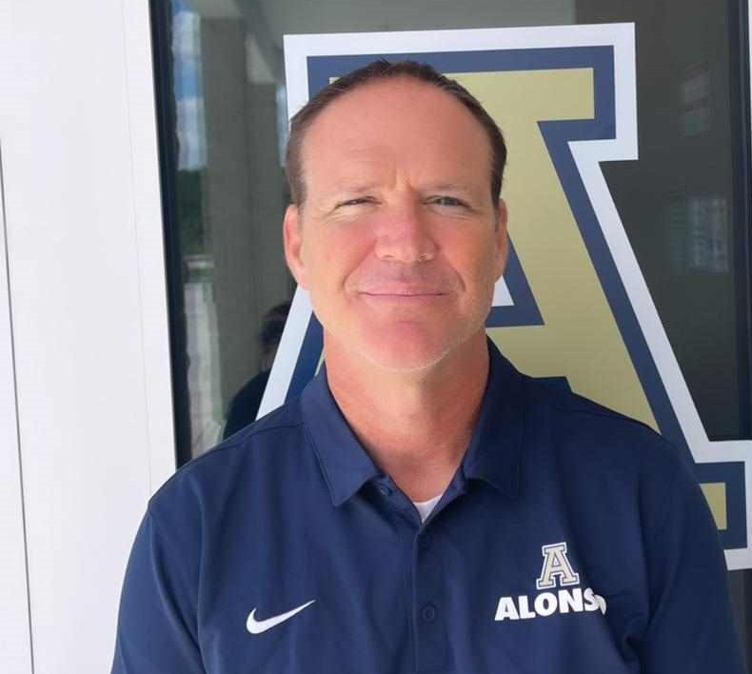

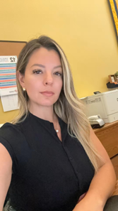
Mr. Warner
Assistant Principal for Administration /Athletic Director
Email Address:
Matthew.warner@hcps.net
Athletics Line:
813-356-1525 ext. 226
Ms. Ocasio
Administrative Assistant for Assistant Principal for Administration /Athletic Director
Email Address:
Angela.uscateguideocasio@hcps.net
Athletics Line:
813-356-1525 ext. 283

Slide 5
Chuck Muller Booter President
Sign up and be a part of Greatness!
https://alonsoboosterclub.com/
The Alonso High School Athletic Booster Club strives to support both athletic and academic excellence by helping our student athletes, teams, coaches/teachers, and school community.

Slide 6


Slide 7
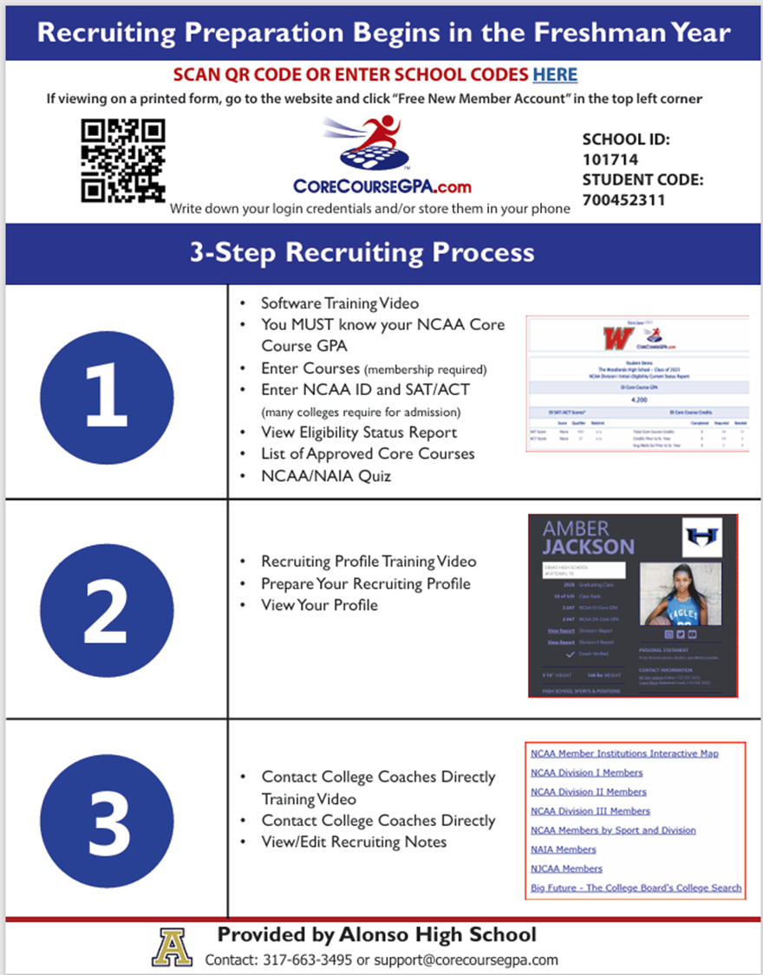


Slide 8
SPORTS OFFERED
GIRLS:
BASKETBALL (W)
Competition cheer (W)
CROSS COUNTRY (F)
FLAG FOOTBALL (S)
GOLF (F)
LACROSSE (PAY TO PLAY) (S)
SOCCER (W)
SOFTBALL (S)
SWIMMING (F)
TENNIS (S)
TRACK AND FIELD (S)
Volleyball
BOYS:
BASEBALL (S)
BASKETBALL (W)
CROSS COUNTRY (F)
FOOTBALL (11 MAN) (F& S)
GOLF (F)
LACROSSE (PAY TO PLAY) (S)
SOCCER (W)
SWIMMING (F)
TENNIS (S)
TACK AND FIELD (S)
WRESTLING (W)

Slide 9

Athletics is a privilege
2.0 required by law to Play
2.5 or lower requires study hall
Game ejections have fines that must be paid by student
Possible suspension from games and team

Slide 10
Athletic Paperwork:
Directions are posted on the School Website! Please communicate with your head coach for assistance. Coaches pre-screen all athletes
All incoming new students must have their coach submit the athletes name to Mr. Warner by 6/5 to be reviewed for Summer conditioning. Start the process now.
Names received after 6/5 from Coaches or directly from Parents will not be cleared for Summer conditioning till July 17th.

Slide 11
Athletic Paperwork continued:
TIPS for SUCCESFUL CLEARANCE:
EL2 (Physical) – MUST be within one calendar year, MUST be on HCPS Form – download from district web page NEW FORM (2/26) upper right corner.
Be careful Dr. Office's do not update :-) they use 2024 still
Some Docters might state ALL athletes must have an ECG ( this is incorrect)
Review All documents and double check your students uploads.
Denied clearances just take longer to get corrected and athlete out to participate.

Slide 12
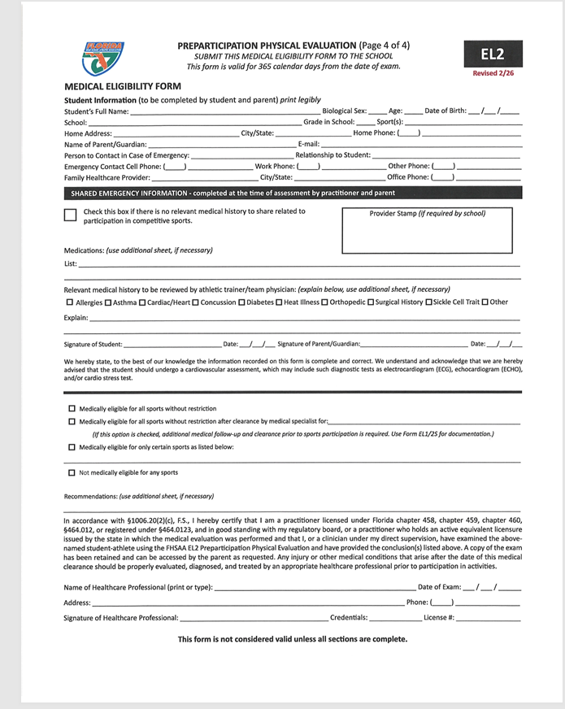






Slide 13
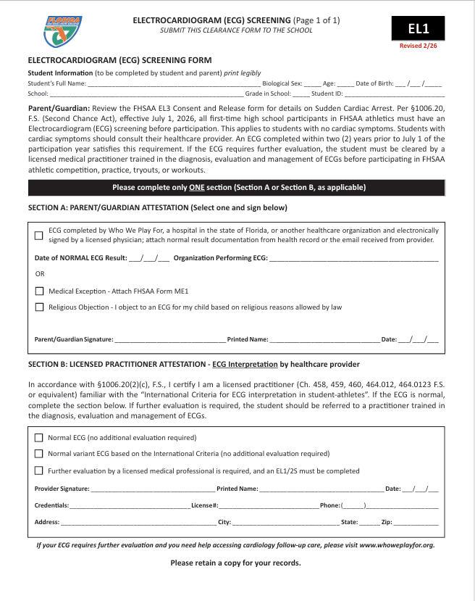
Athletic Paperwork continued
• New ECG requirement form: EL1 (require
starting July 1, 2026)
• EL1 confirms ECG completion with parent and
clinician verification
•ECG must be documented using the official EL1 form
• ECG completed on or after July 1, 2024 will meet the
requirement
• Follow-up clearance required if concerns are identified
• Students cannot participate until fully cleared if further
evaluation is needed
Returning athletes are not required but strongly encouraged to complete an ECG
Returing athletes must upload enrollment history in the
EL1 location

Slide 14
Screening and Access Options for Families
Families can schedule ECGs through:
• Their personal healthcare provider
• Local screening organizations
• School or district partnerships
• Additional screening opportunities:
• WhoWePlayFor.org
• Hillsboroughschools.org/ecgscreenings

Slide 15
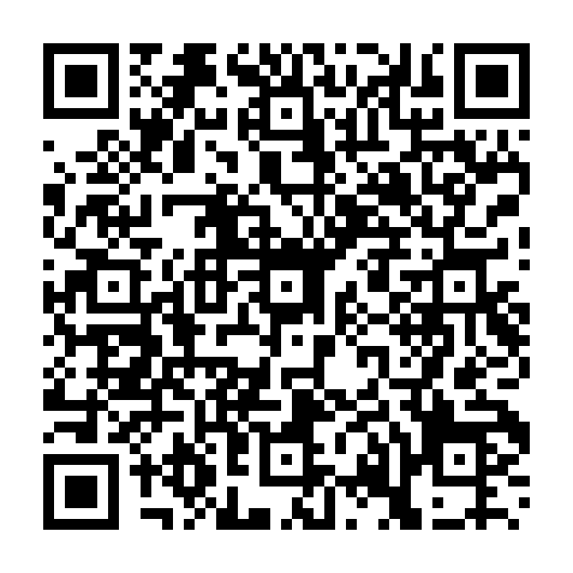
Scan here for information about for ECG

Slide 16


Athletic Paperwork continued:
TIPS for SUCCESFUL CLEARANCE:
Must Purchase School Insurance. Upload ID Card – after purchasing – log back into school health insurance account and download ID card.

Slide 17
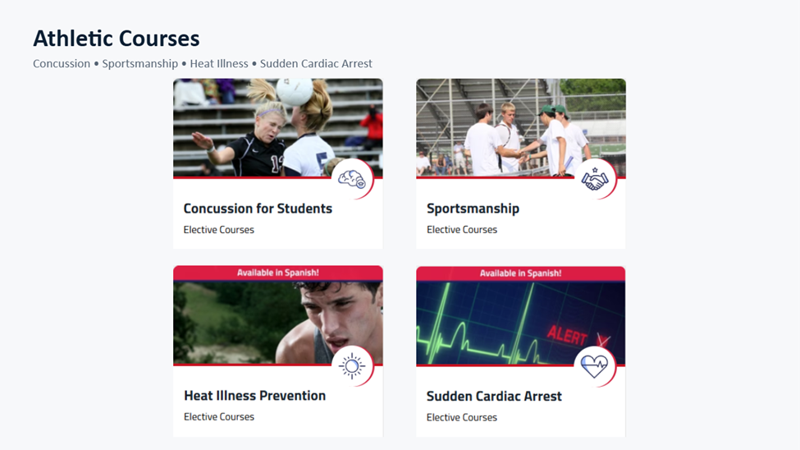
Athletic Paperwork continued:
TIPS for SUCCESFUL CLEARANCE:
Gather ALL required materials to upload:
4 required Video Certificates after completing courses

Slide 18
Athletic Paperwork continued:
Guardian’s government issued ID – usually a DL that has matching address for students information on file at school, and MUST match proof of residence. Guardian whose ID is being uploaded should also be the one signing the electronic signatures. Must be current and ot expired
Proof of Residence – MUST be within 30 days of application, MUST match address on file at school, MUST be in guardians name, MUST be “living proof”. Ex: teco, water bill, mortgage. No cable or phone bill accepted. Date MUST show on bill.
Copy of Birth Certificate
School Specific Forms - Enrollment Form (uploaded under additional forms) – located in the uploads tab

Slide 19


Athletic Paperwork continued:
Once all documents have been gathered – follow the directions on how to create a new account and follow the steps for uploading and answering all information.
Returners – log in and follow the directions for each step.
Reminder – the medical history should be completed accurately. This is for the safety of your student athlete.
Guardian information and phone numbers become the students medical emergency contact information that coaches can access immediately should an injury occur. Please be accurate and give us a number where you can be reached.
Denials come with specific directions PLEASE READ them. It gives you step by step on what to do to correct any information that is not completed correctly that keeps your student from being cleared to play.
Clearance can take up to 15 days. Please be patient. There is only one of me that does this for all sports, Band and ROTC.

Slide 20
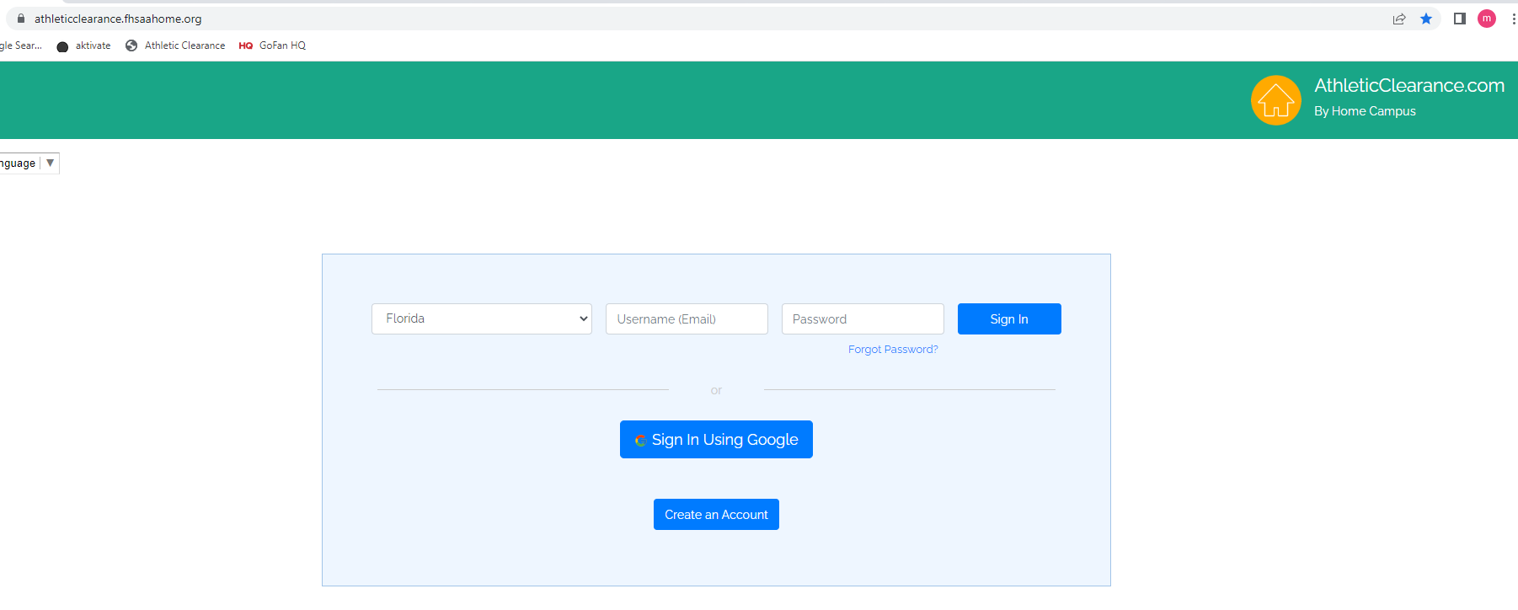




https://athleticclearance.fhsaahome.org/

Slide 21

SPORTS START DATES
Fall Sports Start Dates:
Football July 27 2026
Volleyball July 27 2026
B & G Cross Country July 272026
B & G Swimming July 272026
B & G Golf July 27 2026
Winter Sports Start Dates:
Competitive Cheer TBD
Girls Soccer TBD
Boys Soccer TBD
Girls Basketball TBD
Boys Basketball TBD
Wrestling TBD
Spring Sports Start Date
Baseball TBD
Softball TBD
G & B Track TBD
G & B Lacrosse TBD
Tennis B/G TBD
Flag Football TBD

Slide 22
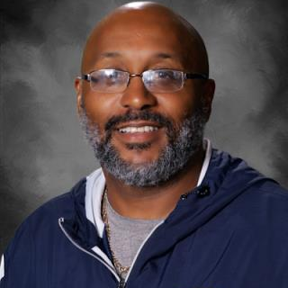
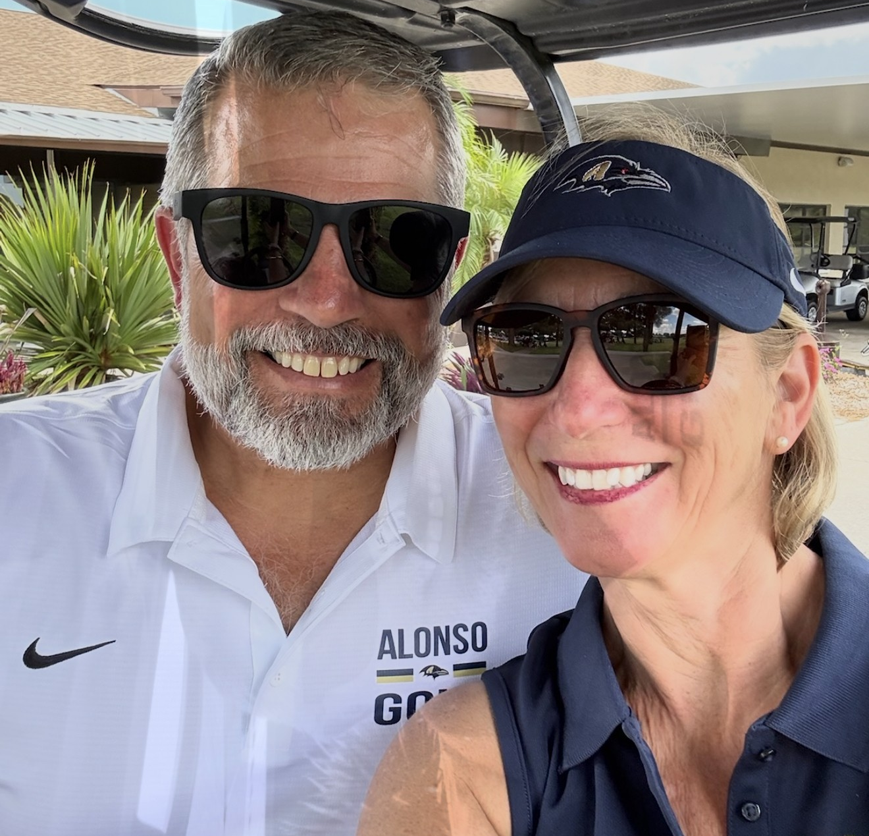



FALL SPORTS COACHES
donwols@hotmail.com
Boys and Girls Cross Country
Coach Mills
Email: roger.mills@hcps.net
Website: ravensdontbllink.com
Twitter:
@RavensXCTnF
On Campus
Volleyball
Coach
TBD
Email:
Off Campus
Boys & Girls Golf
Coach
Email:
donwols@hotmail.com
Off Campus

Slide 23
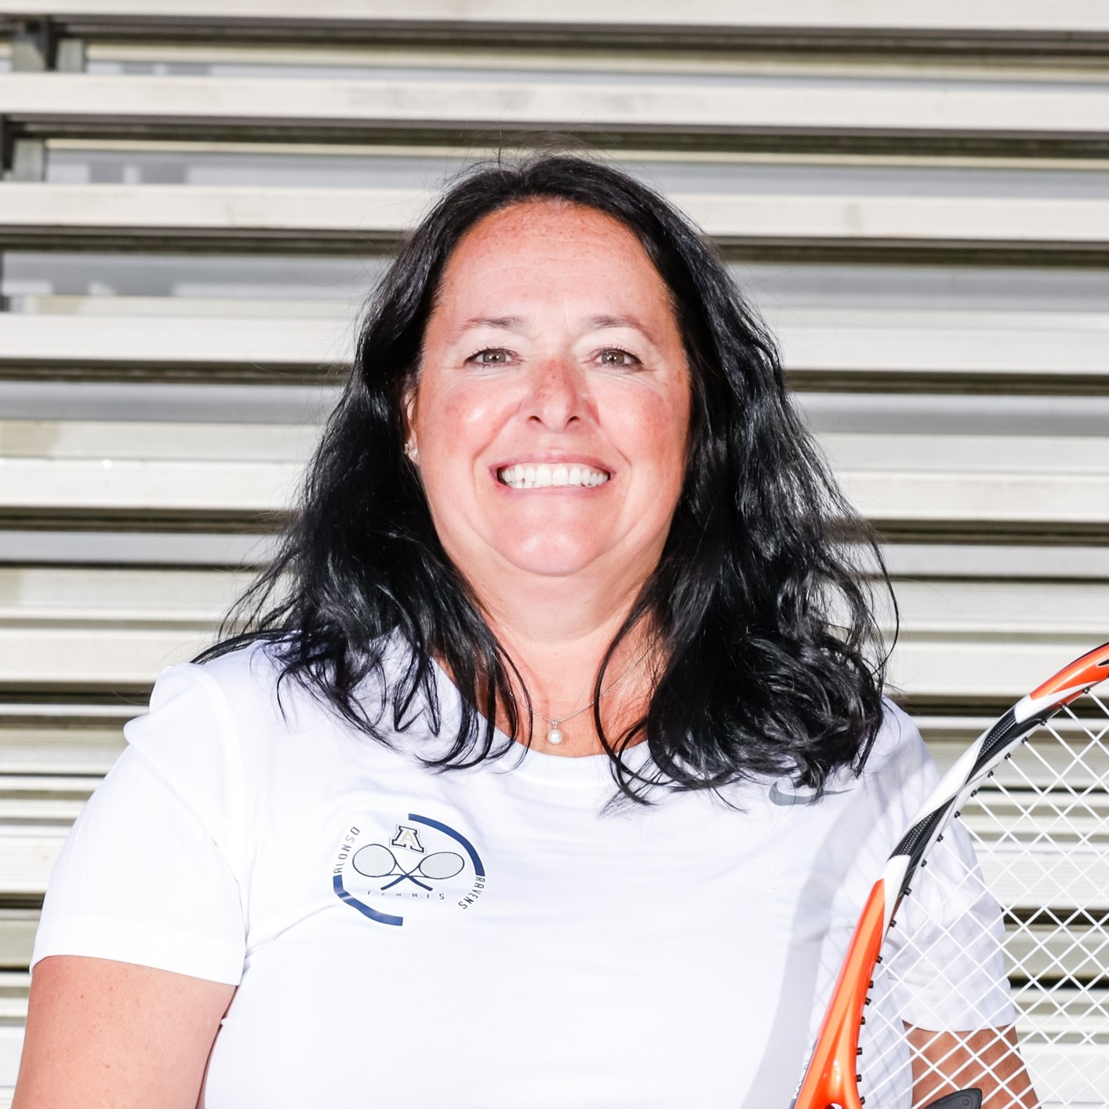
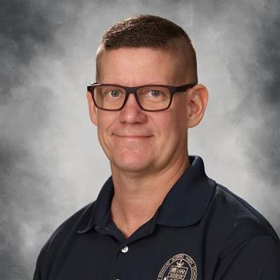
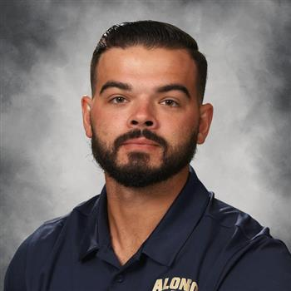
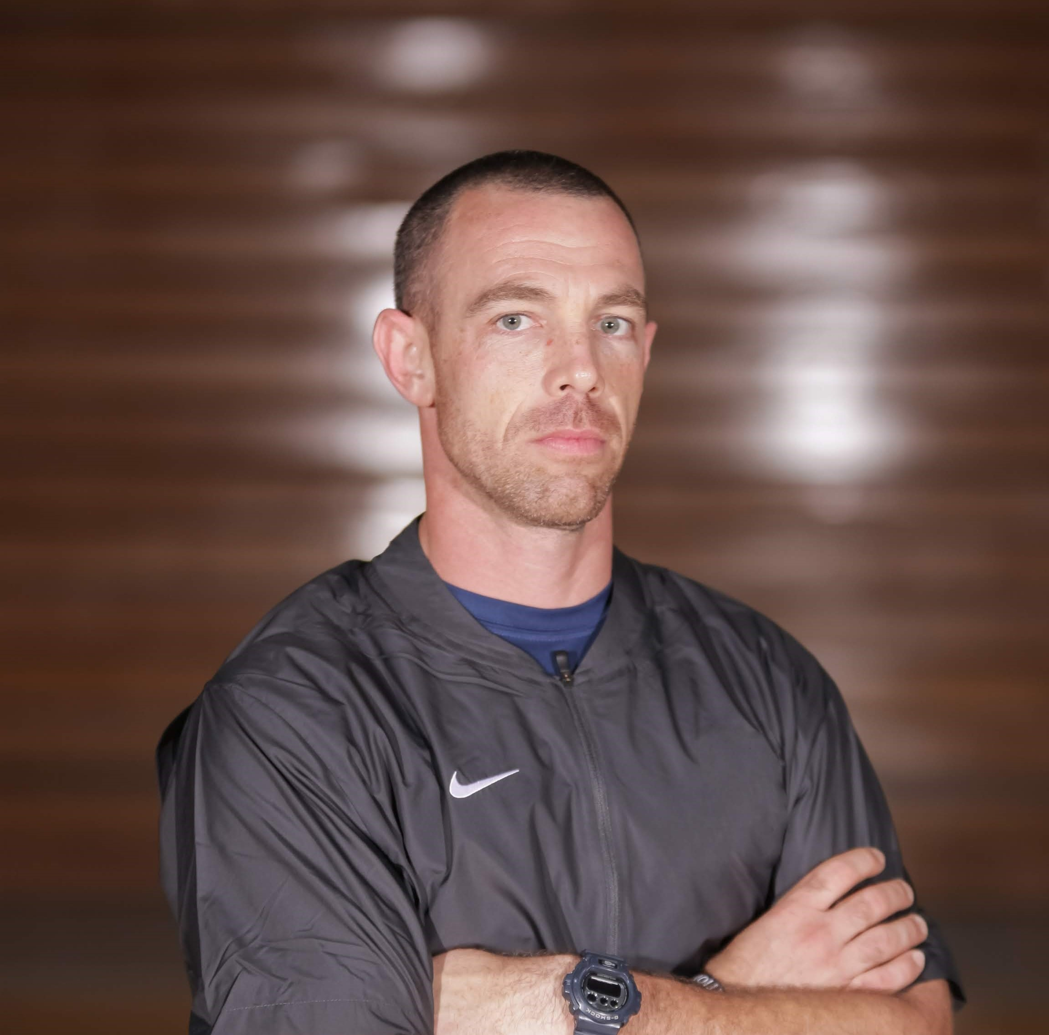
FALL SPORTS COACHES
Boys and Girls Swimming
Coach Kobel
Nathalie.Kobel@hcps.net
Coach Larosse
Email: Matthew.Larosse@hcps.net
Website:
Alonso-acquatics.com
On Campus
Varsity Football
Coach Cantrell
Email: Hayden.Cantrell@hcps.net
Twitter:
@AlonsoRavensFB
On Campus
JV Football
Coach Ruff
Email:
Timothy.ruff@hcps.net
Off Campus

Slide 24
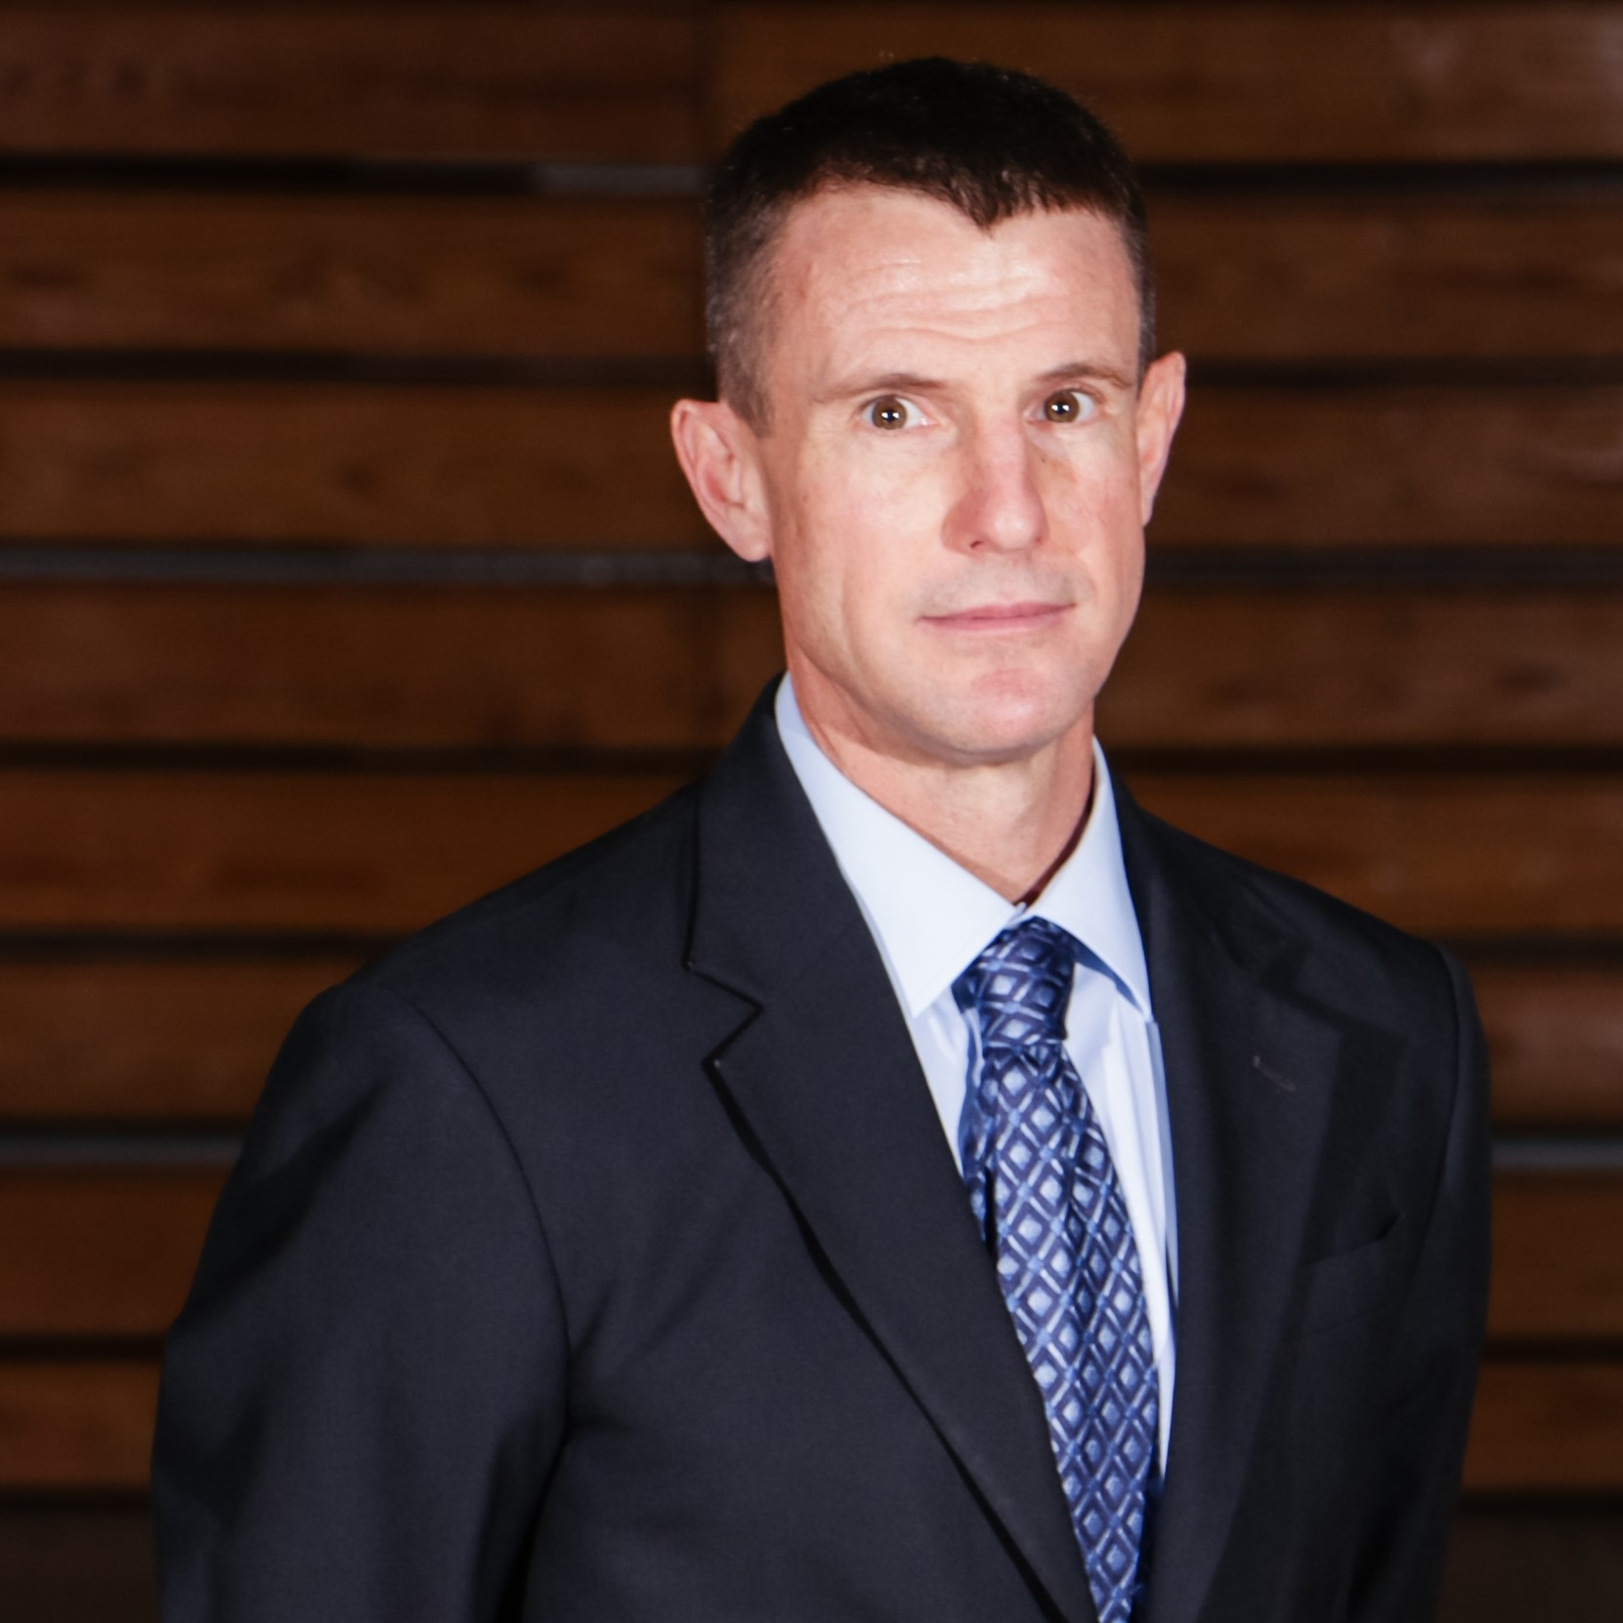
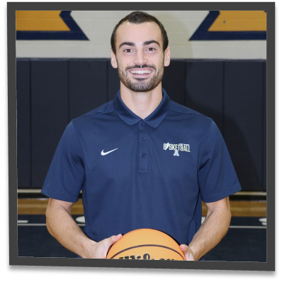
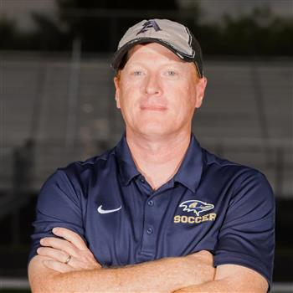

WINTER SPORTS COACHES
Boys Basketball
Coach Price
Email: todd.price@hcps.net
Twitter:
@AlonsoBoys
On Campus
Girls Basketball
Coach Glassman
Email:
Matthew.glassman@hcps.net
Twitter:
@RavensBasketball
On Campus
Boys Soccer
Coach Wilson
Email:
Matthew.Wilson@hcps.net
Off-Campus
Girls Soccer
Coach
TBD

Slide 25
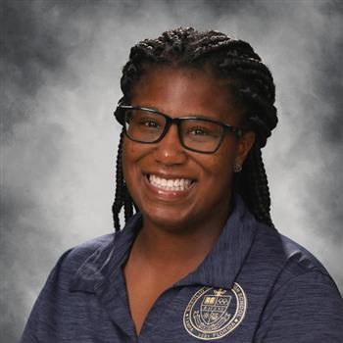

WINTER SPORTS COACHES
Competition Cheer
Coach Lucas
Email: Ann.lucas@hcps.net
Instagram
@Alonsocheer
On Campus
Wrestling
TBD

Slide 26
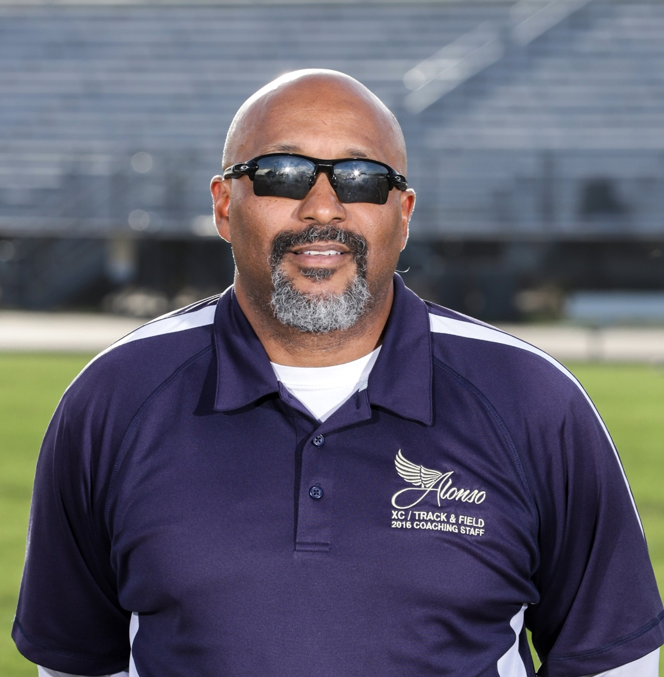
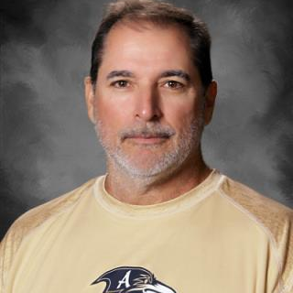
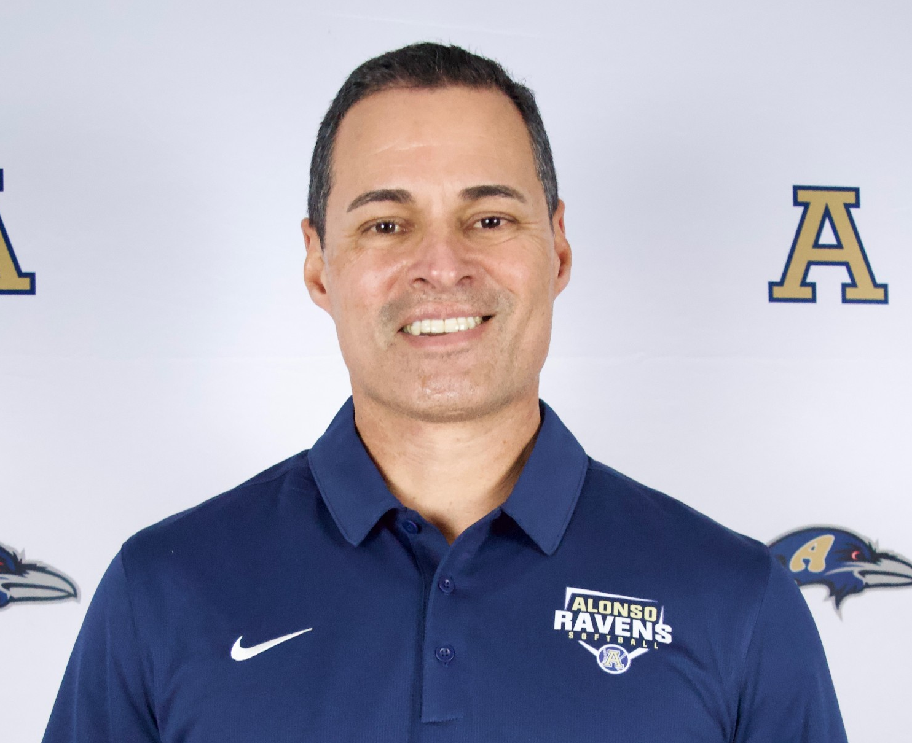


SPRING SPORTS COACHES
Baseball
Coach Faedo
Email: landy.Faedo@hcps.net
Facebook
alonsoravensbaseballclub
On Campus
Softball
Coach Lozada
Email: julio.lozada@hcps.net
Instagram @ahsravenssb
Off Campus
Girls Track
Email:
Website: ravensdontbllink.com
Twitter:
@RavensXCTnF
On Campus
Boys Track
Coach Mills
Email: roger.mills@hcps.net
Website: ravensdontbllink.com
Twitter:
@RavensXCTnF
On Campus

Slide 27
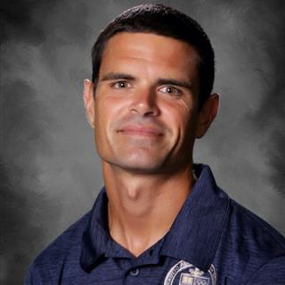
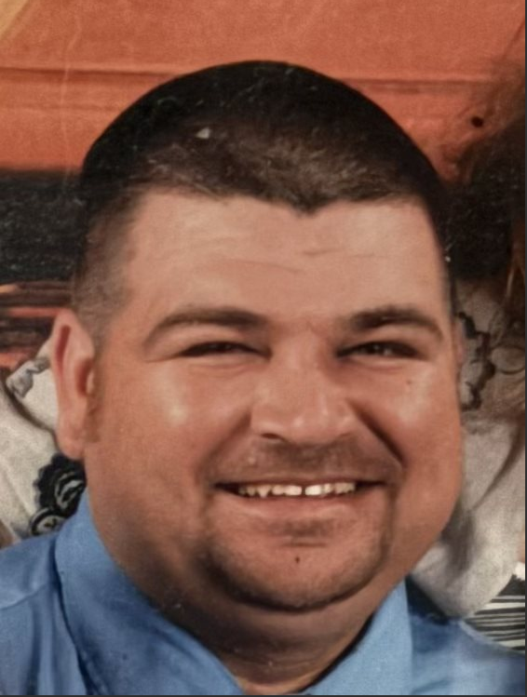



SPRING SPORTS COACHES
Boys and Girls Lacrosse
Coach Most
Email:
Most3636@yahoo.com
Off Campus
Flag Football
Coach Hernandez
Email: matthew.Hernandez@hcps.net
Instagram
ahsflagfootball
On Campus

Slide 28
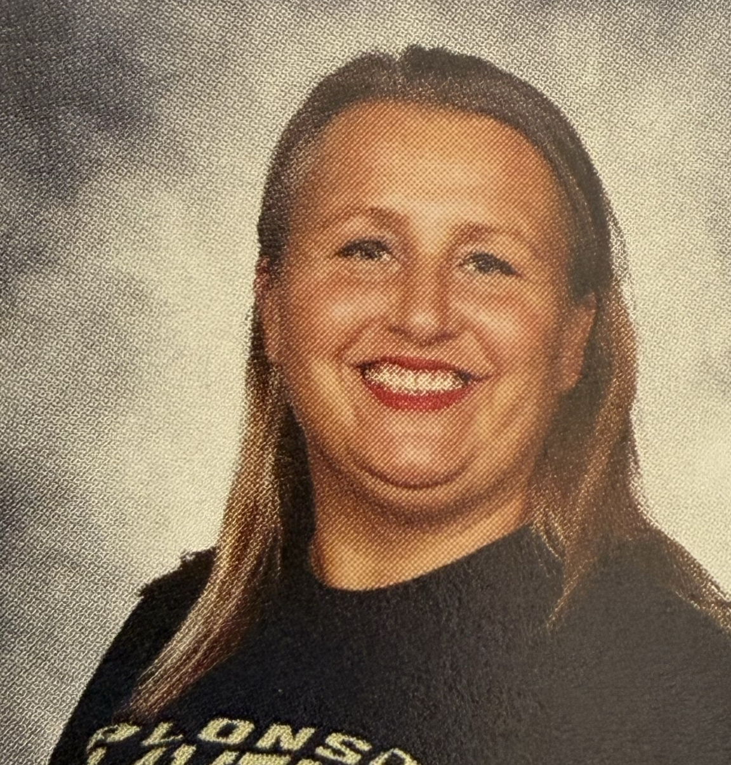

SPRING SPORTS COACHES
Girls Tennis
Coach Kobel
Email: Nathalie.kobel@hcps.net
Off Campus
Boys Tennis
Coach Smith
vanessa.smith@hcps.net
Email:
On Campus

Slide 29
Thank you !
This slide show will be posted on the Athletic page for Alonso
Football will meet in outside
All other programs meet in Auditroium
Have a great Summer!

