Slide 1


Renal Physiology and Pathophysiology
Dr Muhammad Iqbal Abdul Hafidz
UiTM Sungai Buloh
4th Renal Nutrition Seminar

Slide 2
Declaration of Interests
I am a firm believer in nutrition as an important aspect of medical therapy!
I feel you are under appreciated, under valued!
  “diabetic diet”, “reduce weight”, “start NG feeding”
Renal nutrition should be promoted!
Thank you dietitians!!!

Slide 3
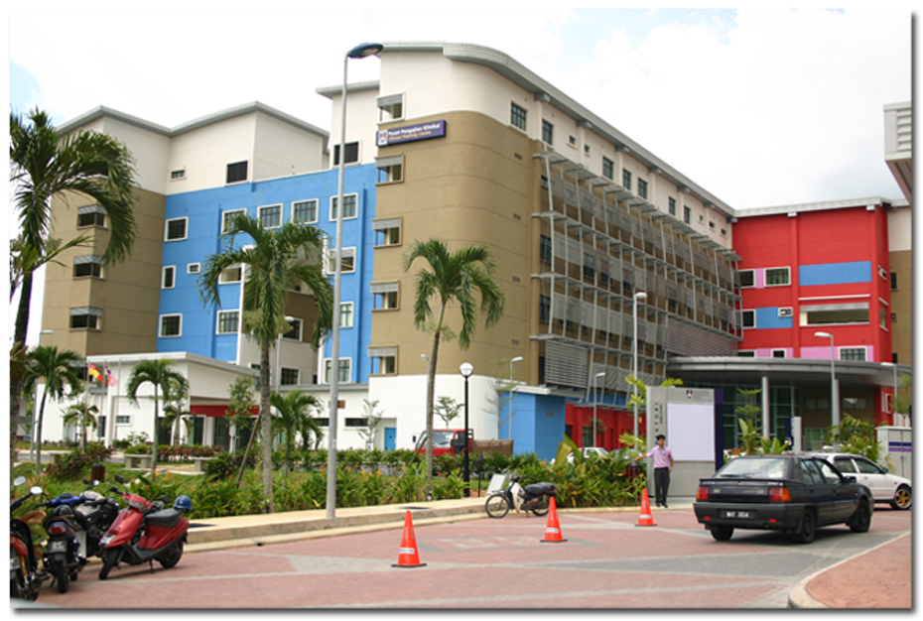
Introduction – Renal UiTM

Slide 4
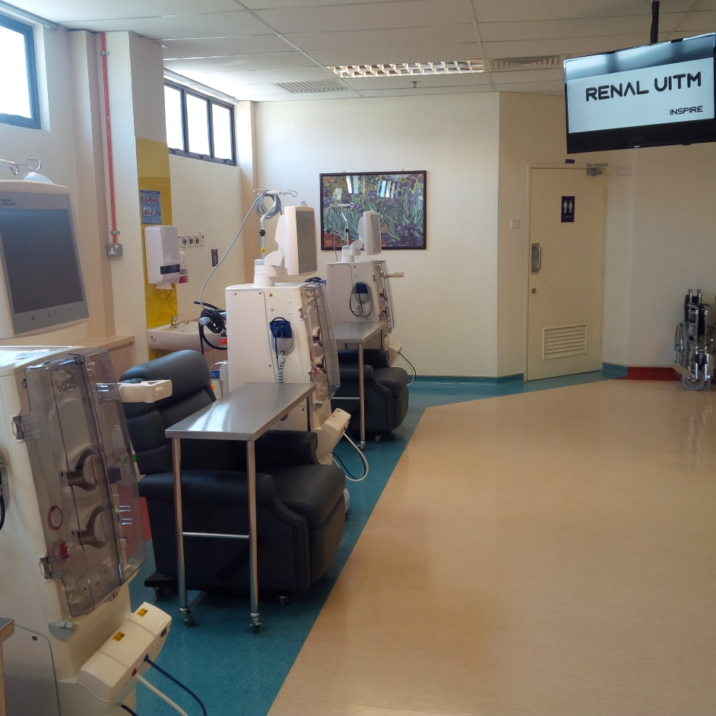
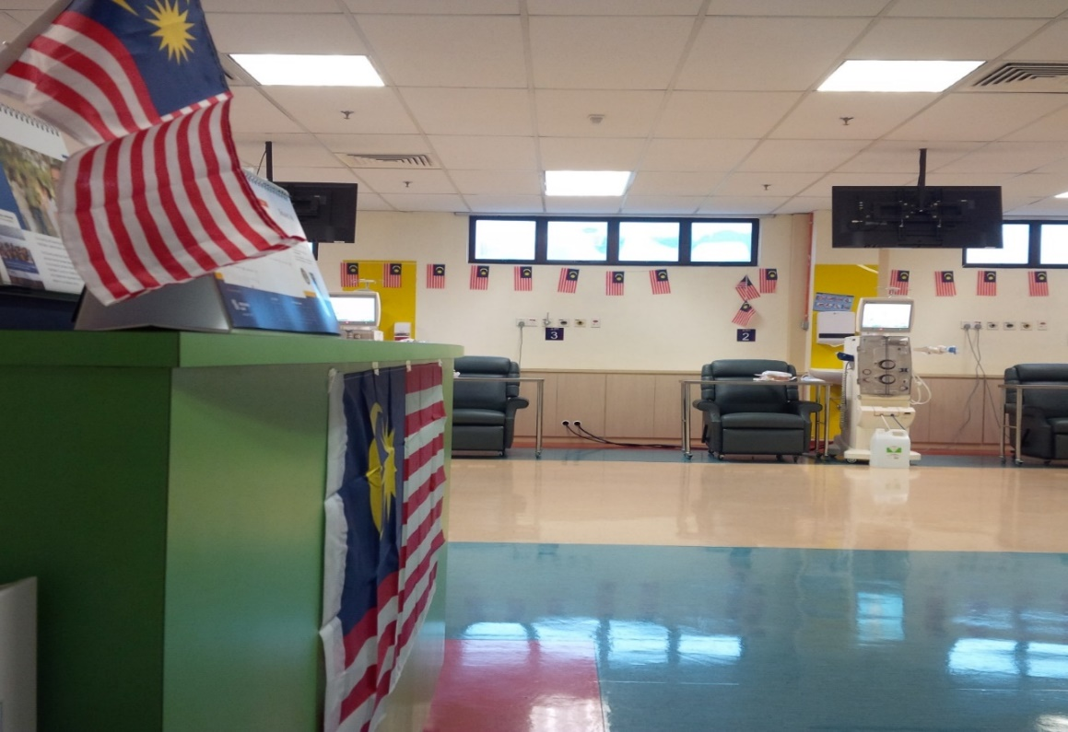
Fully HDF Unit

Slide 5
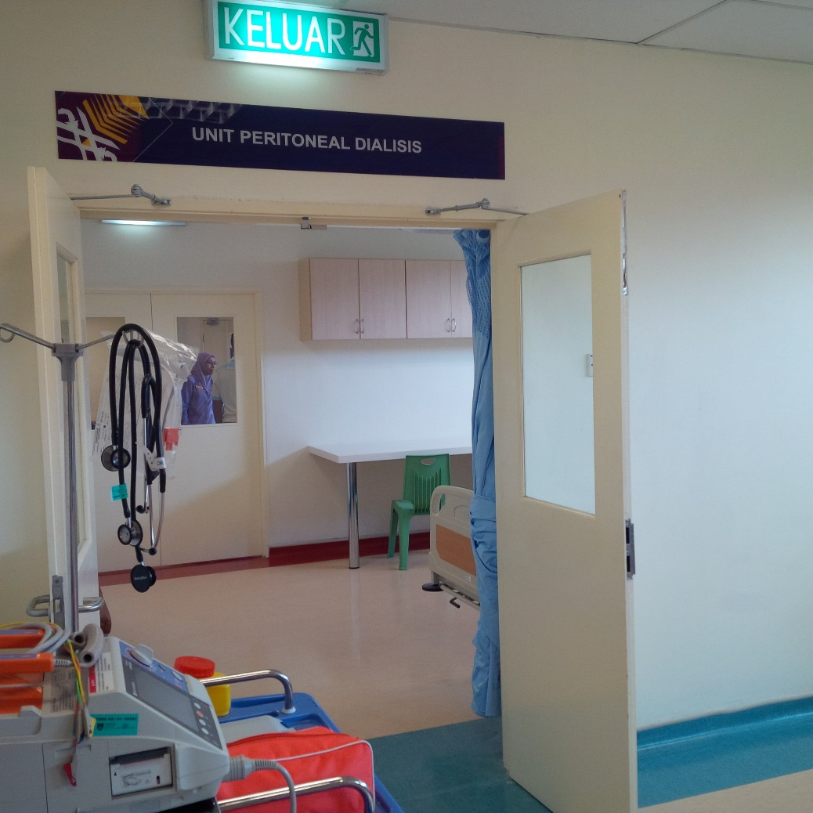
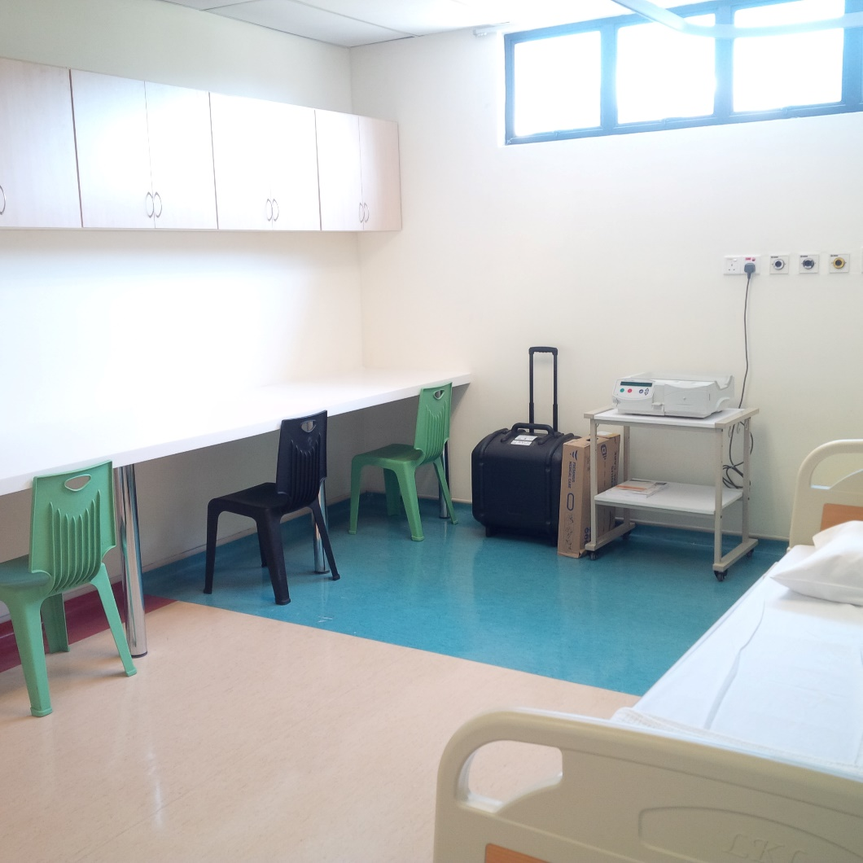
Peritoneal Dialysis

Slide 6
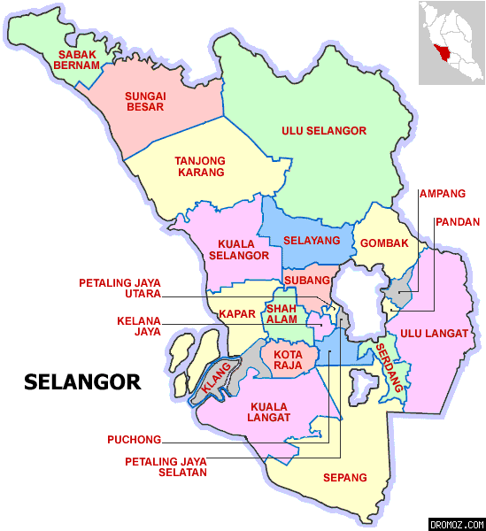
Future
Selayang
Puncak Alam
Teluk Intan

Slide 7
Services Provided
HDF
PD
Tenchkoff Catheter
IJC and perm catheter
Clinic
Ward
Parathyroidectomy
AVF
Transplant - 2017

Slide 8
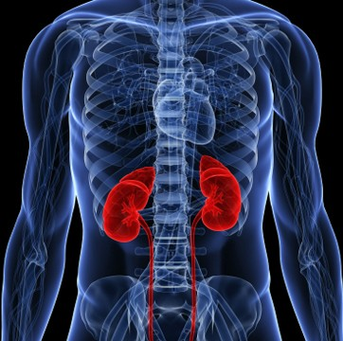
Outline of talk
ANATOMY
PHYSIOLOGY
PATHOPHYSIOLOGY

Slide 9
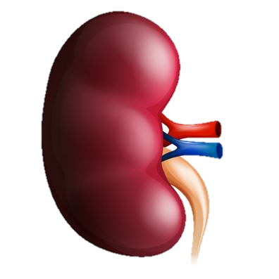
Anatomy
Bean shaped, reddish brown
10-12 cm
Covered by a tough capsule of fibrous tissue – renal capsule
Layer of fat adhering to the surface – to cushion them

Slide 10
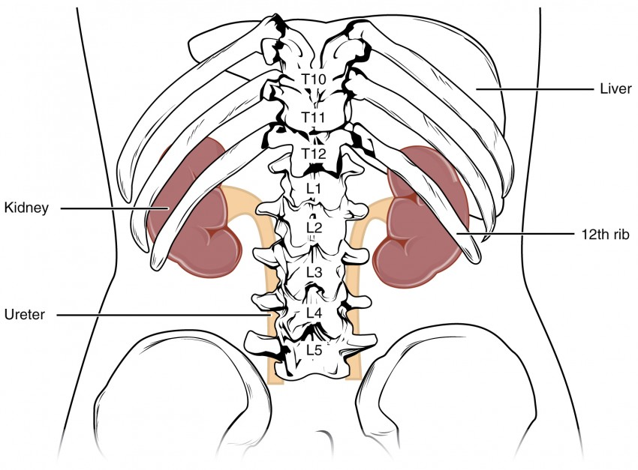
Anatomy
Concaved side – renal artery, renal vein and ureter enters
Retroperitoneal
Left kidney slightly above the right kidney
Protected by ribcage

Slide 11
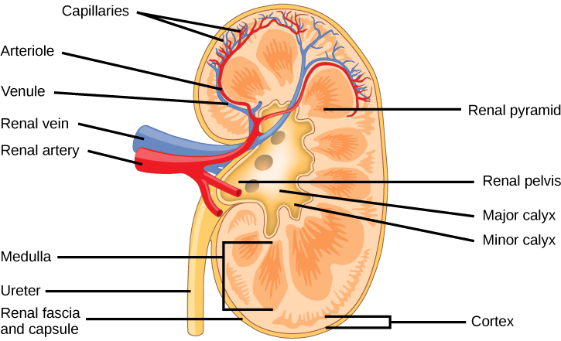
Blood supply
Blood supplied by the renal artery > lobar arteries > arterioles
Blood returns renal vein < lobar veins < venules
“Toxic” blood enters via renal artery, “cleaned” and returned via the renal vein

Slide 12
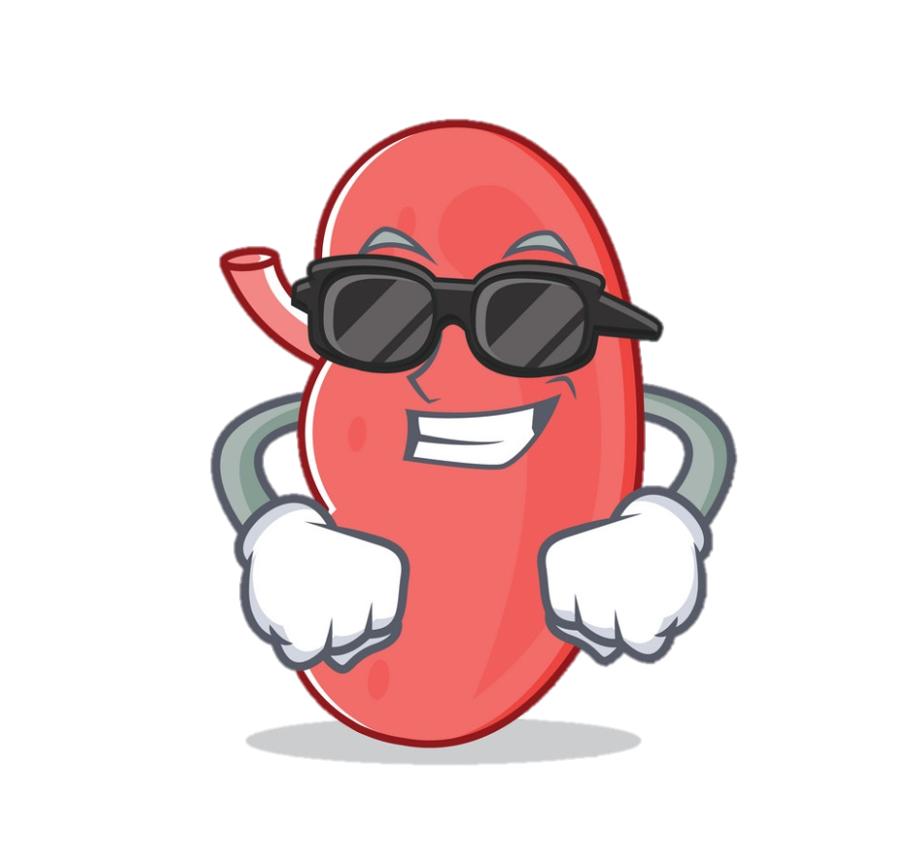
OMG Fact!
The renal arteries deliver to the kidneys of a normal person at rest 1.2 litres of blood per minute!
Thus, a volume of blood equal to all that found in the body of an adult human being is processed by the kidneys once every four to five minutes

Slide 13
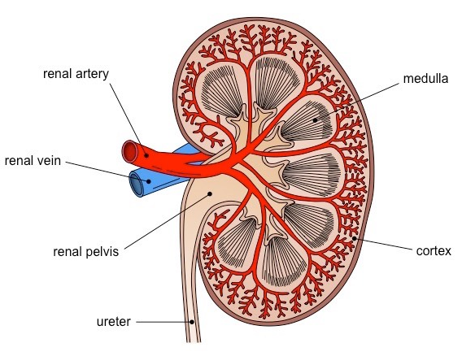
Areas of the kidney
Areas of the kidneys are
  Cortex – glomerulus located
  Medulla - tubules and collecting ducts
  Renal pelvis – urine produced collected
  Ureter – urine drains to the bladder

Slide 14
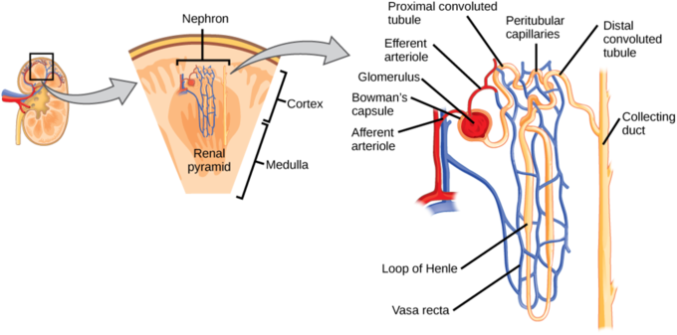
Functioning unit - Nephron
1 million nephrons in each kidney!!

Slide 15
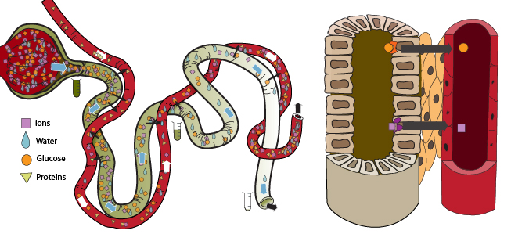
Nephron
Where the filtration of blood occurs and urine is made
Toxic waste is excreted with urine
Non-toxic filtrate is reabsorbed
The tubules are made of cells which
are able to control electrolytes in the body
– sodium, potassium, Ca, PO4+
Also controls water excretion

Slide 16
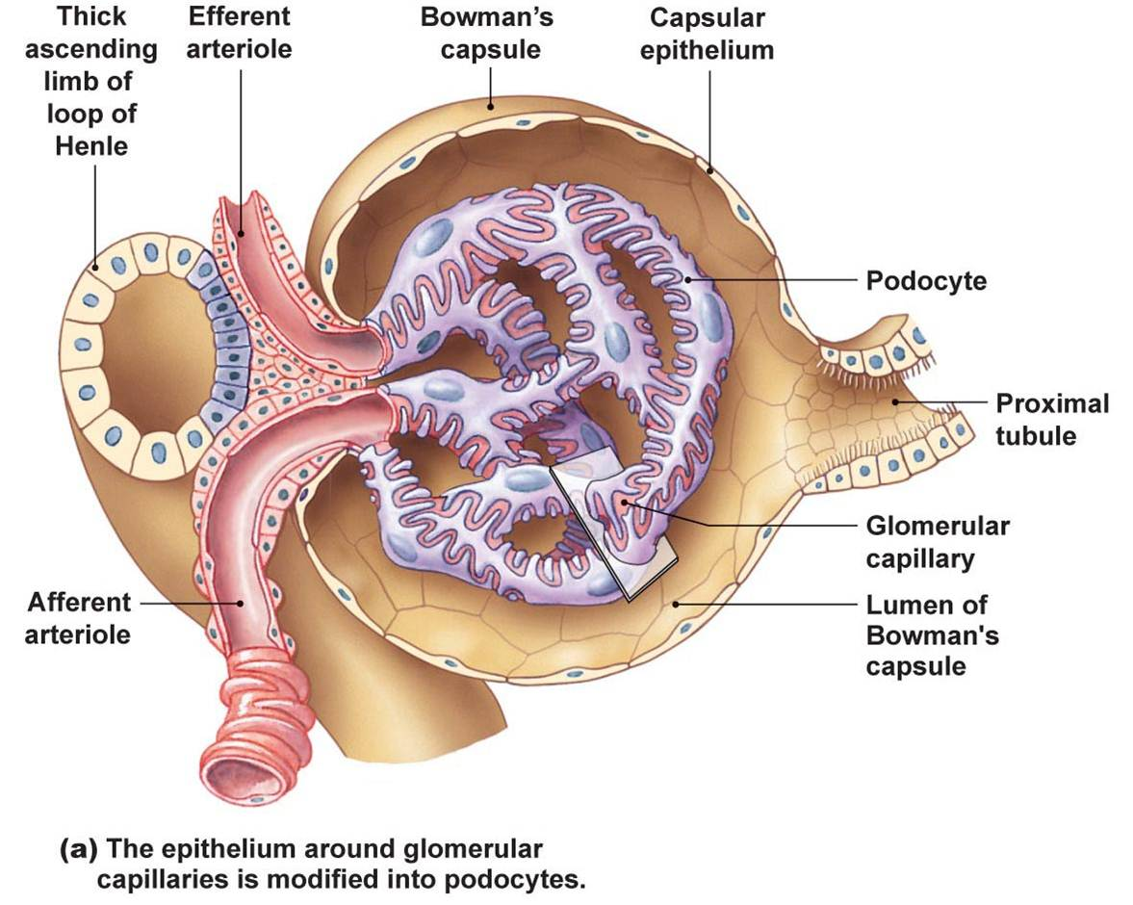
Nephron - glomerulus
Blood enters via the afferent arteriole into the glomerular capillary and then leaves via the efferent arterioles

Slide 17
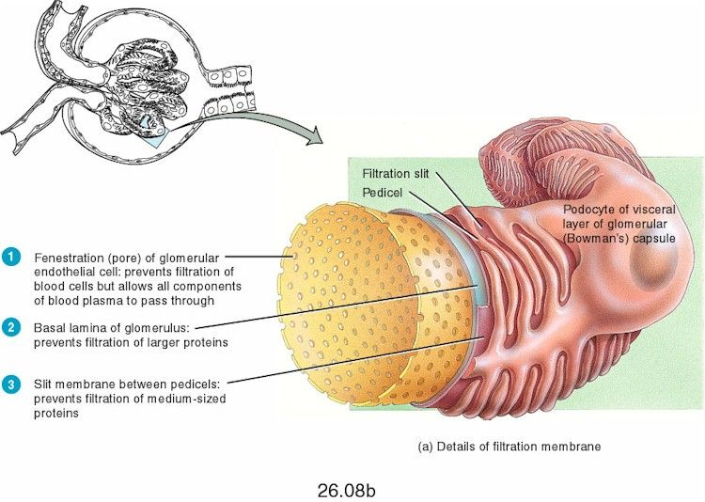
Glomerular filtration barrier
The glomerular filtration barrier consists of
  Endothelial cell
  Glomerular basement membrane
  Podocytes

Slide 18
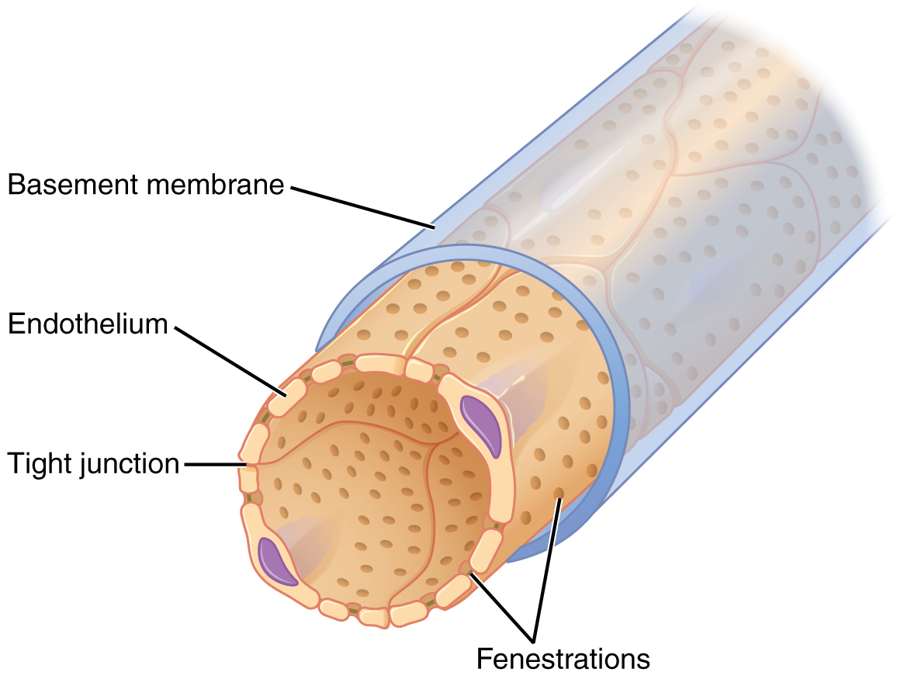
Glomerular filtration membrane

Slide 19
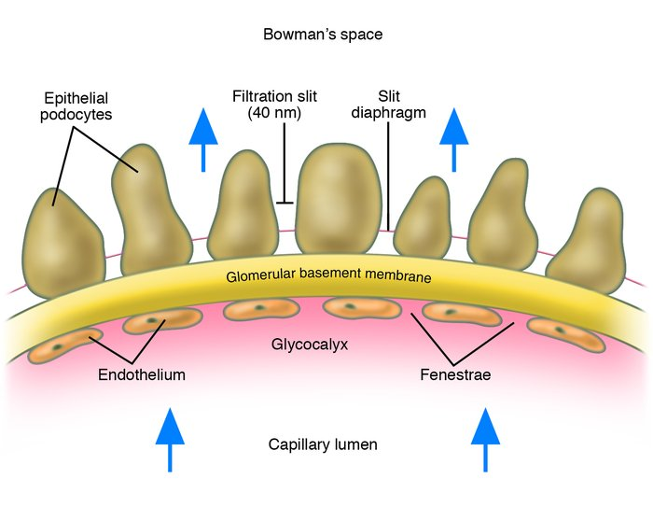
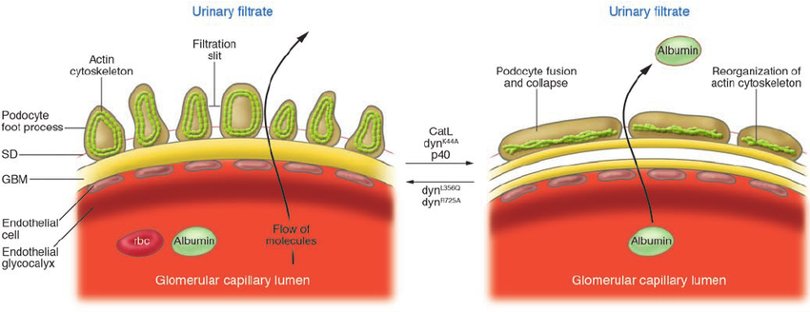
Glomerular filtration barrier

Slide 20
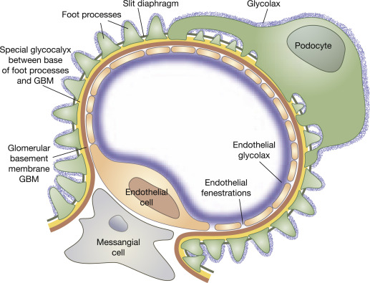
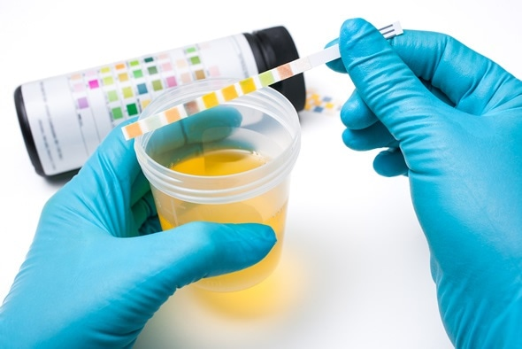
Glomerular filtration membrane
Damage of this structure causes
  Proteinuria / nephrotic syndrome
  Haematuria

Slide 21
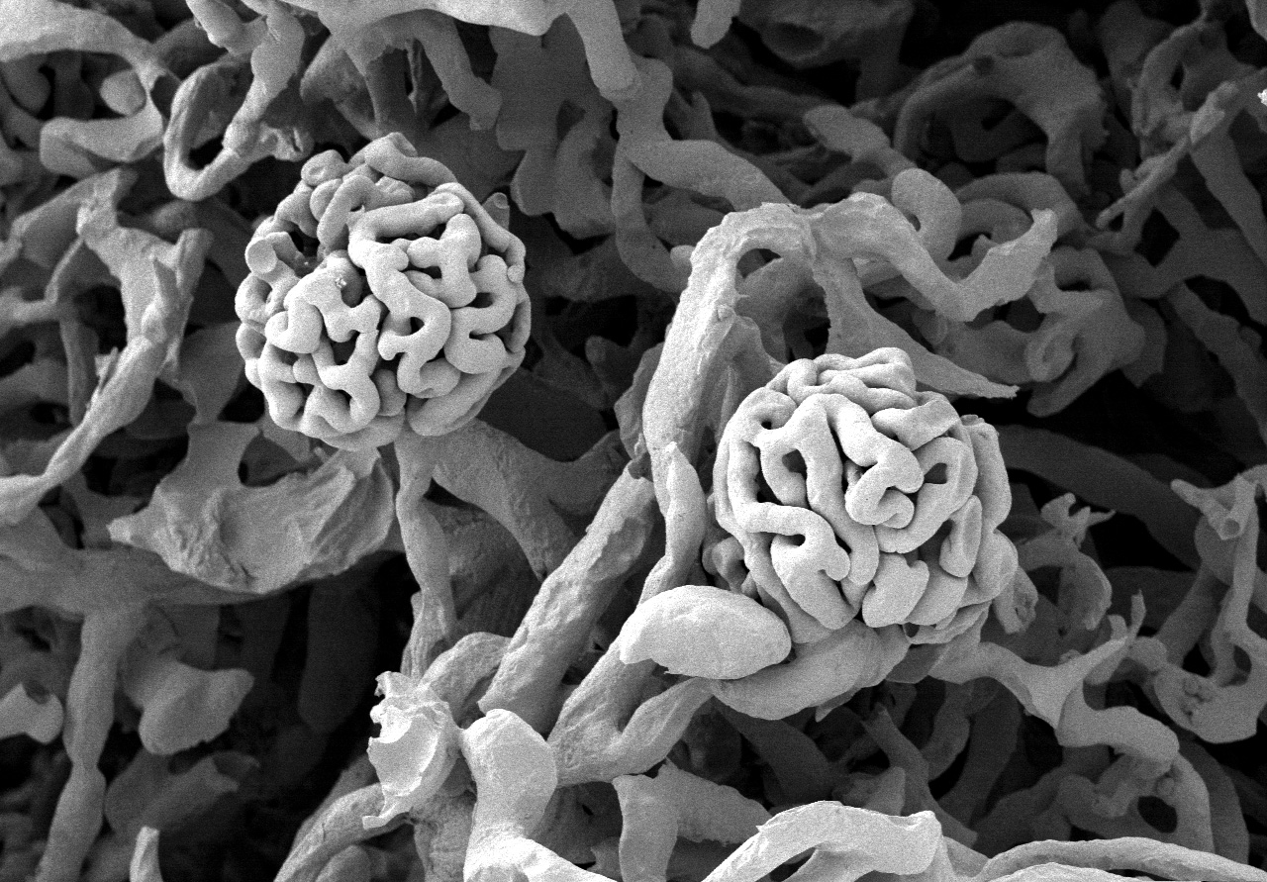
Glomeruli

Slide 22
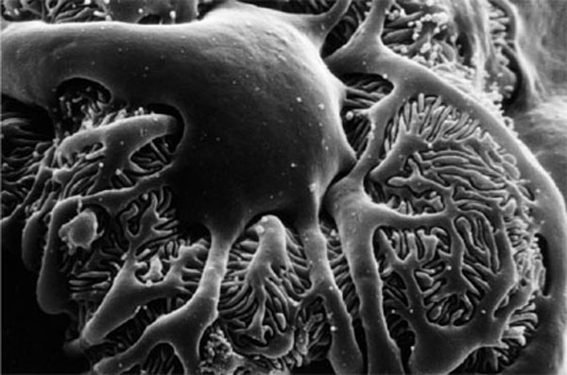
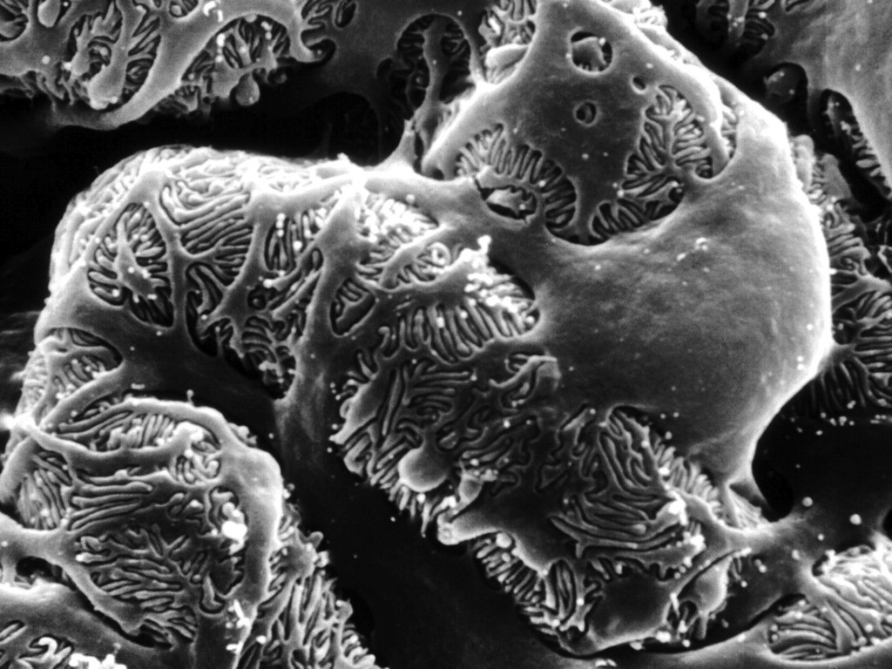
Podocytes

Slide 23
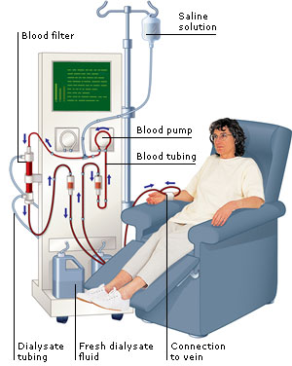

Artificial kidney

Slide 24
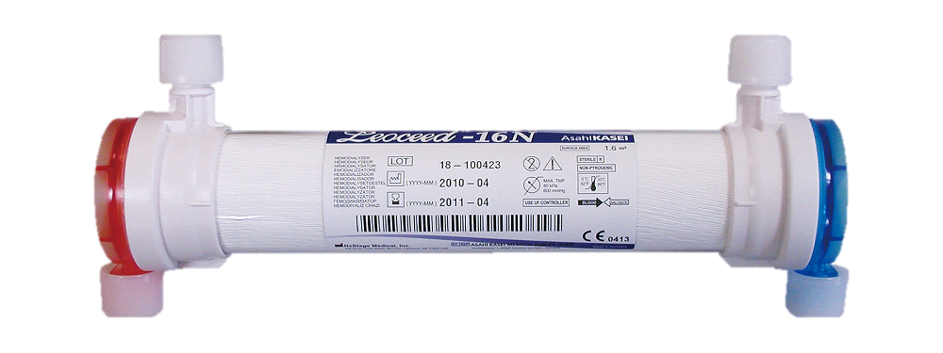
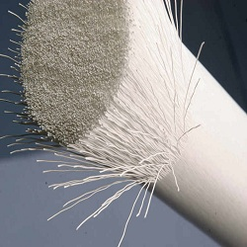
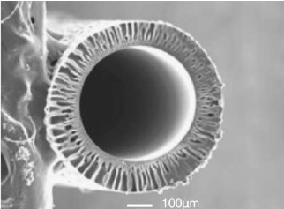
Artificial kidney - dialyzer

Slide 25
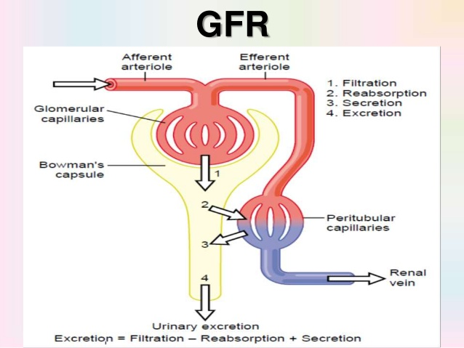
Renal function
Kidney function is determined by measuring glomerular filtration rate (GFR)
Substance that can measure GFR
  Is produced constantly in the body
  Excreted only via the kidneys
  Neither reabsorbed or secreted
Creatinine or Urea
Inulin (not produced by body)

Slide 26
Renal function - creatinine
Creatinine is the waste product formed in muscle from a high energy compound – creatine phosphate
Creatinine is the best indicator of renal function
It is not effected by diet, age and sex

Slide 27
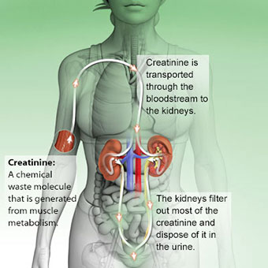
Renal function

Slide 28
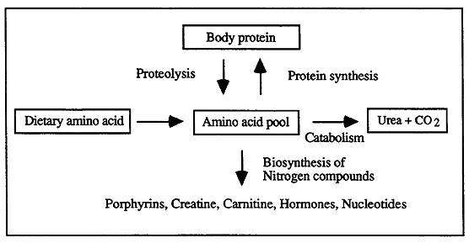
Renal function - urea
Can also be used to assess renal function
Usually elevated before significant changes in creatinine occurs
Because of its metabolism, urea is a non-specific indicator of renal function
It can vary with
  Protein content of diet
  Rate of protein catabolism
  Liver function

Slide 29
Causes of high urea
Renal disease/failure (AKI or CKD)
Dehydration due to:
  low fluid intake
  excessive fluid loss (sweating, vomiting,
  diarrhoea, diuretic drugs, etc.)
Decreased renal perfusion due to:
  heart failure
  hypovolemic shock
  severe hypotension
Gastrointestinal bleed
High-protein diet
Ageing
Catabolic state:
  trauma
  severe infection
  starvation
  some drugs with catabolic effect, e.g. use of corticosteroids)

Slide 30
Causes of low urea
Pregnancy
Low-protein diet
Overhydration
Advanced liver disease (cirrhosis, liver failure)
Inherited defect in “urea cycle” enzymes (reduced urea synthesis)

Slide 31
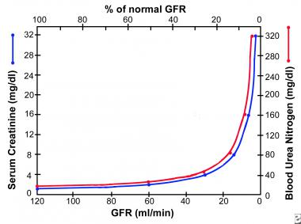
Renal function

Slide 32
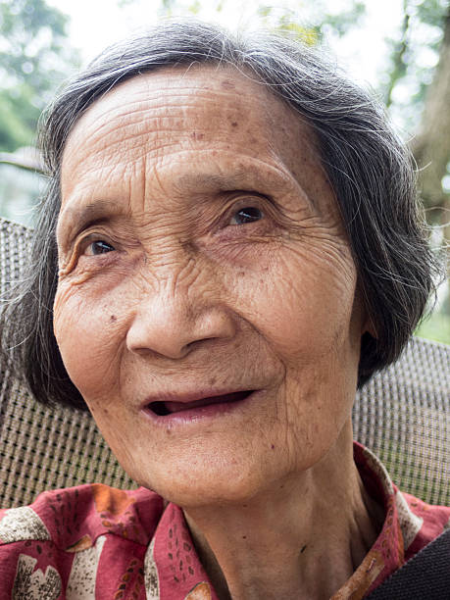
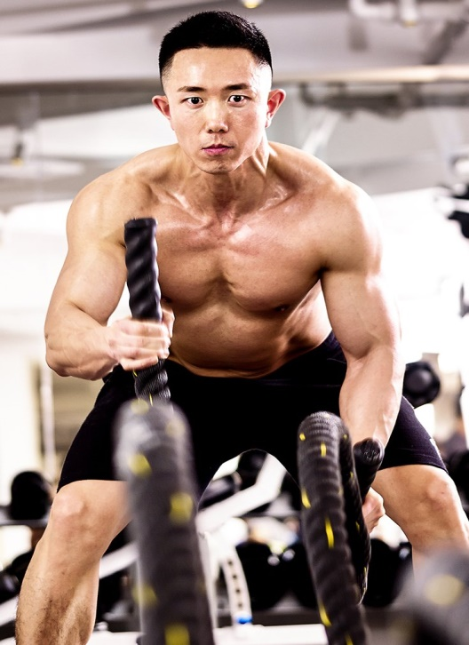
Renal function
Is measured by estimating the GFR
eGFR estimated by formula
  Cockcroft Gault
  MDRD
  CKD-epi
Important to standardize
  Stage CKD
  Research
  Medication
Creatinine 120 µmol/L
Creatinine 120 µmol/L

Slide 33
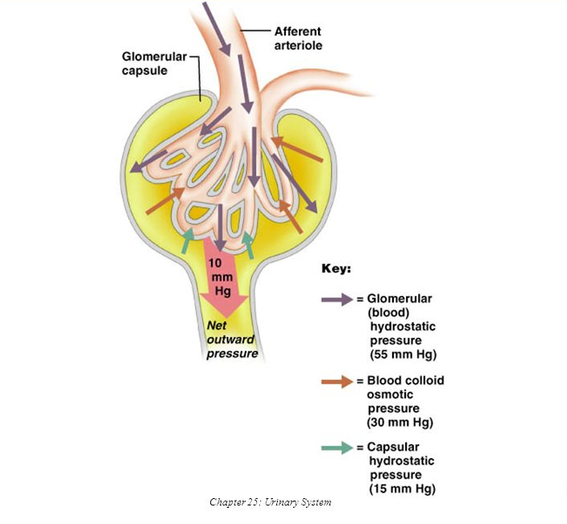
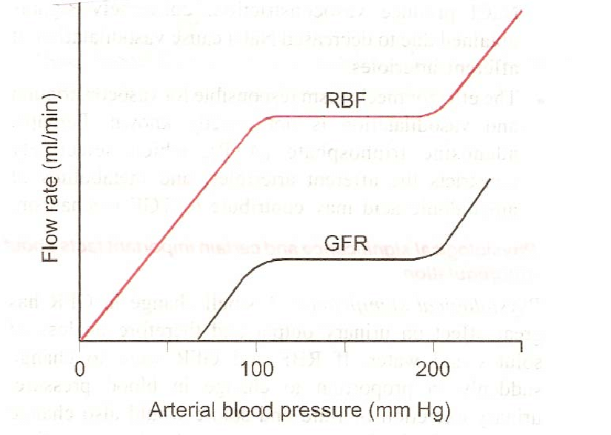
Renal function - GFR

Slide 34
Function of the kidney
Toxic and waste removal
Acid base balance
Water balance
BP control
Erythropoetin production – to produce haemoglobin
Calcium phosphate metabolism

Slide 35
X Function of the kidney
Toxic and waste removal - uraemia
Acid base balance - acidosis
Water balance – fluid overload
BP control - hypertension
Erythropoetin production - anaemia
Calcium metabolism – renal osteodystrophy

Slide 36
Diseases of the kidneys
CKD
AKI
ESRD
Diabetic nephropathy
Renal Stones
Glomerulonephritis
Acute Interstitial nephritis

Slide 37
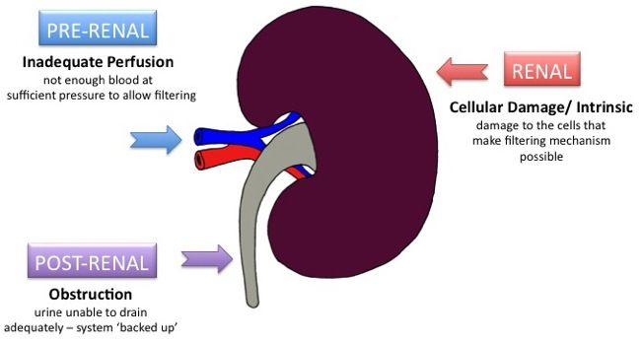
Acute Kidney Injury
Kidney damage that occurs suddenly or acutely
Usually reversible

Slide 38
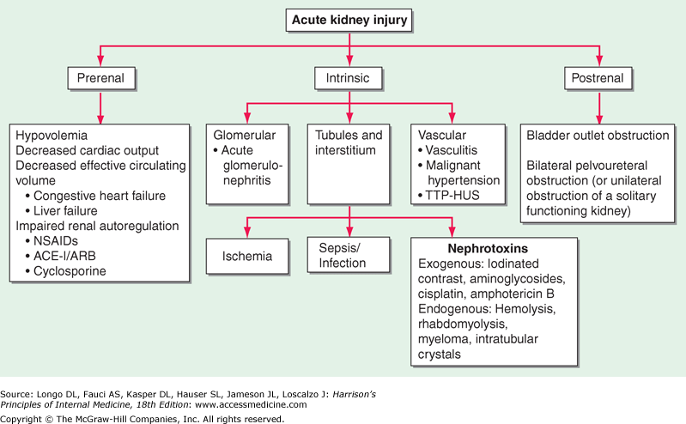
Acute Kidney Injury

Slide 39
Chronic Kidney Disease
Damage occurs over time and is irreversible
Causes of CKD
  Diabetes Mellitus
  Hypertension
  Glomerulonephritis
  Renal Stones
  Chronic Interstitial Nephritis
  Polycystic kidney disease

Slide 40
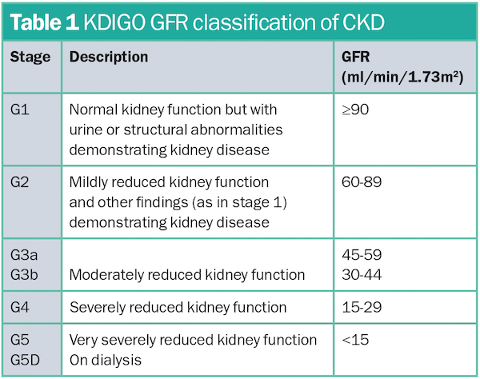
Chronic Kidney Disease
CKD is staged into 5 stages

Slide 41
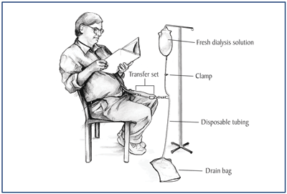
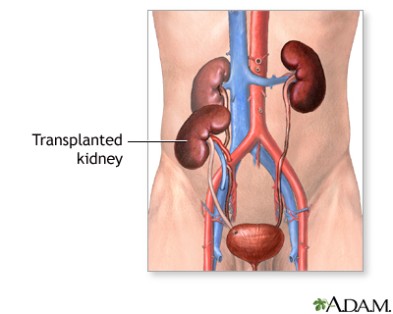
End Stage Renal Disease
Haemodialysis
Peritoneal Dialysis
Transplant

Slide 42
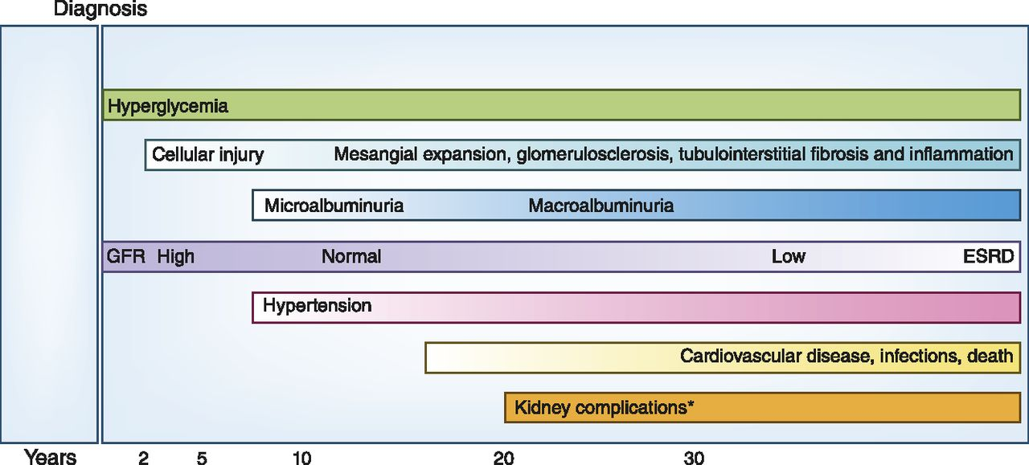
Diabetic Nephropathy

Slide 43
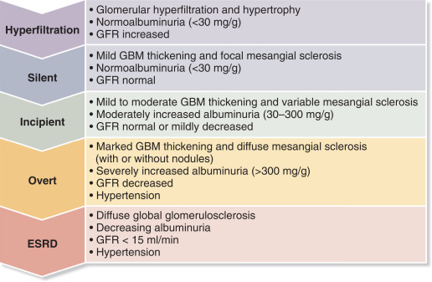
Diabetic Nephropathy

Slide 44
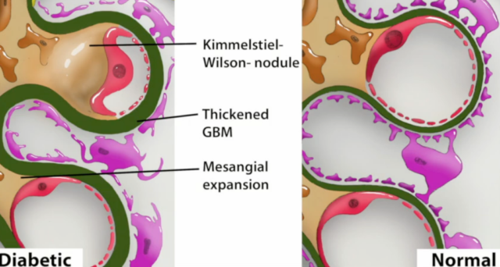
Diabetic Nephropathy

Slide 45
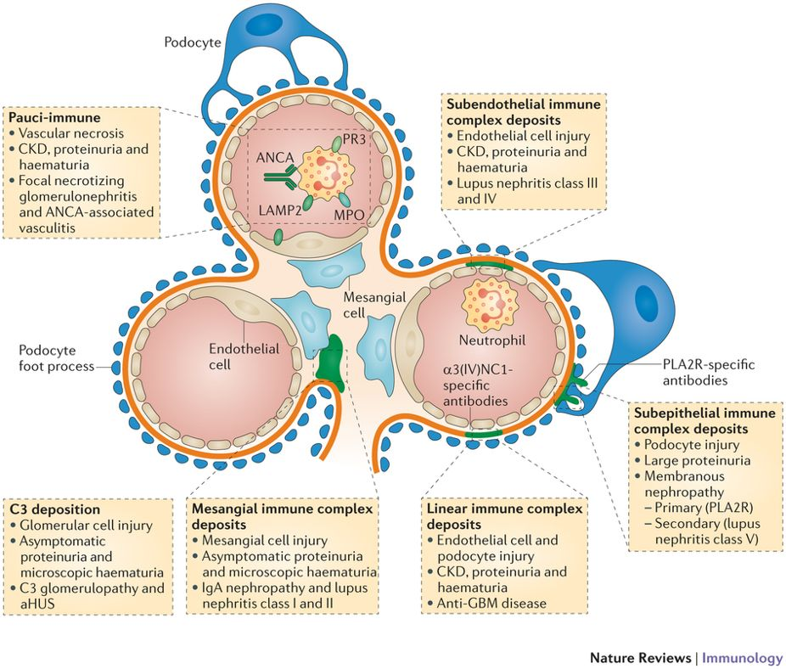
Glomerulonephritis
Body attacks its own body - autoimmune

Slide 46
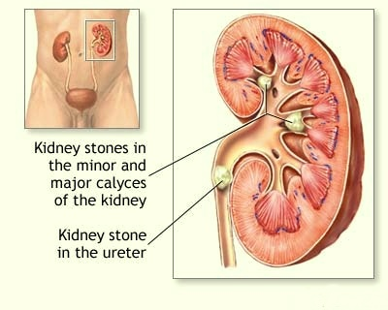
Renal Stones

Slide 47
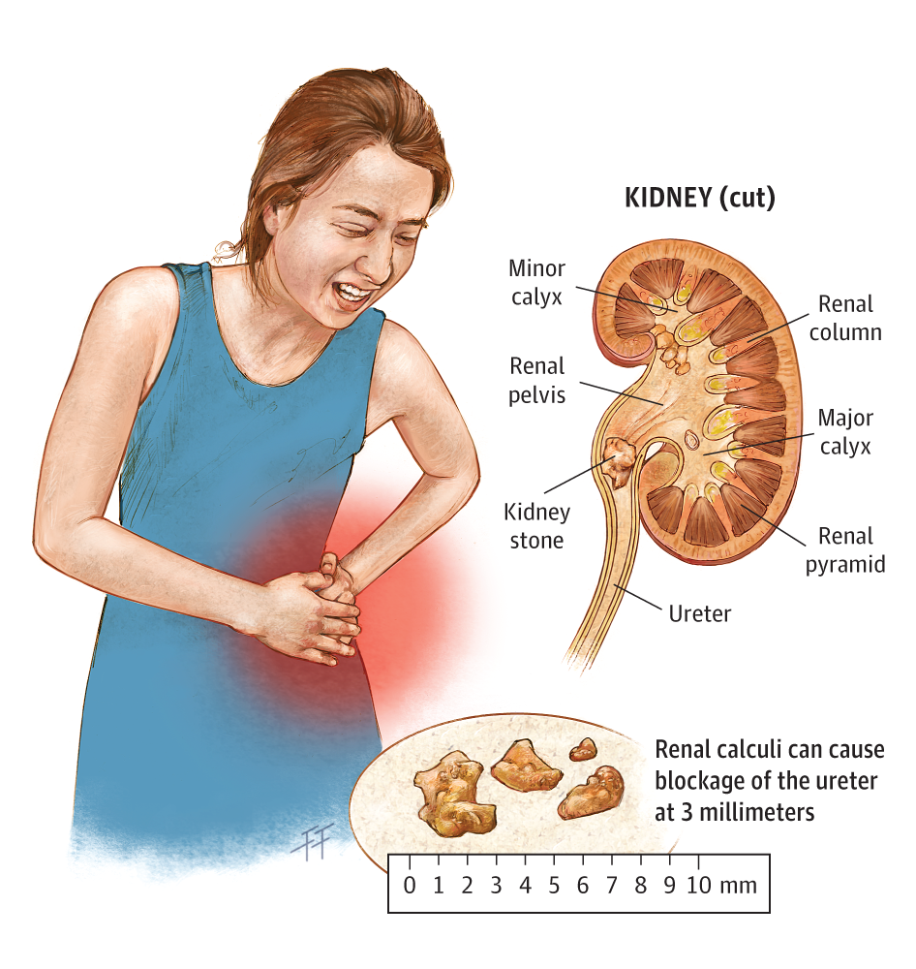
Renal stones - symptoms
Severe colicky pain radiating to the groin
Nausea and vomiting
Haematuria
May pass out stones
AKI
Recurrent UTIs

Slide 48
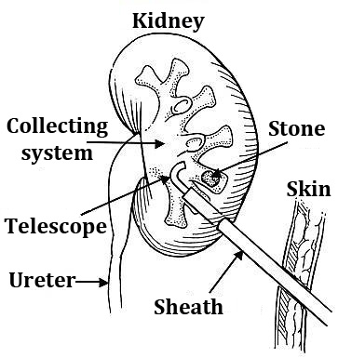
Renal stones - treatment
Ureteroscopy
Extracorporeal shock wave lithotripsy
Percutaneous removal (stone > 2 cm)

Slide 49
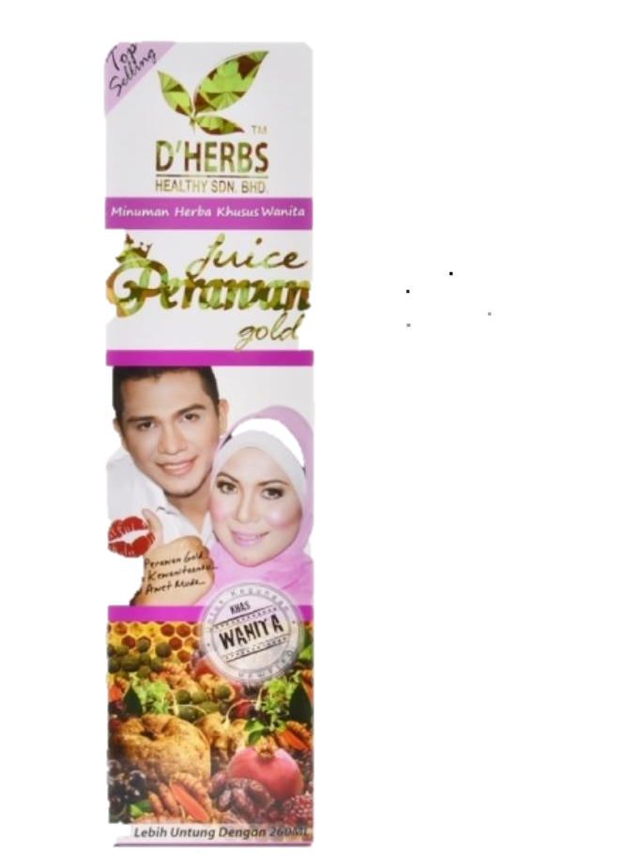
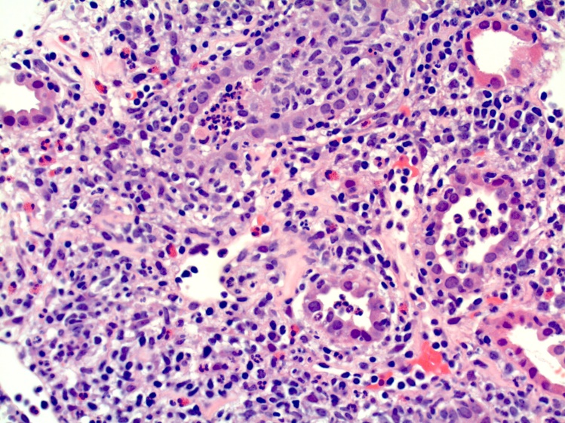


Acute interstitial nephritis
Prevalent in Asia
Due to herbal traditional medications
Can cause CKD and subsequently ESRD

Slide 50


Thank you!!!
Follow us @ Renal Uitm

