Slide 1
Cardiorenal Syndrome
Renal uitm

Slide 2
It is a syndrome! Not a diagnosis.
Renal uitm

Slide 3
Cardiorenal syndrome definition
“condition whereby an acute or chronic dysfunction in one organ may induce acute or chronic dysfunction of the other”
Renal uitm

Slide 4
Relationship is complex!
The heart and the kidney communicate with one another through a variety of pathways in an interdependent relationship
Renal uitm

Slide 5
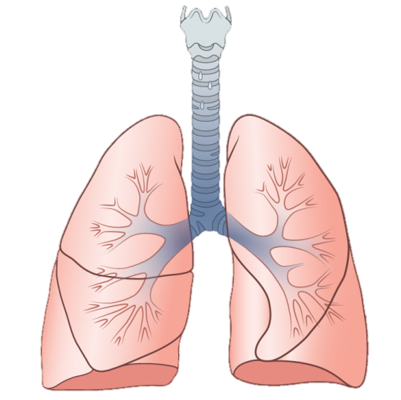
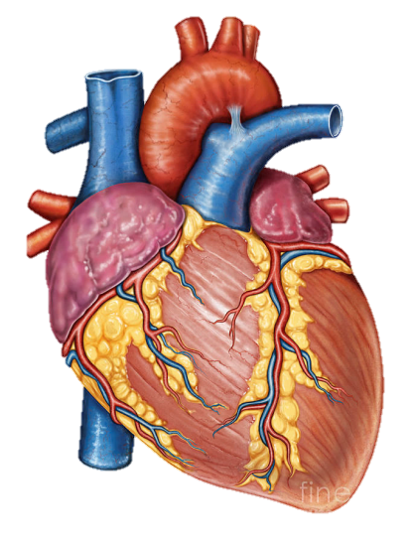
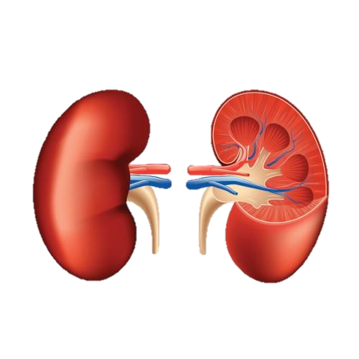
Relationship is complex!
wife
girlfriend
Renal uitm

Slide 6
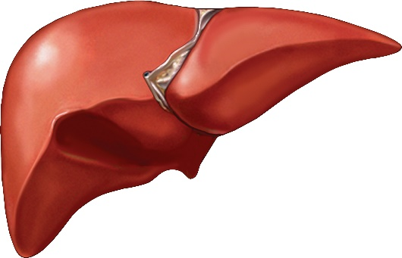
Relationship is complex!
wife
Pulmonary-renal syndrome
Hepato-renal syndrome
girlfriend
Renal uitm

Slide 7
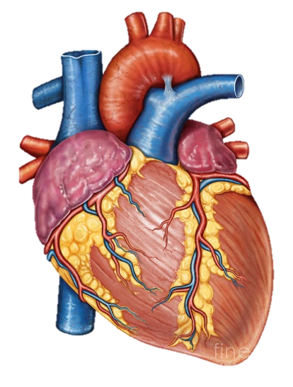
Neurohormonal relationship – BP and Volume
The heart and the kidneys are involved in maintaining hemodynamic stability and organ perfusion through an intricate network.
Renal uitm

Slide 8
Pathophysiology
Haemodynamic related
Non-haemodynamic related – hormonal and immune mediated
Renal uitm

Slide 9
Pathophysiology – underfill or overfill
Haemodynamic related
Renal uitm

Slide 10
Treatment
Accurate Assessment of Volume Status
Renal/Venous Congestion | Arterial Underfilling (Renal Hypoperfusion)
Aggressive Treatment of Volume Overload Removal of Fluid Accumulation in Third Spaces Diuretics and Diuretic Resistance Ultrafiltration | Avoidance of Arterial Hypotension and Intravascular Underfilling Increasing the Effective Circulatory Volume Optimization of Renal Perfusion
Renal uitm

Slide 11
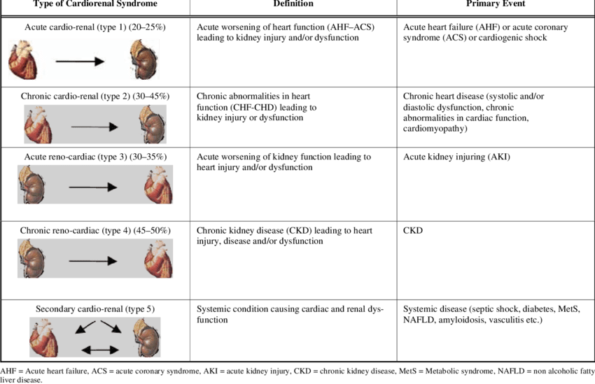
Types of CRS
Renal uitm

Slide 12
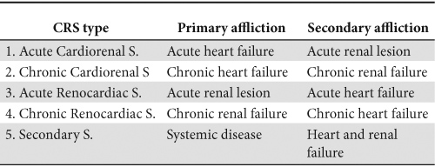
Types of CRS
Renal uitm

Slide 13
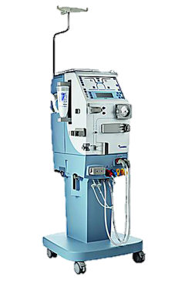
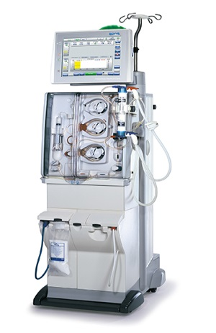
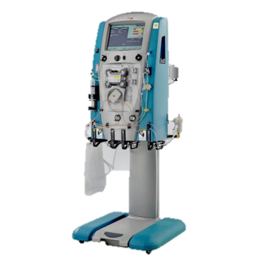
RRT in haemodynamically unstable
intermittent
hybrid
continuous
HD
SLEDD
CVVHD
HDF
SLEDD-f
CVVHDF
Isolated UF
SCUF
Renal uitm

Slide 14
Types of RRT
 | Conventional HD | SLEDD | CRRT
Qb (ml/min) | 300-350 | 150-200 | 150-180
Qd (ml/min) | 500 | 200-300 | (2L/h) 33
Time | 4H | 6-8H | 72H
UF
Variations | HDF | SLED-F | SCUF CVVHD CVVHDF
Cost | Cheap | Fair | Expensive
Patients | Stable | Sepsis shock Single inotropes | Multiple inotropes Cardiogenic shock
Renal uitm

Slide 15
Thank you!
@ Renal Uitm
Renal uitm

