Slide 1
CKD Mineral Bone Disease
Dr Muhammad Iqbal Bin Abdul Hafidz
Consultant Physician and Nephrologist
Universiti Teknologi MARA (UiTM)
Sungai Buloh

Slide 2
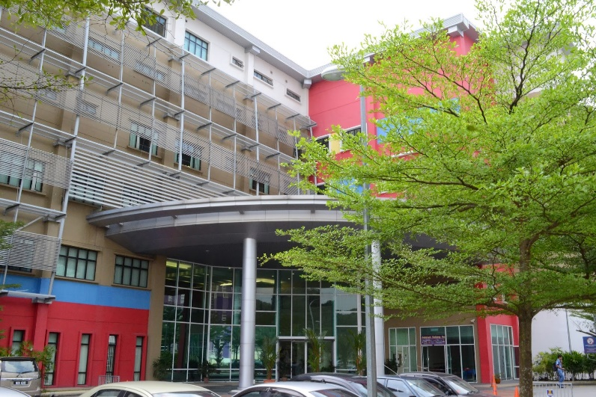
UiTM Medical Faculty
Cardiology, Cardiothoracic surgery
Respiratory, Dermatology, Endocrinologists, Rheumatologist, Nephrology
Surgical, Orthopaedics, Paeds, O&G, Pathologists, Biochemist
Medical and surgical ward, ICU, CCU, CICU, CRW

Slide 3
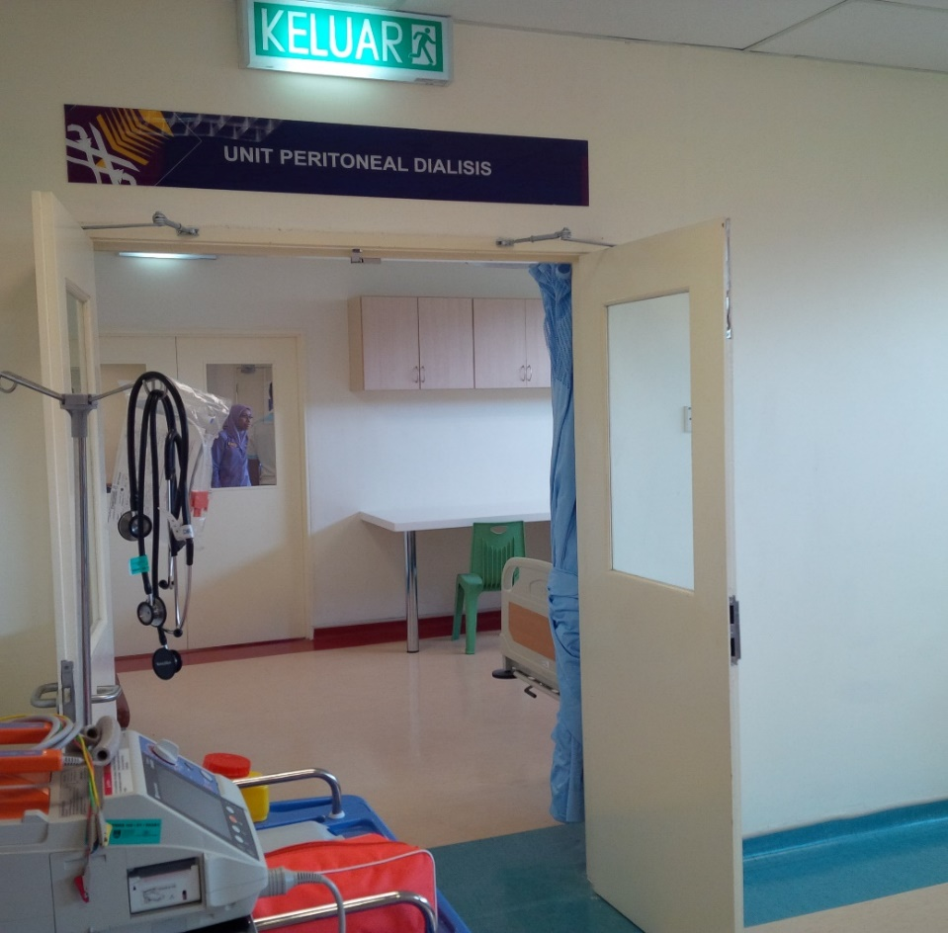
HDF and PD Unit UiTM

Slide 4
Outline of talk
CKD-MBD – New concept and definition
Pathophysiology – old and new
FGF23
PTH, Ca, PO4
Phosphate and mortality
Treatment of CKD-MBD

Slide 5
KDIGO CKD-MBD Guideline 2009

Slide 6
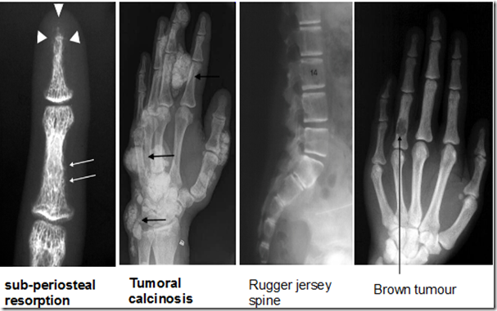
CKD-MBD
CKD – Mineral Bone Disease
Previously known as renal osteodystrophy or renal bone disease

Slide 7
Articular calcification/tumoral calcinosis

Slide 8
Forget the bones for a while..

Slide 9
Vascular calcification

Slide 10
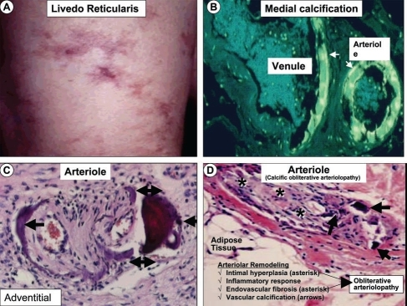
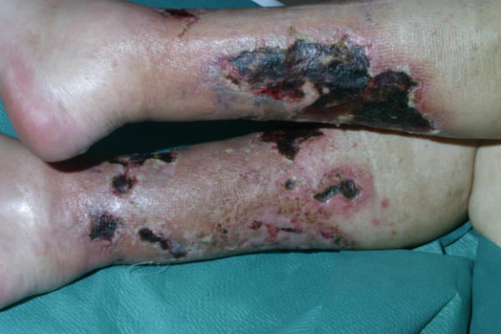
Calciphylaxis / calcaemic uraemic arteriolopathy
Medial calcifications of arterioles of skin and fat-tissue – necrosis
Painful cutaneous ulcers

Slide 11
Vascular calcifications of large vessels

Slide 12
Cardiac calcification
Cardiac CT shows severe mitral valve calcification (arrow) and myocardial calcification (arrowhead, A), diffuse calcification of LAD coronary artery (B), LCX coronary artery (C) and RCA coronary artery (D).

Slide 13
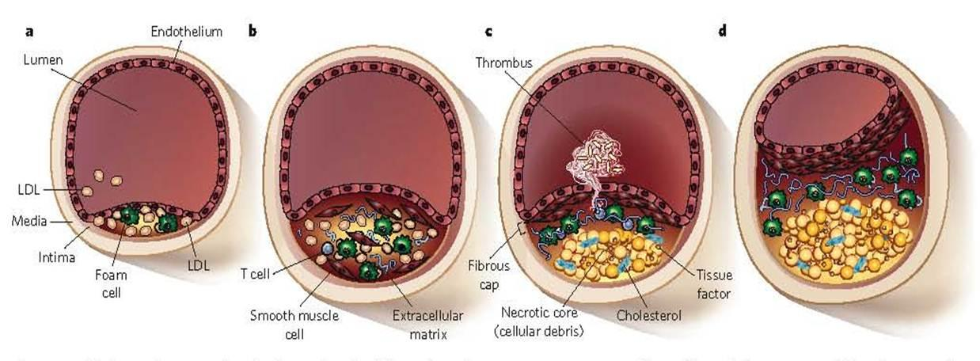
Atheromatous plaques vs calcified vessels

Slide 14
Vascular Calcification in CKD

Slide 15
CKD and Mortality

Slide 16
CKD and Mortality
Westin et al. Circulation. 2014

Slide 17
Cardiovascular mortlity and ESRF
Sarnak et al. Am J Kid Disease. 2000;35 (4)

Slide 19
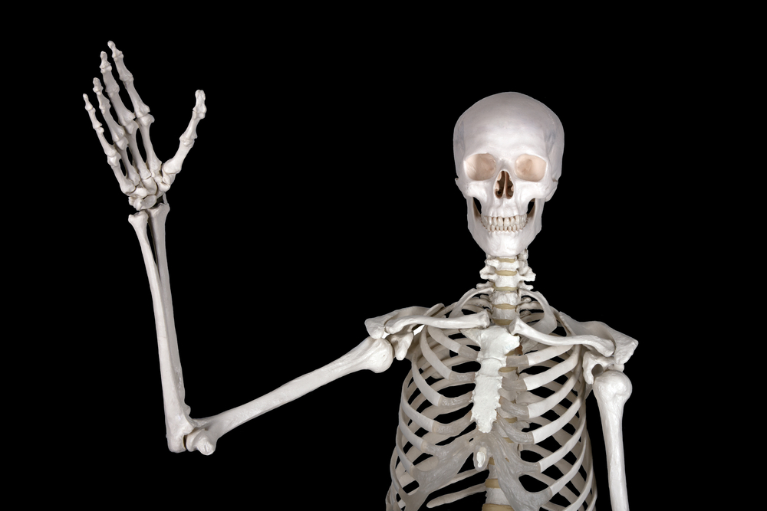
Take home message!!
"think beyond the bones" and strive to improve cardiovascular outcomes and survival.

Slide 20
Definition of CKD-MBD

Slide 22
CKD-MBD: A complex multisystem disorder

Slide 23
Normal Calcium Metabolism

Slide 24
CKD-MBD – State of Secondary Hyperparathyroidism

Slide 26
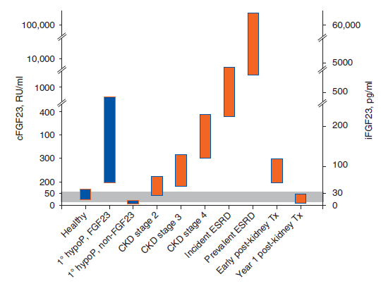

Slide 27
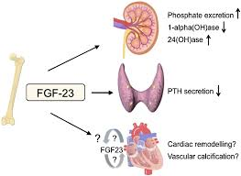
Regulates early phosphate increase
FGF23 receptor and its Klotho co-receptor are expressed in many cell types, including cardiomyocytes, vascular wall, kidneys, and parathyroid glands.
associated with the development of endothelial dysfunction and cardiac hypertrophy in patients with CKD.

Slide 28
FGF 23 Levels

Slide 29
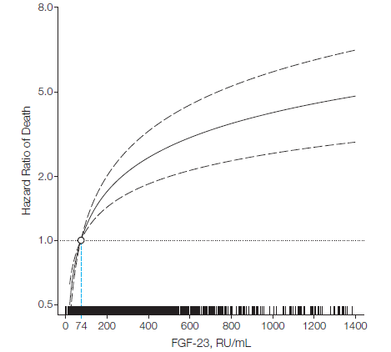

Slide 30
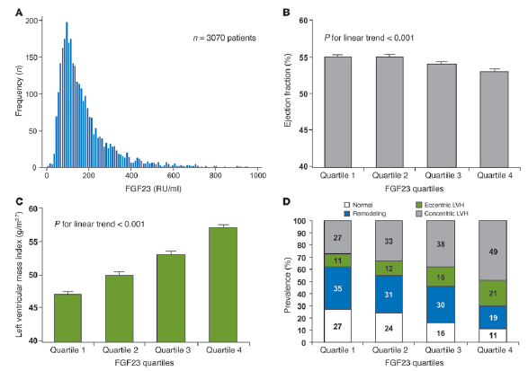
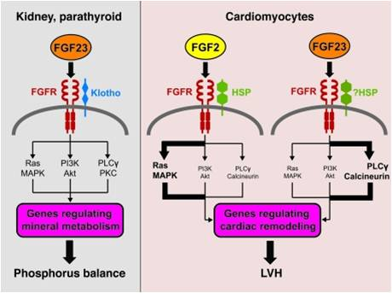

Slide 31
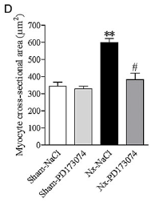
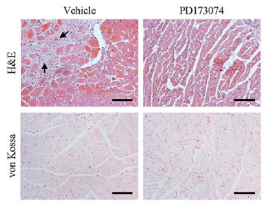
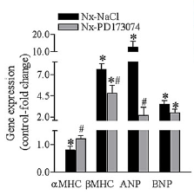

Slide 32
Lab abnormalities – Ca, PO4, Vitamin D, PTH

Slide 33
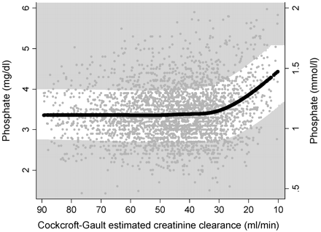
Hyperphosphatemia manifests no sooner than in
CKD stage 4
Kestenbaum B et al. J Am Soc Nephrol. 2004;16:520-528

Slide 34
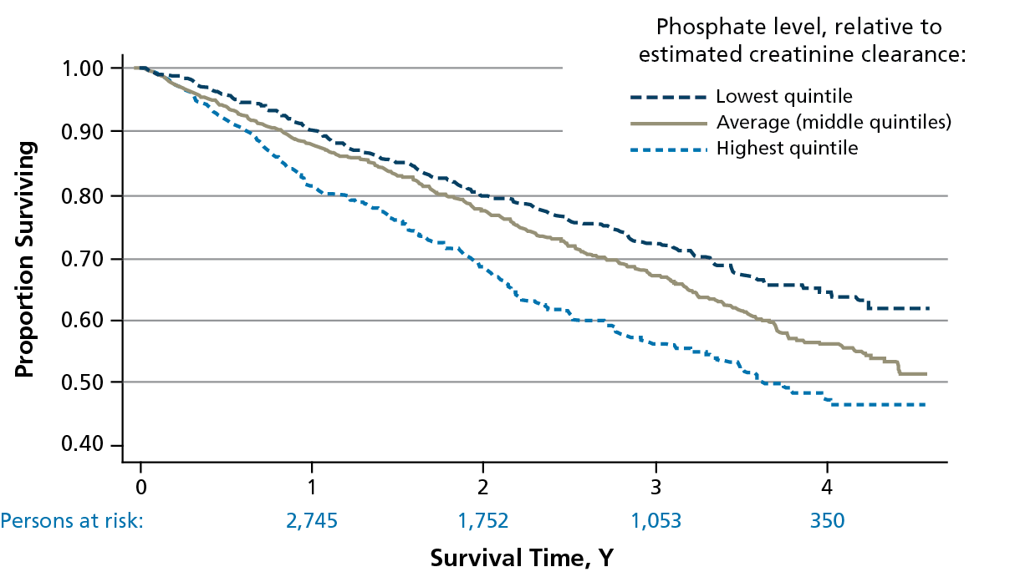
Hyperphosphatemia and mortality in hemodialysis patients
Kestenbaum B et al. J Am Soc Nephrol. 2004;16:520-528

Slide 35
Hyperphosphatemia and mortality in hemodialysis patients
3.2
40538 patients
Fresenius Medical Care
North America Patient Statitics
Multivariate analysis
Block GA et al., JASN 2004
3.2
14435 patients
QiN registry
3 different analyses
no adjustments
multivariate with few parameters
multivariate fully adjusted
Stoffels et al., unpublished
3.0
3.0
2.8
2.8
QiN Daten
2.6
2.6
2.4
2.4
2.2
2.2
Relative mortality risk
2
2
1.8
1.8
1.6
1.6
1.4
1.4
1.2
1.2
1
1
0.8
0.8
<3
3-4
4-5
5-6
6-7
7-8
8-9
>9
<3
3-4
4-5
5-6
6-7
7-8
8-9
>9
S-Phosphate [mg/dl] (mmol :3.1)

Slide 36
PTH level in CKD
KDOQI CKD Guideline 2002

Slide 37
PTH and Vitamin D

Slide 38
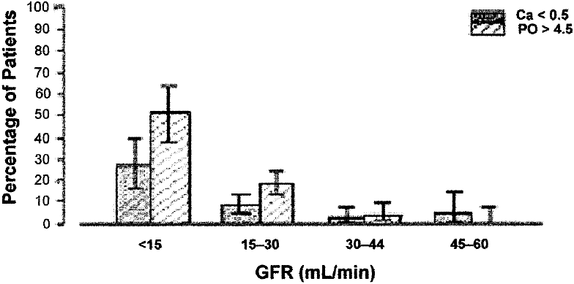
Calcium levels in CKD – change not as expected!!
Canadian Multicentre Longitudinal Cohort
NHANES III , 1984 - 1993

Slide 39
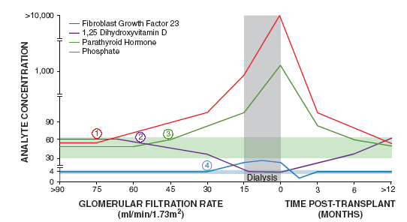
Lab abnormalities in CKD-MBD - Summary
Wolf M. JASN 2010; 21:1427-35

Slide 40
Treatment Target Range

Slide 41
Management of CKD MBD
Dietary advice
Phosphate binders
Vitamin D
Activated Vitamin D
Calcimimetics
Parathyroidectomy
HD – frequent

Slide 42
Watch what you eat!!

Slide 43
Food high in phosphorus
Phosphate restriction to 800-1000 mg daily

Slide 44
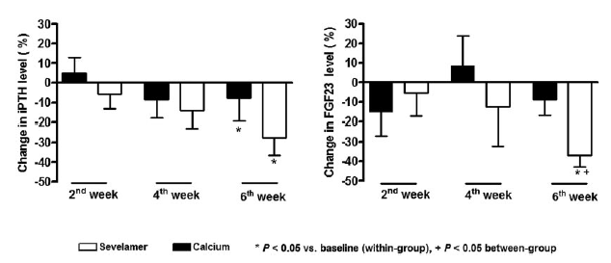
Sevelamer lowers both PTH- and FGF23 serum levels in CKD patients not on dialysis
Oliveira et al., CJASN 2010; 5:286-91
Creatinine 220-230mmol/L

Slide 45
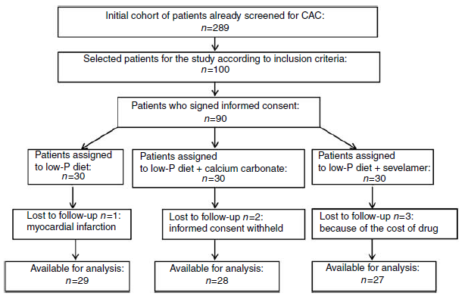
Early phosphate lowering and coronary artery calcification
Russo et al., Kidney Int 2007; 72:1255-63
eGFR 26-30 (Stage IV)
Notes:
Patient flow chart.

Slide 46
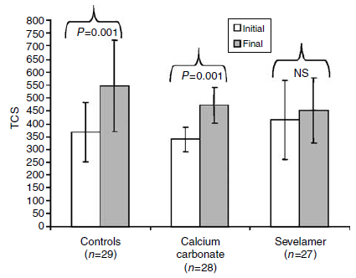
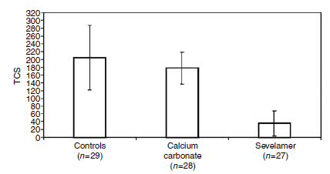
Early phosphate lowering and coronary artery calcification
Russo et al., Kidney Int 2007; 72:1255-63
Absolute TCS*
Annualized TCS* progression
*TCS = total calcium score
Notes:
Patient flow chart.

Slide 47
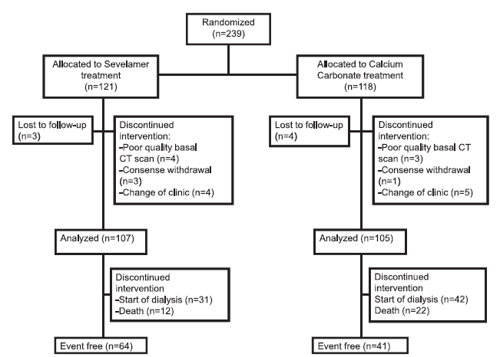
Early phosphate lowering and mortality
Di Iorio et al., CJASN 2012; 7:487-93
Stage III -IV
Notes:
Patient flow chart.

Slide 48
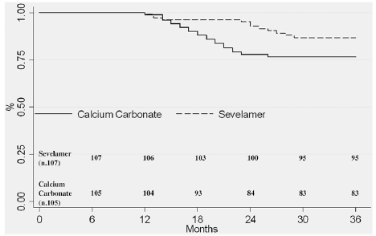
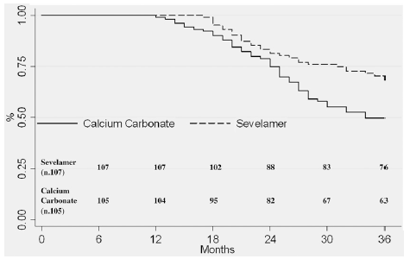
Early phosphate lowering and mortality
Di Iorio et al., CJASN 2012; 7:487-93
All-cause mortality
Inception to dialysis
Notes:
Patient flow chart.

Slide 49
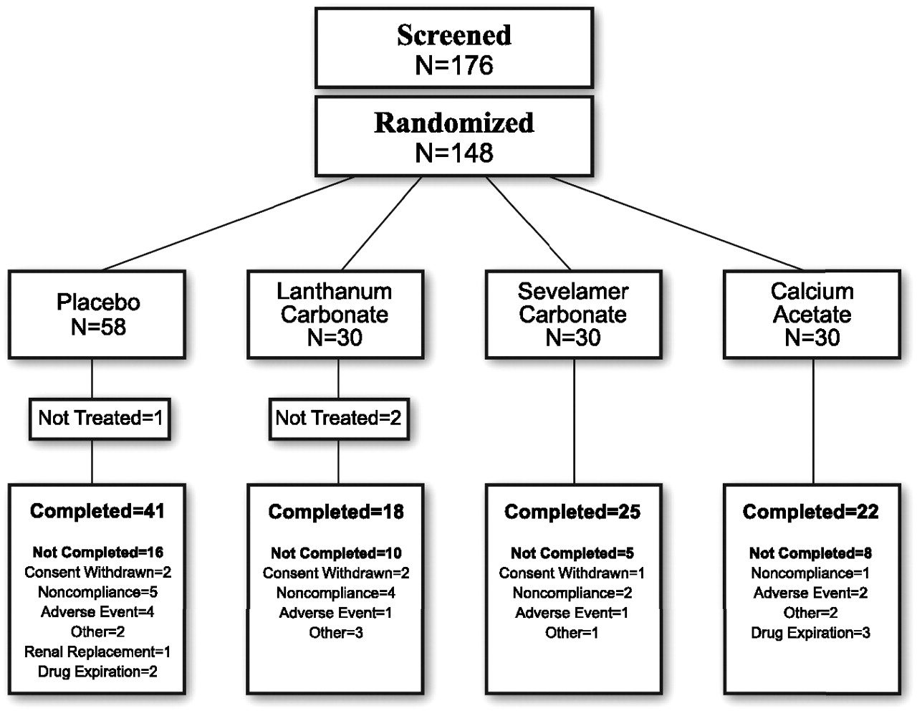
Early phosphate lowering, FGF23, and calcification
Block G A et al. JASN 2012;23:1407-1415
eGFR 30 ml/min
Notes:
Patient flow chart.

Slide 50
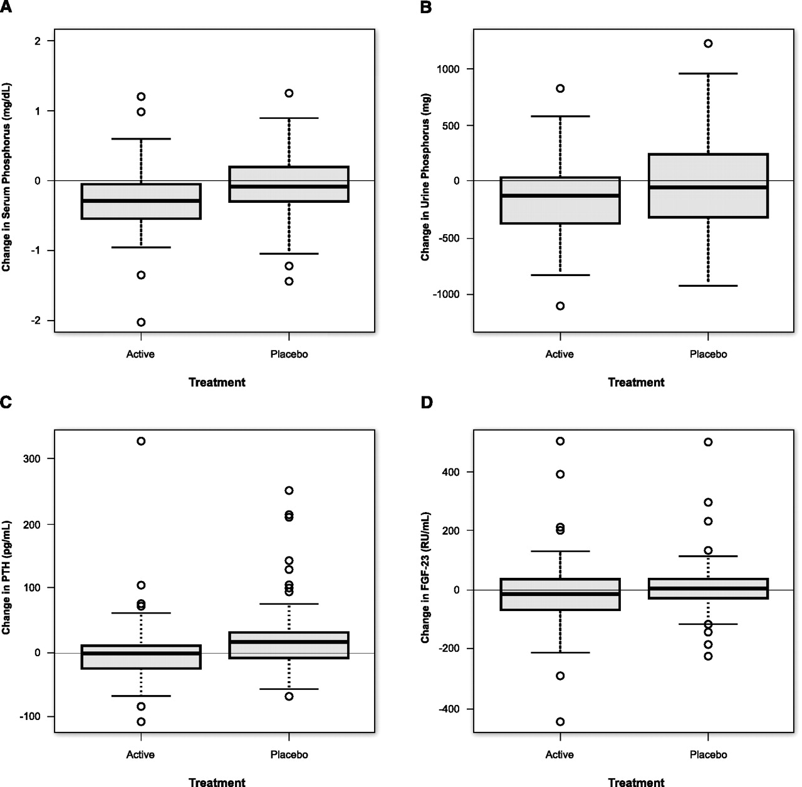
Early phosphate lowering, FGF23, and calcification
Serum P Urinary P
iPTH FGF23
Active Placebo Active Placebo
©2012 by American Society of Nephrology
Notes:
Biochemical changes on study by treatment arm. Change in (A) median (interquartile range [IQR]) serum phosphorus, (B) 24-hour urine phosphorus, (C) PTH, and (D) C-terminal FGF23 over the study period among all active- and placebo-treated patients.

Slide 51
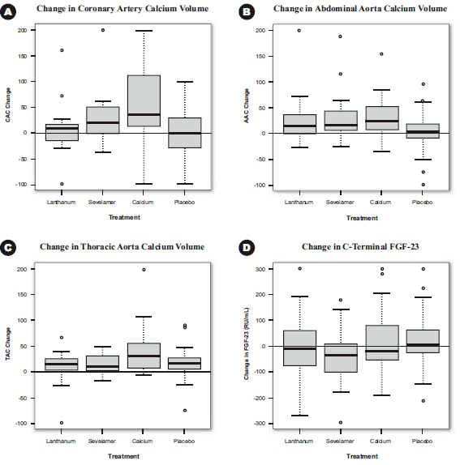
Early phosphate lowering, FGF23, and calcification
Block G A et al. JASN 2012;23:1407-1415
©2012 by American Society of Nephrology
Notes:
Vascular calcification and bone mineral density changes on study by treatment arm. Percent change in (A) median (IQR) annualized total coronary artery, (B) abdominal aorta, and (C) thoracic aorta calcium volume scores among active- and placebo-treated patients. (D) Median (IQR) percent change in annualized BMD among active- and placebo-treated patients. A trained reader examined each region of interest with exclusion of vertebral abnormalities.

Slide 52
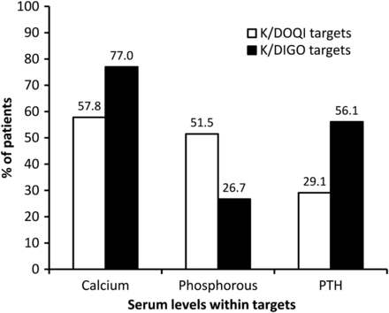
COSMOS Study
NDT: July 2013
A Pan-European prospective study which aims to survey MBD and clinical practice patterns in CKD5D patients

Slide 53
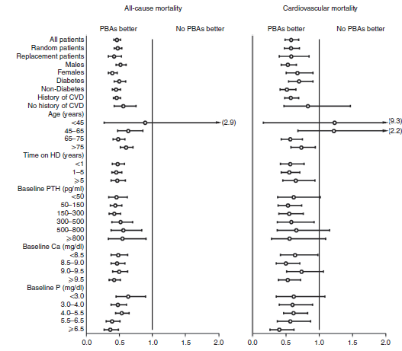
Phosphate binder treatment is associated with improved survival in dialysis patients
Cannata-Andia et al., Kidney Int 2013; 84:998-1008

Slide 54
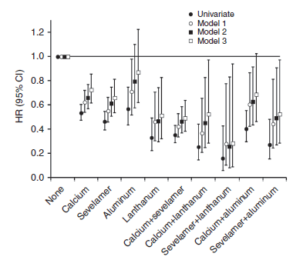
Phosphate binder treatment is associated with improved survival in dialysis patients
Cannata-Andia et al., Kidney Int 2013; 84:998-1008

Slide 55
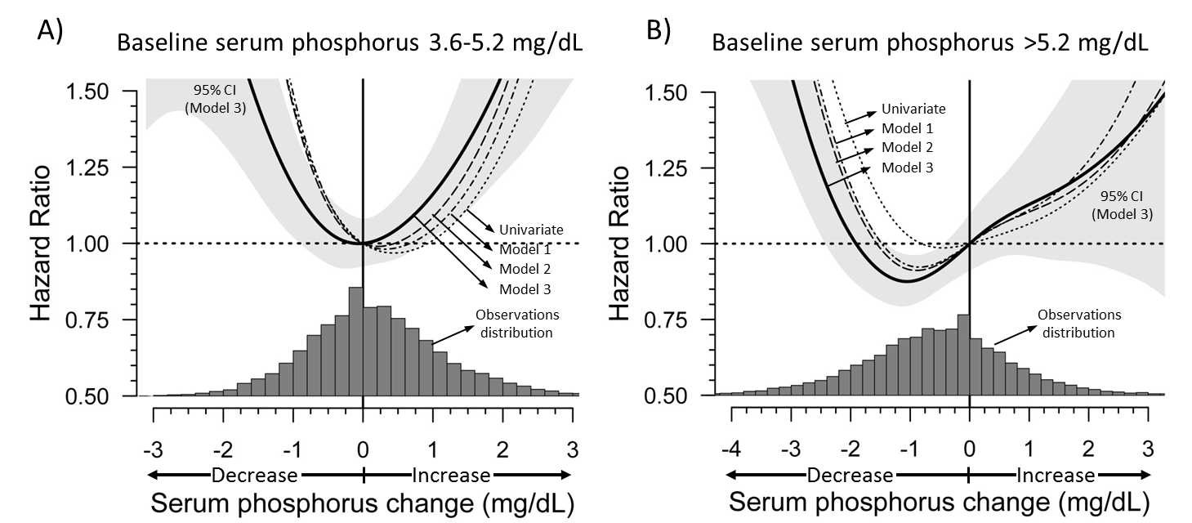
Cannata-Andia J et al, NDT 2015
Correction of hyperphosphatemia in dialysis patients reduces 3-year-mortality
Initial PO₄ controlled (3.6-5.2 mg/dl)
Initial PO₄ elevated (>5.2 mg/dl)
Ideal serum PO₄ in the COSMOS trial: 4.4 mg/dL

Slide 56
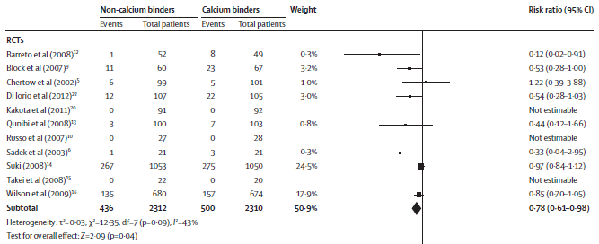
Phosphate binders and mortality: calcium-containing vs. calcium-free binders
Jamal S et al., Lancet 2013; 382:1268-77
When comparing high-dose monotherapies, calcium-free phosphate binders are associated with a 22% survival advantage vs. calcium-based compounds.

Slide 57
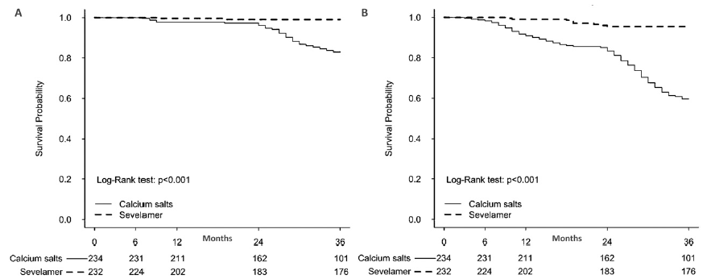
Phosphate binders and mortality: calcium-containing vs. calcium-free binders
Di Iorio B et al., AJKD 2013
Cardiac arrhythmias
CV death

Slide 58
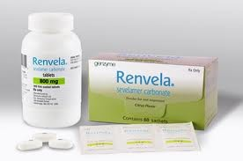
My Practice
Sevelamer for
Young patients
Patients with existing IHD
Patients worked up for transplant
Patients with evidence of vascular calcifications
Patients with hypercalcaemia or borderline hypercalcaemia
CKD patients phosphate increasing trend

Slide 59
Summary
Hyperphosphatemia is one of the most powerful mortality and calcification risk factors in all stages of CKD
Need to take a proactive approach to the management of CKD-MBD because the disorder begins early in the course of CKD
Calcium-free phosphate binders phosphate binder may have survival advantage in HD patients
In hyperphosphatemic CKD patients not on dialysis, sevelamer treatment is associated with improved survival and slower progression to ESRD than calcium carbonate treatment

Slide 61
Thank you!!

