Slide 1


Challenges to Kidney Health: Burden, Disparities & Access
Dr Muhammad Iqbal Bin Abdul Hafidz (UiTM)
Head of Nephrology, UiTM
WORLD KIDNEY DAY 14th MARCH 2019, HTAR

Slide 2



Slide 3
Declaration of interest (Disclaimer)
I am not a Public Health doctor
I am not an expert in health economics

Slide 4
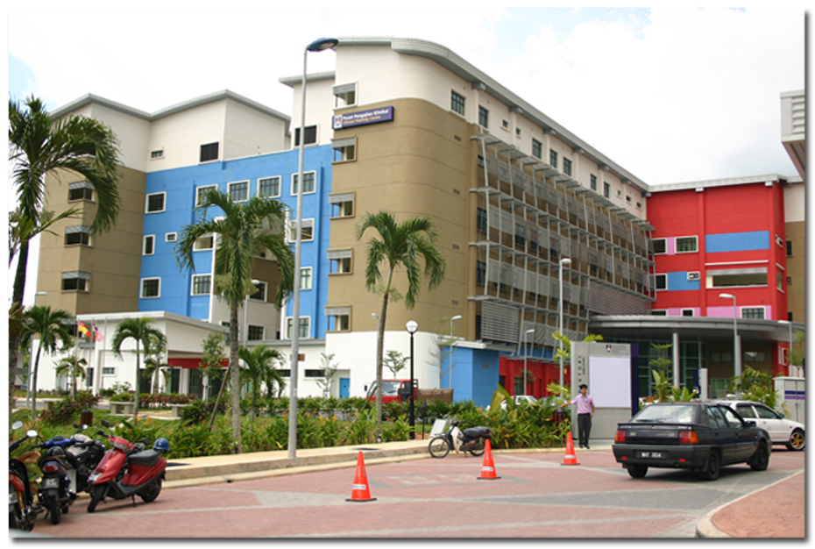
Renal UiTM Sg Buloh

Slide 5
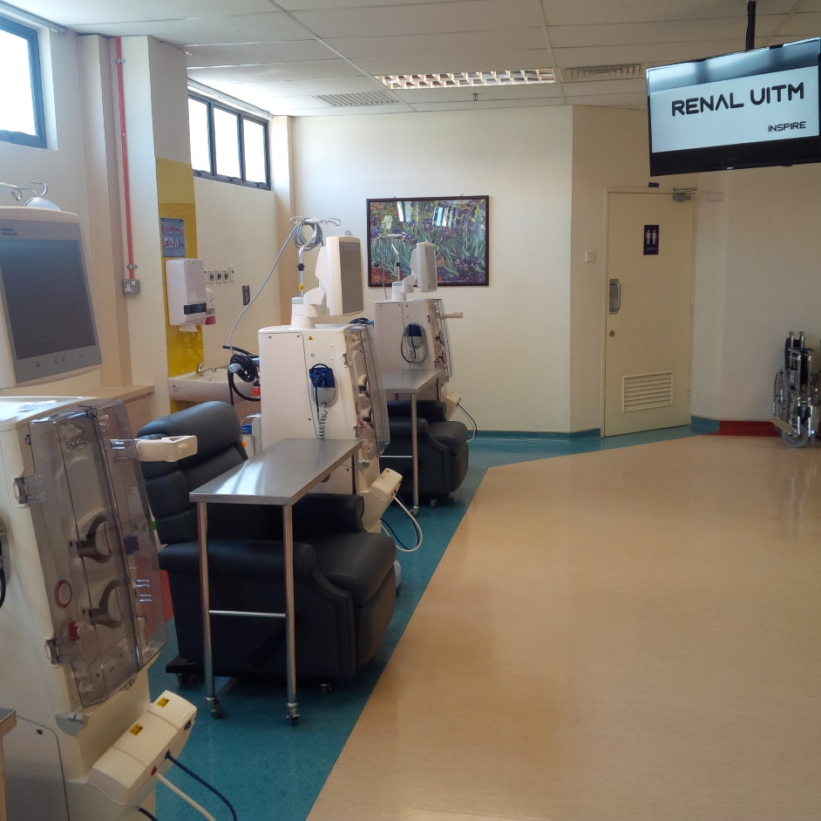
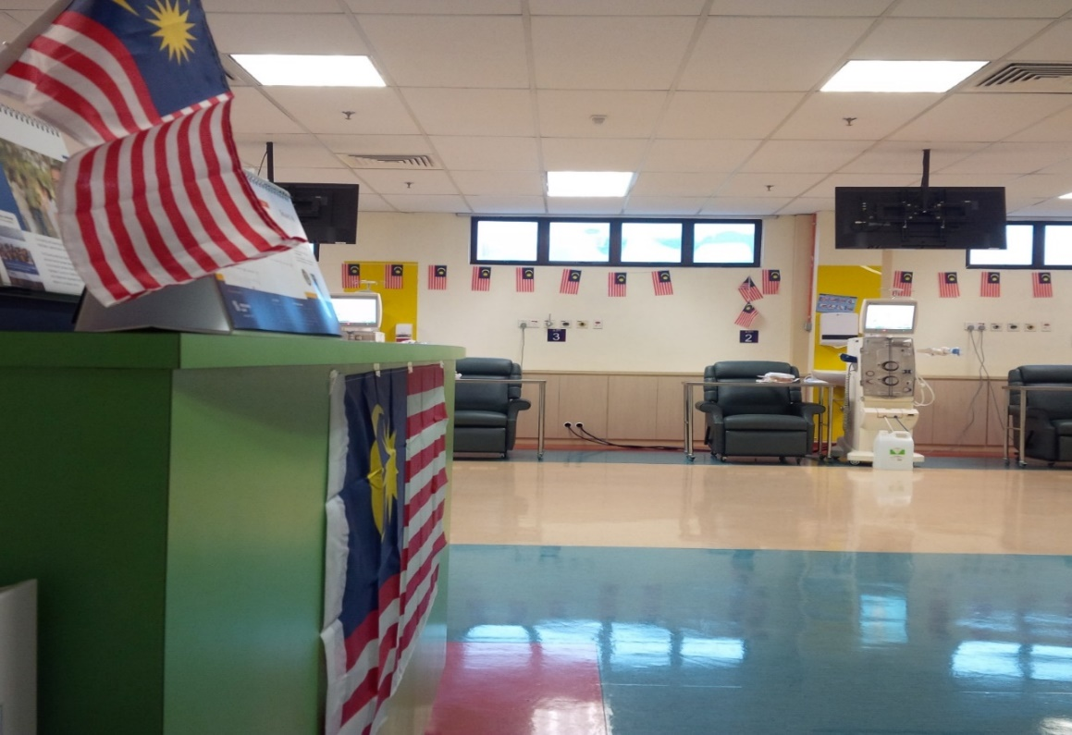
Fully HDF

Slide 6
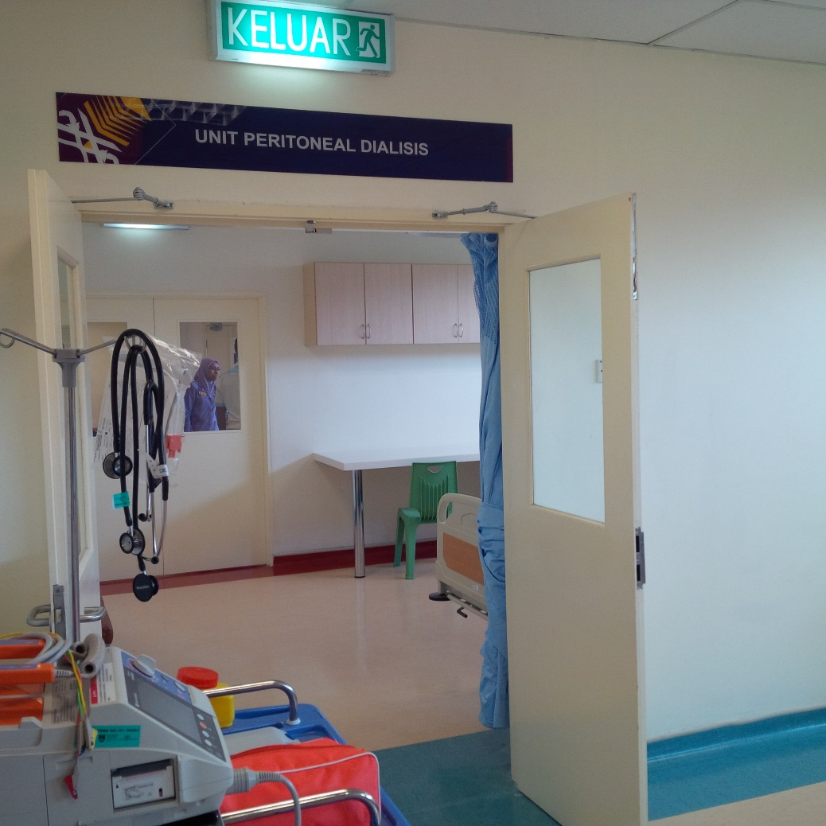
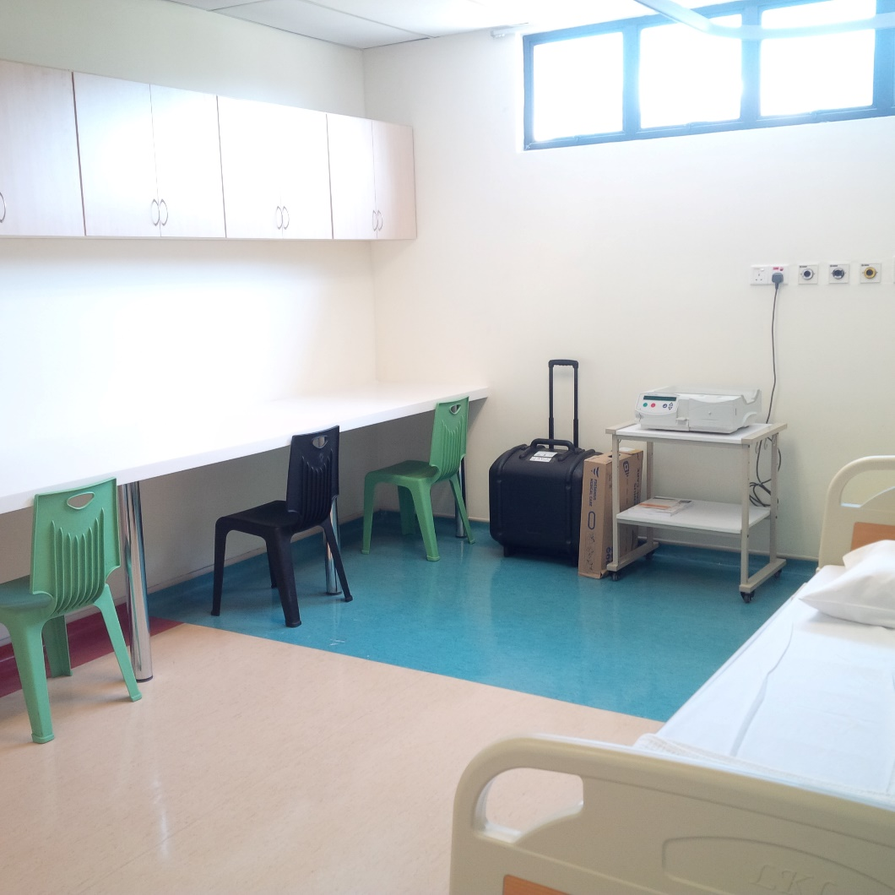
Peritoneal Dialysis

Slide 7
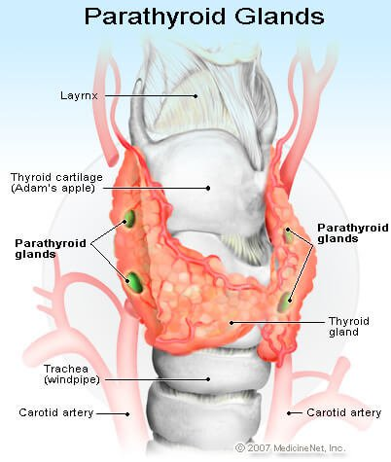
Services Provided
HDF
PD
Tenchkoff Catheter
IJC and perm catheter
Kidney biopsy
Clinic
Ward
Parathyroidectomy
AVF
Transplant – 2017
Lipid apharesis

Slide 8
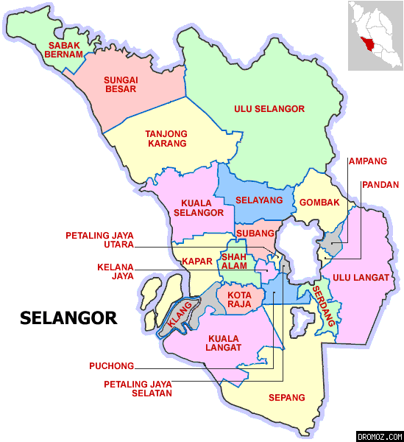
Future
Selayang
Puncak Alam
Teluk Intan

Slide 9
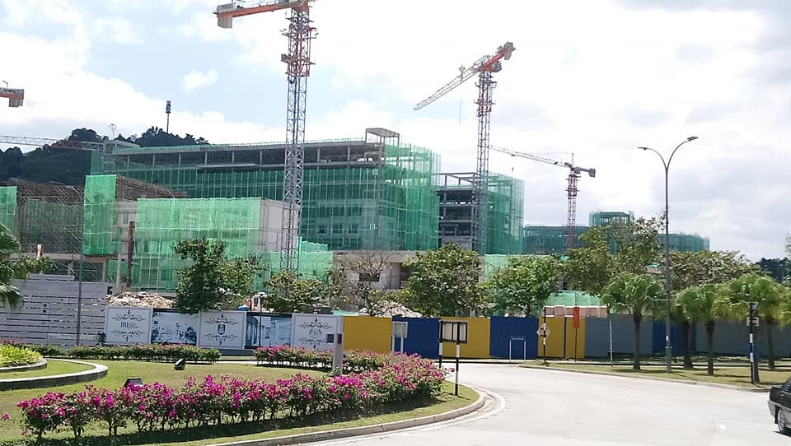
Hospital Universiti UiTM Puncak Alam – April 2020

Slide 10

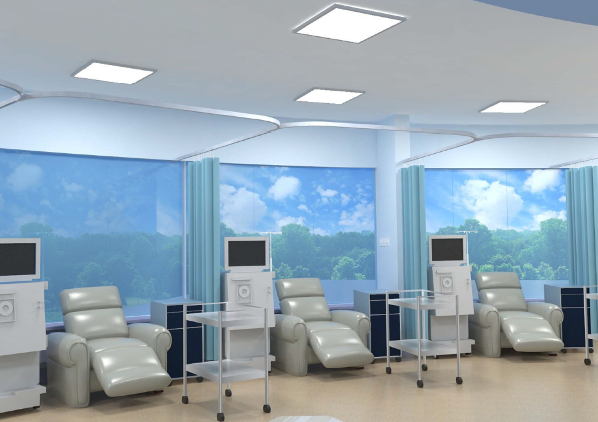
Hospital Universiti UiTM Puncak Alam – April 2020

Slide 11

View of a rakyat
Doctor since 2002
Overseas (NHS)
KKM (Kuantan, Selayang)
MOE (UM, UiTM)
Private (Insurance)
HD (KL and Kedah)

Slide 12
Most important to everyone
Health
Education

Slide 13
Education and Health is related
Education
Health

Slide 14
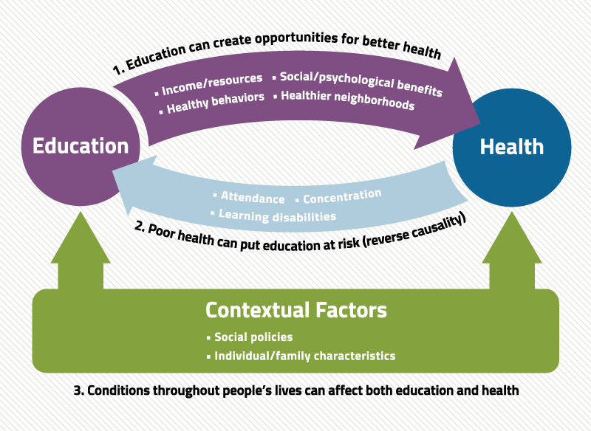
Inequalities (Ketidaksamaan)

Slide 15
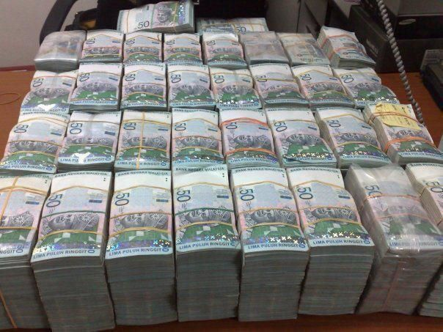
Real cause of inequality

Slide 16
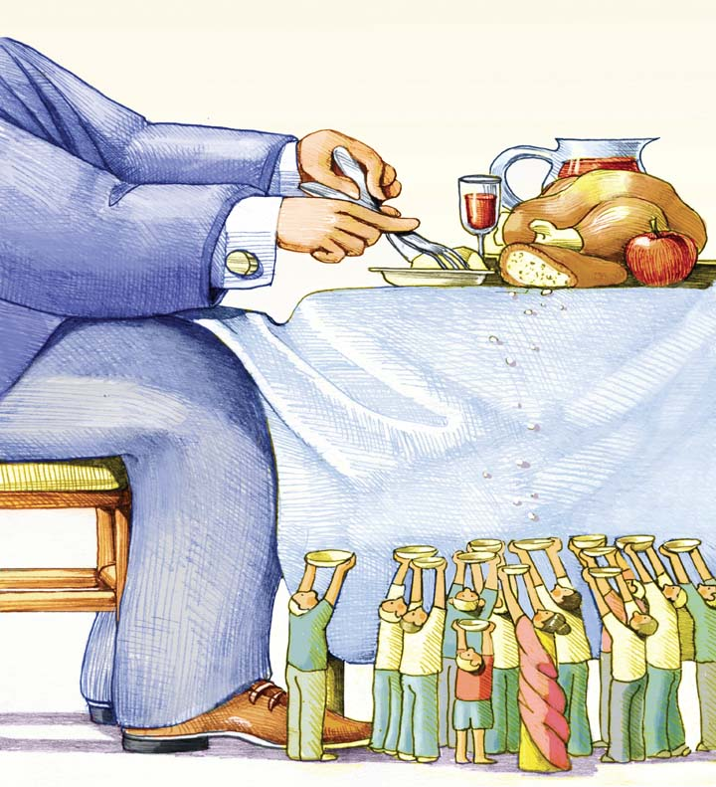
Inequality

Slide 17


Education
vs

Slide 18

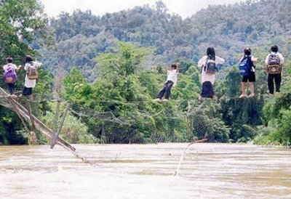
Education

Slide 19
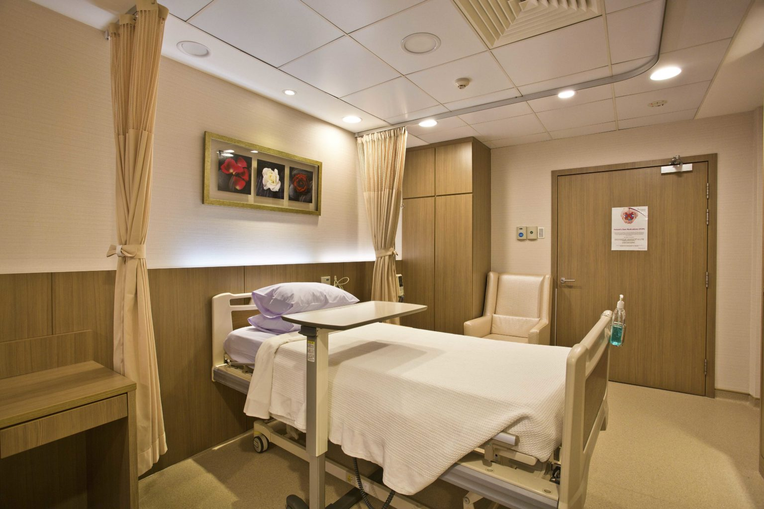
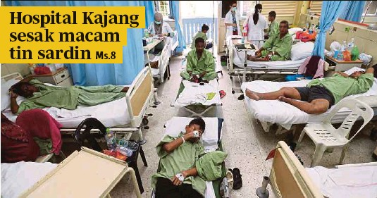
Health
vs

Slide 20

Malaysia Healthcare Is Getting Better
Infant mortality rate is one of the lowest in the world; in 2016, this stood at 6.7 per 1,000 live births.
Between 1970 and 2016, life expectancy increased for women from 65.6 to 77.2 and for men from 61.6 to 72.5 years.

Slide 21
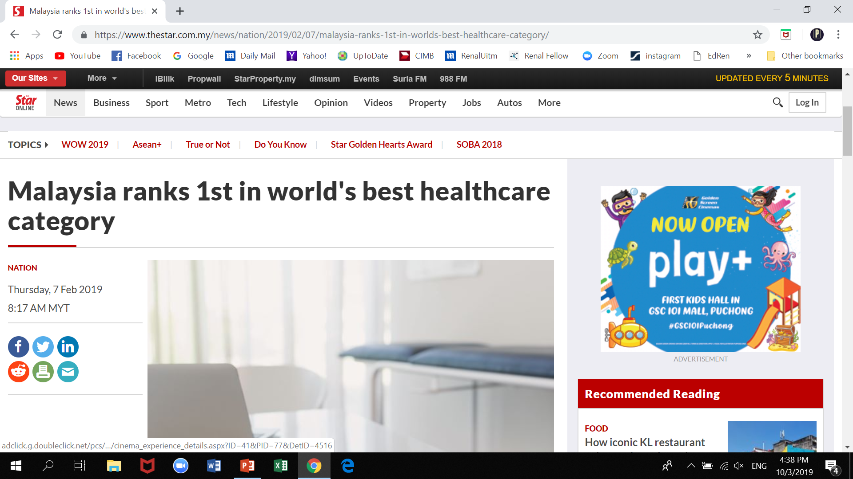

Malaysia Healthcare is World Number 1

Slide 22

Inequalities in Health Malaysia
Despite Malaysia's effort in socio-economic development plans, there still exist issues in equity and accessibility especially for the indigenous groups, rural population and the hard-core poor.
In Putrajaya 1 doctor: 19 people
In KL 1:335
In Sabah 1:1187

Slide 23
Population of Malaysia

Slide 24
Number of Doctors in Malaysia

Slide 25
Public Hospitals in Malaysia

Slide 26
Private Hospitals in Malaysia

Slide 29
Total number of Specialists in Malaysia

Slide 30
Burden of Kidney Disease

Slide 31
CKD in Malaysia
1 in 10 Malaysians have CKD!!!

Slide 32
ESRF in Malaysia

Slide 33
New Dialysis
20-25% are overseas transplant!

Slide 34
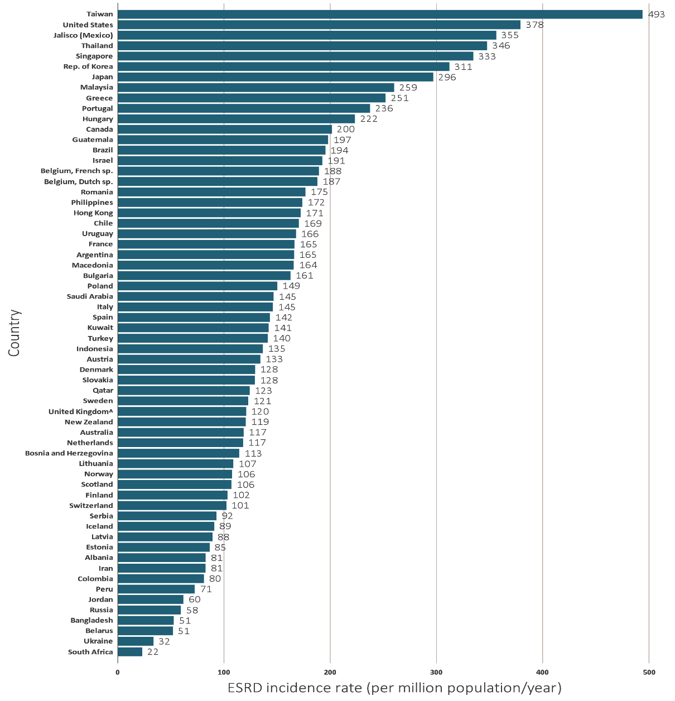
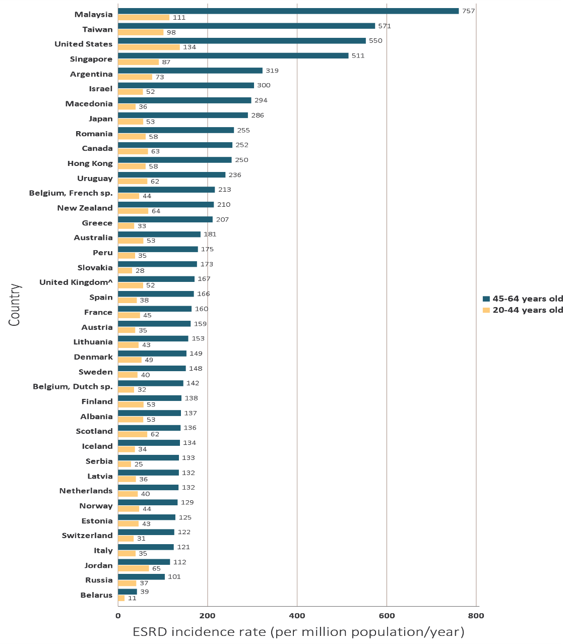
ESRF in Malaysia (USRDS 2018)

Slide 35
Transplant in HKL and Selayang

Slide 36
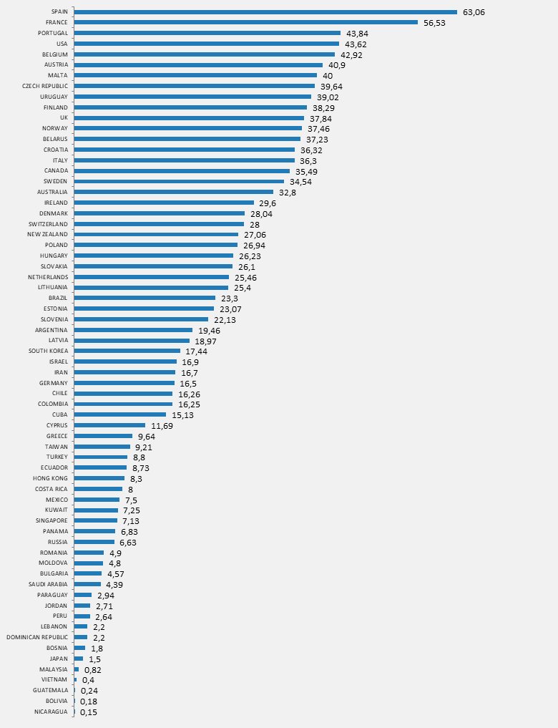
International Registry in Organ Donation and Transplantation 2017 (Kidney)

Slide 37
Transplant is cheaper long term when compared to dialysis

Slide 38
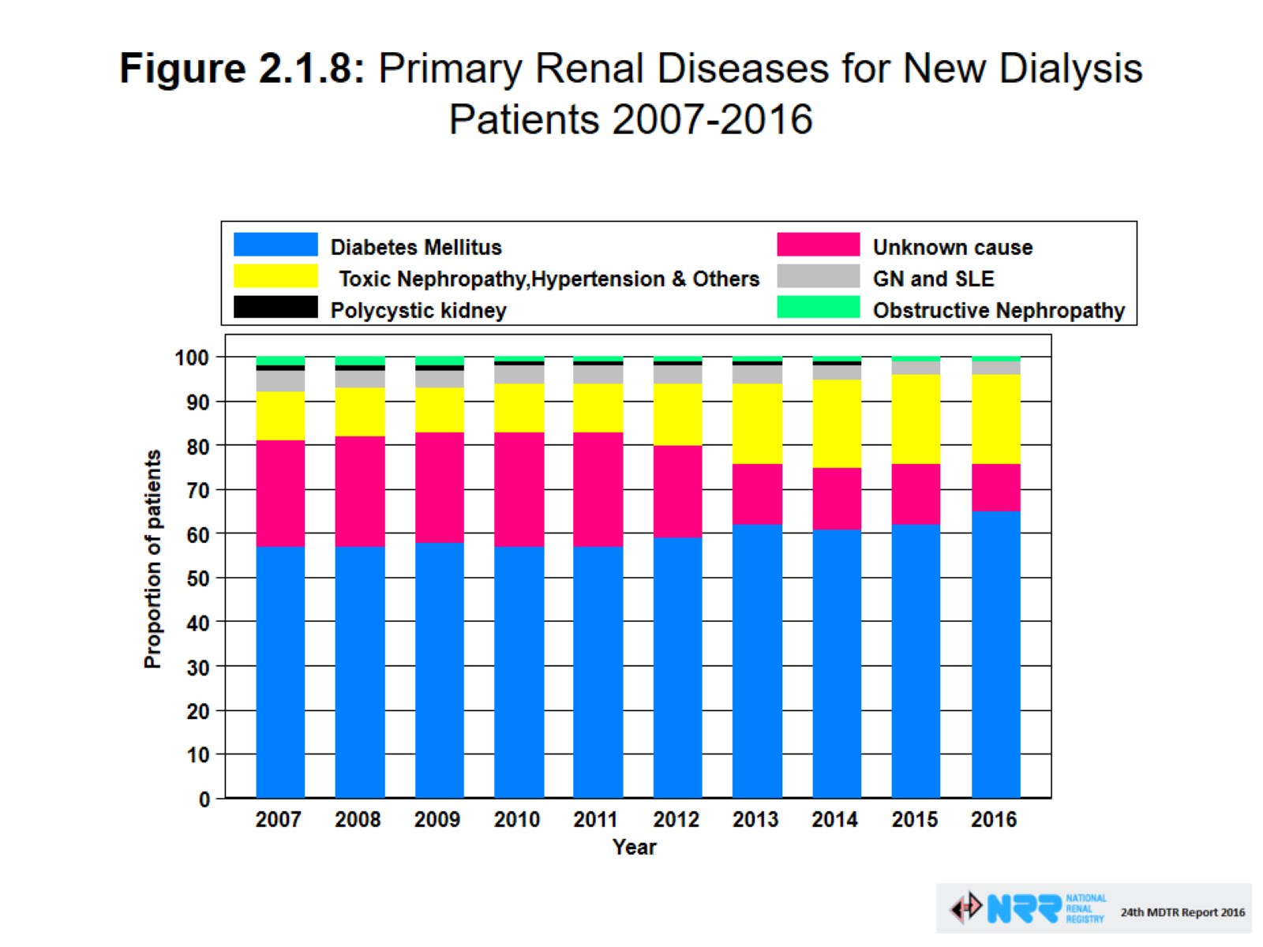
Figure 2.1.8: Primary Renal Diseases for New Dialysis Patients 2007-2016

Slide 39
Causes of ESRF

Slide 40

NHMS
National Health and Morbidity Survey (NHMS 1) was first initiated in 1986 to provide the community-based data on the pattern of common health problems, health service utilisation and health expenditure in the community.
Initially done every 10 years but now shortened to every 5 years.

Slide 41
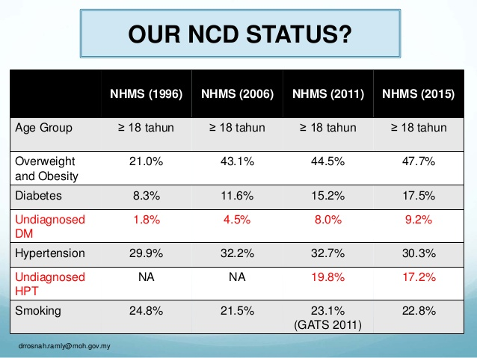
Our NCD data

Slide 42
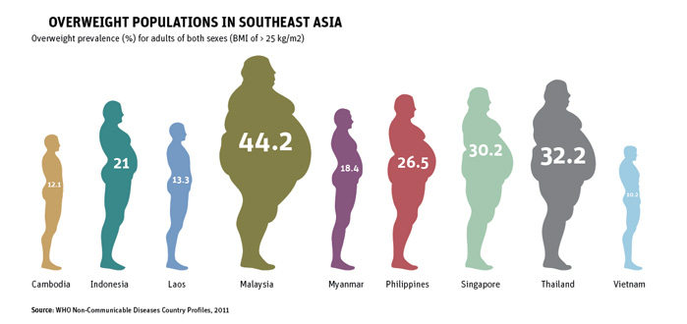
Obesity in SEA

Slide 43
Disparity and Access to Treatment

Slide 44
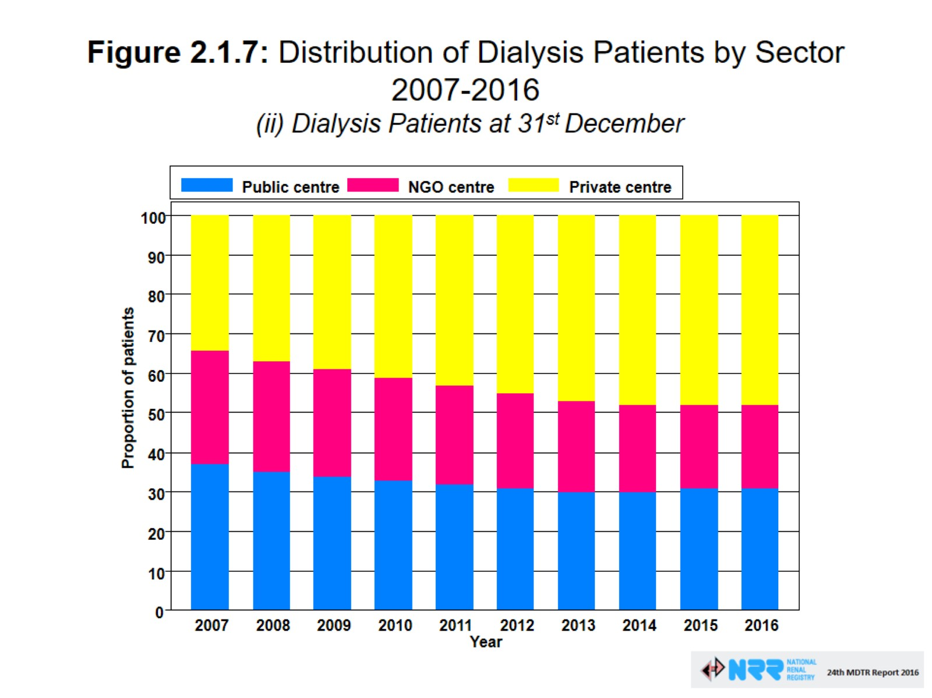
Figure 2.1.7: Distribution of Dialysis Patients by Sector 2007-2016
(ii) Dialysis Patients at 31st December

Slide 45
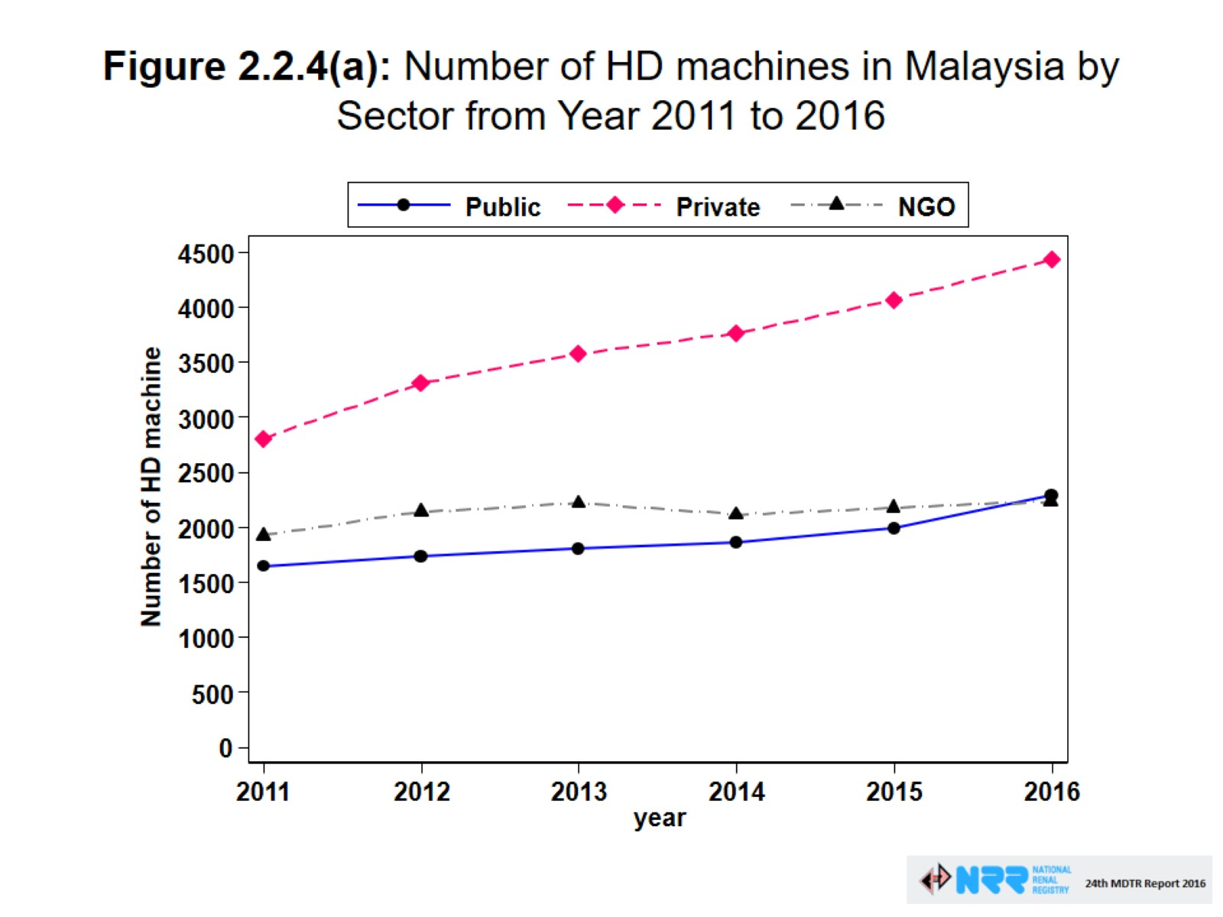
Figure 2.2.4(a): Number of HD machines in Malaysia by Sector from Year 2011 to 2016

Slide 46
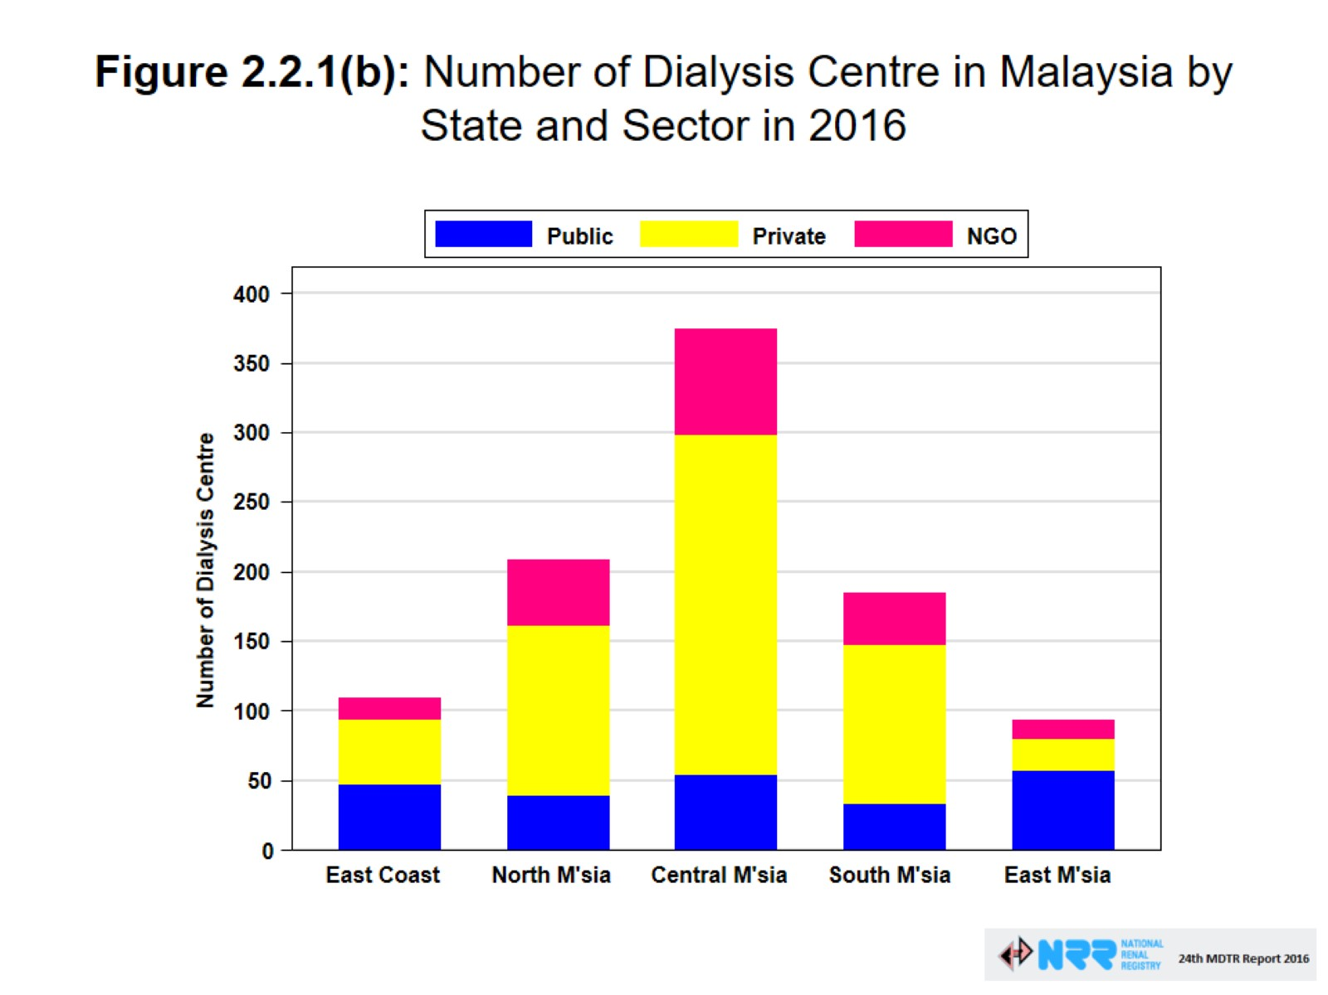
Figure 2.2.1(b): Number of Dialysis Centre in Malaysia by State and Sector in 2016

Slide 47
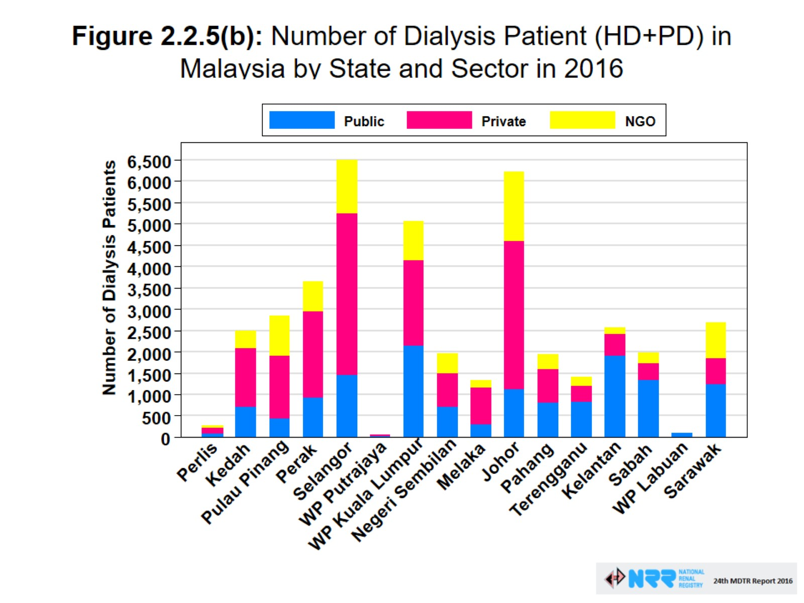
Figure 2.2.5(b): Number of Dialysis Patient (HD+PD) in Malaysia by State and Sector in 2016

Slide 48
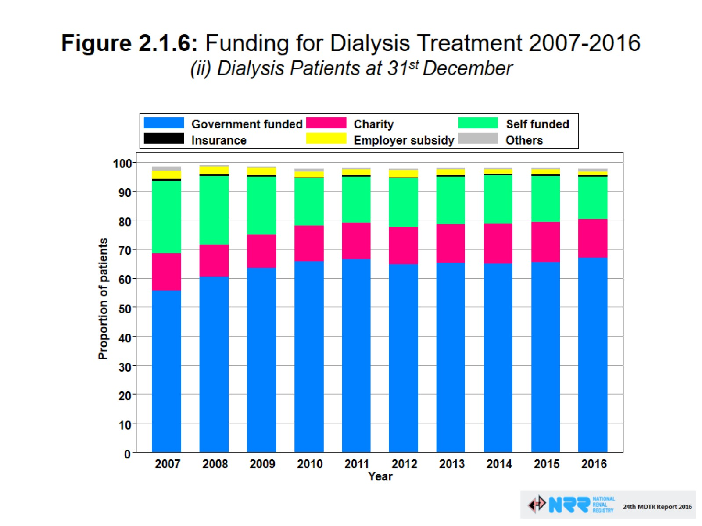

Slide 49
Haemodialysis Support
Hospital KKM – RM13
Self funded
JPA
Perkeso/SOCSO – RM 150 per session, x3 EPO (RM240)
Zakat – RM 150 per session, x3 EPO (RM240)
Selangor Sihat
NKF – RM90, EPO RM18

Slide 50

Total number of nephrologists in Malaysia (as of June 2018)
Total number of nephrologist in Malaysia : 166

Slide 51
Conclusion
Burden – kidney disease is a major health problem in Malaysia and will continue to rise in tandem with diabetes, obesity and hypertension.
Disparity exists and access to kidney care is not equal in the country.

Slide 52

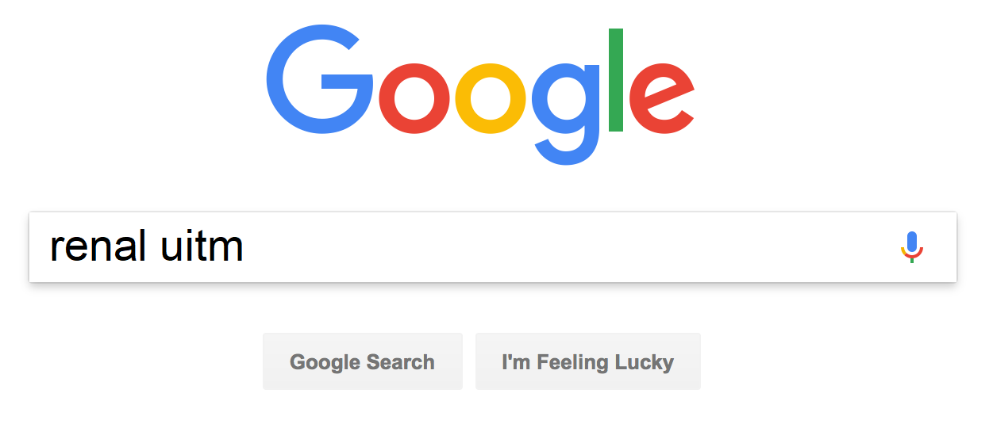




Thank you!

