Slide 1


Slide 2


2 min eduvisual
Transplant Rejection
(Acute Cellular Rejection)

Slide 3
Two types of rejection (Banff)
T Cell Mediated Rejection (Cellular rejection)
Antibody Mediated Rejection (Humoral rejection)
☞ When talking about the pathophysiology of solid organ rejection – we are actually referring to the process of T cell mediated or cellular rejection
*but to be honest to separate transplant rejection as a single process is too simplistic as we know that the T cells and B cells and other cells of the immune system are in constant communication with each other and as such is in someway involved in rejection.

Slide 4
Is it really necessary to understand the pathophysiology of transplant rejection?
Yes! First and foremost to appreciate your immune system – its really amazing!
Yes! So that you can picture the things going on with the kidney whilst it’s inside the new body – especially HOW rejection is happening and WHEN it’s happening.
Yes! To be able to appreciate a transplant biopsy!
Yes! To be able to appreciate how immunosuppression works.

Slide 5
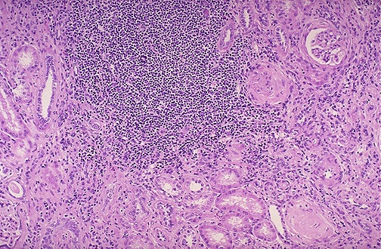
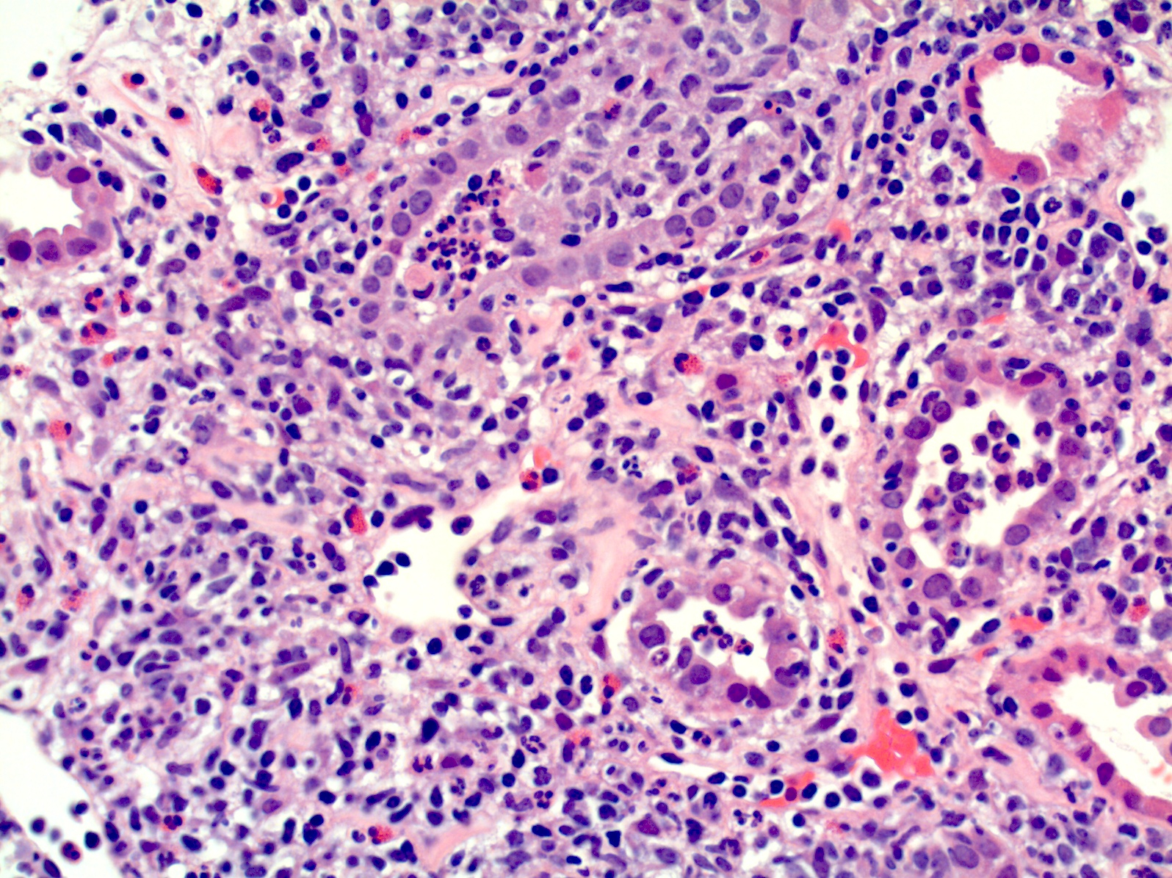
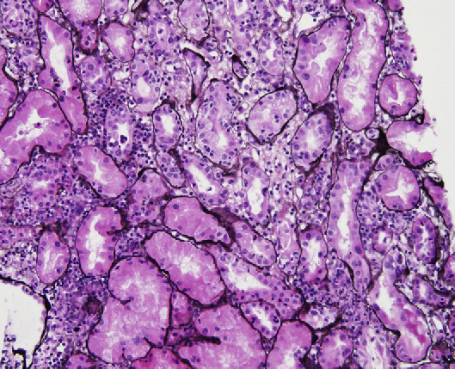
This is inflammation – affecting interstitium and tubules
Acute pyelonephritis
Acute interstitial nephritis
Acute cellular rejection
Looks almost the same right?..that’s because the process is very similar – the inflammatory cells are invited to the kidneys via cytokines and chemotaxis which then causes inflammation to happen

Slide 6
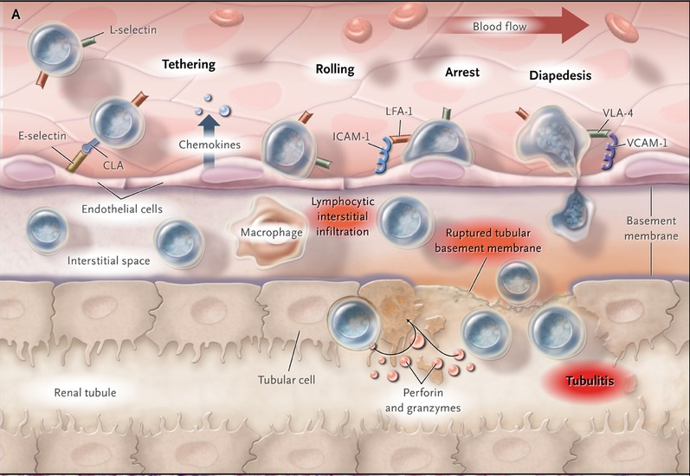
Effector T cells (after being activated by donor APCs)
Endothelial cells
Interstitial space
Renal tubules
Donor or “passenger” APCs in the interstitium

Slide 7
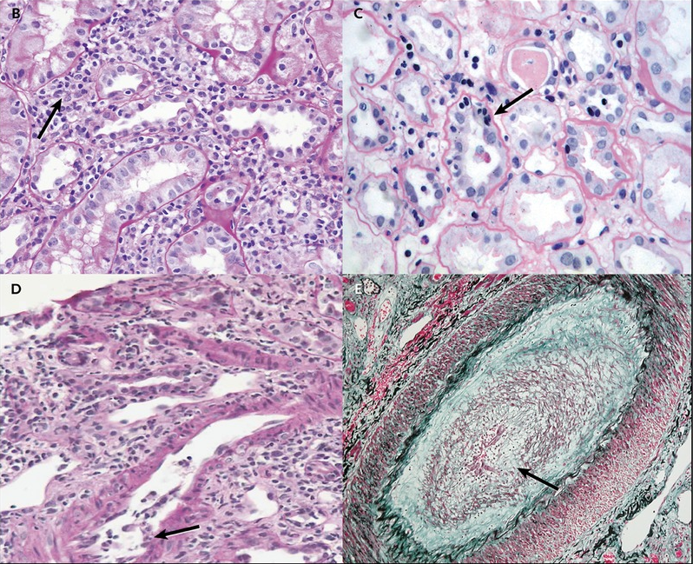
Lymphocytes in the interstitium
How much infiltration of the parenchyma
Lymphocytes in between the tubules epithelial
Count the mononuclear cells amongst the tubules! (every 10 tubular cells)
How do u differentiate between mononuclear cells and epithelial cell?
Use a PAS stain. The infiltrating lymphocytes are more smaller, nucleus more solid, darker, rounder and has a halo around it.
Lymphocytes in the vessels (arteritis/endotheliitis)

Slide 8
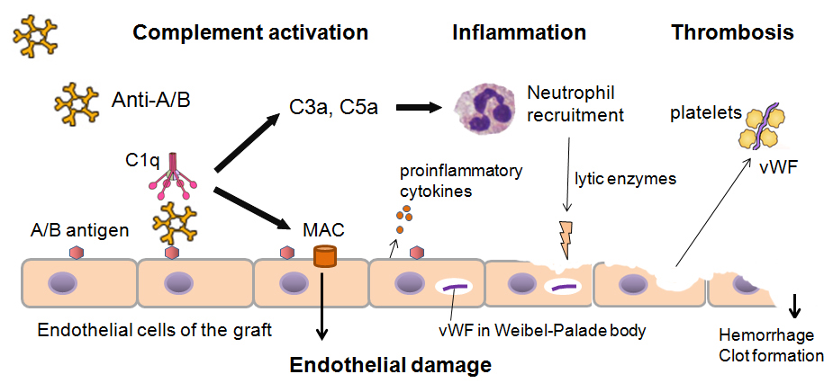
Different from an antibody mediated rejection!
More sophisticated – antibody-HLA/ABO antigens, complement activation, MAC and Ab-mediated cytotoxicity
Attacks the vascular endothelium – so you see changes affecting the peritubular capillaries, glomerulus, vessels

Slide 9
Antibody mediated rejection
Causes hyperacute rejection, acute rejection and chronic rejection
The types of ABMR above is caused by preformed DSAs, amnestic response by memory B cells and de novo DSA respectively.
Cross match is a method to determine whether u have pre-formed antibodies pre-transplant or not.
Understanding of ABMR and evolution of transplant has increased greatly due to Luminex technology
☞
We need to talk HLA, ABMR, Luminex & DSAs another time ok!

Slide 10
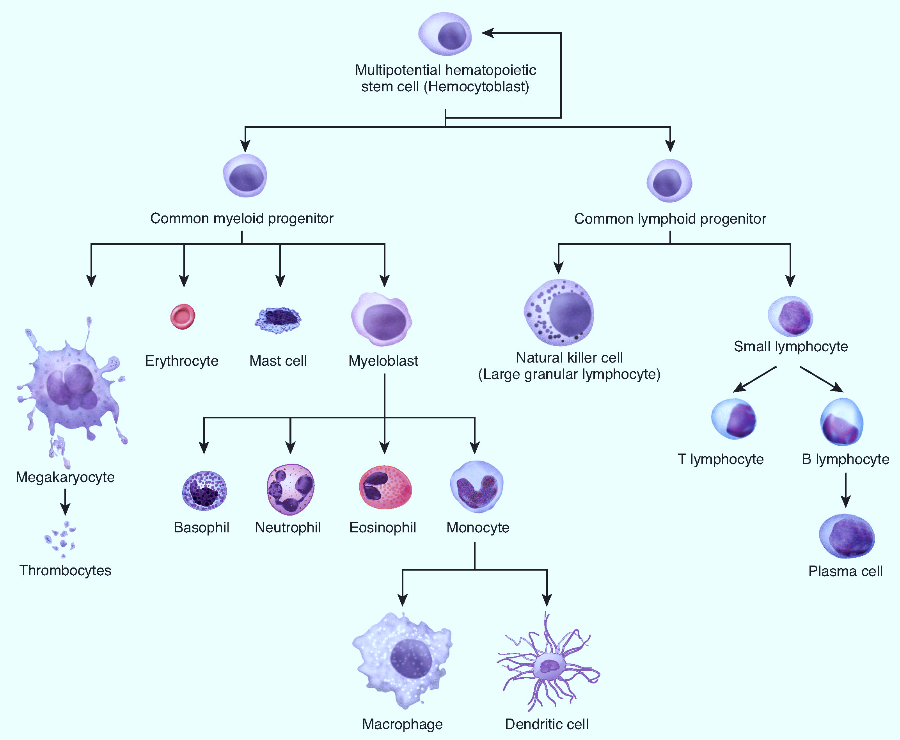
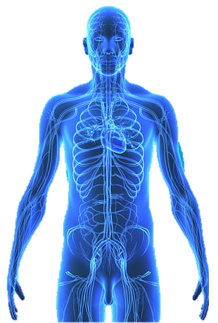
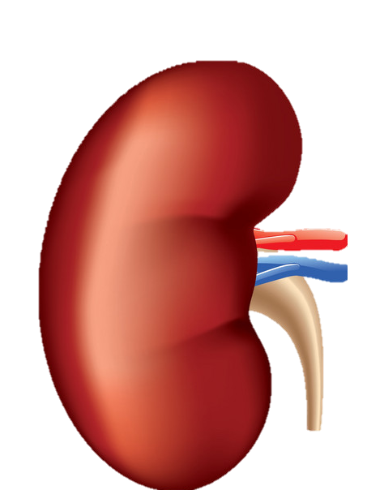
Back to T cell rejection!
Players to know
recipient
Recipients T Cells (CD4 and CD8) – direct pathway
Recipients APCs – indirect pathway
allograft
Donor APCs in the interstitium which express MHC class I and MHC Class II molecules
(most important are dendritic cells as they go out from the graft to the recipient’s lymph nodes)

Slide 11
DIRECT PATHWAY OF
ALLORECOGNITION AND ACTIVATION
unique to transplant

Slide 12
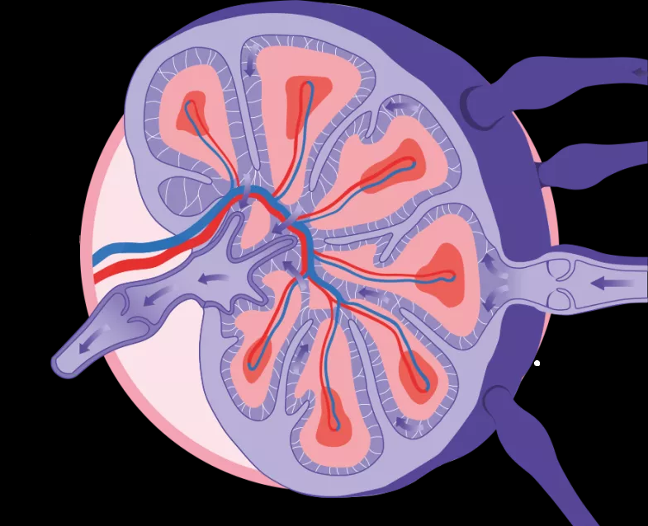
lymph nodes
Donor APCs
Donor dendritic cells
T CELL REJECTION!
Recipients T cells (CD4 and CD8)
new kidney
Recipients APC

Slide 13
In the lymph nodes
MHC CLASS I
DONOR APC
ANTIGEN
RECIPIENT CD8
CD8
TCR
*also can be CD4 T cells

Slide 14
SIGNAL 1
DONOR APC
ACTIVATED T CELL

Slide 15
DON’T FORGET SIGNAL 2 & 3!
Signal 3
cytokines
Signal 2
co-stimulation
IL-2
CD28
DONOR APC
ACTIVATED T CELL

Slide 16
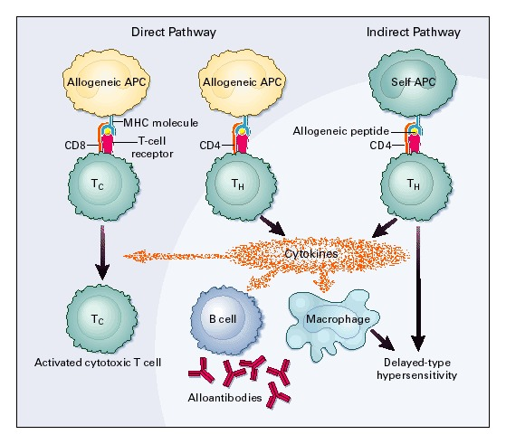
Nicer drawing in NEJM..

Slide 17
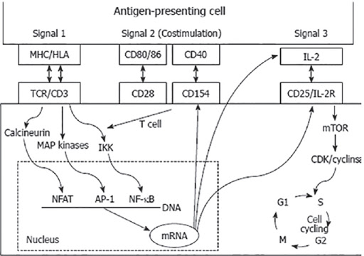
Again..don’t forget !
Signal 1
Signal 2
Signal 3

Slide 18
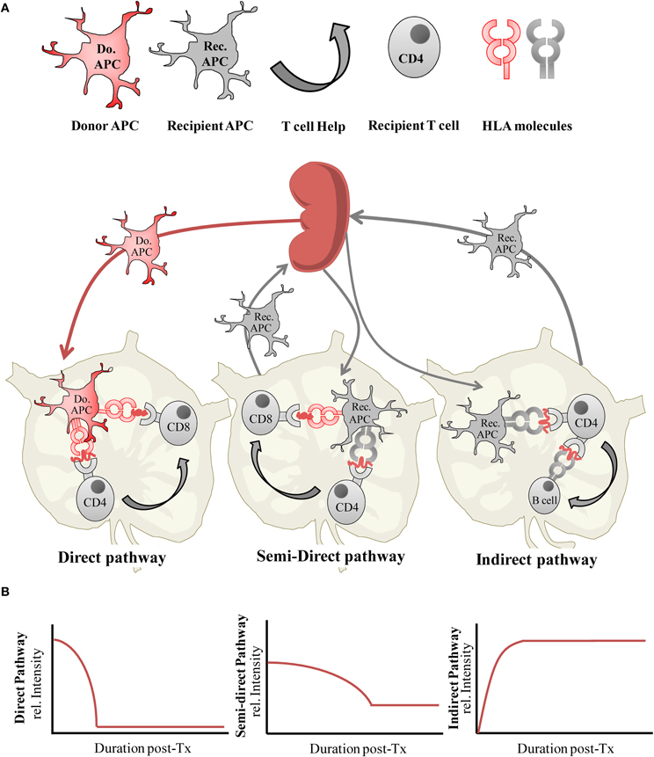
Direct allorecognition and activation
Activation of cytotoxic-CD8 T Cell (or a helper-CD4 T cell) directly by the dendritic cells from the donor kidney
Occurs immediately after kidney gets transplanted
Ongoing until the APCs in the graft disappears
Days to weeks to few months
Immune response
☞
SO MAKE SURE PREVENT THIS by giving INDUCTION (pre transplant) and block this 3 SIGNAL ACTIVATION with ADEQUATE immunosuppression (first days to 3 months to 1 year)

Slide 19
INDIRECT PATHWAY OF ALLORECOGNITION AND ACTIVATION

Slide 20
DONOR APC
RECIPIENT APC
MHC CLASS II
RECIPIENT CD4

Slide 21
RECIPIENT APC
MHC CLASS II
RECIPIENT CD4

Slide 22
RECIPIENT APC
MHC CLASS II
ANTIGEN
RECIPIENT CD4

Slide 23
SIGNAL 1
RECIPIENT APC
ACTIVATED CD4

Slide 24
B cells and subsequently plasma cells and antibodies!
B CELLS
cytokines
RECIPIENT APC
ACTIVATED CD4

Slide 25
That nice drawing in NEJM..

Slide 26
Indirect allorecognition and activation
Uptake and processing of allogenic antigens by recipient APC
Recipient APCs then present processed peptide to CD4 T cells (delayed Type 4 hypersensitivity reaction), cytokines are release - B cells are activated and alloantibodies are produced!
Responsible for de novo DSAs and chronic rejection
Immune response
So in essence although occurs later but causes long term graft loss via de novo DSA formation

Slide 27
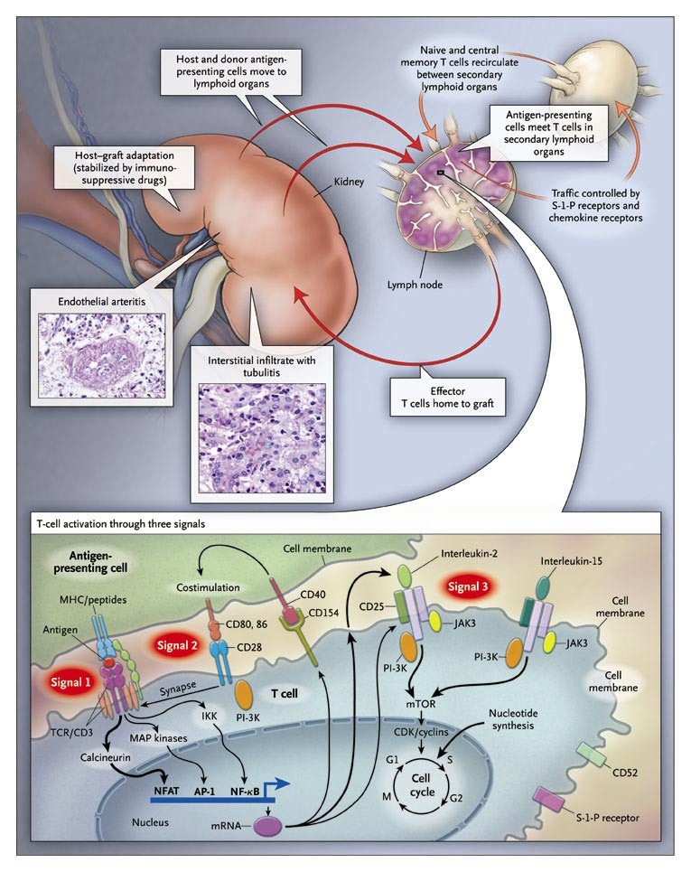
That nice and famous drawing in NEJM

Slide 28
THE SIGNALS AND IMMUNOSUPPRESSION!
Notice how hard we try suppress this process!
So make sure your CSA/Tac and Everolimus levels are correct
And your patients take their meds!
Signal 3
cytokines
Signal 2
co-stimulation
IL-2
CD28
DONOR APC
Signal 1
recognition
T CELL

Slide 29
THE SIGNALS AND IMMUNOSUPPRESSION!
Signal 3
cytokines
Thymoglobulin – Downregulates and kills T cells
Rituximab (anti-CD20) – Kills B cells
Signal 2
co-stimulation
Basiliximab
Daclizumab
IL-2
Belatacept
Azathioprine
MPA
MTORi
Steroids
CD28
DONOR APC
Signal 1
recognition
Tacrolimus
CSA
T CELL

Slide 30
IN SUMMARY
Understanding the pathophysiology of organ rejection is important!
It explains biopsy findings and the immunosuppression we use.
It helps us become better at managing patients ☺
☞

Slide 31


Thanks for watching!
renaluitm.com

