Slide 1


Slide 2

1 min eduvisual
Haemodiafiltration
adviced for regular use

Slide 3
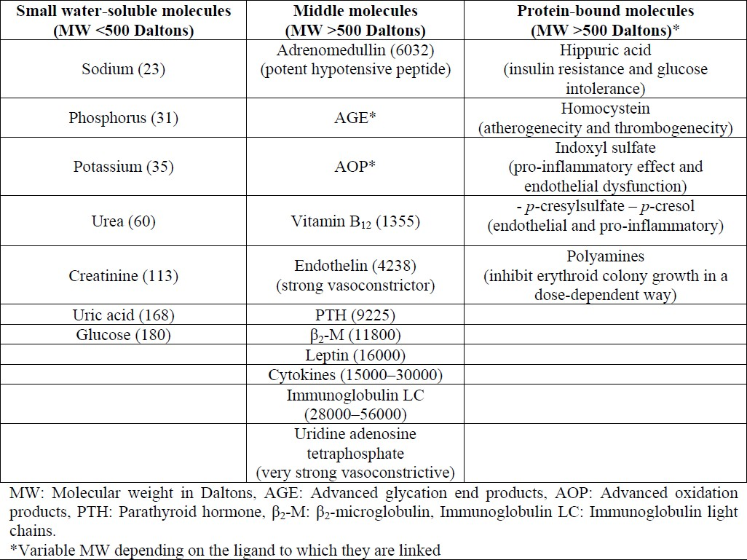
Survival of ESRD patients on dialysis
High flux dialyzers designed to remove more middle size molecule
Will it improve survival?

Slide 4
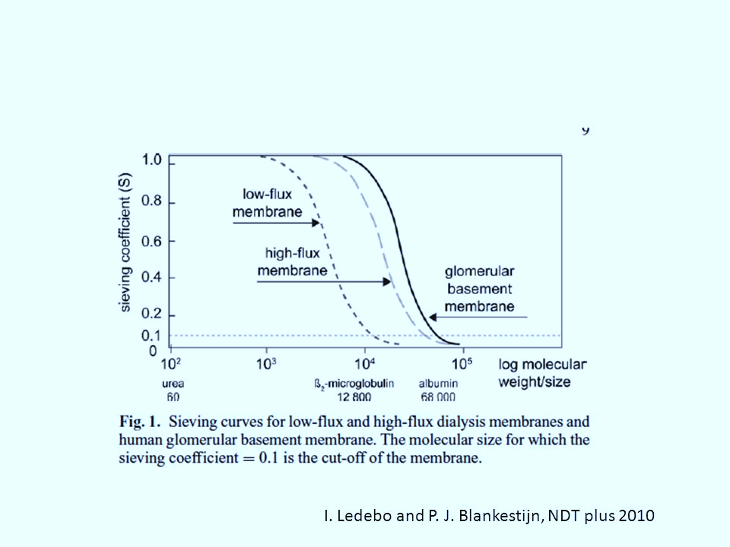
High Flux Vs Low Flux – must surely work!

Slide 5
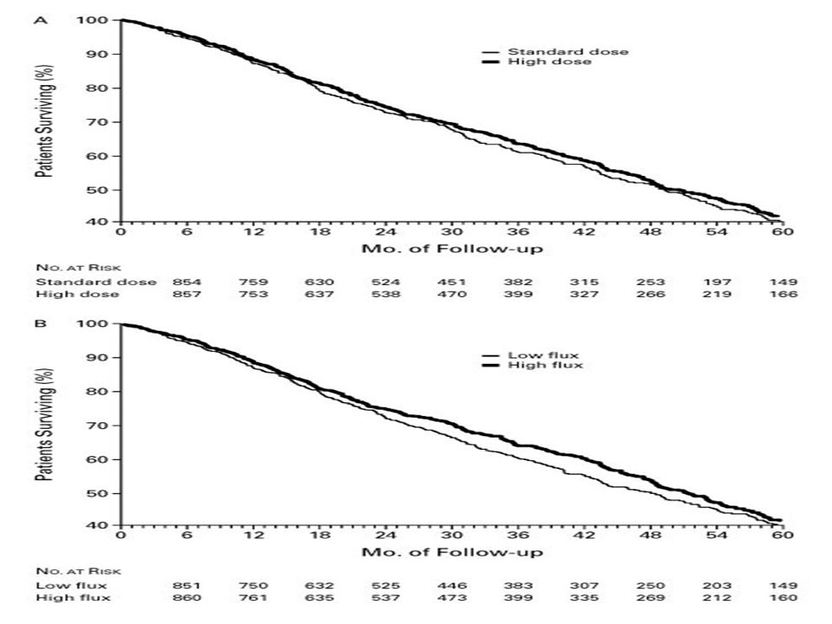
HEMO Study (2002)
RCT (n – 1846)
High Flux vs Low Flux
NO survival benefit!

Slide 6
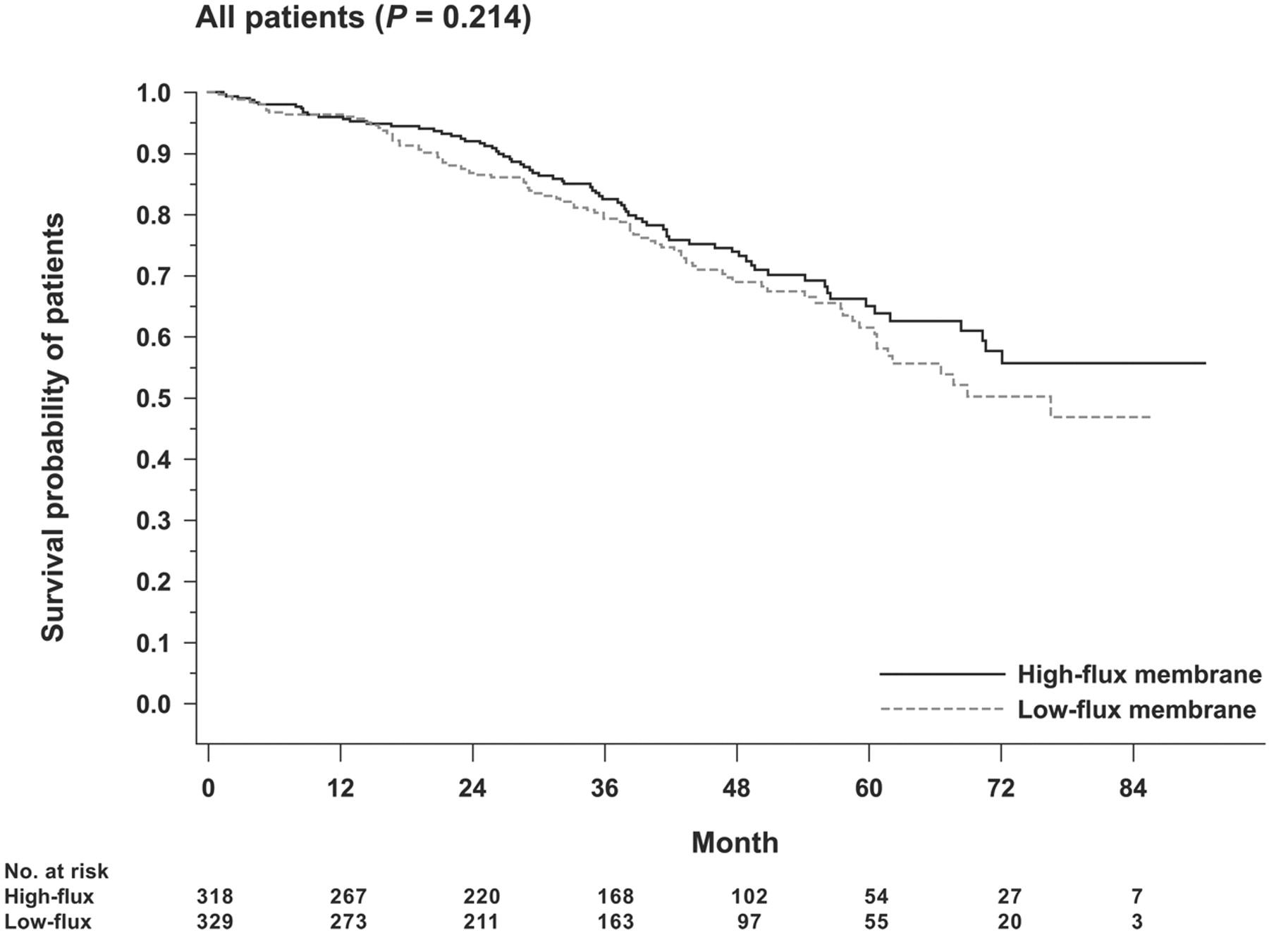
MPO Study (2008)
RCT (n – 738)
High Flux vs Low Flux
NO survival benefit!

Slide 7
Unexpected findings!..but why no improvement?
No explanations except possibly need better range of middle molecule removal
*(answer in truth probably lies in frequent dialysis but we will not discuss this here)

Slide 8
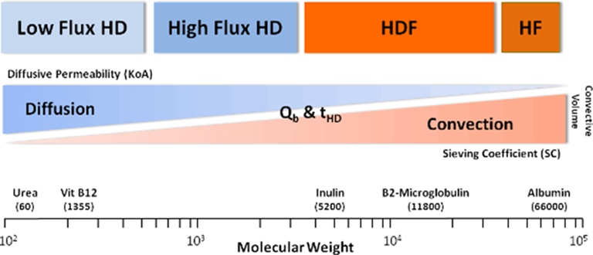
The Golden Question
Will using better convective techniques (HDF) which permit even greater removal of middle molecules improve survival?

Slide 9
How does HDF improve MMW clearance?
Haemodialysis is primarily a diffusive form of therapy (good for small solutes)
Large molecules do get cleared via diffusion too but very slowly
The larger the molecule the slower it diffuses across the membrane.
Large solutes (MWM) are better cleared by convection (solute drag)
*our glomerulus works more like a haemofiltration (intraglomerular pressure by pressure generated by afferent and efferent arteriole)
☞

Slide 10
Haemodiafiltration
Combines diffusive and convective clearance
Better removal of MWM
Will this show survival benefit?
Will try and answer this today as well as learn certain technical aspects of HDF

Slide 11
Solvent drag or convective flux (C) can be improved by increasing both the sieving coefficient of the membrane (using high-flux membranes) and ultrafiltration flow - high volume haemodiafiltration
*There is a very small degree of convection in High Flux membrane btw.
☞

Slide 12
Effective Convective Volume
EUDIAL group felt that it was necessary to add a lower limit to the convection volume, below which the treatment would not qualify as HDF (High Flux is theoretically HDF)
A convection volume equivalent to 20% of the total blood volume processed for the treatment was chosen as the lower limit because it is achievable with post-dilution HDF in the majority of patients without excessive haemoconcentration
☞
*20% was also decided based on typical dialysis treatment times, blood flow which has been associated with clinical benefit

Slide 13
Effective convection rates
e.g. if Qb 300 then convection rate should be at least 20% - 60ml/min = 3600ml/h = 14,400 ml/session

Slide 14
Dialyzer requirements
High-flux membrane characterized by
Kuf > 20 mL/h/mmHg
sieving coefficient (S) for β2-microglobulin > 0.6
(basically dialyzers need to have high hydraulic permeability
and large enough pores for good convection/HDF to occur!)

Slide 15
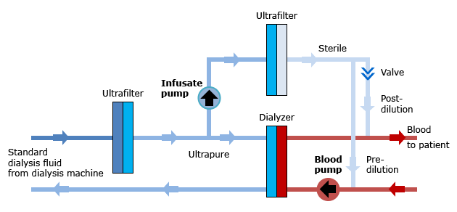
Water for HDF
Remember 2 ultrafilters/endotoxin filters are needed to produce
ultrapure for the dialysate fluid (goes into dialyzer)
sterile for replacement fluid (goes directly into patient)
2
1

Slide 16
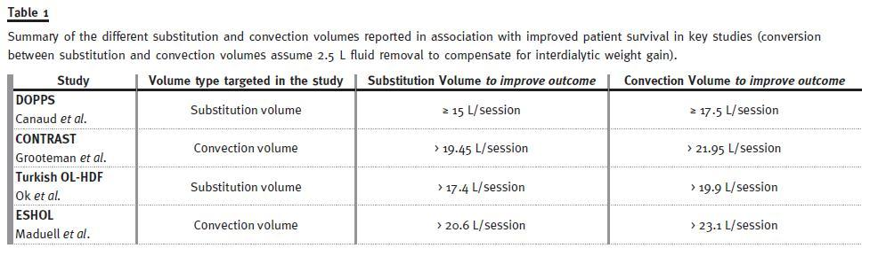
Studies to know!s
☞
a big observational study - Mercadal et al. Hemodiafiltration versus hemodialysis and survival in patients with ESRD: the French Renal Epidemiology and Information Network (REIN) registry – convection volume 23L/session

Slide 17
For optimal HDF
Most important!!

Slide 18
What is the benefit of High Volume OL-HDF?
Reduces cardiac mortality and all cause mortality (likely due to CV events too)
Why?
  Higher MWM molecules related to CVD (phosphate, FGF-23, IL6, TNFα, AGEs etc) removed than just high flux HD (however have NOT been convincingly shown to underlie the beneficial clinical effects of convective therapies)
  Intradialytic haemodynamic stability (better with HDF)

Slide 19
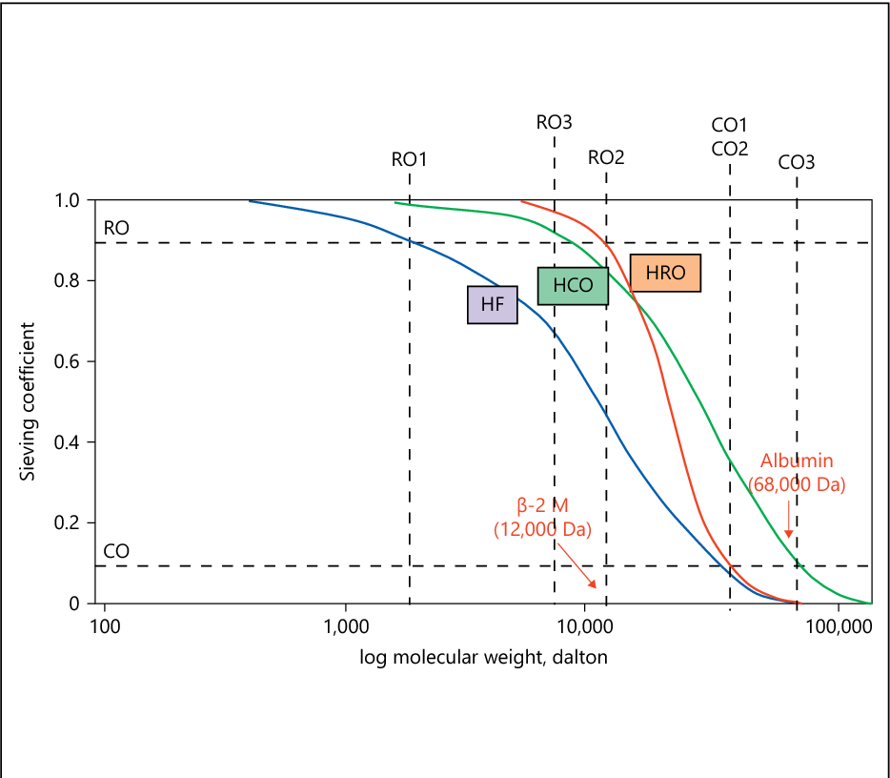
Before we end! – HDx..game changer?

Slide 20


Thanks for watching!
renaluitm.com

