Slide 1


Slide 2


1 min eduvisual
Plasma Exchange
adviced for regular use

Slide 3
Terminologies first!
Apharesis
Plasma exchange = TPE = plasmapharesis
immunoadsorption
DFPP
Cytapharesis
Removing or exchanging plasma Requires centrifugation or plasmafiltration system
Removing or exchanging cells
e.g – leukapheresis
Requires centrifugation system

Slide 4
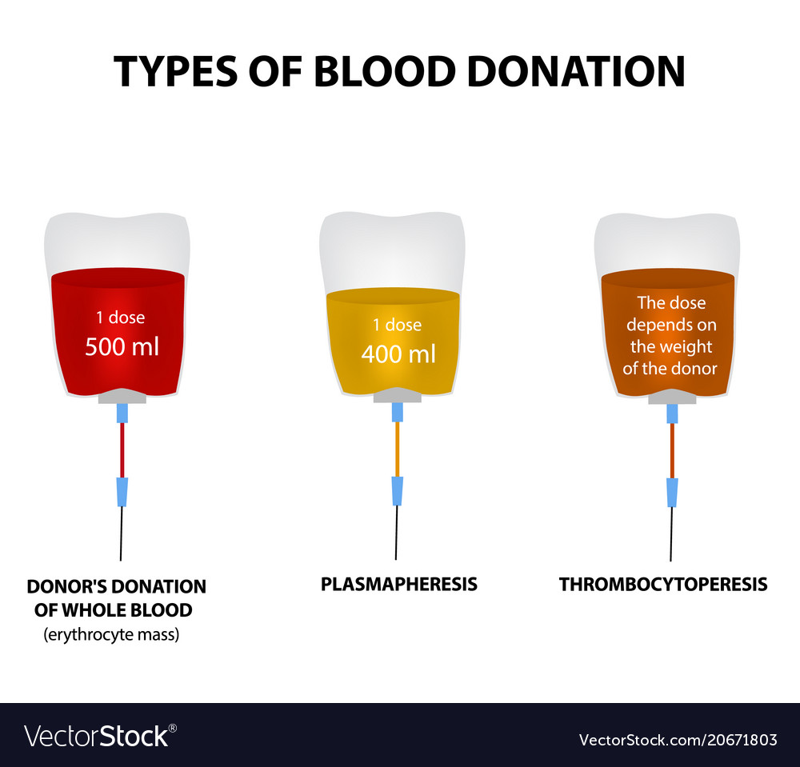
The “real” plasmapheresis
The “real” plasmapheresis done in the blood bank removes a smaller amount of plasma (<15%) of the patient’s blood volume and therefore does not require replacement of the removed plasma.
Plasma is collected from healthy donors for transfusion or manufactured into products such as albumin, IVIG, factor concentrates.
In common usage, the terms plasma exchange and plasmapheresis are used interchangeably, although the 2 procedures are different.

Slide 5
2 methods of therapeutic apharesis
Centrifugation (talk to the bloodbank)
  Need only a peripheral line
  Able to do cytapharesis
  More efficient at removing all plasma components
  Uses citrate
Membrane (talk to the nephrologists)
  Need a dialysis catheter
  Can be adapted for cascade filtration (DFPP)
  Uses heparin
Concentrating on this today!

Slide 6
Why plasmapheresis? to remove from plasma -
Autoantibodies – Goodpastures, ANCA, SLE, Myaesthaenia gravis, GBS, TTP, vasculitis,
Immunoglobulins – Hyperviscosity syndrome, Waldensterom, multiple myeloma, cryoglobulins
Kidney transplant – ABMR and desensitization
Hormones – thyroid storm (99% of T4 and T3 protein bound)
Toxins – amanita phalloides
Lipids

Slide 7
Did you know ASFA has classified the indications of PLEX based on evidence?

Slide 8
Its all about sizes of molecules to be removed!
dialyzer membrane (30 microns)
PLEX membrane
(50 microns)
LDL
IgG
(150 000 Daltons)
creatinine
urea
IgM
B2 microglobulin
Does not remove anything bigger than albumin
hormones
phosphate
Removes everything in plasma except blood cells!
Albumin
(68 000 Daltons)
Coagulation factors
haemodialysis
plasma exchange

Slide 9
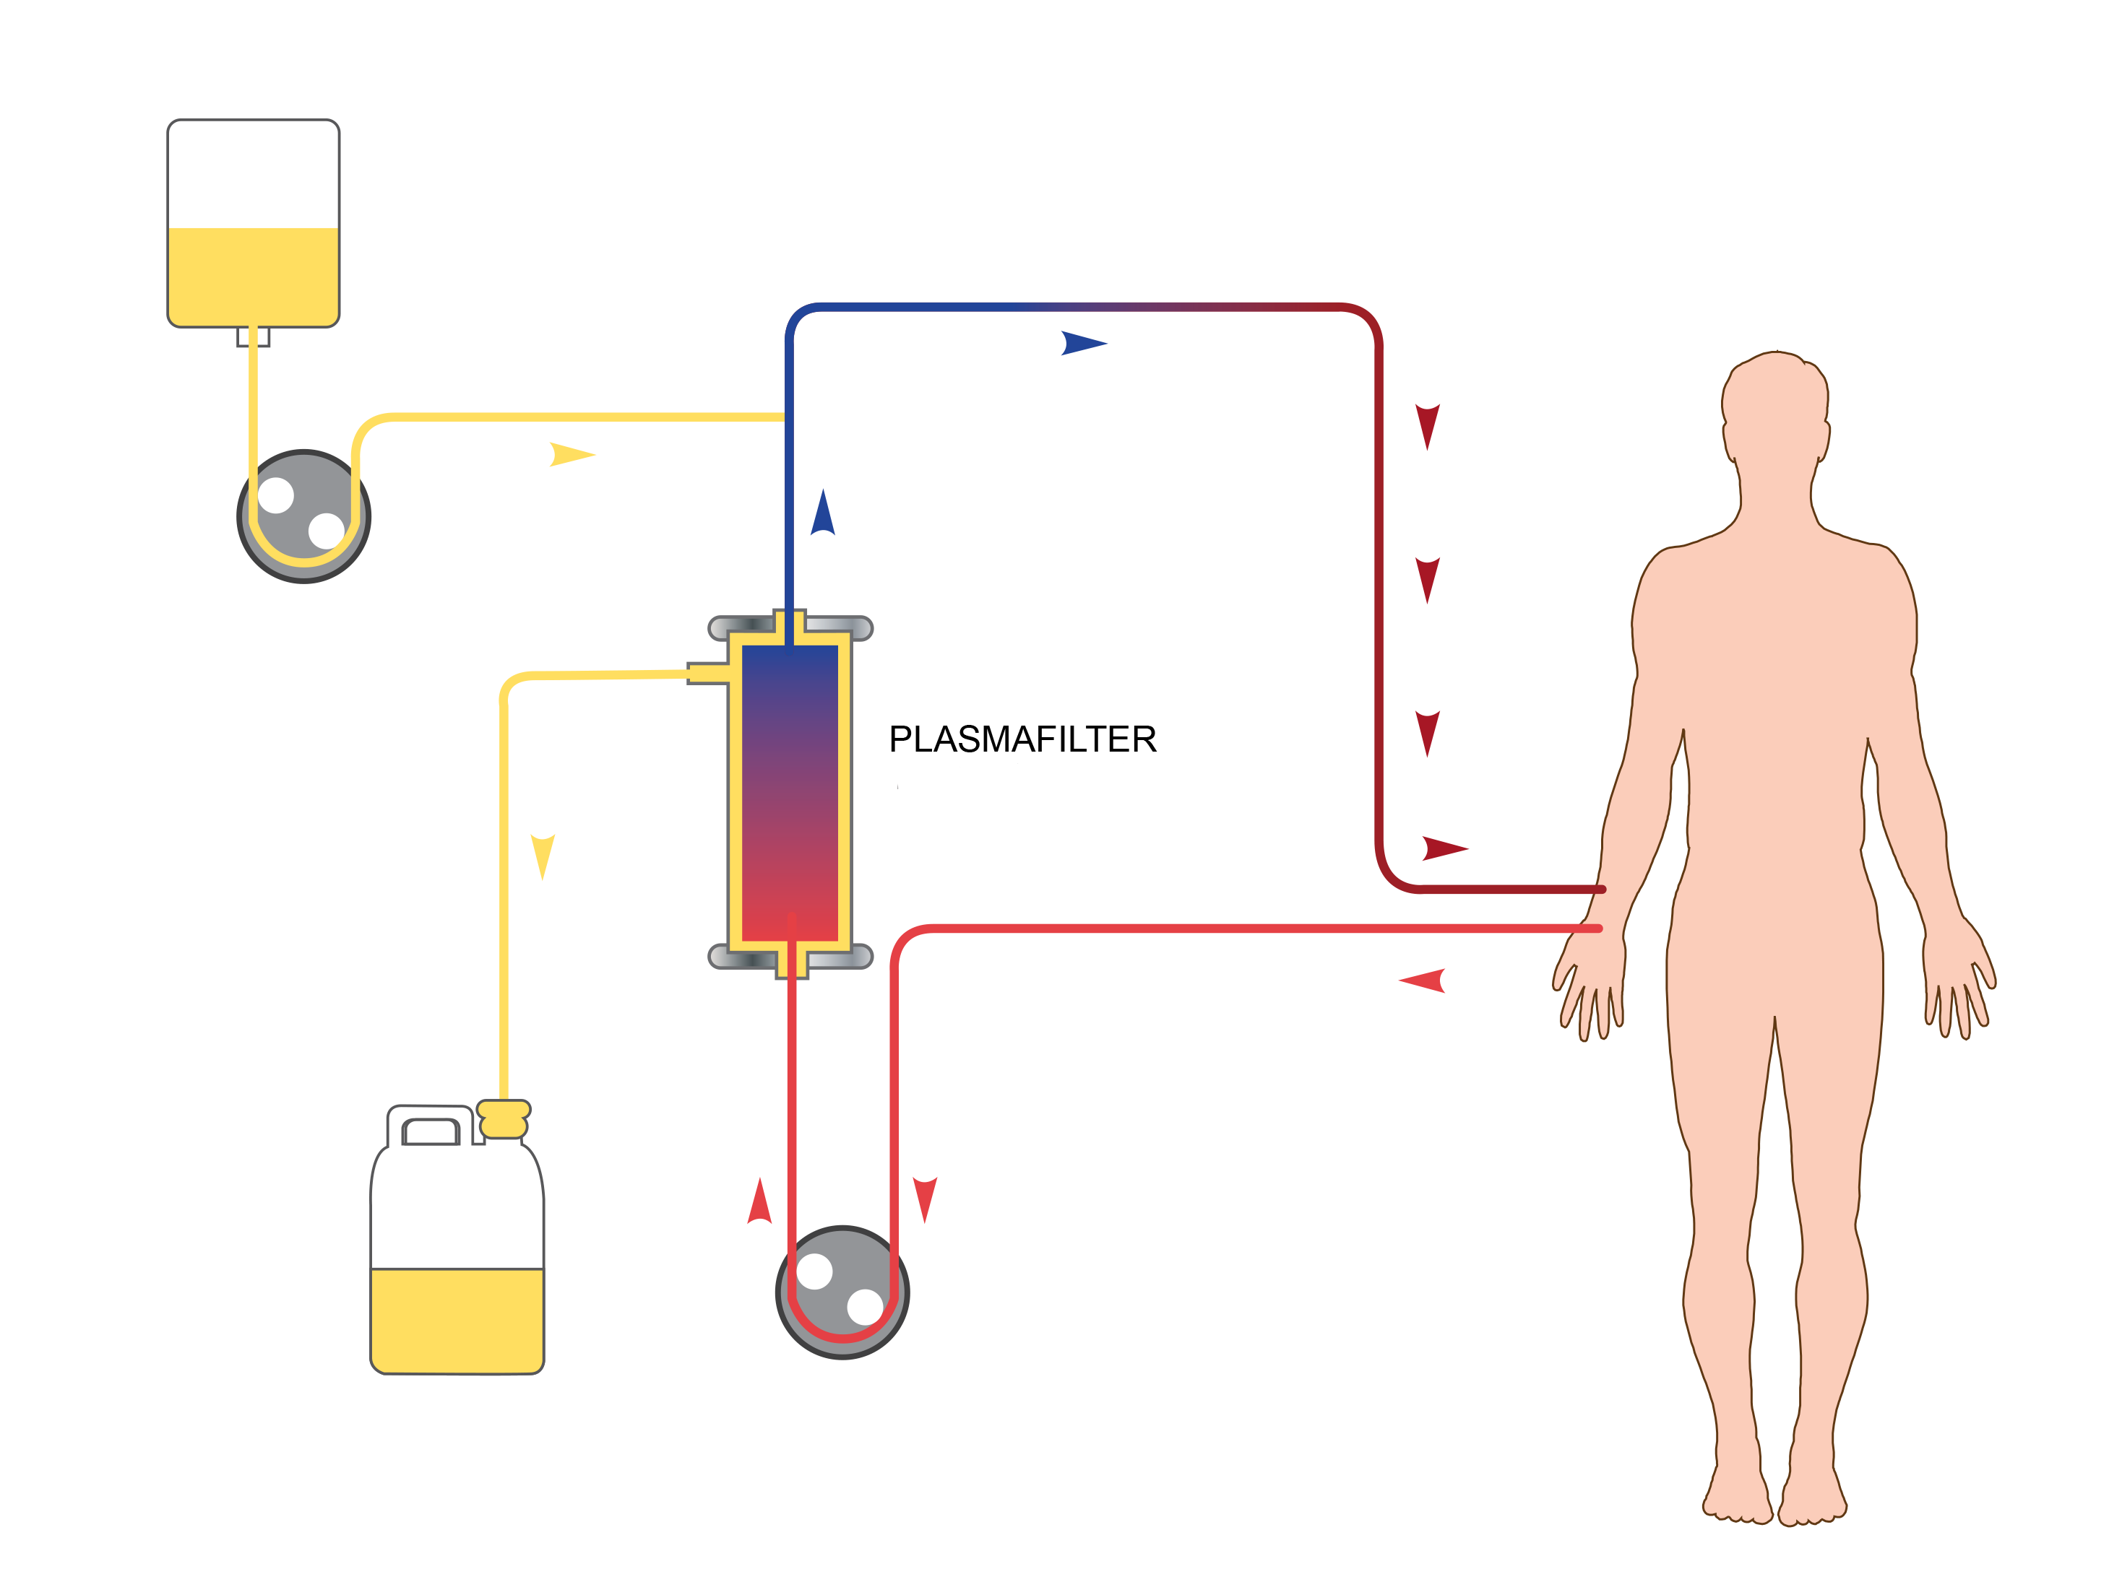
plasma exchange circuit
Substitution fluid
Plasma separator
Bad plasma with bad antibodies

Slide 10
Plasma volume calculation
1 plasma volume - 0.065 x Weight x (1-Hct)
e.g
1 plasma volume in a 60kg man
0.065 x 60 x (1- 0.40) = 2.34 L
1.5 plasma volume = 1.5 x 2.52 = 3.51 L

Slide 11
Replacement fluids
Human Albumin 5% (either whole replacement or ¾ albumin and ¼ saline)
Normal saline
FFP (in TTP where need to replace ADAMTS13, in cases of pulmonary haemorhage or pre or post op)
* For DFPP – replacement volume is 20% of target plasma volume
e.g. if 3L then 600ml

Slide 12
Prescription
Qb 100-150 ml/min
Time – based on target plasma volume
  Plasma pump – 25ml/min
  If 3000 ml/ 25 = 120 min

Slide 13
Immunoglobulin compartmental shifts and rebound
☞
IgG (most auto-antibodies) – only 45% of IgG is intravascular, and within 48 hours, plasma IgG returns to approximately 60% of the pre-apheresis level.
production also show "rebound" phenomenon, and cessation of TPE after several procedures can result in pretreatment or even higher levels of IgG, especially if the patient is not on immunosuppressive therapy.
So need rigorous regimen involving several TA procedures and the institution of immunosuppressive therapy are important to significantly reduce IgG levels.
IgM – 75% of IgM is intravascular. As a result, only one or two procedures are usually required to rapidly reduce IgM levels.

Slide 14
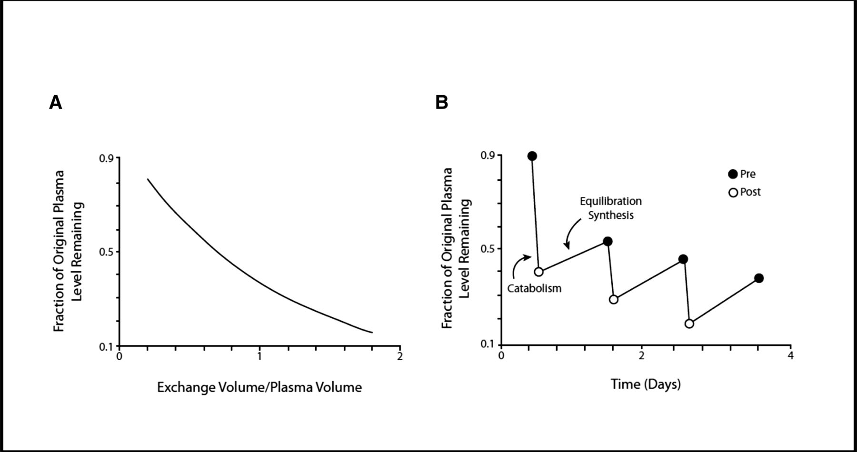
How much immunoglobulins removed per session
Redistribution from extravascular to intravascular
Ig levels rebound after each PLEX sessions!
1 plasma volume
60%
1.5 plasma volume
75%
More plasma volume – not much difference plus more longer PLEX
5 sessions over 7-10 days will remove 90%

Slide 15
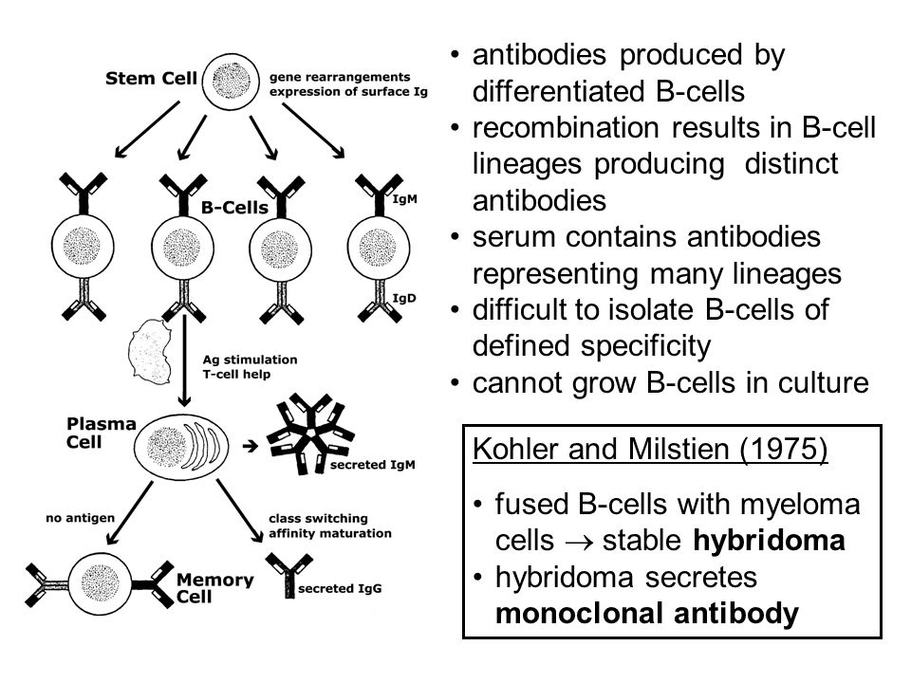
How to lower immunoglobulins
Immunoglobulins
Production by plasma cells
Redistribution – immunoglobulins not only intravascular
Lower it by
Chemotherapy or immunomodulation
Plasma exchange

Slide 16


Thanks for watching!
renaluitm.com

