Slide 1
Fluid Overload in Dialysis Patients
Dr Muhammad Iqbal Abdul Hafidz
UiTM Sg Buloh

Slide 2
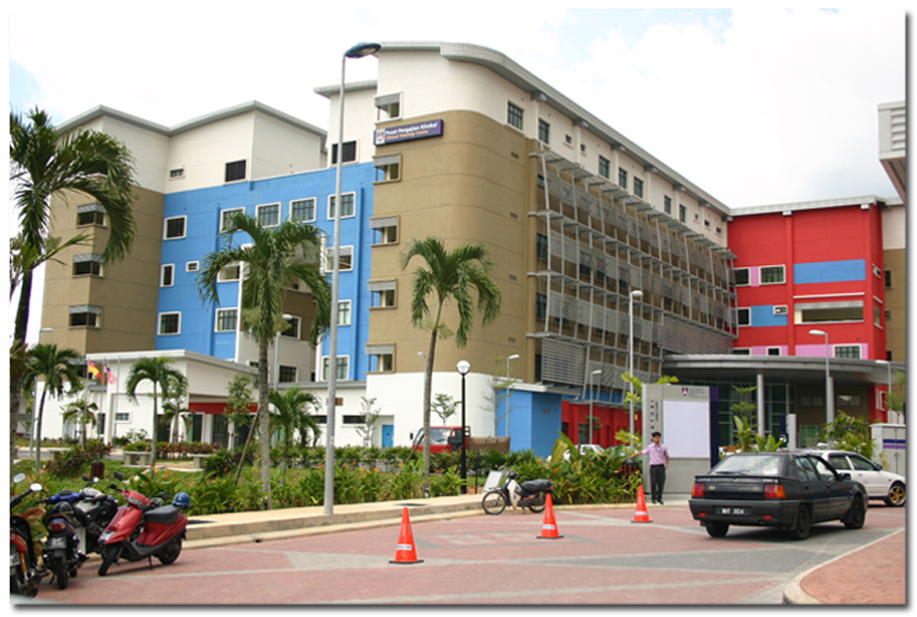
Renal UiTM

Slide 3
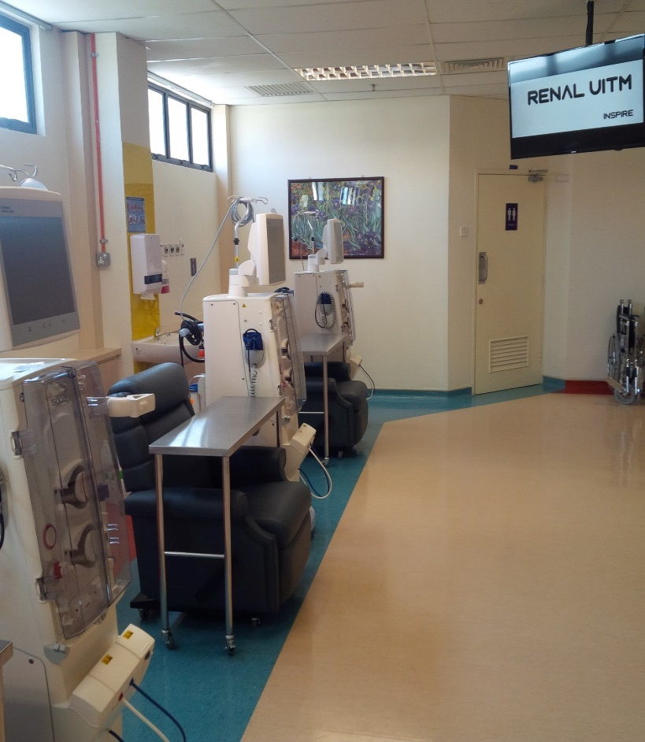
Fully HDF

Slide 4
Peritoneal Dialysis

Slide 5
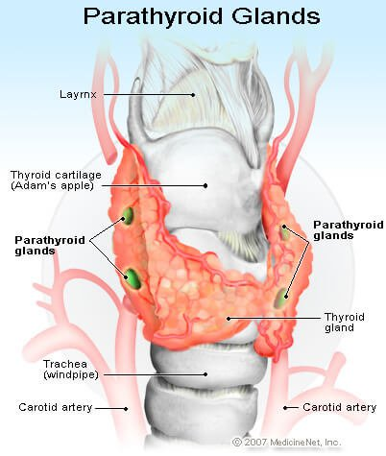
Services Provided
HDF
PD
Tenchkoff Catheter
IJC and perm catheter
Clinic
Ward
Parathyroidectomy
AVF
Transplant - 2017

Slide 6
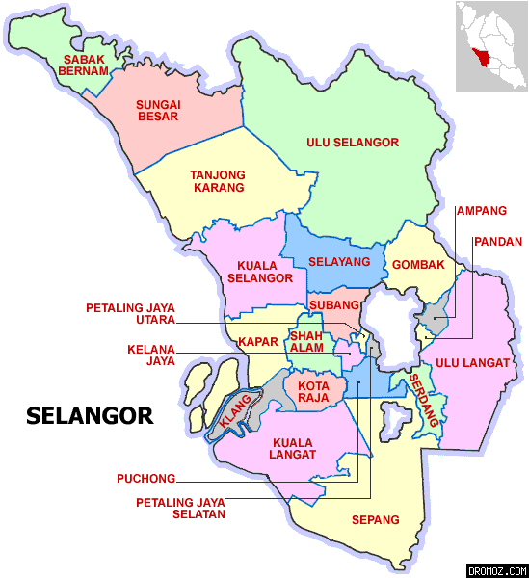
Future
Selayang
Puncak Alam
Teluk Intan

Slide 7
Future

Slide 8
Future

Slide 9
Outline
Fluid overload (hypervolaemia) - pathophysiology
Overload symptoms
Hypertension
Dry weight
How to assess dry weight
Approach to overload patients

Slide 10
Fluid compartment

Slide 11
Fluid compartment

Slide 12
Dry Weight
Dry weight is defined as the lowest weight a patient can tolerate without
the development of symptoms - cramps
hypotension

Slide 13
Fluid overload
Weight above the dry weight

Slide 14
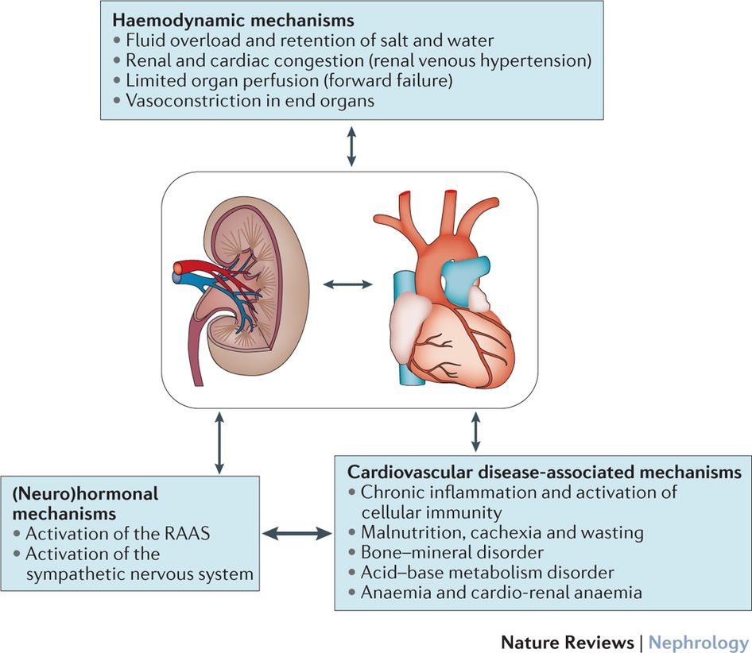
Hypervolaemia (Fluid overload)

Slide 15
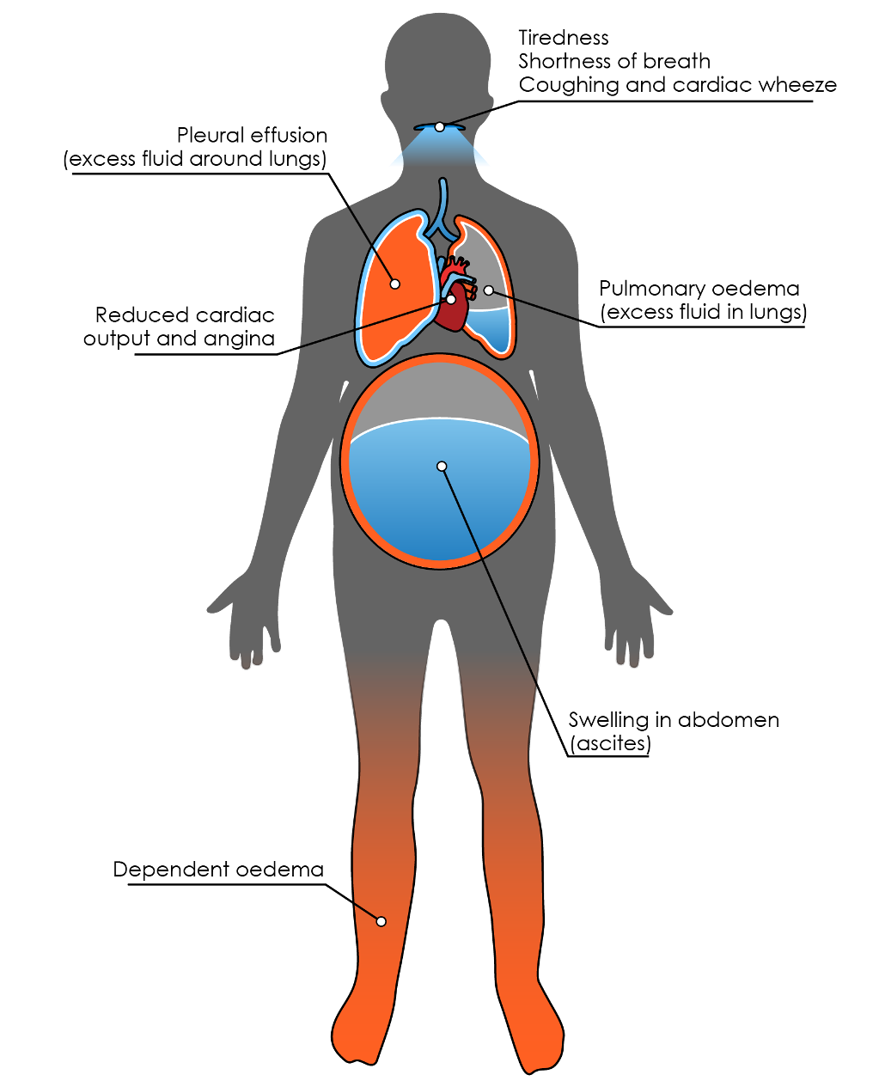
ESRF

Slide 16
Symptoms of overload
SOB
Orthopnea – breathless on lying flat
Lower limb swelling
Ascites
Generalized oedema

Slide 17
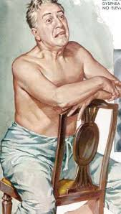
Symptoms

Slide 18
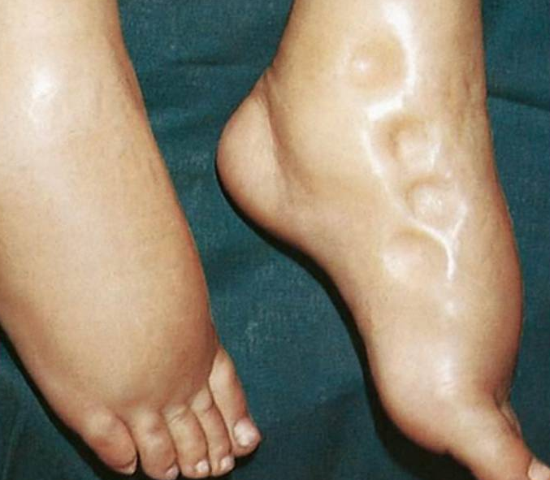
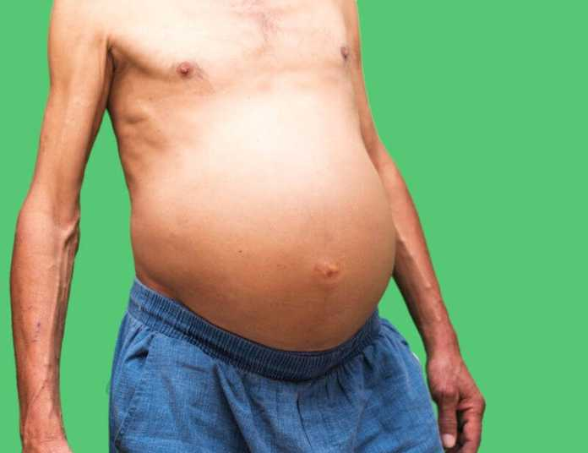
Symptoms

Slide 19
Clinical examination

Slide 20
Consequences of fluid overload
Hypertension
Cardiomyopathy

Slide 21
Hypertension
BP > 140/90

Slide 22
Hypertension
Causes of hypertension in ESRF
Fluid overload (80%)
High renin activity
Overactive sympathetic activity

Slide 23
Risks of hypertension

Slide 24
The heart in overload

Slide 25
Cardiomyopathy and LVH

Slide 26
Investigation
CXR
IVC
BNP
Bio-impedence
Blood volume monitoring

Slide 27
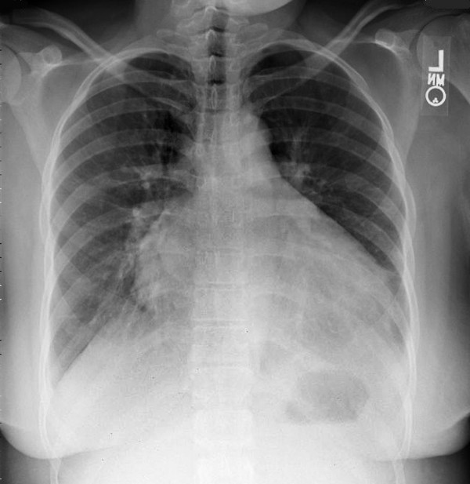
CXR - cardiomegaly

Slide 28
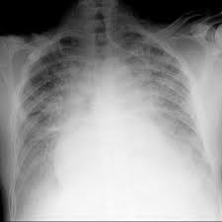
CXR – pulmonary oedema

Slide 29
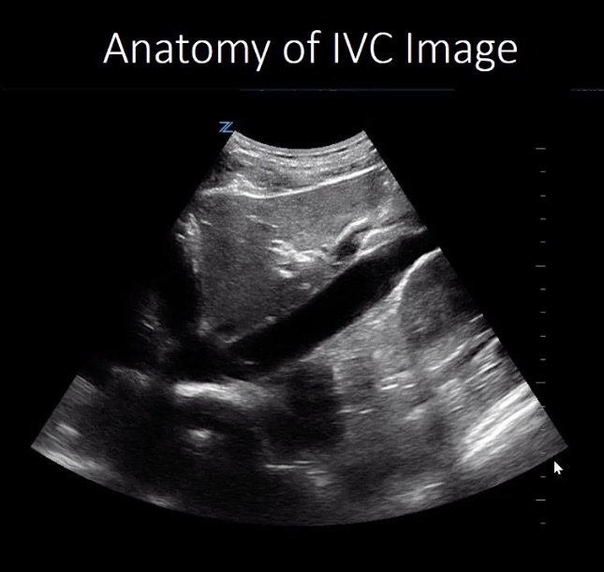
Inferior vena cava (IVC)

Slide 30
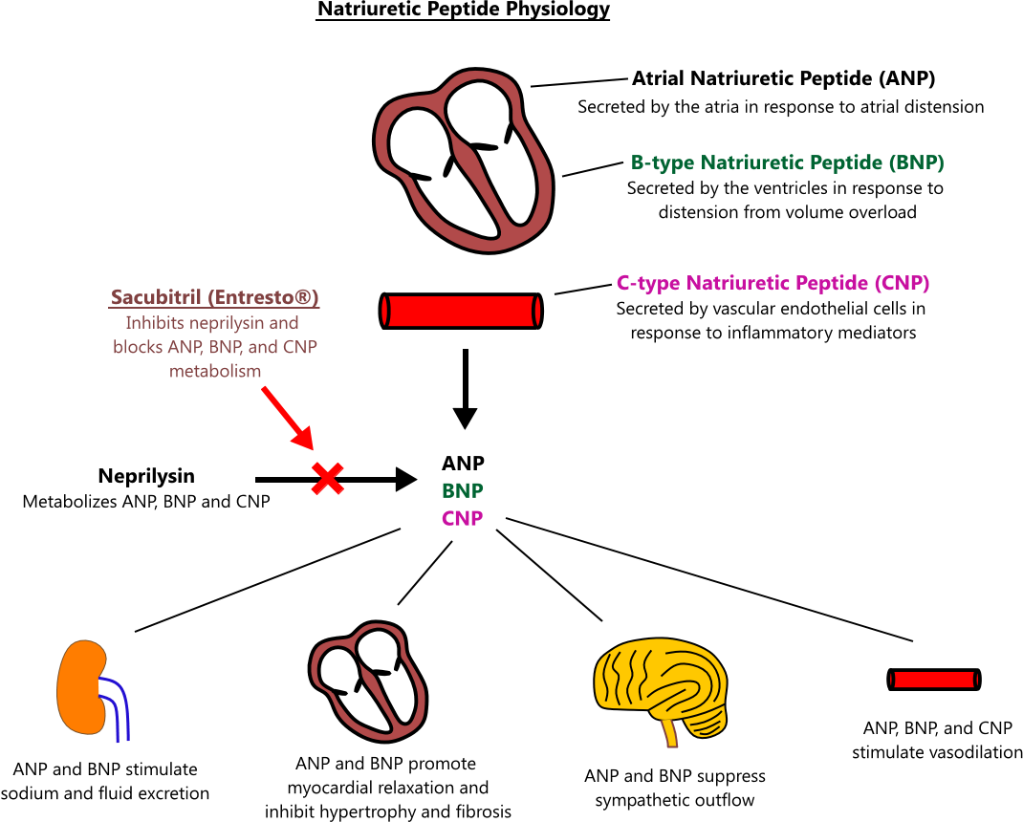
ANP/BNP
Atrial natriuretic peptide (ANP) and B-type natriuretic peptide (BNP) released by cells of the heart in heart failure

Slide 31
Bioimpedence
Non-invasive measurement of body fat, lean muscle mass and hydration
A small current is used to measure the resistance at difference frequencies against the various tissues in the body
Fat/lipid has a high resistance to the flow of current, therefore shows a high impedance reading.
Lean muscle and water are good conductors of current, therefore will show low resistance or impedance readings.

Slide 32
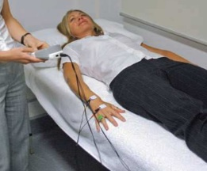
Bioimpedence

Slide 33
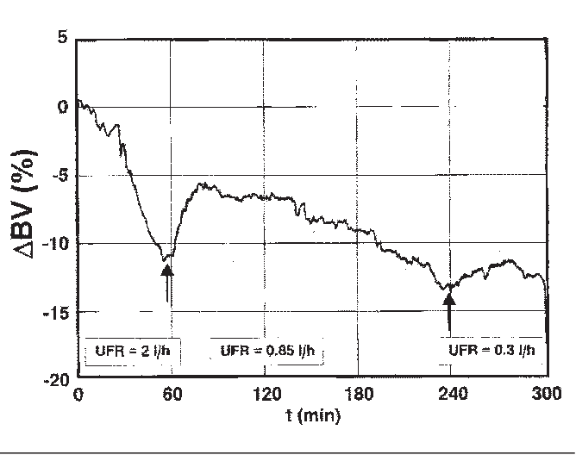
Blood volume monitoring (BVM)
Based on the Haematocrit

Slide 34
Dry Weight
Dry weight is defined as the lowest weight a patient can tolerate without
the development of symptoms - cramps
hypotension

Slide 35
Assessment of DWT
Symptom
BP
Weight
JVP
Oedema
Ascites
Lungs

Slide 36
Intradialytic Weight Gain
<4% of total body weight
Weekend ~4% over the weekend interval

Slide 37
Approach to overload patients
Diagnose
History
Symptoms
Determine the cause of overload
Meds – anti-hypertensives
Investigate
HD to dry weight
Counselling

Slide 38
Causes of overload
Non-compliance to fluids
High salt diet
Incomplete dialysis
Inaccurate dialysis prescription
Cardiac problems
Liver disease

Slide 39
Counselling
Fluid intake – UO + 500cc/day
Reduce salt intake - 2.3g day = 1 teaspoon daily
Diet – soup (hidden water)
Talk about heart complications!!!! Which can cause early death!

Slide 40
Treatment
HD to Dry Weight over 2-3 weeks
UF not more than 3L (with ROF)

Slide 41
Summary
Fluid overload (hypervolaemia) increases mortality of ESRF patients
Hypervolaemia causes cardiac disease and hypertension
Important to understand dry weight and how to achieve it

Slide 42
Thank you! Be our friend – Renal UiTM
https//: renaluitm.com

