Slide 1


Improving patient outcome in haemodialysis: conventional, short daily or nocturnal HD
Dr Muhammad Iqbal Abdul Hafidz
UiTM, Sungai Buloh
PGRSM 2019 HKL
Notes:
Tq v much. My name is iqbal. I am a lecturer in nephrology from UiTM Sg Buloh.
First and foremost I would like to thank PGRSM especially Dr Rosna for inviting me to this workshop. I am really happy to be here becoz its my first time and also I like my dialysis.

Slide 2
Outline of my talk
Few important concepts
Compare conventional and frequent dialysis
FHN trials
This talk can be downloaded at renaluitm.com

Slide 3
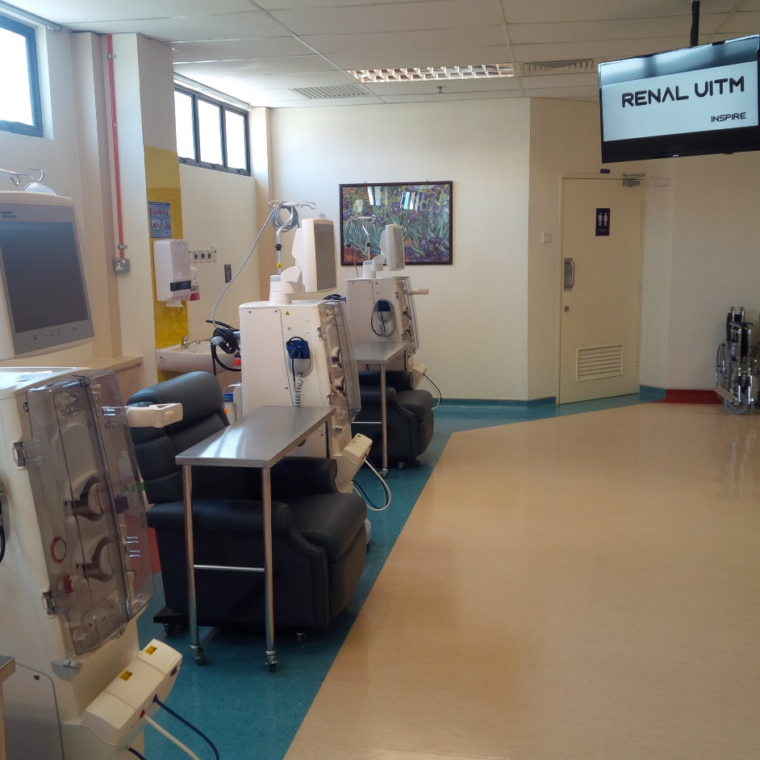
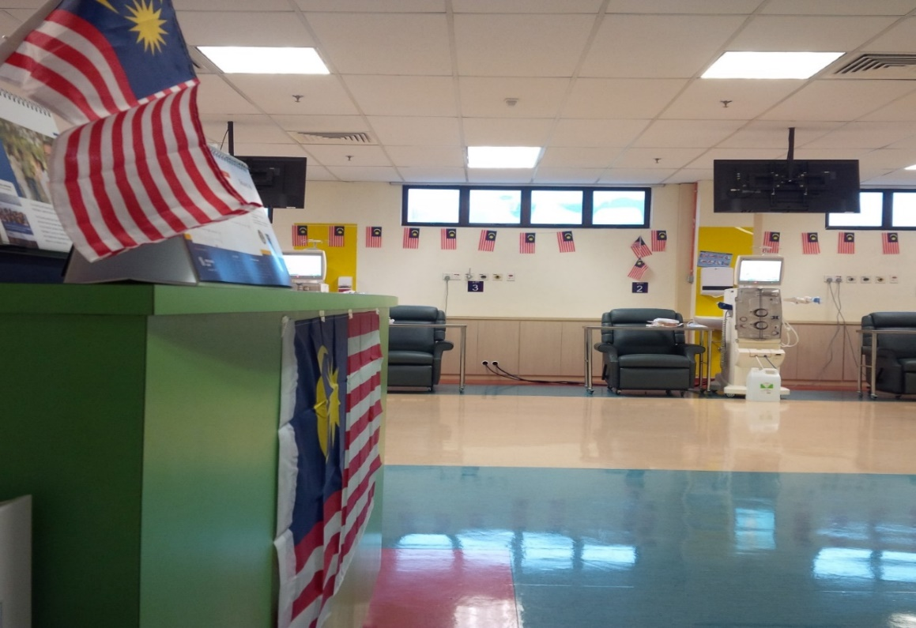
Fully HDF Unit

Slide 4
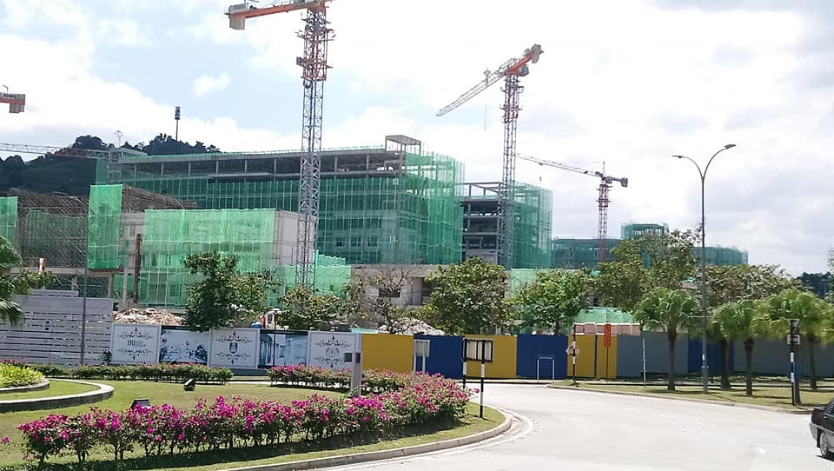
Hospital Universiti UiTM Puncak Alam – April 2020

Slide 5


Hospital Universiti UiTM Puncak Alam – April 2020

Slide 6
#3 important concepts!

Slide 7
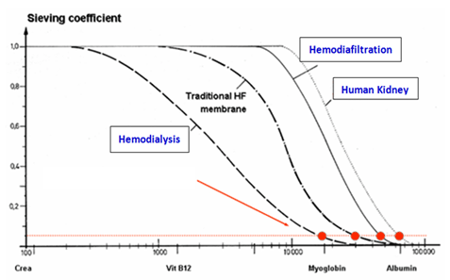
#1. HDF, High Flux, MCO
Modifying the dialyzer and process of dialysis.
Objective – to remove wider range (larger sizes) of uraemic toxins
Sieving coefficient
HDF
High Flux
Kidney/GBM
Low Flux
Notes:
It is important to differentiate between HF, HDF and MCO and frequent and extended HD
Above aims to shift the sieving coefficient so it becomes as close as the kidney/GBM
As a result the aim is clearance of solutes of a wider range especially the larger middle molecules
Freqeunt and extended HD is all about increasing the intensity or dose od the given dialysis

Slide 8
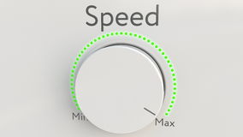
Frequent HD
Increasing the dose of dialysis!
Dose

Slide 9
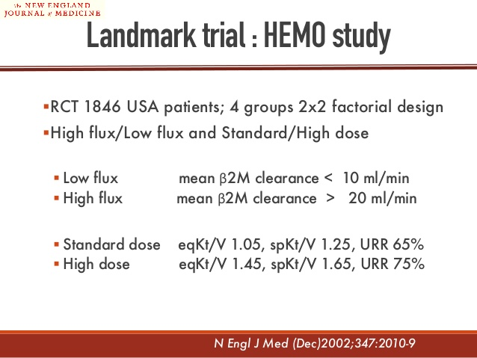
HEMO study?
It showed that increasing the dose of dialysis did not confer any benefit.
So why bother?

Slide 10
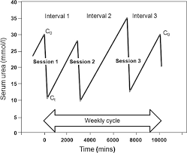
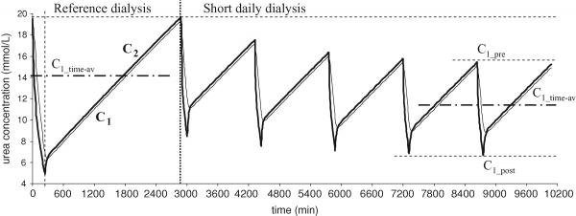
Why we should increase dose of dialysis
Logically more dialysis should be better
Intermittent HD - rebound of urea and other uraemic toxins, potassium, fluid control/IDWG
Kidney is a continuous form of dialysis
Notes:
Logically increasing the dose of dialysis should be better!

Slide 11
#2. Kt/V and clearance
Single pool spKt/V (Kt/V) is what we use to assess dialysis adequacy
It is essentially assessing urea clearance in a single session of HD
Urea is used – good surrogate - small molecule, easy to measure
Notes:
To understand frequent dialysis you need to understand Kt/V and standardized kt/v
At end of HD BUN from blood (first pool)
Not in other compartment (tissue, muscles) – second pool
Urea diffuse to blood to equilibrate takes about 45-60 mins resulting in lower Kt/V

Slide 12
Kt/V
Simple, easy to modify
K – dialyzer clearance of urea
t – dialysis time
V – volume of distribution of urea, approximately equal to patient's total body water
Kt
v

Slide 13
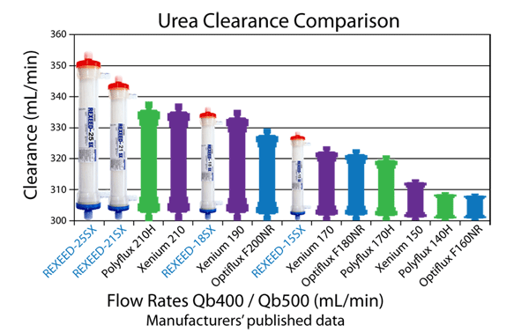

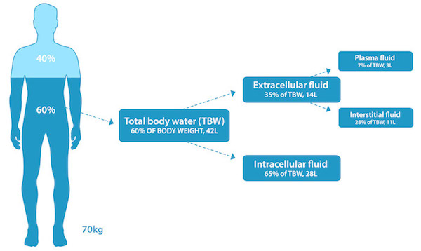
Kt
v
Notes:
If the dialyzer’s clearance (K) is known (based on the packet insert provide by the manufacturer at a Qb of 400ml/min) and is 250 ml/min and the dialysis session time is 240 minutes (4 hours)
then Kt (dialysis dose)= 250 x 240 = 60,000ml or 60 liters
If the patient weighs 70kg. His TBW is 60% of 70kg
then V = 70 kg multiplied by .60 = 42 liters
So the ratio – K multiplied by t to V, or Kt/V – compares the amount of water that passes through the dialyzer and is cleared of urea to the amount of water in the patient’s body.
KT/V for this patient will be= 60/42 = 1.42
Caveat: If this same patient has 3 kg of edema fluid (EDW of 70kg) then V = 60% (70kg)+ 100%(3kg)= 45L and not 42L. This is because edema fluid adds to the TBW in its entirety as urea distributes evenly across body water.

Slide 14
Standardized Kt/V
Kt/v - measures the effectiveness of a single treatment.
Not the most accurate
A continuous clearance equivalent is needed.
Std Kt/V estimates the weekly effectiveness of a dialysis regimen.
Can be used to compare any dialysis schedule
COMPLEX!!
Need a std Kt/V calculator available online
Notes:
Not the best way of measuring continuous

Slide 15
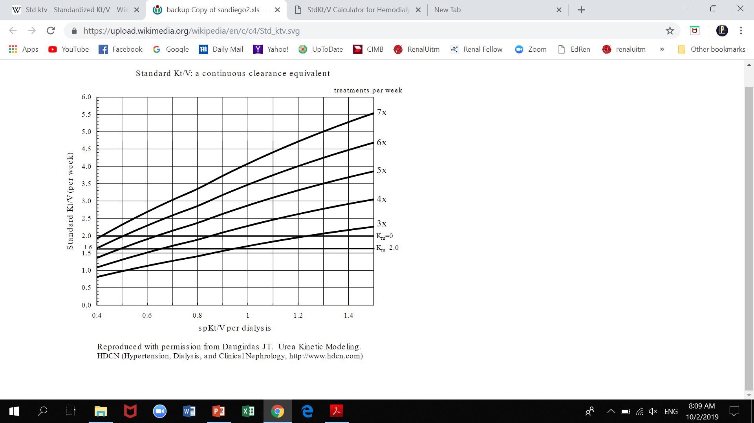
Relationship between Kt/V and standardized Kt/V
Notes:
Relationship not linear
Plot relating standardized Kt/V, Kt/V and treatment frequency per week.

Slide 16
Kt/V
HEMO study
Notes:
Plot relating standardized Kt/V, Kt/V and treatment frequency per week.

Slide 17
HEMO comparing spKt/v
stdKt/V showed that dose (intervention) based on spKt/V between intervention and control group were too small and results were likely to be negative!
Notes:
Relationship not linear
Plot relating standardized Kt/V, Kt/V and treatment frequency per week.

Slide 18
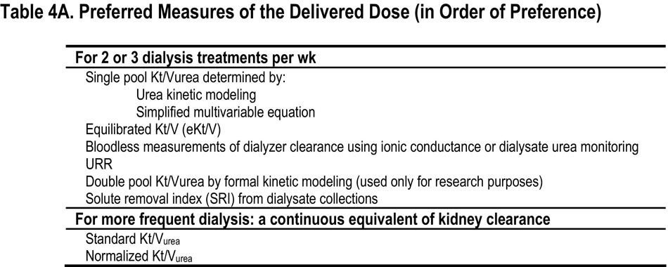
Kt/V
KDOQI Guidelines
Notes:
Relationship not linear
Plot relating standardized Kt/V, Kt/V and treatment frequency per week.

Slide 19
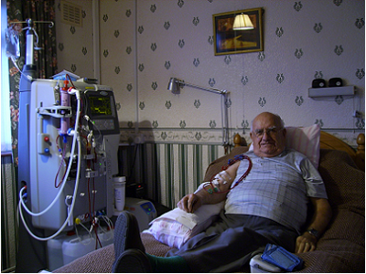
#3. FD and SDHD - Home Haemodialysis
Frequent HD is designed for home HD programme!!
Notes:
Listen to this talk as if u will become HoU, state nephrologist or HoS.
Decide this is something novel or something to consider, applicable
Home HD – totally new ball game, effort infrastructure, patient training

Slide 20

Home Haemodialysis in Malaysia
Patient
Staff
Infrastructure
Economic costs
Notes:
Money is probably worth investing in more hospital dialysis or PD or transplant

Slide 21
Home Haemodialysis in Malaysia
Medical staff
  Nephrologists and nurses have to BELIEVERS!
Patient
  Patients and carers have to BELIEVERS!
  Training! – cannulate, prime, dialysis related emergencies
Infrastructure
  New training unit, staff, home plumbing and electrical system
Economic costs
  Contractors, building costs
Notes:
Money is probably worth investing in more hospital dialysis or PD or transplant

Slide 22
Exit exam Q
If you were the state nephrologist and was given a RM10 million budget, would you set up home haemodialysis?

Slide 23
FHD and SDHD – novel or applicable in Malaysia?

Slide 24
Difference Modalities
MODALITY | Sessions/week | Duration/session (hours) | Qb | Qd
DAYTIME
Conventional | 3 | 3-5 | 300 | 500
Long Day Intermittent (Tassin) | 3 | 6-9 | 300 | 500
Short Daily | 6-7 | 1.5-3 | 400-500 | 500-800
NOCTURNAL
In-centre | 3 | 8 | 300-400 | 500
NHHD - Daily | 5-7 | 6-10 | 200-350 | 200-300
NHHD – Alternate days | 3 | 8 | 300 | 500

Slide 25
NCDS
The NCDS was a RCT between 9 renal units and first RCT in haemodialysis.
The patients' mean age was 49, on dialysis for an average of 4.2 years.
Half were white, there were no diabetics, many were taking androgens for anaemia in the pre-erythropoietin era.
151 patients were randomised to two different time average concentrations (TAC) urea (adjusted by varying dialyser size and flow rates), and to two different durations of dialysis (2.5-3.5h and 4.5-5h three times weekly), in all 4 possible combinations, for 6-12 months.
Lowrie. Effect of the haemodialysis prescription on patient morbidity (NCDS). NEJM 1981

Slide 26
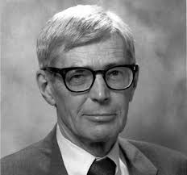
NCDS
Increased morbidity appears to accompany prescriptions associated with a relatively high BUN.
Revisited NCDS
Came up with Kt/V
Kt/v < 1.0 associated with poor outcome¹
1. Gotch et al. A mechanistic study of NCDS. KI 1985
Frank Gotch and John Sargent

Slide 27

NCDS
Revisited NCDS
Recalculated and found that Kt/V <1 was actually <1.2
Kt/V < 1.2 associated with poor outcome¹
1. Keshaviah, P. Urea kinetic and middle molecule approaches to assessing the adequacy of hemodialysis and CAPD. Kidney Int. 1993; 43: S28–S38
Prakash Keshaviah
NKF-DOQI reviewed this and as a result recommended that the minimum adequate spKt/V was increased to 1.2

Slide 28
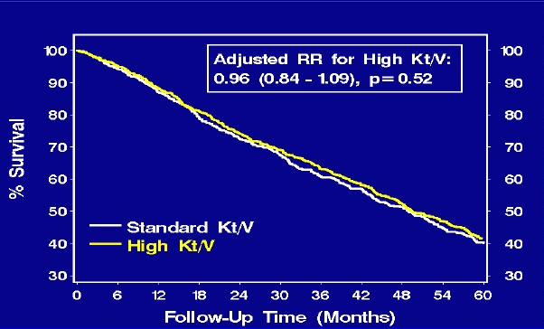
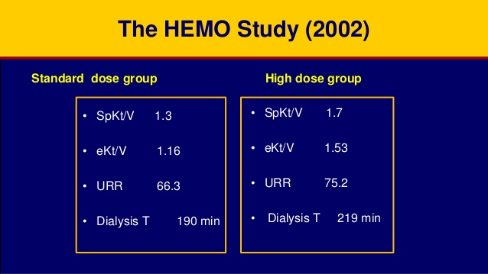
HEMO study (2002)
1846 patients, 3 x weekly HD

Slide 29
Conventional dialysis
From NCDS and HEMO study – dose established at
  3 x week
  3.5-5 hours per session
  Kt/V 1.2
Conventional prescriptions are also influenced by
  Costs
  Convenience
  Patients acceptance

Slide 30

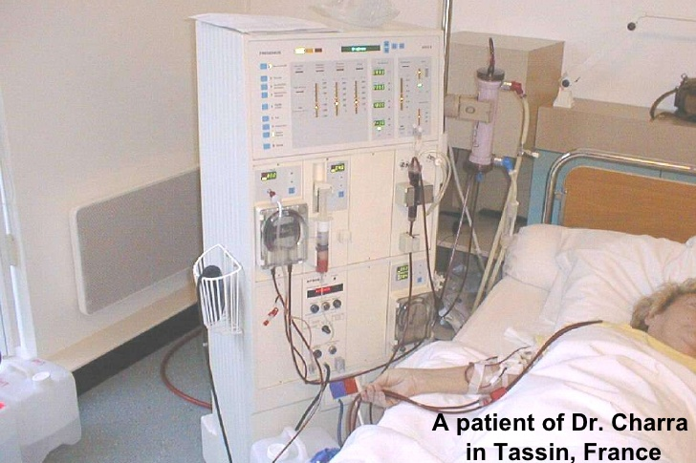
Tassin experience – Long haemodialysis
3 x 8 hours/week, has been used without significant modification in Tassin, France since over 35 years
Treatment method for almost all patients whether in the unit or at home
Studies from Tassin show
  Lower mortality
  BP control
  Low incidence of intradialytic hypotension

Slide 31
Small, observational studies - Frequent dialysis
Recovery time reduced
Less heparin used
Less dietary restrictions
Less fluid restrictions
Better BP control
Less intradialytic hypotension
Better anaemia control
Better LVH
ALL WHICH MAY BE MORE IMPORTANT THAN KT/V IN PROGNOSIS
Notes:
Relationship not linear
Plot relating standardized Kt/V, Kt/V and treatment frequency per week.

Slide 32
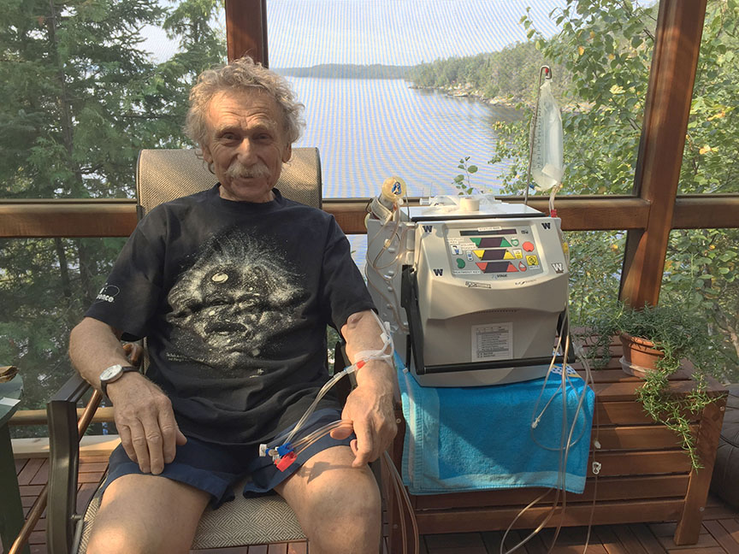
Frequent dialysis (done as home HD) – Lifestyle benefits
Convenience and flexibility
Fewer trips to HD centres
Nocturnal HD frees up the day

Slide 33
Frequent Haemodialysis Network Group (FHN)
2 trials
  Short Daily
  Nocturnal

Slide 34
FHN Short Daily

Slide 35
FHN Daily
250 patients
Followed up 12 months
Assessed 2 co-primary composite outcome
  Death or change in left ventricular mass
  Death or change in the physical-health composite (PHC) score of the RAND 36-item health survey.

Slide 36
FHN Daily

Slide 37
FHN Daily
3.6 hours
2.6 hours

Slide 38
FHN Daily

Slide 39
FHN Daily

Slide 40
FHN Daily

Slide 41
FHN Nocturnal

Slide 42
FHN Nocturnal
87 patients
3 times per week conventional hemodialysis v nocturnal home haemodialysis 6 times per week
Followed up 12 months
Assessed 2 co-primary composite outcome
  Death or change in left ventricular mass
  Death or change in the physical-health composite (PHC) score of the RAND 36-item health survey.

Slide 43
FHN Nocturnal
4 hours
6 hours

Slide 44
FHN Nocturnal

Slide 45
FHN nocturnal

Slide 46
FHN Nocturnal

Slide 47
Cons
Overall, any benefits of more frequent HD regimens definitely need to be balanced against potential harmful effects on vascular access, residual renal function and patient adherence to the prescribed therapy
Frequent HD also considerably increases the burden for patients and their caregivers, logistics and costs, especially with in-centre frequent schedules.

Slide 48
Exit exam Q
What is your opinion on frequent haemodialysis?

Slide 49
Conclusion
Frequent HD shown to have many benefits.
Frequent HD may increase access problems.
Frequent HD designed mainly for home haemodialysis.
Critically analyze a study. Study in HD is never easy. Negative result could be due to failure in methodology - choosing wrong intervention or small sample.

Slide 50






Thank you!
https//: renaluitm.com

Slide 51
More reading
https://homedialysis.org/news-and-research/blog/137-what-can-we-em-really-em-conclude-about-the-fhn-trials-and-mortality-on-frequent-hemodialysis

