Slide 1


High Volume HDF
Dr Muhammad Iqbal Abdul Hafidz
Consultant Nephrologist
UiTM, Sungai Buloh
QID 2018 PJ HILTON.

Slide 2
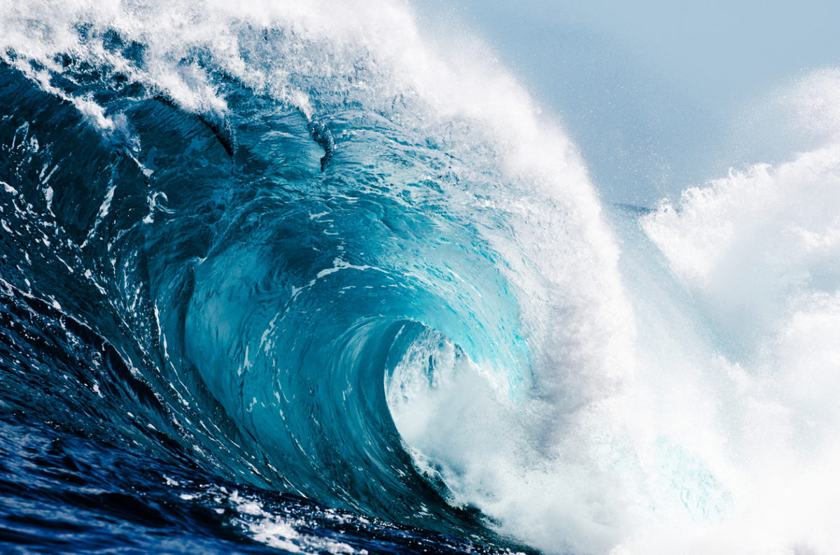
Disclosure - I am a believer in HDF

Slide 3
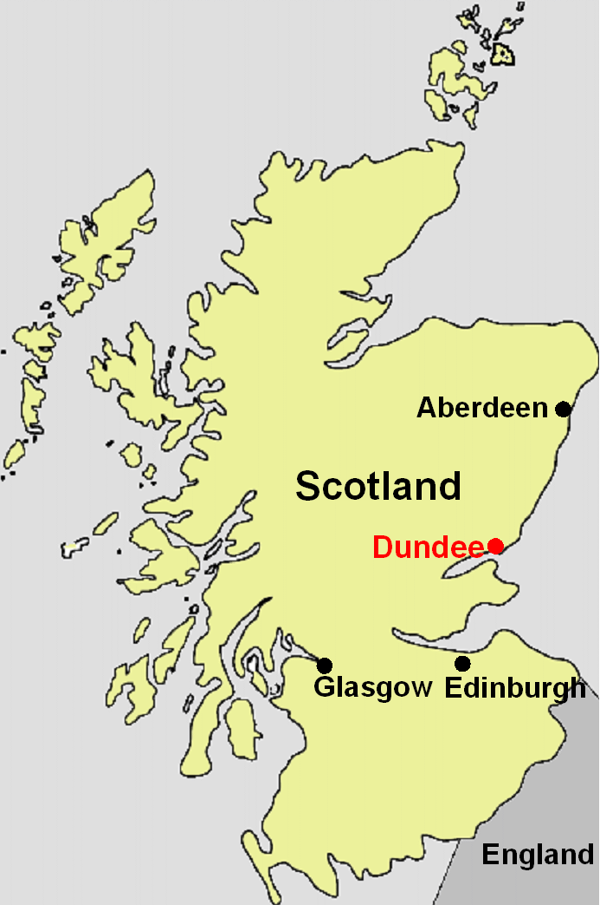
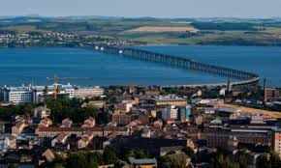
Dundee, Scotland

Slide 4
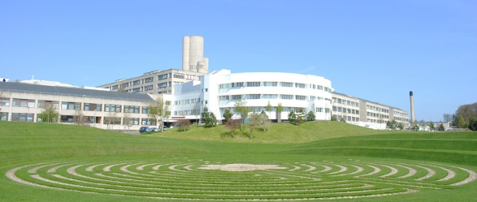
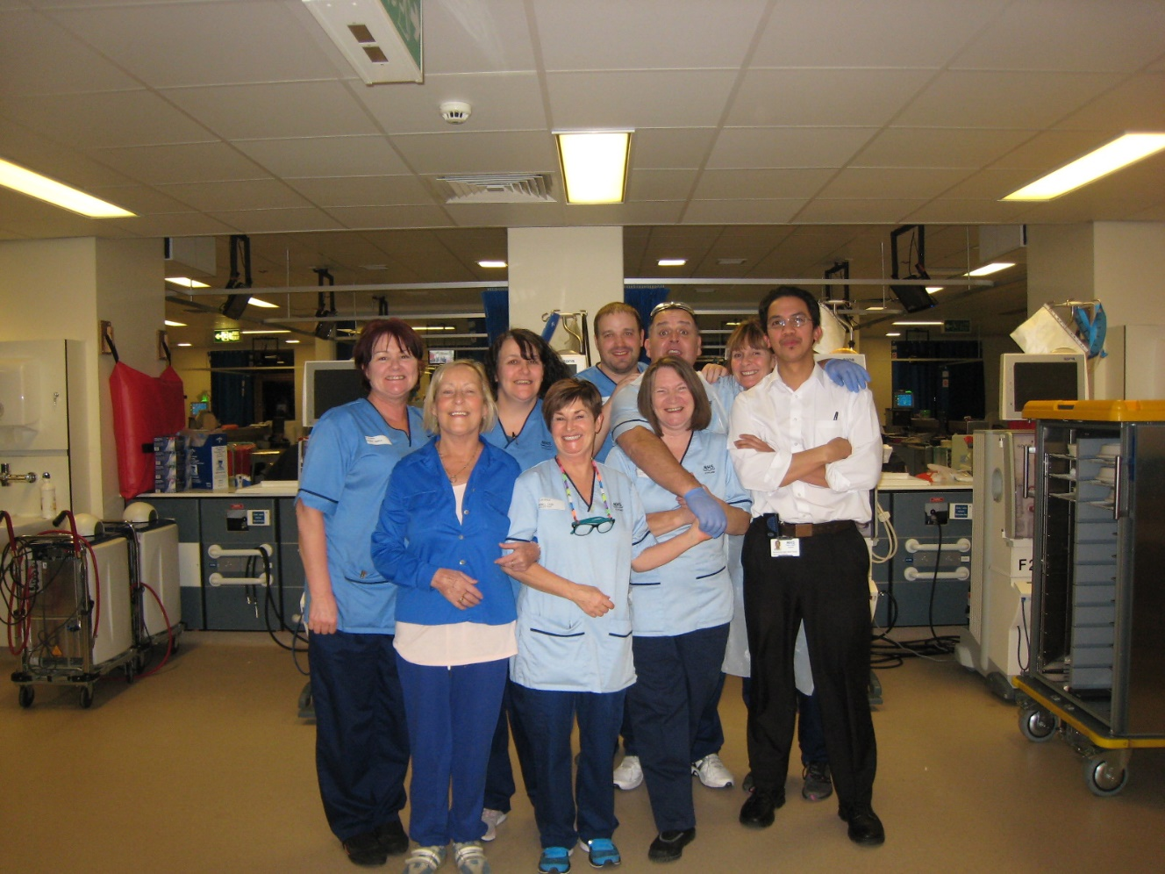
Ninewells Hospital, Scotland

Slide 5
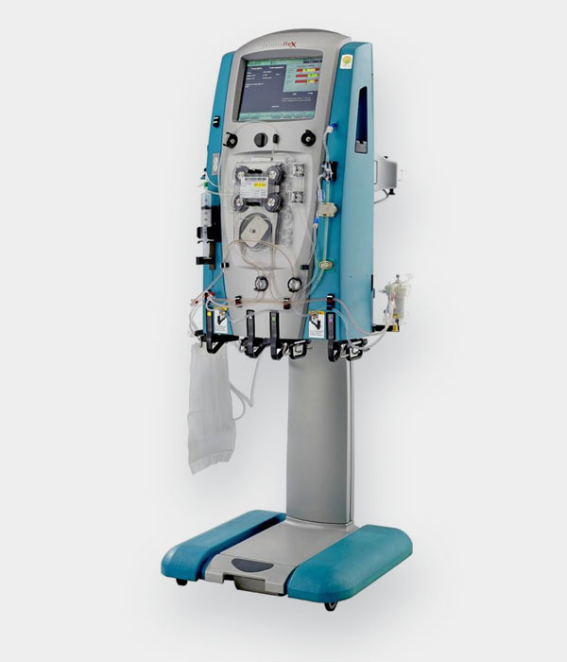
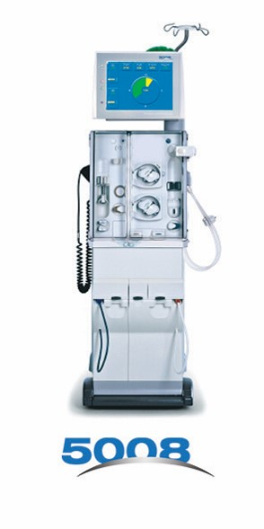
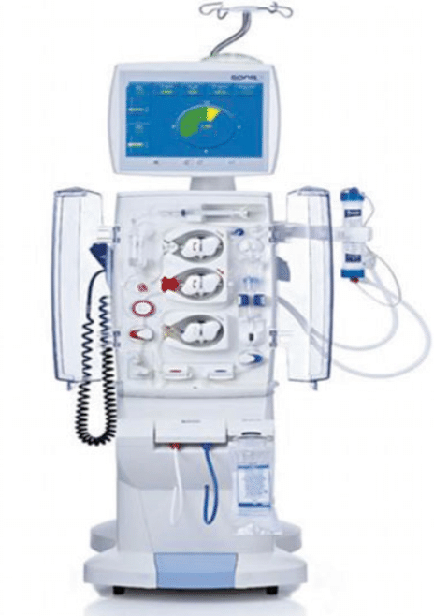
Introduction
CRRT
= HDF
= CVVHDF

Slide 6
Introduction
Principles of HDF
  Difference between HD and HF
HighVolume HDF

Slide 7
Concepts to understand
Haemodialysis + Haemofiltration = HaemoDiaFiltration
Have to understand a few concepts
  Clearance – Diffusion v Convection
  Ultrafiltration (UF)
  Substitution (Replacement)
  Substitution vs Convective volume
High-volume online-HDF

Slide 8
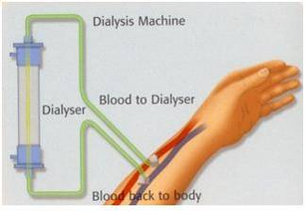
Haemodialysis
Objectives:
  To remove toxins
  To remove fluids

Slide 9
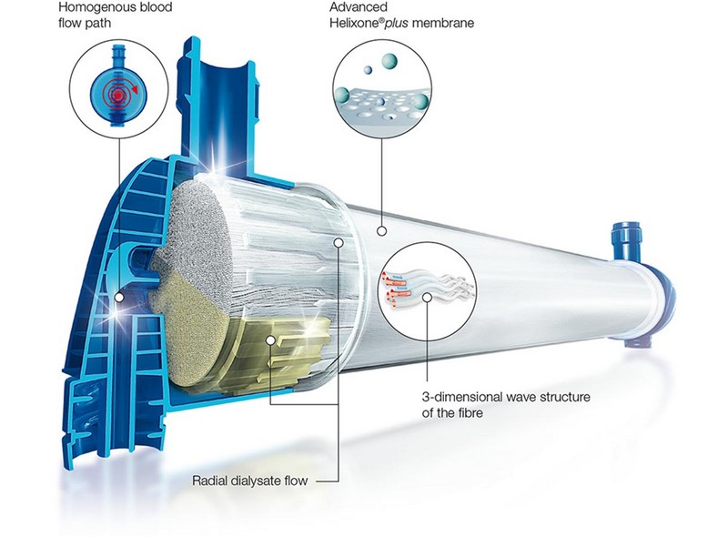
Dialysis
Occurs in dialyzer
Clearance
Ultrafiltration

Slide 10
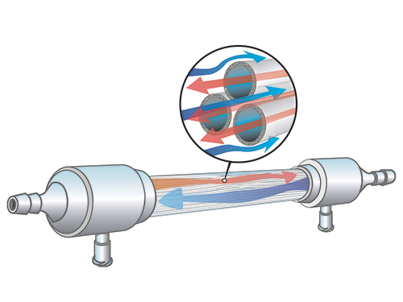
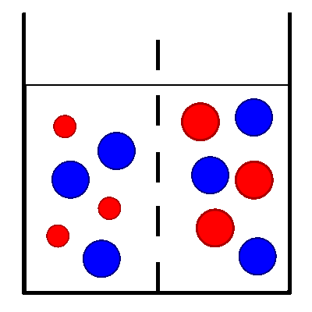
Dialysis
blood
dialysate

Slide 11

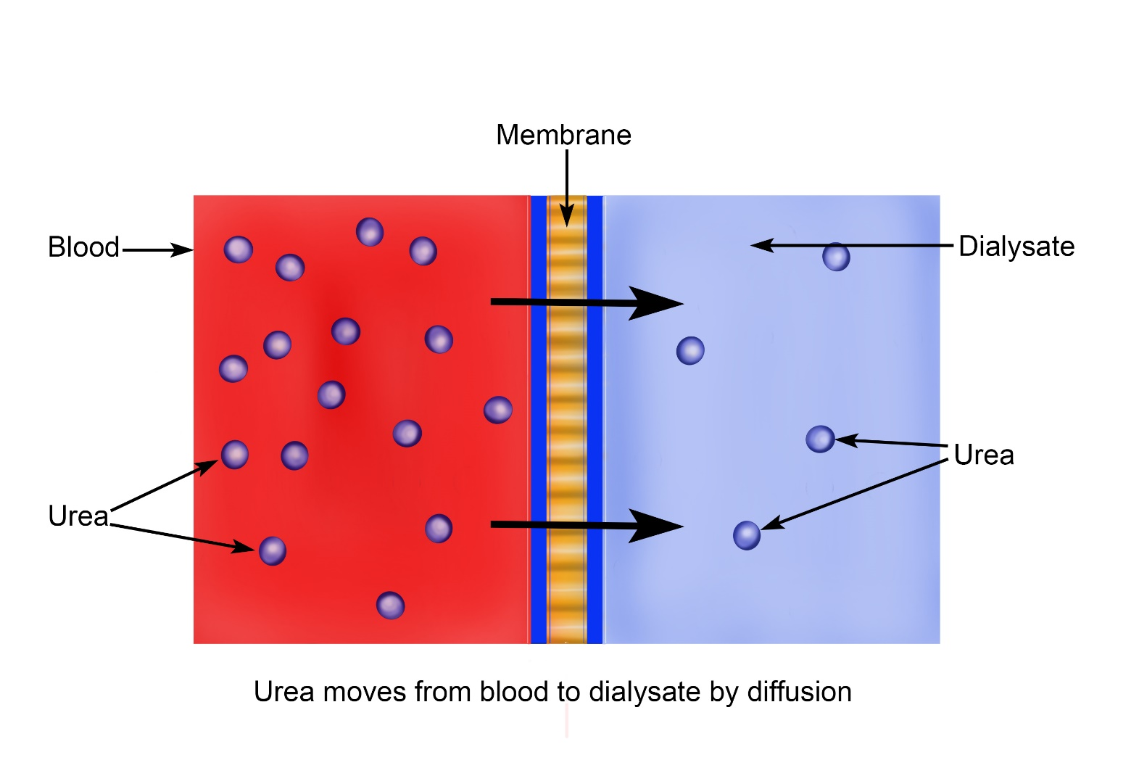
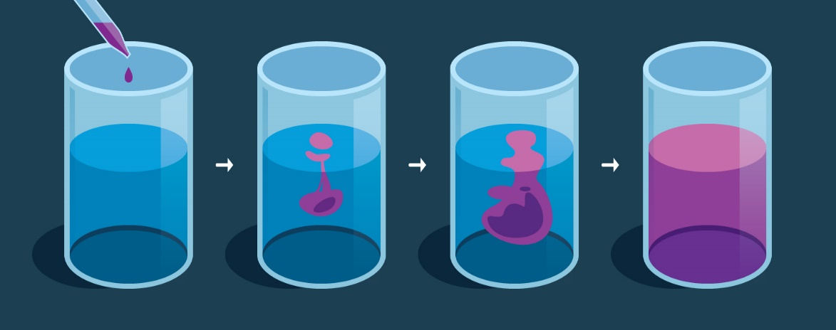
Toxin removal
Occurs in dialyzer
  Diffusion (resapan)
DIFFUSION

Slide 12
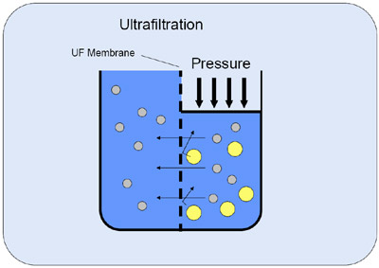
Ultrafiltration
Occurs in dialyzer
  Utrafiltration
TMP = Transmembrane pressure

Slide 13
Haemofiltration – 2 key points
Removal of LARGE VOLUME of fluid by ULTRAFILTRATION
NO DIALYSATE component

Slide 14
Haemofiltration
Semi-permeable membrane
Urea
NO DIALYSATE / EMPTY
BLOOD
DIALYZER

Slide 15
Clearance in HF – CONVECTION!!
LARGE VOLUME
CONVECTION
Solute drag

Slide 16
Haemofiltration
Proses sama seperti Ultrafiltration
Tanpa dialysate (macam isolated UF/ SUF)
UF yang dilakukan adalah jumlah yang besar
Dengan proses haemofiltration ini –proses penyingkiran toxin berlaku melalui proses “convection”
Berlaku di belakang tabir

Slide 17
Haemofiltration
If I ask you to do UF 4L per hour????

Slide 18
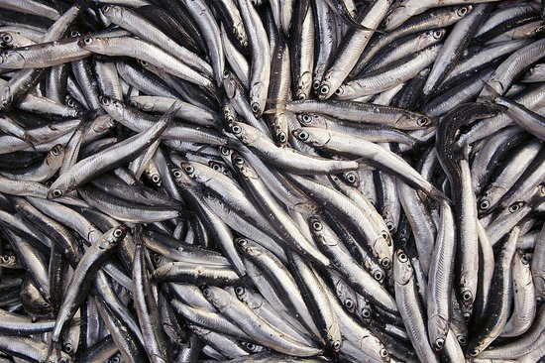
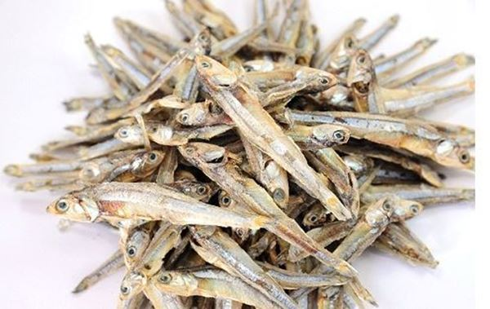
Substitution (replacement) Fluid
If large volume of UF is performed (e.g 4L in 1 hour)
  BP
Large volume of substitution (replacement) fluid is needed! AT THE SAME TIME

Slide 19
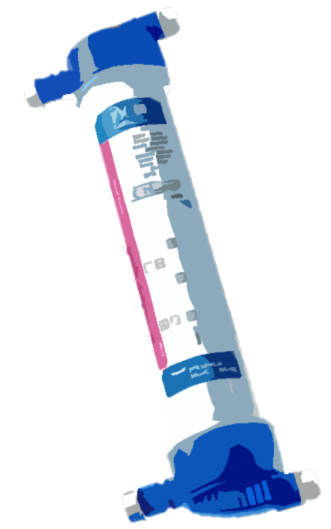
Clearance in HF – CONVECTION!!
Solute drag

Slide 20
Substitution (Gantian) Fluid
UF
Substitution
DIRECT INTO PATIENT
AT THE SAME TIME!
Di Belakang Tabir

Slide 21
Pre-filter
e.g. – Total 16L per session (4L per hour)
4L
4L
Di Belakang Tabir

Slide 22
Post-filter
e.g. – Total 16L per session (4L per hour)
4L
Di Belakang Tabir
4L

Slide 23
MIXED (Pre &Post-filter)
e.g. – Total 16L per session (4L per hour)
2L
4L
Di Belakang Tabir
2L

Slide 24
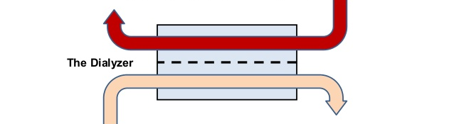
HD
BLOOD
DIALYSATE

Slide 25
HDF
POST-FILTER
PRE-FILTER
BLOOD
DIALYSATE
***Haemofiltration + belakang tabir

Slide 26
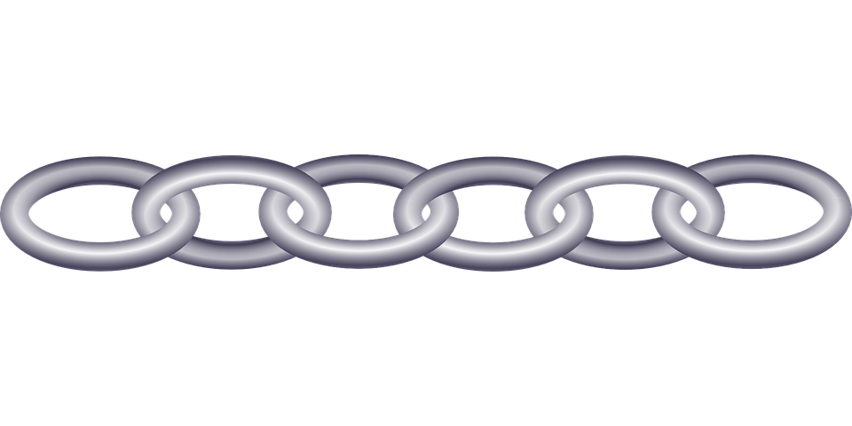
Difference
CLEARANCE
HD | HF
DIFFUSION Small molecules Urea, phosphate | CONVECTION Middle molecules B2 microglobulin

Slide 27
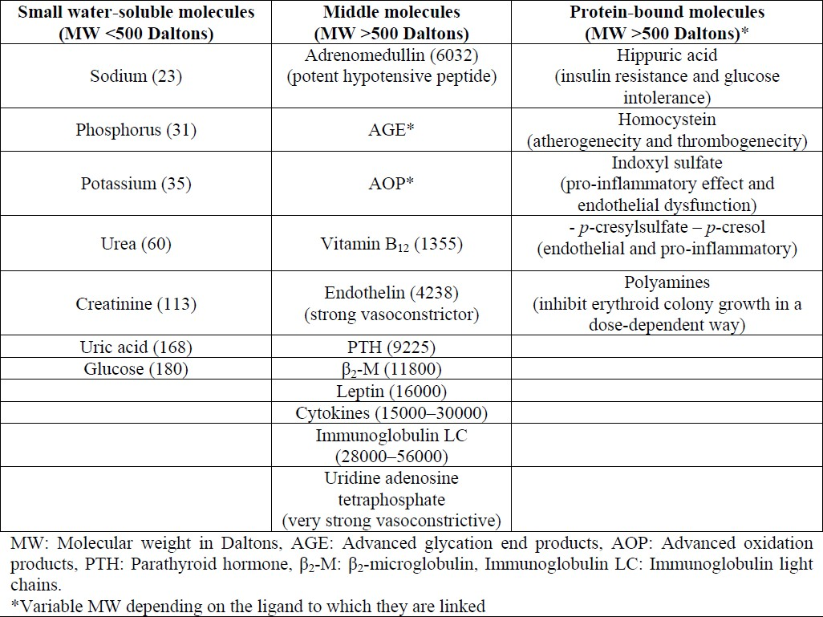
Uraemic toxins
Uraemic toxins
HD
HF

Slide 28
Clearance

Slide 29
Evidence
HD vs HDF
Notes:
Flow chart of study participation.

Slide 30
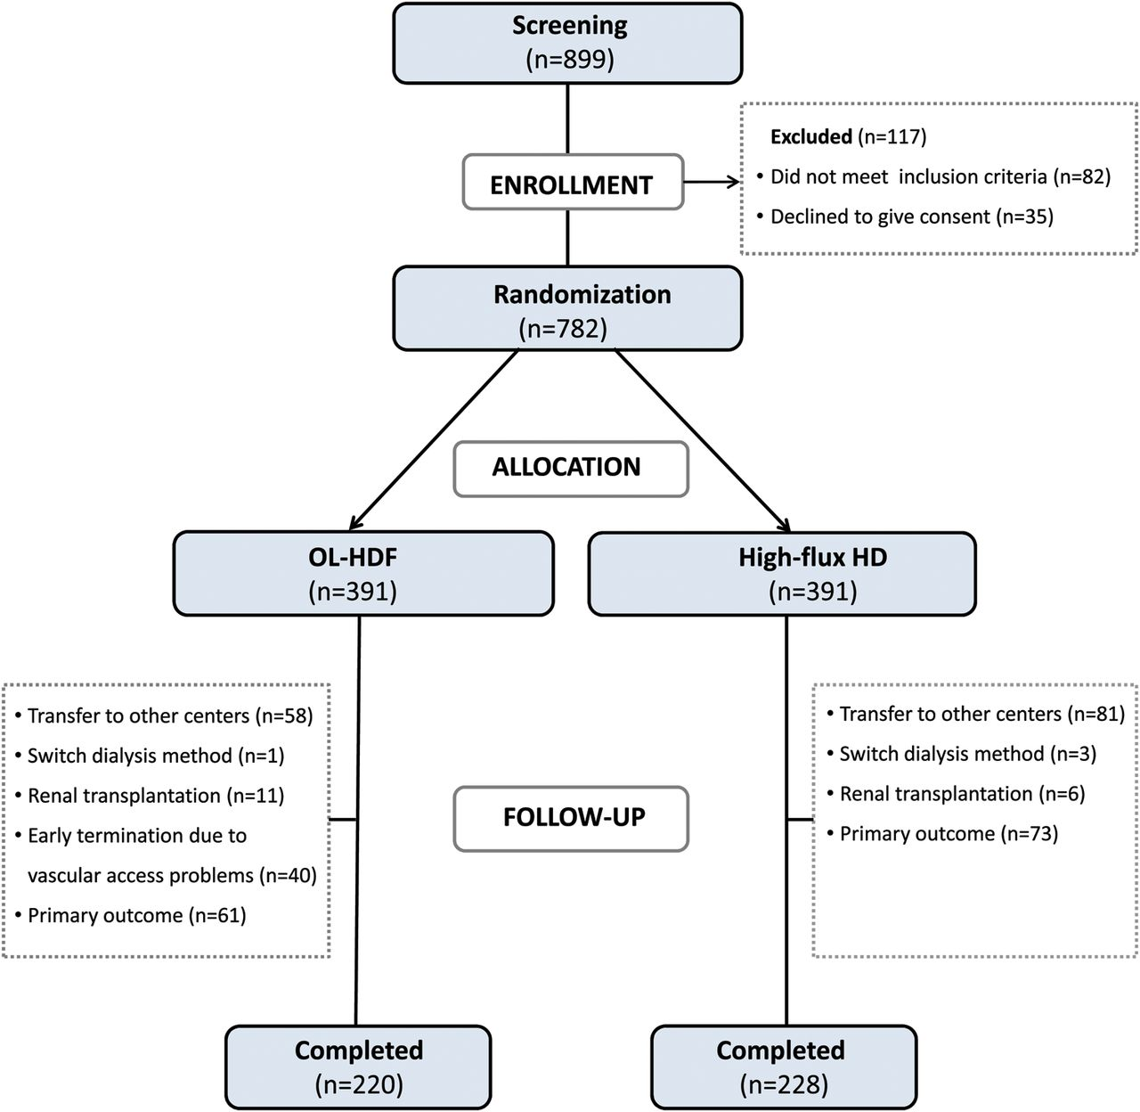
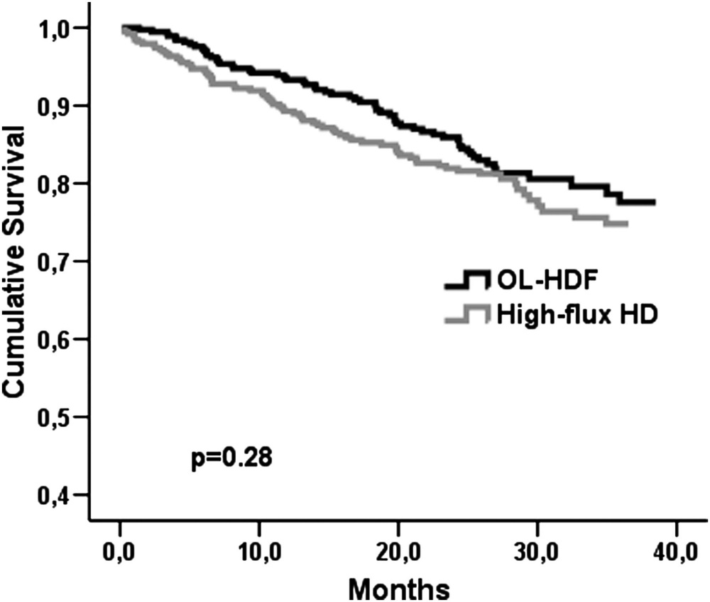

Turkish Online-HDF study
HF HD v OL-HDF
Qb 290-400
Qd 500
Ercan Ok et al. Nephrol. Dial. Transplant. 2013;28:192-202
Notes:
Flow chart of study participation.

Slide 31
Sub-analysis
Low Volume HDF (<17.5) v High Volume HDF (>17.5L)
46% risk reduction for overall mortality
71% risk reduction for cardiovascular mortality
Notes:
Composite event-free survival in patients treated with OL-HDF and high-flux HD.

Slide 32
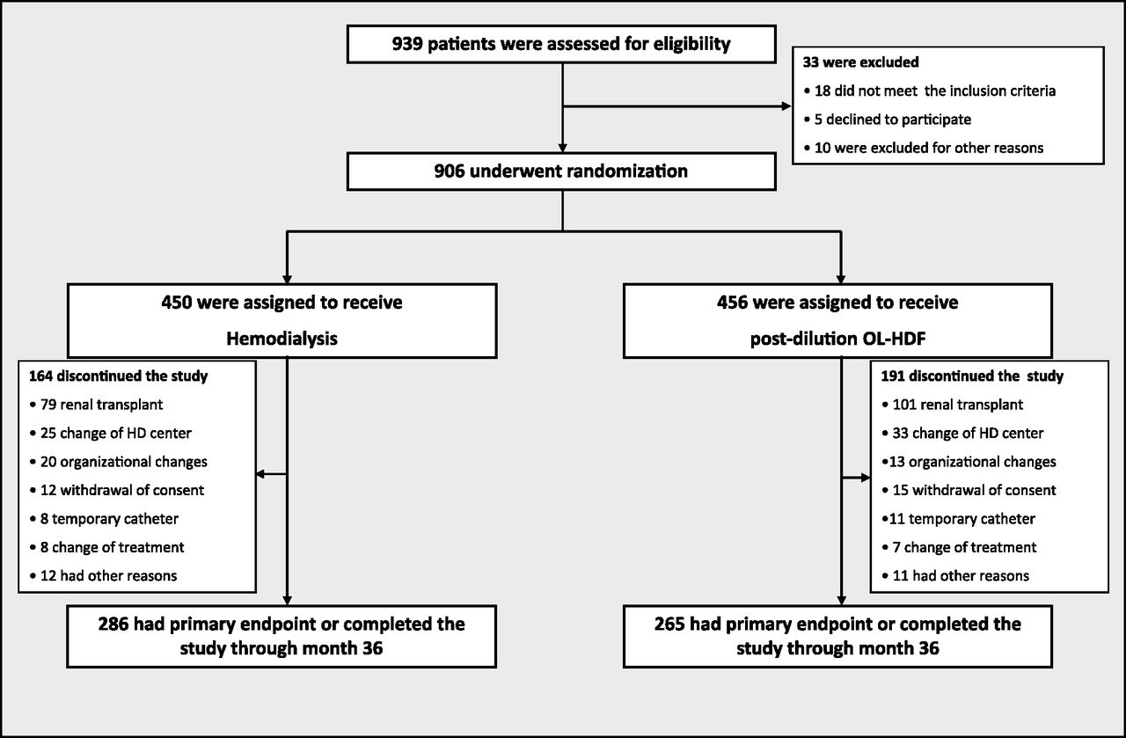
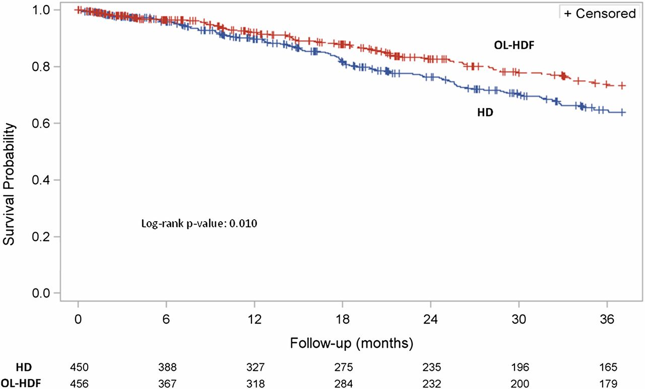

Spanish Online-HDF study
HF HD v OL-HDF
Qb 380-400
Qd 550
Convection 2L v 23L
Francisco Maduell et al. JASN doi:10.1681/ASN.2012080875
Notes:
Flow chart of study populations, including the number of patients who were screened, underwent randomization, and completed the study treatment or presented the primary variable. HD, hemodialysis.

Slide 33
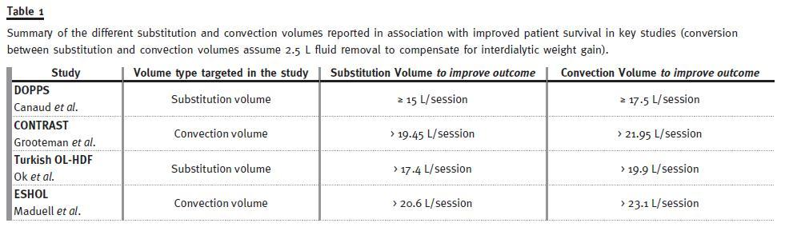
For HDF to have benefit
HDF must be high volume!!
At least > 18 L
Substitution + UF

Slide 34
Other benefits
Reduction in intradialytic hypotension
Better control of HPT
Improved EPO response
Improved phosphate clearance
Improved mortality risk

Slide 35
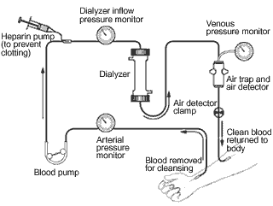

HD circuit

Slide 36
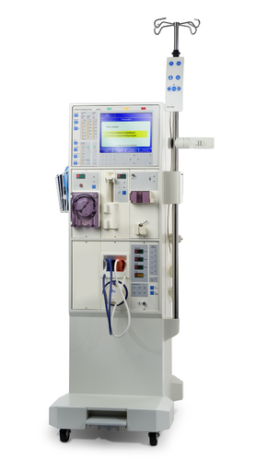
1. HDF Machine
Blood Pump
Blood Pump
Substitution fluid Pump

Slide 37
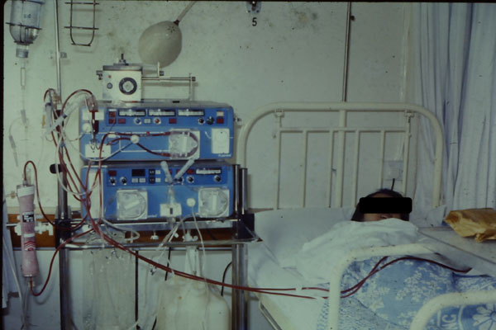
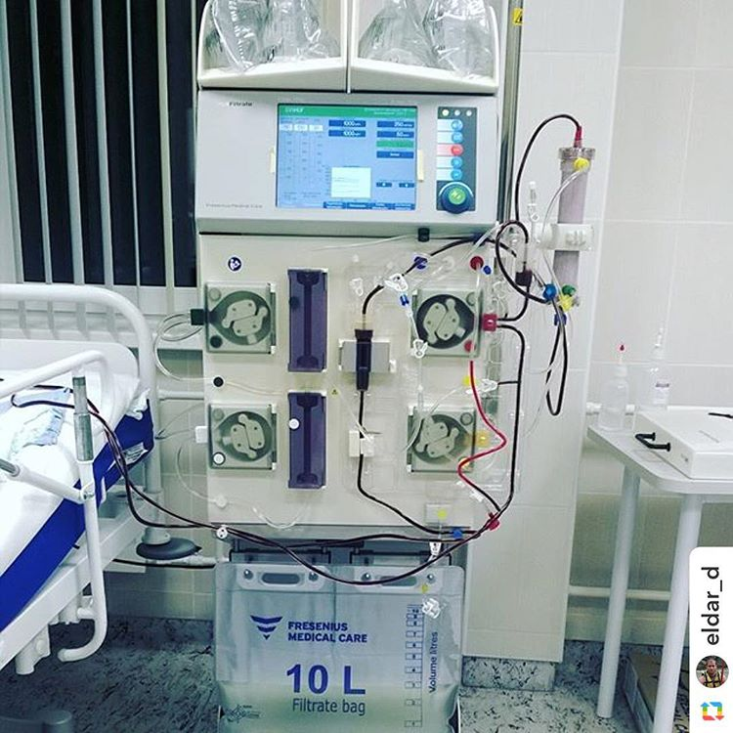
On-line water production
First HDF machines
CRRT machines

Slide 38
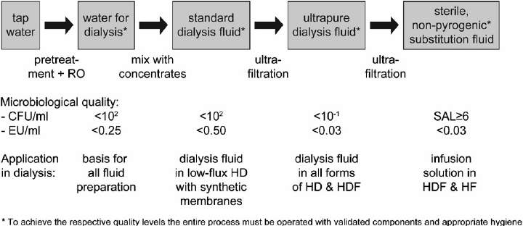
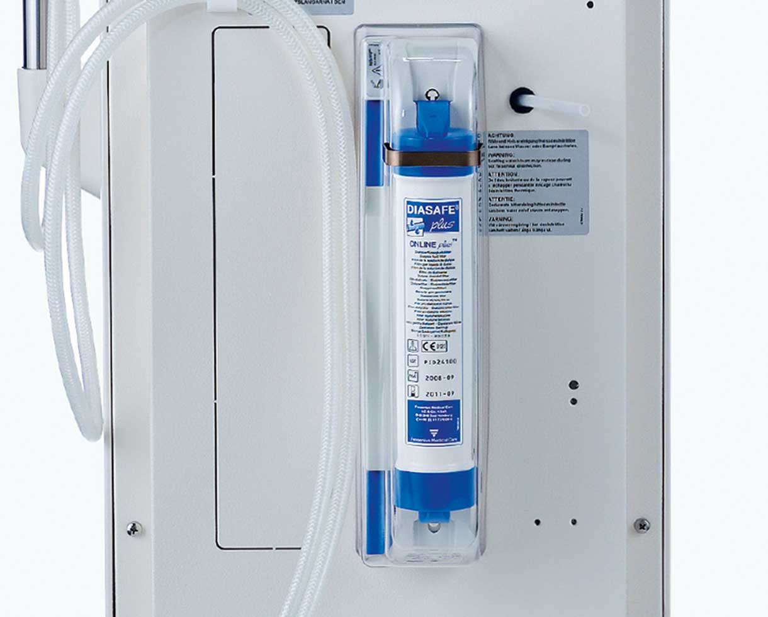
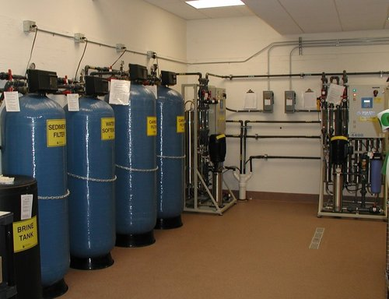
Online water production - ULTRAPURE
ISO/AAMI

Slide 39
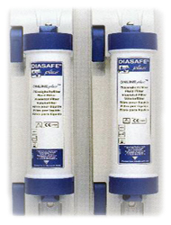
2. Online water production - STERILE
IMPORTANT
ISO/AAMI

Slide 40
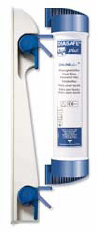
Water system
Sterile
(HF)
Ultrapure
(HD)

Slide 41
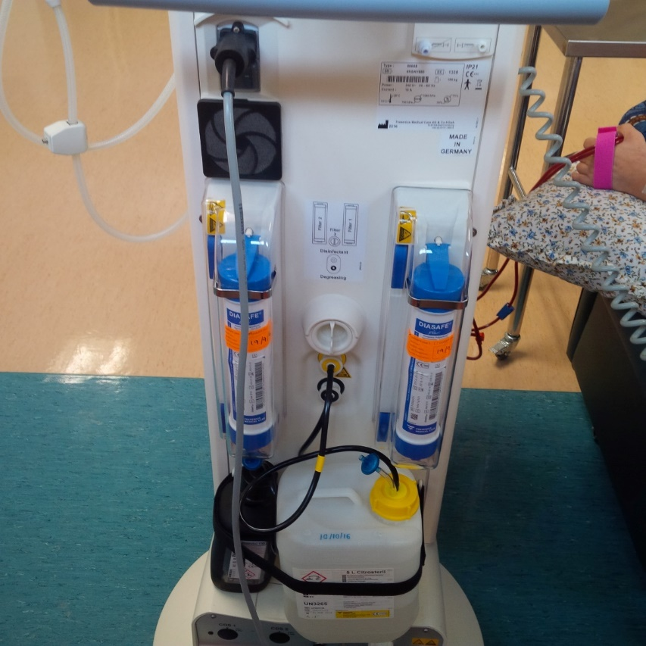
Pyrogen filters (Ultrafilters)

Slide 42
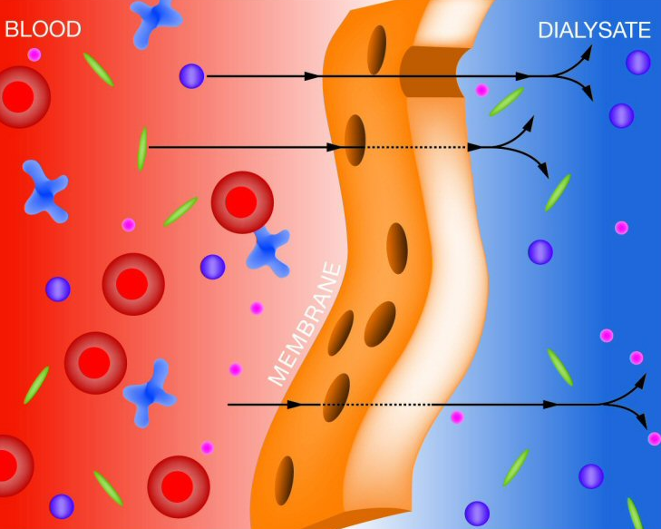
3. High Flux dialyzers
The dialyzer used for HDF must contain membranes that are highly permeable for :
  Water (Kuf >20 mL/h/mmHg)
  High sieving coefficient for β2M≥0.6
  KoA > 600
  Adequate dialyzer surface area.

Slide 43
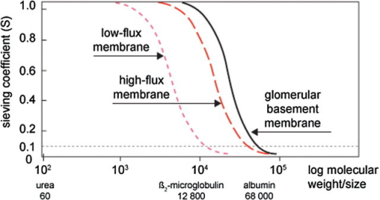
High Flux dialyzers

Slide 44
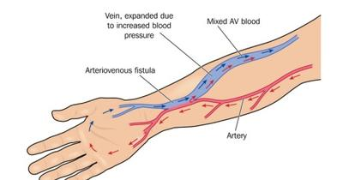
4. Fistula
Qb >300 ml/min
Need good blood flow to prevent high Filtration Fraction (easily clots)

Slide 45
Training
Principles of HDF
How to prime (extra bloodline for substitution)
Ensure HDF settings (Qb, Qd, Substitution) are met.

Slide 46

Dialysis patient review
Clearance – Kt/V , URR
Anaemia
CKD-MBD
Dry weight
Vascular access
HDF – Qb, Qd, Substitution

Slide 47
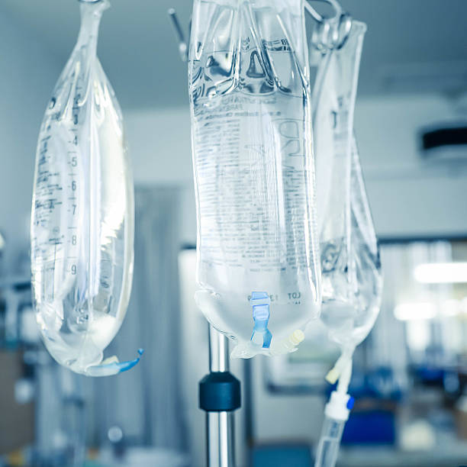
Advantages to our staff
On-line priming
  Saline bags
  Minimize staff
Patient stable

Slide 48
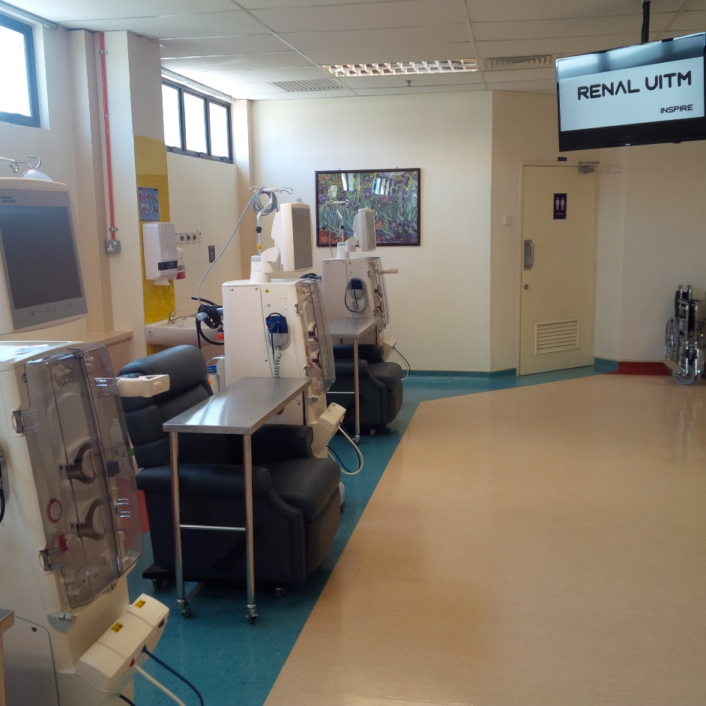
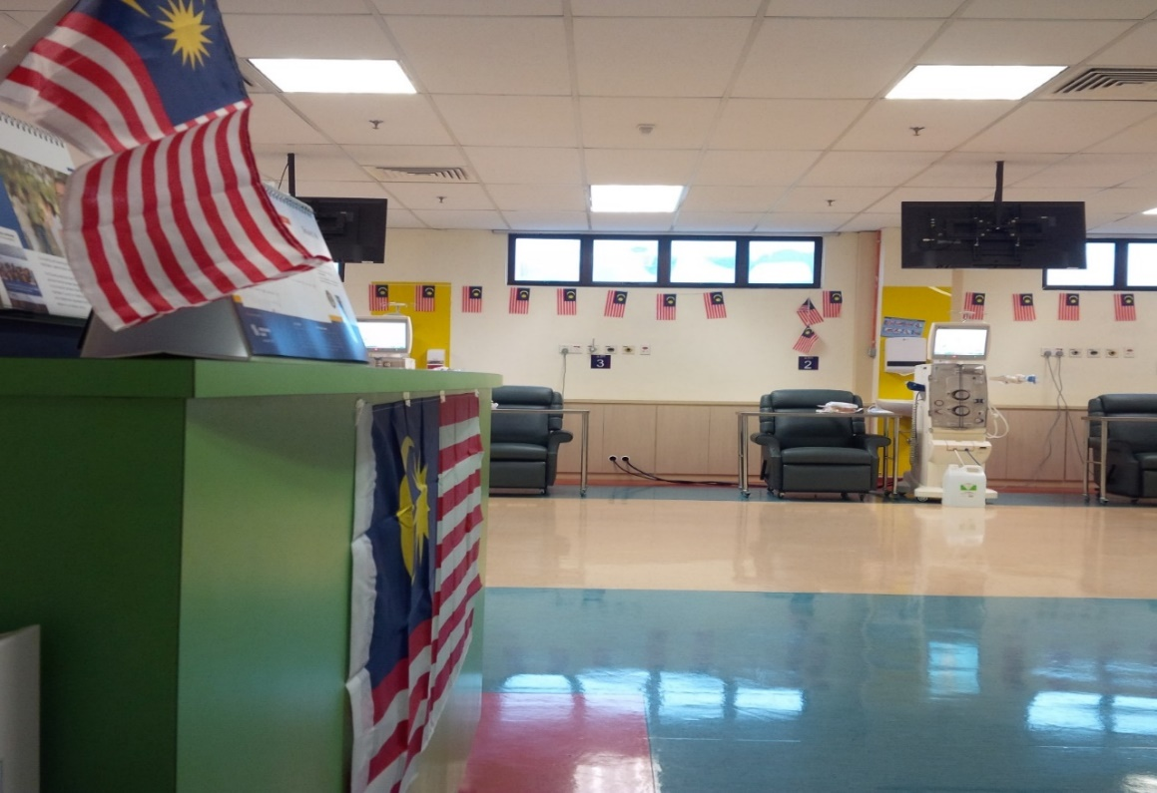
Come join us!!

Slide 49

Summary
HDF combines diffusive and convective clearance.
High volume online HDF may be beneficial over HD.
Follow us @ Renal Uitm

