Slide 1
Immunosuppression and Rejection
Dr Muhammad Iqbal Abdul Hafidz
Pre congress: Kidney Transplant Coordinator Workshop
FOR THE NURSES

Slide 2
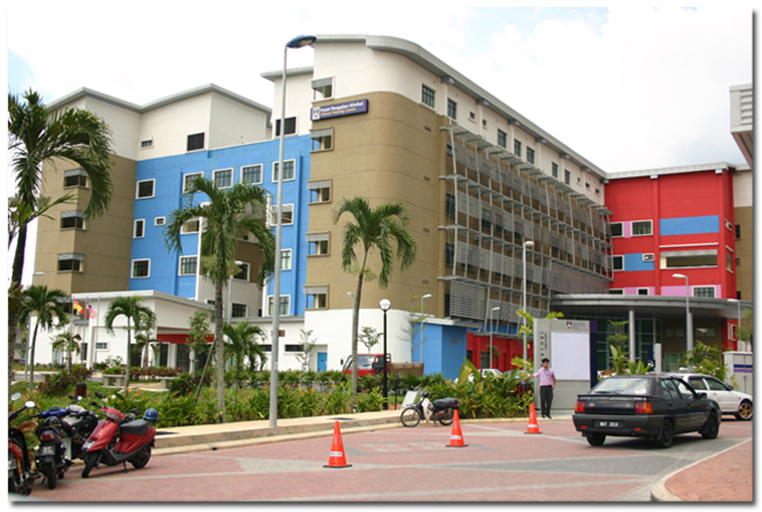
Renal UiTM Sg Buloh

Slide 3
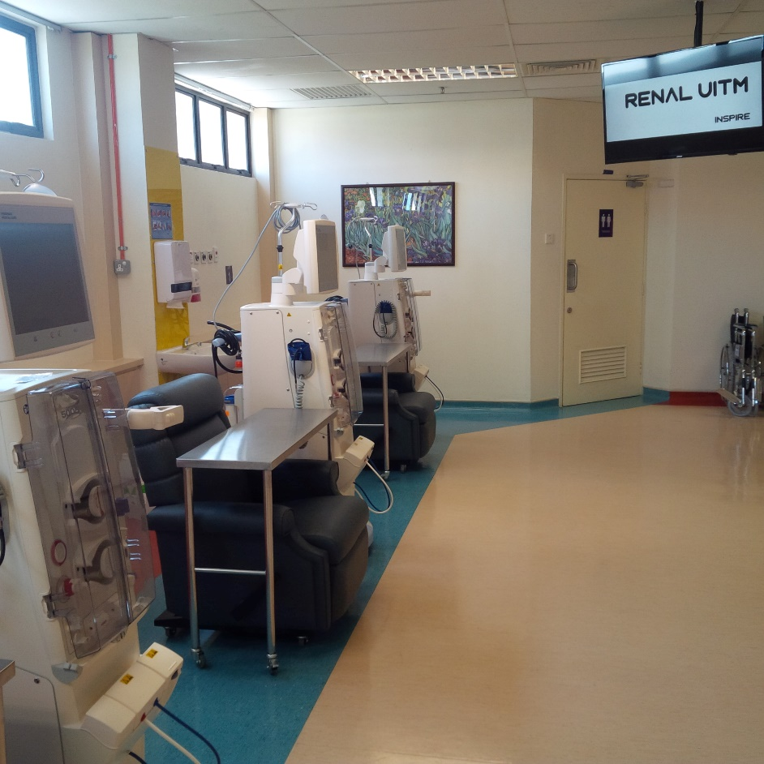
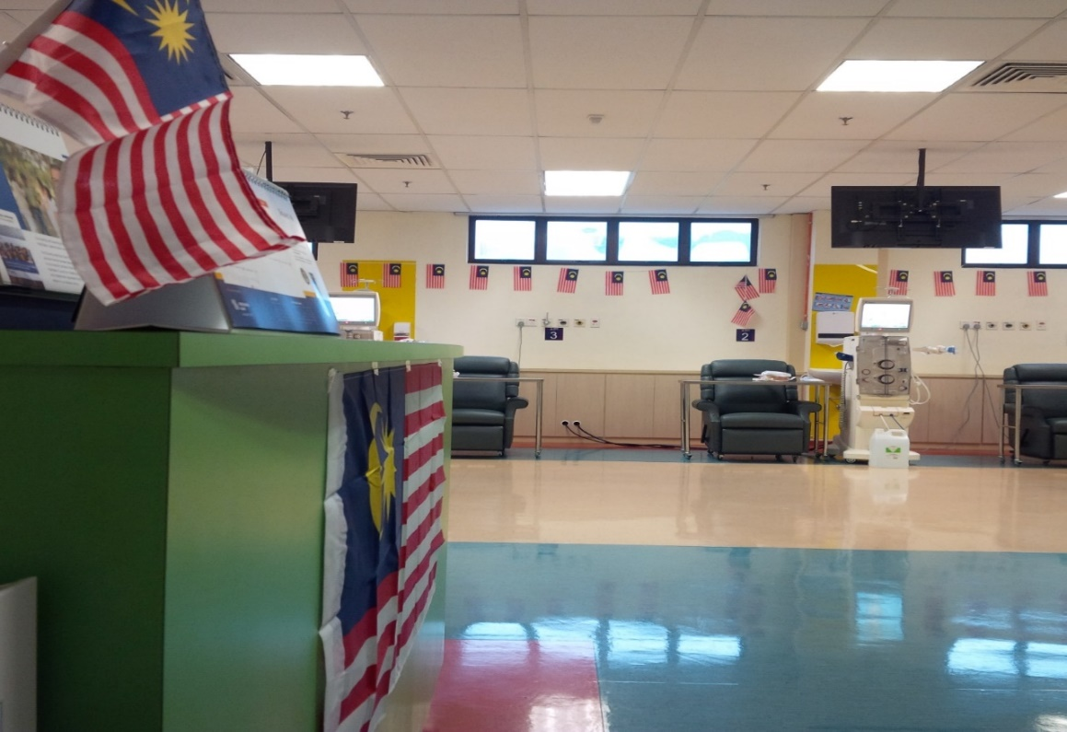
Fully HDF

Slide 4
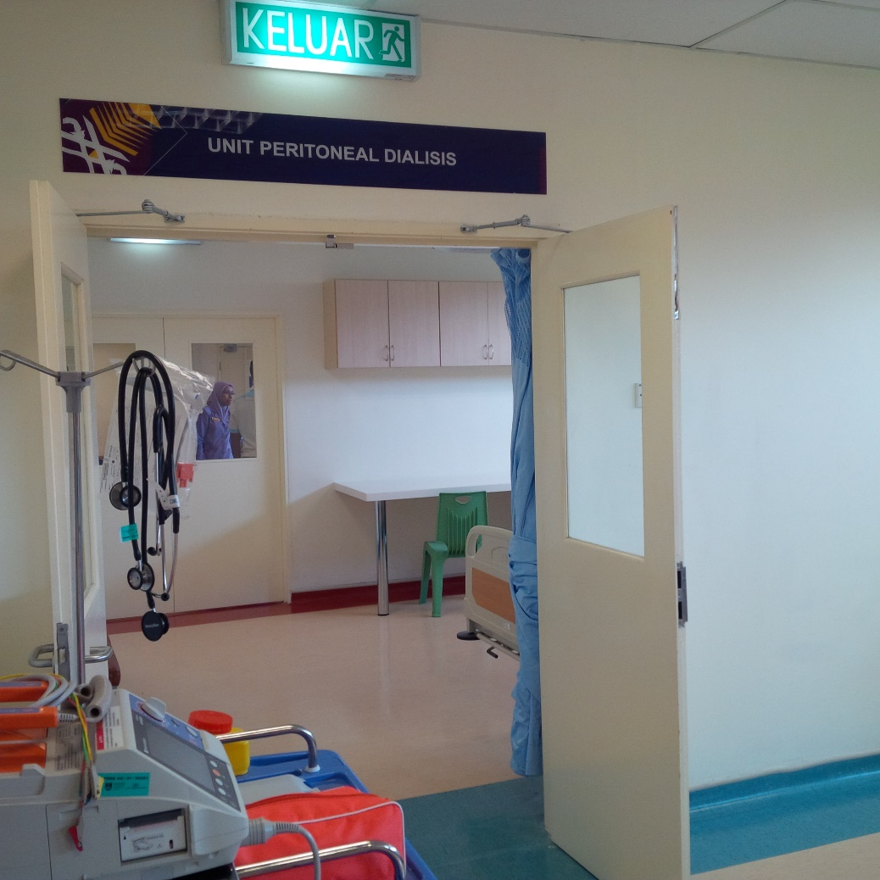
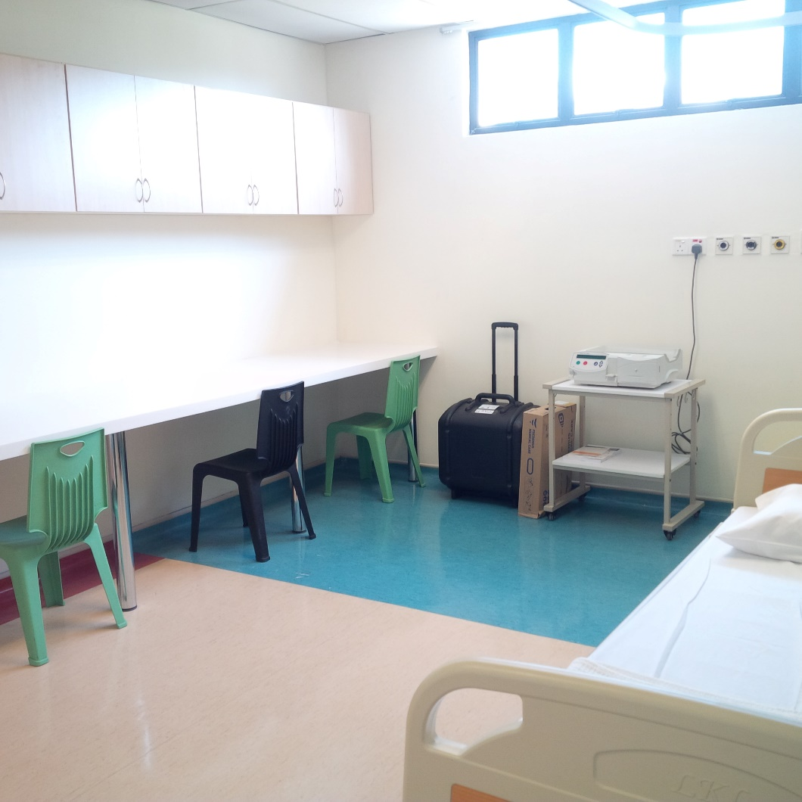
Peritoneal Dialysis

Slide 5
Hospital Universiti UiTM Puncak Alam – April 2020

Slide 6
Hospital Universiti UiTM Puncak Alam – April 2020

Slide 7
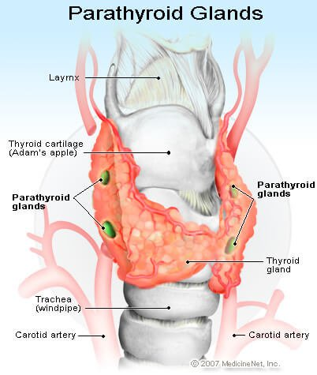
Services Provided
HDF
PD
Tenchkoff Catheter
IJC and perm catheter
Kidney biopsy
Clinic
Ward
Parathyroidectomy
AVF
Transplant – 2017
Lipid apharesis

Slide 8
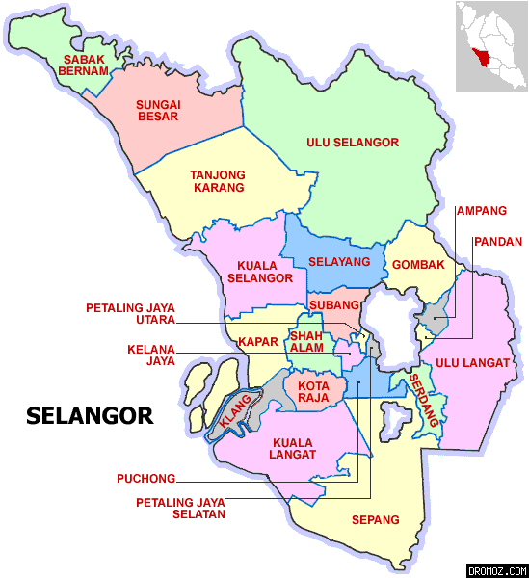
Future
Selayang
Puncak Alam
Shah Alam
Teluk Intan

Slide 9
Outline
Rejection
Immunosuppression

Slide 10
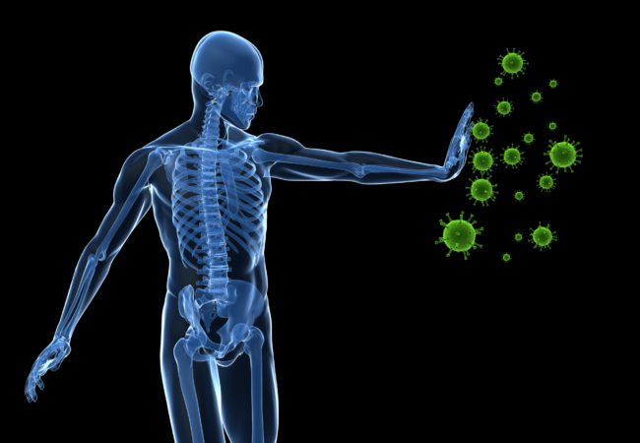
The Amazing Immune System
Helps fight infection
Recognizes own self
Allergies
Blood transfusion reaction
Tumour cells
Auto-immune disease
REJECTION

Slide 11
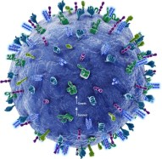
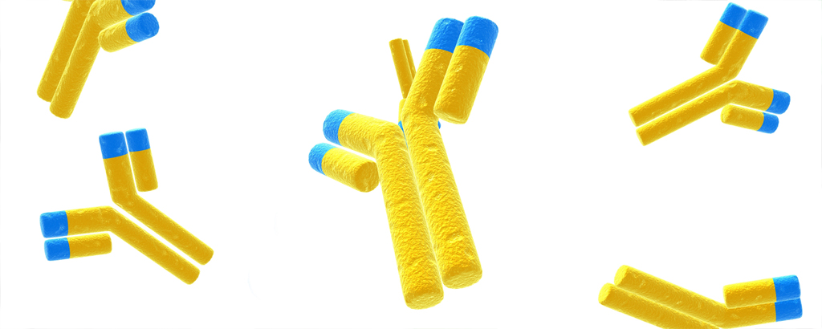
Immune System

Slide 12
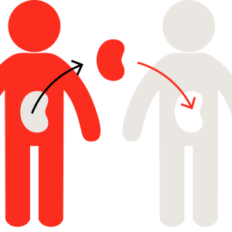
Rejection
Hyperacute (immediately)
Acute (week 1-12)
Chronic (month 1 onwards)

Slide 13
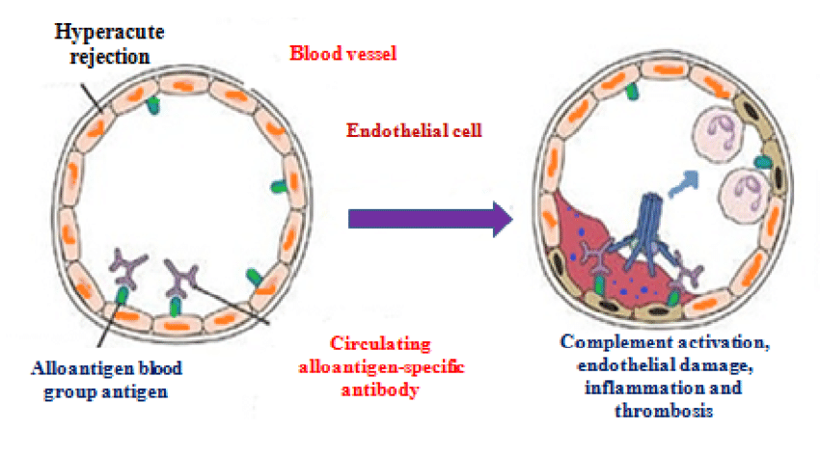
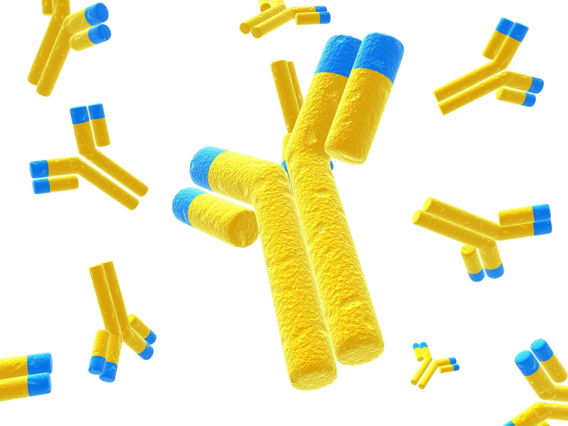
Hyperacute Rejection
Occurs immediately after release of clamp
Due to preformed antibodies (usually highly sensitized or ABO incompatible)
Causes activation of the complement cascade within the graft
Followed by endothelial necrosis, platelet deposition and local coagulation and thrombosis

Slide 14
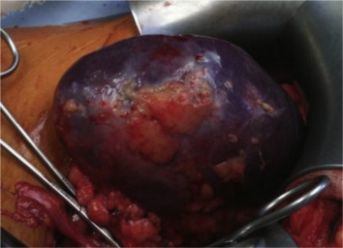
Hyperacute Rejection
Kidney appears flaccid and mottled
Reflects the deposition of antibodies against HLA expressed on the endothelium of the glomeruli and microvasculature
Severe and life threatening!!
Treatment is removal

Slide 15
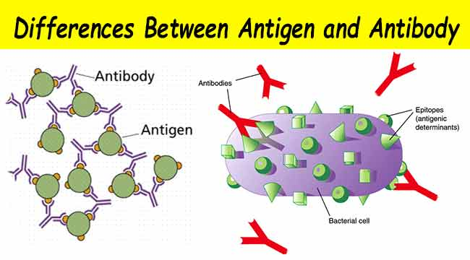
How to prevent Hyperacute Rejection
Ensure no ABO or HLA antibodies!
ABO crossmatch ☑
CDC crossmatch ☑
HLA antibodies ☑
Antigen

Slide 16
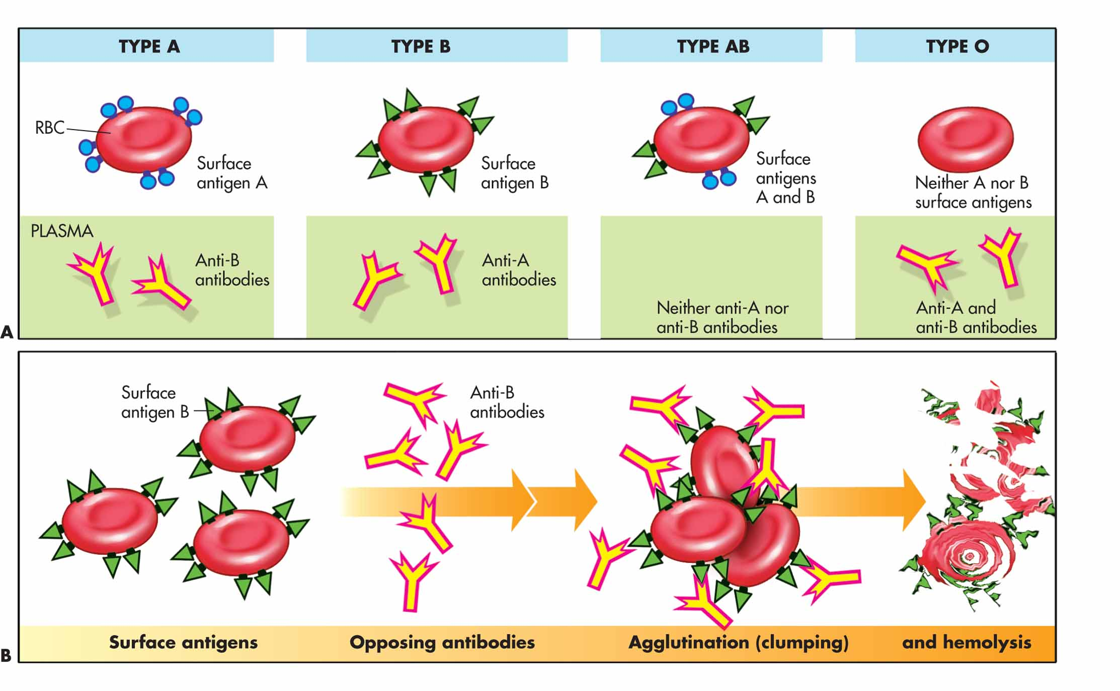
How to prevent Hyperacute Rejection
Ensure no ABO antibodies (also present on the endothelial cells of the kidneys)

Slide 17
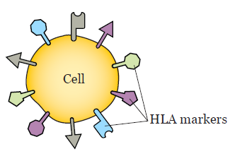
How to prevent Hyperacute Rejection
Ensure no HLA antibodies (present on the cells of the kidneys)
HLA antigens for self recognition
HLA Class I and II
HLA antibodies not present unless
sensitization (different from naturally
occurring ABO antibodies)
Sensitization events
Blood transfusion
Previous transplant
Pregnancy
Send HLA antibodies
Preformed HLA antibodies – DANGEROUS!!

Slide 18
T Cell Activation/Rejection
Most common rejection
Antigen Presenting Cell and T cell

Slide 19
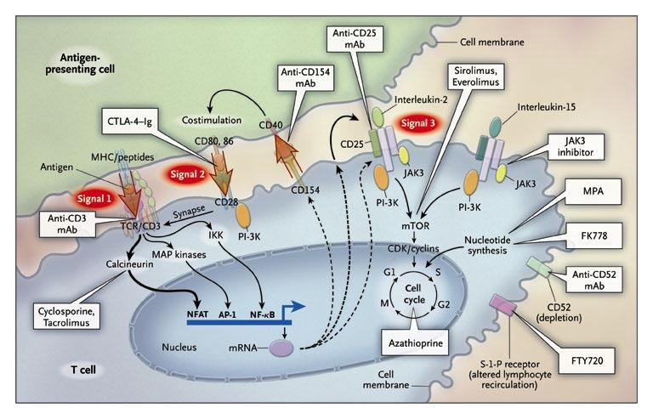
Rejection

Slide 20
T cell activation/rejection – APC and T cell

Slide 21
How to prevent T cell rejection

Slide 22
Antibody mediated rejection
Antibody-mediated rejection (AMR) caused by antibodies directed against donor-specific HLA molecules, blood group antigen (ABO)-isoagglutinins, or endothelial cell antigens.

Slide 23
Antibody mediated rejection

Slide 24
How to prevent Antibody mediated cell rejection
PEX
Steroids
IVIg
Thymoglobulin
Eculizimab
Bortezomib
Rituximab

Slide 25
How to prevent Antibody mediated cell rejection
Bortezomib

Slide 26
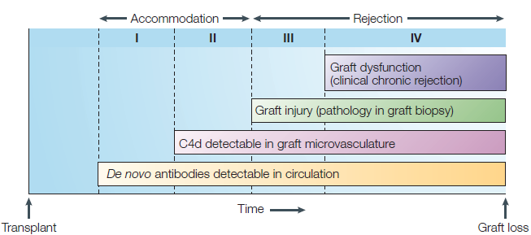
Chronic Antibody Mediated Rejection
Low DSA or de novo DSA

Slide 27
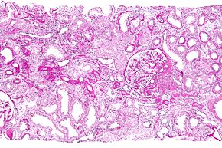
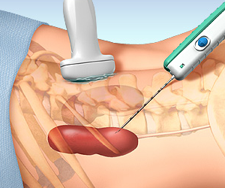
How to diagnose rejection
Serum Creatinine
Biopsy
DSA (if AMR is suspected)

Slide 28
Banff Classification

Slide 29
Immunosuppression
Induction
Maintainance
Rejection

Slide 30
Immunosuppression
Concentrate on T cell-APC activation

Slide 31
Immunosuppression
Induction Therapy | Maintainence Therapy
Monoclonal Antibodies Basiliximab Daclizumab Alemtuzumab | Calcineurin Inhibitors Cyclosporin Tacrolimus
Polyclonal antibodies ATG | Antimetabolites/PSI Azathioprine Mycophenolate
 | MTOR inhibitors Sirolimus Everolimus

Slide 32
Induction
Rabbit anti-thymocyte globulin (Thymoglobulin)
Basiliximab (Simulect)
Horse anti-thymocyte globulin (Atgam)
Alemtuzumab (Campath)
Daclizumab

Slide 33
Thymoglobulin
Thymoglobulin are antibodies (IgG) against T‐cell markers such as CD2, CD3, CD4.
The mechanism of action by which thymoglobulin suppresses the immune response is not fully understood, but may include:
T-cell clearance from the circulation
Modulation of T-cell activation, homing, and cytotoxic activities
Causes T-cell depletion
For high risk cases

Slide 34
Thymoglobulin
Dose : 1-1.5mg/kg for 5-7 days
Premedicate with PCM 1g and IV Piriton or Hydrocortisone 1 hour prior to infusion
Calculate dose required (1.5mg/kg) , each vial contains 25mg
Transfer each vial into a normal saline or dextrose solution (each vial should be diluted in 50mL of solution)
Run over a minimum of 6 hours via a central line (subsequent doses can be run over 4 hours)
Observe patient closely! Patient can get anaphylaxis.

Slide 35
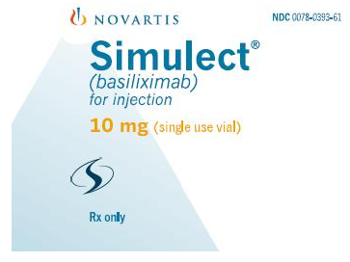
Basiliximab
Chimeric mouse-human monoclonal antibody to the α chain (CD25) of the IL-2 receptor of activated T cells
Course: 2 doses of 20mg. 1st dose before transplant op, 2nd dose 4 days post op.
Can be used via central or peripheral administration administered as a bolus.
Keep refrigerated!
RM6918.75 per dose!

Slide 36
Maintainence
Prednisolone
CNI
MPA
MTORi
Belatacept

Slide 37
Steroids
Methylprednisolone 500mg IV pre op and at anastomosis.
Prednisolone 20mg OD and taper over 3 month.
Side effects
Acne
DM
HPT
Cushingoid

Slide 38
CNI
Tacrolimus (Prograf®)
start 0.1mg/kg bd 5 days pre-transplant.
need to ensure target level
8-10 ng/dl (0-3 months)
5-7 ng/dl ( > 3 months)
Cyclosporin

Slide 39
Calcineurin Inhibitor (CNI)
Side effects
HPT
DM
Dyslipidaemia
Hirsutism and gum hypertrophy ( Cyclosporin)

Slide 40
Azathioprine
Usual dose is 1-2mg/kg/day
May be used in place of mycophenolate (e.g. during pregnancy)
Concomitant use of allopurinol and azathioprine may result in hematological toxicity

Slide 41
Mycophenolic Acid (MPA)
Mycophenolate mofetil (Cellcept®)
Usual dose is 1 gm bd
Gastrointestinal side effects (esp. when combined with Tacrolimus)
Hematological side effects (esp. when combined with Sirolimus)
Mycophenolic acid (Myfortic®)
Used in place of mycophenolate mofetil
Usual dose is 720 mg bd

Slide 42
MTOR inhibitors
Sirolimus
Everolimus – newer
Can be used with CNI or MPA
Poor wound healing, proteinuria (Sirolimus)
Reduce malignancy risk
Reduce risk of BK and CMV
Regress PTLD, Kaposis sarcoma and non-melanotic skin malignancy

Slide 43
Differential diagnosis of Acute Rejection
CNI toxicity – Tacrolimus level high
Hypovolaemia/ Dehydration
Obstruction
ATN
Recurrence of disease
Infection – UTI
Viral infection BK Virus
Recurrence – FSGS
Urinary Leak
Renal vein thrombosis
Thrombotic Microangiopathy

Slide 44
Role of Nurse Coordinator
Advice and make sure patient compliant to medications
Check medication list physically
Advice for them not to take any new medications without informing
No products
Explain that it is easy for them to get infection! So ensure cleanliness

Slide 45
Thank you!

