Slide 1

Prevention and Management of Infections in Dialysis
Dr Muhammad Iqbal Abdul Hafidz
UiTM, Sungai Buloh
Selangor Dialysis Update 2019, HTAR UKAPS
Renal uitm
renaluitm.com

Slide 2

Letih..nak balik…
Renal uitm
renaluitm.com

Slide 3
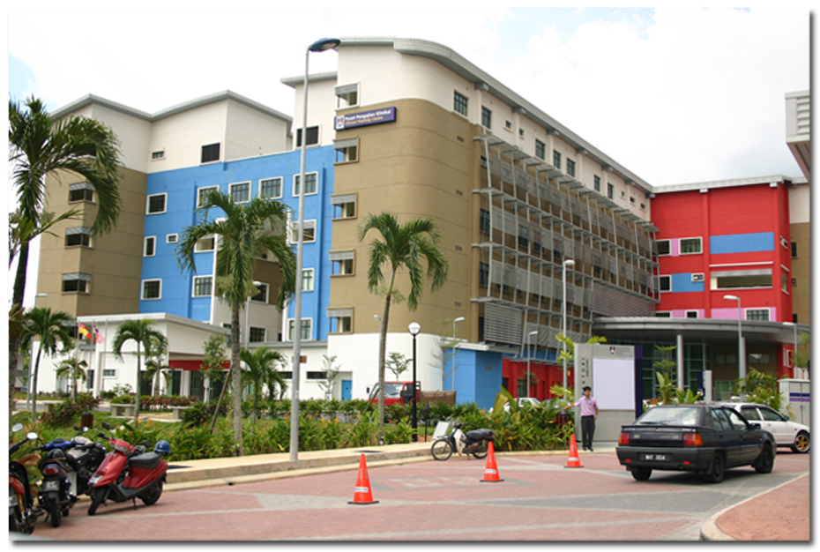
Introduction – Renal UiTM
Renal uitm
renaluitm.com

Slide 4
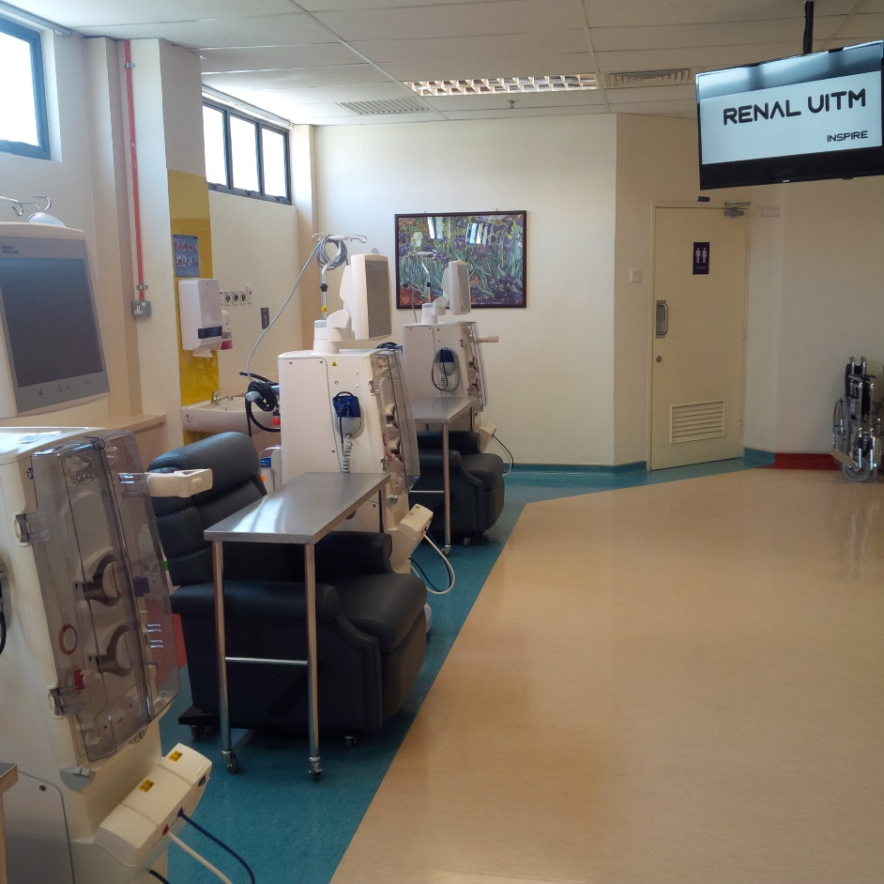
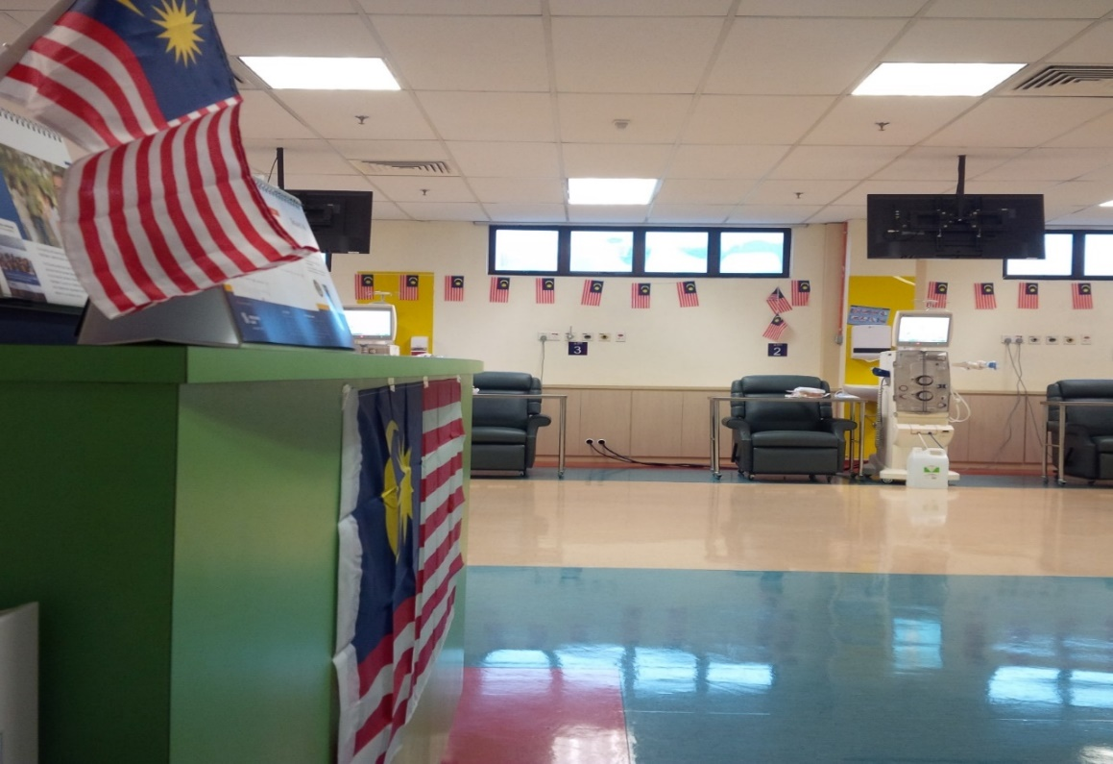
Fully HDF Unit
Renal uitm
renaluitm.com

Slide 5
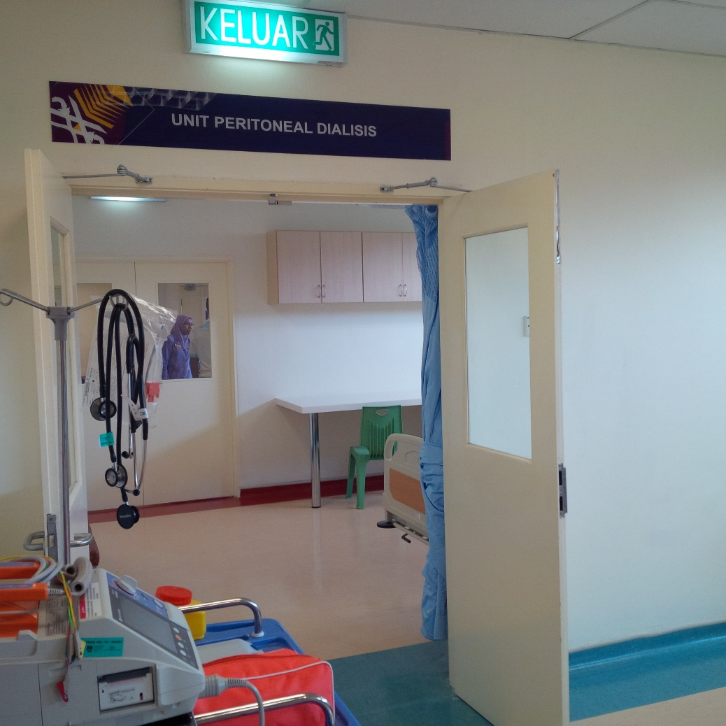
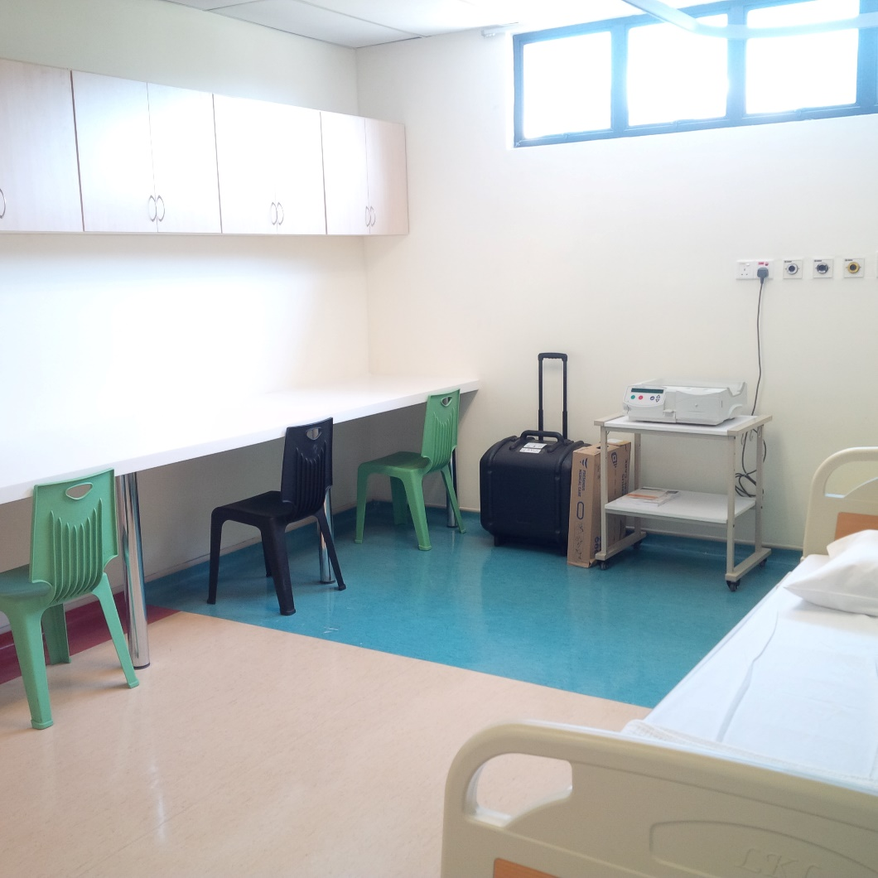
Peritoneal Dialysis
Renal uitm
renaluitm.com

Slide 6
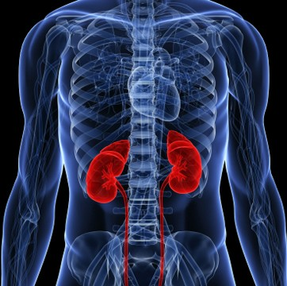
Services Provided
HDF
PD
Tenchkoff Catheter
IJC and perm catheter
Clinic
Ward
Parathyroidectomy
AVF
Transplant
Lipid Apheresis
Renal uitm
renaluitm.com

Slide 7

Future
Sungai Buloh
Selayang
Puncak Alam
Teluk Intan
Renal uitm
renaluitm.com

Slide 8
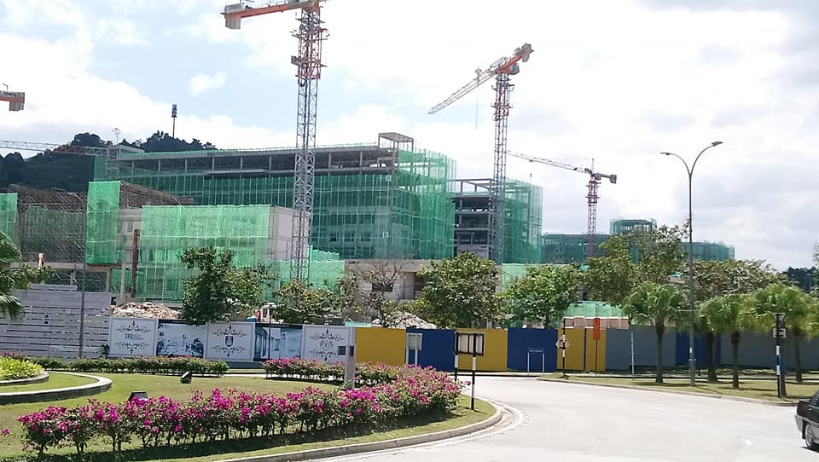
Hospital Universiti UiTM Puncak Alam
Renal uitm
renaluitm.com

Slide 9
Infections in Dialysis
Catheter related infection
  CRBSI/line related sepsis
Non-catheter related infection
  Hepatitis B
  Hepatitis C
  HIV
Renal uitm
renaluitm.com

Slide 10
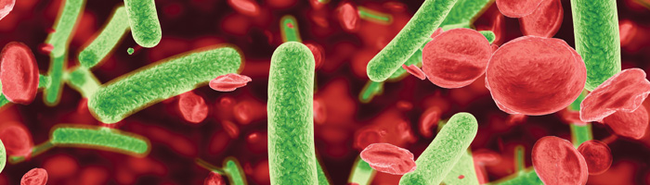
Catheter Related Infection
Renal uitm
renaluitm.com

Slide 11
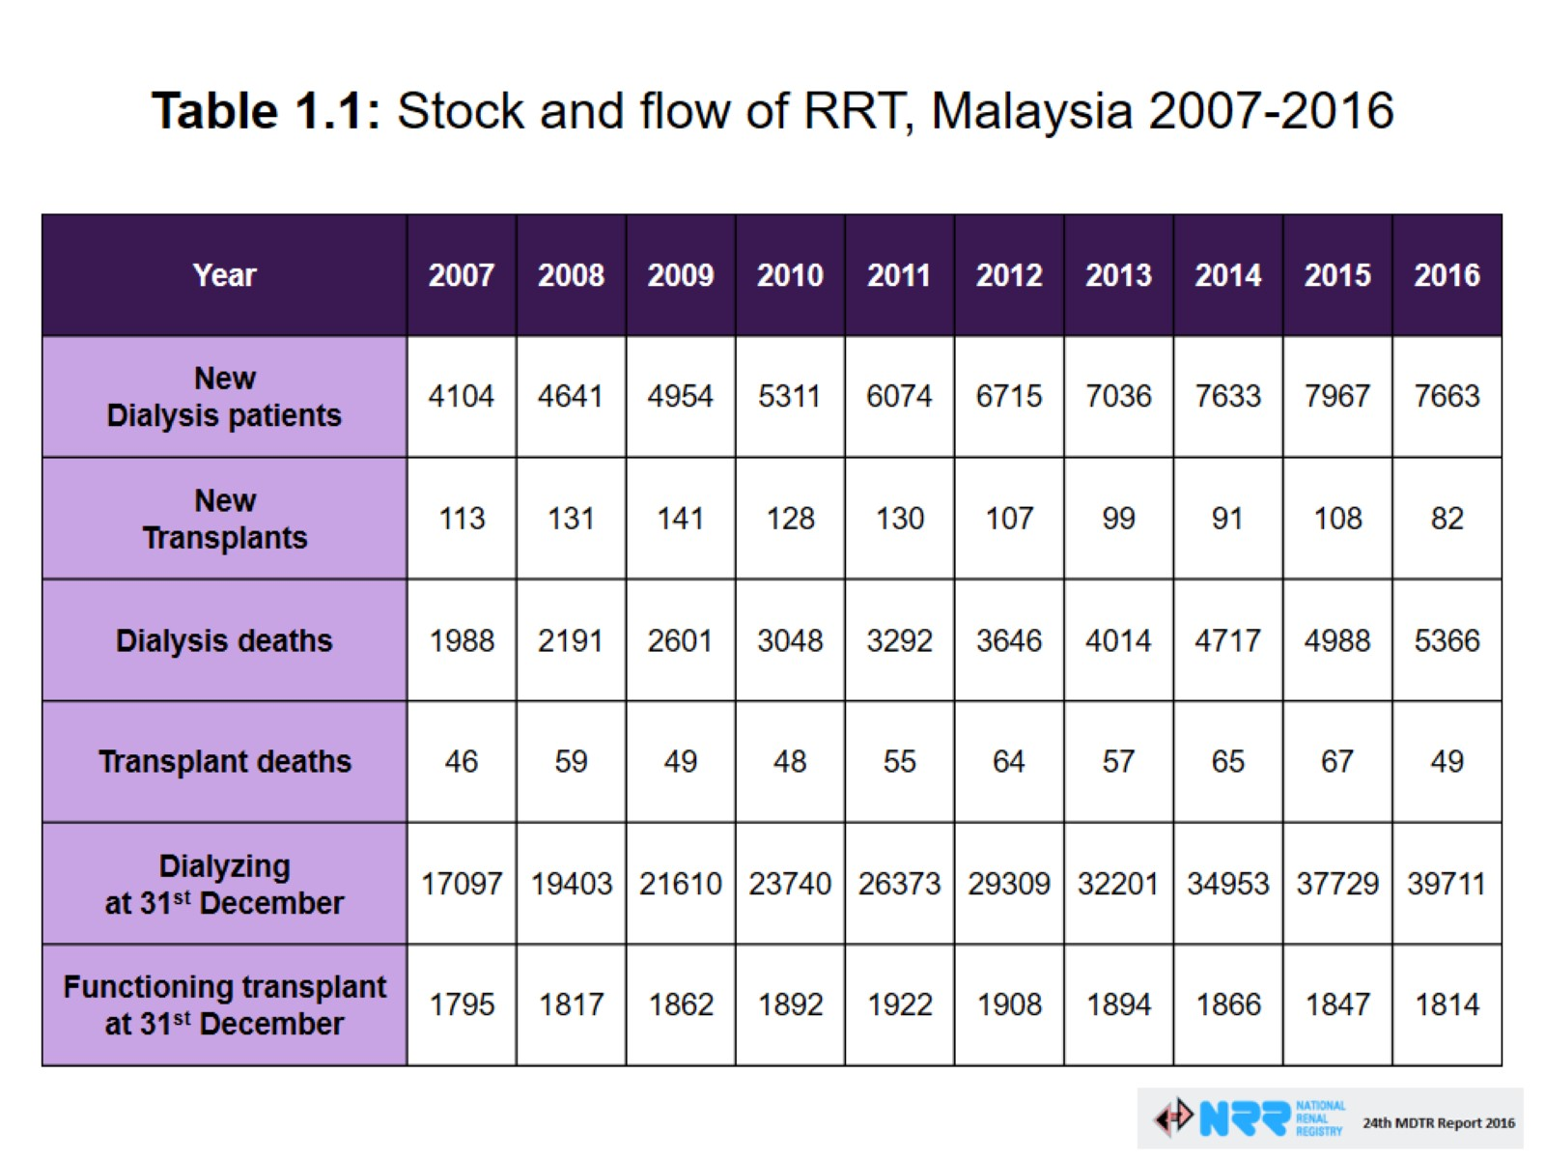
#10yearchallenge
Renal uitm
renaluitm.com

Slide 12
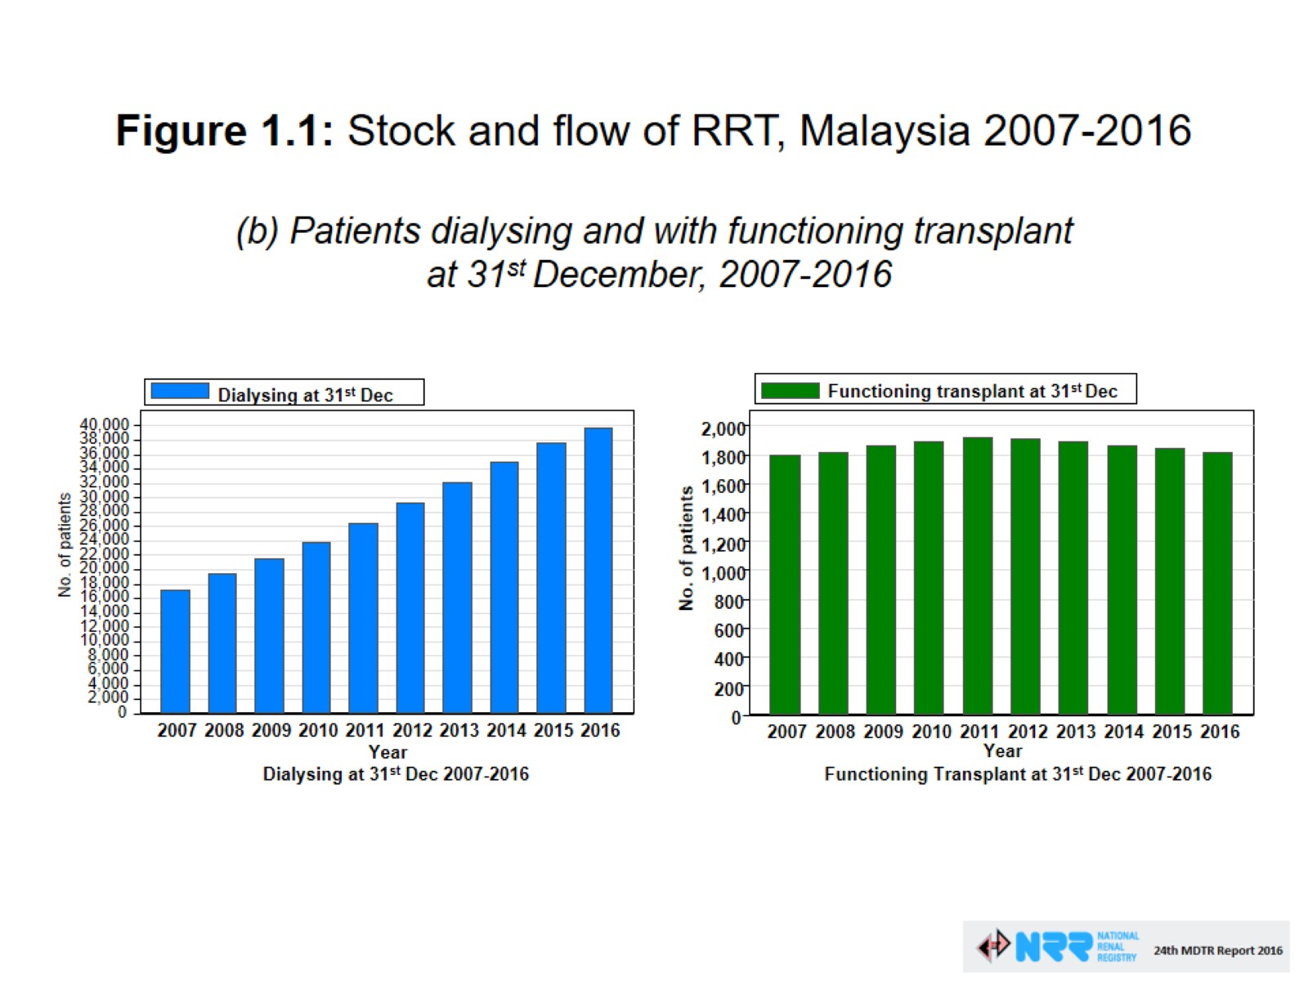
Number of dialysis patients
Renal uitm
renaluitm.com

Slide 13
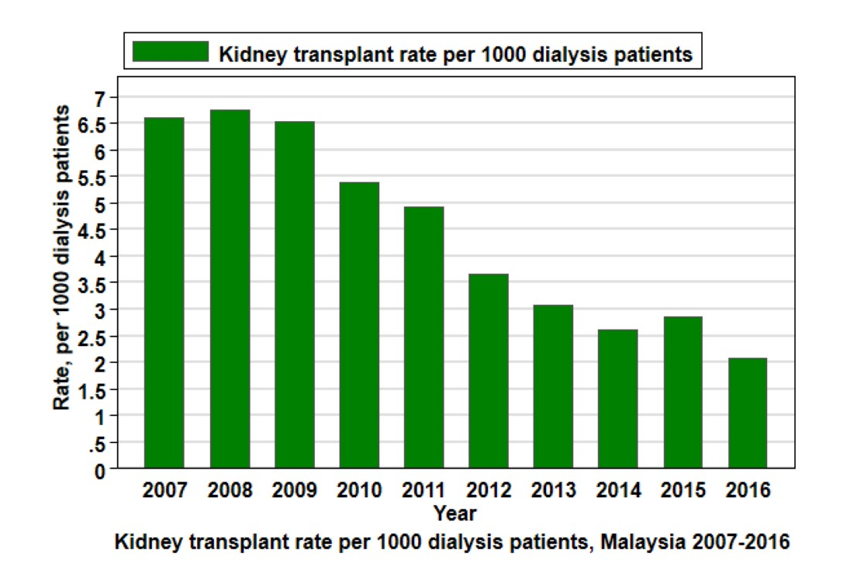
Kidney transplant
Renal uitm
renaluitm.com

Slide 14
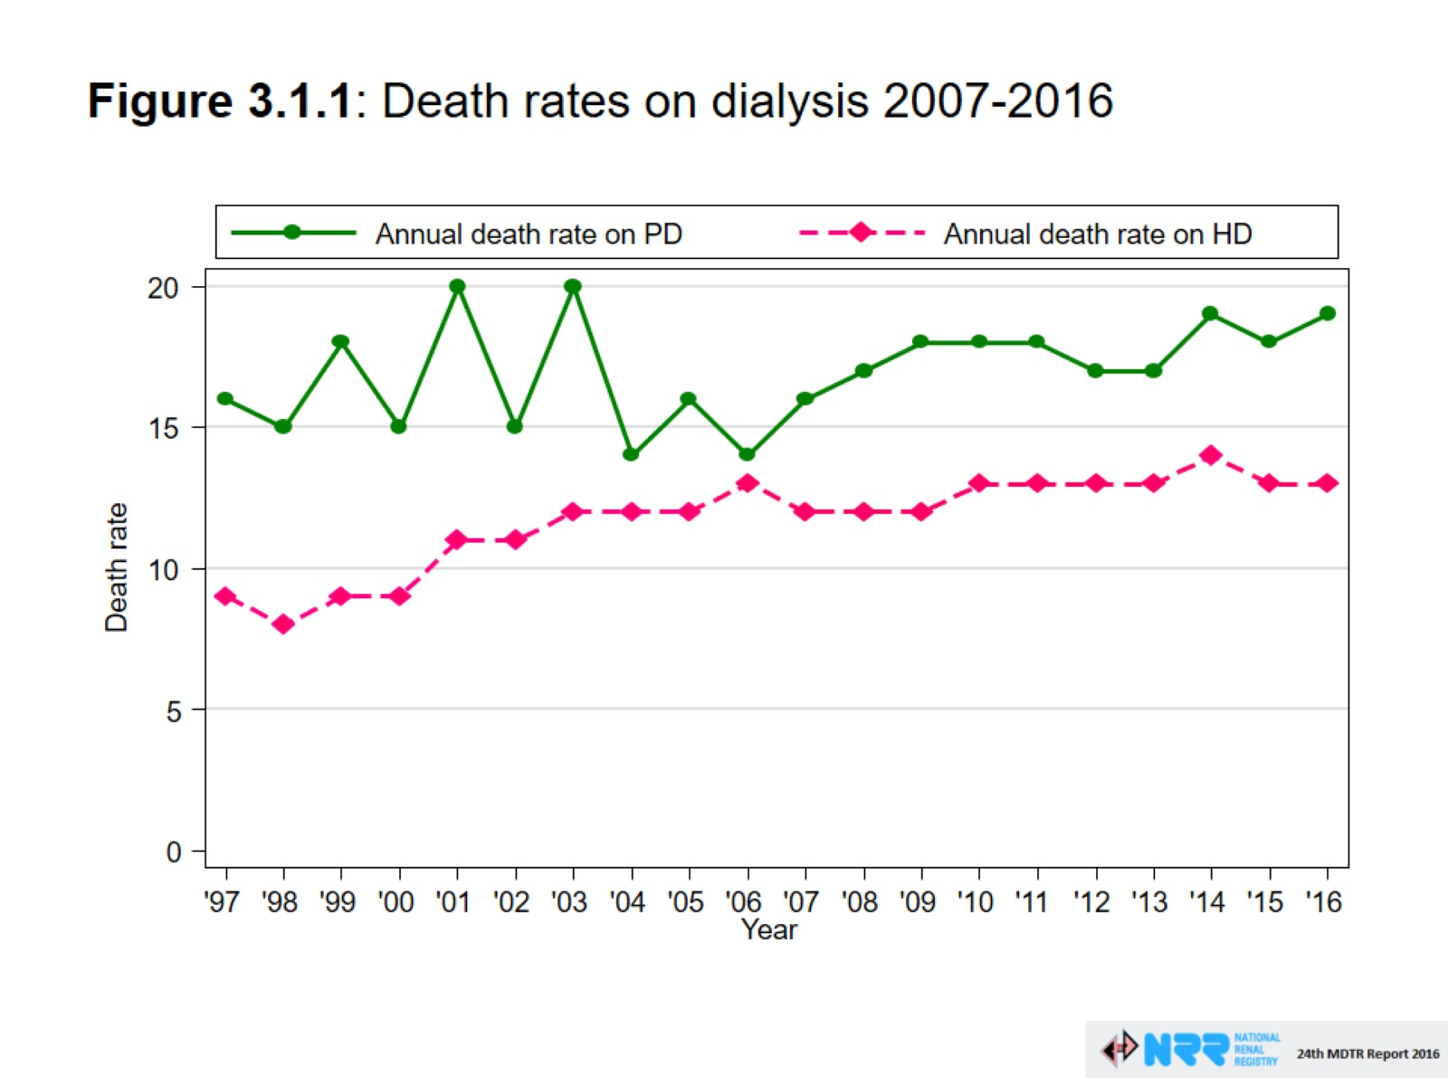
Death on HD
Renal uitm
renaluitm.com

Slide 15
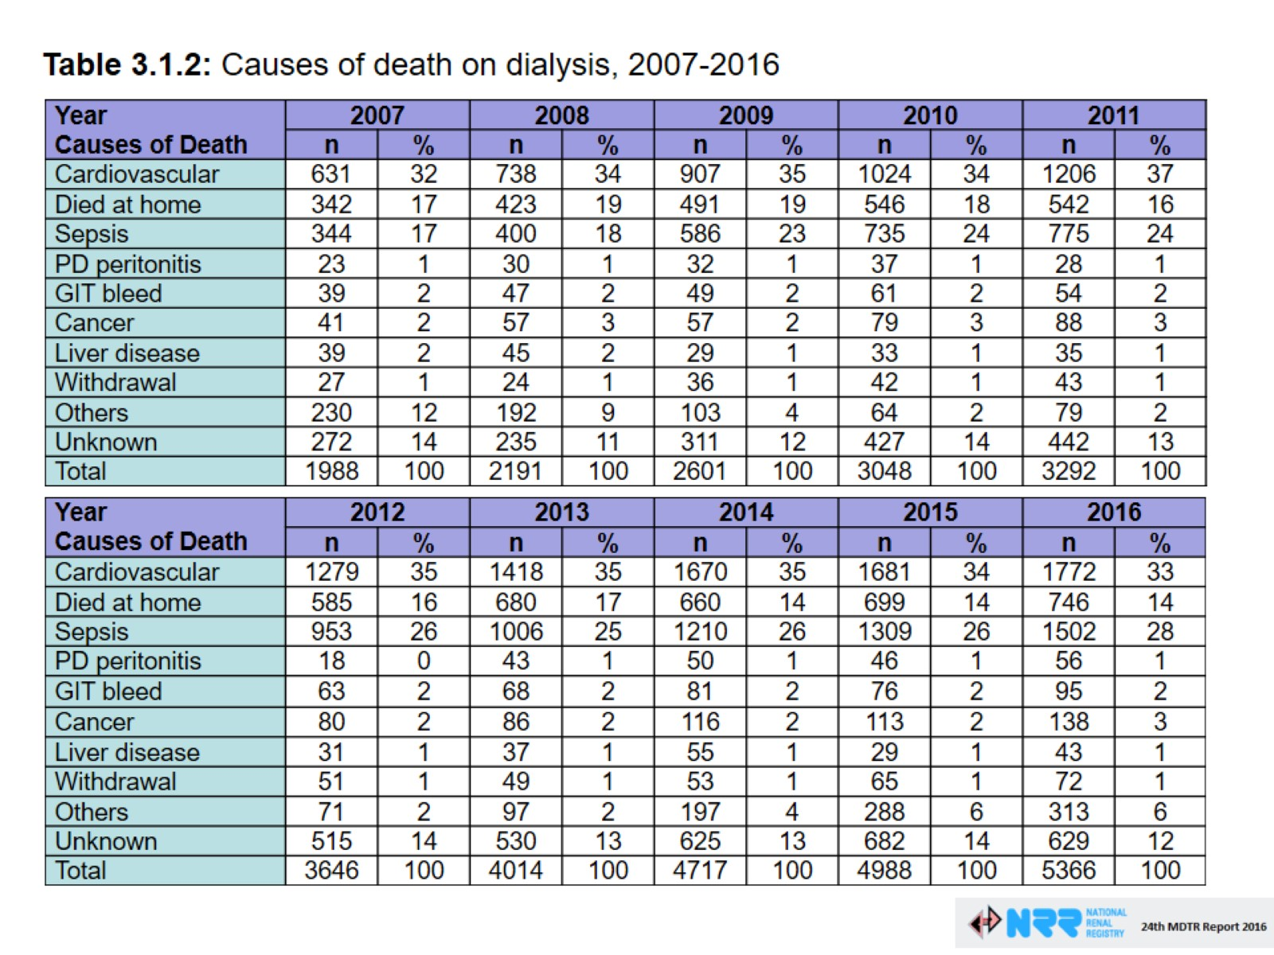
Causes of Death
28%
Renal uitm
renaluitm.com

Slide 16
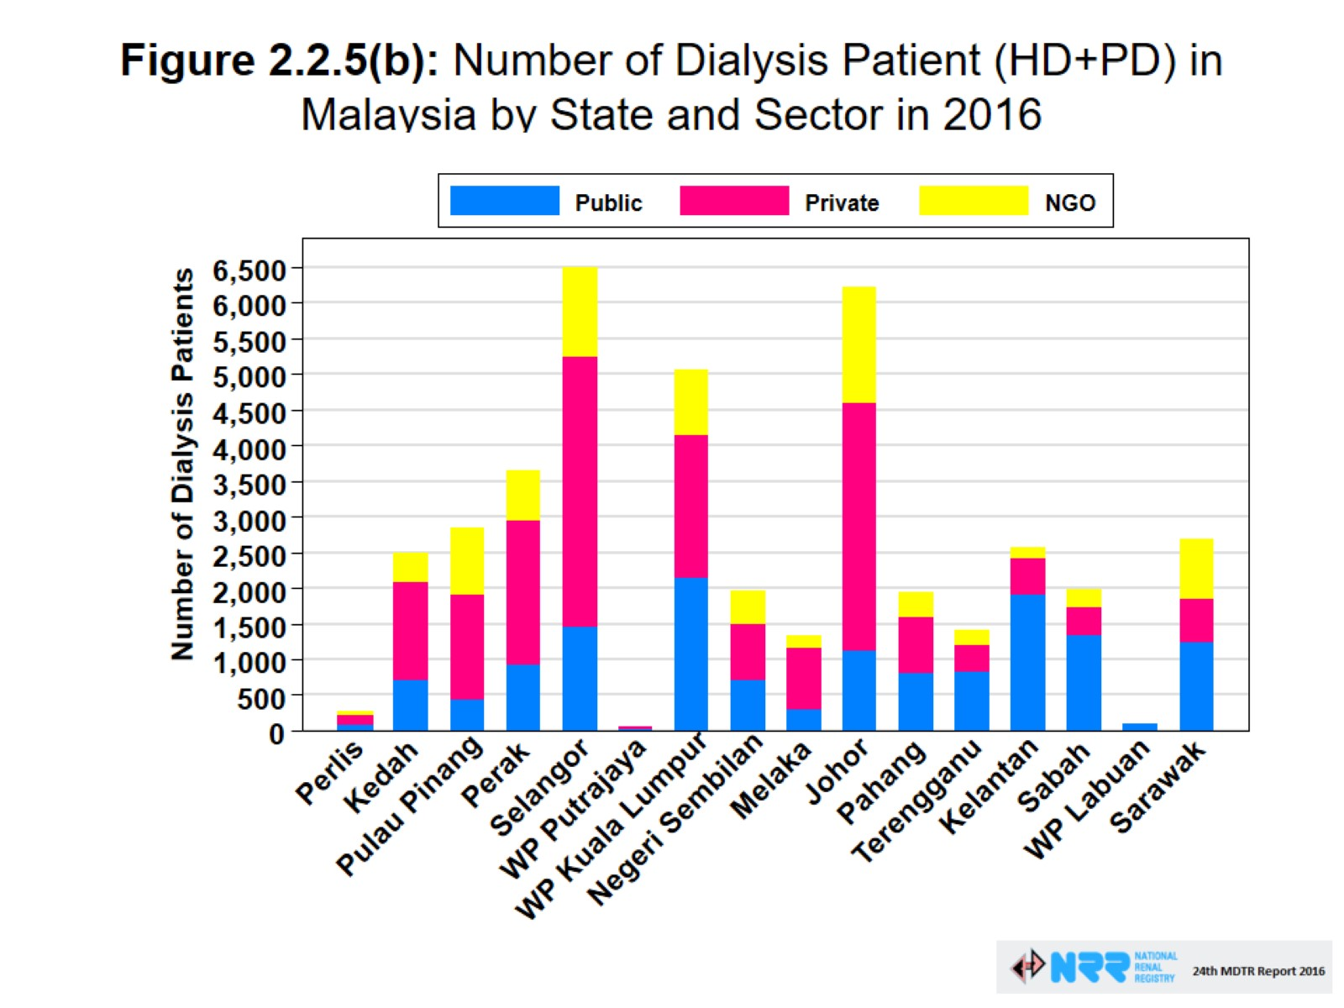
Dialysis patients
Renal uitm
renaluitm.com

Slide 17

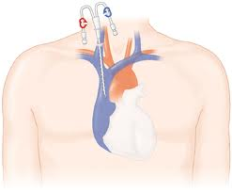
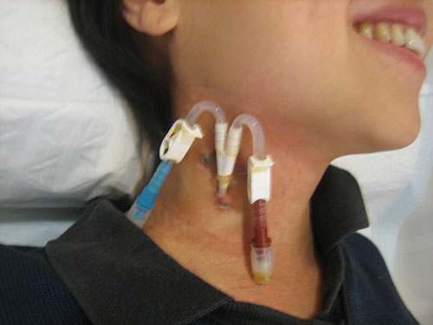
Cause of Sepsis! - IJC!!!
Renal uitm
renaluitm.com

Slide 18
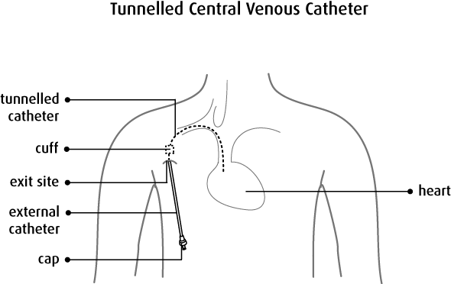
Perm Catheter
Renal uitm
renaluitm.com

Slide 19
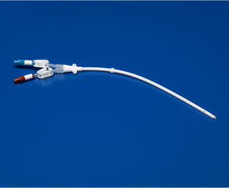
Perm/cuff/tunnel Catheter
Dacron cuff forms a fibrosis under the skin
Renal uitm
renaluitm.com

Slide 20
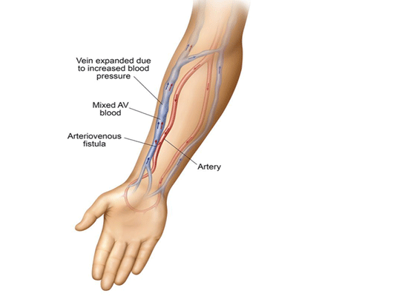
NKF-KDOQI Guidelines
IJC – 3 weeks!
> 3 weeks – cuffed (perm) catheter
AVF!!!
Renal uitm
renaluitm.com

Slide 21
Pathogenesis
Immediately after insertion, the surfaces of the catheter become coated with plasma proteins called fibrin.
Bacteria migrate from skin along the catheter track or from the catheter hubs down the lumen and become embedded in this protein sheath.
This can happen within hours of insertion.
Renal uitm
renaluitm.com

Slide 22
Source of CRBSI
Renal uitm
renaluitm.com
Notes:
Dialysis catheter-related bacteremia can arise from one of two sources [13]:
●Migration from the skin along the outside of the catheter into the bloodstream. The Dacron cuff in tunneled catheters typically incites an inflammatory response with fibrosis that, in turn and in time, may create a mechanical barrier to migration of bacteria from the skin along the outside of the catheter.
●Direct inoculation from a biofilm containing pathogenic micro-organisms that may form on the inner surface of the catheter [13].

Slide 23
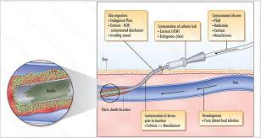
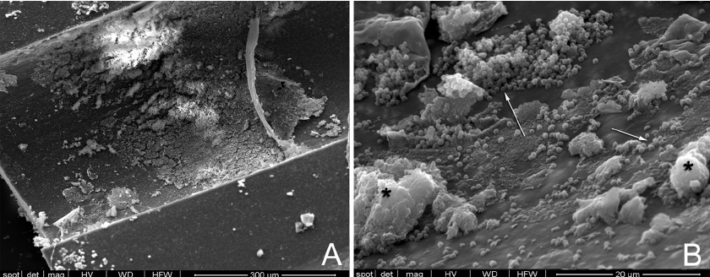
Biofilm on catheter
Staph, Pseudomonas, Candida
Renal uitm
renaluitm.com

Slide 24
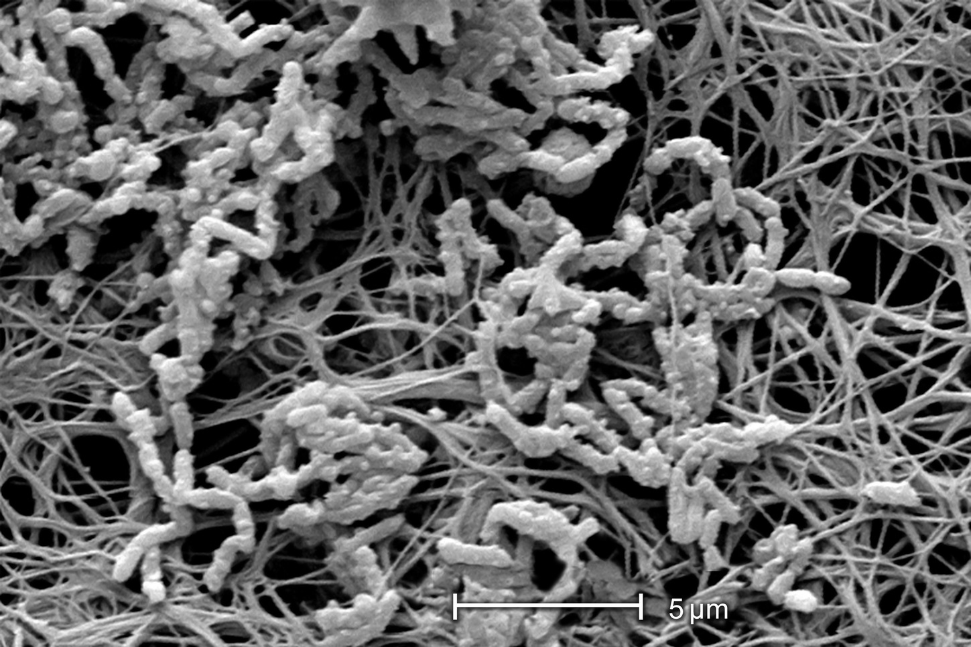
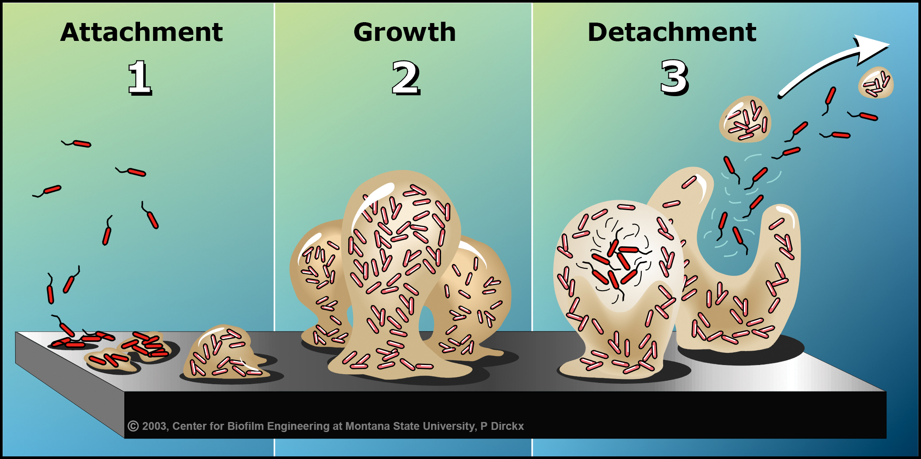
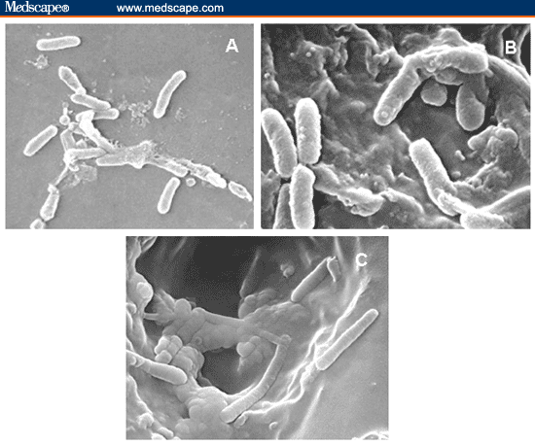
Biofilm on catheter
Renal uitm
renaluitm.com

Slide 25
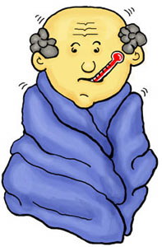
Symptoms
Fever or chills during HD
No other localizing signs (cough, diarrhoea)
Lethargy and unwell
Hypotension
Changes in mental status
Pain and redness at exit site
Pus discharge at tunnel
Renal uitm
renaluitm.com

Slide 26
Complications
CRBSI triggers a systemic inflammatory response (SIRS), ranging from fever and leucocytosis through to septic shock and multiple organ failure.
The reported mortality rate varies from 3 to 25%.
Metastatic infection - septic thrombosis, endocarditis and septic arthritis.
Deep-seated infection – psoas abcess
Renal uitm
renaluitm.com

Slide 27
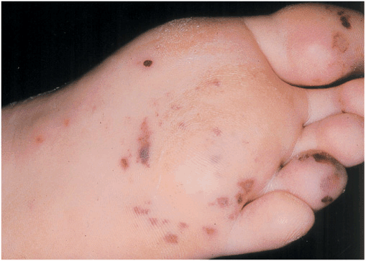
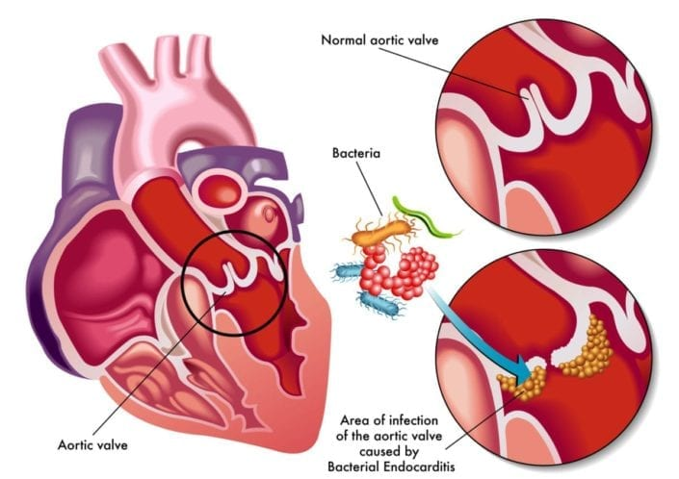
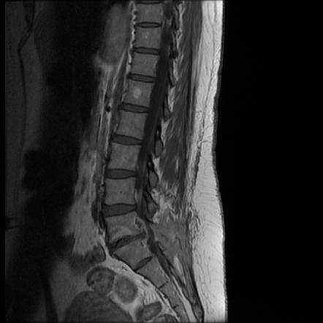
Complications
Renal uitm
renaluitm.com

Slide 28
Prevention
Catheter insertion and position
  Aseptic technique, no femoral
Antimicrobial locks
  Citrate lock, antibiotics locks
Nursing care
  Exit site care, aseptic technique, patient advise
Renal uitm
renaluitm.com

Slide 29
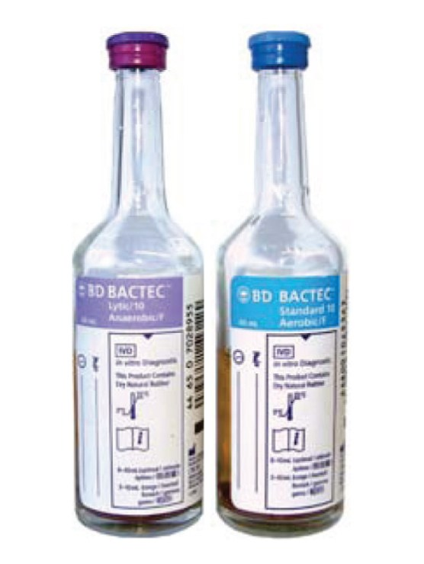
Management
Before starting antibiotic therapy
Blood cultures
  Catheter (both lumen)
  Peripheral
Remove catheter if possible
Guidewire exchange if difficult vascular access
and no tunnel infection.
Renal uitm
renaluitm.com

Slide 30
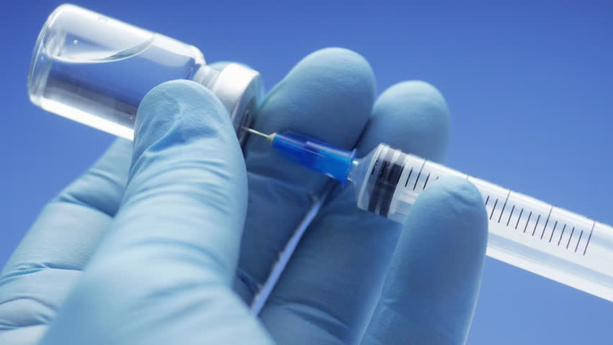
Antibiotics
Depends on severity and likely organism
IV Cloxacillin 1g QID
IV Cefazolin 2g EOD
IV Vancomycin 1-1.5g loading dose
(repeat level after 48h)
IV Tazosin (unwell)
IV Fortum
Renal uitm
renaluitm.com

Slide 31
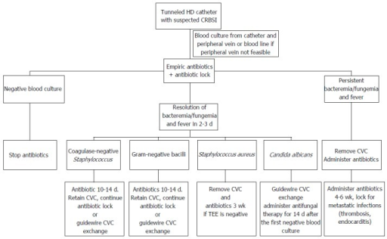
Antibiotics
Renal uitm
renaluitm.com

Slide 32
Further reading - Guidelines NKF/KDOQI
HD Adequacy
PD Adequacy
Vascular access
Renal uitm
renaluitm.com

Slide 33
Hepatis B , Hepatis C and HIV
Understand nature of viruses
Understand how to get infected
What to do if detect a new infection
Centres who offer Hep B, Hep C and HIV
Renal uitm
renaluitm.com

Slide 34
Factors in transmission
Cross contamination
Health care worker can transfer the virus to another patient’s skin or blood line access port
Breakdown in standard infection control practices
Equipment and supplies not disinfected between patient use
Common medication carts
Sharing of multiple-dose medication vials
Blood spills
Renal uitm
renaluitm.com

Slide 35
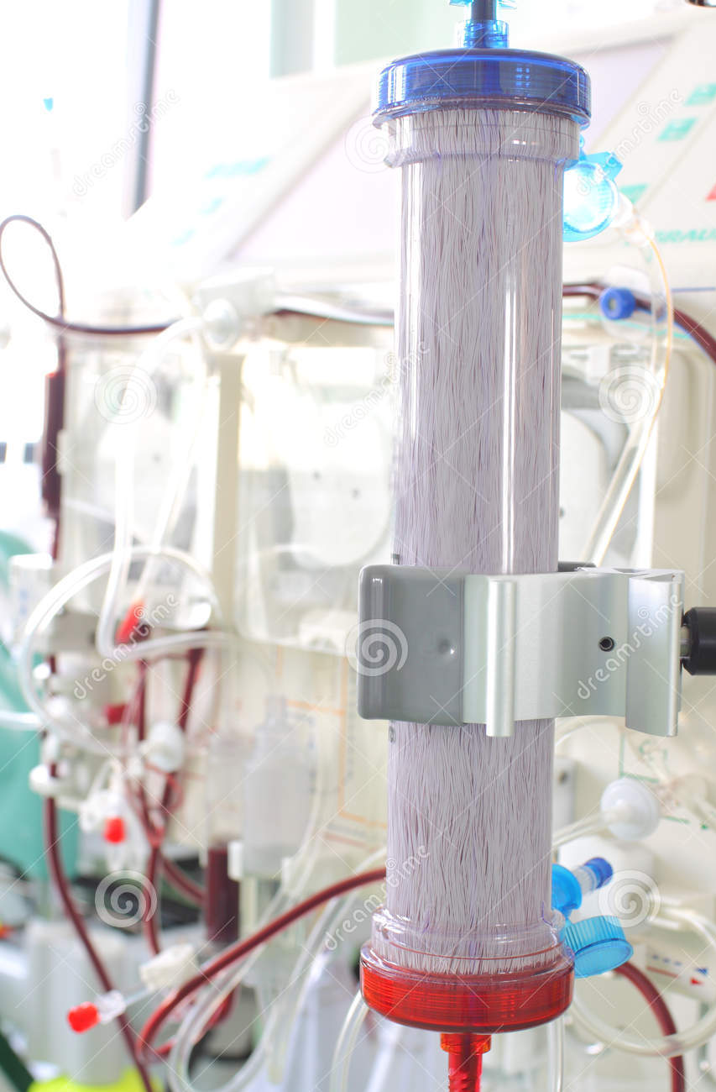
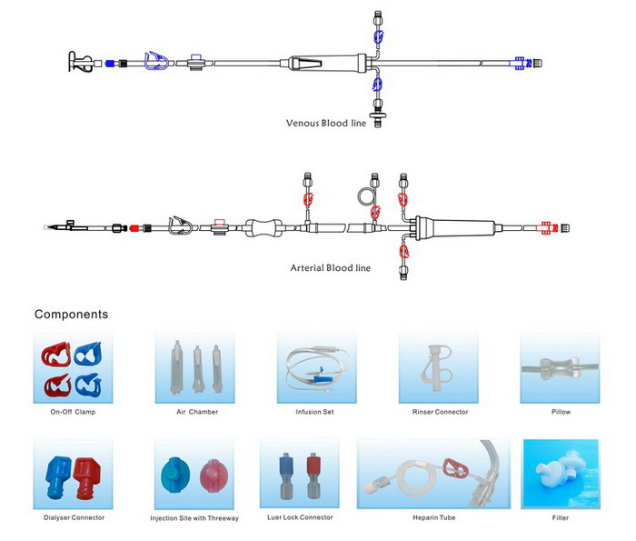
Transmission via HD machine(dialyzer or blood line)?
NO!
Blood does not touch machine!
Virus too big to pass through membrane!
Renal uitm
renaluitm.com

Slide 36
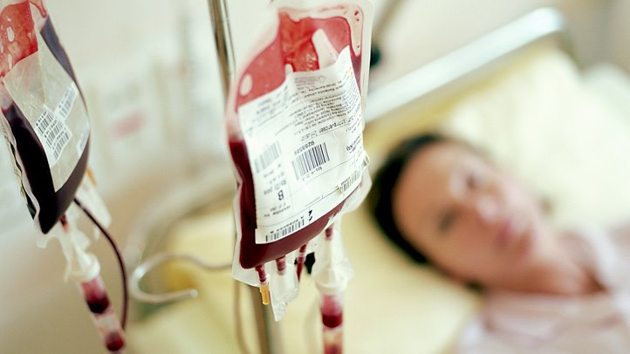
Highest risk of viral transmission – blood transfusion!!
Renal uitm
renaluitm.com

Slide 37
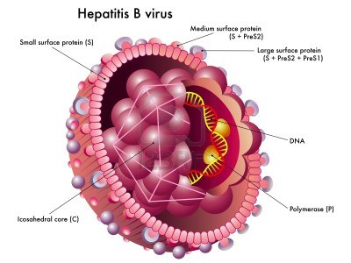
Hepatitis B
Hepatitis B virus (HBV) is a double-stranded DNA virus.
Causes hepatitis.
Transmission
  Blood (transfusion)
  Semen (sex)
  Needles (needle prick)
  Mother to baby (vertical)
  Nosocomial (hospital, HD centres)
  Breast milk - NO
Renal uitm
renaluitm.com

Slide 38
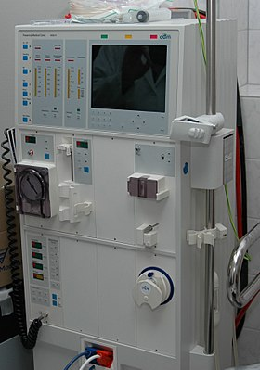
FACT! Hepatitis B
HBV is stable in the environment, remains viable for 7 days in room temperature
Renal uitm
renaluitm.com

Slide 39
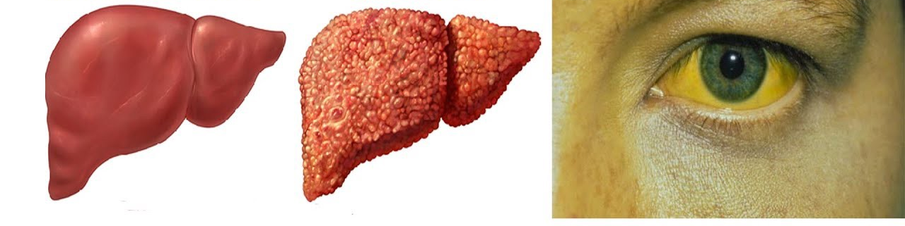
Chronic Hepatitis B
Renal uitm
renaluitm.com

Slide 40
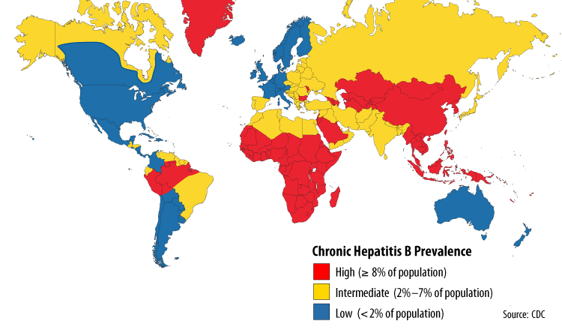
Hepatitis B
Renal uitm
renaluitm.com

Slide 41
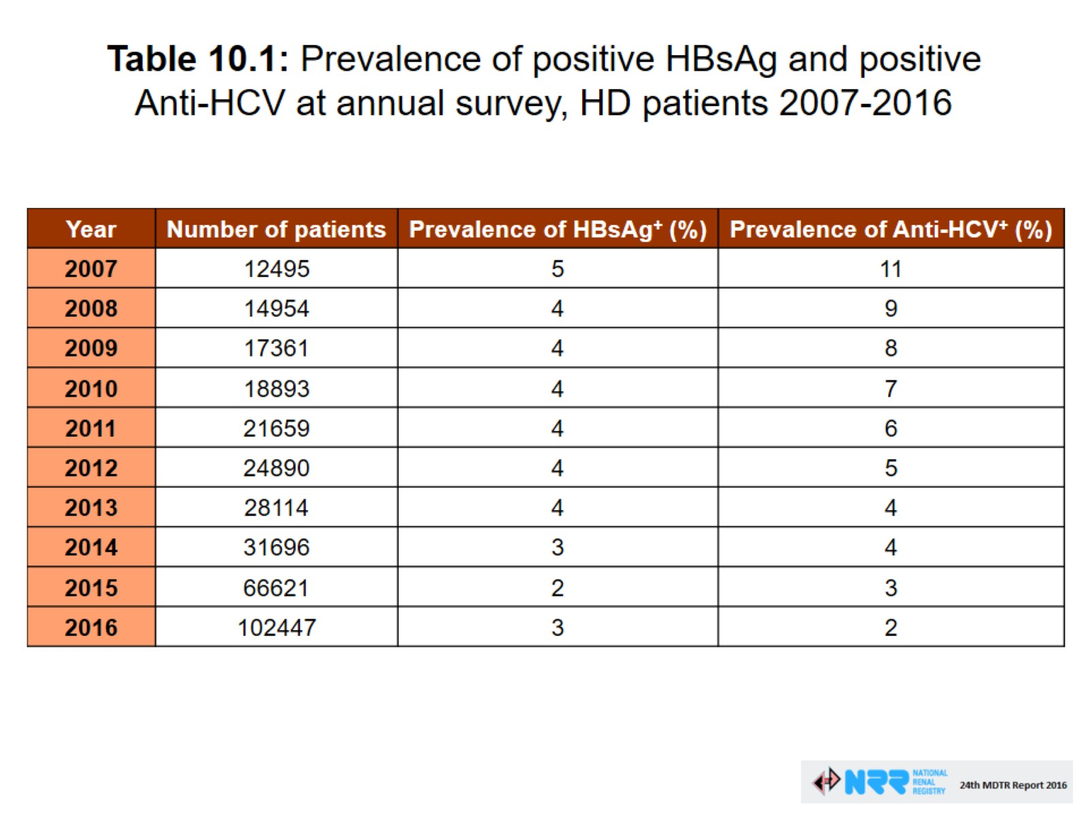
Hepatitis B and C
Renal uitm
renaluitm.com

Slide 42
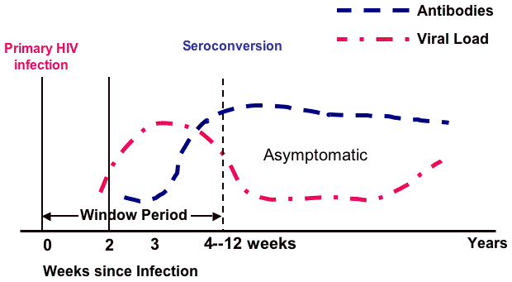
Seroconversion
Seroconversion is the time period during which a specific antibody develops and becomes detectable in the blood.
After seroconversion has occurred, the disease can be detected in blood tests for the antibody.
Renal uitm
renaluitm.com

Slide 43
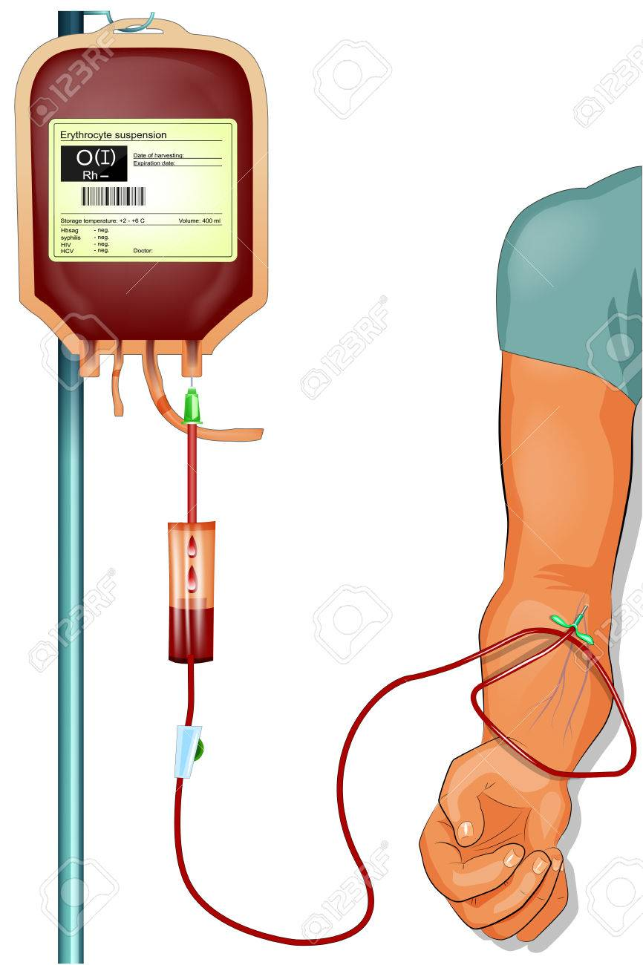
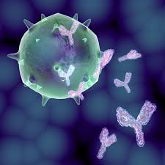
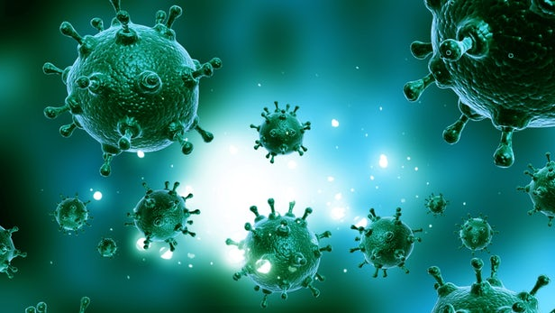
Seroconversion
DETECTABLE
(SEROCONVERSION)
NOT DETECTABLE
(WINDOW PERIOD)
Renal uitm
renaluitm.com

Slide 44
Hepatitis B - Screening
New patients with an unknown viral status
Patients who were negative for anti-HBs with history of recent transfusion of blood/ blood products
Patients with negative HBsAg and negative anti-Hbs returning from another HD facility with higher risk of hepatitis transmission
Renal uitm
renaluitm.com

Slide 45
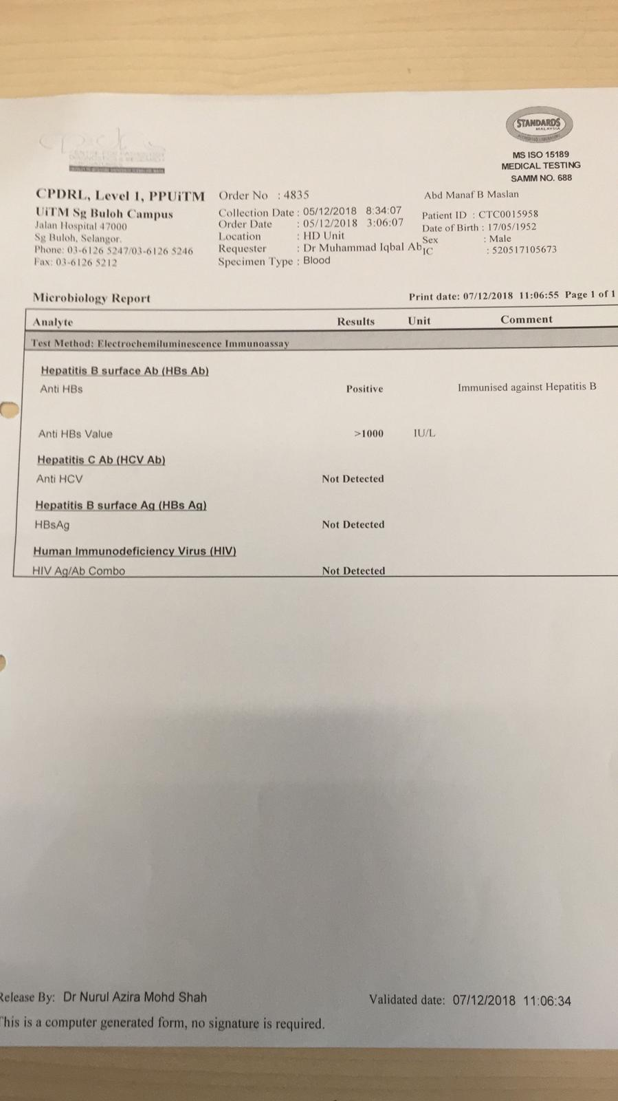
Hepatitis B
HBsAg at least every 6 months
Anti HBs shall be repeated at least yearly in patients who have responded to hepatitis vaccination
If anti HBs Ab <10 mIU/ml a booster dose should be given
Renal uitm
renaluitm.com

Slide 46
Hepatitis B - Vaccination
4 doses double-strength vaccination (40mcg) schedule is recommended at 0,1,2, and 6 months
Anti-HBs Ab should be checked 1-2 months after completing the vaccination course
Those that do not develop anti-HBs Ab response would unlikely response to further dose
Renal uitm
renaluitm.com

Slide 47
Hepatitis B - Isolation
All HBsAg positive persons are considered infectious and shall be isolated in a separate room.
They shall be dialysed using separate machines, equipment and instruments
Staff caring for HBsAg positive patients shall not care for Hepatitis B negative patients at the same shift
Renal uitm
renaluitm.com

Slide 48
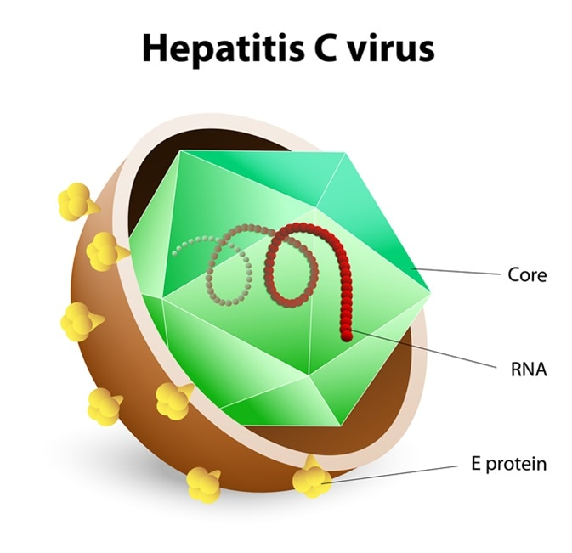
Hepatitis C
Hepatitis C virus (HCV) is a single-stranded RNA virus.
6 major genotypes
Causes hepatitis like Hepatitis B.
Transmission
  Blood (transfusion)
  Needles (needle prick)
  Mother to baby (vertical)
  Nosocomial (hospital, HD centres)
  Semen (sex) – (MINIMAL)
  Breast milk - NO
Renal uitm
renaluitm.com

Slide 49
Hepatitis C
NO VACCINATION
Screening anti-HCV
If positive send HCV viral load
Treatment previously was peg-interferon + ribavirin which achieved 40-50% cure (SVR)
Now with combination direct anti-virals (DAA) – can reach 90-100% SVR
Hepatitis does not return if SVR is achieved
Renal uitm
renaluitm.com

Slide 50
Isolate Hepatitis C?
Renal uitm
renaluitm.com
KDIGO GUIDELINES HEPATITIS C IN CKD 2018

Slide 51
Reprocessing and Dialyzer Use
Single use dialyzer is recommended for Hep B & Hep C patients
Where dialyzer reuse is unavoidable, dialyzers of infected patients can be reused provided there is implementation of & adherence to strict infection-control procedures
Proper separation and reprocessing procedures should be observed
Use separate rooms to reprocess dialyzers from anti-HCV +ve and -ve patients
Studies have not shown ↑ incidence of HCV infection in patients treated in units that reprocessed dialyzers
Renal uitm
renaluitm.com

Slide 52
HD Infection prevention
Proper hand hygiene and glove changes, especially between patient contacts, before invasive procedures, and after contact with blood and potentially blood-contaminated surfaces/supplies.
Proper injectable medication preparation practices following aseptic techniques and in an appropriate clean area, and proper injectable medication administration practice.
Thorough cleaning and disinfection of surfaces at the dialysis station, especially high-touch surfaces
Adequate separation of clean supplies from contaminated materials and equipment.
Renal uitm
renaluitm.com

Slide 53
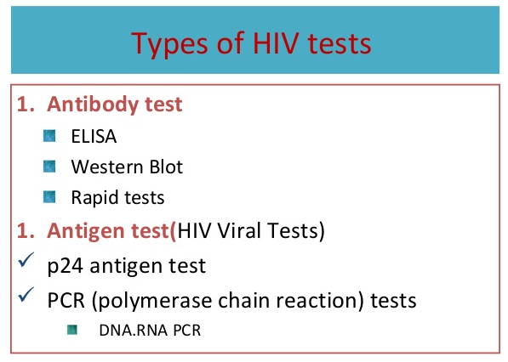
What if newly detected positive patient?
Identify the potential source
  recent medical/travel history (blood transfusion, other centres, hospitalization, Haj)
  high risk behaviour
  any breach in unit practices & procedures
Notify the nephrologist, inform the other centre involved
Repeat test to confirm – send HBV DNA or HCV RNA (costly)
Renal uitm
renaluitm.com

Slide 54
What if newly detected positive patient?
Meanwhile precaution measures
  suspected seroconverted patients – isolation, if not to be placed at a corner of the common area, last shift of the day
  single use dialyzer for the suspected patient
Screen for all patients in same shift (if it has not been done), or entire unit if frequent change of shift among pts
Tests need to be repeated for all pts in 1-3 month time, for total 3-6 months to detect new infection
Once confirmed seroconverted – refer to hospital
Renal uitm
renaluitm.com

Slide 55






Thank you!
https//: renaluitm.com
@ renal uitm
Renal uitm

