Slide 1


MST Debate
Opt out – Is Malaysia Ready?
Dr Muhammad Iqbal Abdul Hafidz
Nephrologist, UiTM

Slide 2
Is Malaysia Ready?
ABSOLUTELY - way overdue!

Slide 3
Outline
Convince you that there is a transplant crises.
Define opt out and why it’s a good move.

Slide 4
Adakah Malaysia Bersedia Untuk Sistem “OPT OUT”
Untuk Menjadi Penderma Organ (Cadaveric)
OPT IN – Register/berikrar untuk menjadi penderma
atau
OPT OUT – Semua orang DIANGGAP Penderma – Kalau Tak Nak Kena Cakap

Slide 5

OPT OUT = taking your organs without your consent.

Slide 6
Why are we debating opt out?
Objective of opt out is to increase cadaveric donation.

Slide 7
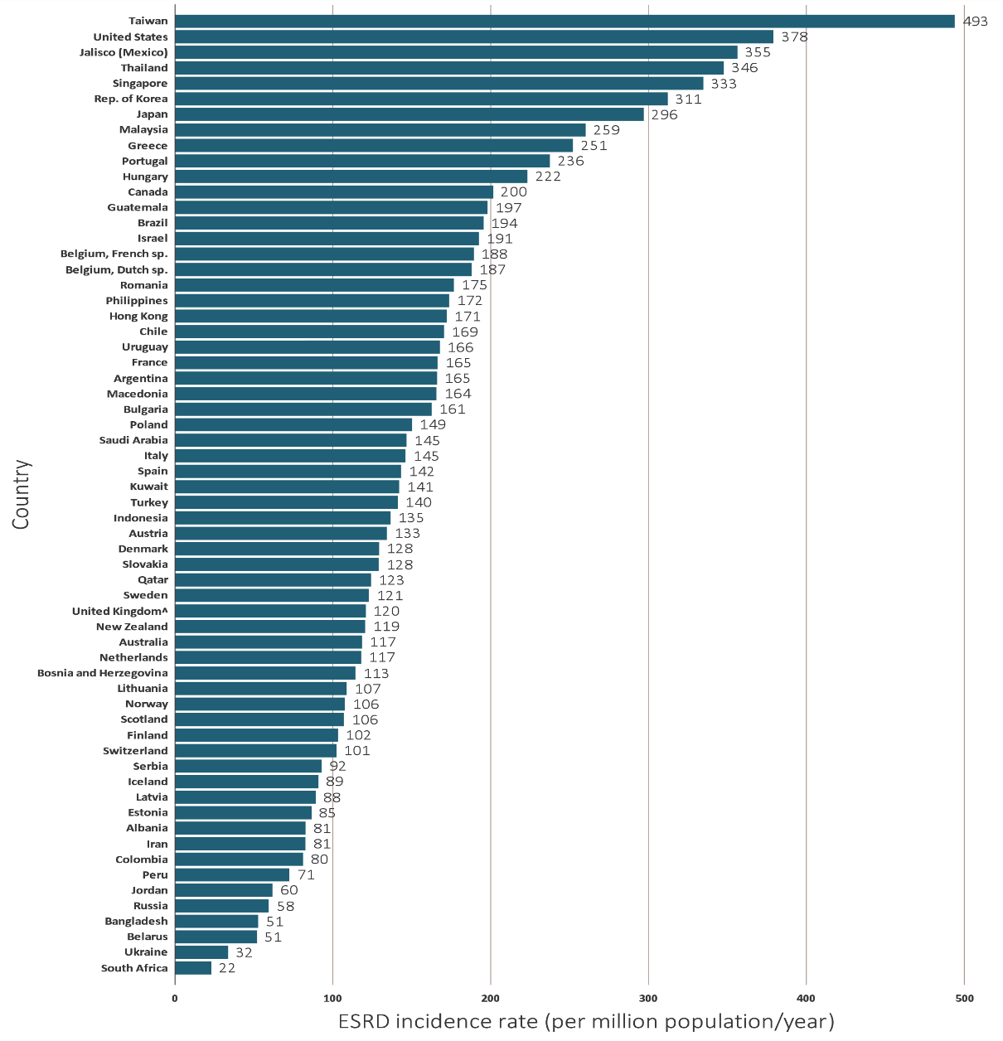
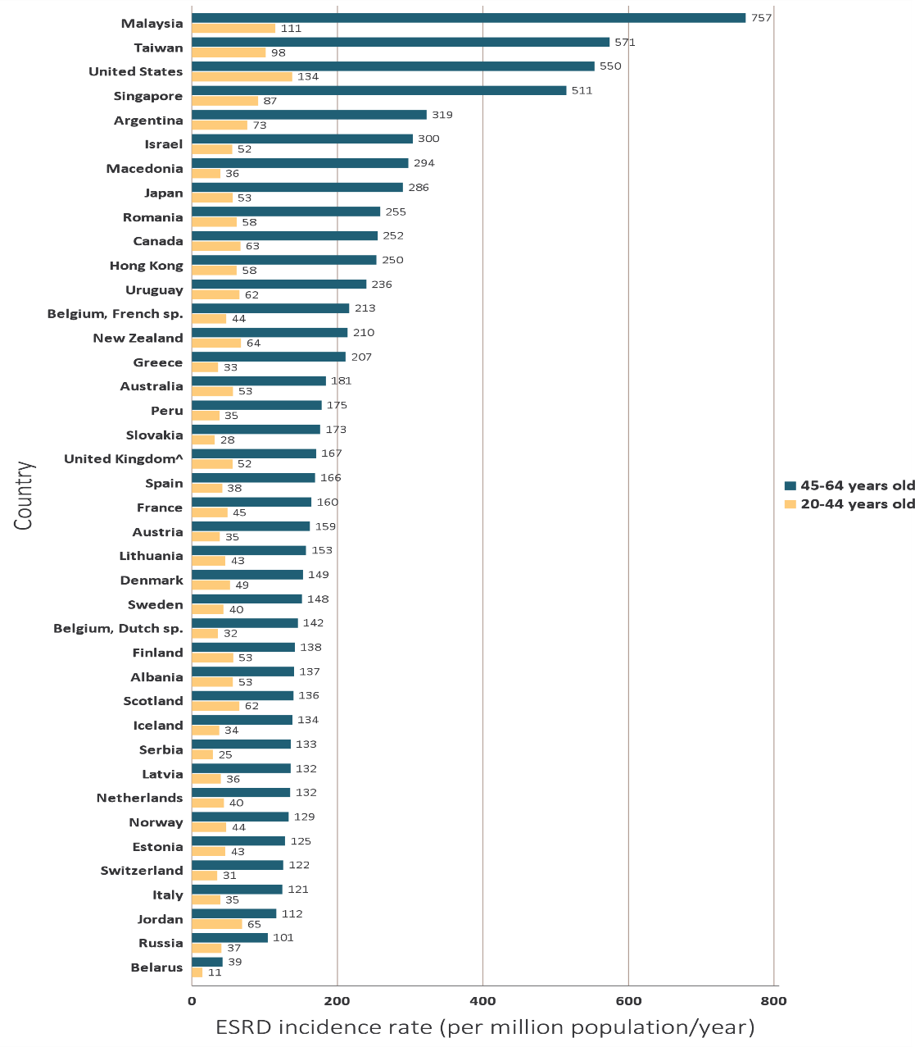
ESRF in Malaysia (USRDS 2018)

Slide 8
ESRF in Malaysia

Slide 9
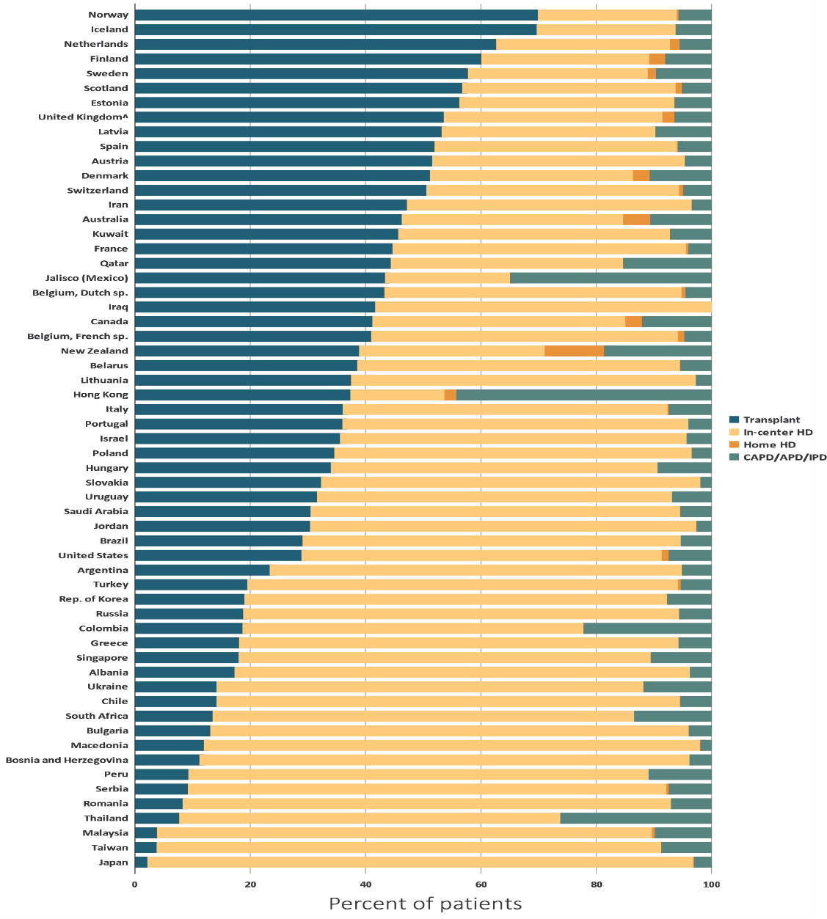
Percentage distribution of type of RRT modality used by ESRD patients, by country, in 2016
cadaveric
transplant
HD
PD

Slide 10
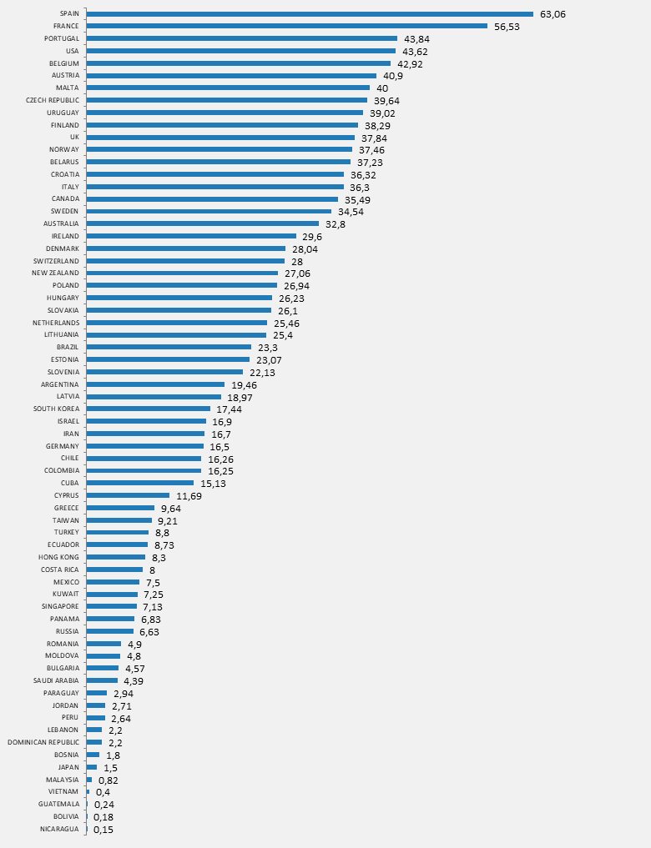
International Registry in Organ Donation and Transplantation 2017 (Kidney)

Slide 11
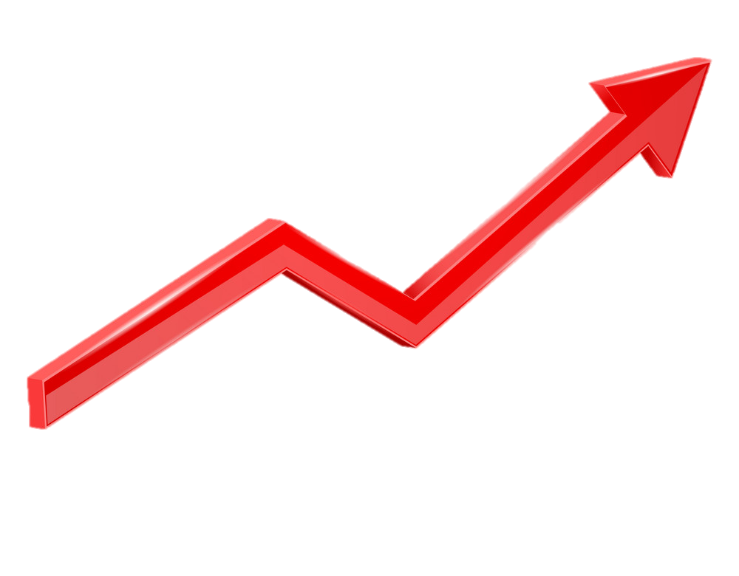
Transplant decline in Malaysia
First living related renal transplant was performed in HKL 1975
First deceased kidney transplant 1976.
However numbers of kidney transplant are on the decline.
First liver transplant 1995 in SJMC.
The first heart transplant was 1997 and lung transplant 2005.
All in decline.
First CABG performed in 1975
44 years of trying and failing..

Slide 12
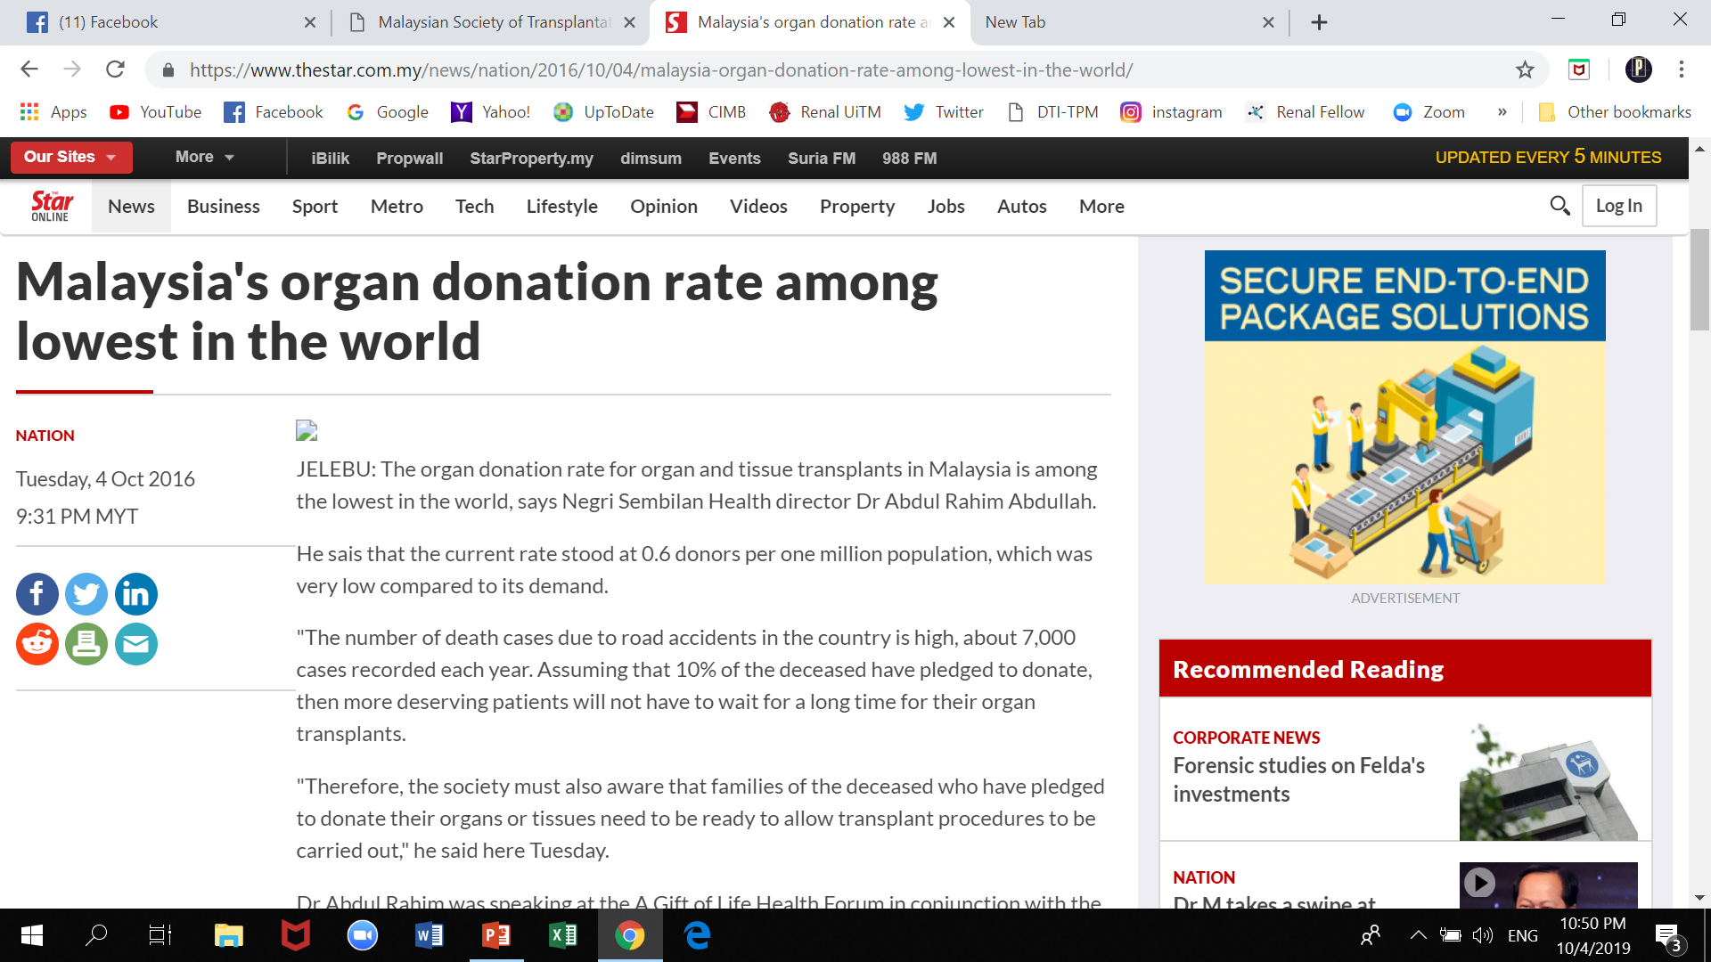
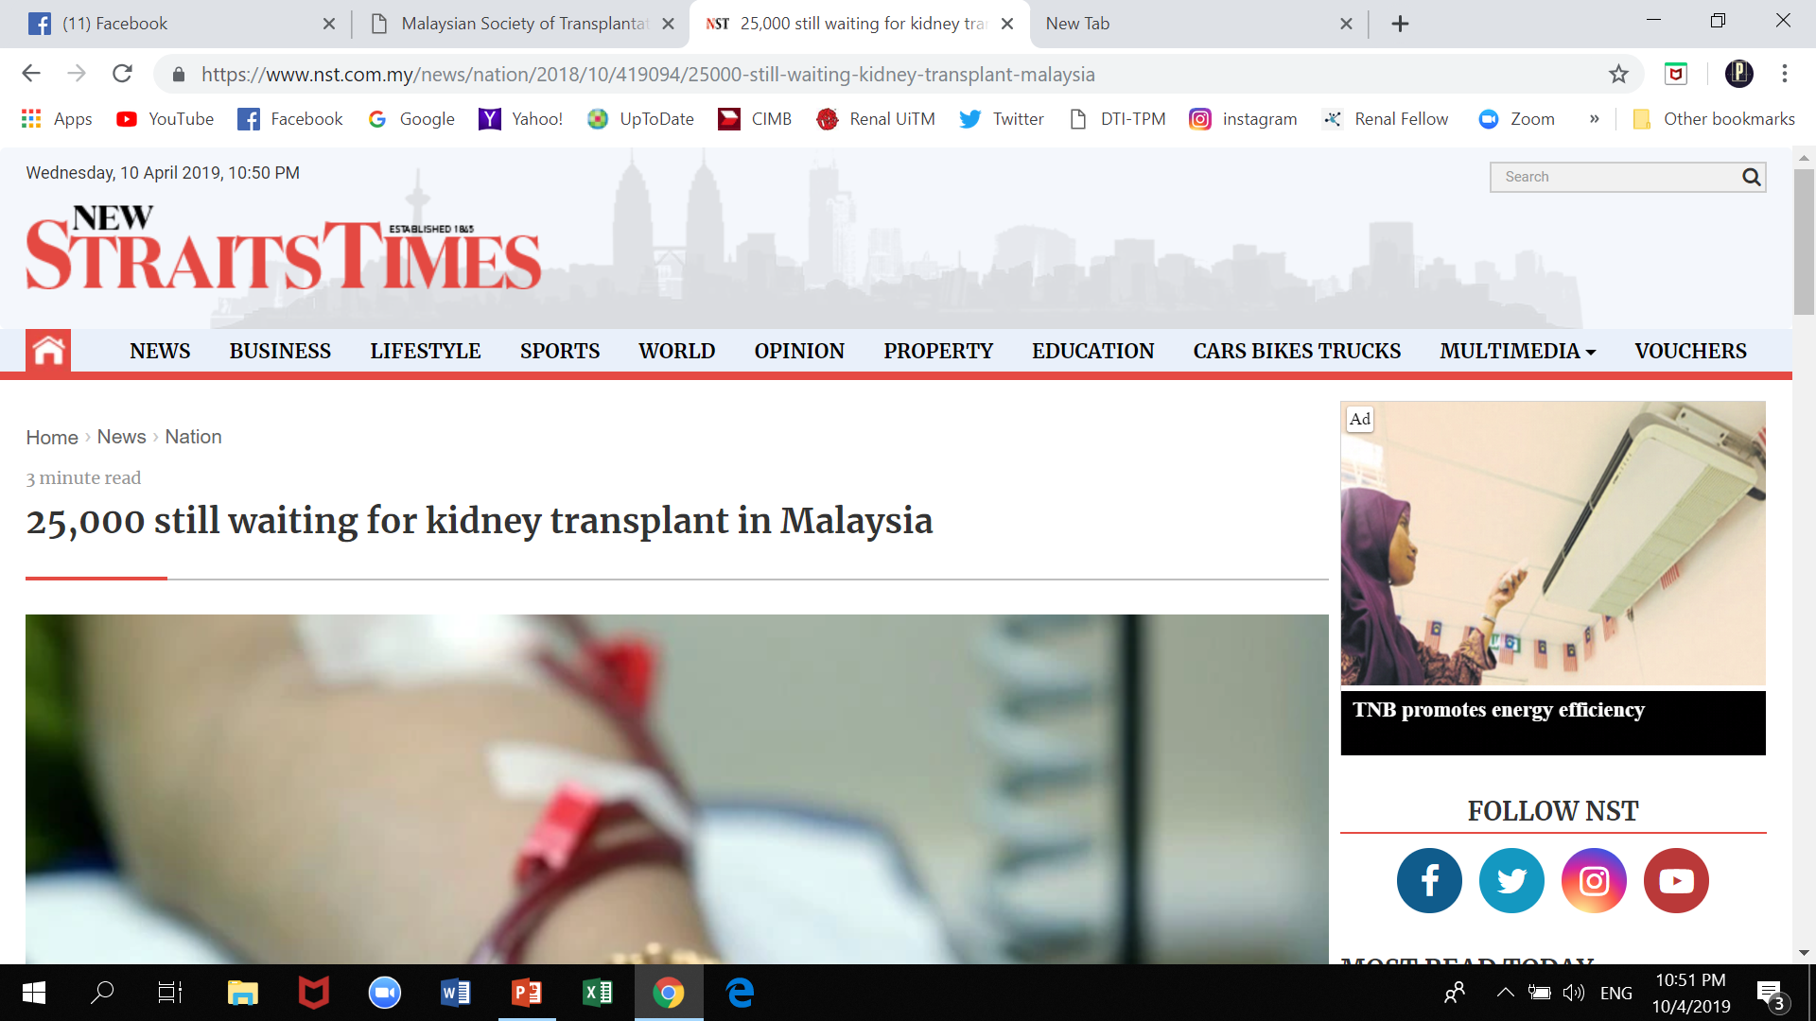
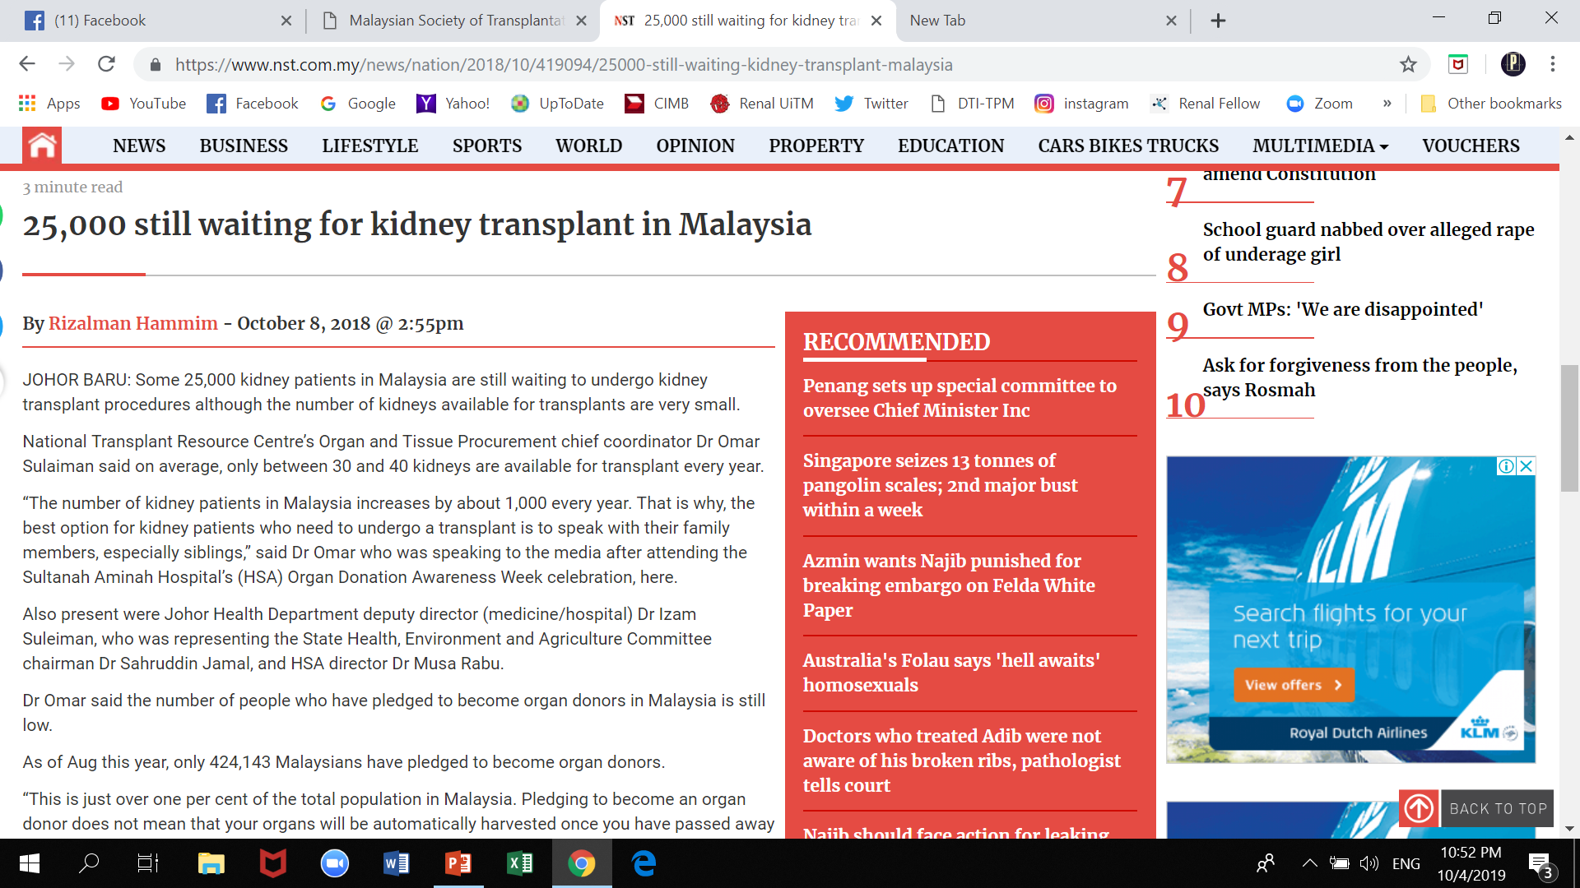
25,000 patients are waiting for a transplant

Slide 13
#1
Transplant is in a crises and we need to do something about it – opt out

Slide 14
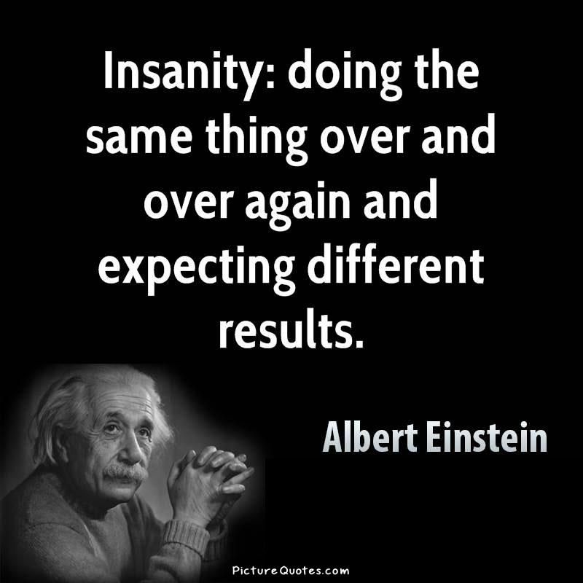

Slide 15
New Strategies
Start a subspeciality in transplant surgery
Continue educating public, politicians, religious leaders, policy makers.
Work hard on cadaveric! (not living)
  Invest in NTRC, IMR
  myKAS
  ODISSea – academic program on organ donation and transplantation
  Decentralize (East Coast, East Malaysia)
  Share responsibility – MOH MOE Private
  Opt out

Slide 16
Don’t just think about the kidneys!
Lungs, heart, cornea all dependent on a successful cadaveric system!

Slide 17
Definition of OPT OUT
OPT OUT – presumes that everyone agrees to donate their organs unless they express not to
Soft opt out - organs may be taken unless objection of their family members (next of kin).
Hard opt out - requires doctors to only inform the relatives about which organs are to be procured, and not ask their permission to procure.
NEVER BEEN ABOUT FORCING PEOPLE TO HAND
OVER THEIR ORGANS!!!

Slide 18
Pros of Opt-out
Systematic inclusion and more efficient way
Reduces organ “waste” due to a potential donor not being a pledger
Going around asking for pledgers not necessary
Brings transplant into a public debate
Increase awareness amongst public
Increase awareness amongst doctors and healthcare workers
Treat the problem of inertia and apathy amongst doctors and change mindset
INDIRECTLY INCREASING AWARENESS & EDUCATING RATHER THAN FORCING EVERYONE TO GIVE ORGANS

Slide 19

“Spain says a successful cadaveric programme has nothing to do with opt-out”..

Slide 20
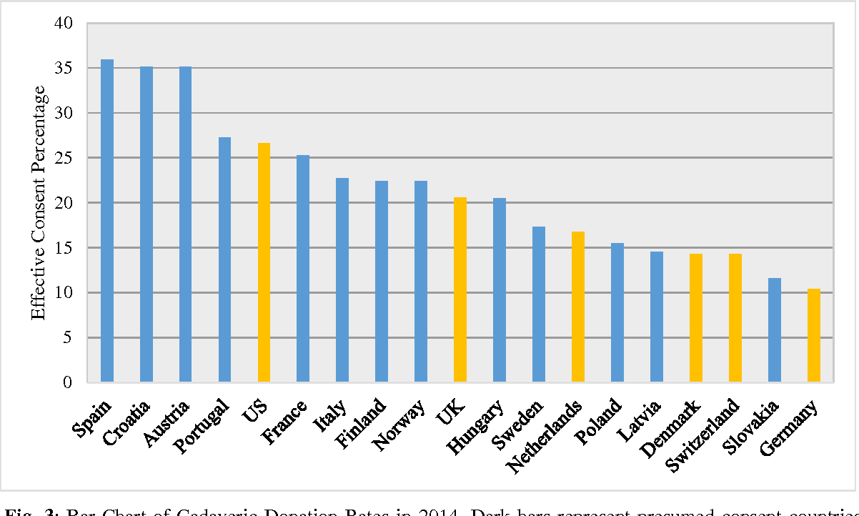
Opt in and Opt out countries
Most successful transplant programmes are OPT OUT!!
Opt out
Opt in
Cadaveric donation rate 2014

Slide 21
Don’t compare Durians with Oranges!
Don’t compare Malaysia with Spain.
Compare apples with apples (Germany vs Austria)

Slide 22
Many countries are changing to opt-out!
2020
2020
Bill passed 2019
Bill passed 2018
Malaysia

Slide 23
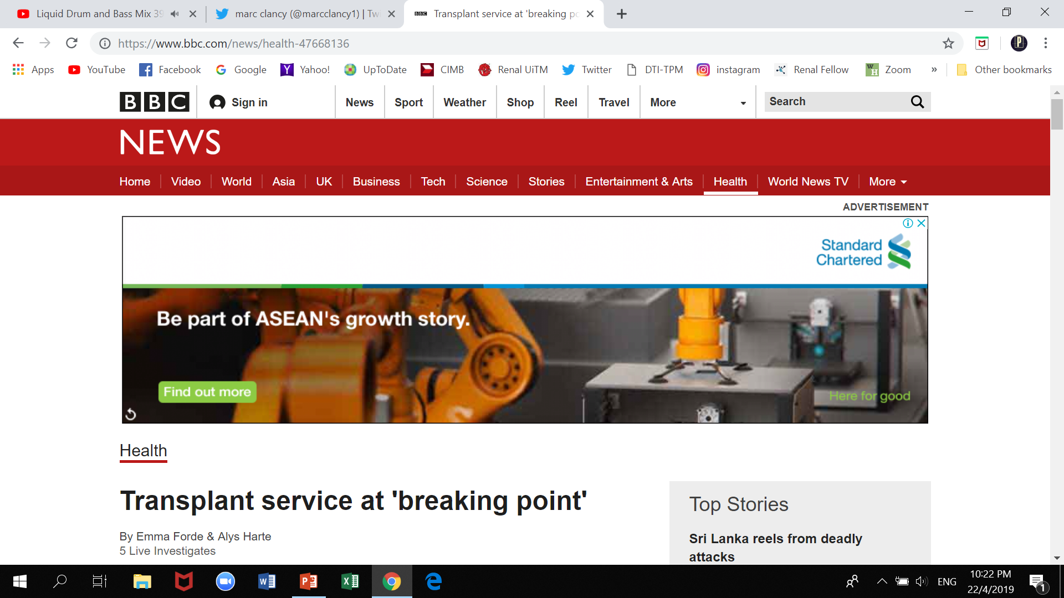
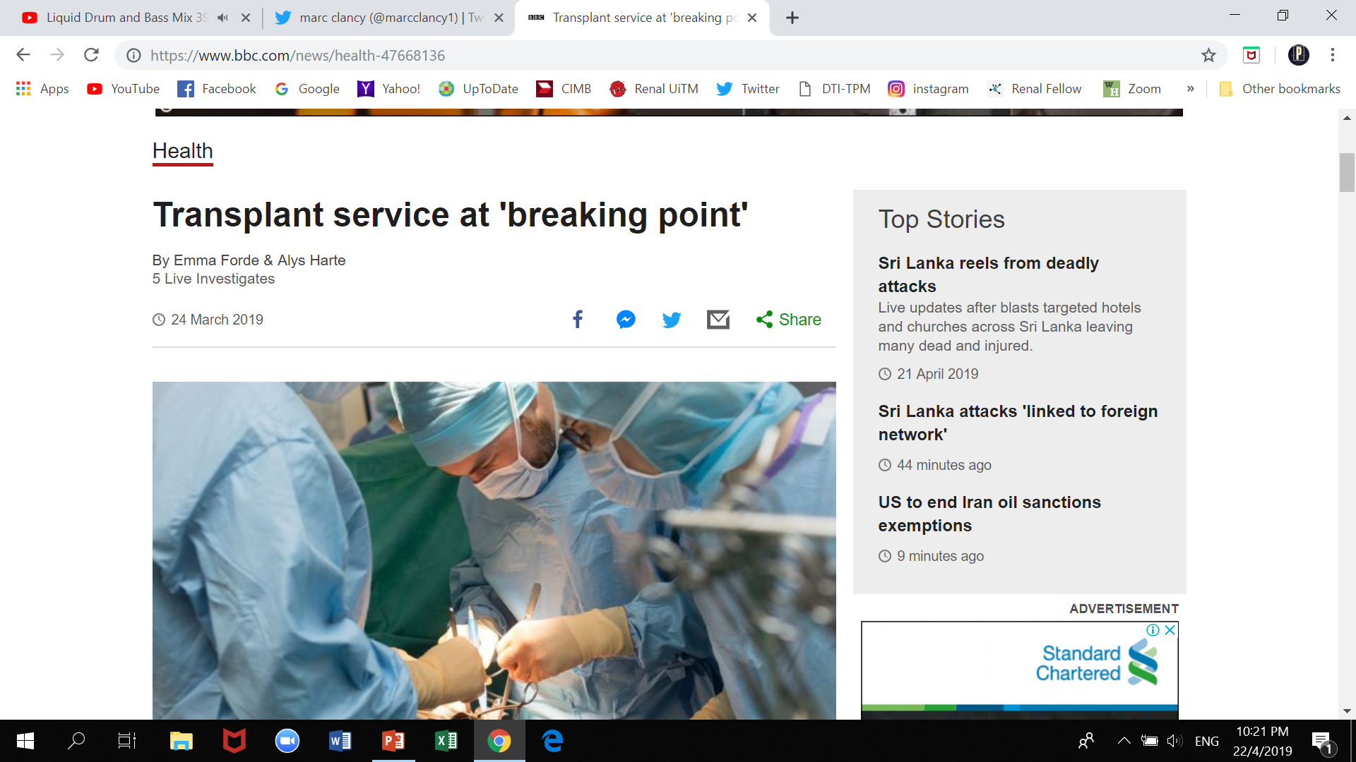
UK still plan for opt-out!
Hoping to save at least 700 lives!
Eventhough they are up to their necks with transplant!
So much to lose and may backfire!
INDIRECTLY INCREASING AWARENESS & EDUCATING RATHER THAN FORCING ORGANS

Slide 24
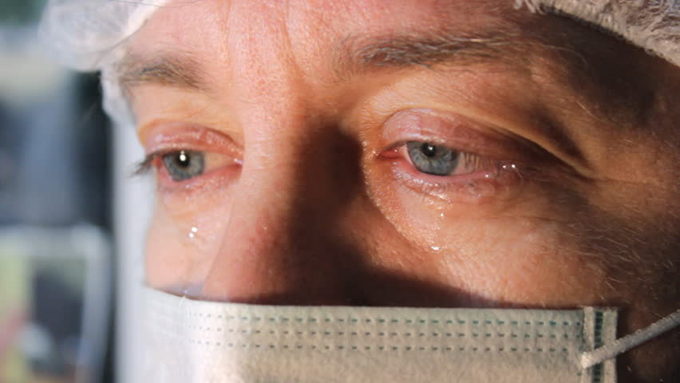
Negative effect? Backfire? Backlash?
The number of cadaveric transplant January 2019 till today – 2 cases
WHAT DO WE HAVE TO LOSE?????

Slide 25
Special cases – Brazil and France – HARD OPT OUT
Brazil
The public were not well informed – brain dead
Most Brazilians poor, illiterate – no ID and couldn’t opt out
High levels of mistrust towards the medical profession!
France
Negative publicity after corneas were taken from 19 year old without family’s consent
WE LEARN AND AVOID THIS

Slide 26
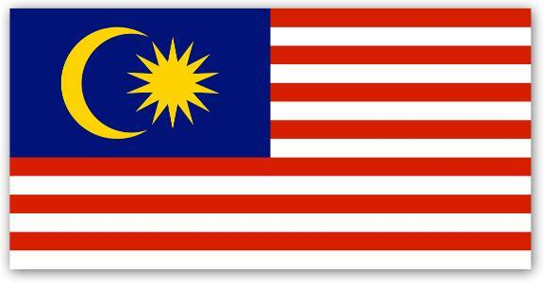
Will there be a revolt, outcry!?
We implemented black school shoes ☑
We implemented smoking ban. ☑
We abolished GST and implemented SST. ☑
We have local elections every other week ☑
WE CHANGED GOVERNMENT LIKE A PRO! ☑
MALAYSIANS ARE MORE MATURED THAN WE THINK!!!

Slide 27
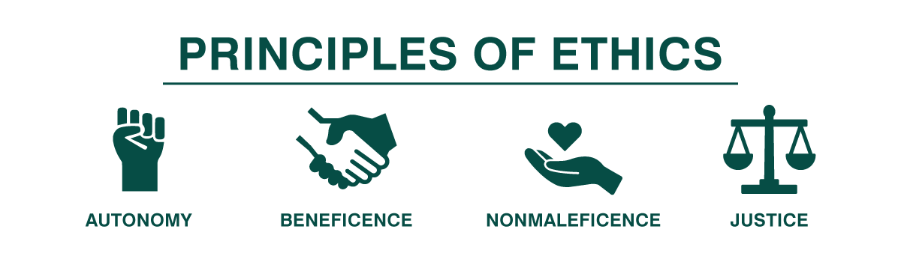
Its not just about autonomy
Smokers
Anti-vax
Increase awareness
Cost benefit and QALY
25 000 waiting for transplant
Those who want to donate but never had the chance

Slide 28
A knowledge, attitude & practice survey on cadaveric organ transplantation among pharmacy staff of HKL (2019)
Total – 217 respondents
178/217 (82%) – not pledged as a donor
  99 (55.6%) had never thought of donating
  37 (20.7%) did not know how to register (so why rest 42 did not register?)
55.2% disagree on the implementation of opt-out in Malaysia.
TEST WHETHER WE GET THE SAME RESULTS IN THE CROWD.

Slide 29
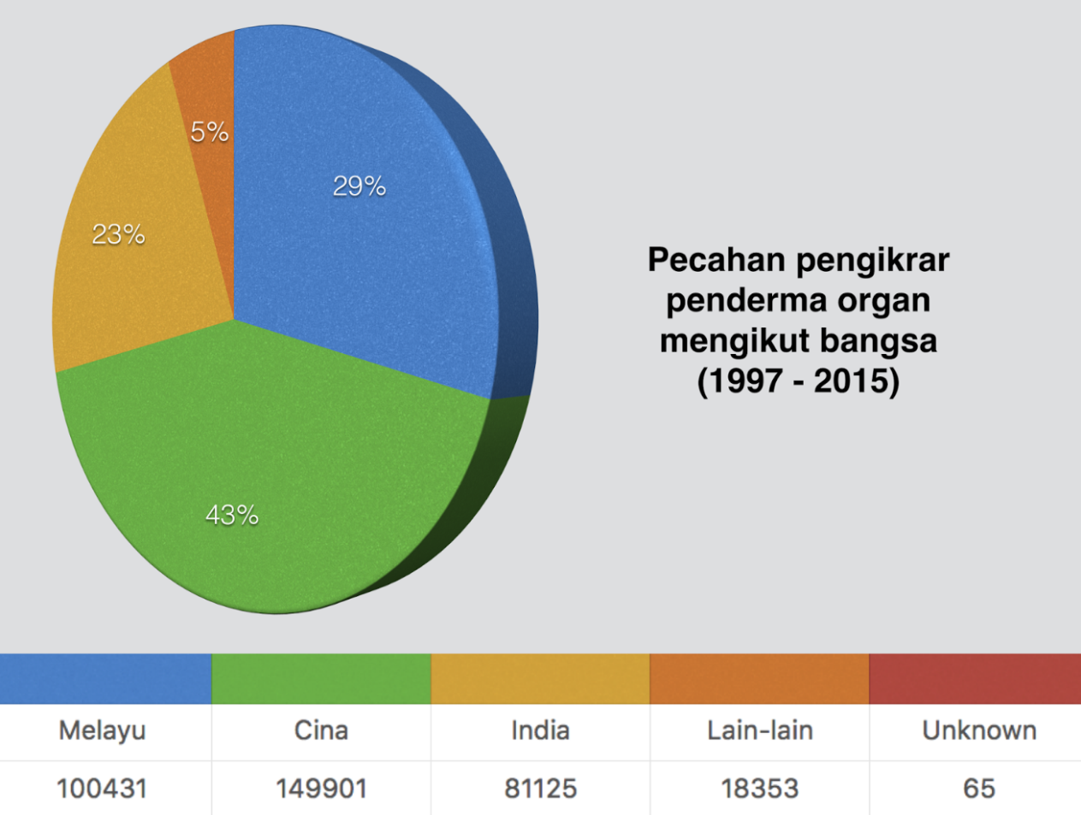
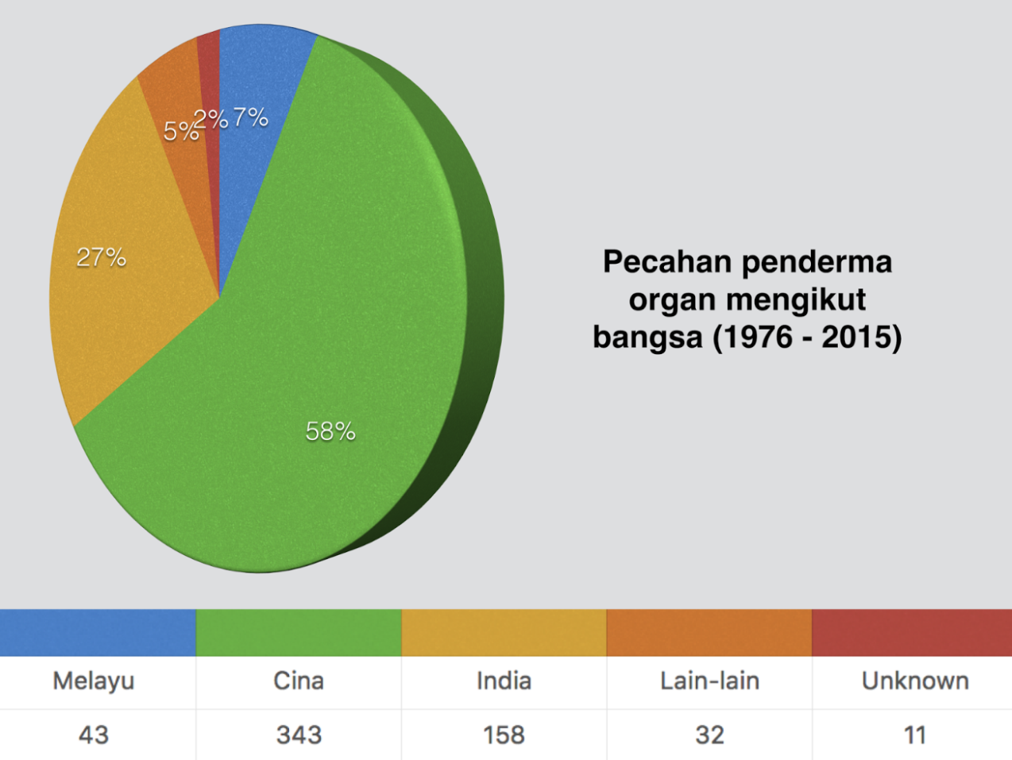
Pledging does not mean donation!
Pledgers ≠ Donors
Not because Chinese die more
Malays ?opt-in doesn’t work (don’t blame religion or culture)
Most organs that are donated were all initiated by the intensivists/anaesthetists i.e (non pledgers)

Slide 30
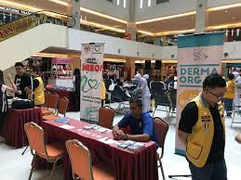
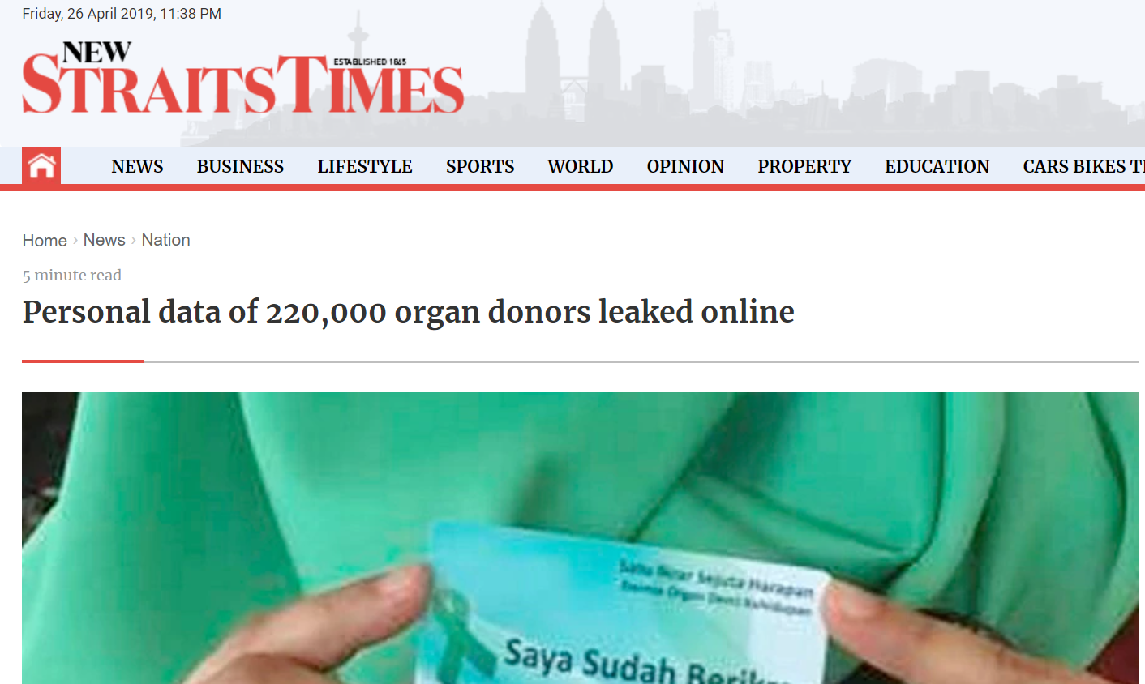
If a person wanted to pledge – how?
dermaorgan.gov.my – DOWN
Go to NTRC Wisma Sejarah
Wait for derma organ booth

Slide 31

Malaysia Model Muslim Transplant Country
Reputations – Turkey and Malaysia always mentionedto be leaders amongst Muslim nations
Can be a leader in cadaveric transplant if its successful!

Slide 32
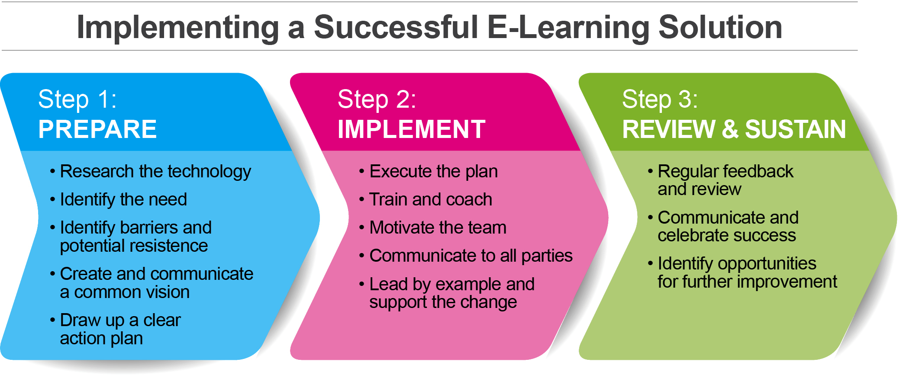
Implementing a successful opt-out
Define the change and justification
Clear plan
Must be able to perform transplant
Educate
Campaign
Increase awareness, public engagement
Gain support and trust
Transparent
Weed out /counter the trolls

Slide 33
Campaigning
Anti opt-out
Pro opt-out
Taking organs without consent!
The organs are the property of the state!
You have no choice!
Its against our will!
We presume that you are happy to donate your organs
Those who have not refused to donate is considered a donor.
You have the rights to refuse.
You will not be treated differently if you opt-out

Slide 34
To those opting out
Effective measures should be in place to enable those who do not wish to donate to record their decision and to ensure that this decision is respected.

Slide 35
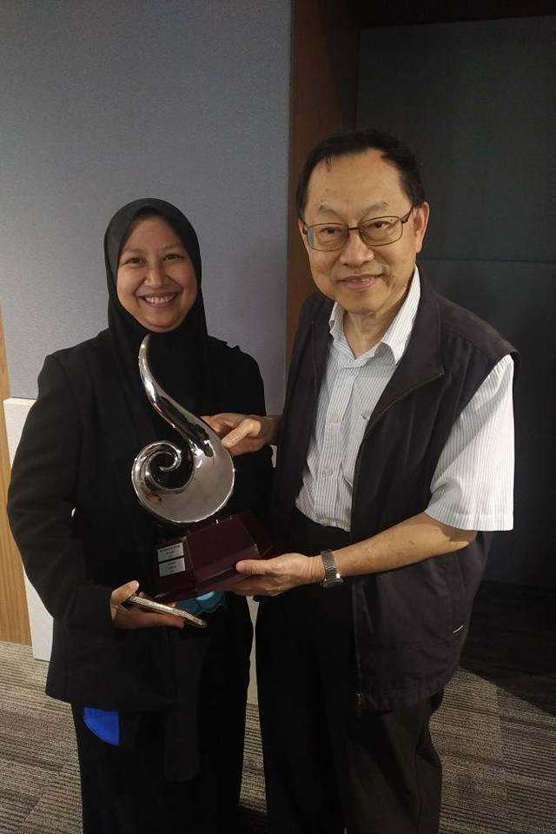
Thank you Fadhlina
Honour to debate with the “Diamond” @ “Debate Queen”
However this an opportunity to present opt out to:
  MST
  NTRC
  MSN
  Nephrologists – young and old
  EVERYONE in this hall!
We are responsible for the fate of transplant
- gotto be brave to change.

Slide 36
Conclusions – Transplant Crossroads
Transplant is in a crises and lots of people are dying waiting for an organ.
After 44 years we need to act.
Opt out is a presumed consent and does not mean forcing everyone to give the organs.
Opt out is a good option to increase our cadaveric rate
Transplant momentum is positive currently
#MSTdebate
#diamondvslonewolf
#nephroupmvsrenaluitm

Slide 37

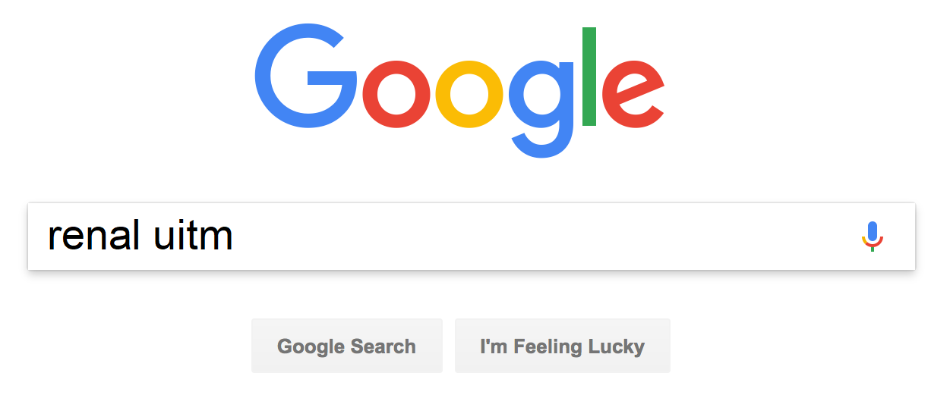




Thank you!
Slides available at https://renaluitm.com

