Slide 1


Debate: Obese ESRD Patients: HD or PD first?
Dr Muhammad Iqbal Abdul Hafidz
Consultant Nephrologist, PPUiTM Sg Buloh.
34th Annual Congress MSN, Penang 2018

Slide 2

In an obese ESRF..
Should PD be offered as a FIRST modality?

Slide 3
HD first!
Put yourselves in your own shoes (not of the PD experts) – realistic, rational, practical within your own practice.
2. Evidence for HD v PD in obese ESRD patients.

Slide 4
PD – surgical component
Emphasize - Strong surgical component to it
First step to PD
Tenchkoff catheter –Achilles Heel
Successful PD catheter placement and technique survival are crucial for its success and expansion
Frustrating and demoralizing to patientand self if fail
Later – revision, tunnel infection, transfer set change
OBESE PATIENTS – TECHNICALLY DIFFICULT set change

Slide 5
Methods of catheter placement
(best option for visualization)
Peritoneoscope
Saldinger technique (blind v fluoroscopy)
Open/Mini laparotomy
Laparoscopic
Also consider
Nephrologist vs Surgeons
Surgeons – General v Urologist, Specialist v MOs?
How confident are you?
Who do you trust?

Slide 6
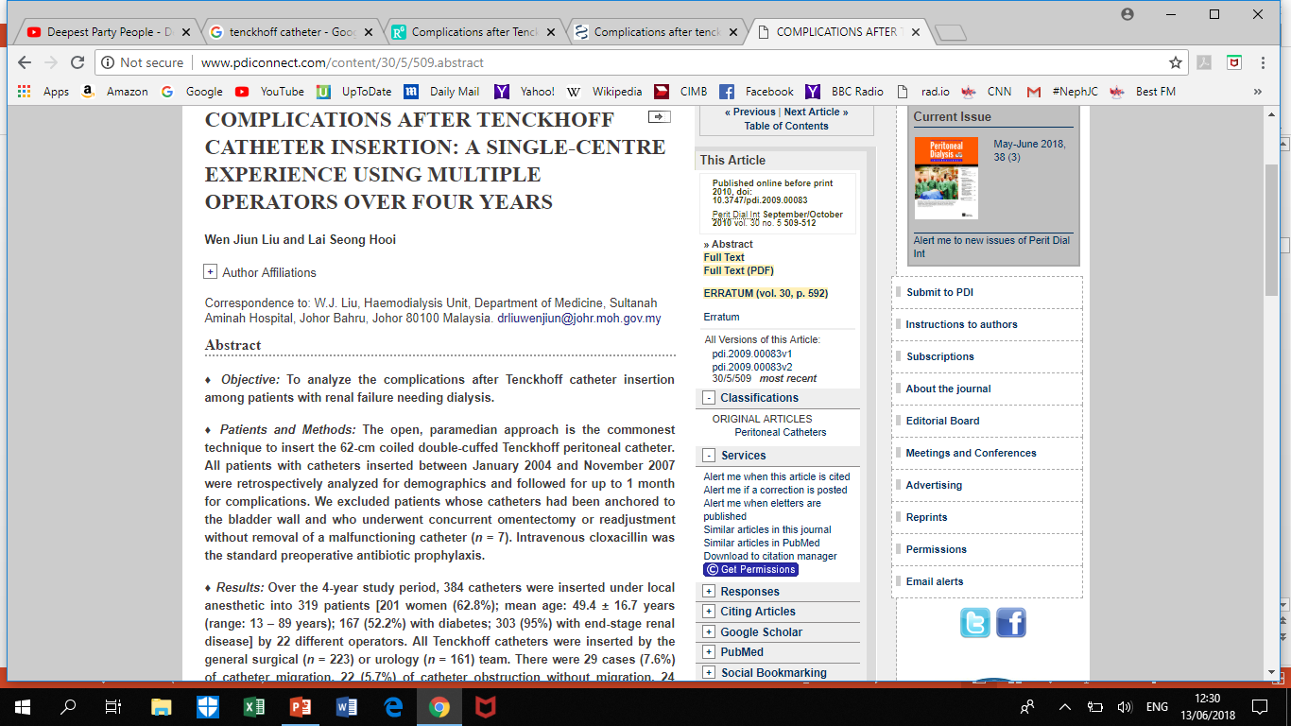
Complications of PD
384 cases
open method
22 different surgeons!
? resulted in primary failures

Slide 7
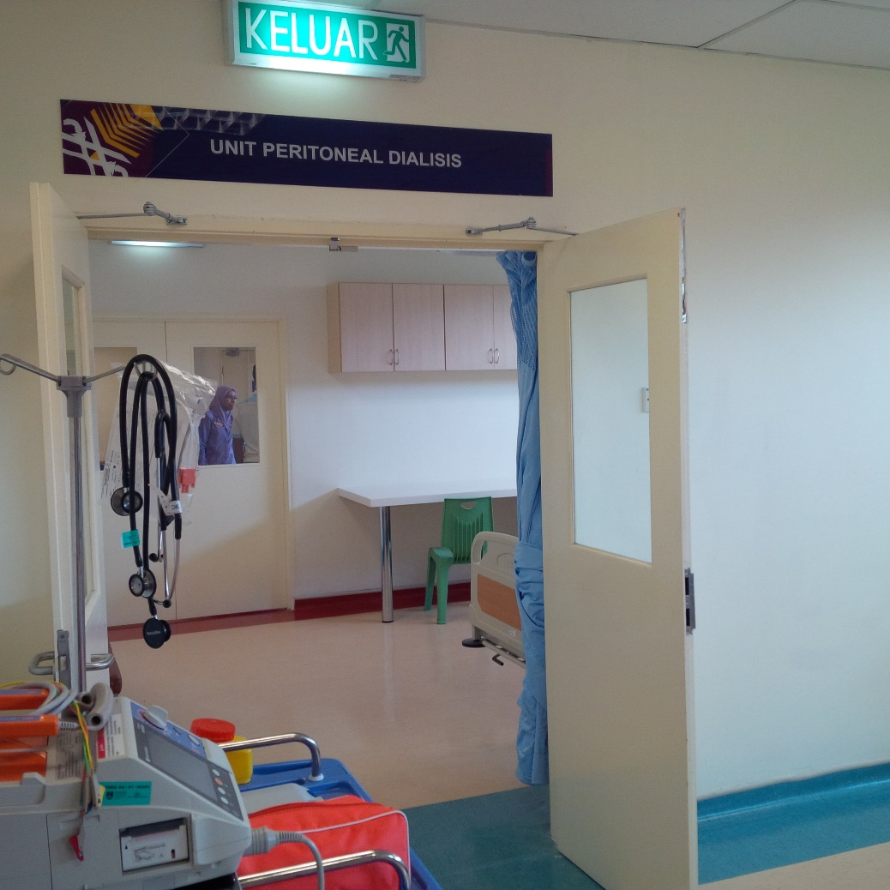
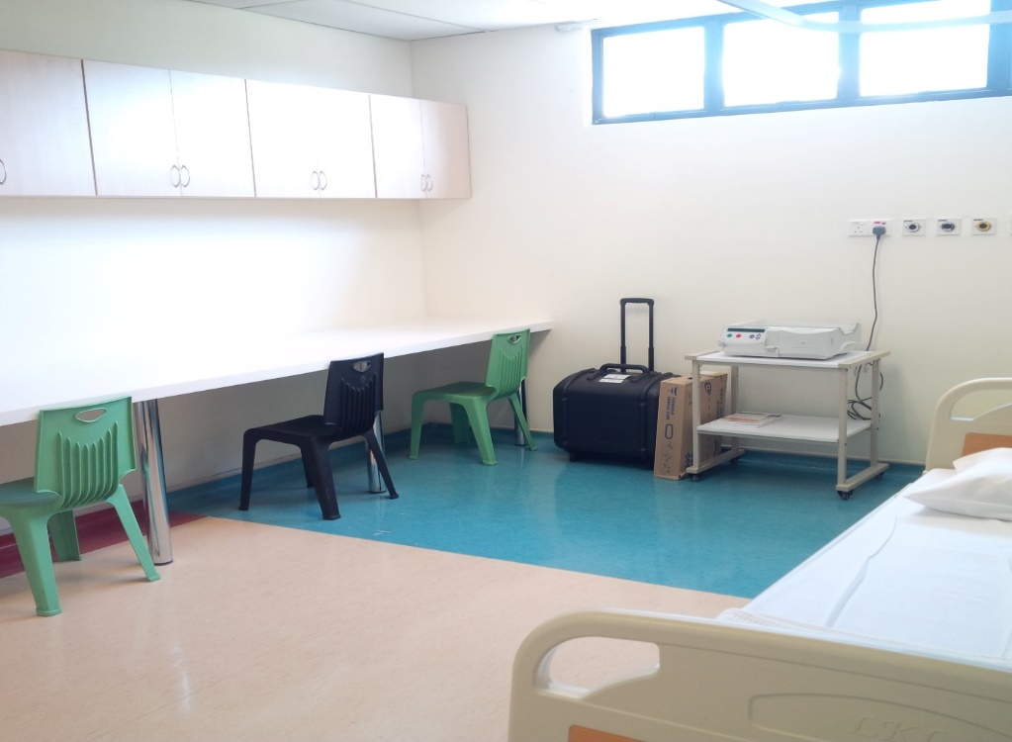
In UiTM
No PD first or PD priority policy
PD – should be a patients choice
PD are carefully selected to get RIGHT results (have referred an obese case to HS for Tenchkoff)

Slide 8
In UiTM
Open/mini laparotomy
Surgeons “claims” they can do Tenchkoff (I don’t believe them)
Same two general surgeons and myself
Surgeons – dissect(median approach)
I insert the Tenchkoff and make sure flow ok, layers are closed, cuff embedded, exit site correct, apply transfer set, dressing approriate

Slide 9
In UiTM
Successful!
Only 1 revision of Tenchkoff – functioned ok.
1 leak (patient had massive ascites) – resolved.
NO PRIMARY CATHETER FAILURES (failure of catheter within 1 month of insertion)
CAREFUL SELECTION OF PATIENTS!

Slide 10
In UiTM
Important until you feel you are better
Now simultaneous and

Slide 11
Other nephro-surgical based services
Kidney transplantation
Renal biopsy
CAREFUL SELECTION OF PATIENTS!
Notes:
Apply this to other nephro-surgical based services as well

Slide 12
Promoting PD in Private?
45 PD centres – only 7 are private (3% of total patients¹)
PD practice in private - “high stake” treatment
Approach – start of with non-complicated cases
1. Dialysis Provision and Implications of Health Economics on Peritoneal Dialysis Utilization: A Review from a Malaysian Perspective. Manaf et al. Int Journal of Nephrology. 2017.

Slide 13
Point # 1
Important to get catheter insertion correct first time.
Not all centres are well equipped
MINIMIZE SURGICAL FAILURE by choosing right patients.

Slide 14
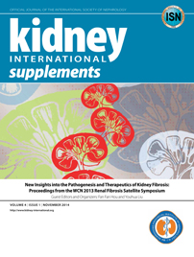
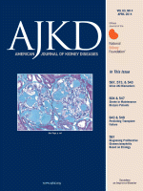
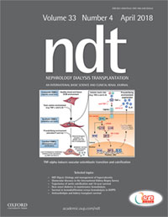
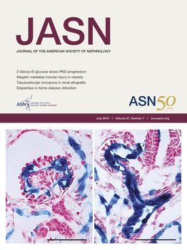
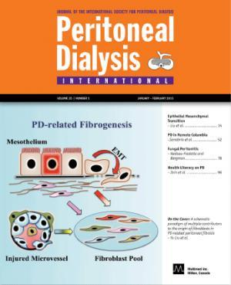
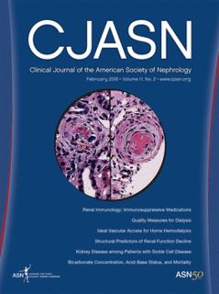
Evidence : PD vs HD in obese ESRF

Slide 15
PD

Slide 16
PD

Slide 18
PD
Put yourselves in your own shoes
Obesity in HD v PD

Slide 19
PD
Put yourselves in your own shoes
Obesity in HD v PD

Slide 20
PD
Put yourselves in your own shoes
Obesity in HD v PD

Slide 21

PD
#inanobeseESRFchooseHDfirst
Follow us @ Renal Uitm

Slide 22
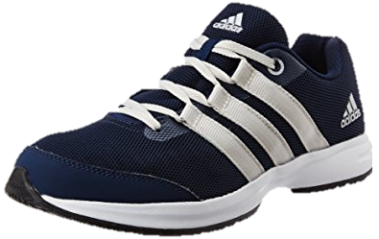

HD first!
Put yourselves in your own shoes (not of the PD experts)
2. Evidence for HD v PD in obese ESRD patients

