Slide 1


Understanding the RO Water System
MSN Mini Webinar Series
Dr Muhammad Iqbal Abdul Hafidz
Consultant Nephrologist, UiTM

Slide 2
Outline of Talk
Why do we need to use Reverse Osmosis (RO)
What is the RO Water System
How does RO occur
Different standards of water for dialysis

Slide 3
Introduction
Water very important aspect of haemodialysis
Haemodialysis patients are exposed to large amount of water (dialysate)
We drink water 2-2.5L /day
Dialysis patients are exposed to 120L of water session (Qd 500ml/min)

Slide 4
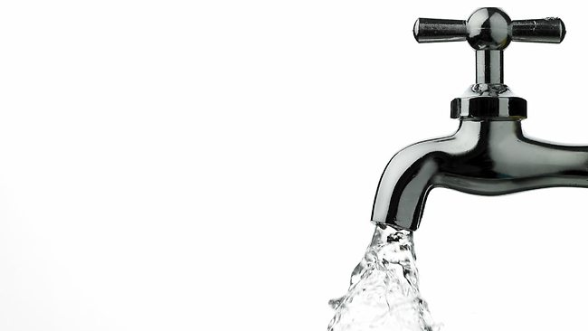
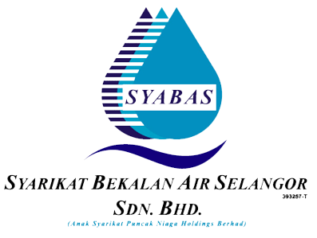
Why can’t we just use tap water?
Municipal water is not suitable for haemodialysis

Slide 5
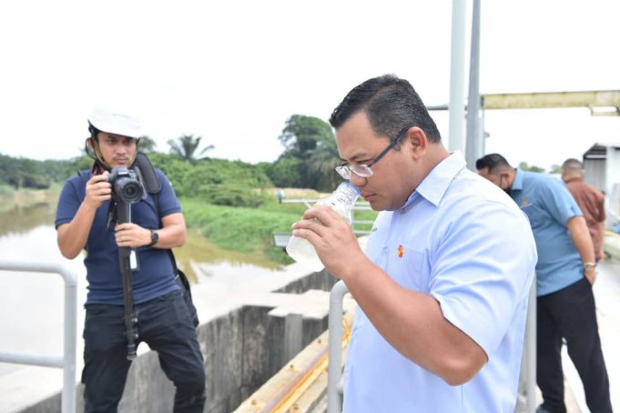
One good reason!
One good reason!
Notes:
From recent events – water cuts because rivers are polluted and as a result the water is not fit to be used for human consumption

Slide 6
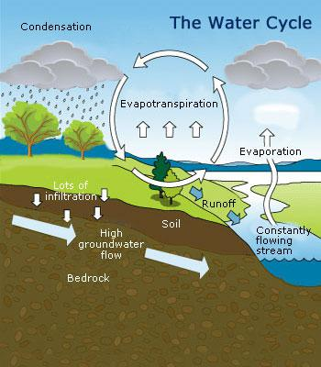
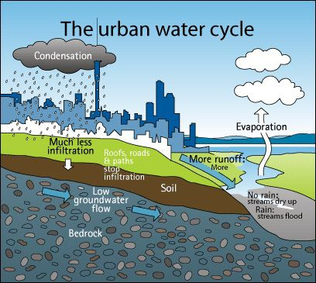
The Water Cycle

Slide 7
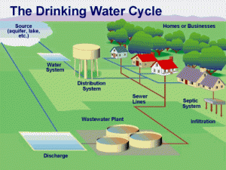
The drinking water cycle
Actually Syabas are doing a great job to provide us safe water
Process all the natural water as well as the waste water
However the water produced still has traces of elements and bacteria
Notes:
Waste water treatment and drinking water for consumption

Slide 8
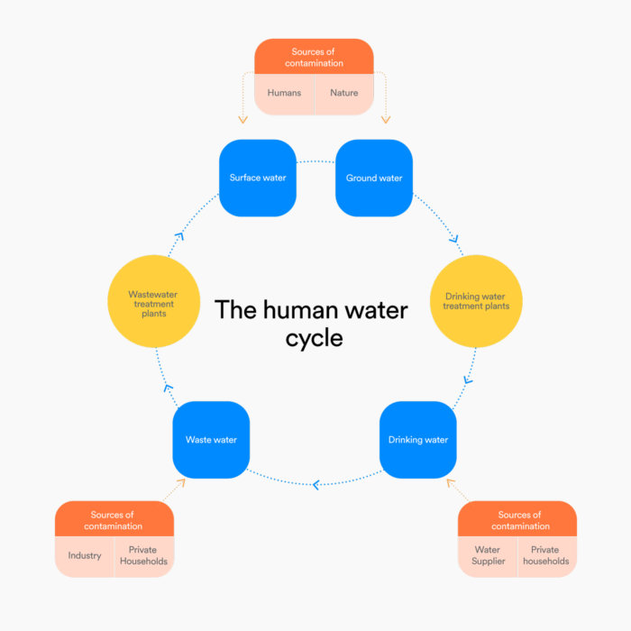
Water treatment – consumption and daily use
Waste water treatment and drinking water treatment

Slide 9
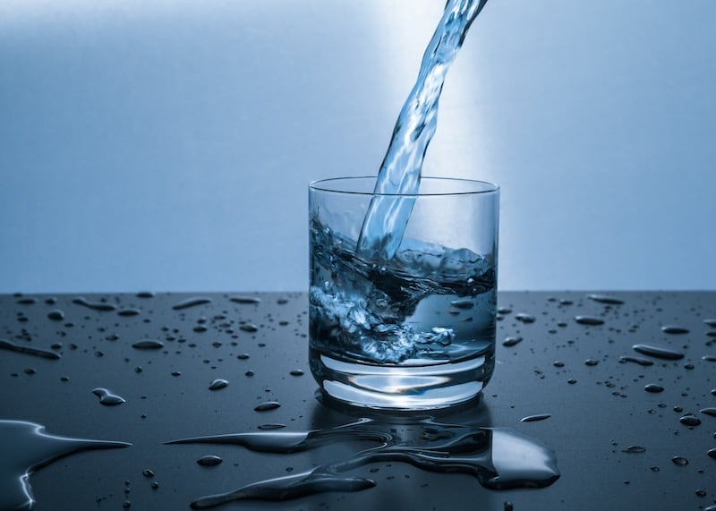
The drinking water
Three categories of contaminating substances in municipal water can cause patient injury or equipment malfunction:
chemical solutes
bacteria or bacterial products (endotoxins)
particulate matter
Notes:
Of these, the chemical and bacterial contaminants may be directly harmful to patients receiving dialysis

Slide 10
Effects of water contaminants

Slide 11
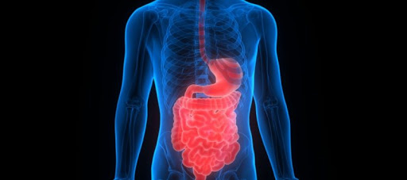
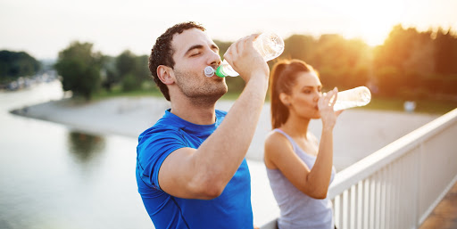
Drinking water
We drink only 2-2.5L day of clean water
Barrier is our gut which is sufficient to protect us from bacteria and small amount impurities.

Slide 12
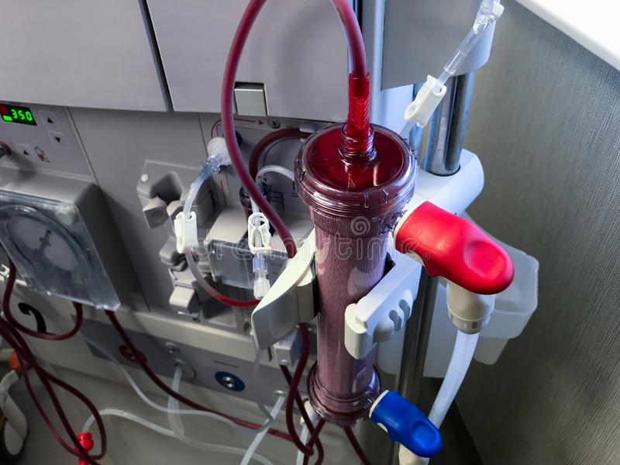
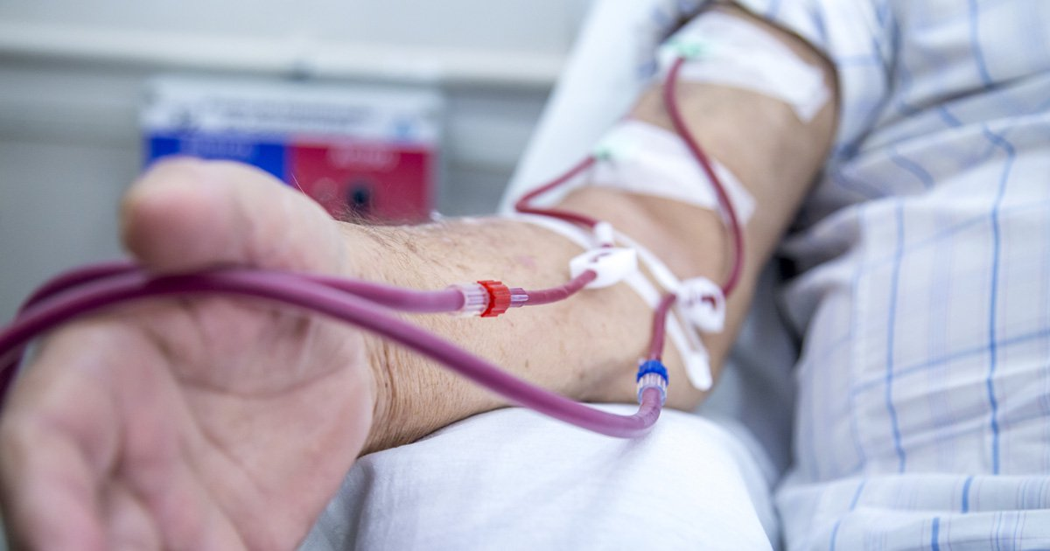
In Dialysis
Water (Dialysate) is in contact with the patient’s blood
Notes:
Blood is directed into the dialysis machine where the process of dialysis and ultrafiltration occurs
And clean blood is returned into the body

Slide 13
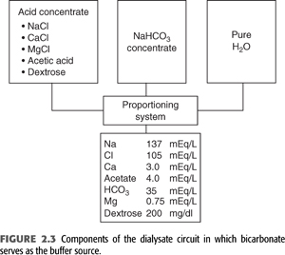
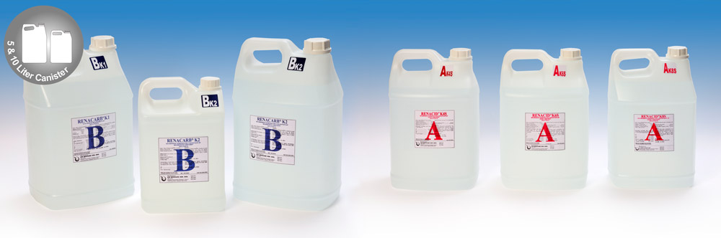
How is Dialysate made?
Dialysate is made from a mixture of treated water at a ratio of 34:1 for acid concentrate and 20:1 for bicarbonate concentrate

Slide 14
In Dialysis
Dialysis patients are exposed to dialysate flow (Qd) 500ml/min
Calculation
Qd 500 ml/min
1 hour = 30,000 ml (30L)
4 hours = 120 L
Per week = 120L x 3 = 480 L water in contact with patient!!
Only barrier is dialyzer membrane

Slide 15
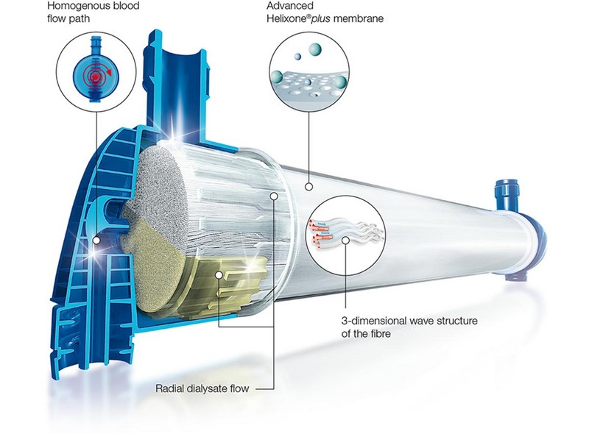
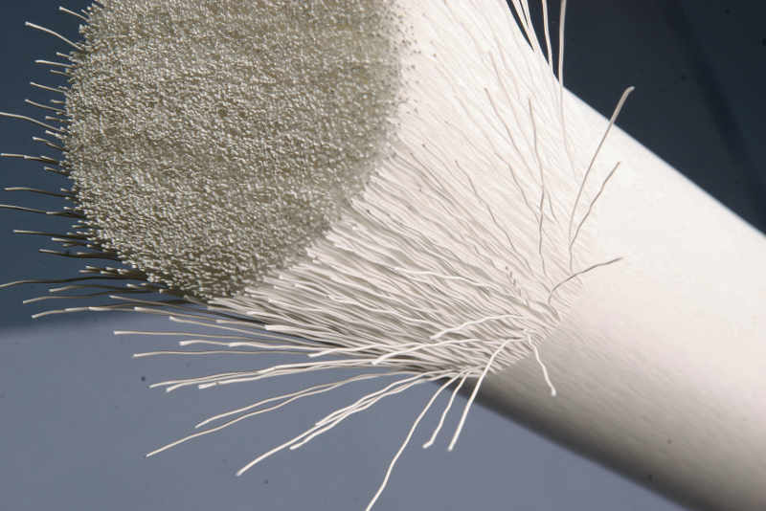
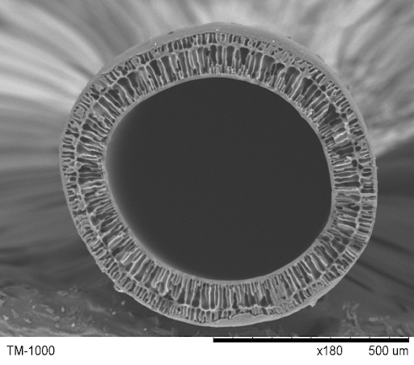
In Dialysis (Dialyzer)
Occurs in dialyzer
  Clearance
  Ultrafiltration
Diameter – 2-3 x size of a hair
Notes:
Big tube with lots of straws in it (20 thousand hollow fibres/straw)

Slide 16
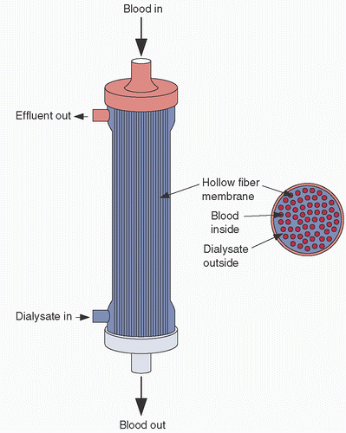
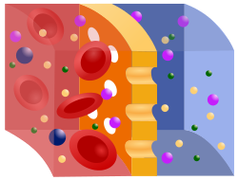
In Dialysis (Dialyzer)
In the dialyzer – blood is contact with the dialysate
Separated by a semi-permeable membrane

Slide 17
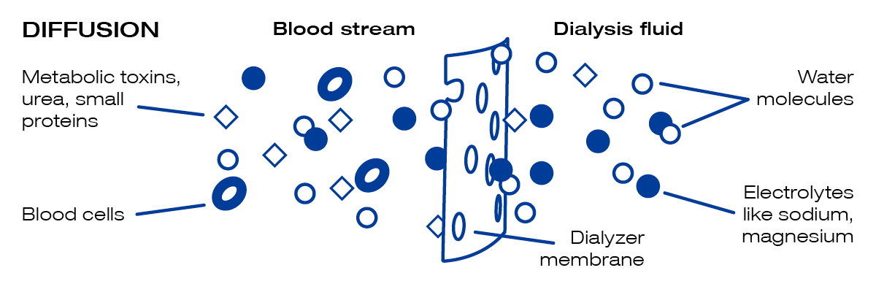
In Dialyzer (Diffusion)

Slide 18
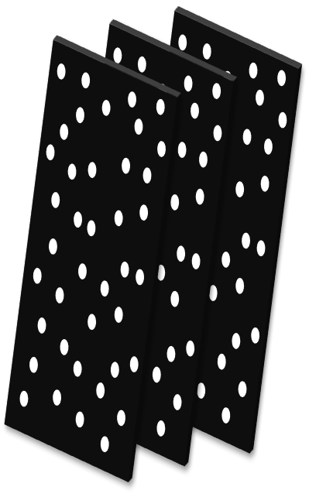
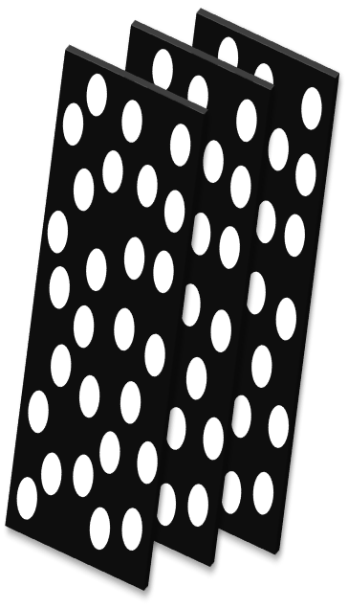
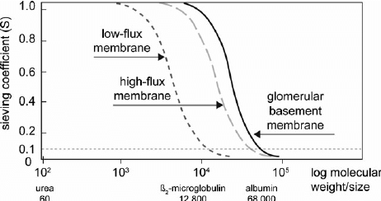
High flux vs Low flux
High flux membranes
More water can pass through
Bigger molecules can pass through (β2 macroglobulin)
Low-flux membrane
High-flux membrane
(Pores bigger)
Notes:
High flux
More water can pass through
Bigger molecules can pass through (B2 macroglobulin)

Slide 19
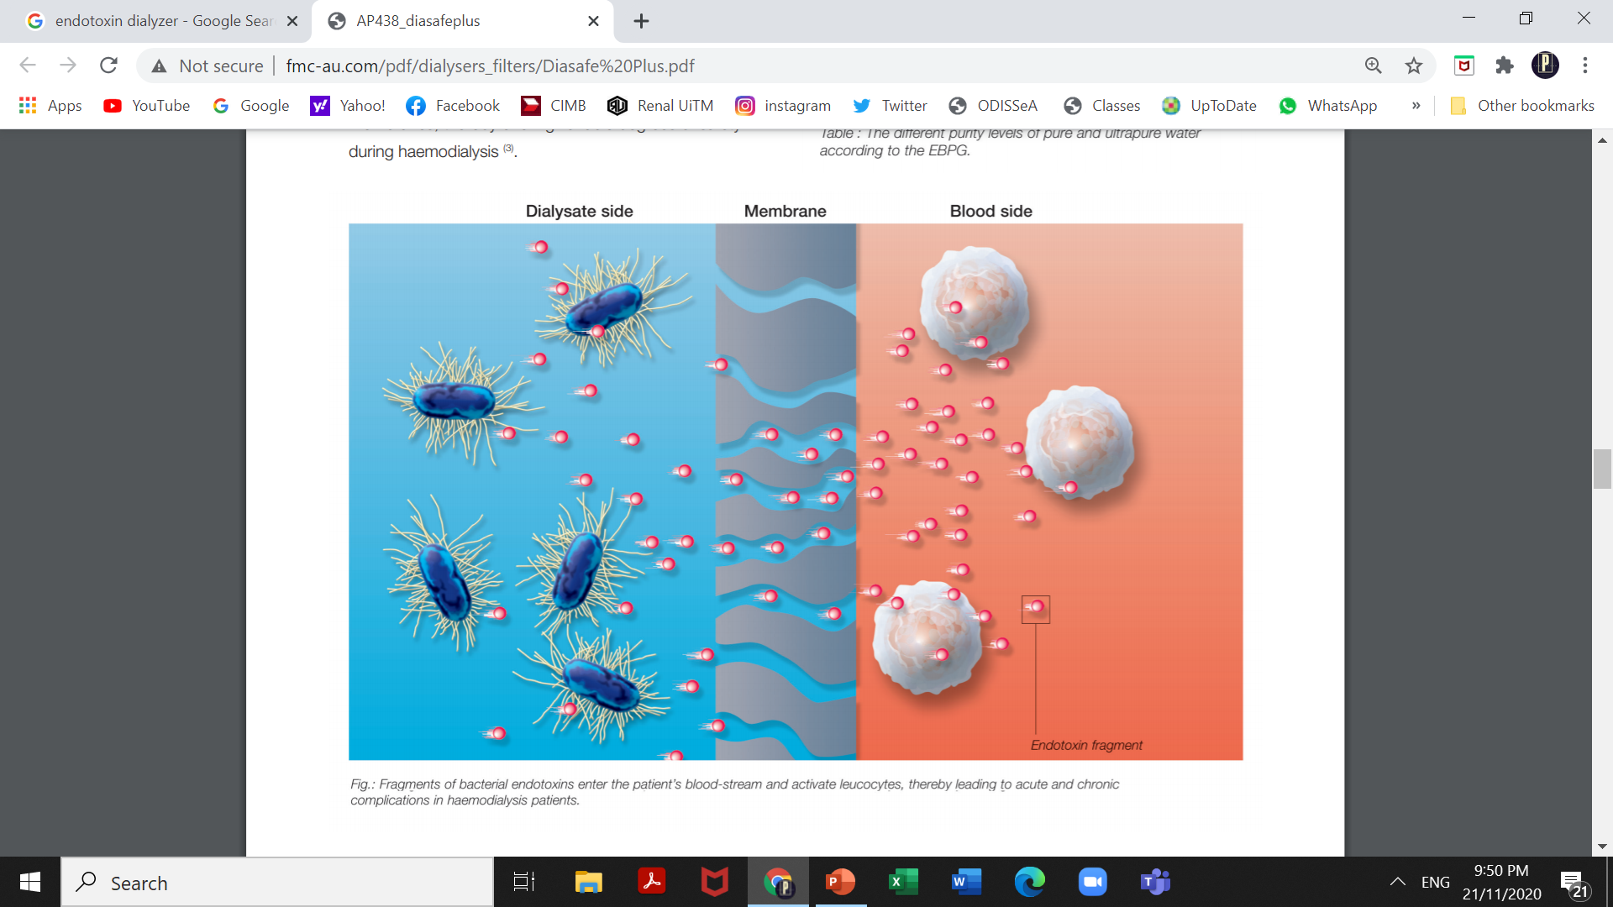
Endotoxin can pass through membrane!
Bacteria and endotoxin can pass through membrane

Slide 20

Pyrogens
Endotoxins can cause pyrogenic reactions in dialysis patients
  Unwell
  Fever
  Chills
  Rigors

Slide 21
Bacterial and Endotoxin monitoring is the most important!
Only thing to be monitored monthly.

Slide 22
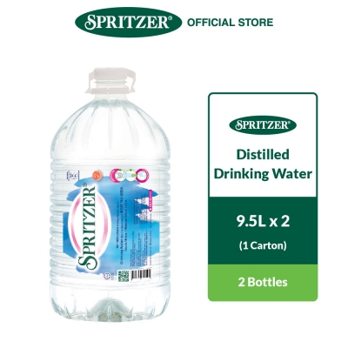
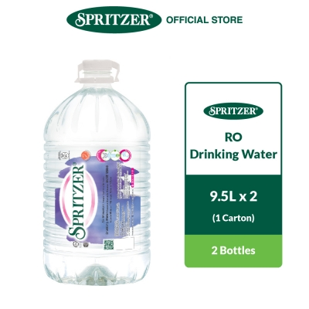
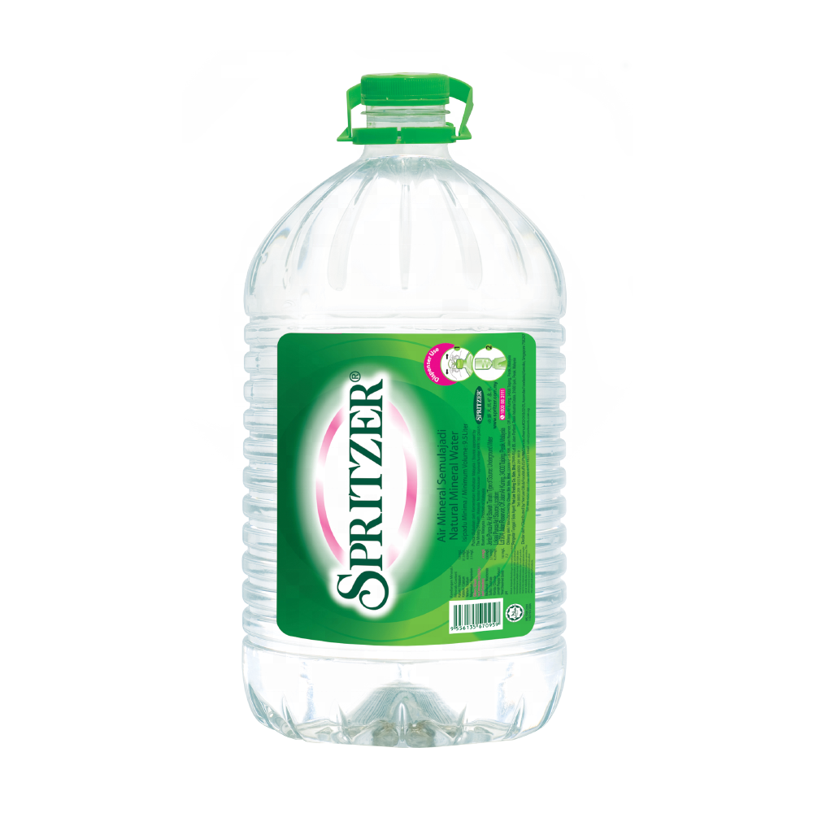
Ways to purify water
Distill
Reverse Osmosis
Deionization
Notes:
Distillation is the process of separating the components or substances from a liquid mixture by using selective boiling and condensation
Deionization is a physical process that uses specially manufactured ion exchange resins to remove mineral ions. Because the majority of water impurities are dissolved salts, deionization results in high purity water that is generally similar to distilled water.

Slide 23
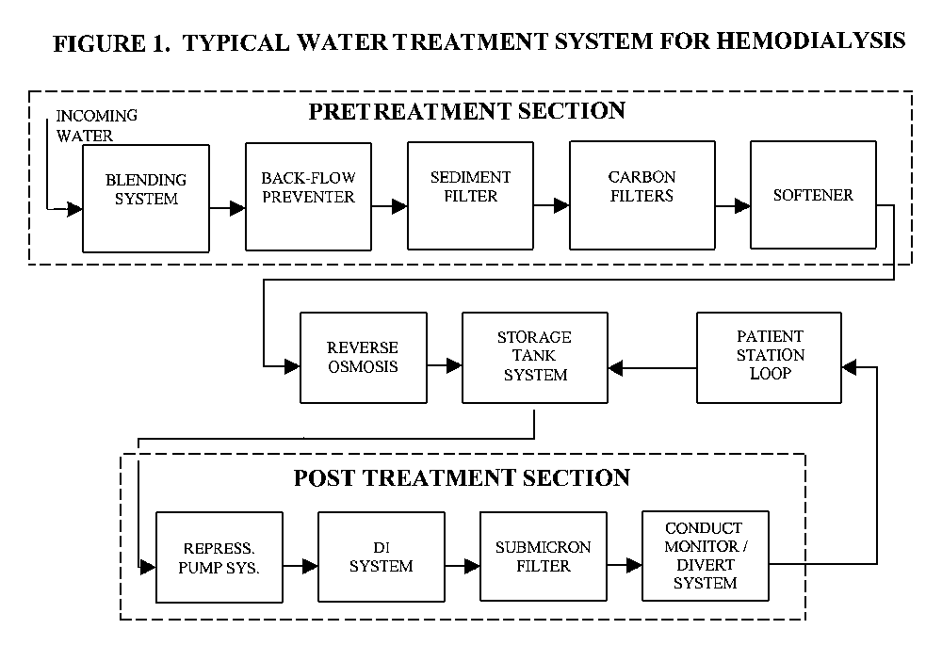
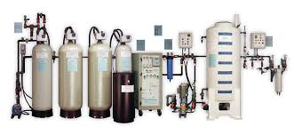
In dialysis RO system
RO water system only method accepted in haemodialysis
Components of an RO water system

Slide 24
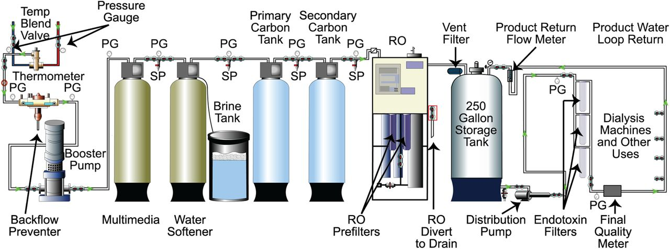
Components of an RO System
Pre-filter
Reverse Osmosis
Distribution

Slide 25
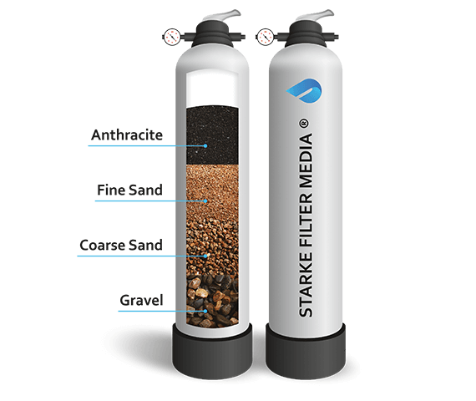
Multimedia
1st component
Filters particles more than 20 microns – dirt, silt, colloidal matter
Prevents clogging of carbon and softener tanks, RO pump and foul the RO membrane

Slide 26
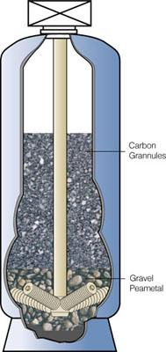
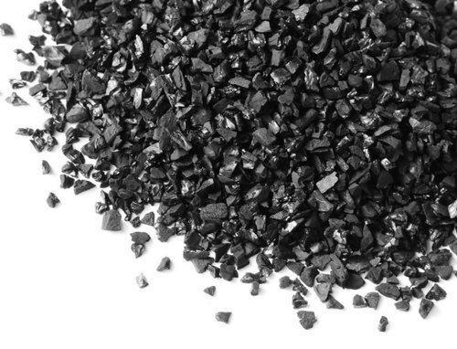
Activated Carbon
2nd component – 2 columns
Removes chlorine additives from the feed water via adsorption
Chlorine and chloramines are added to drinking water for disinfective purposes
Notes:
The carbon tank contains granular activated carbon, which removes chlorine and chloramines from the water by adsorption. Chlorine and chloramines are toxic to the blood and patient exposure to these organics can be extremely harmful. Carbon filters or tanks also remove organic matter and odor-producing materials by the same method. Adsorption is a physical process that does not require a chemical reaction and is simply the process in which liquids, gases, or suspended materials cling to a surface, such as the activated carbon. The carbon tank will not remove electrolytes, such as calcium or sodium.

Slide 27
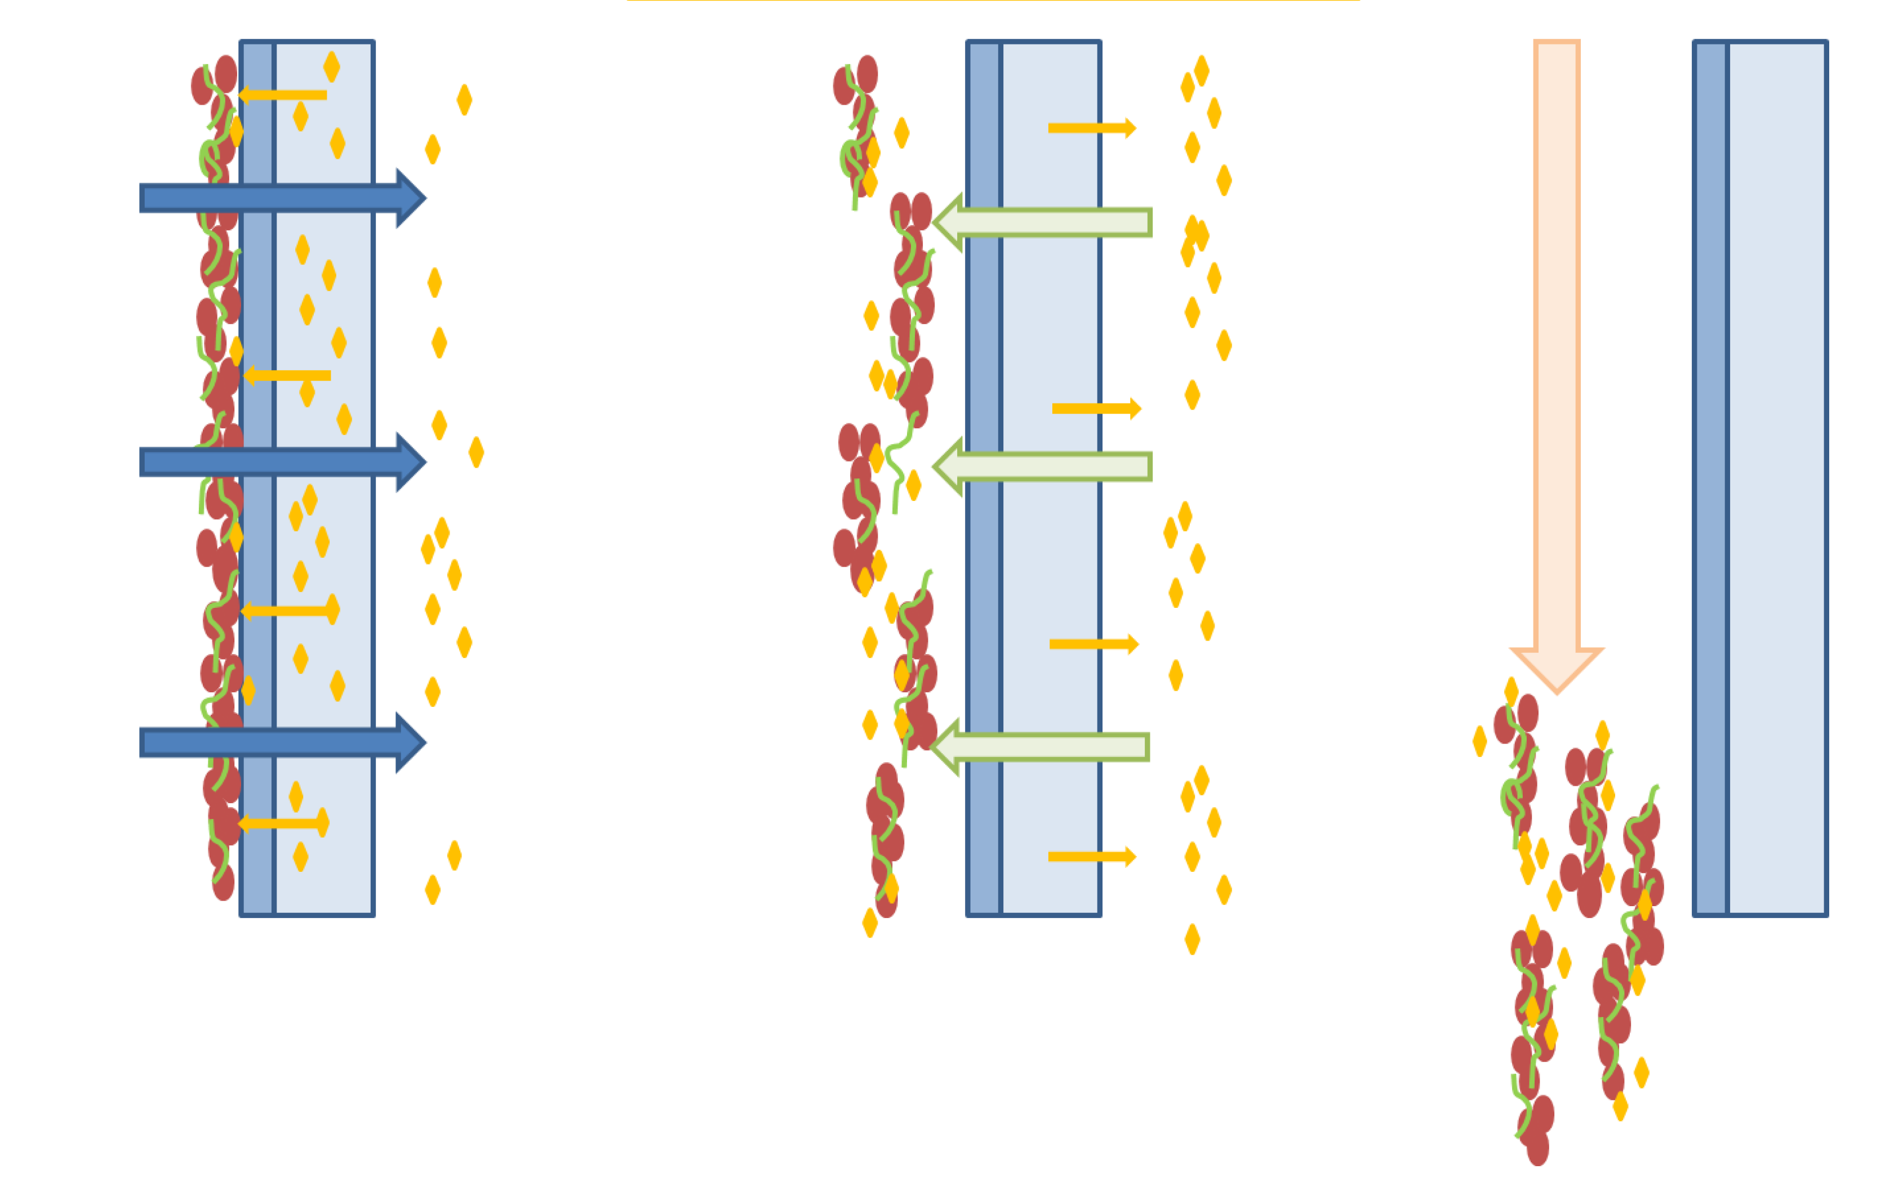
Backwash
Backwashing consists of reversing the flow of water so that it enters from the bottom of the filter bed, lifts and rinses the bed, then exits through the top of the filter tank
Done 3 x week
Service flow
Backwash flow
Rinse
Notes:
Cake compaction, bacwash dislodges the deposits, rinse

Slide 28
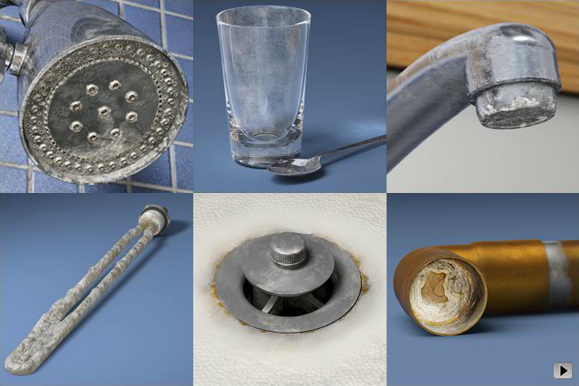
Do you see this in your home?
Notes:
Falling rainwater passing through the air contacts carbon dioxide and sulfur dioxide, forming carbonic and sulfuric acid in weak solution. Upon hitting the ground, this water encounters limestone and other minerals to form calcium bicarbonate and sulfate, magnesium carbonate, and other salts. Calcium carbonate is the most prevalent impurity in tap water and accounts for most of its hardness.

Slide 29
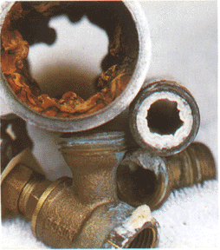
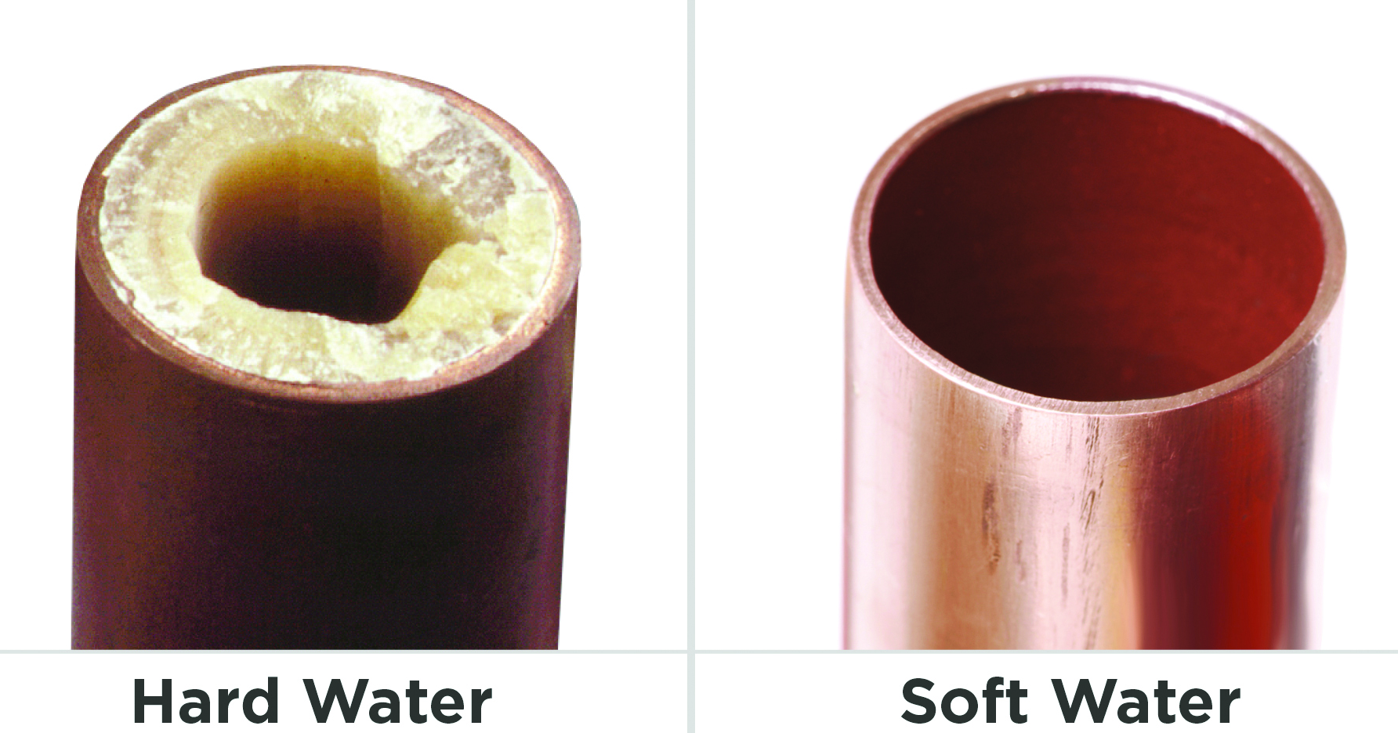
Hard water
Water described as "hard" is high in dissolved minerals, specifically calcium and magnesium.
Notes:
When water is combined with carbon dioxide to form very weak carbonic acid, an even better solvent results. As water moves through soil and rock, it dissolves very small amounts of minerals and holds them in solution. Calcium and magnesium dissolved in water are the two most common minerals that make water "hard." The degree of hardness becomes greater as the calcium and magnesium content increases and is related to the concentration of multivalent cations dissolved in the water.

Slide 30
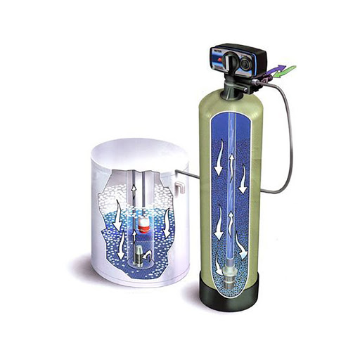
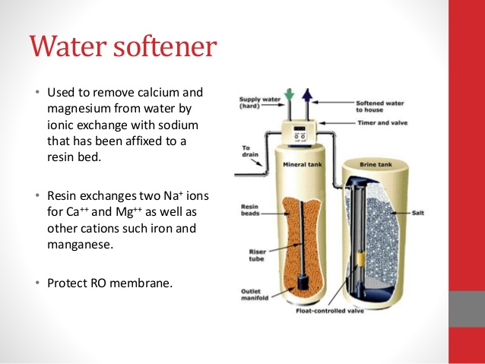
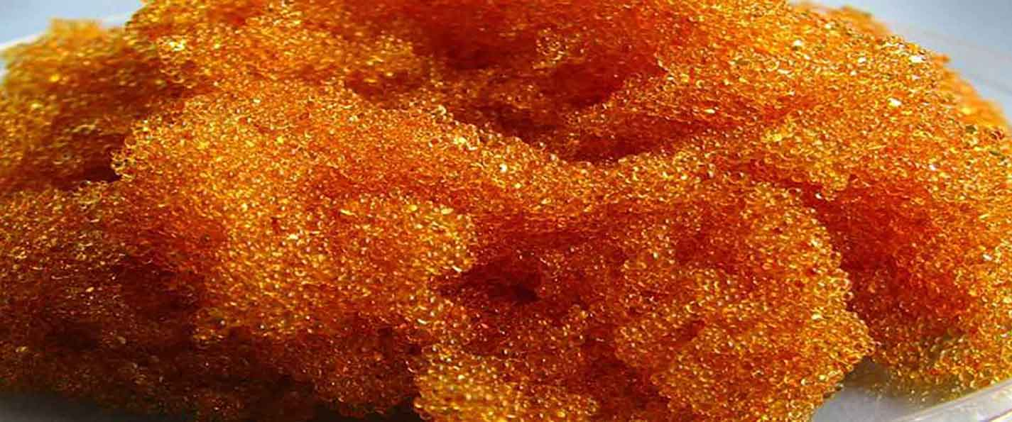
Water Softener
Used to remove Calcium and Magnesium from water (hard water) by ionic exchange wit Na⁺ that has been fixed to a resin bed.

Slide 31
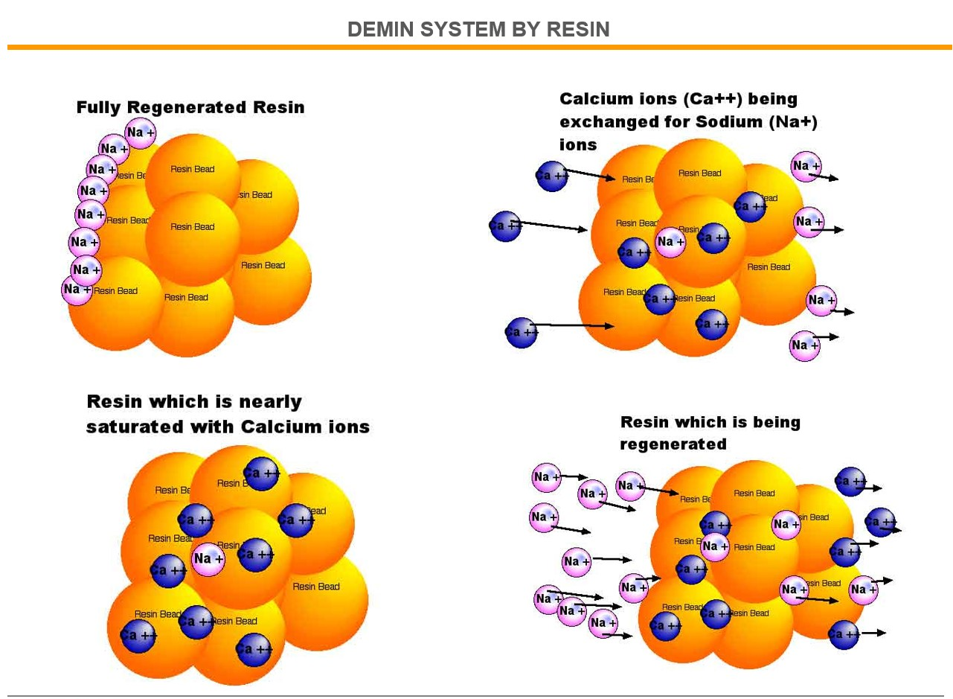
Water Softener -resins
Resin exchanges 2 Na⁺ ions for Ca²⁺ and Mg²⁺ and also other cations such as iron and manganese

Slide 32
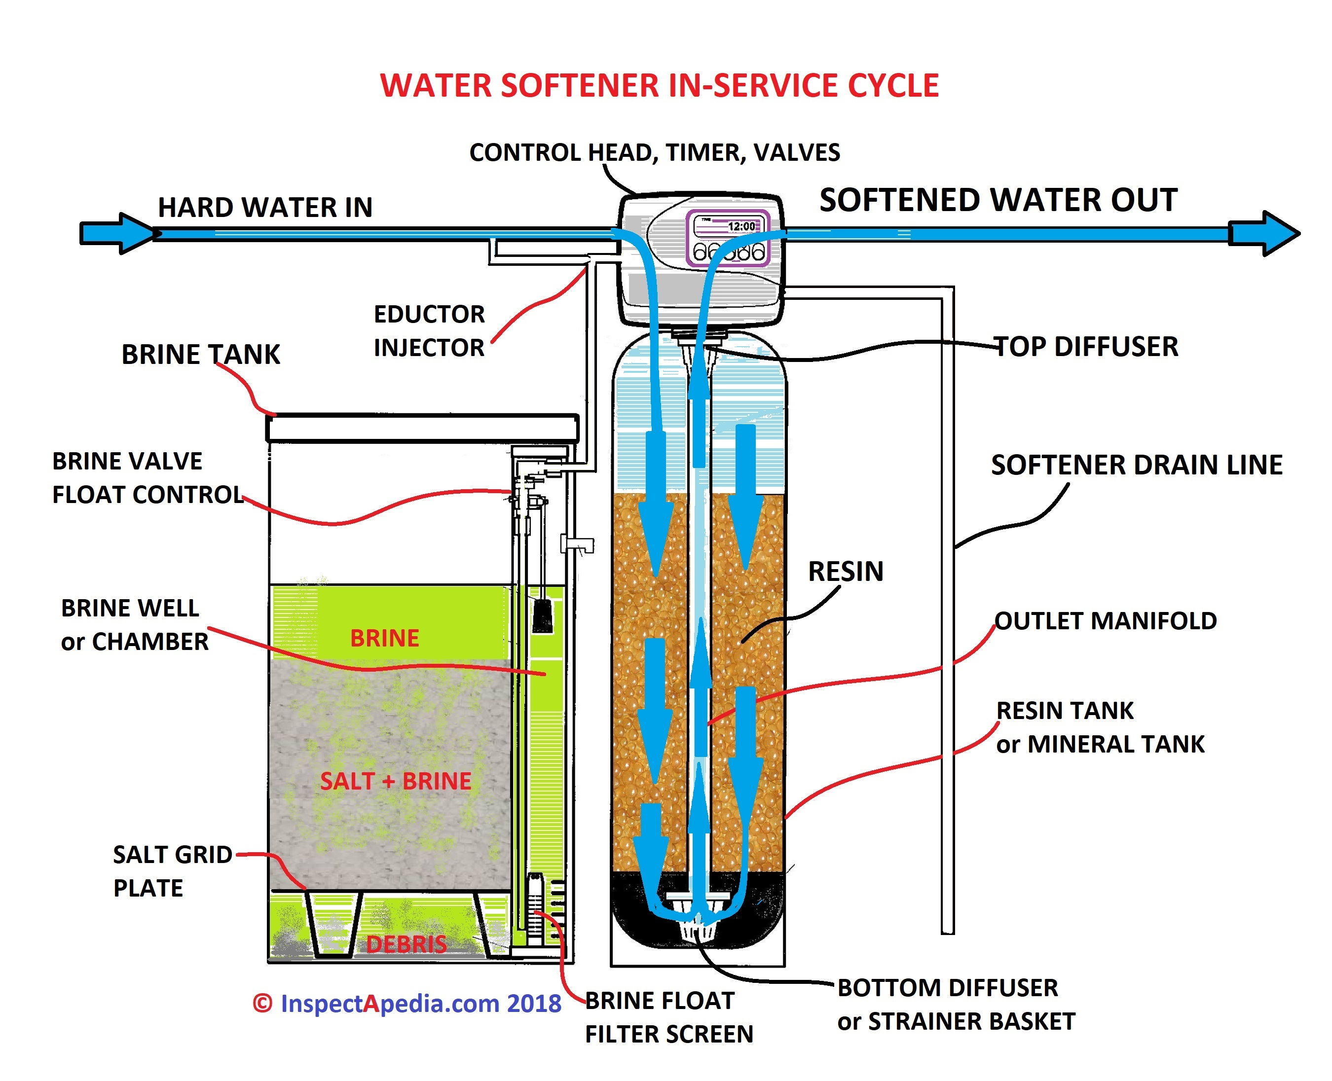
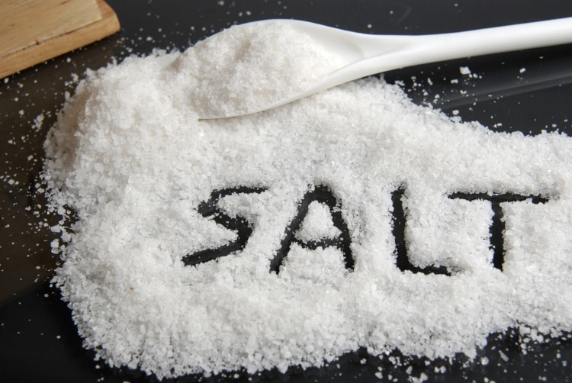
Resin regenerated
Maintenance – ensure salt is present to regenerate resins
Notes:
The backwash phase removes dirt from the mineral tank.
Recharging the mineral tank with sodium from the brine solution displaces calcium and magnesium, which is then washed down the drain.
The final phase rinses the mineral tank with fresh water and loads the brine tank so it's ready for the next cycle.

Slide 33
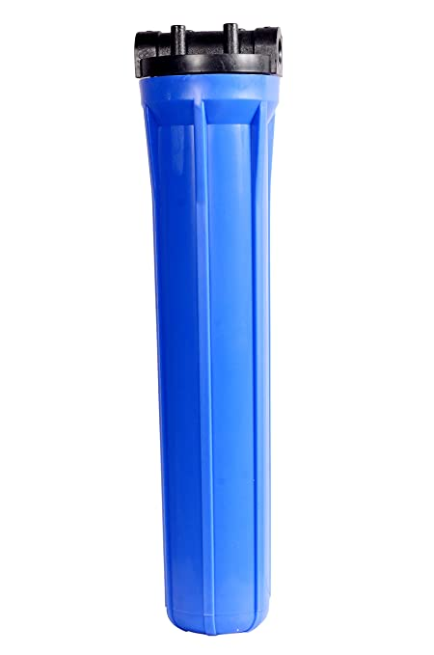
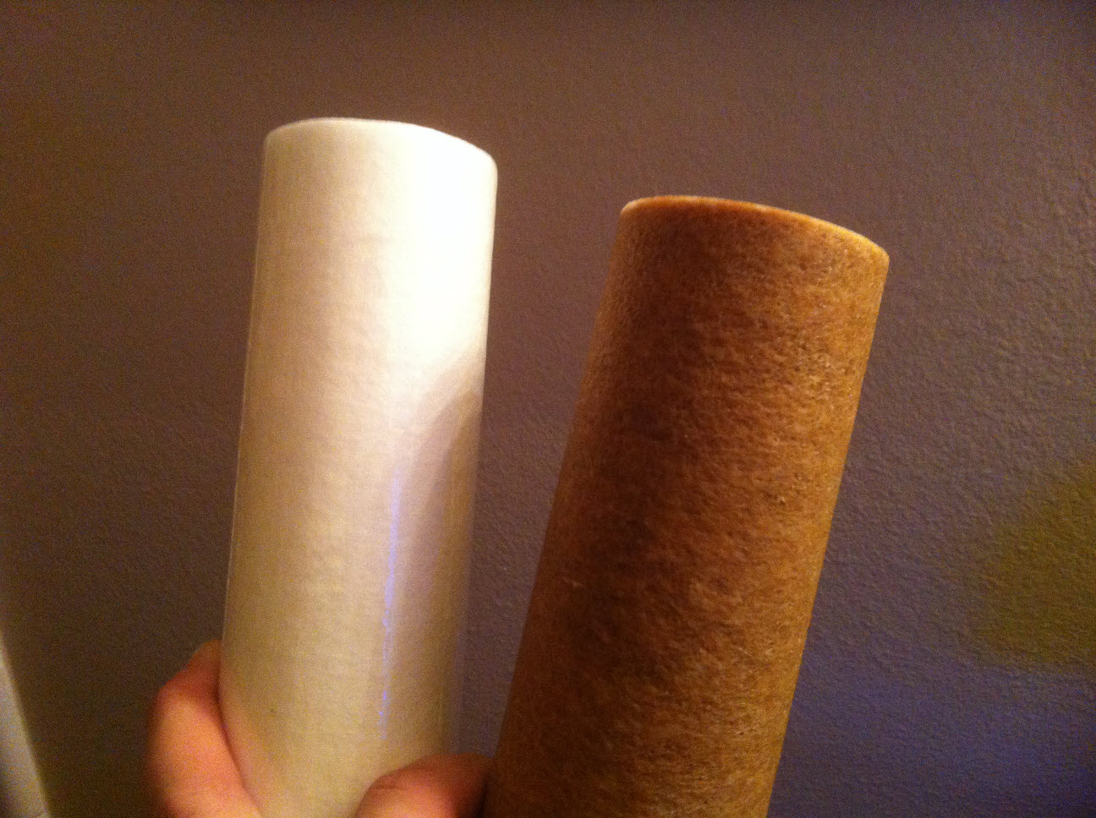
Guard (Pre-filter) Filter
Positioned before RO membrane
Filters particles more than 5 microns
Change monthly

Slide 34
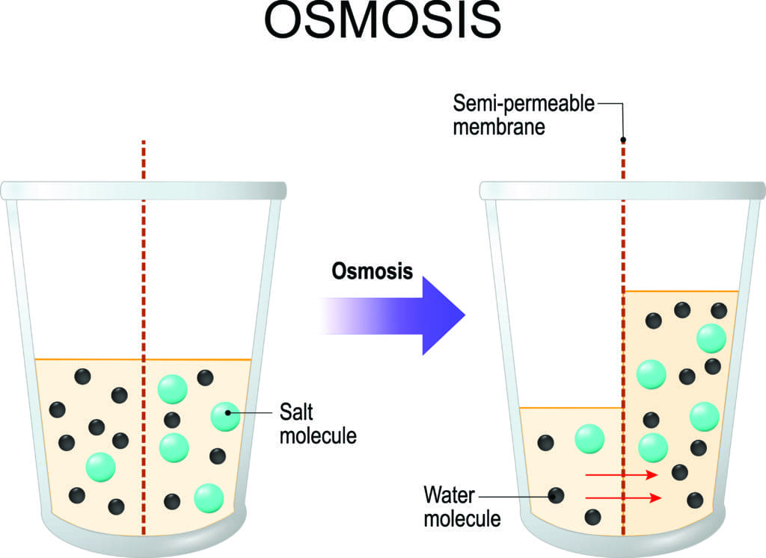
Osmosis
Movement of a water through a semipermeable membrane into a solution of higher solute concentration that tends to equalize the concentrations of solute on the two sides of the membrane.
Applied in peritoneal dialysis.

Slide 35
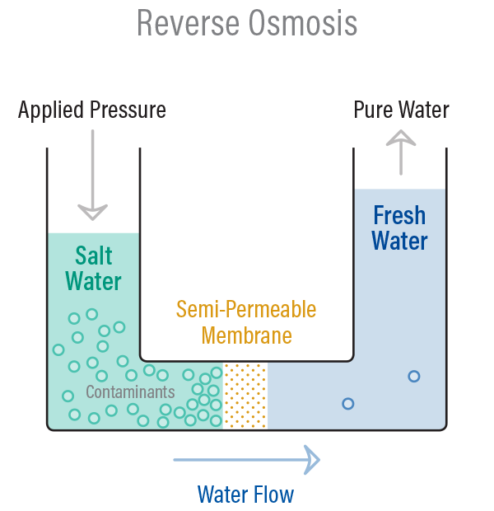
Reverse Osmosis
In reverse osmosis, concentrated water is forced to flow in the opposite or unnatural direction across a semi-permeable membrane by means of high pressure
Natural osmotic flow is overcome and pure water passes through the membrane leaving the dissolved solids and other constituents behind on the concentrated side

Slide 36
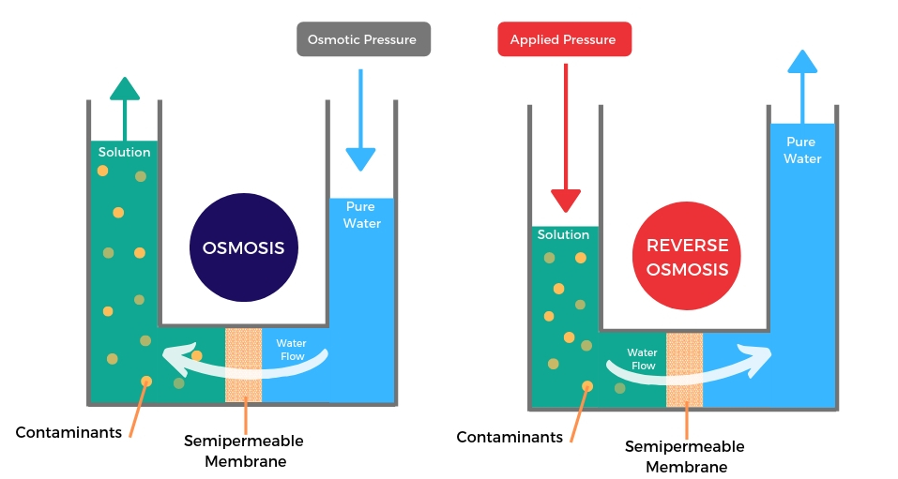
Reverse Osmosis

Slide 37
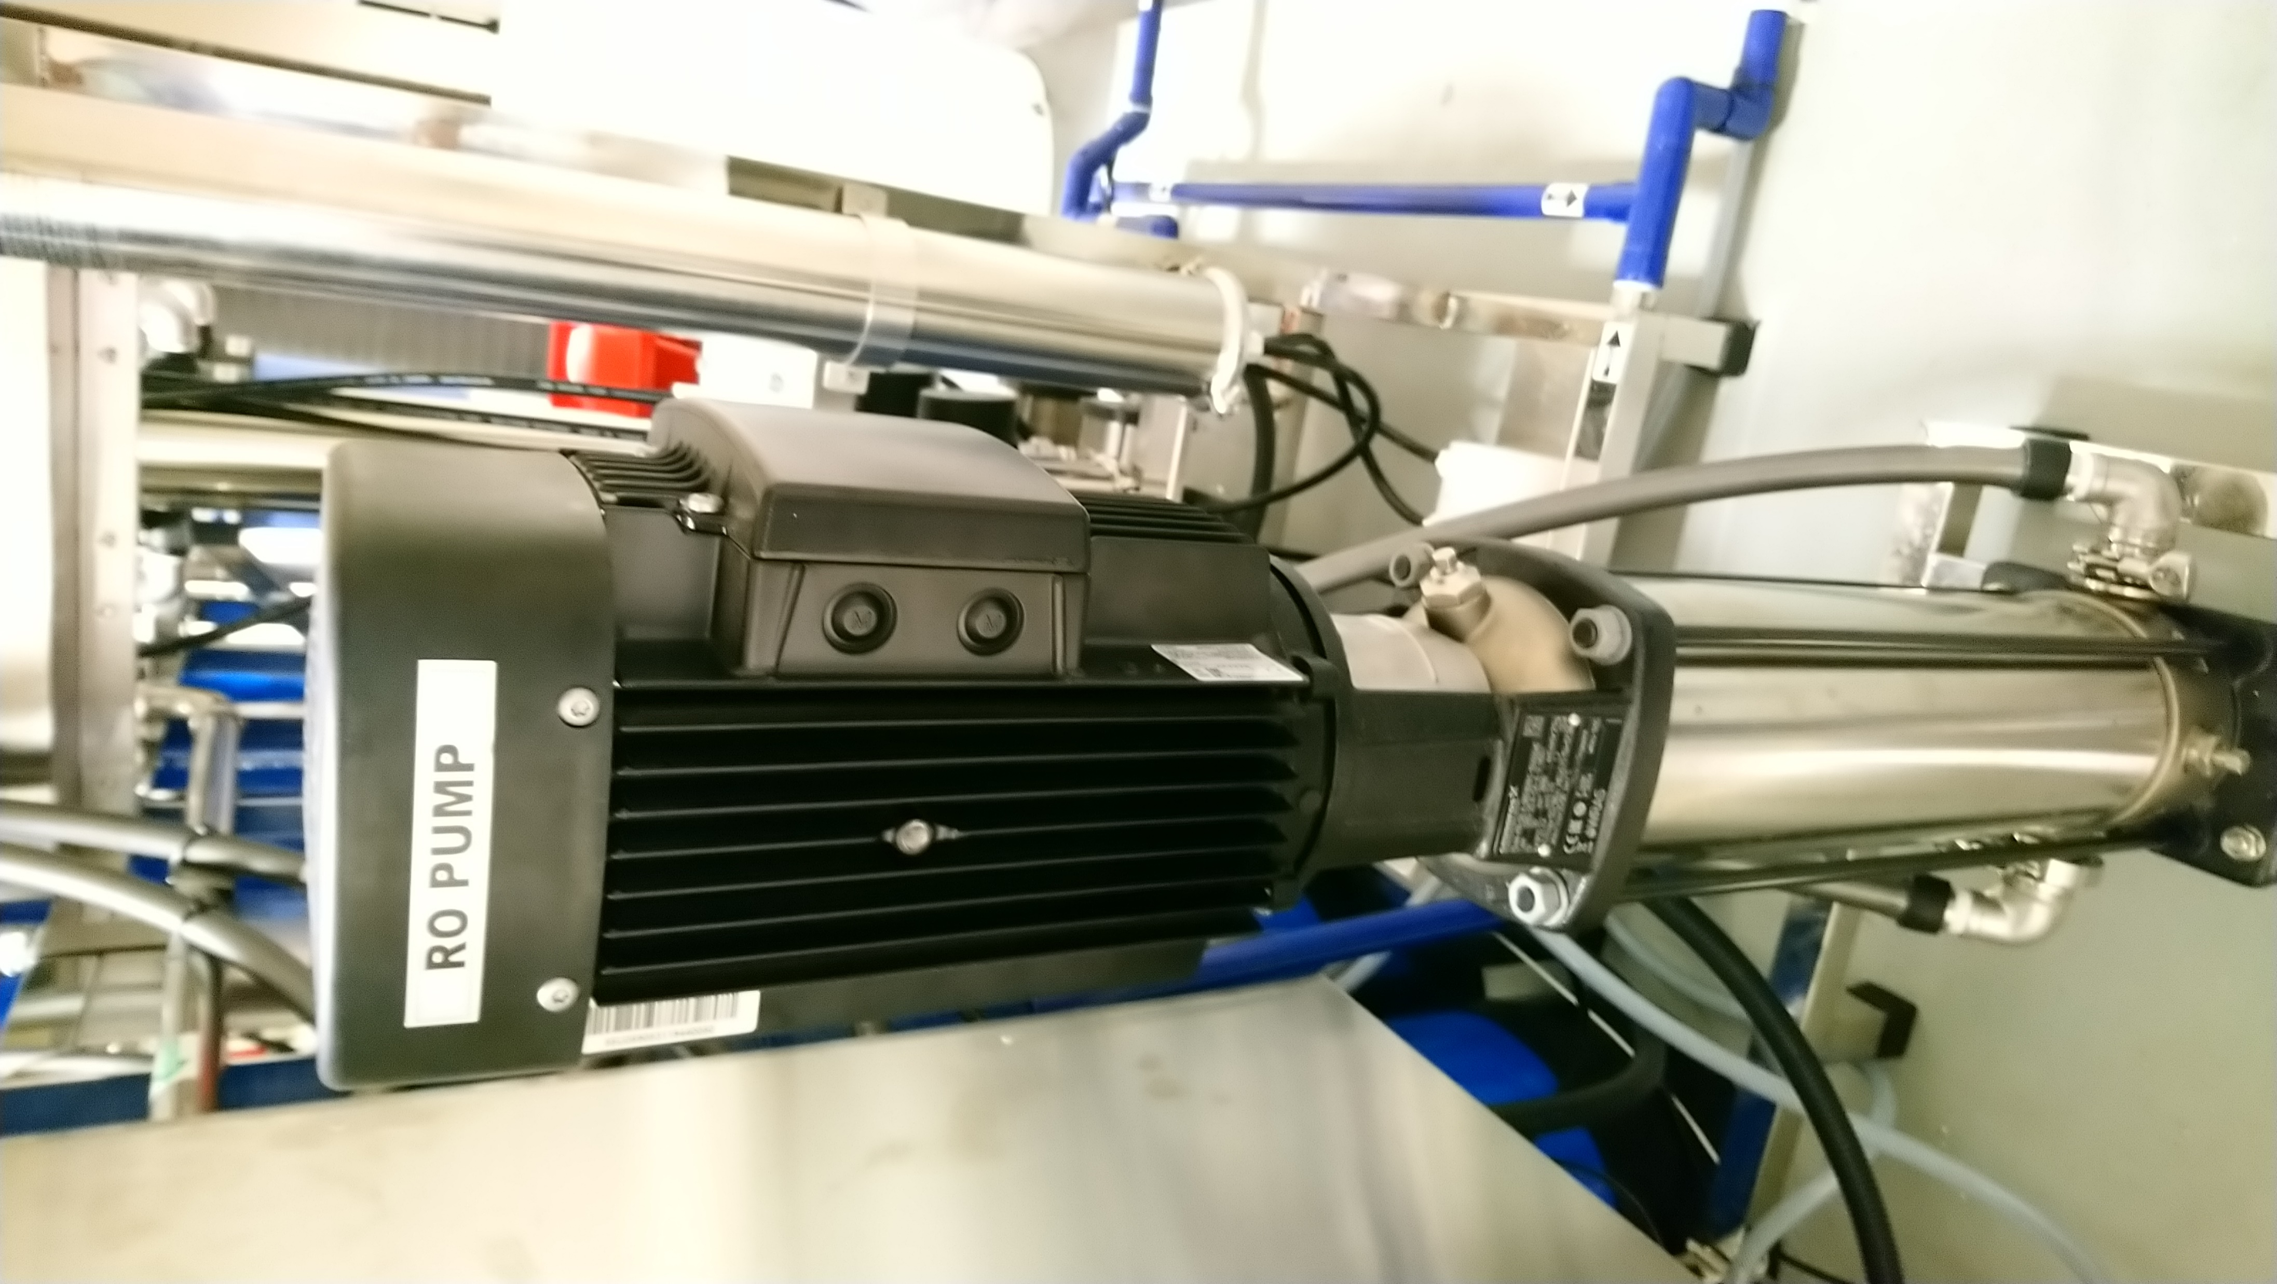
RO Pump
The RO pump increases water pressure across the membrane to increase both product water flow rejection characteristics of the RO membrane.

Slide 38
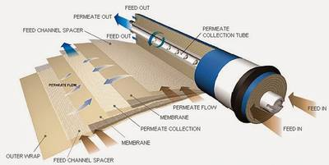

RO Membrane
RO membrane made of thin polyamide
RO membrane rejects dissolved inorganic elements such as ions of metals, salts and chemicals and organics including bacteria, virueses and endotoxin.
Rejection of charged ionic particles ranges from 95-99% whereas contaminatnt such as oganics that have no charge are rejected at a greater than 200 daltons.
Ionic contaminants are highly rejected compared to neutrally-greater charged particles and polyvalent ions are more readily rejected than monovalent ions

Slide 39

Permeate and Reject Water
Treated water -Product water
Reject water and concentrated solutes filtered is sent to the drain

Slide 40

RO membrane

Slide 41


RO membrane pore size chart

Slide 42
RO membrane performance
RO membrane performance is measured by percent rejection (concentrate) and final product (permeate) quality can be measured by either conductivity (S/m) or total dissolved solids.
They should be continuously displayed with audible and visual alarms that can be heard in the patient care area.

Slide 43
Different water quality

Slide 44


Why different standards water?
Dialyzer technology improving – more porous
High Flux, Theranova

Slide 45

Why different standards water?
HDF

Slide 46


Why different standards water?
HDx

Slide 47
Water Standard
2 different water standard:
  AAMI
  ISO

Slide 48

Purification of water post RO treatment
To ensure that fluid is free of bacteria or endotoxin - ultrafilters and dialyzer
Notes:
Modern thin film membranes are made from polyamide and polysulfone which retains Endotoxin > 2000 Daltons

Slide 49
Ultrapure water
Ultra-pure RO water can be produced by dual stage RO system
Can also be produced by the use of an ultra-filter (pyrogen filters) which have a pore size between 0.001 and 0.5µm and are able to filter endotoxin particles > 1000 Daltons
Ultra-pure RO water must comply to bacterial limits <0.1 CFU/ml and endotoxin limits <0.03 EU/ml

Slide 50

Haemodiafiltration
HDF is a hybrid therapy combining within the same dialyzer module the two main solute transport mechanisms - diffusion and convection.
It requires large volume of substitution fluid which is infused directly into the patient
Fluid needs to be sterile, non-pyrogenic

Slide 51

Substitution Fluid
produced by passing dialysis fluid through 2 ultra-filters (pyrogen filters)
Ultra-pure RO water must comply to bacterial limits SAL > 6 and endotoxin limits <0.03 EU/ml
* Sterility Assurance Level

Slide 52

Substitution Fluid for HDF
Dialysate water undergoes 2 ultrafilters

Slide 53


Substitution Fluid for HDF
2 pyrogen filters behind a HDF machine

Slide 54
Summary
Reverse Osmosis System for haemodialysis is important to ensure the patients receive safe water for dialysis.
Important to understand definitions of different types of water quality (ultrapure and substitution) as dialyzers and HD machines evolve.

Slide 55


Come Join Renal UiTM!

Slide 56

THANK YOU!
follow us @ Renal Uitm

Slide 59

Distribution

Slide 60


Slide 61


Slide 62



Slide 63

Notes:
Fig. 1. Theoretical sieving curves for 3 different classes of membranes: (1) high flux (HF), (2) high retention onset (HRO), and (3) high cutoff (HCO). The point in the curve where sieving coefficient is 0.1 determines the molecular weight cutoff (CO) value. The point in the curve where the sieving coefficient is 0.9 determines the molecular weight retention onset (RO) value. It appears evident that HRO membrane, although presenting a similar cutoff value of the HF membrane, displays a completely different behavior. While the RO for the HF membrane is in the range of 1,200 Da (Vit B12), the RO for the HRO membrane is in the range of 12,000 Da (-2 microglobulin). MWCO value can be different in the 2 membranes with small leakage of albumin in the HRO class, but this effect is rapidly neutralized after a few minutes from the beginning of the treatment due to protein deposition at the blood membrane interface. HCO membrane has a CO value beyond the molecular weight of albumin and determines some albumin loss. Modified from Ronco and La Manna [33]

Slide 64

Distribution

Slide 66
Multimedia

Slide 67
Introduction
https://doctorlib.info/urology/hemodialysis/6.html

