Slide 1
2018
Sunday | Monday | Tuesday | Wednesday | Thursday | Friday | Saturday
 |  | RUBY SPRINGS LODGE
Welcome to Banks Outdoor Products Event Calendar
STONE CREEK
FLY BOY ANGLER
BLACKFOOT RIVER GUIDES
LOST RIVER OURFITTERS
GREAT DIVIDE
WEST FORK MOUNTAIN CRAFTS
JACKLIN’S SPORTING GOODS
PATAGONIA RIVER GUIDES
TIGHTLINE
RED’S FLY SHOP
HOOK –N- HORN
HENDRIX OUTDOORS
BITTERROOT FLY SHOP
BEARTOOTH
TOP QUALITY HAND TIED FLIES AT THESE FINE RETAILERS AND DISTRIBUTORS

Slide 2
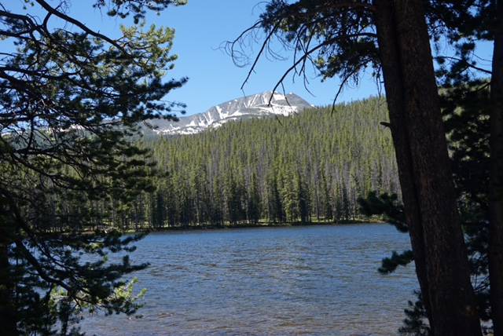
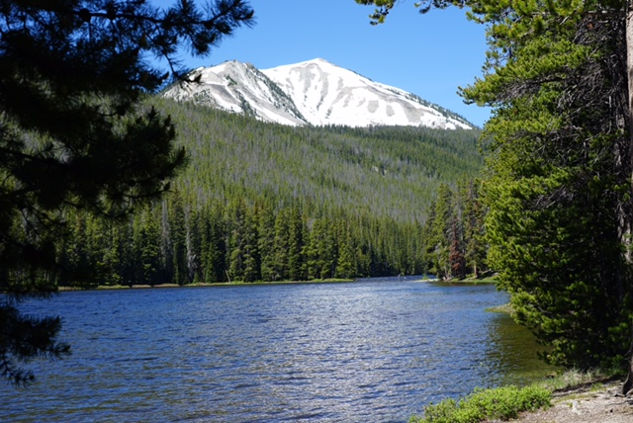
JANUARY 2018
SUNDAY | MONDAY | TUESDAY | WEDNESDAY | THURSDAY | FRIDAY | SATURDAY
12/31 | 1/1 mailto:dwhouston73@gmail.com, | 2 | 3 | 4 | 5 | 6
7 | 8 | 9 | 10 | 11 | 12 | 13
14 | 15 | 16 | 17 | 18 | 19 | 20
21 | 22 | 23 | 24 | 26 | 26 | 27
28 | 29 | 30 | 31

Slide 3
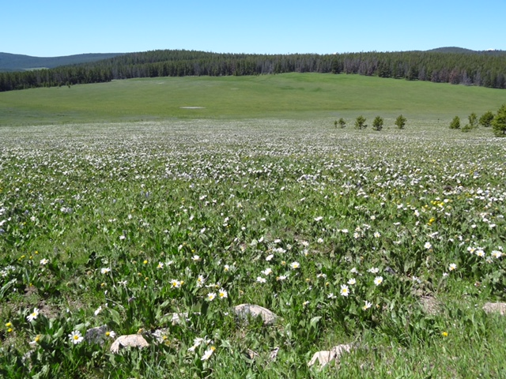
FEBRUARY 2018
SUNDAY | MONDAY | TUESDAY | WEDNESDAY | THURSDAY | FRIDAY | SATURDAY
1/28 | 1/29 | 1/30 | 1/31 | 2/1 | 2 | 3
4 | 5 | 6 | 7 | 8 | 9 | 10
11 | 12 | 13 | 14 | 15 | 16 | 17
18 | 19 | 20 | 21 | 22 | 23 | 24
25 | 26 | 27 | 28

Slide 4
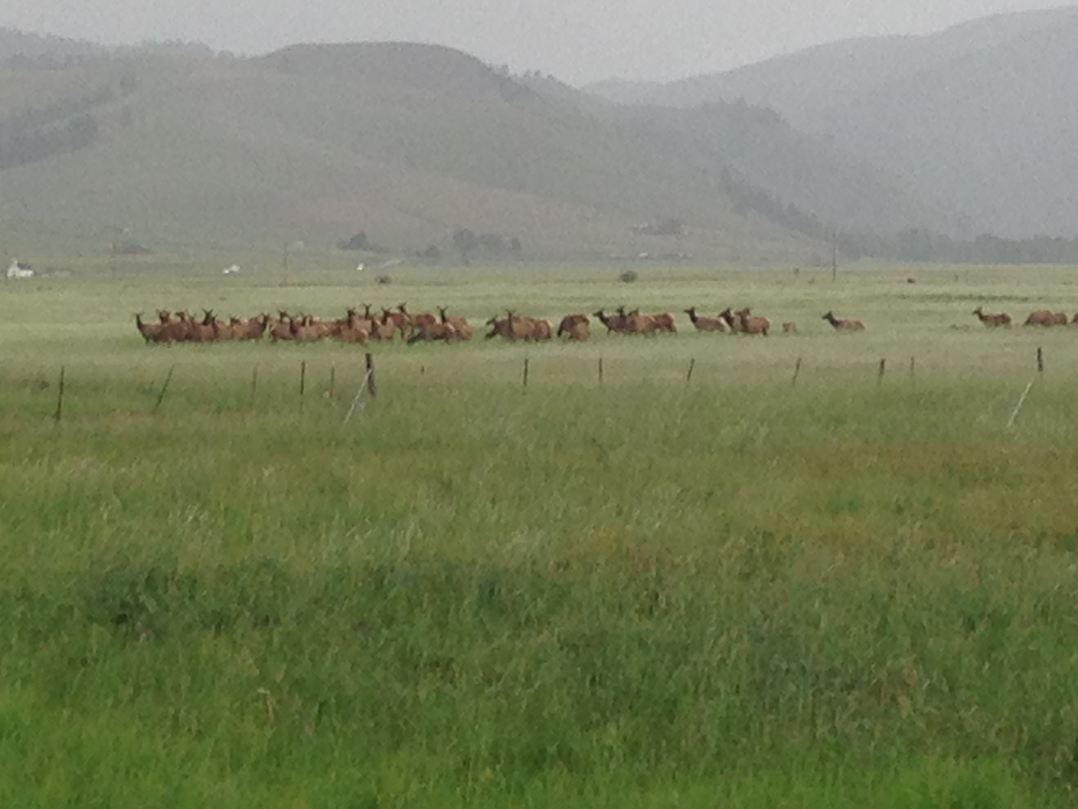
MARCH 2018
SUNDAY | MONDAY | TUESDAY | WEDNESDAY | THURSDAY | FRIDAY | SATURDAY
2/25 | 2/26 | 2/27 | 2/28 | 3/1 | 2 | 3
4 | 5 | 6 | 7 | 8 | 9 | 10
11 | 12 | 13 | 14 | 15 | 16 | 17
18 | 19 | 20 | 21 | 22 | 23 | 24
25 | 26 | 27 | 28 | 29 | 30 | 31

Slide 5
APRIL 2018
SUNDAY | MONDAY | TUESDAY | WEDNESDAY | THURSDAY | FRIDAY | SATURDAY
4/1 | 2 | 3 | 4 | 5 | 6 | 7
8 | 9 | 10 | 11 | 12 | 13 | 14
15 | 16 | 17 | 18 | 19 | 20 | 21
22 | 23 | 24 | 25 | 26 | 27 | 28
29 | 30

Slide 6
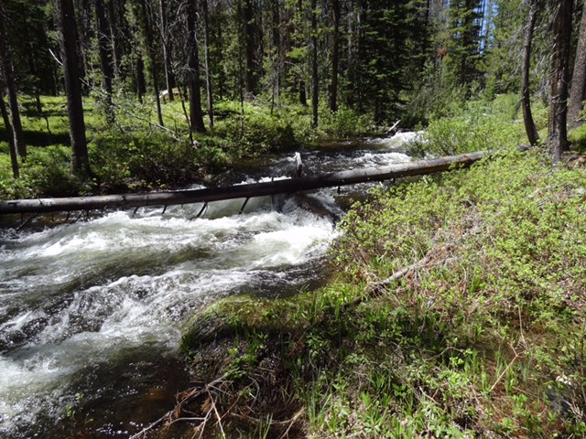
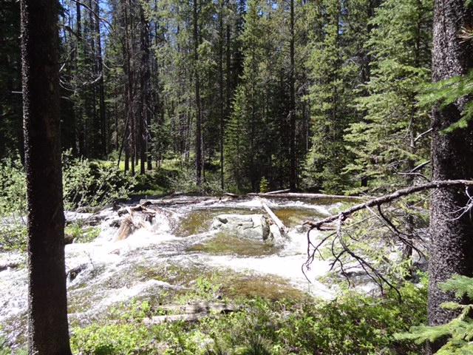
MAY 2018
SUNDAY | MONDAY | TUESDAY | WEDNESDAY | THURSDAY | FRIDAY | SATURDAY
4/29 | 4/30 | 5/1 | 2 | 3 | 4 | 5
6 | 7 | 8 | 9 | 10 | 11 | 12
13 | 14 | 15 | 16 | 17 | 18 | 19
20 | 21 | 22 | 23 | 24 | 25 | 26
27 | 28 | 29 | 30 | 31

Slide 7
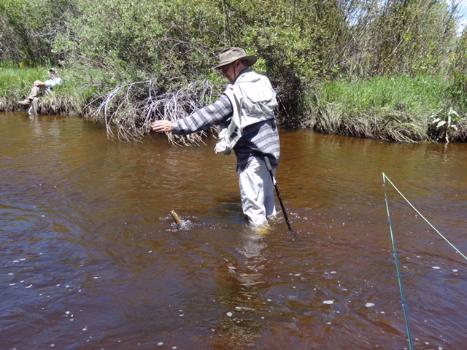
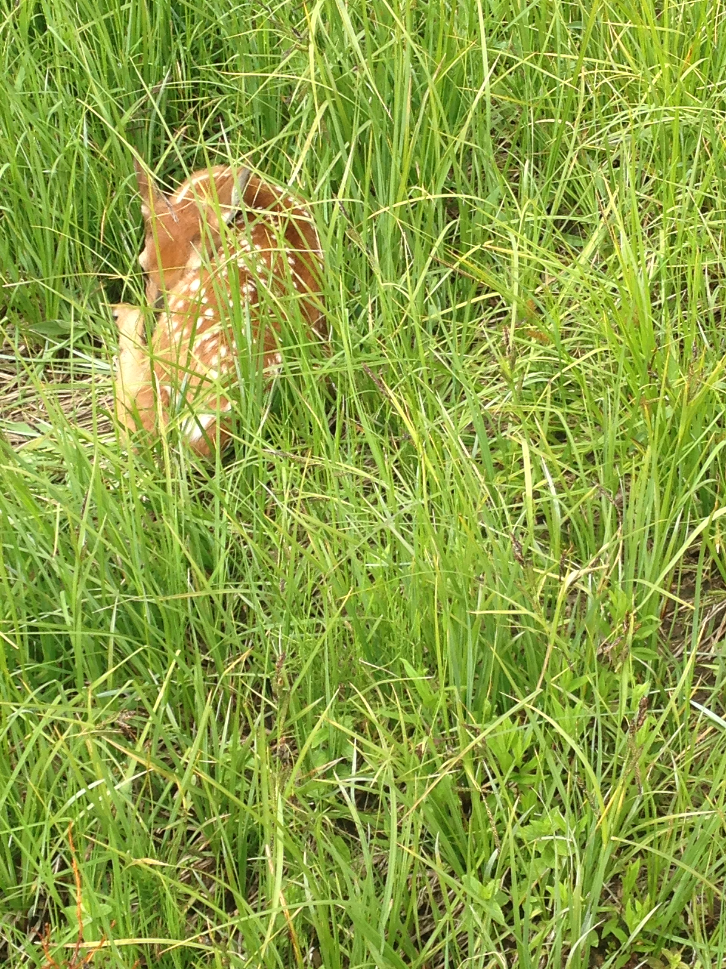
JUNE 2018
SUNDAY | MONDAY | TUESDAY | WEDNESDAY | THURSDAY | FRIDAY | SATURDAY
5/27 | 5/28 | 5/29 | 5/30 | 5/31 | 6/1 | 2
3 | 4 | 5 | 6 | 7 | 8 | 9
10 | 11 | 12 | 13 | 14 | 15 | 16
17 | 18 | 19 | 20 | 21 | 22 | 23
24 | 25 | 26 | 27 | 28 | 29 | 30
mailto:banksoutdoorproducts@aol.com?subject=test

Slide 8
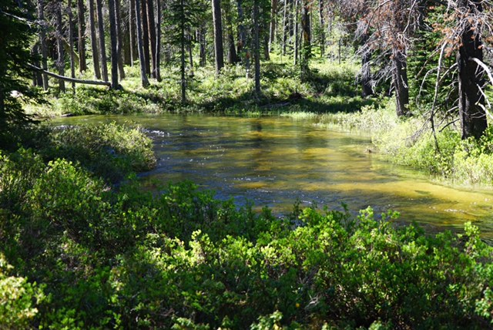
JULY 2018
SUNDAY | MONDAY | TUESDAY | WEDNESDAY | THURSDAY | FRIDAY | SATURDAY
1 mailto:banksoutdoorproducts@aol.com?subject=test | 2 | 3 | 4 | 5 | 6 | 67
8 | 9 | 10 | 11 | 12 | 13 | 14
15 | 16 | SAMPLE 17 EVENT | 18 | 19 | 20 | 21
22 | 23 | 24 | 25 | 26 | 27 | 28
29 | 30 | 31 BIG SAMPLE EVENT EXTRA

Slide 9
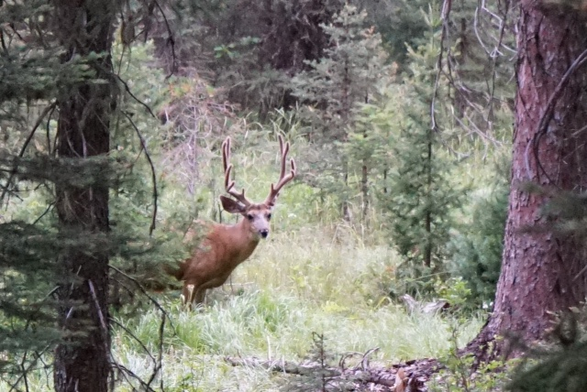
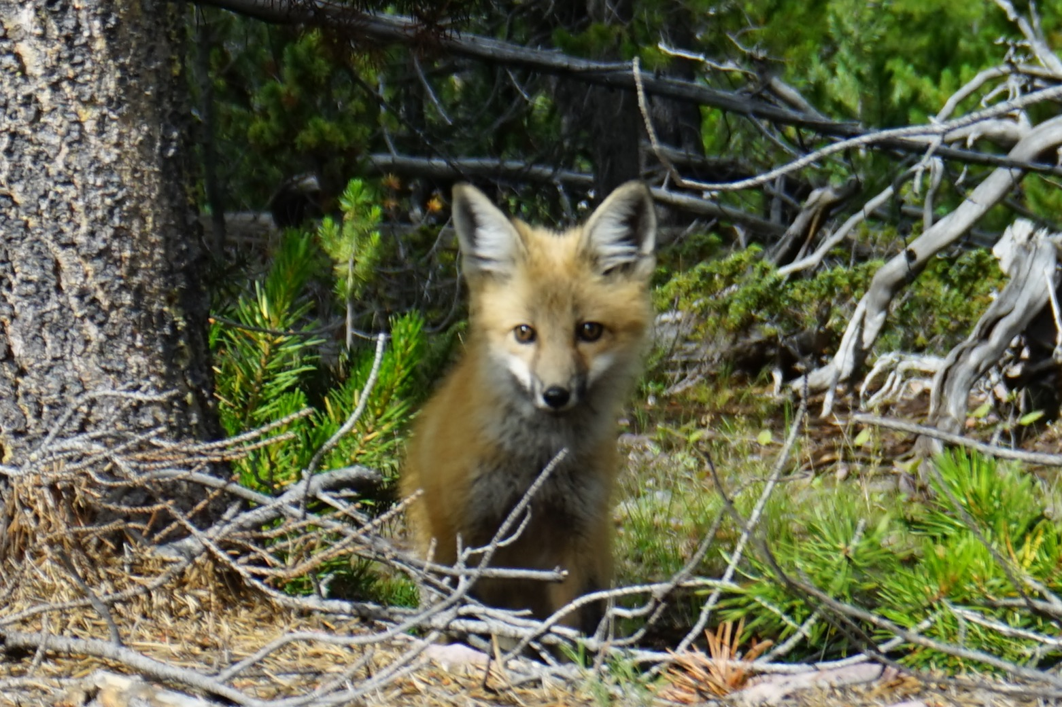
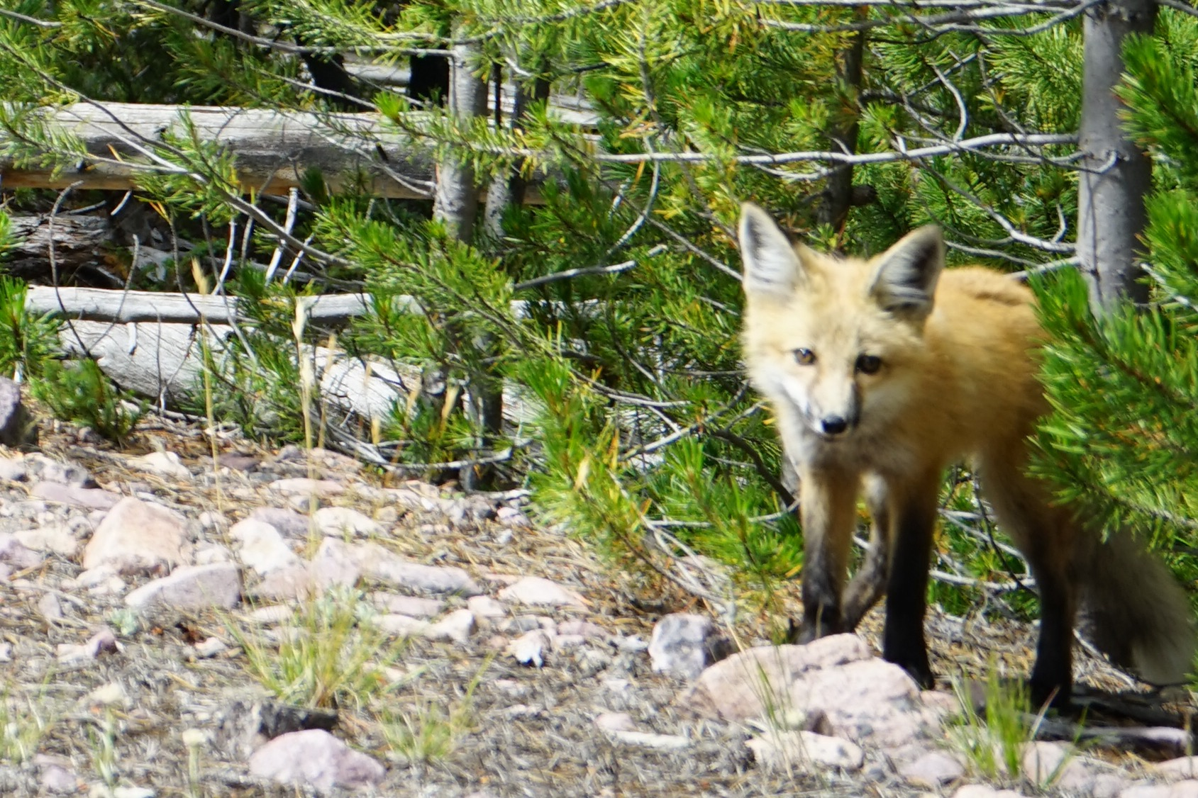
AUGUST 2018
SUNDAY | MONDAY | TUESDAY | WEDNESDAY | THURSDAY | FRIDAY | SATURDAY
7/29 | 7/30 | 7/31 | 8/1 | 2 | 3 | 4
5 | 6 | 7 | 8 | 9 | 10 | 11
12 | 13 | 14 | 15 | 16 | 17 | 18
19 | 20 | 21 | 22 | 23 | 24 | 25
26 | 27 | 28 | 29 | 30 | 31

Slide 10
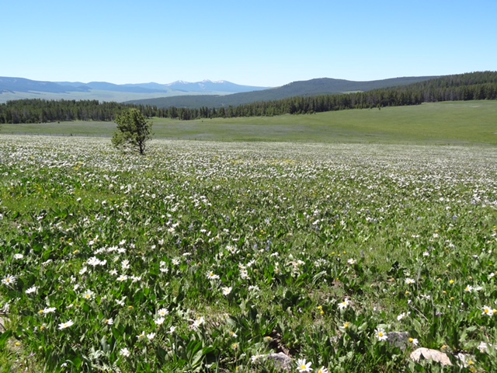
SEPTEMBER 2018
SUNDAY | MONDAY | TUESDAY | WEDNESDAY | THURSDAY | FRIDAY | SATURDAY
8/26 | 8/27 | 8/28 | 8/29 | 8/30 | 8/31 | 9/1
2 | 3 | 4 | 5 | 6 | 7 | 8
9 | 10 | 11 | 12 | 13 | 14 | 15
16 | 17 | 18 | 19 | 20 | 21 | 22
23 | 24 | 25 | 26 | 27 | 29 | 29
30

Slide 11
OCTOBER2018
SUNDAY | MONDAY | TUESDAY | WEDNESDAY | THURSDAY | FRIDAY | SATURDAY
9/30 | 10/1 | 2 | 3 | 4 | 5 | 6
7 | 8 | 9 | 10 | 11 | 12 | 13
14 | 15 | 16 | 17 | 18 | 19 | 20
21 | 22 | 23 | 24 | 25 | 26 | 27
28 | 29 | 30 | 31

Slide 12
NOVEMBER 2018
SUNDAY | MONDAY | TUESDAY | WEDNESDAY | THURSDAY | FRIDAY | SATURDAY
10/28 | 10/29 | 10/30 | 10/31 | 11/1 | 2 | 3
4 | 5 | 6 | 7 | 8 | 9 | 10
11 | 12 | 13 | 14 | 15 | 16 | 17
18 | 19 | 20 | 21 | 22 | 23 | 24
25 | 26 | 27 | 28 | 29 | 30

Slide 13
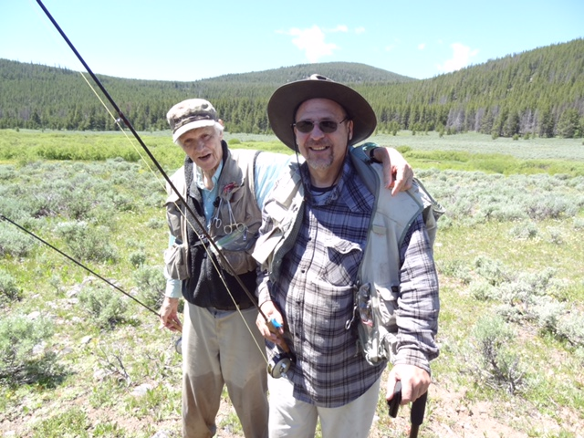
DECEMBER 2018
SUNDAY | MONDAY | TUESDAY | WEDNESDAY | THURSDAY | FRIDAY | SATURDAY
11/25 | 11/26 | 11/27 | 11/28 | 11/29 | 11/30 | 12/1
2 | 3 | 4 | 5 | 6 | 7 | 8
9 | 10 | 11 | 12 | 13 | 14 | 15
16 | 17 | 18 | 19 | 20 | 21 | 22
23 | 24 | 25 | 26 | 27 | 28 | 29
30 | 31
THANK YOU FOR YOUR BUSINESS

Slide 14
2019
Sunday | Monday | Tuesday | Wednesday | Thursday | Friday | Saturday
 |  | RUBY SPRINGS LODGE
Welcome to Banks Outdoor Products Event Calendar
STONE CREEK
FLY BOY ANGLER
BLACKFOOT RIVER GUIDES
LOST RIVER OURFITTERS
GREAT DIVIDE
WEST FORK MOUNTAIN CRAFTS
JACKLIN’S SPORTING GOODS
PATAGONIA RIVER GUIDES
TIGHTLINE
RED’S FLY SHOP
HOOK –N- HORN
HENDRIX OUTDOORS
BITTERROOT FLY SHOP
BEARTOOTH
TOP QUALITY HAND TIED FLIES AT THESE FINE RETAILERS AND DISTRIBUTORS

Slide 15
JANUARY 2019
SUNDAY | MONDAY | TUESDAY | WEDNESDAY | THURSDAY | FRIDAY | SATURDAY
30 | 31 mailto:dwhouston73@gmail.com, | 1 | 2 | 3 | 4 | 5
6 | 7 | 8 | 9 | 10 | 11 | 12
13 | 14 | 15 | 16 | 17 | 18 | 19
20 | 21 | 22 | 23 | 24 | 25 | 26
27 | 28 | 29 | 30 | 31

Slide 16
FEBRUARY 2019
SUNDAY | MONDAY | TUESDAY | WEDNESDAY | THURSDAY | FRIDAY | SATURDAY
27 | 28 | 29 | 30 | 31 | 1 | 2
3 | 4 | 5 | 6 | 7 | 8 | 9
10 | 11 | 12 | 13 | 14 | 15 | 16
17 | 18 | 19 | 20 | 21 | 22 | 23
24 | 25 | 26 | 27 | 28

Slide 17
MARCH 2019
SUNDAY | MONDAY | TUESDAY | WEDNESDAY | THURSDAY | FRIDAY | SATURDAY
24 | 25 | 26 | 27 | 28 | 1 | 2
3 | 4 | 5 | 6 | 7 | 8 | 9
10 | 11 | 12 | 13 | 14 | 15 | 16
17 | 18 | 19 | 20 | 21 | 22 | 23
24 | 25 | 26 | 27 | 28 | 29 | 30
31

Slide 18
APRIL2019
SUNDAY | MONDAY | TUESDAY | WEDNESDAY | THURSDAY | FRIDAY | SATURDAY
31 | 1 | 2 | 3 | 4 | 5 | 6
7 | 8 | 9 | 10 | 11 | 12 | 13
14 | 15 | 16 | 17 | 18 | 19 | 20
21 | 22 | 23 | 24 | 25 | 26 | 27
28 | 29 | 30

Slide 19
MAY 2019
SUNDAY | MONDAY | TUESDAY | WEDNESDAY | THURSDAY | FRIDAY | SATURDAY
28 | 29 | 30 | 1 | 2 | 3 | 4
5 | 6 | 7 | 8 | 9 | 10 | 11
12 | 13 | 14 | 15 | 16 | 17 | 18
19 | 20 | 21 | 22 | 23 | 24 | 25
26 | 27 | 28 | 29 | 30 | 31

Slide 20
JUNE 2019
SUNDAY | MONDAY | TUESDAY | WEDNESDAY | THURSDAY | FRIDAY | SATURDAY
25 | 26 | 27 | 28 | 30 | 31 | 1
2 | 3 | 4 | 5 | 6 | 7 | 8
9 | 10 | 11 | 12 | 13 | 14 | 15
16 | 17 | 18 | 19 | 20 | 21 | 22
23 | 24 | 25 | 26 | 27 | 28 | 29
30 mailto:banksoutdoorproducts@aol.com?subject=test

Slide 21
JULY 2019
SUNDAY | MONDAY | TUESDAY | WEDNESDAY | THURSDAY | FRIDAY | SATURDAY
mailto:banksoutdoorproducts@aol.com?subject=test 30 | 1 | 2 | 3 | 4 | 5 | 6
7 | 8 | 9 | 10 | 11 | 12 | 13
14 | 15 | SAMPLE 16 EVENT | 17 | 18 | 19 | 20
21 | 22 | 23 | 24 | 25 | 26 | 27
28 | 29 | 30 BIG SAMPLE EVENT EXTRA | 31

Slide 22
AUGUST 2019
SUNDAY | MONDAY | TUESDAY | WEDNESDAY | THURSDAY | FRIDAY | SATURDAY
28 | 29 | 30 | 31 | 1 | 2 | 3
4 | 5 | 6 | 7 | 8 | 9 | 10
11 | 12 | 13 | 14 | 15 | 16 | 17
18 | 19 | 20 | 21 | 22 | 23 | 24
25 | 26 | 27 | 28 | 29 | 30 | 31

Slide 23
SEPTEMBER 2019
SUNDAY | MONDAY | TUESDAY | WEDNESDAY | THURSDAY | FRIDAY | SATURDAY
1 | 2 | 3 | 4 | 5 | 6 | 7
8 | 9 | 10 | 11 | 12 | 13 | 14
15 | 16 | 17 | 18 | 19 | 20 | 21
22 | 23 | 24 | 25 | 26 | 27 | 28
29 | 30

Slide 24
OCTOBER2019
SUNDAY | MONDAY | TUESDAY | WEDNESDAY | THURSDAY | FRIDAY | SATURDAY
29 | 30 | 1 | 2 | 3 | 4 | 5
6 | 7 | 8 | 9 | 10 | 11 | 12
13 | 14 | 15 | 16 | 17 | 18 | 19
20 | 21 | 22 | 23 | 24 | 25 | 26
27 | 28 | 29 | 30 | 31

Slide 25
NOVEMBER 2019
SUNDAY | MONDAY | TUESDAY | WEDNESDAY | THURSDAY | FRIDAY | SATURDAY
27 | 28 | 29 | 30 | 31 | 1 | 2
3 | 4 | 5 | 6 | 7 | 8 | 9
10 | 11 | 12 | 13 | 14 | 15 | 16
17 | 18 | 19 | 20 | 21 | 22 | 23
24 | 25 | 26 | 27 | 28 | 29 | 30

Slide 26
DECEMBER 2019
SUNDAY | MONDAY | TUESDAY | WEDNESDAY | THURSDAY | FRIDAY | SATURDAY
1 | 2 | 3 | 4 | 5 | 6 | 7
8 | 9 | 10 | 11 | 12 | 13 | 14
15 | 16 | 17 | 18 | 19 | 20 | 21
22 | 23 | 24 | 25 | 26 | 27 | 28
29 | 30 | 31
THANK YOU FOR YOUR BUSINESS

