Slide 1
FHFA – UAD Dataset
St. Louis Perspective
Doug Potts, MAI, AI-GRS
Delta Real Estate Analytics, LLC
January 10, 2023
AI - GoToWebinar

Slide 2
It’s All About Wealth Creation
with
MORE EQUAL ACCESS

Slide 3
Breaking the Inequality Trifecta
No Capital Access = Crushed Mobility in Income / Wealth / Opportunity
This chart illustrates the economic mobility of
White Americans born in
1980s through the 1990s.
US income by quintile at birth (top scale) and achieved by age 40 (left scale).
White American starting in the poorest 20% have a 1-in-6 chance to achieve top 20% by age 40
Only 1-in-10 remain stuck in the bottom by age 40.
But what does it look like for Black America?
51% likely to stay in bottom rung
Poorest 20%
1 in 4 will stay poor
1 in 6 will get to top 20%
by age 40

Slide 4

Real Estate Floats on a Sea of CAPITAL
What happens when the water runs out?
Buyers can’t buy, sellers can’t sell
Collapse of activity
Collapse of prices
Collapse of maintenance
Collapse of tax base
Collapse of services & schools
Once vibrant markets atrophy
Abandonment & Collapse of Community

Slide 5
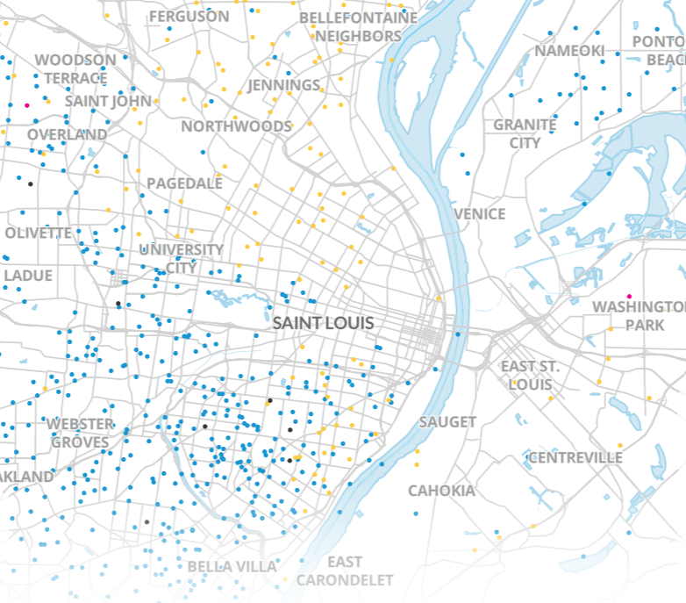
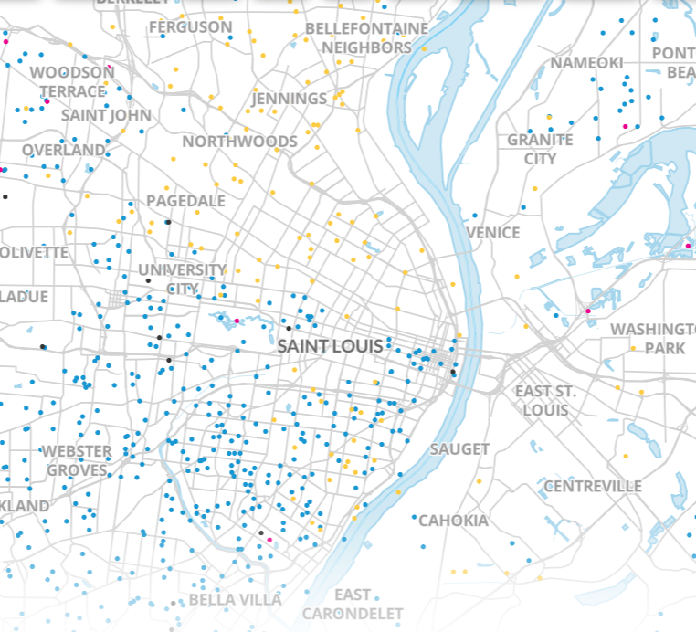
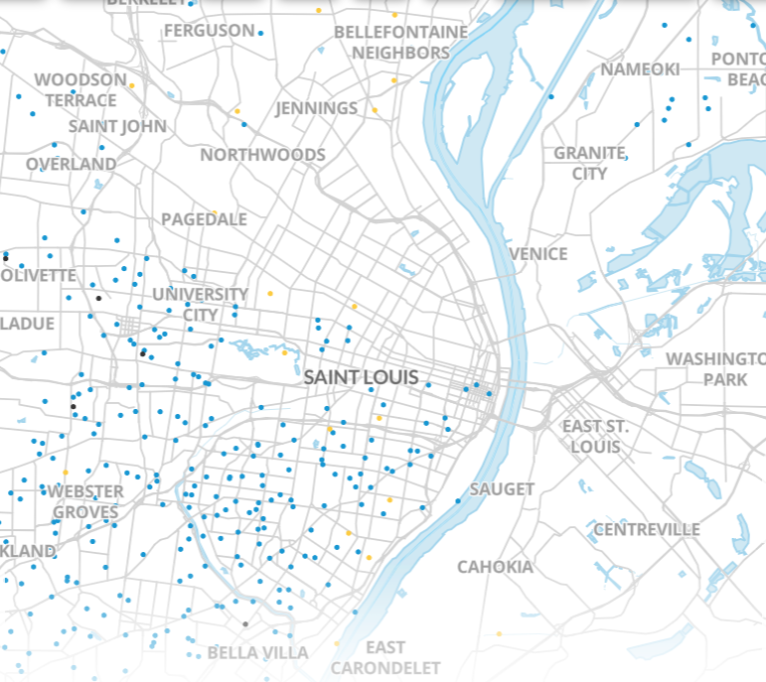
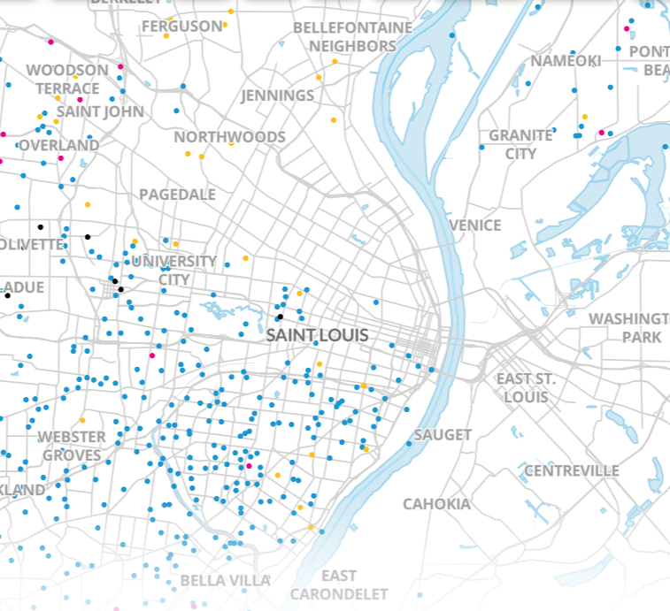
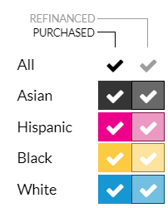
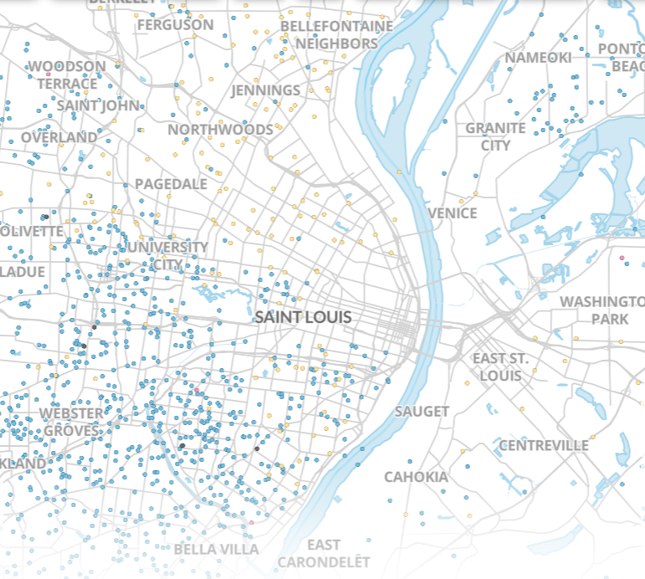
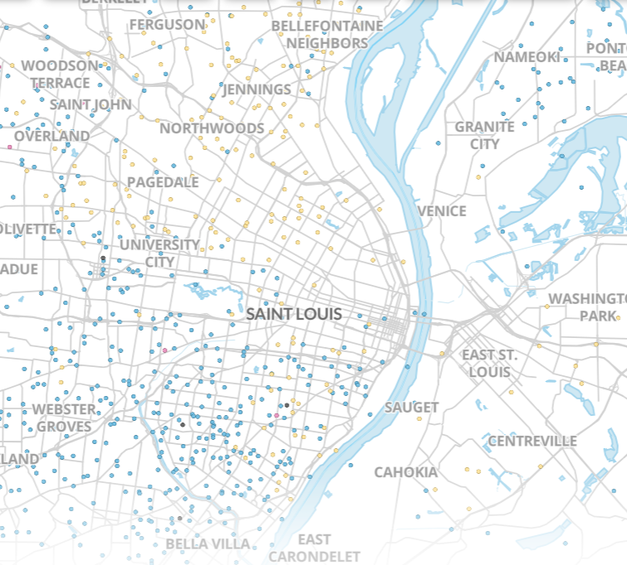
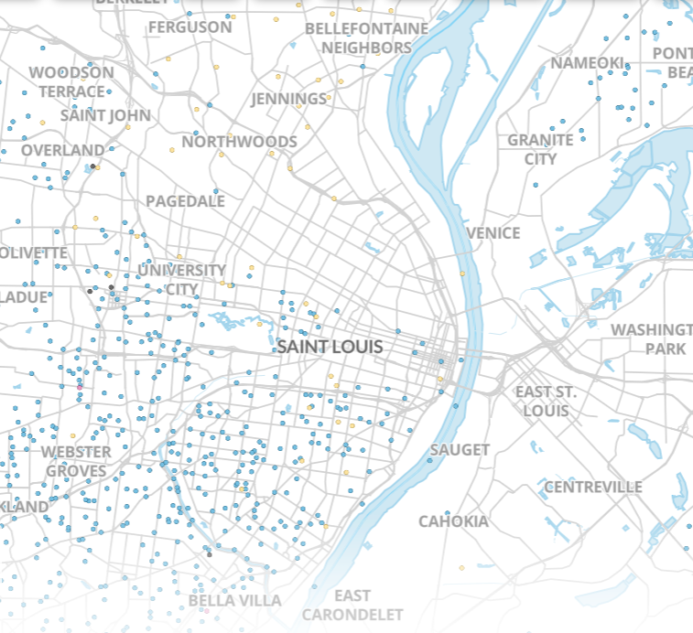
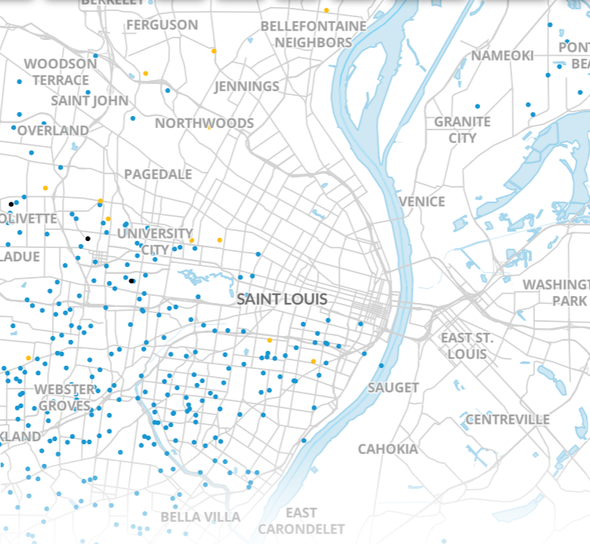
Active & Inactive Markets v Lending Deserts
2001
2007
2013
2019
Purchase Loans
Refinance Loans
National Coverage Data @ https://apps.urban.org/features/mortgages-by-race/

Slide 6
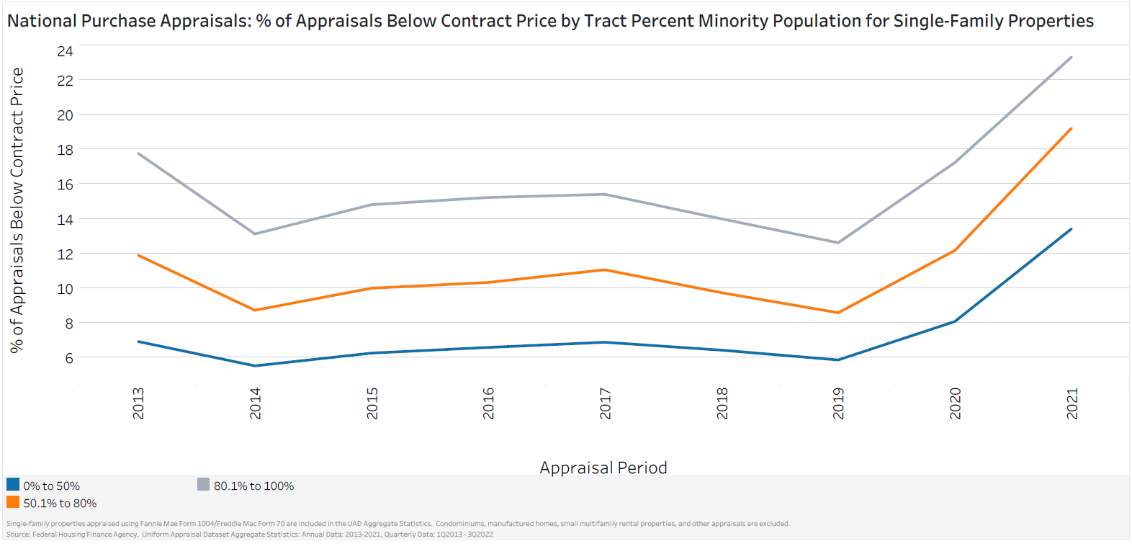
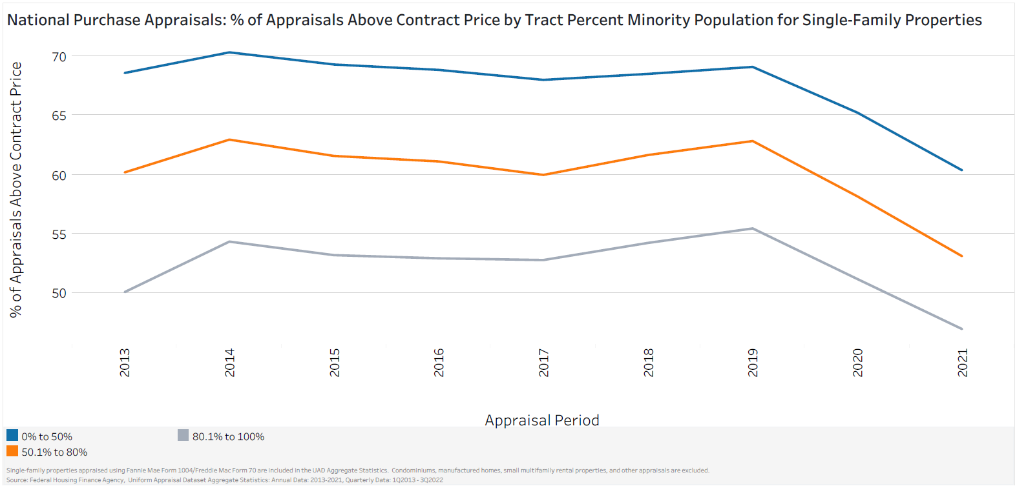
FHFA UAD Dataset - Critical Info for the Nation
Appraisal values < PP more frequent as areas become more “minority*”
Unfolding story -- 2020 & 2021 data has broken prior trends
Appraisal values > PP more frequent as areas become more “white*”
* Census definitions per FHFA

Slide 7
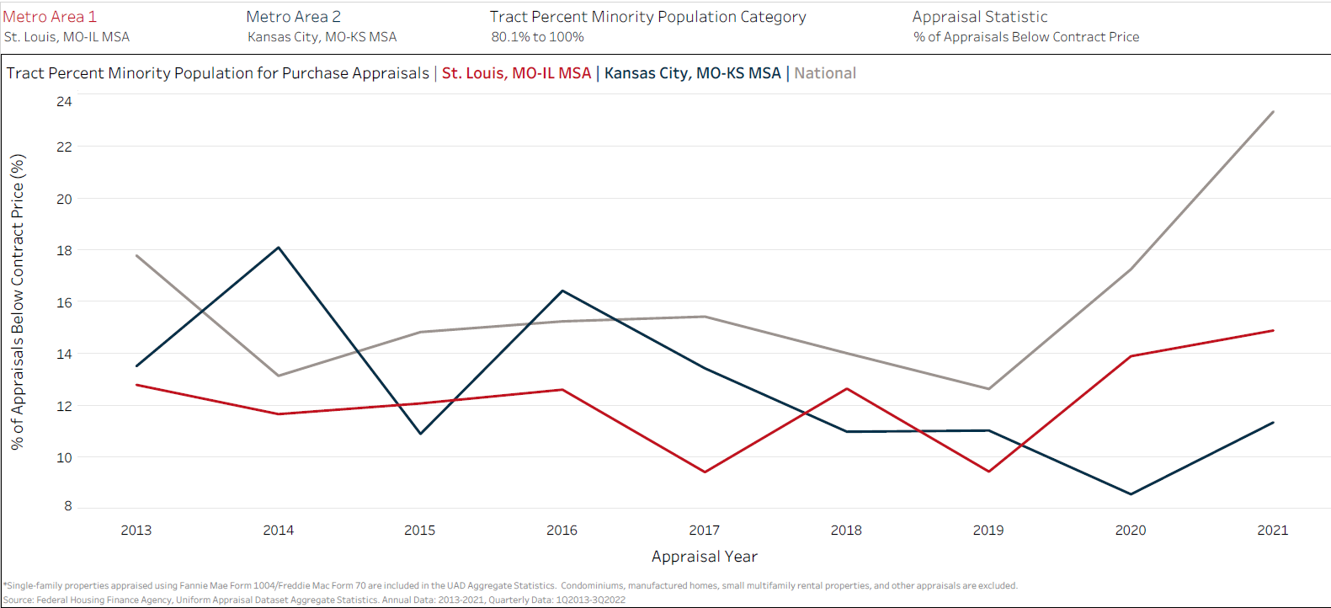
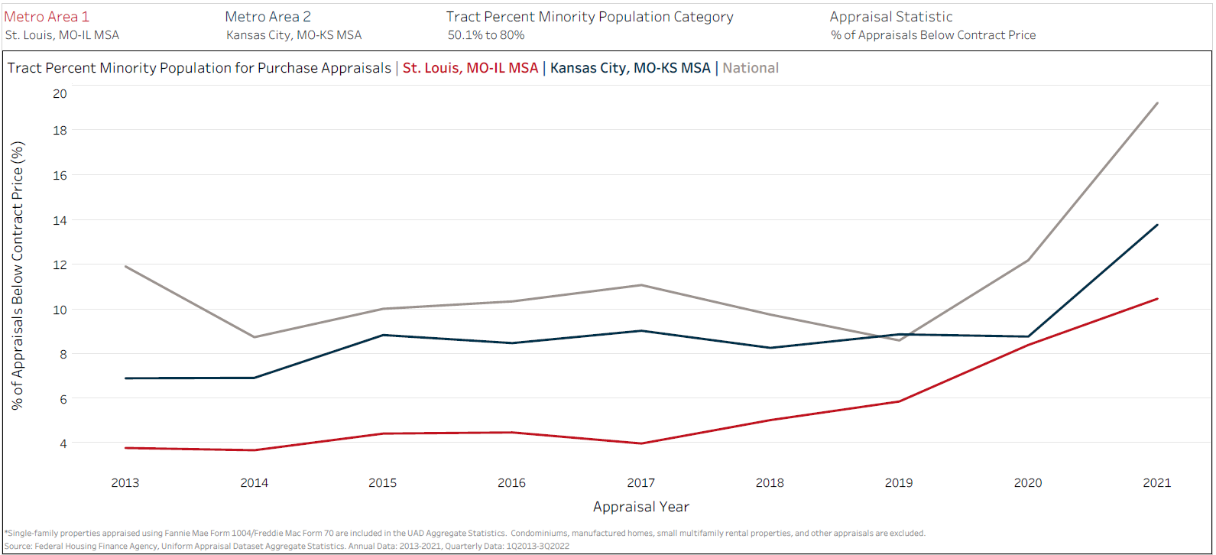
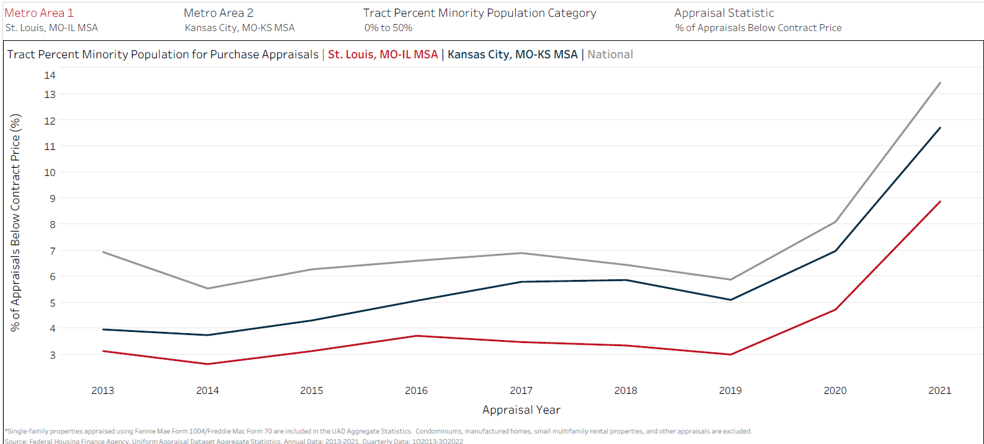
National FHFA Data – the St. Louis Angle
USA
Over 80% “minority*”
St. Louis still appraises fewer houses below PP v National.
STL
USA
* Census definitions per FHFA
50.1% to 80% “minority*”
St. Louis appraises fewer houses below PP v National.
STL
USA
Up to 50% “white*”
St. Louis appraises fewer houses below PP v National.
STL

Slide 8
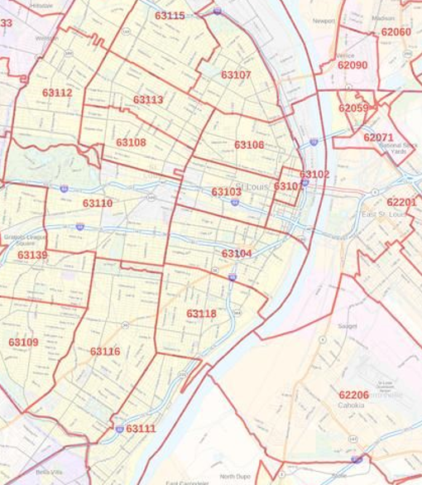
Inactive Markets & Price Crush #1
63113 – Kingsway
Avg Age = 1923
Avg GLA = 1,795 SF
Style = 1½ - 2½ Sty
# Sales 2021 = 43
Avg $ = $72,132
63116 – Southampton
Avg Age = 1919
Avg GLA = 1,801 SF
Style = 1½ - 2½ Sty
# Sales 2021 = 416
Avg $ = $252,545

Slide 9
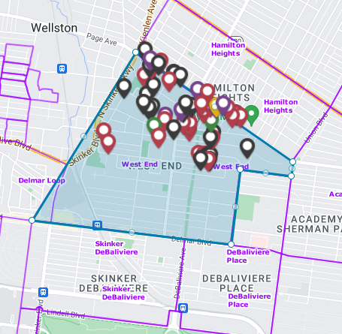
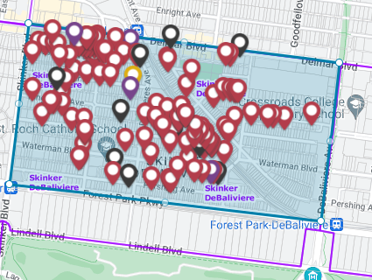
Inactive Markets & Price Crush #2
West End Neighborhood
Avg 1924 built w/ 2,018 SF
13 Sales in 2021 – avg $111,700
13 Sales in 2022 – avg $105,100
Skinker DeBaliviere Neighborhood
Avg 1908 built w/ 1,919 SF
39 sales in 2021 – avg $327,900
19 sales in 2022 – avg $385,300

Slide 10
Traditional Comparability Triangle
GSE Criteria = Traditional BOK
(Does it recycle past market damage?)
  Traditional Subject Property Method
  Location – highest priority
  Size / Rooms
  Age
  Amenities & Features
Location
  Traditional Comparable Triangulation
  Location Location Location
  Similarity of Features
  How Recent a Transaction
Subject
Property
Features
Recent
Copyright © 2023 Appraisal Institute. All rights reserved. Published in the United States of America. No part of this publication may be reproduced, stored in a retrieval system, or transmitted in any form or by any means, electronic, mechanical, photocopy, recording or otherwise, without the prior written consent of the publisher.

Slide 11
RESTORATIVE COMPETITIVE VALUE
  Reframe the Subject Property
  De-Prioritize Location
  Size / Rooms
  Age
  Amenities & Features
Re-Imagining the Comparability Triangle
Features
Location
  Adjust the Comparability Triangle
  Prioritize Similarity of Features
  De-Prioritize Location
  Other Areas w/Similar Buildings?
  Any Nearby Older Unicorn Sales?
Subject
Property
Older Sales
Possible
Flexible
Location
Features
Recent
EXPAND THE COMPARABILITY TRIANGLE
Restore Value to Structurally Underserved Areas?
Copyright © 2023 Appraisal Institute. All rights reserved. Published in the United States of America. No part of this publication may be reproduced, stored in a retrieval system, or transmitted in any form or by any means, electronic, mechanical, photocopy, recording or otherwise, without the prior written consent of the publisher.

Slide 12
NEXT STEPS – LEVERAGING FHFA UAD DATA
FHFA UAD DATASET STRENGTHS
MASSIVE DATASET
Comprehensive
High consistency
Excellent granularity
Appraiser-verified
FHFA UAD DATASET WEAKNESSES
Available regional stats too broad
Can more refined geography be published?
Granularity vs anonymity challenges
NEXT STEPS – ST LOUIS
What geographies need CRV?
  Define comparability expansion methods
    Criteria for choosing expanded geography
    Criteria for choosing expanded timescale
The 2-Value Solution
  Show Your Homework – all candidate comps
  Value by traditional Selling Guide Requirements
  Value by Restorative Competitive Value
  Transparency in Assignment Conditions
  Built for CRA purposes in portfolio
  Not a product for GSA/FHA/VA lending
What defines success?
  When does a neighborhood revert to traditional underwriting … if ever?

Slide 13

THANK YOU!

