Slide 1
Talking Points
A translation tool
Name / Date

Slide 2
Agenda
What is Talking Points?
Why should we use Talking Points?
Who can use Talking Points?
Classroom Implications & Recommendations

Slide 3

What is Talking Points?
It is an app (or you can go on the website) to send messages to guardians in their home language.
Guardians will get the message in their home language.
There is an app, but guardians do not need to download the app.
They can reply back in their home language, and we will get it back in English (or whichever language you put as you would like to receive messages in).
Free
Uses a human translator and AI.

Slide 4
Home Languages at ___ our MLs know
Home Languages of our MLs
What is a home language?
A language that is used at home, or that they grew up using.

Slide 5
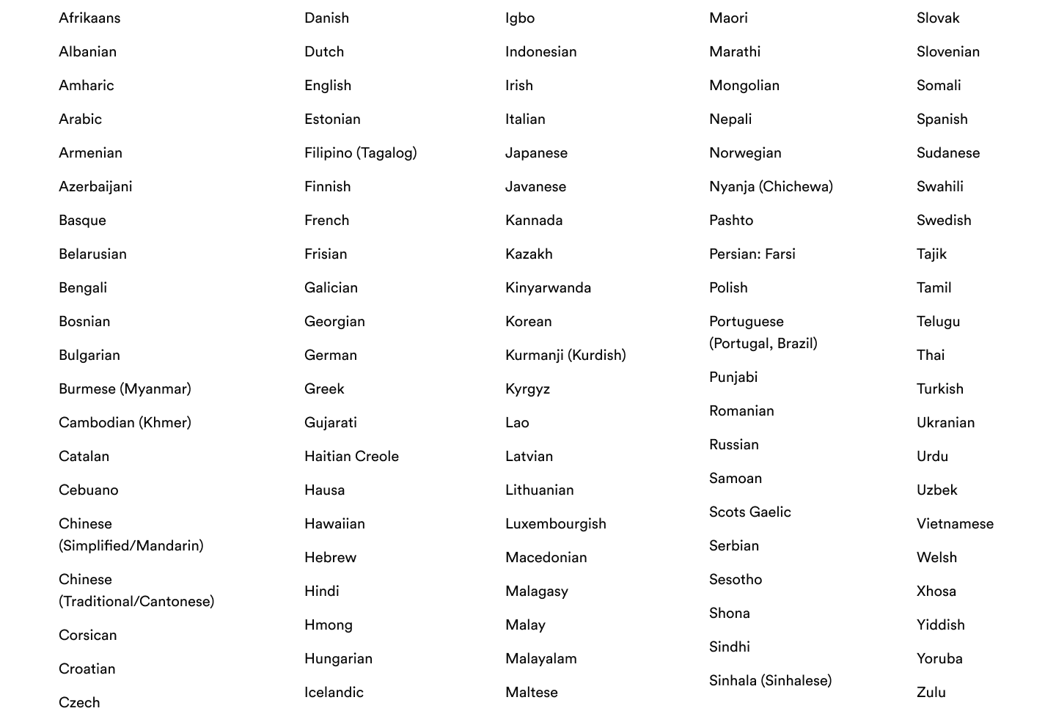

Languages on Talking Points
What is Talking Points?
DeLozier, Paige (2022). Languages used in Talking Points. Talking Points. https://intercom.help/talkingpoints/en/articles/455534-what-languages-does-talkingpoints-support

Slide 6


Why should we use Talking Points?
To engage guardians
To communicate about events, conferences, important information.
Share student progress.

Slide 7
Who can use Talking Points?
All Staff
Guardians
It is free

Slide 8
Classroom Implications
Guardians will know how their student is doing in school.
Guardians will be able to communicate more easily with staff.
With more guardian involvement, students academics, attendance and behaviors improve since their guardians will be more involved in their education (Simon, 2004).

Slide 9
Recommendations
Use for multilingual guardians in your classroom
Not just ML
Connect with the ML Teacher of which guardians need their messages translated.

Slide 10
How to sign up
www.talkingpts.org -- how to use Talking Points.

Slide 11
Interactive Activity: Brainstorm in Groups & Share Out
In groups, talk about how you could use Talking Points in your current teaching position, or in a future one.
  How would you use this tool to engage guardians?
  What would you communicate to guardians about using Talking Points, rather than making a phone call?

Slide 12
References
Talking Points (2018, October 5). TalkingPoints Introduction Video [Video]. YouTube.
https://www.youtube.com/watch?v=gMEuUyk4QvE
DeLozier, Paige (2022). Languages used in Talking Points. Talking Points.
https://intercom.help/talkingpoints/en/articles/455534-what-languages-does-talkingpoints-support
Simon, B.S. High School Outreach and Family Involvement. Social Psychology of Education 7, 185–209
(2004). https://doi.org/10.1023/B:SPOE.0000018559.47658.67

