Slide 1
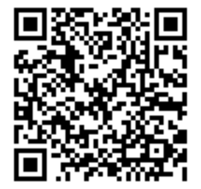
Are you interested in participating in Project Grace?
Voicemail: (816) 775-1910
Email: ProjectGrace2021@gmail.com
follow this link
https://redcap.link/EnrollmentProjectGrace
or scan QR code here:
Open Enrollment for the 1st Survey of Project Grace will be open March 7th - March 27th
For your participation you will receive:
$25 electronic gift card to Walmart for completing the 1st survey
$30 electronic gift card to Walmart for completing the 2nd survey (at later date)
* In order to take the 2nd survey, you must have completed the 1st *
To participate you must be:
•African American and age 55 and older
•Live in the Kansas City, Missouri metropolitan area
•Willing to participate in 2 surveys
•Willing to provide contact information for yourself and for two additional persons with whom you have ongoing contact
•Have a cell phone number that can send and receive text messaging and/or a working email address that can be accessed
•Regularly attending this church (at least once a month) or using this church’s outreach ministries (3-4 times per year)
Any Questions? Please contact:
Jensen Davis or Tacia Burgin
ProjectGrace2021@gmail.com
(816) 775-1910
Other Questions? Please contact:
Jensen Davis or Tacia Burgin
ProjectGrace2021@gmail.com
(816) 775-1910
Notes:
1

