Slide 1

2024 NCSTS Meeting
August 14, 2024
Traverse City, MI

Slide 2

Conference Agenda:
8:00 AM – 9:15 AM: Welcome Reception & Breakfast
9:15 AM – 9:30 AM: Welcome, Pledge of Allegiance, Intro
9:30 AM – 10:30 AM: Human Trafficking (Lt. Col. Michael Krumm)
10:30 AM – 10:45 AM: Break
10:45 AM – 11:45 AM: NEMTAC (Peter Hicks)
11:45 AM – 12:45 PM: Lunch
12:45 PM – 1:45 PM: ATRI Non-Consensual Towing (Alex Leslie)
1:45 PM – 3:00 PM: Tyler Technologies (Teri Berschneider)
3:00 PM – 3:15 PM: Break
3:15 PM – 3:45 PM: ICC HHG Sting Ops (Cmdr. Ryan Nance)
3:45 PM – 4:15 PM: Enforcement & Trends Presentation (Lt. Chris Keller)
4:15 PM – 5:00 PM: Open Forum

Slide 3
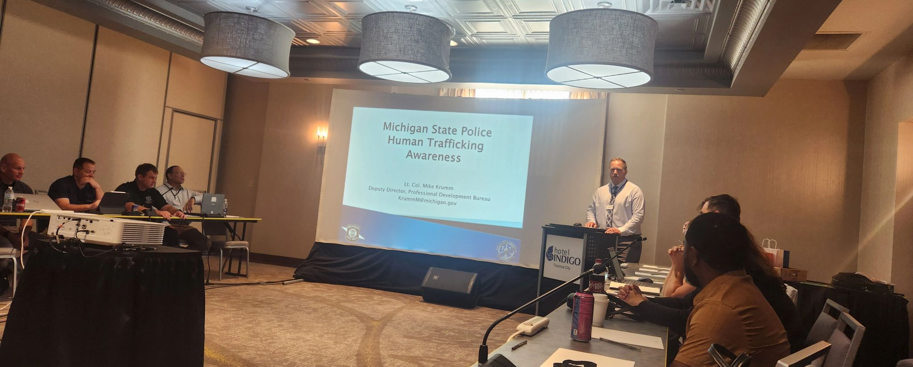
President Abe Droste introducing speaker Lt. Col Mike Krumm (MI State Police)
Agenda Item#3: Human Trafficking Awareness

Slide 4
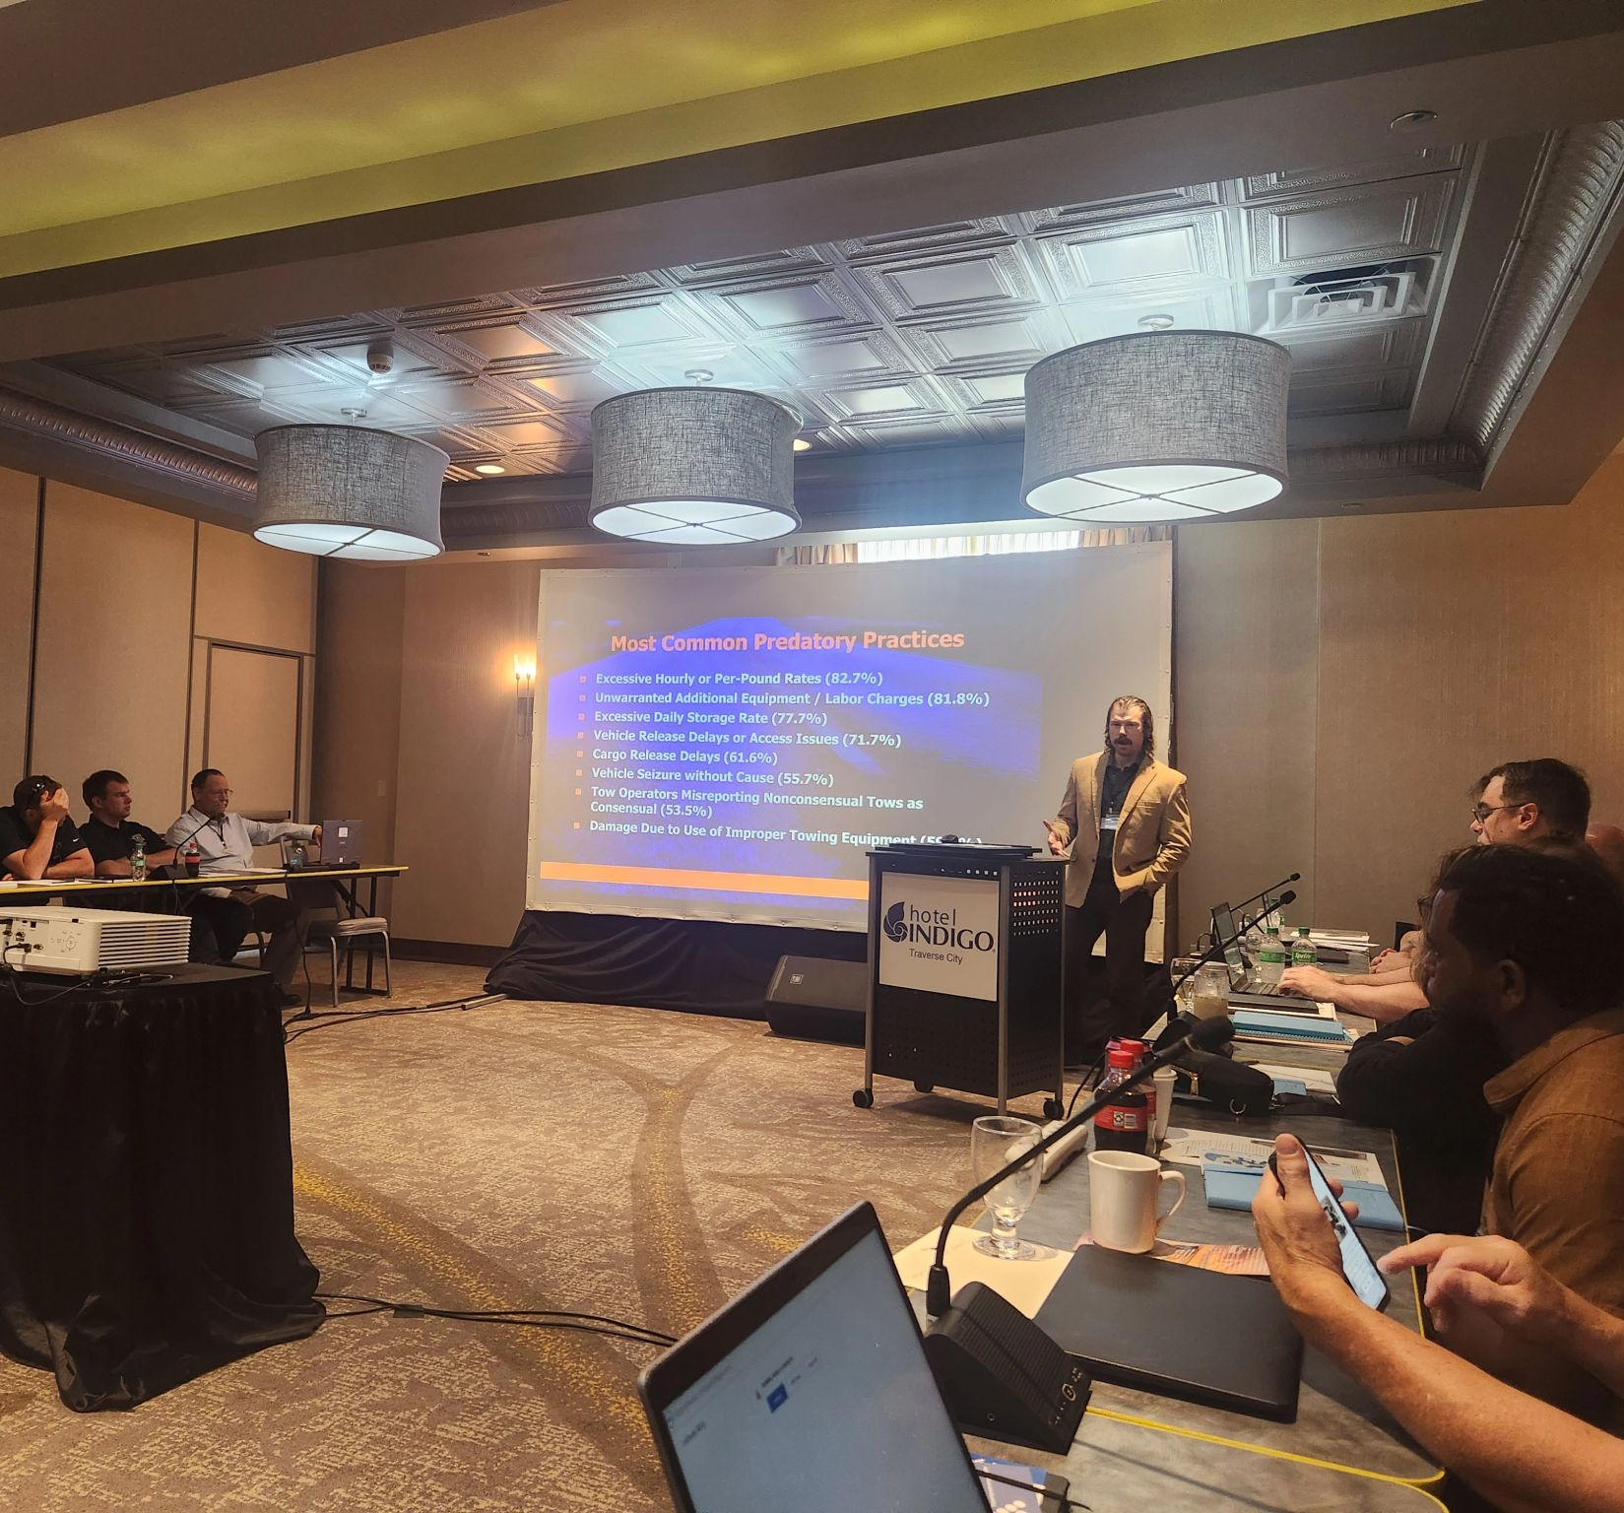
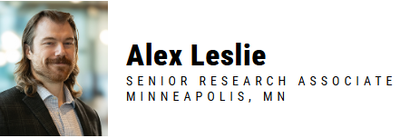
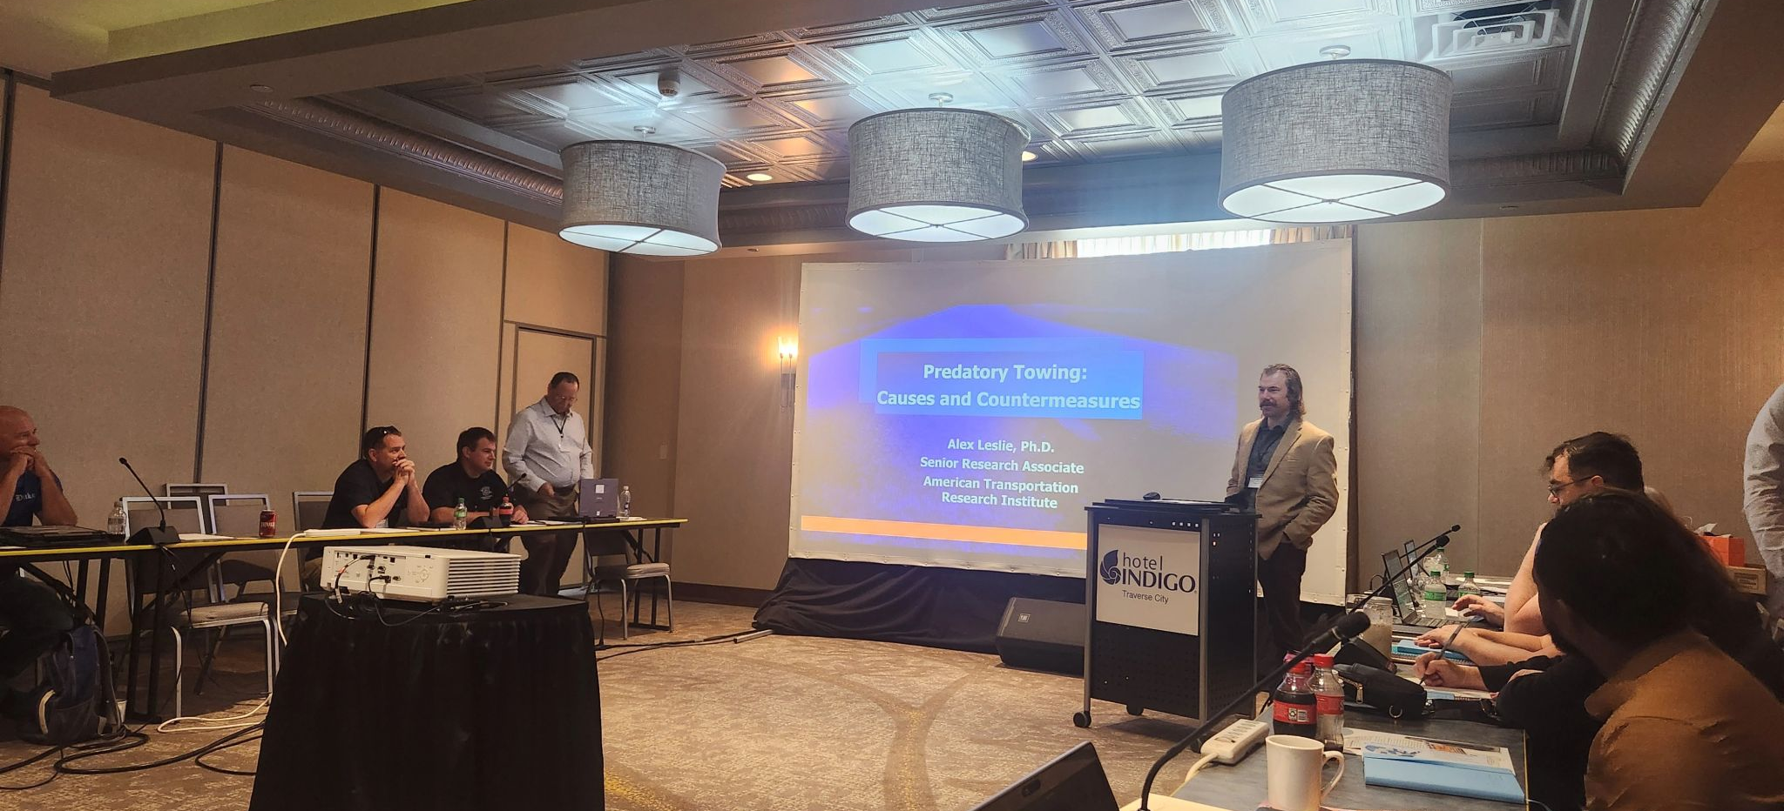

ATRI: American Transportation Research Institute
Agenda Item#7:
Speaker Dr. Alex Leslie spoke about Predatory Towing research that ATRI completed in 2023.

Slide 5
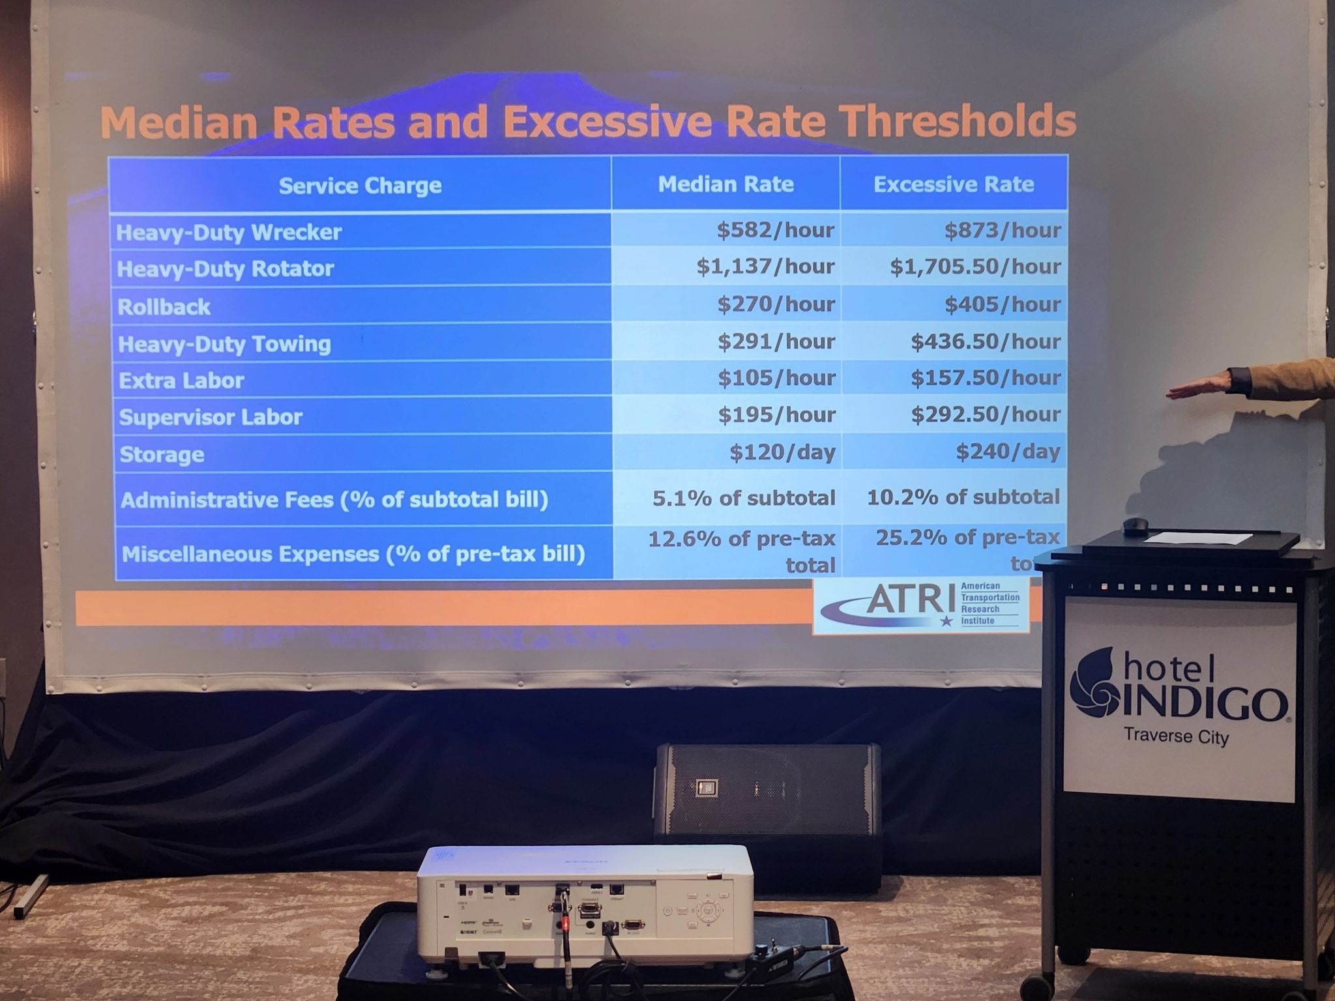
Median Rates vs. Excessive Rates

Slide 6

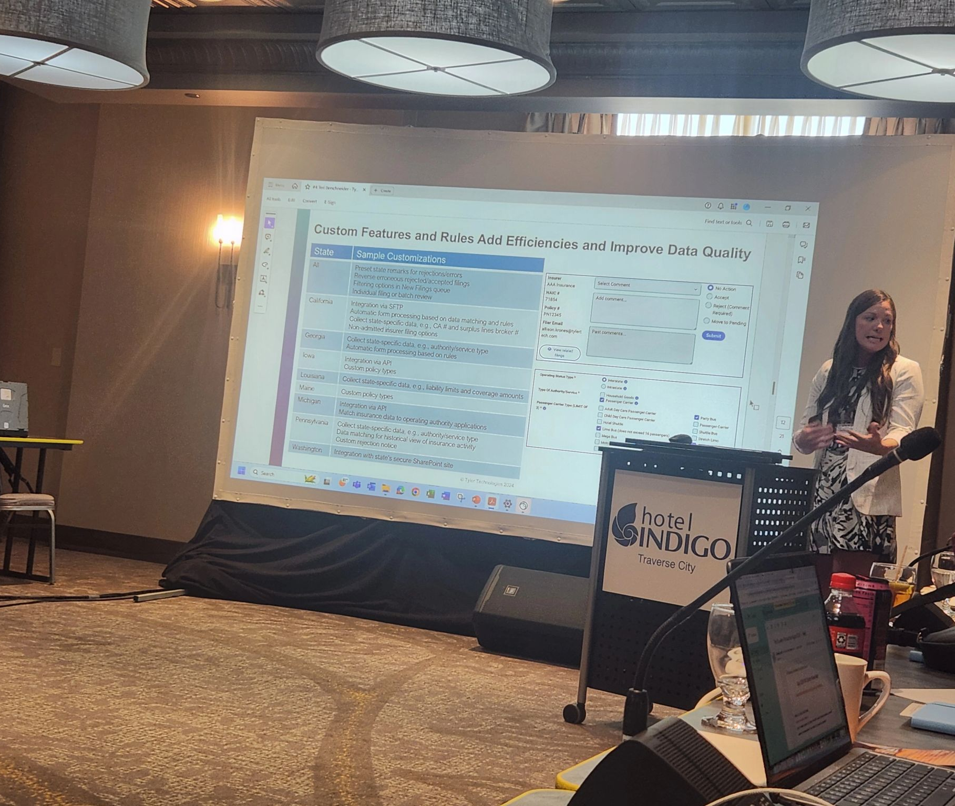
Tyler Technologies
Agenda Item #8: Insurance Filings Product Demo
Speaker: Teri Berschneider

Slide 7
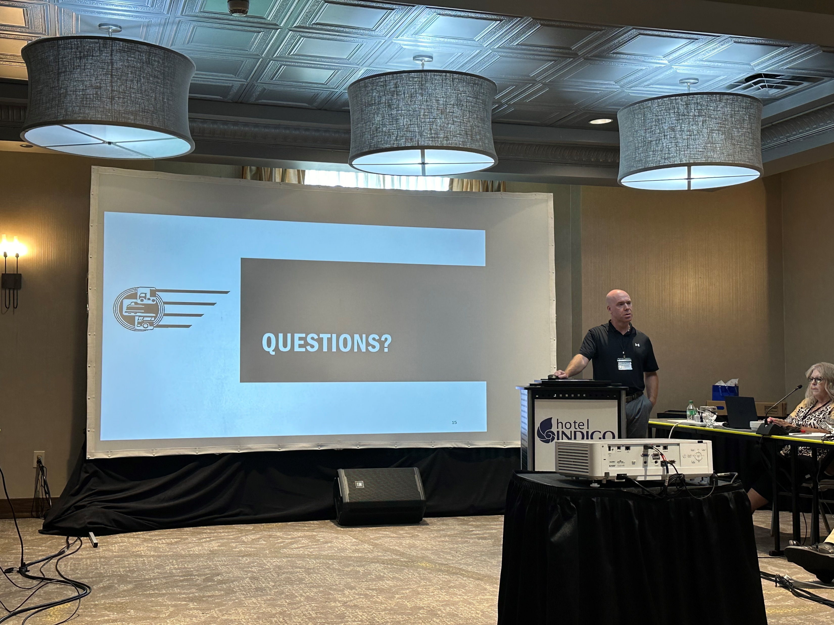

Illinois Commerce Commission Police: HHG Sting Ops
Agenda #10:
Speaker Commander Ryan Nance discussed the in-depth process for Illinois handling unlicensed (Illegal) HHG movers

Slide 8
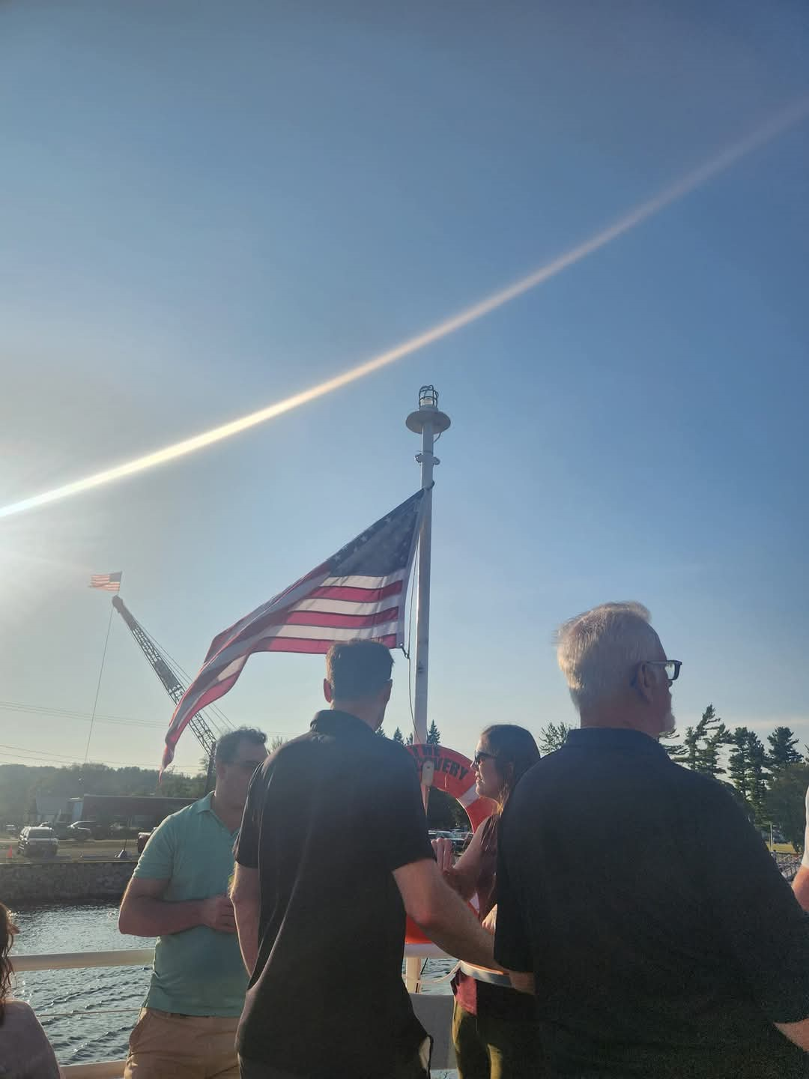
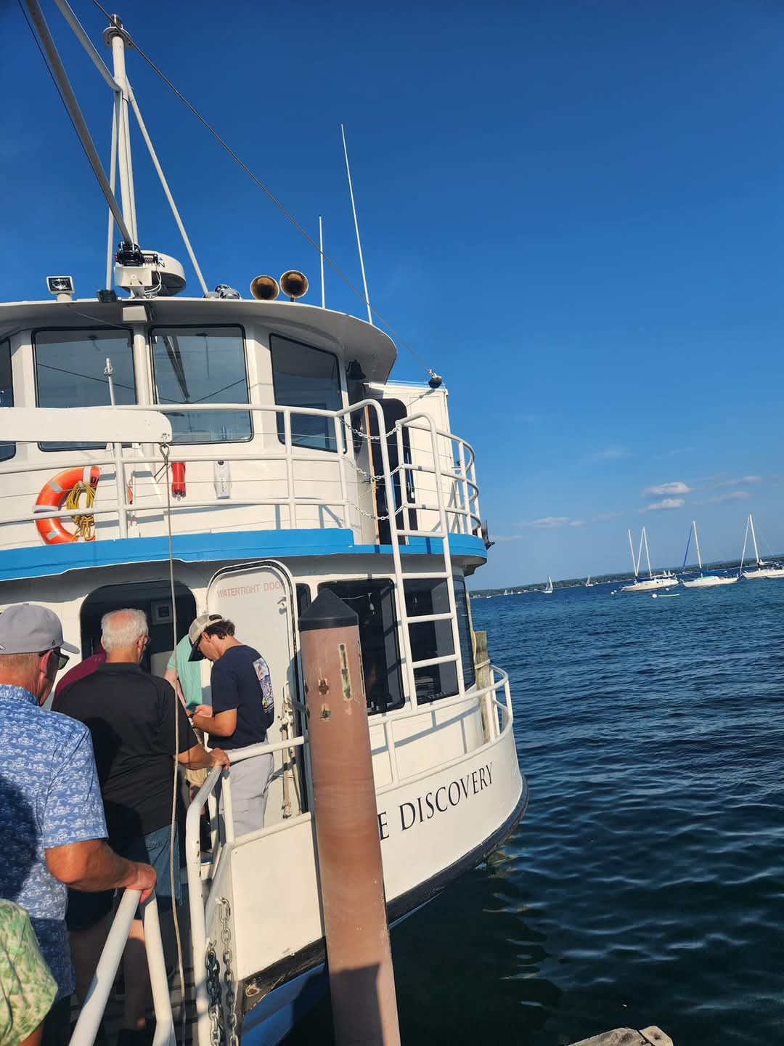
After Conference Event: Discovery Traverse City Tours

Slide 9
NCSTS Officers and Executive Members (2024-2025)
OFFICERS ELECTED
EXECUTIVE COMMITTEE
Eric Belford MT DOT- President
Kristen Burch ICC Police- Vice President
Cindy Denny IN DOR- Secretary
Carol Fallin TX DMV- Treasurer
Ryan Nance-ICC Police
LaBrina Matthews-TX DMV
Mathew Perkinson-WA UTC
Billy Johnson-Virginia DMV
Patrick Remfrey-WA UTC
Jodi McBride-WA UTC
Jared Smith-KS CC
Joshua Clemons-IN DOR
1 VACANCY
PAST PRESIDENTS
William Debord-KY TC
Mike Hoeme-KS CC
Terry Mercer-RI DPUC
Crystal Stevens-OK CC
Luke Bentley-AL PSC
Abraham Droste- MI State Police (new)

