Slide 1
2026 Annual Meeting Agenda
President’s Opening Comments (David Lester)
Secretary’s Report and Approvals (Bryan Sowatzke)
Lake Preservation Program Report (Terry Klaves)
Architectural Committee Report (Deb Hoff)
Community Event Committee Report (Debbie Smith)
Treasurer’s Report and New Budgets (Kevin Streetar)
Closing Comments (David Lester)

Slide 2
2026 Annual Meeting Agenda
President’s Opening Comments (David Lester)
Secretary’s Report and Approvals (Bryan Sowatzke)
Lake Preservation Program Report (Terry Klaves)
Architectural Committee Report (Deb Hoff)
Community Events Committee Report (Deborah Smith)
Treasurer’s Report (Kevin Streetar)
Closing Comments - (David Lester)

Slide 3
Annual Meeting Highlights:
2026 Board of Directors Election Results:
      Neil Howell (100 Votes)
      David Richter (85 Votes)
Today’s Agenda:
2025 Annual Meeting Minute Approvals
2026 Budget Approval (following Committee Reports)
Lake Preservation Program Reports
Architectural Committee - Construction Activity Reports
Community Event Overview
Treasurer’s Reports & Expenditure Forecast

Slide 4
Presidents Report
The Association’s Mission:
To maximize our lake’s recreational value, protect property values, and create the best community for everyone
Primary Objectives:
        Manage Weed Growth
        Reverse lake aging
        Improve communications

Slide 5
Improving Communications:
    Website Enhancements:
          Announcements page:
          Private Directories
          Financial Reports’
          Committee Meeting Reports

Slide 6
Recreation and Lake Preservation
Reversing Lake Aging:
Weed Harvesting Program
Monitor and remove Invasive Weeds
Shoreline Maintenance Services
Consider Targeted Dredging

Slide 7
2025 Achievements:
Boat Launch Driveway
Entry sign electrical
Little Book Library
No Wake Buoys
Community Events

Slide 8
Financial Reporting
Lake Preservation Program: 85-90%
Administration; Maintenance; Community Events
Treasurer’s Reports:
2023-2029 multi-year income and expense forecast
2026/2027 Budget Approval

Slide 9
2025 Annual Meeting Agenda
President’s Opening Comments (David Lester)
Secretary’s Report and Approvals (Bryan Sowatzke)
Lake Preservation Program Report (Terry Klaves)
Architectural Committee Report (Deb Hoff)
Community Event Committee Report (Debbie Smith)
Treasurer’s Report and New Budgets (Kevin Streetar)
Closing Comments (David Lester)

Slide 10
Secretary’s Report (Bryan Sowatzke)
Throughout the year, approved Board Meeting Minutes, Committee Reports, Event Fliers, and Special Announcements are emailed and/or posted on the Association Website
(public pages) www.SilverSpringsNeshkoro.com
The Board Meeting Minutes have been expanded to provide more details and we try to make them available in a timely manner

Slide 11
Pause for Association Member Voting
Approval of the 2025 Annual Meeting Minutes

Slide 12
2026 Annual Meeting Agenda
President’s Opening Comments (David Lester)
Secretary’s Report and Approvals (Bryan Sowatzke)
Lake Preservation Program Report (Terry Klaves)
Architectural Committee Report (Deb Hoff)
Community Event Committee Report (Debbie Smith)
Treasurer’s Report & Budget Approval (Kevin Streetar)
Closing Comments (David Lester)

Slide 13
Lake Preservation Program Report:
(LPC Chairman - Terry Klaves)
      Natural Lake Aging - Eutrophication
      Silver Springs Lake History
      SSL POA Lake Management History
      Lake Preservation Program Elements
Inlet Stream Nutrient Testing Program:
(LPC Member - David Lester)
Shoreline Maintenance Program Update:
(LPC Member - Tony Mainiero)

Slide 14
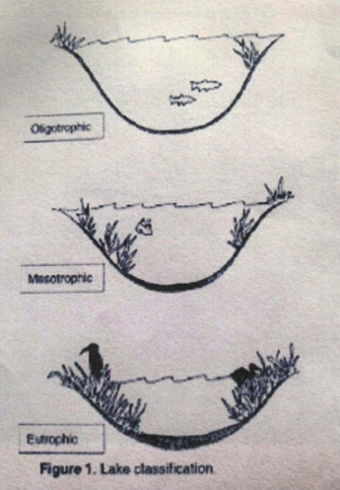
Lake Preservation Program Overview:
(LPC Chairman - Terry Klaves)
Natural Lake Aging is caused by the continuous addition of nutrients to the lake ecosystem.
We are at stage 3 of 5, Lake Eutrophication, marked by heavy weed growth and biomass/sediment build-up
Nutrient sources include dead leaves, pollen, dust, lawn and farm fertilizer runoff, and outdated/ineffective septic tank/field leaching
Nutrient build-up promotes increasing plant and algae growth. Dead plant detritus collects on the lake bottom as silt and muck.
In Geologic time all lakes will fill with plant detritus to become wetlands, swamps, marshes and peat bogs.

Slide 15
Lake Preservation Program Elements
Reverse Natural Lake Aging by (cost effectively) removing nutrients, without disrupting the lake’s ecosystem
Maintain the Lake’s Recreational Value by controlling weed growth patterns with Harvesting and DASH
Support Shoreline Maintenance Service Providers
Provide ‘Best Practices’ Information to Homeowners

Slide 16
Lake Preservation Program Activity - 2023
Chemical Herbicide use & Weed Cutting
Maintain Aeration Pumps & Diffusers
Weed Harvesting Equipment Evaluation
Weed Harvesting Service Provider Identification
Launch Ramp and Pier Improvement Planning
Lake Weed proliferation is accelerating
Monitor water clarity and dissolved oxygen

Slide 17
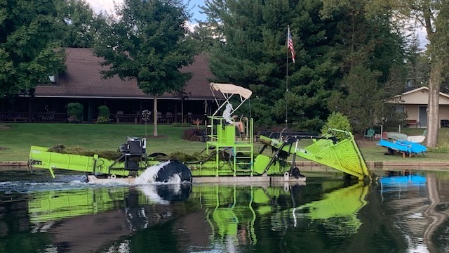
Aquatic Plant Management & ILH-250 Aquatic Weed Harvesters

Slide 18
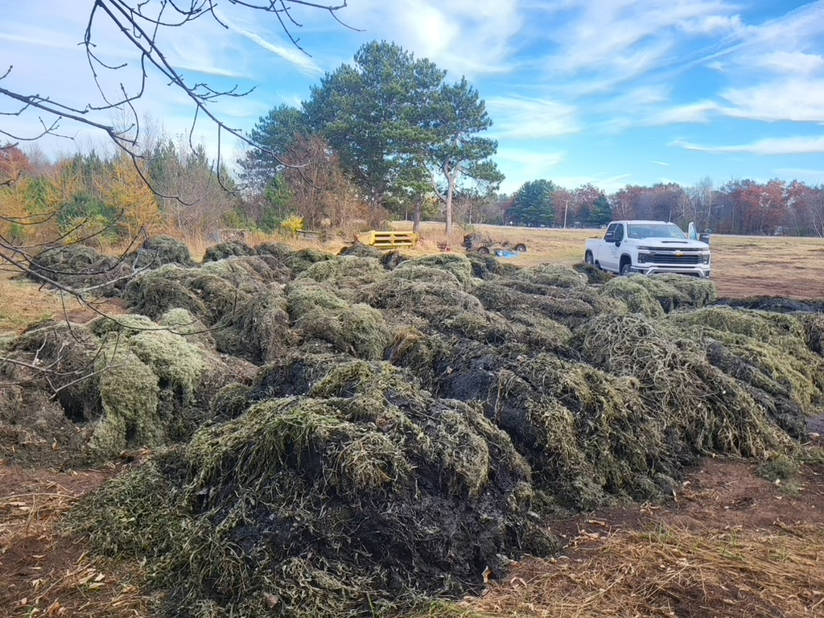

Slide 19
Lake Preservation Program Activity - 2024
  Invasive Weed Mapping (Onterra):
    Eurasian Water Milfoil (EWM) and Curly Leaf Pondweed (CLP)
  Aquatic Plant Management (APM) Weed Harvesting:
    Native Weeds: Illinois Pond Weed (IPW) and Chara Algae
    Three (3) one-week Harvesting Campaigns: June, August, October
    >800 Cubic yards (30 Truckloads) of nutrient biomass removed
    Cut weeds are deposited at Henke’s Farm
  Invasive Weed Removal - Diver Assisted Suction Harvesting:
        16 EWM & CLP weed beds removed
  Results: Harvest quantities, Navigation, Fishing, Water Clarity, and Oxygen Levels met our expectations

Slide 20
Lake Preservation Program Activity - 2025
Onterra Invasive Weed Mapping (CLP & EWM):
  DASH Weed Bed Removal was not recommended
Weed Harvesting (Aquatic Plant Management (APM):
  Three one-week campaigns: June, August, September
Results:
      Harvesting time was increased in response to thinner and more widely disbursed weed growth patterns.
      LPC members intervened to facilitate APM’s weed bed targeting
    30 Truckloads of nutrient biomass were removed

Slide 21
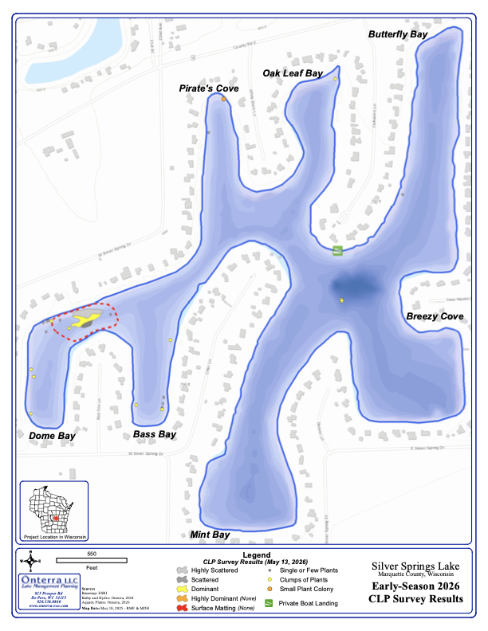
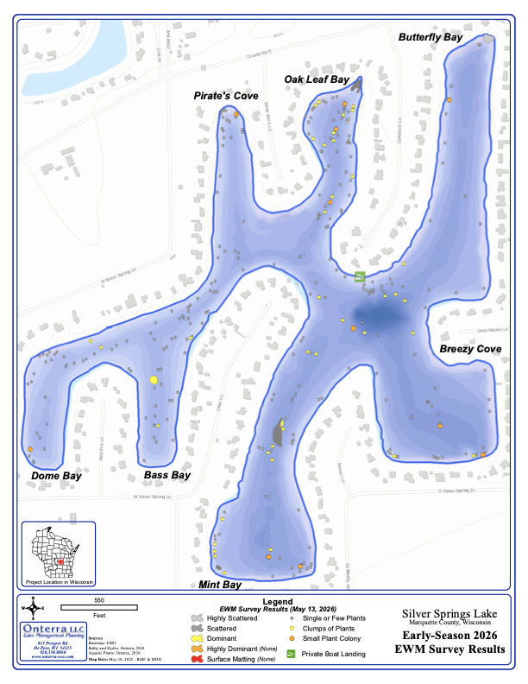
Onterra: 2026 CLP and EWM Invasive Weed Bed Maps.

Slide 22
2026 Lake Preservation Program
2026 Invasive Weed Survey (Onterra):
  DASH Treatment: Planned for 2027
Weed Harvesting: 3 Campaigns (APM)
Continue Aerator use for Water Turnover
Inlet Stream - Chemical Nutrient Monitoring Complete
Support Shoreline Maintenance Service Providers

Slide 23
The Future of the Lake Preservation Program
Remove nutrient rich biomass to reverse natural lake aging.
Weed Harvesting is the most cost effective and least invasive means available to remove more nutrients from the lake than Mother Nature (and man) put into it.
Targeted Dredging can be used to remove more substantial tonnage of nutrient rich muck from our lake bed. Costs and funding requirements for this program are more substantial.
Continuing with 15% per year dues increases for several more years will make dredging feasible by 2029 or 2030.

Slide 24
Lake Preservation Program Report:
(LPC Chairman - Terry Klaves)
        Lake Aging - Eutrophication
        Silver Springs Lake History
        SSL POA Lake Management History
        Lake Preservation Program Elements
Inlet Stream Nutrient Testing Program:
(LPC Member - David Lester)
Shoreline Maintenance Program Update:
(LPC Member - Tony Mainiero)

Slide 25
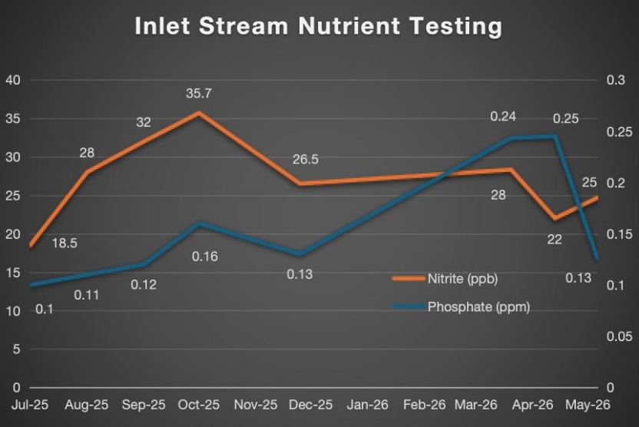
Inlet Stream Phosphate and Nitrogen Testing

Slide 26
Our inlet stream is not a source of excessive Phosphates or Nitrates
The Mean Phosphate level (0.15 ppm) is near mid-range for uncontaminated lakes (0.03-0.22 ppm).
The Mean Nitrate level (0.27 ppm) is in the low-range for uncontaminated US streams (0.12-2.2 ppm)
Human Contamination of US Streams and Lakes is indicated if Nitrate test values are >1 ppm.
92% of Groundwater tested has Nitrate levels >0.3 ppm.
Drinking water us considered safe if Nitrates are <10 ppm.

Slide 27
Inlet Stream Effect Management
Chemical Nutrient Testing at the Inlet stream was initiated in 2025 to tell us whether chemical nutrient sequestering is needed.
Phosphate and Nitrare Testing results indicate that our inlet stream water is well within the range for uncontaminated lakes and streams.
Sample testing will be discontinued after June (one full year).
Future Particulate Content Testing will tell us whether installing a sediment settling basin (within the inlet stream easement) is needed to reduce silt deposition, at the mouth of the inlet on Bass Bay, where muck and silt deposits are more than one foot thick.

Slide 28
Lake Preservation Program Report:
(LPC Chairman - Terry Klaves)
        Lake Aging - Eutrophication
        Silver Springs Lake History
        SSL POA Lake Management History
        Lake Preservation Program Elements
Inlet Stream Nutrient Testing Program:
(LPC Member - David Lester)
Shoreline Maintenance Program Update:
(LPC Member - Tony Mainiero)

Slide 29
Shoreline Maintenance
The lake bed from the shoreline to the boating Navigation Lane is maintained by lot owners
The Association posts “best practices” information to help members cut weeds and reduce muck.
Look for new Best Practices articles about preferred Shoreline Maintenance Tools.

Slide 30
Shoreline Maintenance Services:
LPC members encouraged Silver Mist and Aquatic Plant Management to develop and offer these new shoreline maintenance services
These services are needed to enable everyone to clear weeds and muck, from their shoreline.
These services are only available to Silver Springs Lake residents, after we guarantee Silver Mist and APM a minimum number of customers for their services.

Slide 31
Continuing Shoreline Maintenance Services
The Association’s LPC members are only involved in customer sign-up activities.
Prospective customer sign-up sheets are forwarded to each service provider. Thereafter, business is conducted directly with each customer or small groups of customers.
We hope that the new APM & Silver Mist Shoreline Maintenance Service businesses are successful and that they will available to our residents for many years to come.

Slide 32
2026 Annual Meeting Agenda
President’s Opening Comments (David Lester)
Secretary’s Report and Approvals (Bryan Sowatzke)
Lake Preservation Program Report (Terry Klaves)
Architectural Committee Report (Deb Hoff)
Community Event Committee Report (Debbie Smith)
Treasurer’s Report (Kevin Streetar)
Closing Comments (David Lester)

Slide 33
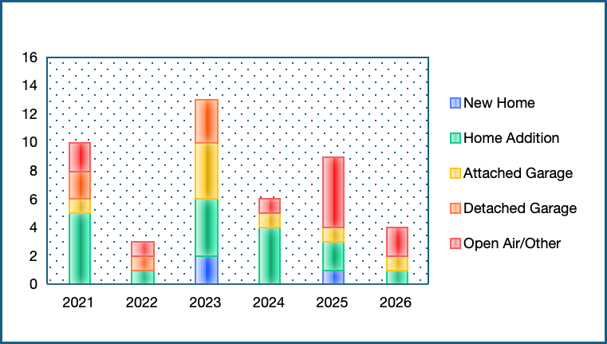
Construction Projects Initiated - by Year
We have had 36 Board Approved construction projects in this period
The total is 50 or more with patio decks and retaining walls

Slide 34
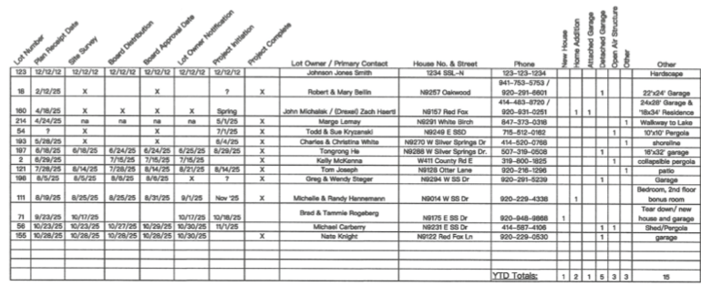
2025 Construction Activity Ledger

Slide 35
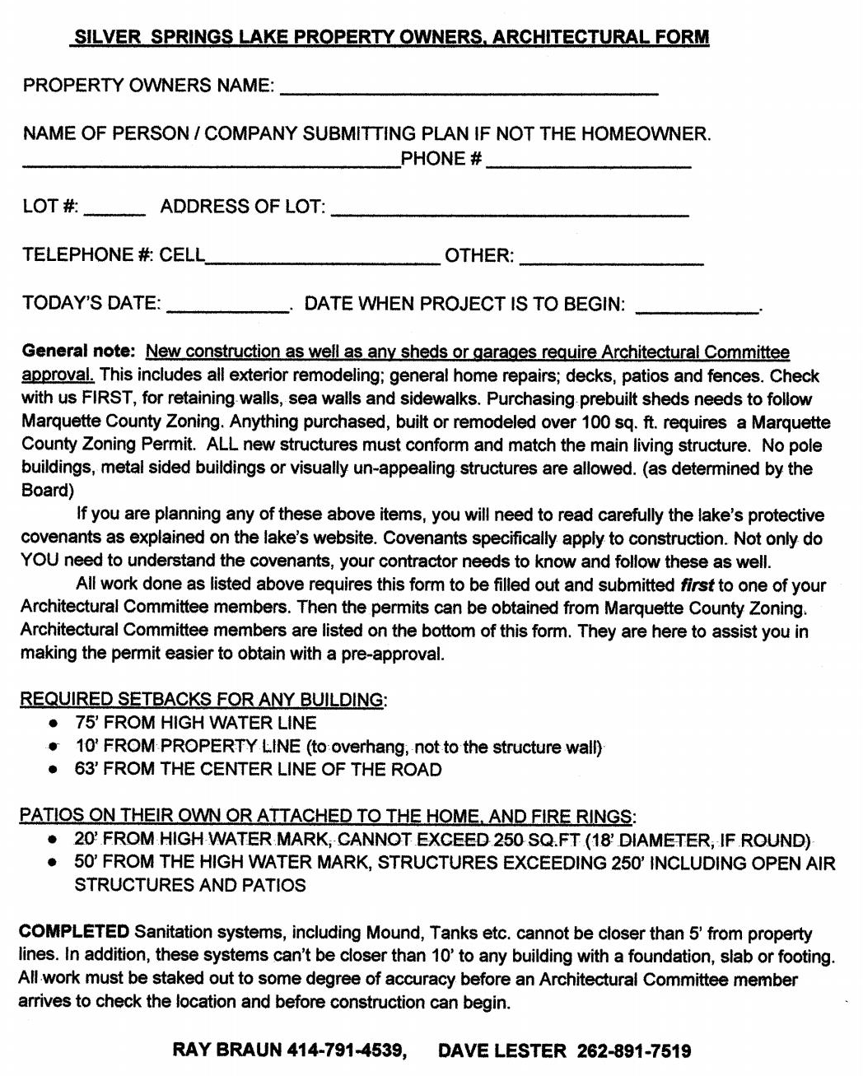
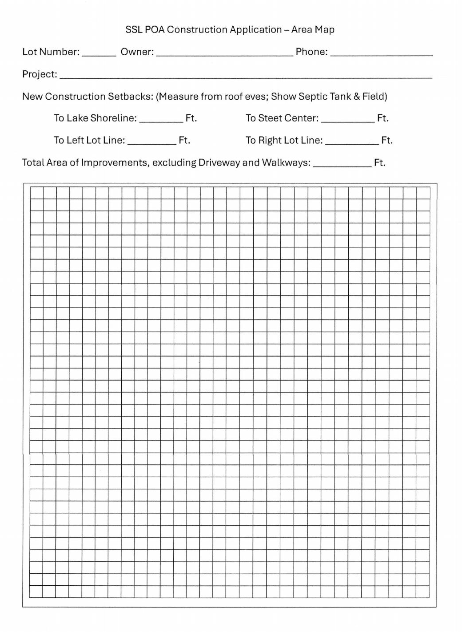

Slide 36
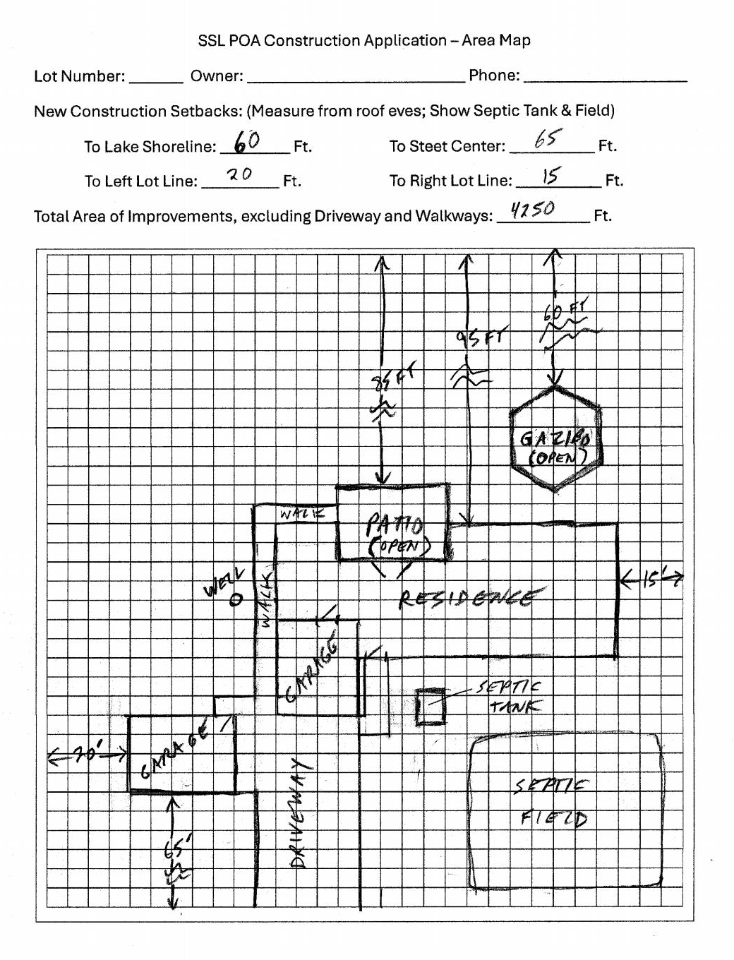
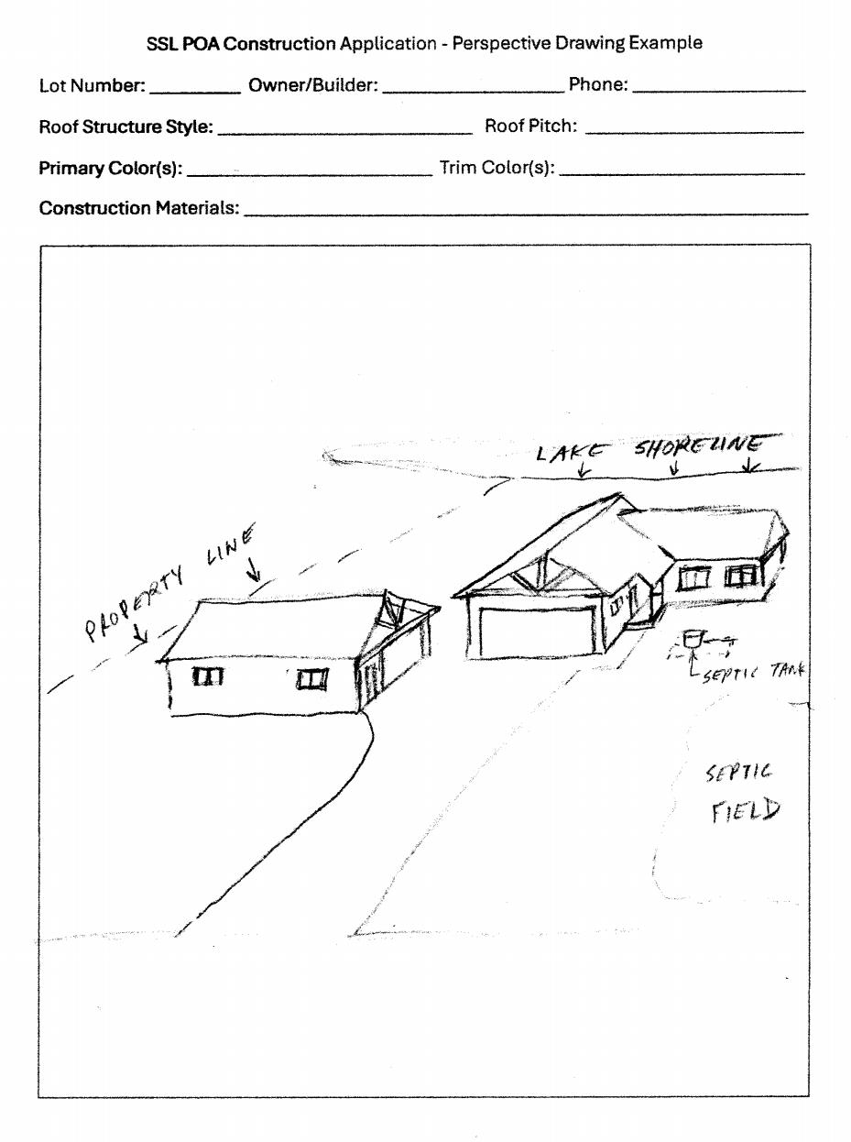
Project Applications should include Area Maps and Perspective Drawings

Slide 37
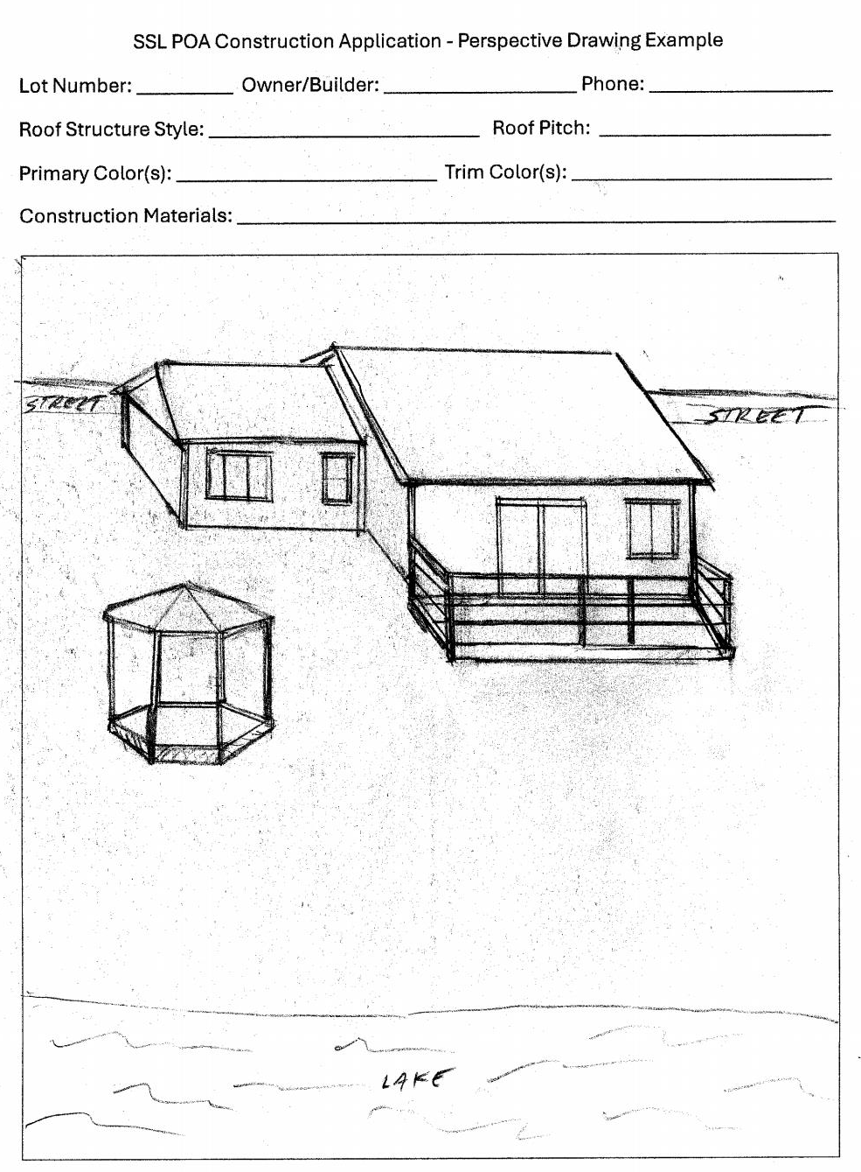
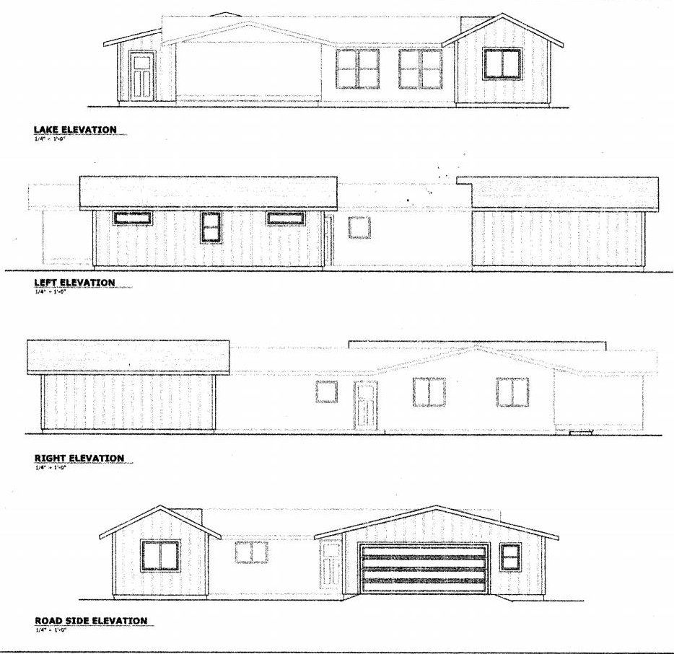
Covenant Conformance Protects Community and Property Values

Slide 38
Marquette County Zoning - Ordinances and Statutes:
Primary Residential Zoning: R-1 (Chapter 63 Sect. 8.0.9; pages 33-34)
Shoreline Zoning Ordinance (Sect. 7.4 (page 25) and Sect. 16 (page 40): define structures and structure setbacks from the lake-shore, roadways, and side lot lines, for all structures built after 2015.
Lake Construction Ordinance (Chapter 62, Sect. 4.0) and General Provisions (Items N, O; pages 8-9): define retaining wall height (and depth): wall measurement maximums are two (2) feet above and 18 inches below starting grade.

Slide 39
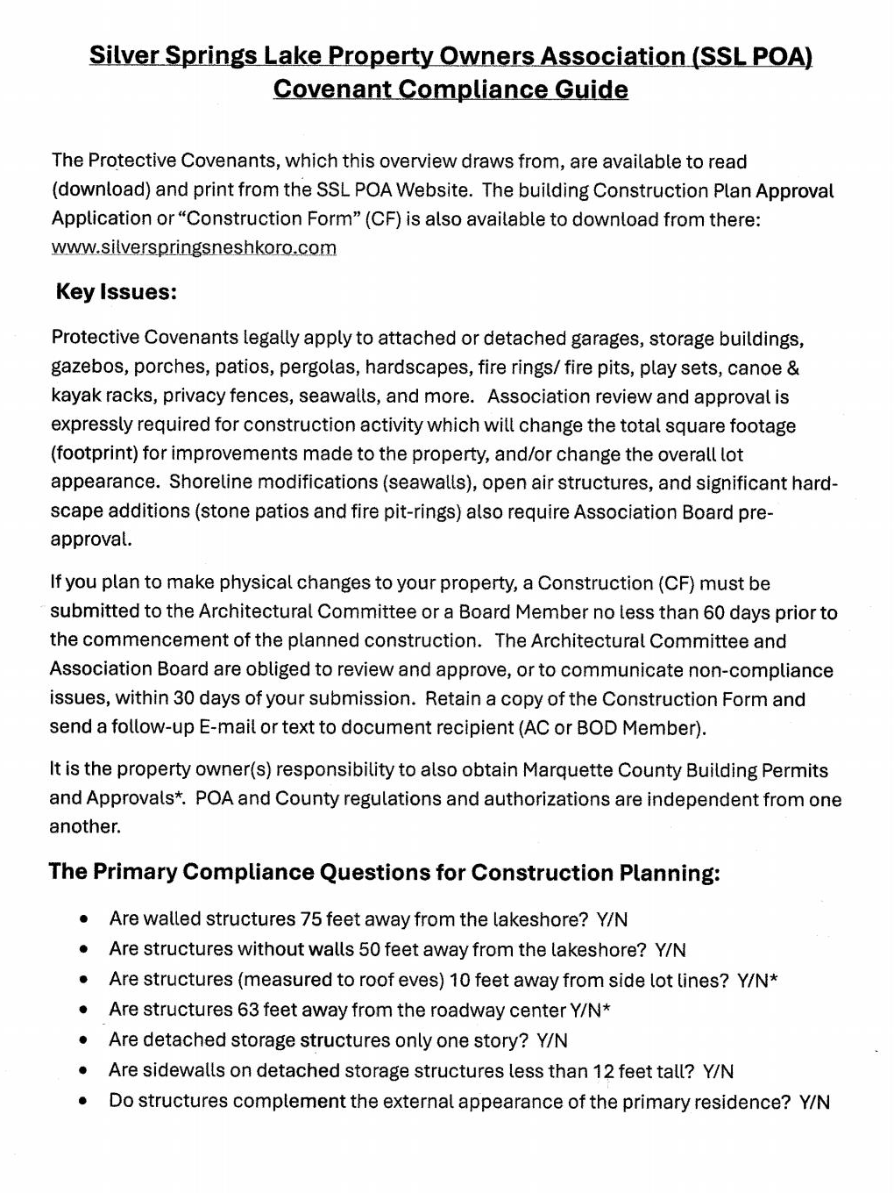
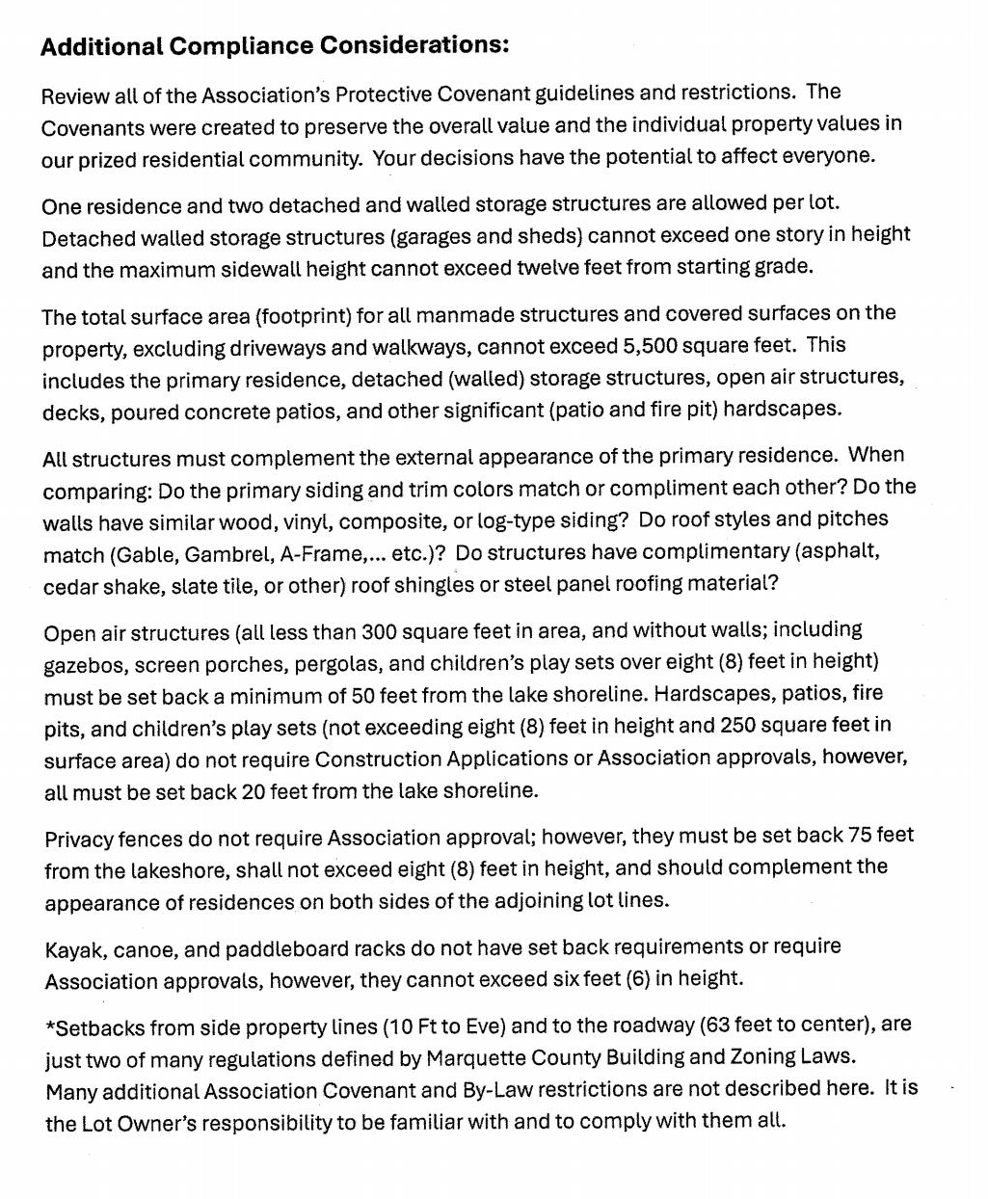
Additional Guidance is available on the Association Website

Slide 40
2026 Annual Meeting Agenda
President’s Opening Comments (David Lester)
Lake Preservation Program Report (Terry Klaves)
Architectural Committee Report (Deb Hoff)
Community Event Committee Report (Debbie Smith)
Treasurer’s Report (Kevin Streetar)
Secretary’s Report and Approvals (Bryan Sowatzke)
Closing Comments (David Lester)

Slide 41
Community Event Schedule
June 8th Spring Lakes Rummage Sales
June 20th Association Golf Outing
July 4th July 4th Boat Parade
Sep 5th Kid’s Fishing Jamboree
Sep 12th Poker Run & Pot Luck
Oct 24th Trunk-or-Treat
Dec 5th Christmas Holiday Banquet

Slide 42
Community Events Committee:
Debbie Smith, Nancy Adkins, Donna Ohm, Pam Minarek, Linda Beyer, Sue Weinhert, and Shirley LaShay
Event Leaders:
      Golf Outing - Steve Manlick
      Parade - Committee
      Kids Fishing Jamboree - open
      Poker Run and Potluck Dinner - Debbie Smith
      Trunk or Treat - Nate Lehner
      Holiday Party - Shirley LaShay
      Spring Lakes Rummage Sales 2027 - open

Slide 43


The sign-up deadline for the Golf Outing is June 1st. All are welcome for Dinner ($20.00)
Hidden Springs Lake will not be participating in the 2026 Spring Lakes Rummage Sale Event

Slide 44
2026 Annual Meeting Agenda
President’s Opening Comments (David Lester)
Lake Preservation Program Report (Terry Klaves)
Architectural Committee Report (Deb Hoff)
Community Event Committee Report (Deborah Smith)
Treasurer’s Report (Kevin Streetar)
Secretary’s Report (Bryan Sowatzke)
Closing Comments (David Lester)

Slide 45
Treasurer’s Reports
2025/2026 Final Treasurer’s Report Overview
Financial Planning for Lake Management
Multi-year Expenditure Forecast Overview
2026/2027 Annual Budget Review & Approval

Slide 46
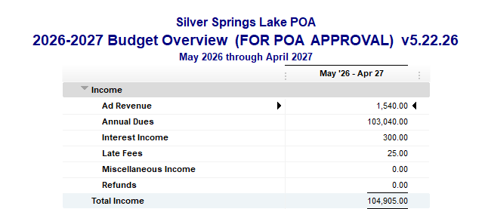
Treasurer’s Reports
  2025/2026 Final Treasurer’s Report Overview
  This was available at the front door
  We’ll review before we vote
Notes:
2025/2026 Final Treasurer’s Report Overview
This was available at the front door
We’ll review before we vote
(additional details…if need be)
Dues were $400 per lot for total of $88,800; dues fee was increased from $230 in 2024
Advertiser income was $1,040
Interest income – from savings account – was $297
Total income was $90,137
Increase in Cash Reserves from $30,910 to $49,534 (primarily due to fee increase)

Slide 48
Notes:
Financial Planning for Lake Management
(#6) This slide shows us where dues increase are being spent
As revenue rises so do expenses - primarily due to lake maintenance
Our overall goal is to get our association’s cash reserves to $100,000 & maintain. This should happen in 2028.
Our POA needs these cash reserves to support lake preservation plan and maintenance
Dues increases are needed to build up our cash reserves – maintaining our lake is not inexpensive!
Quick overview as to where our dollars have gone:
2022: rebuilt overflow outlet
2023: rebuilt boat launch
2024 thru 2026: fairly flat, weed harvesting
2027: for DASH invasive weed removal
2028-2029: cash reserves flat. expenses then rise for targeted dredging in Bass Bay by the inlet

Slide 49
Notes:
Expenditure forecast
Future outlays are dominated by preserving our lake
this pie chart highlights where dollars will go for 2026
For this fiscal year, 2026, managing our lake comprises about 83% of our total budget

Slide 50
Notes:
2027 Lake Preservation is projected to comprise about 88% of our total budget

Slide 51
Notes:
2028 Lake Preservation is projected to comprise about 85% of our total budget
2029 Lake Preservation is projected to comprise about 91% of our total budget

Slide 52
Notes:
Breaks out Lake Preservation expenditures in dollars 2023 thru 2029

Slide 53
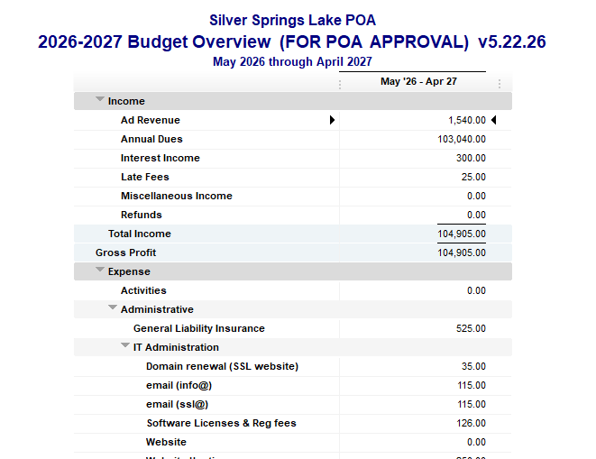
Notes:
2026-2027 budget breakout were handed out as you entered this morning

Slide 54
Pause for Association Member Voting
Approval of the 2026/2027 Annual Budget

Slide 55
2025 Annual Meeting Agenda
President’s Opening Comments (David Lester)
Secretary’s Report (Bryan Sowatzke)
Lake Preservation Program Report (Terry Klaves)
Architectural Committee Report (Deb Hoff)
Community Event Committee Report (Deborah Smith)
Treasurer’s Report (Kevin Streetar)
Closing Comments (David Lester)

Slide 56
Welcome back summer!
The Best Community in Central Wisconsin
Thanks for your community investment
Thanks to our past Board Members:
Ray Braun (12) and Nate Lehner (3)
Welcome to our new Lake Board Directors:
Neil Howell and David Richter
Thank you to our Community Event Leaders

Slide 57
Thanks to our Volunteers:
Terry Klaves & Tony Mainiero: LPC & SMP
Debbie Smith: Community Event Committee
Peter Zopf: Website Admin. & Email
Kathy Walker: Welcoming Committee, Little Book Library, and Septic Service
Trudy Kemps: Spider Spraying Service
Kay Castillo & Joyce Jaeger: Financial Auditors
Bob Noga: Fish Stocking Program

Slide 58
We are on the right path!
Community Rejuvenation
Shoreline Maintenance Services
Wee Harvesting and DASH
Targeted Dredging Considerations

