Slide 1

CURE TAPESTRy Capstone Talk
Dr. Whitni Redman, PhD
Binghamton University

Slide 2
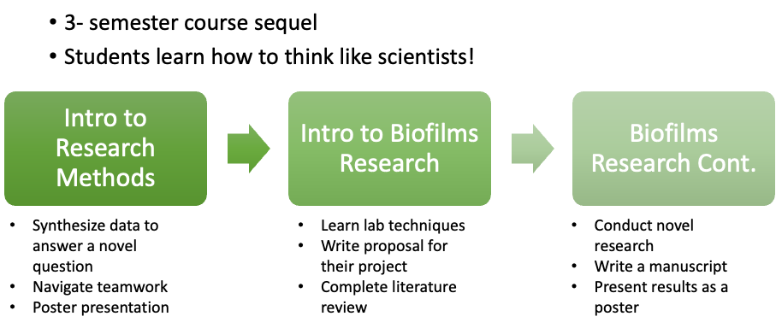
First-year Research Immersion Program

Slide 3
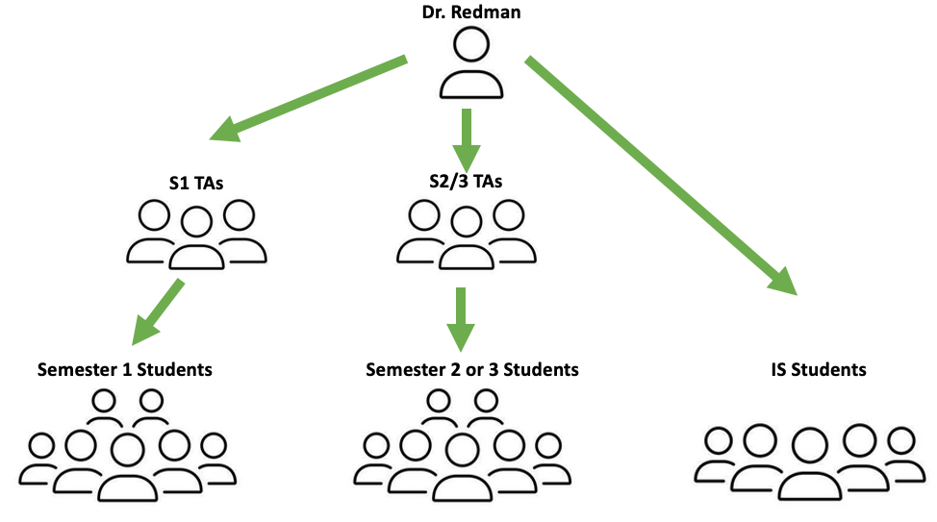
Course Description
Research Educator (n=1)
Lead Undergraduate PM (n=1)
Undergraduate PM (n=16)
FRI Students (n=30)

Slide 4
Course Description
Research Educator (n=1)
Preps and instruct courses
  1st semester- Introduction to Research Methods
    poster
  2nd semester- Biofilm Basics
    lab learning techniques
    proposal
  3rd semester- Biofilm Basics ll
    novel research
    manuscript
    poster
Manage Undergraduate PMs
Manage Lab Equipment/ Supplies/Etc.
Mentor Independent Study

Slide 5
Course Description
Assists with lab prep
  2nd semester- Biofilm Basics
    autoclaving
    overnights
  3rd semester- Biofilm Basics ll
    autoclaving
    overseeing weekends
Office Hours
Attends lecture
Runs weekly PM meeting
  trainings
  grading
  updates
  check-ins
Research Educator (n=1)
Lead Undergraduate PM (n=1)

Slide 6
Course Description
2nd and 3rd semester
  Lead Team PMs
    1 per team
    Attends weekly team meetings
    Assists with course products
  Team PMs
    Assists Lead Team PMs
    Assists with course products
  Lab PMs
    Assists with lab training/ hour check
All PMs
  Attends weekly PM meetings
  Grading
Research Educator (n=1)
Lead Undergraduate PM (n=1)
Undergraduate PM (n=16)

Slide 7
Course Description
Lecture Teams (Semester 1-3)
  Work in 5 teams ranging from 5-7 students
  Work towards proposal, manuscript, poster
Lab Groups (Semester 2)
  Work in 8 groups (4 per lab section)
  3-4 students per group
  Learn lab techniques by working with isolates
Research Educator (n=1)
Lead Undergraduate PM (n=1)
Undergraduate PM (n=16)
FRI Students (n=30)

Slide 8
Objectives (Biofilms 1)
Know/understand (knowledge):
  Describe molecular and cellular structures of microbes
  Explain mechanisms of microbial genetics and evaluate how specific external influences could impact the relationship and regulation of DNA, RNA, and proteins
  Connect specific molecular research topics and questions to real life applications of microbiology research for health care, industry, and environmental health
Be able to (skills):
  Discover, understand, and discuss primary research literature and evaluate the validity of hypotheses generated by others
  generate testable scientific hypotheses and develop research plans to test these hypotheses
  evaluate the validity of hypotheses generated by others
  apply research protocols and instrumentation appropriately
  collect and analyze research data appropriately
  develop professional skills including time management, teamwork, flexibility, perseverance, and problem-solving
Have created (products)
  a research proposal that effectively argues and communicates your plans and rationale for your fall research project

Slide 9
Objectives (Practicum in College Teaching)
Develop mentorship and leadership skills
Demonstrate the ability to guide students through research techniques, projects, and problem solving
Facilitate collaborative learning and enhance team dynamics within research groups
Maintain professional standards of confidentiality and academic integrity in all interactions

Slide 10
Overview of FRI
Director (n=1)
Assistant Director (n=1)
Semester 1 PMs (n=~50)
Research Educators (n=12)
Undergraduate PMs (n=~100?)

Slide 11
Overview of FRI
Director (n=1)
Assistant Director (n=1)
Semester 1 PMs (n=~50)
Research Educators (n=12)
Undergraduate PMs (n=~100?)

Slide 12
Overview of FRI
Director (n=1)
Assistant Director (n=1)
Semester 1 PMs (n=~50)
Research Educators (n=12)
Undergraduate PMs (n=~100?)
How do we Standardize PM Trainings?

Slide 13
Overview of PM Training Modules
Module 1: What is a Mentor?
Module 2: Mentoring Strategies
Module 3: Assessing Mentorship
Module 4: Team Mentorship
Module 5: Success Coach

Slide 14
Piloted PM Training Modules
Design Your Mentorship
Setting Boundaries
Mentee Professional Development
Negative Mentorship
Navigating Team Dynamic Issues
Addressing Unequal Work Distribution
Maintaining Effective Communication

Slide 15
Pilot PM Training Modules
Conducted during some of the weekly UGPM meetings
Tried to align trainings with what was happening in class
Implemented:
Instruction
Case scenarios
Group brainstorming
Prompted discussion questions
‘Application’ responses

Slide 16
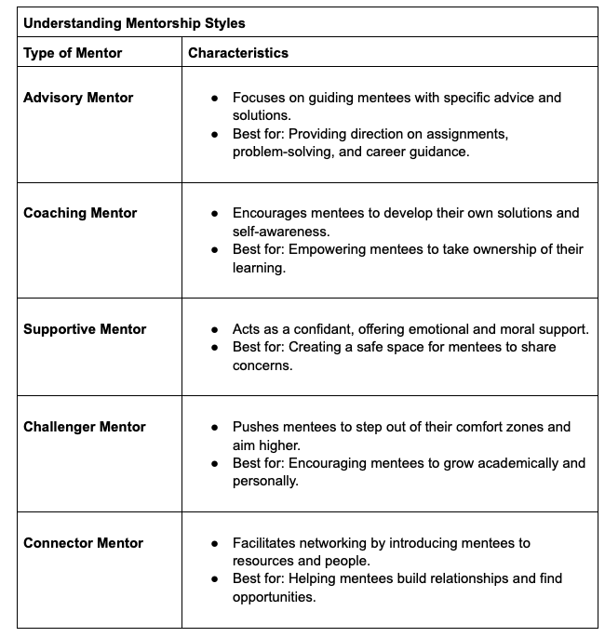

Design Your Mentorship
Step 1: Instruction
Step 2:Think/Pair/Share
What mentorship style(s) will you use this semester?
How will you balance your mentorship style with the needs of your mentees?
What strategies will you use to communicate effectively?
What challenges might you face as a mentor?
Step 3: Apply

Slide 17
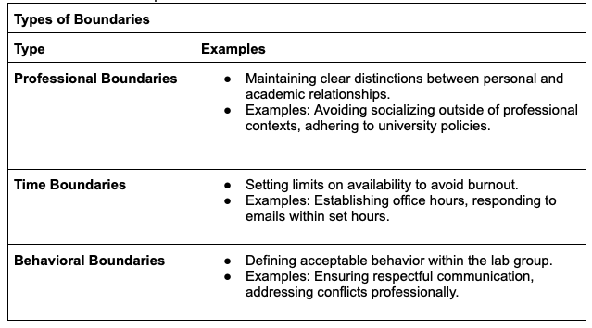

Setting Boundaries
Step 1: Instruction/Application
Step 2: Brainstorm
Brainstorm what you want your boundaries to look like.
Share if you would like!
Write down below:
Step 3: Apply

Slide 18
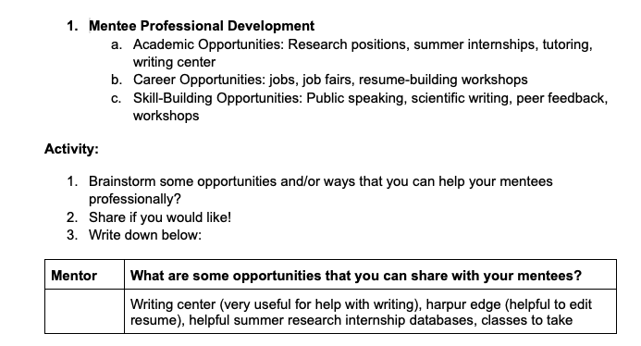
Mentee Professional Development
Step 1: Instruction
Step 2: Think/Pair/Share

Slide 19
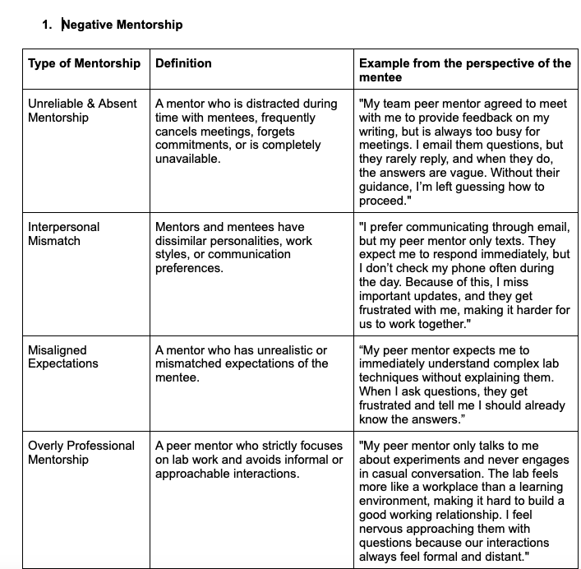
Negative Mentorship
Step 1: Instruction
Just to show a few…
Step 2: Apply

Slide 20

Navigating Team Dynamic Issues
Step 1: Review Scenario/Discuss in Pairs/Share
Team dynamic issues
  Scenario 1 - Unequal Work Distribution: Your research team is working on a written assignment summarizing experimental results. One member contributes minimal effort, while others take on the majority of the writing and editing. When asked to do more, they say they’re “too busy with other commitments.”
    Reflection Questions:
      How should the team address this imbalance while ensuring fair contributions moving forward?
      What are the long-term consequences of allowing unequal work distribution to continue?
  Scenario 2 - Poor Communication Leading to Errors: A team member misunderstood the experimental protocol because they received instructions verbally rather than in writing. As a result, they performed the wrong procedure, setting the project back by a week.
    Reflection Questions:
      How can the team improve communication and documentation to prevent similar errors in the future?
      How could repeated instances of miscommunication impact the team dynamic and the quality of work?
Step 2: Apply

Slide 21
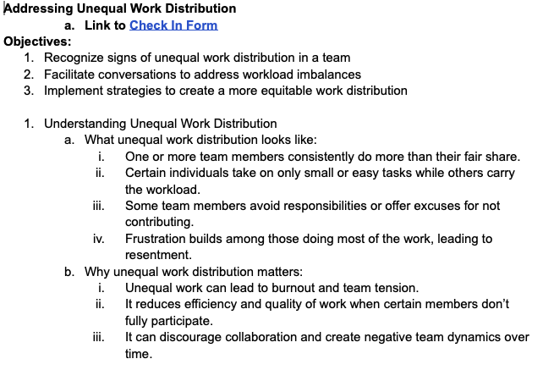
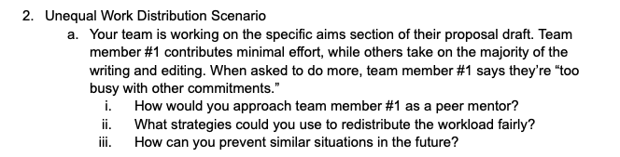
Addressing Unequal Work Distribution
Step 1: Instruction
Step 2: Case Scenario

Slide 22
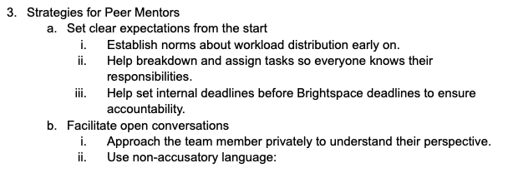
Addressing Unequal Work Distribution
Step 3: Strategies
Step 4: Apply

Slide 23
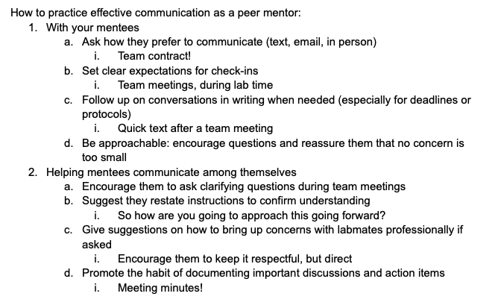
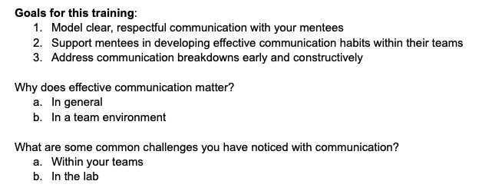
Maintaining Effective Communication
Step 2: Instruction
Step 1: Discussion

Slide 24
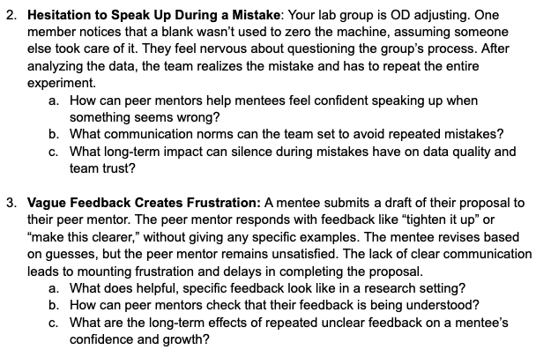

Maintaining Effective Communication
Step 3: Case Scenario
Step 4: Apply

Slide 25
PM Feedback
Anonymous google form
Short
Required to fill out in our last PM meeting

Slide 26
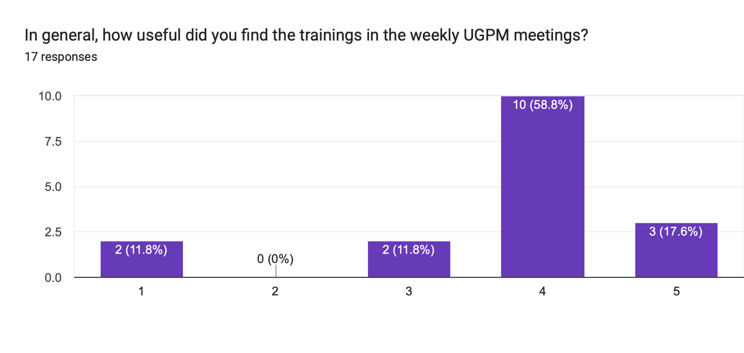
Feedback on PM Training Modules

Slide 27
Feedback on PM Training Modules
Question: Did you implement any of the strategies or ideas from these sessions in your mentoring? If so, how?
General themes:
Set boundaries- communicated boundaries, and followed them
Mentorship style- helped decide lab TA role, improve team communications, create team environment, remaining an active peer mentor
Group conflict/work distribution- able to address issues before they got out of hand

Slide 28
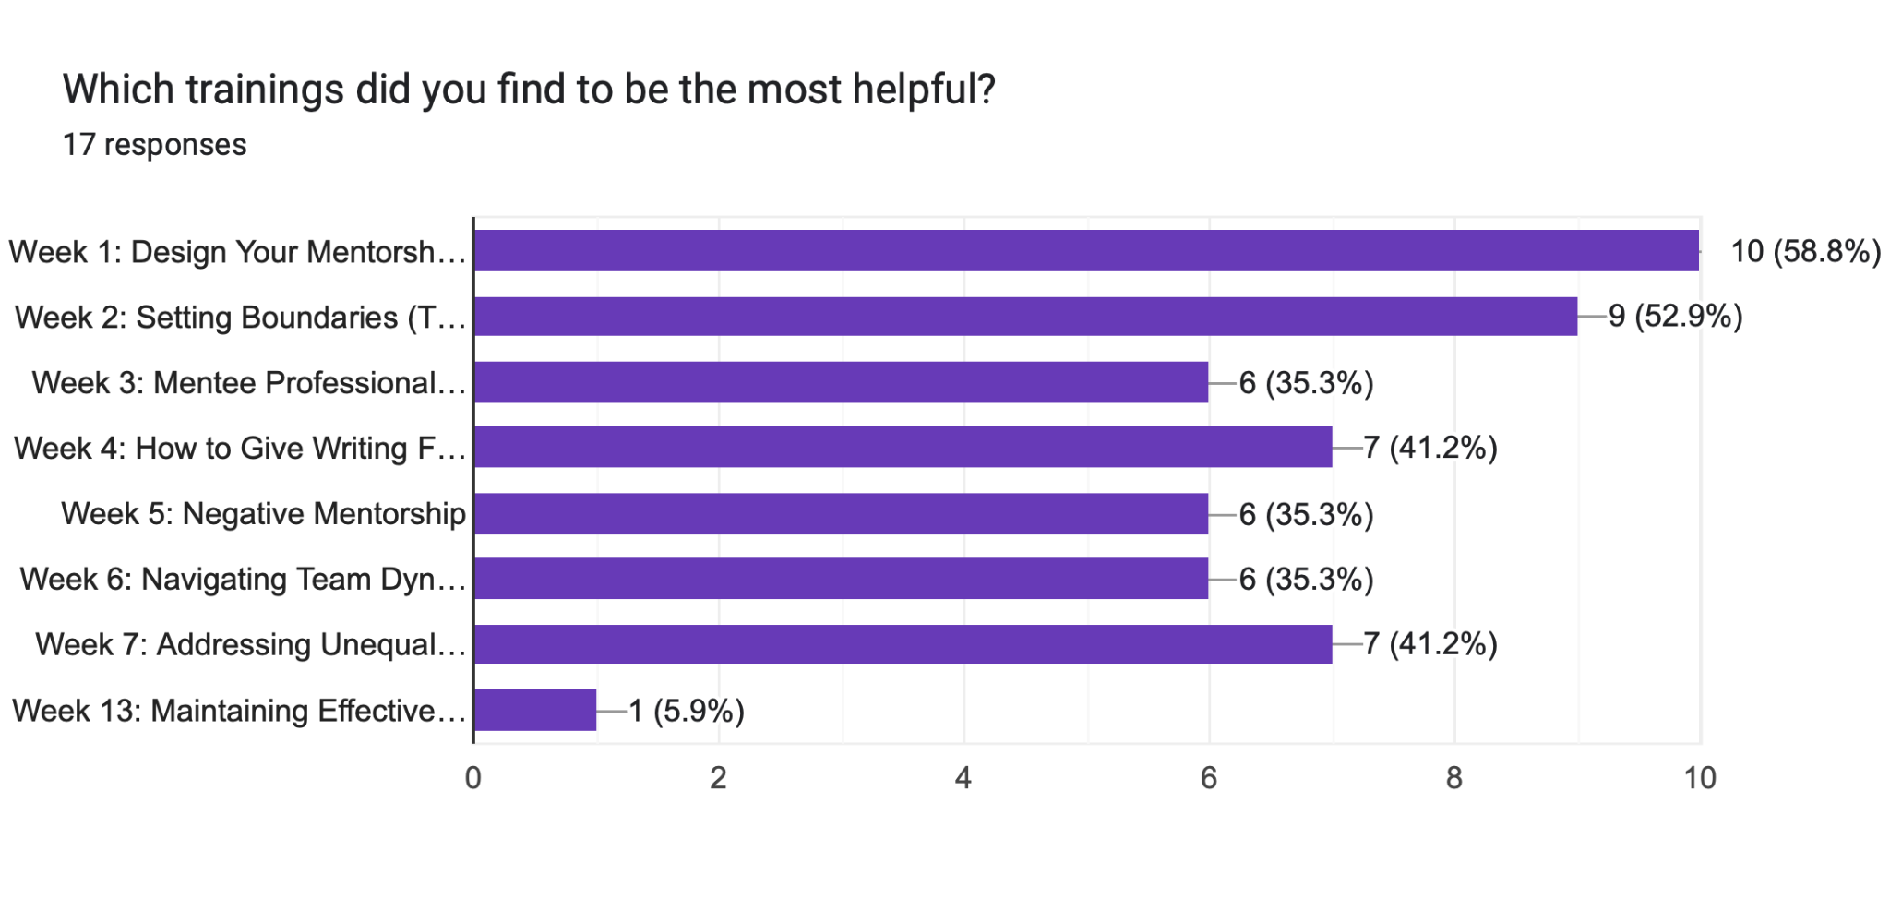
Feedback on PM Training Modules

Slide 29
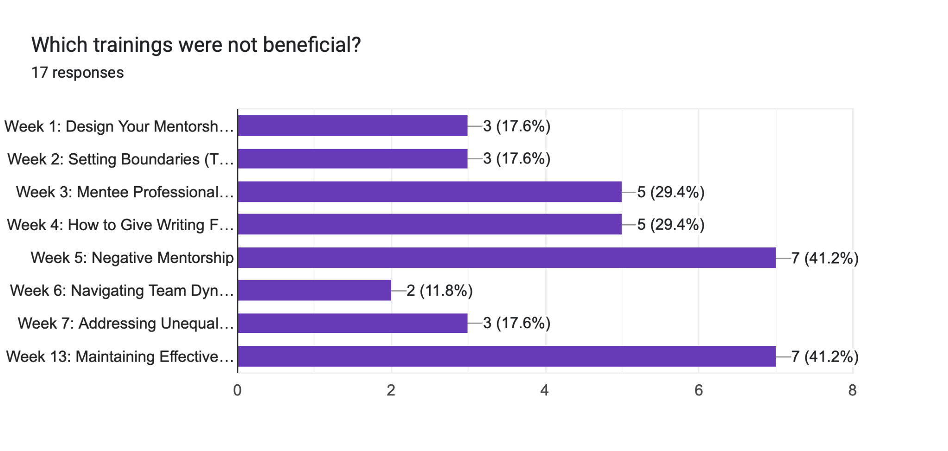
Feedback on PM Training Modules

Slide 30
Feedback on PM Training Modules
Question: What aspects of the trainings were most effective? (information, discussion, case studies, etc.)
General themes:
Discussion- gain different perspectives
Timing- timing of trainings were spot on to the class
Case studies- real world application

Slide 31
Was it a Success?
Generally, yes!
There were a lot less fires to put out in both teams and lab groups
PMs were more mindful of their roles leading to better mentorship
Way less work distribution issues
PMs were able to successfully set and follow boundaries preventing burn out

Slide 32
Lessons Learned from Fellowship
Overall, a mindshift in how I see TAs
  Ask yourself- what can I do for them INSTEAD of what can they do for me?
  Supporting/training how to be a TA was something I had not thought of
Measuring ‘soft’ science
  Realizing the importance of measuring ‘success’
    very different from the lab!
  It was always interesting to hear how others were measuring results
Modifications:
  shorter training sessions
  more ‘in the moment’ trainings
  more case scenarios and less reading information

Slide 33
Future Directions
Short-Term:
  Apply trainings to Fall 2025:
    More of a ‘reminder’ than module as many PMs are returners
    Implement suggested topics
    Remove or adjust unnecessary topics
Long-Term:
  Christina Summer Duty- Upload to Brightspace
  PM Training Committee Spring 2026
    finish Brightspace upload
  Distribute to other programs/ institutions

