Slide 1


CURE TAPESTRy Capstone Talk
Jacob Adler

Slide 2


Course Description
First-Year Biology Majors Biology Laboratory CURE
Semester-long community-based research project examining the soil microbiomes within the local community urban gardens
200 students Fall
100 students Spring
5 TAs Fall
3 TAs Spring

Slide 3

Resource Focus and Objectives
Working with TAs on:
understanding the benefits of CUREs, and
growing their mentoring skills.
Learning Outcomes/Objectives
  #1: Demonstrate understanding of the benefits of CUREs.
  #2: Demonstrate areas to grow their mentoring skills.

Slide 4
Evaluation Strategies
Learning Outcome/Objective | Associated Evaluation Strategy/Strategies
Demonstrate understanding of the benefits of CUREs. | Mid semester survey prompt asking TA to provide what they see as a benefit of CUREs.
Demonstrate areas to grow their mentoring skills. | Mid semester survey prompt asking TA to provide an area they wish to grow in mentoring.

Slide 5
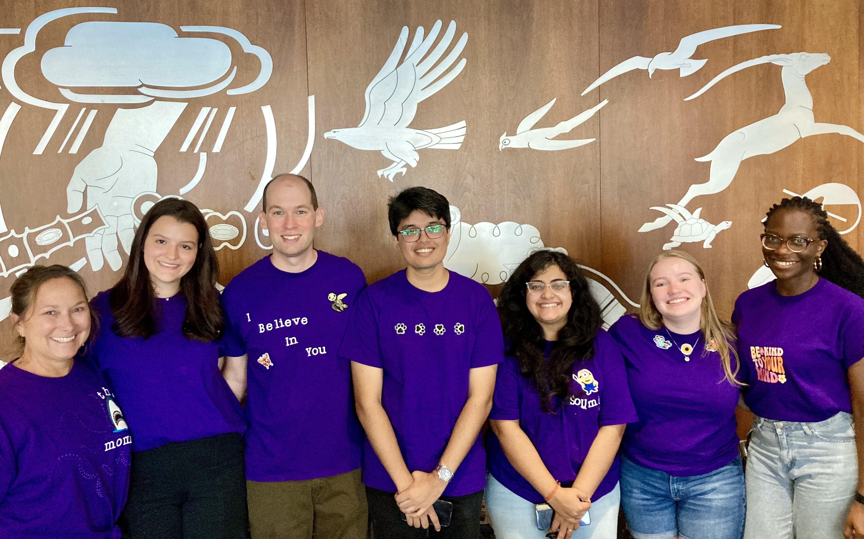
Activities
Team Building (t-shirt design)
Intro to Features of CUREs (Auchincloss et al., 2014)
Benefits of CUREs Jigsaw Activity (Bangera and Brownell, 2014)
True-Good-Beautiful Activity
Weekly Check-ins
Week 7 Effective Mentoring Reflection on Table from (Fleming et al., 2013)
Week 9 Mid semester survey and then one-on-one meeting with TA to discuss mentorship plan d and teaching in CURE context

Slide 6
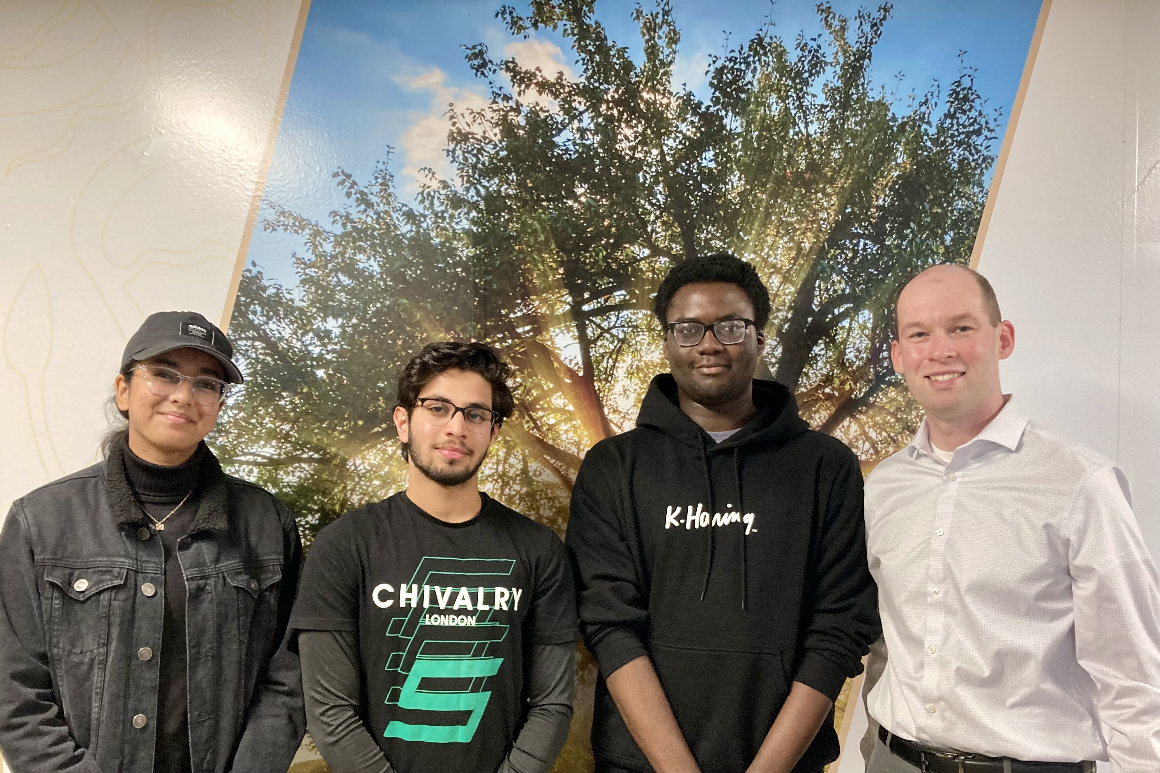
Outcomes
IRB-2024-1543 study approved
Qualitative content analysis of survey responses.
Three trained undergraduate researchers performed inductive coding of the prompt responses.
Then some codes were developed based upon: Goodwin et al., 2021 and Kern, 2022. Overlapping codes were combined as needed.
Coders came to 100 % consensus on all coded responses over two rounds of coding through discussion.

Slide 7
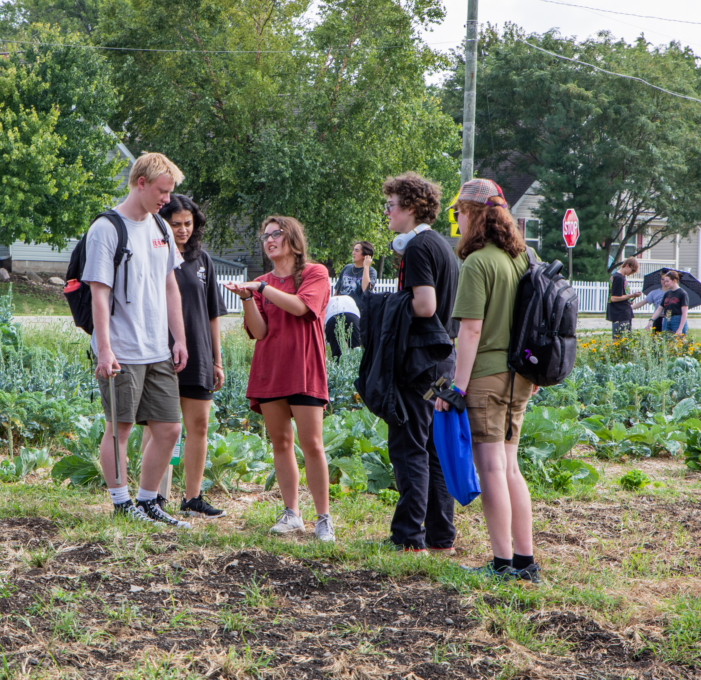
Outcomes
Major Themes from Coding:
Enrichment
TA describes engaging and creating an environment where the focus is the relationship with the student via helping students in their courses and building upon student experiences.

Slide 8
Outcomes
Benefits of CUREs Coding Analysis:
Prompt: What are the benefits of a CURE course?
100% of codes came from the Enrichment theme
Three top codes are presented on the next three slides.

Slide 9




Enrichment
Learning Focused
TAs describes focusing on helping the students learn instead of focusing on the student’s grades
TAs mentioned how the CURE course provided students with multiple opportunities to be assessed, this way the students can get a feel of learning something that is measured through experience and not points.
“Allowing [the students] to be assessed on individual goals rather than a points system and punishing them for not mastering all things science on the first week of school.”
“Learning goals allows the students to focus on learning rather than fretting about their grade.”

Slide 10

Enrichment
Forward-thinking
TA refers to providing students with beneficial opportunities so that students will be well prepared for their future science courses and careers.
TAs mentioned how the CURE course allowed students from all backgrounds to get firsthand research experience that could become very valuable for the students’ future careers.
“For example, students with part-time jobs or those unaware of research opportunities or cultural norms associated with research due to various backgrounds are provided an opportunity to engage with the scientific method firsthand. It may also provide a resume experience that students can leverage for more research opportunities later in their academic career.”.

Slide 11

Enrichment
Role: Student Supporter TA implied that their role, purpose, or personal goal was to provide support to their students. Including: empowerment, inclusion, mentorship, and acclimation.
TAs described working with each student individually.
“We are meeting each student where they are…”.
TAs acknowledged supporting the students by giving them opportunities for success.
“[The course] provides research inclusivity to a very diverse group of students. Unlike the traditional research opportunities, in a CURE class all students have access to research because it has been incorporated into the course work.”

Slide 12
Outcomes
Other Major Themes from Qualitative Coding of Prompts:

Slide 13

Outcomes
Major Themes from Coding:
Conflict of Responsibilities
TA describes multiple things that they are working on that interfere with TA responsibilities
TA recognizes when others are doing well in this area
TA recognizes when they themselves are doing well in this too.
TA had a plan to build a schedule to grade due to their fluctuating workload

Slide 14

Outcomes
Major Themes from Coding:
Meeting Expectations
TA describes fulfilling a set of standards or responsibilities through competence, reflection and continuous growth.
Upholding the required standards for the course through the different descriptions given.

Slide 15

Outcomes
Major Themes from Coding:
Workload
TA discusses the similarities or differences in their work compared to other TAs.
Can be a comparison of inequitable or equitable workload.

Slide 16

Outcomes
Major Themes from Coding:
Professional Effectiveness
TA outlines the development and improvement of teaching techniques along with the efficient and coherent conveying of information between themselves and others.

Slide 17
Outcomes
Mentoring Focus Coding Analysis:
Prompt: Which area of mentoring would you like to focus on and work more on this semester? What is a tangible thing that you are going to do to address that area of mentoring?
Codes came from three themes: Enrichment, Conflict of Responsibilities, and Professional Effectiveness.

Slide 18
Enrichment
“Building confidence; I have noticed some students are scared of making mistakes in class and get really concerned when they realize it. I would like to encourage them to have a growth mindset.”
Learning Focused
Role: Student Supporter
“I want to help [students] realize scientific skills develop through effort and practice.”
Forward-thinking
“I want to make sure that students are learning skills that will make them effective scientists and motivated learners in the future. I think having them self-reflect on their contributions to their research projects and imagine future directions for those projects can stimulate creativity and independence.”

Slide 19
Enrichment
Connection
TA describes the level of interaction and closeness between the TA and the student.
“And I also want to use ice breakers during the class to help my students relax and bond with them as a communication strategy.”
Role: Research Mentor
TA describes offering guidance or support to students in a manner that would allow students to develop their autonomy and independence as a researcher
“Foster independence in research. One way I can do that is discuss how I can help them but let them work on their own as much as possible.”

Slide 20
Conflict of Responsibilities
“I am planning to take some class time to show them how to effectively use Excel as many are still struggling with it.”
Advanced Planning
TA describes setting a plan to optimize student learning.
Struggle
TA explains that how they are struggling with delegation of tasks, time management, grading, unpredictability of research and/or lack of expertise. More than a feeling of inadequacy. TA describes exactly what they need to work on.
“I feel like I struggle with knowing when to step in and help. On the one hand, I don't want anyone to be confused.”

Slide 21
Professional Effectiveness
Communication
TA explained their prompt correspondence with their students, teaching team members, instructor, and others.
TA may have included how the CURE course helped them hone their skill in communication. TA may have mentioned the importance of clear communication.
“I would like to focus on maintaining effective communication. In a mentor-mentee setup, I believe it is crucial to be accessible to students, especially in research.

Slide 22
Lessons Learned and Future Directions
What did you learn from implementing your activity, resource, or intervention?:
That TAs get it but can confuse CURE practices with other pedagogical practices.
What next?:
Plan to continue analysis of codes this fall. Continue to develop TA PD in CUREs and expand for those lab courses outside of CUREs in the mentorship area.

