Slide 1


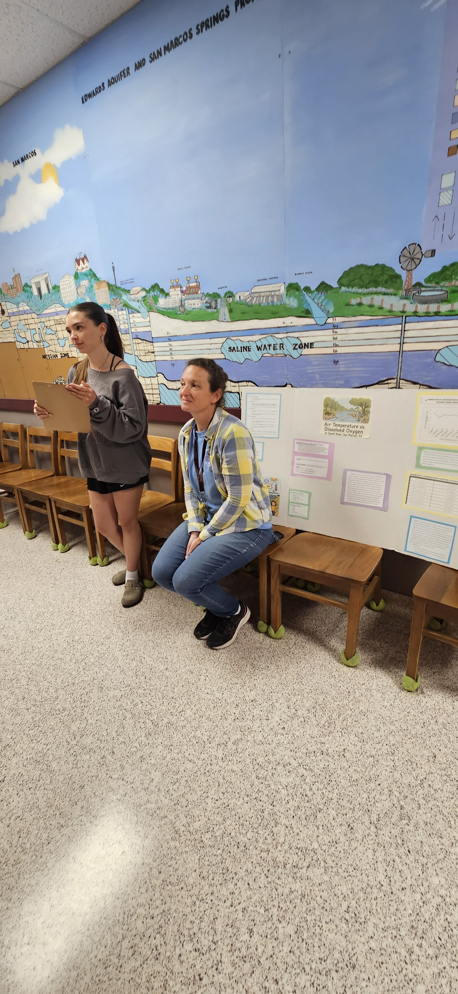

CURE TAPESTRy:
Gen. Sci. Water Quality
Carrie Jo Bucklin, Ph.D.
Sunni Taylor, Ph.D.

Slide 2
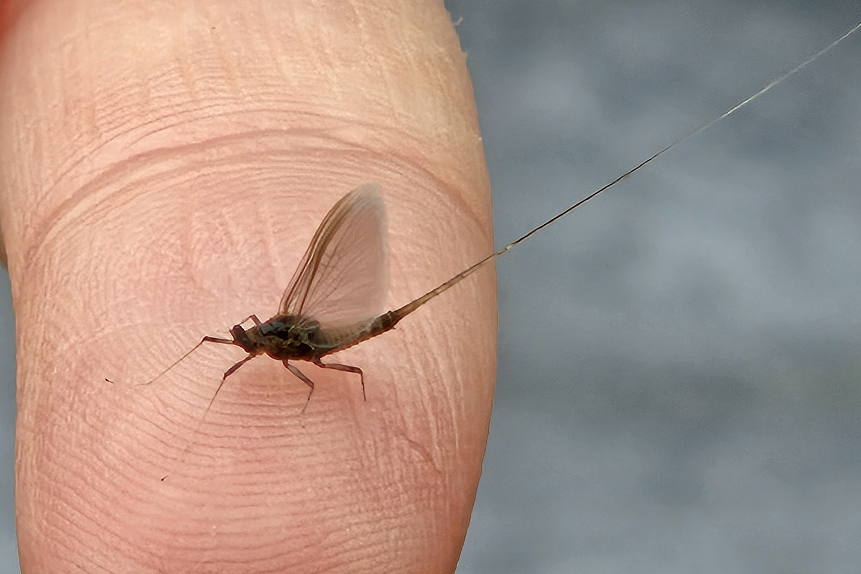
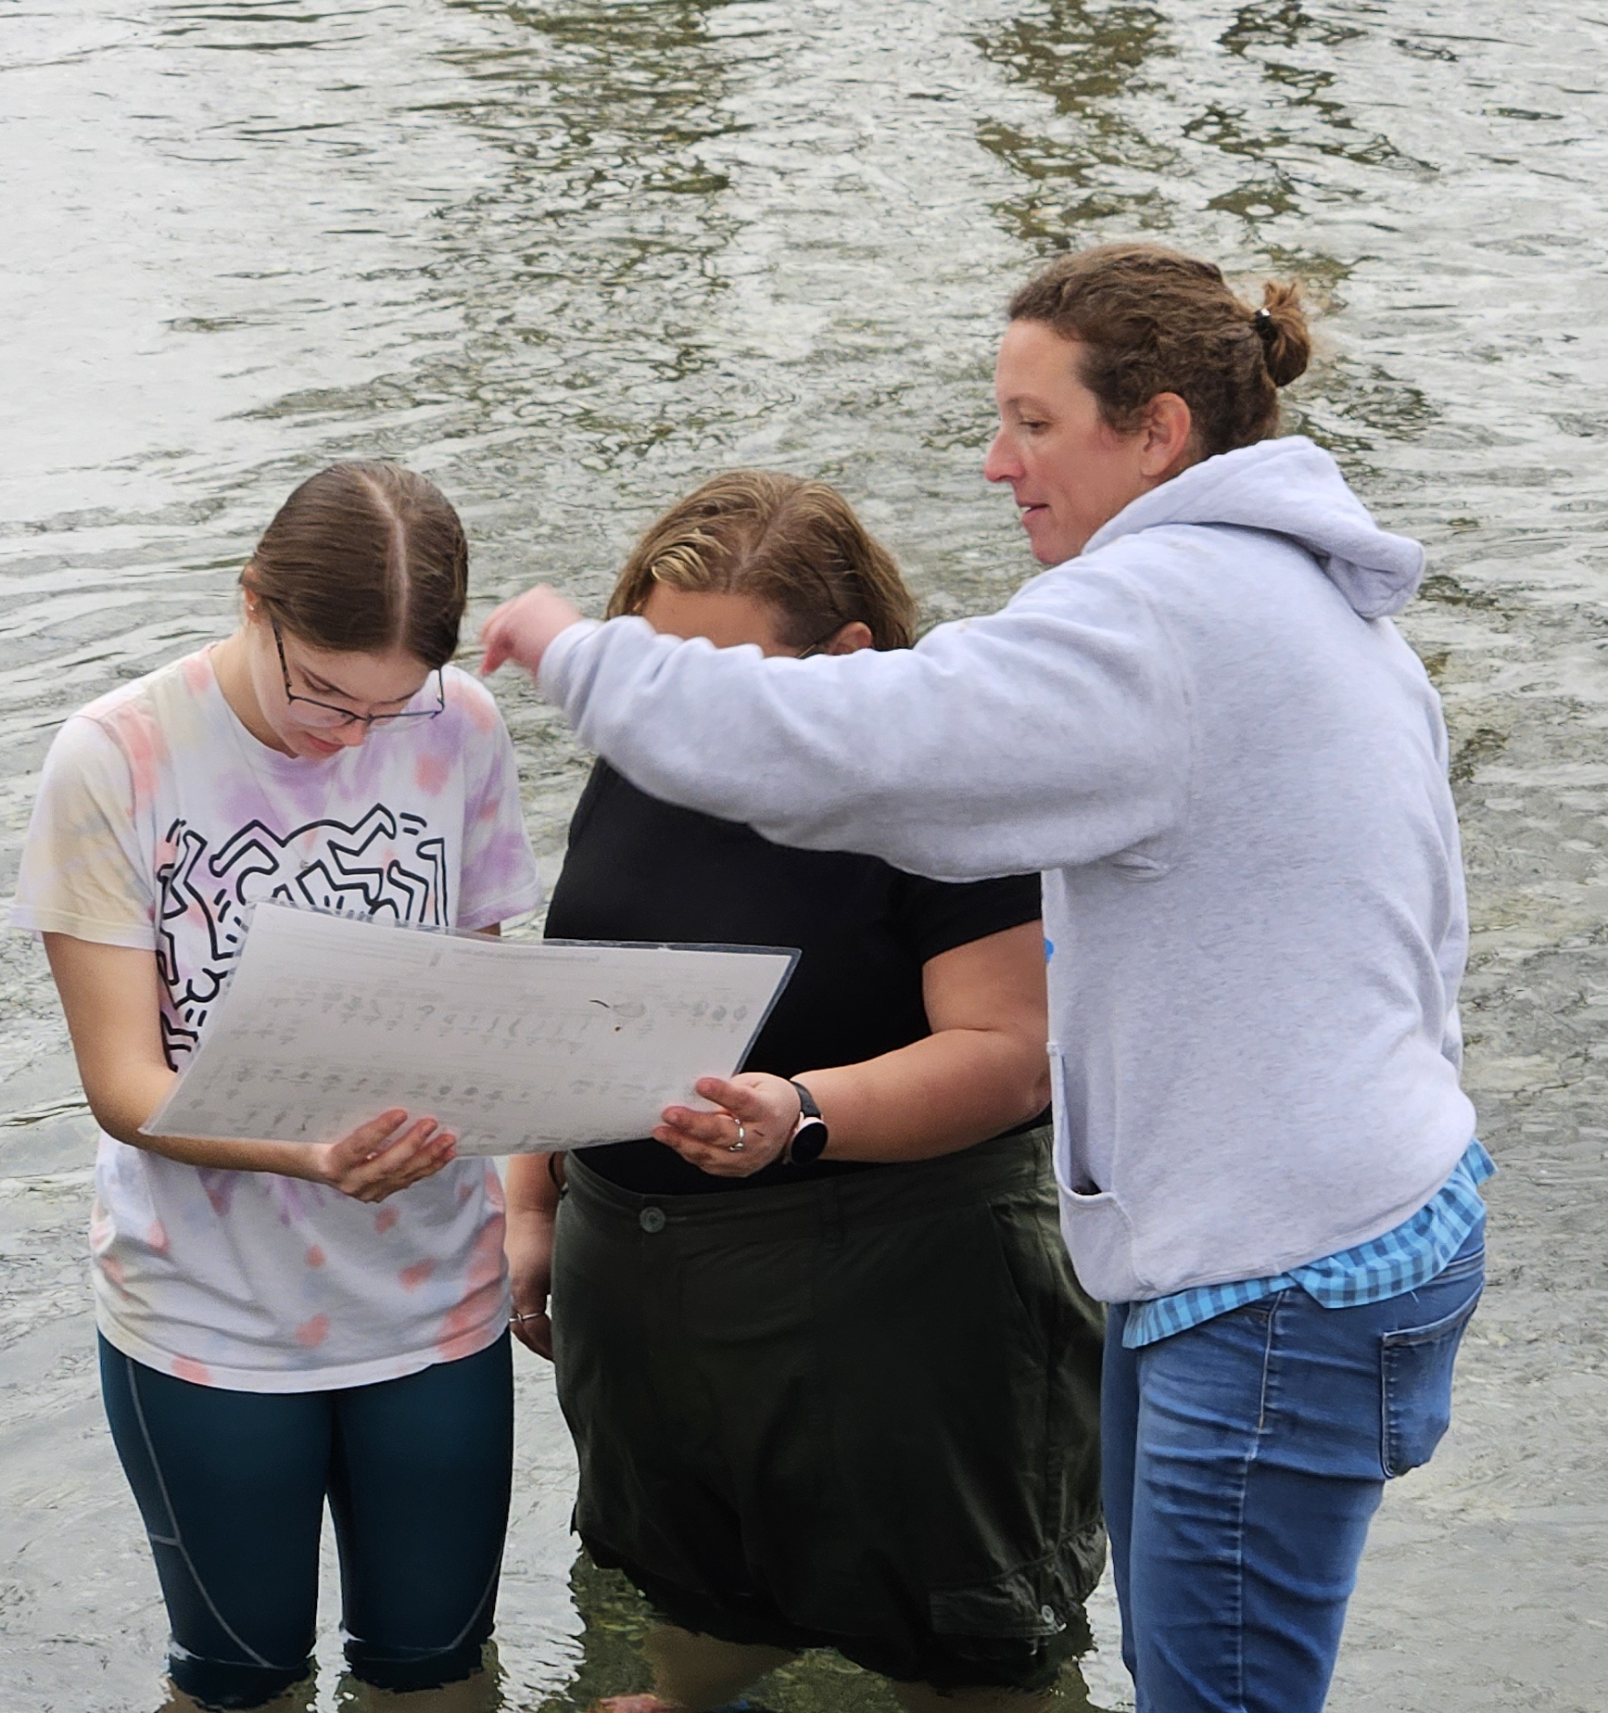
Course Description
General Life Science Course
Counts at GE credit
Water Quality/Monitoring
~192 sophomores (about 10% other)
~90% pre-service elementary students (PSETs)
7 TAs (5 are senior PSETs)

Slide 3
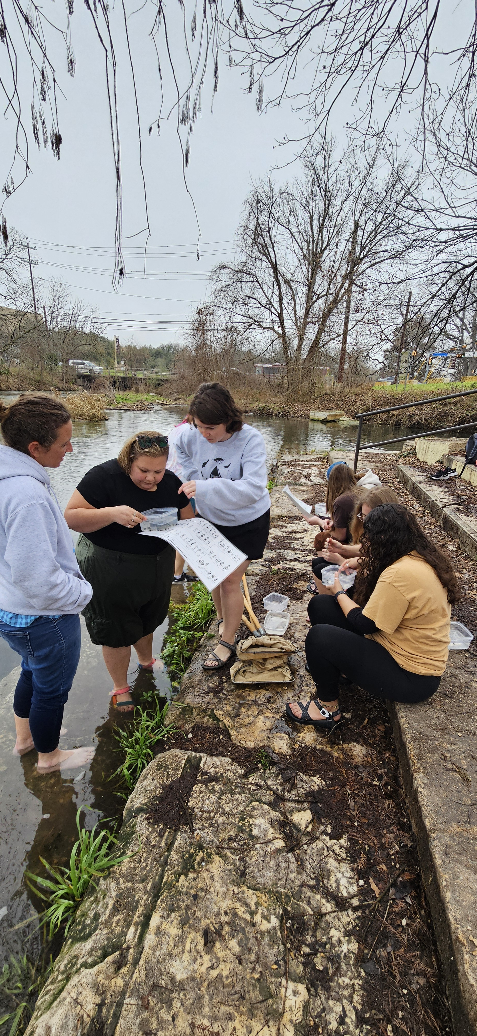
Resource Focus and Objectives
Reimagined TA handbook
Content
Science Skills
Teaching Guidance
Learning Outcomes/Objectives
  Increase science teaching self-efficacy in TAs
  Increase general teaching confidence
  Decrease apprehension of TA-student interactions

Slide 4
Evaluation Strategies
Learning Outcome/Objective | Associated Evaluation Strategy/Strategies
Increase science teaching self-efficacy in TAs | Weekly Lab Reflections & Prep Meetings
Increase general teaching confidence
Decrease apprehension of TA-student interactions

Slide 5
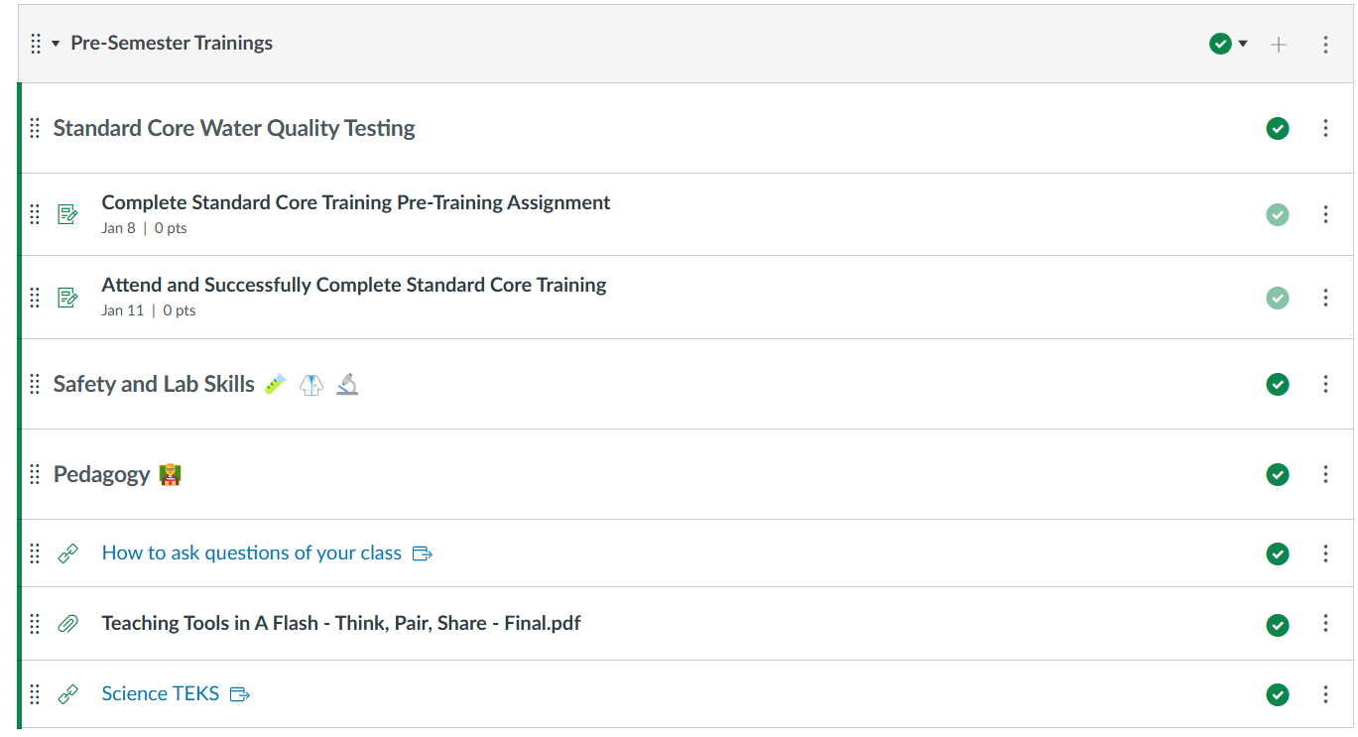
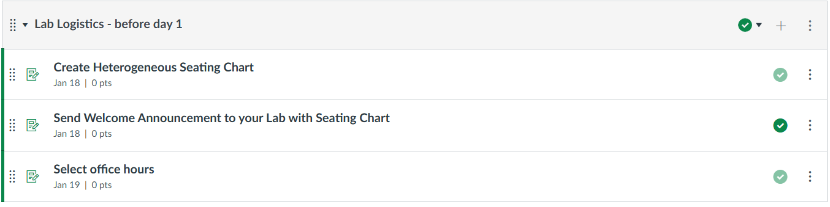
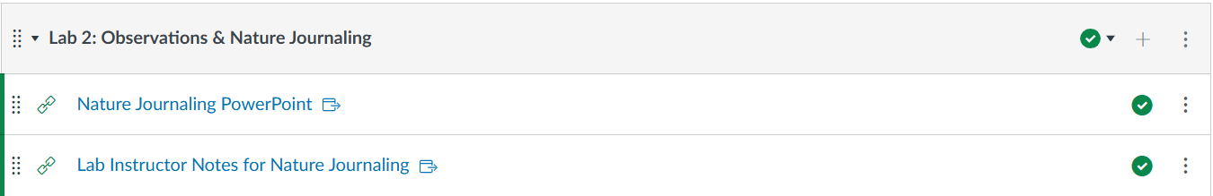
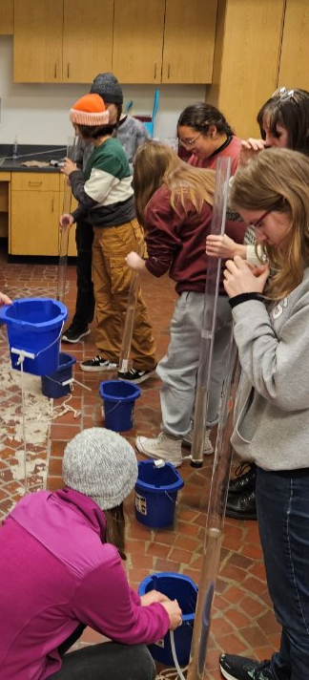
Activities
Pre-Semester Science Prep
  Water Quality Training Sessions – 3rd Party
  ~6 hours
Pre-Semester Teaching Prep
  Asking questions
  Active Learning Strategies
  Accessory Teaching Components
  ~4 hours
Weekly Teaching Module
  Course PPT (instructional fidelity)
  Instructor Notes
  Complete prior to Lab Prep Meetings
    15-45 min depending on the students
  Weekly Lab Prep Meetings

Slide 6
Outcomes - Anecdotal
Returning TAs
New TAs
Felt better about science this time
Liked that we changed the office hours/student interactions
Liked the grading notes
Liked that it was structured
Wanted more guidance on how to anticipate student actions
Notes:
TAs hesitant to formally share + Research student changes = Pivot!

Slide 7
Lessons Learned and Future Directions
Our TAs benefit from an “old school” approach
  We treated Canvas like a file organization system
Scaffolding “how to work” very beneficial for quality of TA tasks
Next up:
  We’re going to modify the CURE weeks
  Make TA field kits to use during CURE data collection
  Implementing CURE into Bio 1 sections with Instructor then expanding → train IAs
Notes:
What did you learn from implementing your activity, resource, or intervention? This might include how the process impacted your own CURE TA PD knowledge and skills; how the activity might be modified for use in future semesters; etc.
What next? Are you interested in developing additional activities, resources, or interventions? Has this inspired you to incorporate TA PD in other spaces? In short, what are your future directions?

Slide 8
