Slide 1

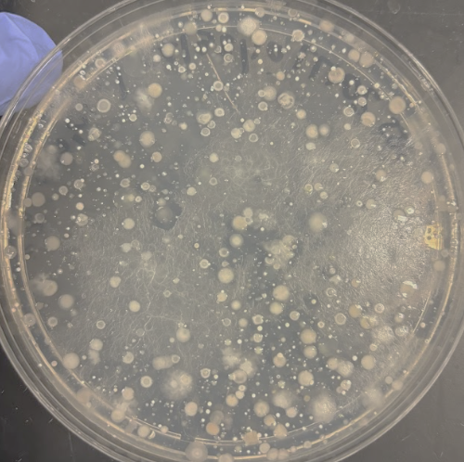
CURE TAPESTRy Capstone Talk
Maria Goodrich
Eastern Michigan University

Slide 2
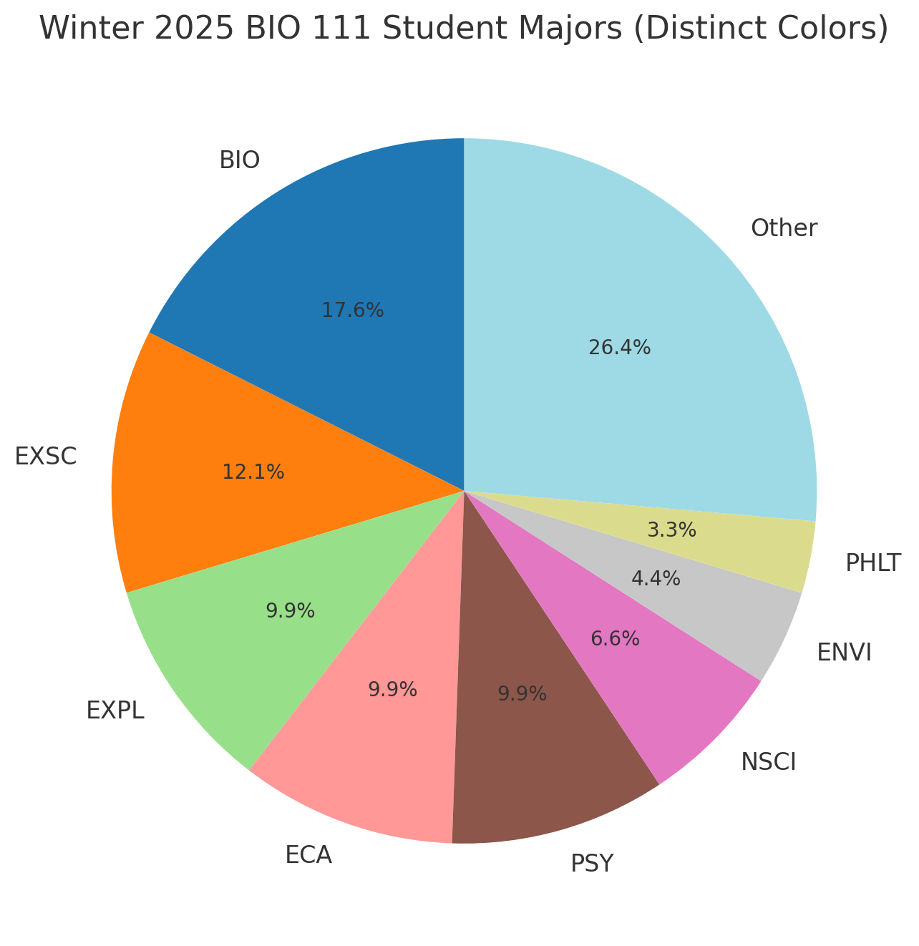
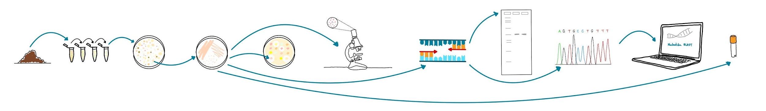
Course Description
W25 Majors
BIO 111 Introductory Biology Lab: Cells & Molecules (majors-focused but also gen ed)
Tiny Earth antibiotic discovery CURE
100-250 students per semester (sections of 24 that meet for 2 hours 2x per week)
  ~40% 1st year students
7-10 graduate student instructors (GAs)
  each GA teaches two sections in different teams, one they“lead” and one they “back”

Slide 3
Resource Focus and LOs
This tool supports the development of research and teaching acumen in our diverse GA team, preparing them to facilitate specs-based assessments, active learning, and inclusive mentoring throughout students’ semester-long research projects.
Cultivate a research mindset that embraces iteration and supports student discovery
Implement specifications-based assessments and provide clear, constructive feedback
Use active learning strategies to promote engagement and collaboration
Mentor students in scientific communication (presenting and interpreting results)
Create inclusive, supportive environments for diverse learners
Understand and articulate the defining features of a CURE

Slide 4
Evaluation Strategies
Learning Outcome/Objective | Associated Evaluation Strategies (no IRB)
Cultivate a Research Mindset | GA Survey: Likert + open text (Sections 1.1–1.3) “Confidence in helping students navigate research uncertainty”
Implement Specs-Based Assessments | GA Survey: Likert + text (Section 2) Student Surveys (Mid & Final): “Prepared for KCs/SCs,” “Benefit from resubmission,” “Thoughts on specs grading”
Engage Students Through Active Learning | GA Survey: Likert + example (Section 3) Student Final Survey: frequency of help-seeking/giving during lab; perceived learning
Communicate Scientific Results | GA Survey: Likert + open text (Section 4) Student Final Survey: reflections on Tiny Earth project, challenges, and favorite lab activities
Support Diverse Learners | GA Survey: Likert + open text (Section 5) Student Surveys: “Belonging,” “Challenges,” and “Instructor support” questions
Understand & Communicate the CURE Model | GA Survey: Likert + open response (Section 6) Student Final Survey: Reflections on Tiny Earth project (indirect evidence)

Slide 5
Activities
Three-hour weekly meetings blended skill-building, reflection, and collaboration, supporting both new and returning GAs in leading an authentic, inclusive CURE experience.
Time devoted to each activity was variable from week to week based on the needs of the team and the timing with respect to the course workflow.

Slide 6
Activities
📝 Assessment Calibration & Peer Grading Practice
GAs worked in pairs to grade student submissions using specs rubrics, then as a group compared and discussed differences to improve consistency and clarity.
✅ Implement Specs-Based Assessments
✅ Communicate Scientific Results
🔬 Protocol Modeling & Peer-Led Prelab Demos
GAs took turns modeling how to teach or troubleshoot key lab techniques (e.g., PCR setup, crowded plate interpretation), followed by peer feedback.
✅ Cultivate a Research Mindset
✅ Engage Students Through Active Learning
✅ Understand & Communicate the CURE Model

Slide 7
Activities
💡 Active Learning Strategy Design & Share-Out
Brainstormed and tested classroom activities (whiteboard work, table discussions, jigsaw, etc.) to enhance engagement and understanding.
✅ Engage Students Through Active Learning
✅ Communicate Scientific Results
✅ Support Diverse Learners
🧠 Case-Based Pedagogy Reflections
Discussed real lab situations or student struggles (e.g., motivation after project setbacks, grading dilemmas) to explore inclusive mentoring strategies.
✅ Cultivate a Research Mindset
✅ Implement Specs-Based Assessments
✅ Support Diverse Learners

Slide 8
Activities
📂 Canvas & Assignment Walkthroughs
Previewed how students will experience the upcoming week’s modules, highlighting pacing, new assignments, and points of confusion.
✅ Implement Specs-Based Assessments
✅ Understand & Communicate the CURE Model
🔄 Course Feedback & Troubleshooting Rounds
GAs reviewed student feedback, shared emerging issues from their sections, brainstormed solutions together, and adapted plans (e.g., late assessment versions, research pivoting).
✅ Cultivate a Research Mindset
✅ Support Diverse Learners
✅ Communicate Scientific Results
✅ Understand & Communicate the CURE Model

Slide 9
Outcomes (summary of feedback)
PD Learning Outcome | Representative Themes and Feedback
Cultivate a Research Mindset | GAs reported greater confidence guiding students through failure and iteration. Students reflected on “feeling like real scientists.”
Implement Specs-Based Assessments | Students valued resubmission opportunities and clarity of expectations. GAs noted improved understanding and ability to explain the system.
Engage Students Through Active Learning | Students described regular collaboration and engagement during labs. GAs highlighted successful use of interactive elements.
Communicate Scientific Results | GAs gained confidence mentoring students through figure creation and oral/poster presentations. Students noted improvement in these skills.
Support Diverse Learners | Both students and GAs emphasized inclusive environments. GAs cited growth in identifying and responding to diverse learning needs.
Understand & Communicate the CURE Model | GAs reported increased confidence in explaining the value and uniqueness of the CURE model to students. Students expressed appreciation for doing research with real-world value.

Slide 10
Lessons Learned ✅
GAs thrive when given ownership of instruction and course improvement
Modeling labs from both instructor and student roles is key for building confidence and surfacing pitfalls
Protected time for peer teaching, reflection, and collaboration is essential
My role is to facilitate teamwork and shared purpose, not just deliver content
Our GA team mirrors the kind of collaborative learning we want students to experience in their research teams

Slide 11
Future Directions 🚀
Refine team meeting structure to better balance logistics, reflection, and modeling
Offer more targeted support for admin/logistical tasks while preserving pedagogical depth
Use this work to advocate for greater GA voice in department instructional planning
Explore cross-departmental partnerships to expand access to rigorous TA PD
Highlight the dual benefit of GA teaching development - for instruction and for their own research and communication growth

