Slide 1

CURE TAPESTRy Capstone Talk
PAOLA BARRIGA

Slide 2
Course Description
The CURE allows students to explore the range of expansion of two invasive plant species in the US. We use iDigBio data, clean and organize data, map and calculate areas and perform statistic analyses.
We have on average 15 students per section with four to five sections (~75 students) and 2 to 3 Teaching Assistants. The course is a non-majors Plant Biology course that fulfils the Life Science requirement.
.

Slide 3
Resource Focus and Objectives
The focus of this Professional Development effort is to assist the TAs with some aspects of the research acumen (be prepared to troubleshoot) and aspects of effective mentoring.
Learning Outcomes/Objectives
Assist TAs in feeling confident teaching the CURE
Prepare TAs to foster an environment where critical thinking is practiced
Prepare TAs to discuss the broader impacts of the CURE with undergraduates.
Create an environment where TAs can reflect about their teaching beliefs.

Slide 4
Evaluation Strategies
Learning Outcome/Objective | Associated Evaluation Strategy/Strategies
Assist TAs in feeling confident teaching the CURE | TA Survey item with Likert scale
Prepare TAs to foster an environment where critical thinking is practiced | Undergraduate Survey item with Likert scale
Prepare TAs to discuss the broader impacts of the CURE with undergraduates. | TA Survey item with Likert scale.
Create an environment where TAs can reflect about their teaching beliefs | TA Survey item with Likert scale.

Slide 5
Activities
Weekly teaching meetings to practice prompting questions that fosters critical thinking in undergraduates (10 minutes)
Weekly teaching meetings to practice the research and software associated with teaching the CURE (1 hour)
One time brainstorming about broader impacts (15 minutes)
Weekly discussion of the five pillars of a CURE (10 minutes first meeting and 5 minutes subsequent minutes)

Slide 6
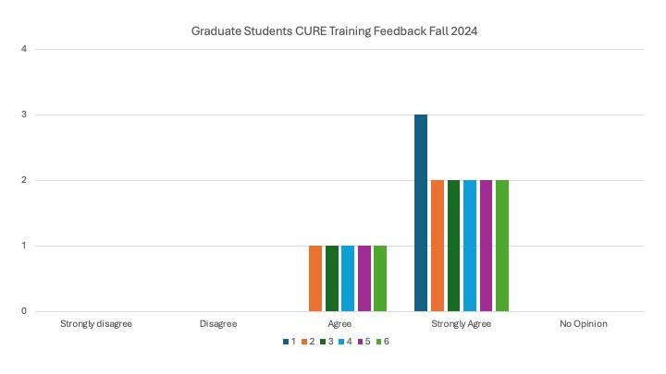
Outcomes
Key for Figure
I gained a deeper understanding of the broader impact of the CURE on student learning
I was able to enhance undergraduate’s understanding of the broader impacts of the CURE
After learning about its five pillars, I feel more confident in teaching the CURE.
I became a more effective mentor in the classroom by participating in mock sessions.
I feel more comfortable navigating failures in the CURE project
I have critically reflected on my teaching beliefs as a result of teaching the CURE.
Completion Rate 100%

Slide 7
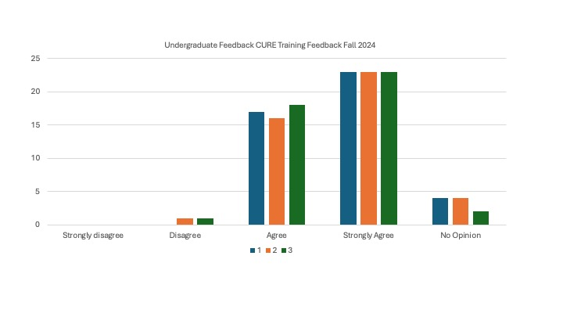
Outcomes
Key for Figure
I practiced the unpredictability associated with research outcomes.
I learned that failure is a component of progress.
I learned that repeated experimentation is a component of progress.
Completion Rate = 95.31%

Slide 8
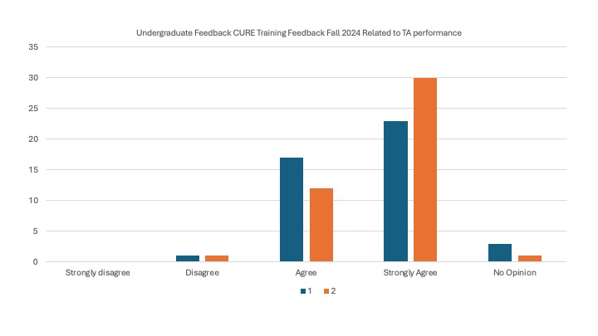
Outcomes
Key for Figure
1. My TA Challenged me to think critically.
2. My TA encouraged me to troubleshoot effectively.
Completion Rate = 95.31%

Slide 9
Lessons Learned and Future Directions
I am learning that I need to have different ways to implement the professional development. For instance, a half the semester anonymous survey that was well received by the TA cohort in the fall did not work at all for the cohort in the Spring. Instead, now I may have slides to discuss during the TA training. And/or offer both.
This has inspired me to continue adapting what I created and offering my expertise to other TAs in the department who may be teaching other CUREs.
Notes:
Written examples of what a reflection after teaching looks like for TAs.
Continue thinking what administrative part of the meetings can be worked in a different way to free time to do more professional development.

