Slide 1
Enhancing TA Training and Student Engagement in Introductory Science Courses
(CURE TAPESTRy)
Experiences from USA and Canada
Dr. Amr El Zawily

Slide 2
Introduction : TAs importance & impact
Teaching Assistants (TAs) play a crucial role in the educational experience of undergraduate students. TAs could have positive and/or negative influences of TAs on student engagement.
TAs enhance learning by providing personalized instruction (individual attention) and support than professors in large classes.
TAs can make lab sessions more interactive and engaging, which helps maintain student interest and motivation. Their closer interaction with students fosters a more dynamic learning environment.
TAs create a supportive atmosphere where students feel comfortable asking questions and seeking help. This can significantly boost students' confidence and sense of belonging.

Slide 3
Introduction : TAs importance & impact
TAs often guide students through practical exercises and experiments, helping them develop essential lab skills and techniques.
TAs can serve as mentors, offering advice on academic and career paths. Their recent experience as students themselves makes them well-positioned to understand and address the challenges undergraduates face.
Effective TAs can positively impact student retention rates, particularly in STEM fields.
By providing support during the formative years of undergraduate education, TAs help maintain diversity and inclusion within these disciplines

Slide 4
Foundations of Biology, Biol 1411
Teaching in the Department of Biology, University of Iowa
Course Details:
Large introductory course for science majors (Foundations of Biology, Biol 1411). Approximately 1100 students annually.
Lab component worth 30%.
TAs Training:
Weekly TA trainings (~ 3 hrs)

Slide 5
Intervention (2024)
Educational teaching sessions (5 - 10 minutes) at the beginning of each weekly meeting were applied.
During this time, TAs and myself discuss various teaching methods to diversify their approaches and improve their effectiveness.
TAs discuss their challenges that they face in teaching: giving TAs a platform to share the challenges they face which can foster a supportive environment and lead to collaborative problem-solving.
TAs and myself share techniques for keeping students engaged and motivated during lab sessions.

Slide 6
Foundations in Molecular Biology and Genetics, MBG 2040
Teaching in the Department of Molecular and Cellular Biology at the University of Guelph
Course Details:
Large introductory course for majors and non-majors students (Foundations in Molecular Biology and Genetics, MBG 2040). Approximately 1600 students annually.
TAs Training:
Weekly TA trainings (~ 1 hr)

Slide 7
Intervention (2025)
Optional educational teaching sessions (20 minutes) weekly.
During this time, TAs and myself discuss various teaching methods to diversify their approaches and improve their effectiveness.
TAs discuss their challenges that they face in teaching: such as how to respond to unknown questions, interacting with shy, loud, or inattentive students
TAs and myself share techniques for keeping students engaged and motivated during lab sessions.
Encouraging open discussion and feedback.

Slide 8
Interviews
During our final meeting of the semester, I gathered feedback from the TAs regarding the educational sessions I organized. I asked them the following questions to reflect on the impact and future direction of these sessions:
What are your overall thoughts on the sessions?
At the beginning of the semester, what did you expect these sessions to provide?
Do you believe these sessions should be continued in the future?
Did you observe any changes or improvements in your lab sections as a result of attending these sessions?
What suggestions or ideas do you have for future sessions?

Slide 9
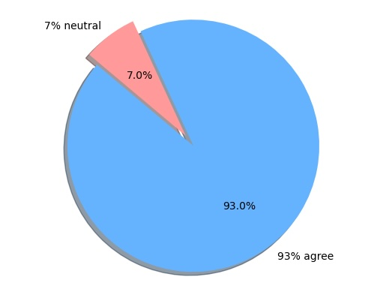
Results
This chart illustrates the survey results, indicating that 93% of TAs found the educational sessions to be highly beneficial , while 7% remained neutral, reporting no noticeable impact

Slide 10
What do you hope to accomplish as a result of sustaining (and scaling) your CURE TA PD efforts?
Ensuring that TAs are well-equipped with the necessary skills and knowledge to effectively support undergraduate research experiences. This includes training in both teaching (pedagogical) techniques and subject-specific content.
By providing high-quality training to TAs, we aim to improve the overall learning experience for students, leading to better engagement, understanding, and retention of biology concepts.
Developing and refining professional development materials that can be easily accessed and utilized by future TAs, ensuring the continuity and consistency of training programs.
Building a network of TAs, faculty, and staff who can share best practices, resources, and support each other in their teaching and research efforts.
Expanding the reach of our PD efforts to include more institutions and programs, thereby amplifying the positive impact on undergraduate education in biology.

Slide 11
Who will be impacted as you continue to scale and/or sustain those effort?
TAs: They will benefit from enhanced training and resources, which will improve their teaching skills and confidence in facilitating undergraduate research experiences.
UG Students: Students will experience higher quality education and research opportunities, leading to better engagement, understanding, and academic success in Biology.
Faculty and Staff: Faculty members and staff involved in the program will have access to a well-trained pool of TAs, making it easier to manage and support undergraduate research projects.
Educational Institutions: As the program scales, more institutions will be able to implement effective CURE TA PD initiatives, leading to widespread improvements in biology education.
Research Community: The broader research community will benefit from the increased number of well-prepared students entering the field, contributing to advancements in biology research.

