Slide 1
Establishing TA independence with an undergraduate CURE
Ilva Cabrera,phd
California state university, long beach

Slide 2
Course Description
A Course-Based Undergraduate Research Experience (CURE) involves hands-on applications of investigative research within the classroom. This class will introduce you to the fundamentals of research, including methods for conducting a hypothesis-driven project.
Catalog Description
Intensive course of modern laboratory techniques used in both cell and molecular biology. Topics include tissue culture, genomics, bioinformatics, proteomics, microscopy, and/or purification and functional characterization of recombinant proteins. Provides extensive laboratory experience for students.
Letter grade only (A-F). Course fee may be required. (Lecture 1 hr., laboratory 6 hrs.)
*Upper division, Majors*
I have 11 students at the start of the semester

Slide 3
Class Student Learning Outcomes:
• Gain technical, hands-on skills in molecular and cellular biology techniques.
• Gain an understanding of how techniques in the current literature actually work.
• Gain the ability to use bioinformatics tools for specific problems.
• Learn how to keep an effective laboratory notebook with an emphasis on reproducibility.
• Improve writing skills with formal laboratory reports.
• Learn to work in a small team of two students.
• Learn how to conduct experiments using general protocols, which may need to be modified for specific conditions.
• Enjoy the feeling of accomplishment that comes from successful results after much hard work!

Slide 4
Initial thoughts
Teaching a brand-new CURE (BIOL 440L- Molecular Biology Laboratory).
Had a lot of work to do; prepping, ordering and getting paperwork for approvals (way more work than I thought!)
Student who recently graduated contacted me to be a TA in this course to gain additional molecular experience prior to an internship.

Slide 5
Conflicts due to finances
As the student is an international student who is now a postbacc., they would have to PAY to be my TA.
We flipped it for them to be volunteer instead.

Slide 6
Other road bumps
As I was busy working and prepping my class, I minimized the priority for personal development for my volunteer.
I wasn’t officially assigned to a POD, so I was only able to go to 1 POD meeting ☹
[VERY HELPFUL THOUGH, MORE THOUGHTS TO COME……]

Slide 7
Reaching out for help
Prior to the semester start, I reached out to Dr. Tolu Noah, CSULB’s Instructional Learning Spaces Coordinator.
She offered some suggested websites and books (next slide):

Slide 8
Links and book suggestions
Stanford TA Training & Support
University of Pennsylvania TA Training Workshop Descriptions
University of Texas at Austin: Graduate Student Development
University of Mississippi: Graduate Students
UCLA Basic Pedagogy Training
Teaching Matters: A Guide for Graduate Students
Teaching Gradually: Practical Pedagogy for Graduate Students, by Graduate Students
Preparing for College and University Teaching: Competencies for Graduate and Professional Students
Teaching and Learning STEM: A Practical Guide
Teaching Undergraduate Science: A Guide to Overcoming Obstacles to Student Learning
The Missing Course: Everything They Never Taught You about College Teaching
I noticed that this was mostly geared towards graduate students (maybe it can help others in the cohort?)- I was more interested in undergraduate training.

Slide 9
Other advice
Dr. Kelly McDonald suggested to do an interview with my volunteer
From our March meeting, we talked about how we can scale TA professional development.

Slide 10
My thoughts
I’ve learned a lot during this whole process. I am planning to have a sit-down session with my volunteer to discuss self-reflections and input for the future.
The dynamics of having a TA/volunteer allowed for students to freely ask questions, really made the lab interactive.
There were many modalities of interaction with the TA/volunteer; one-on-one, and small group discussions.

Slide 11
Future
I hope to teach a less intense CURE soon (special topics course), which I would like to advertise specifically to undergraduate students to become TA’s
As active students they can enroll into BIOL 495 (Instruction lab teaching) for class credit.
I would like to have more than one TA for both to learn from each other.
I want to development a more standardized lab manual to provide TA’s with additional points to reference.
I will have to be in the classroom; however, I want the TA to take responsibility of atleast one class.

Slide 12
The following slide is a summary of my class.
The remaining slides were completed by my students, as their second module project.
All were shown during a new student welcome event on campus.
Although the class is not done, I believe the students learned a lot. The volunteer TA did help with student success.

Slide 13
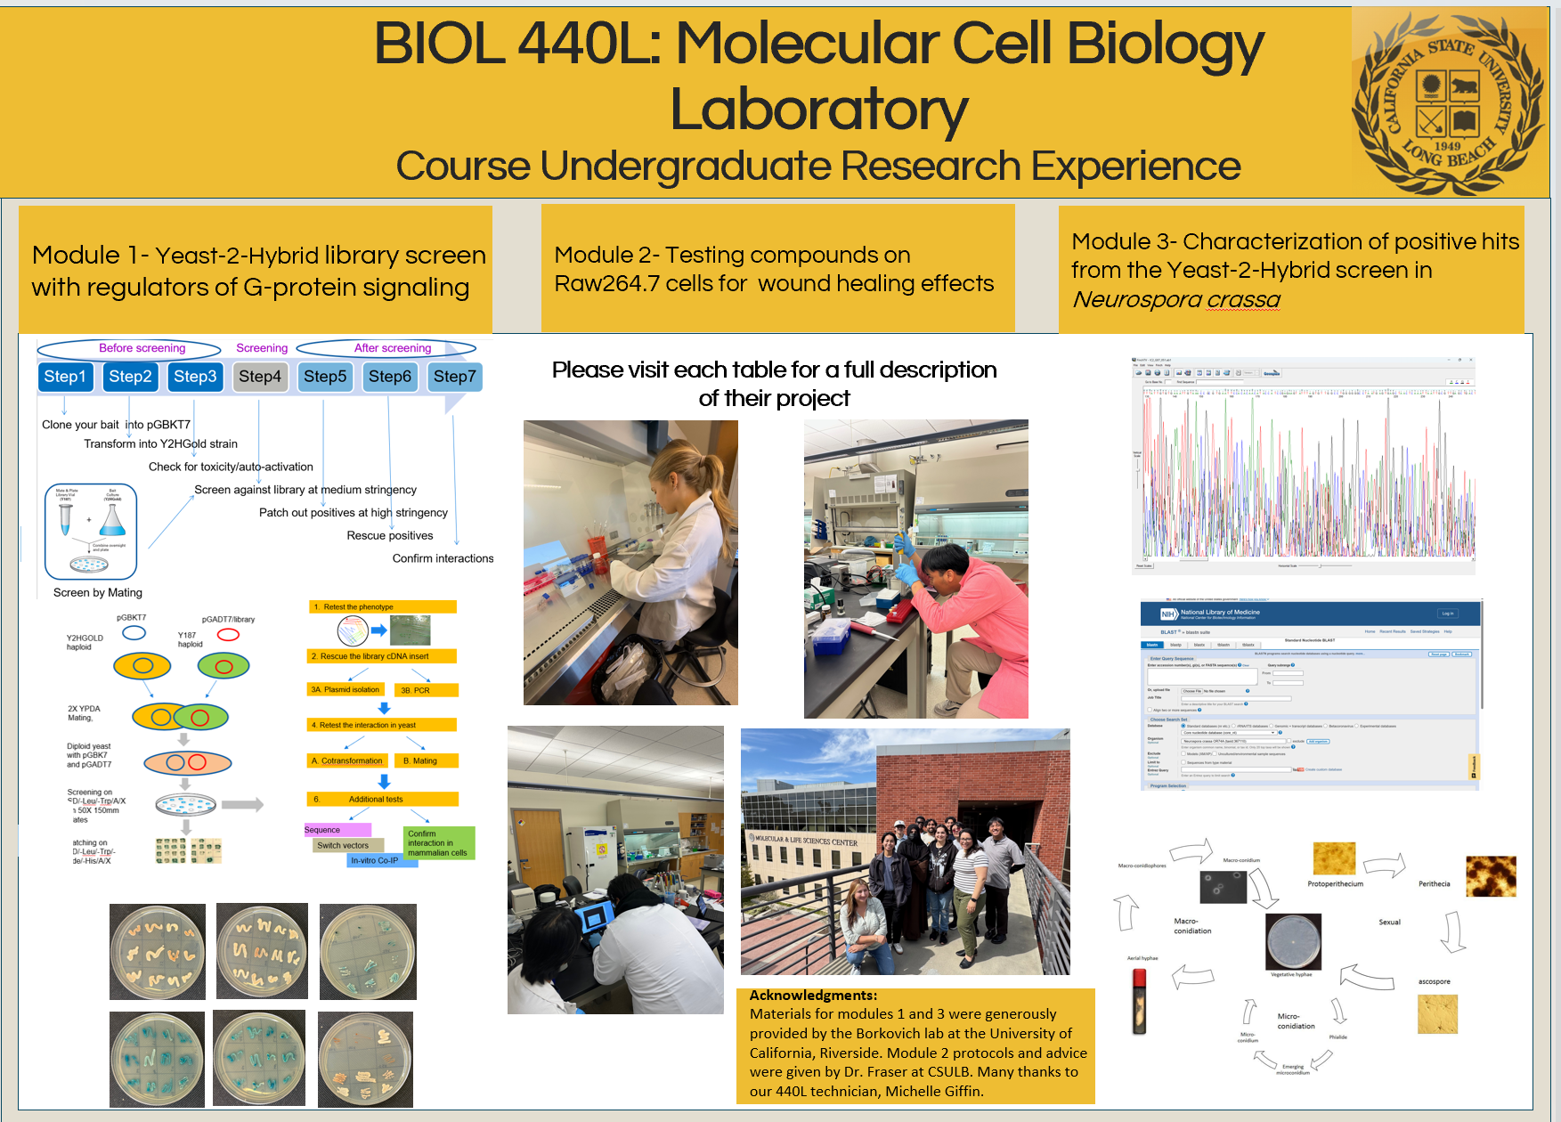

Slide 14
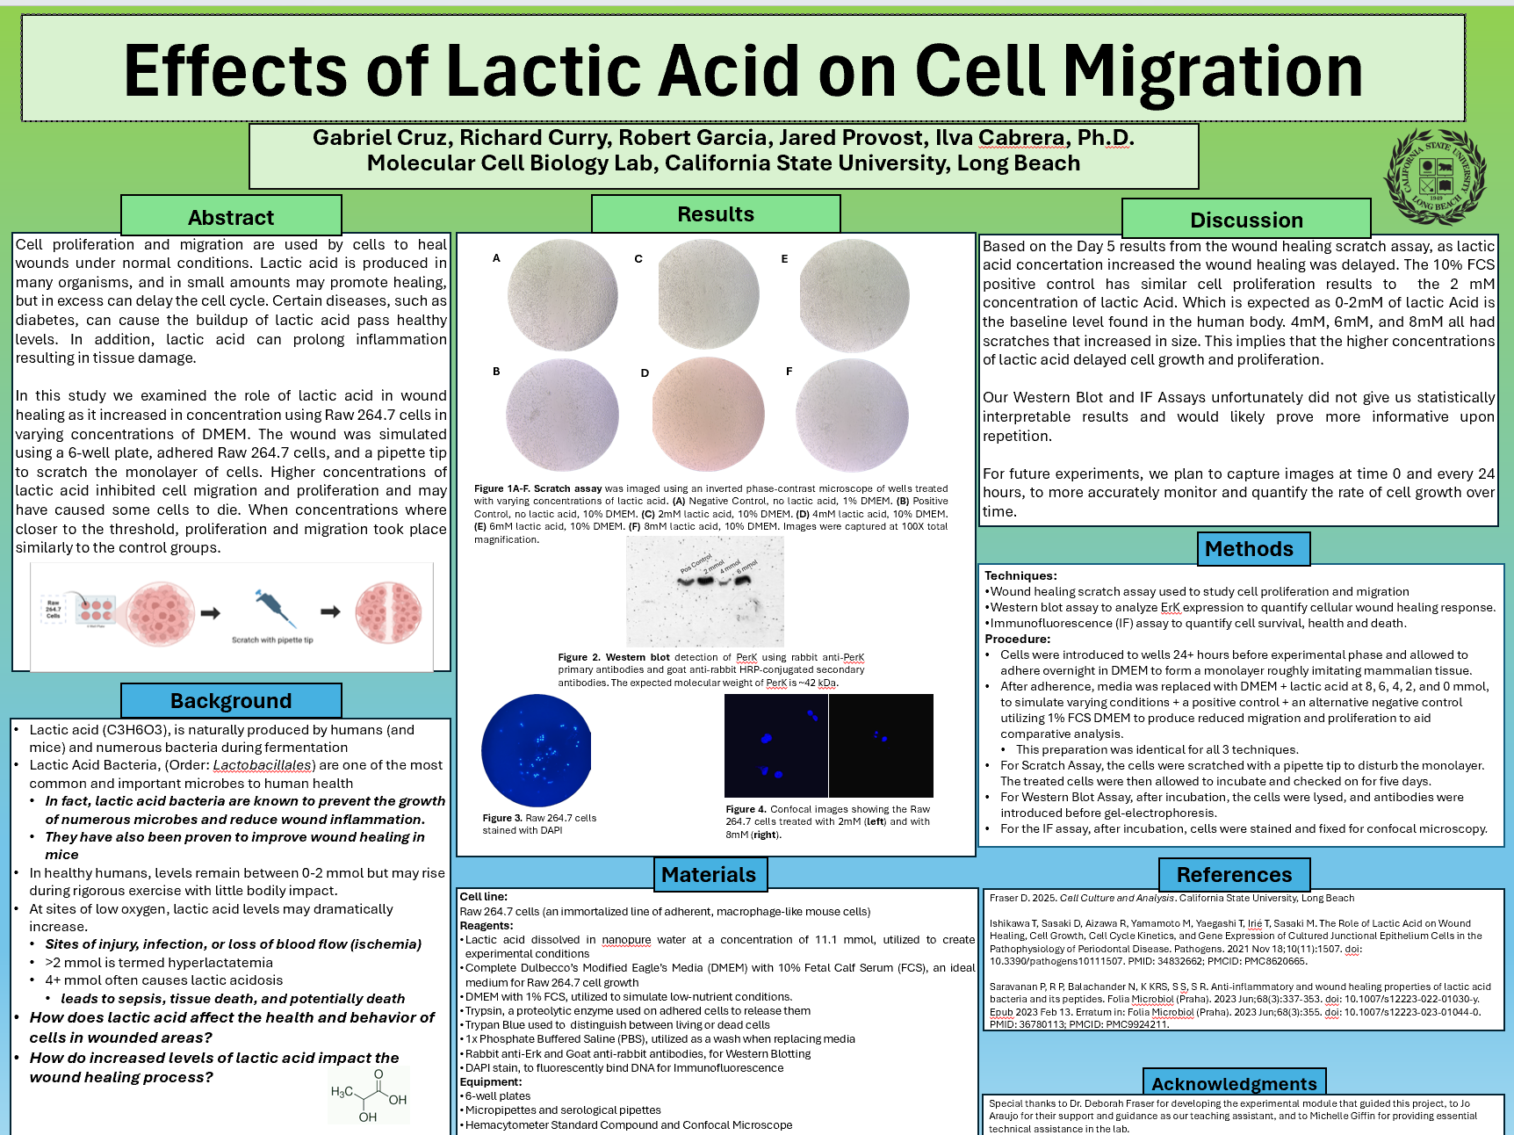

Slide 15
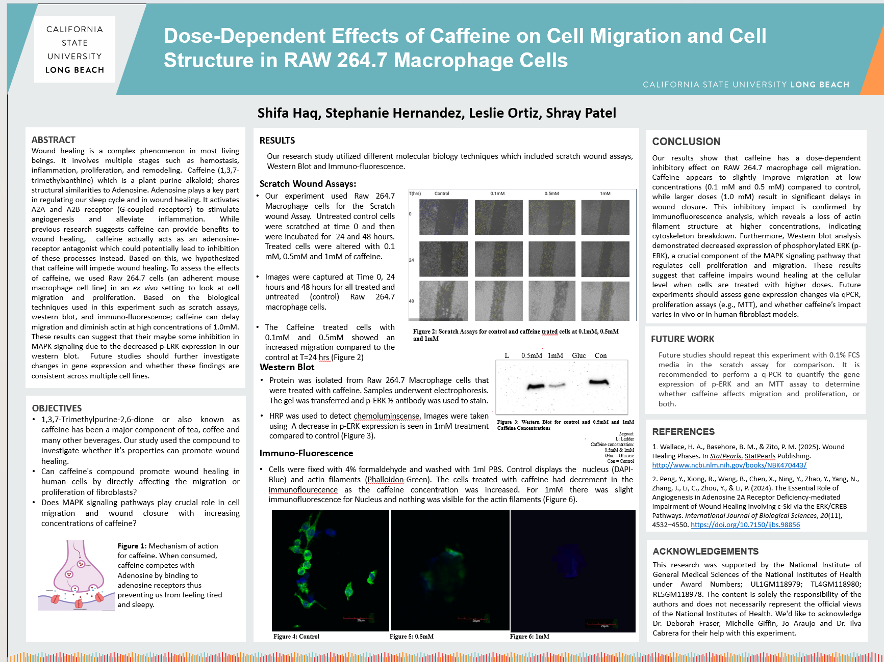

Slide 16
