Slide 1







RENAISSANCE
SOUTH LA
Re-Entry Food Services
Certification & Job Placement
Dr. Henry R Armstrong III, DBA, MBA

Slide 2
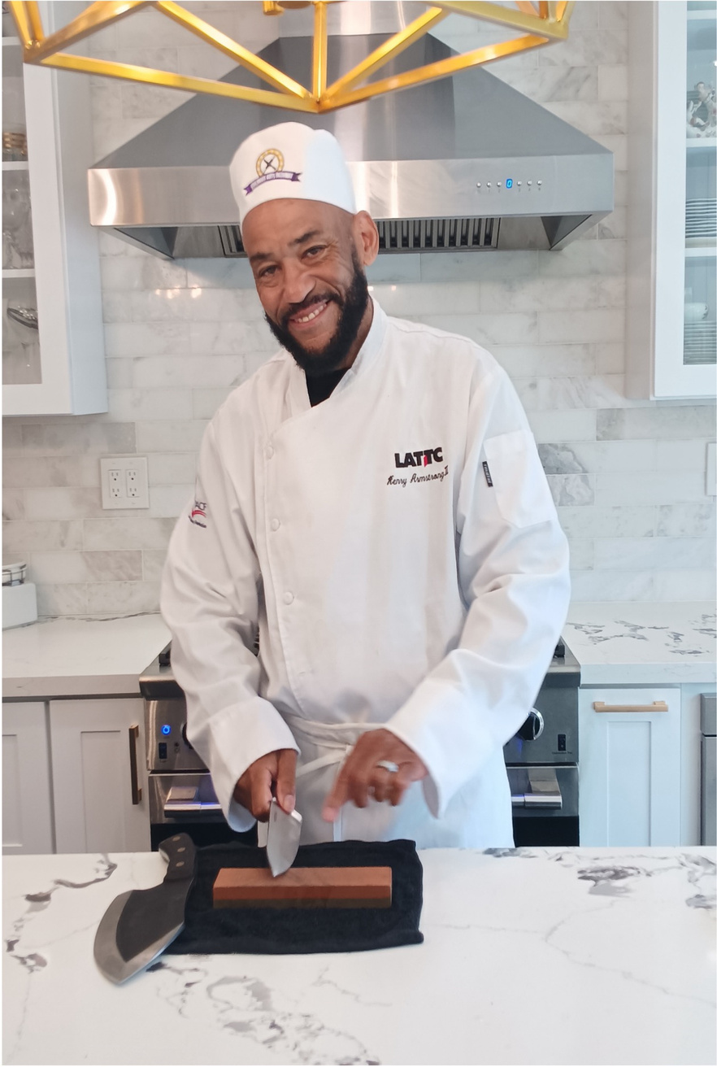

ABOUT THE HEAD CHEF
ACADEMICALLY, I HOLD A BACHELOR’S DEGREE FROM PEPPERDINE UNIVERSITY'S SCHOOL OF BUSINESS, A MASTER’S DEGREE FROM LOYOLA MARYMOUNT UNIVERSITY, AND A DOCTORATE IN BUSINESS FROM WESTCLIFF UNIVERSITY. I AM CURRENTLY COMPLETING A MASTER’S IN PUBLIC HEALTH, WITH AN EMPHASIS ON URBAN NECESSITIES, EXPECTED IN MAY 2026. I ALSO SERVE AS A LECTURER AT RIVERSIDE CITY COLLEGE AND LOS ANGELES TRADE–TECHNICAL COLLEGE.
MY PASSION LIES IN ADVANCING EQUITY IN EDUCATION AND ADDRESSING CRITICAL PUBLIC HEALTH ISSUES INCLUDING MENTAL HEALTH, SUBSTANCE USE DISORDERS, HOMELESSNESS, AND REDUCING INCARCERATION. I BELIEVE THIS PROGRAM HAS THE POTENTIAL TO CREATE MEANINGFUL AND LASTING IMPACT IN THESE AREAS.
Dr. Henry R Armstrong III, DBA, MBA

Slide 3


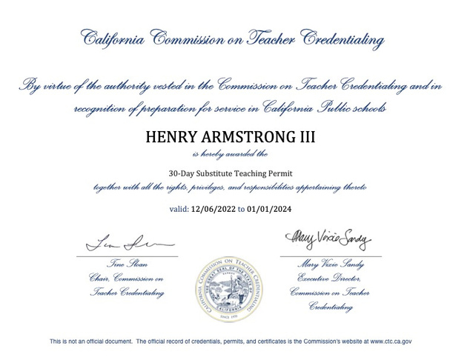
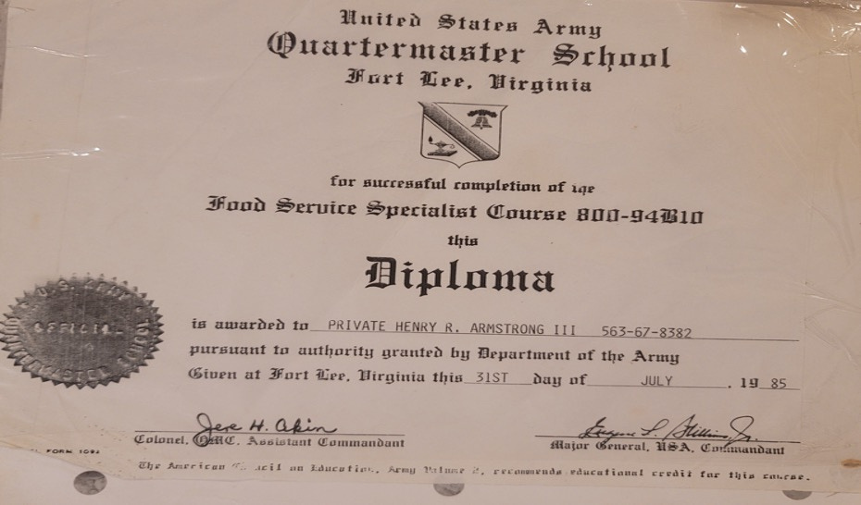
ABOUT THE HEAD CHEF
WITH OVER FOUR DECADES OF CULINARY EXPERIENCE, MY JOURNEY BEGAN WITH FORMAL TRAINING IN THE UNITED STATES ARMED FORCES AND CONTINUED THROUGH THE ACHIEVEMENT OF MY FOOD HANDLER’S CERTIFICATE FROM THE NATIONAL ASSOCIATION OF REGISTRY OF EXAMINATIONS (NARE), AS WELL AS SANITATION CERTIFICATION FROM SERVSAFE, A NATIONALLY RECOGNIZED CERTIFICATION BODY.

Slide 4
Why This Program?
  Accelerated Career Path: direct aligned curriculum to ensure certifications at end of course
  Hands-on Training: Learn directly from experienced chefs with scenario based farm to table training
  Affordable & Accessible: Scholarships and financial aid options available
  Job Placement Assistance: Strong industry connections and networking opportunities

Slide 5
According to an article called Planting Seeds for Success: An Evaluation of Agricultural Reentry Programming for Formerly Incarcerated Individuals; it states that
“Formerly incarcerated people face several barriers to attaining a comfortable financial situation including securing employment, housing, and getting access to loans” (Travis and Visher 2011)[1].
[1] WORKS CITED: VISHER, CHRISTY A. AND JEREMY TRAVIS. 2011A. "LIFE ON THE OUTSIDE: RETURNING HOME AFTER INCARCERATION." THE PRISON JOURNAL 91 (3): 102S-119S. DOI:10.1177/0032885511415228. HTTPS://DOI.ORG/10.1177/0032885511415228.

Slide 6

PROGRAM GOALS
The program aspires individuals that were recently released from a correctional facility an opportunity to re-enter society with a chance to succeed in hopes to lower the statistical rate of going back to prison. This program allows these individuals to learn a trade that will provide a certification which is beneficial to landing a job and/or career in the food service and sanitation industry.

Slide 7
COURSE WORK
  Safety and Sanitation in Culinary Arts
  Equipment and Procedure in Food Service
  Food Service Operations (Farm to Table)
  Work Ethics and Legal Responsibilities
  Communication and Professional Etiquette Development
  Professionalism and Employability Skills
  Leadership, Citizenship, and Teamwork
  Mathematics and Science in Food Service
  Technology in Food Service Operations
  Career Development and Exploration

Slide 8
REQUIRED TEXTBOOKS
  Culinary Arts Orientation 1: A Practical Guide
    Culinary Arts: A Practical Career Guide 1st Edition is written by Tracy Brown Hamilton and published by Rowman & Littlefield Publishers.
  Integrated Introduction to Culinary Arts Management: Coursebook: Safety Recipes and Certification
    Integrated Introduction to Culinary Arts Management - Coursebook: Safety, Recipes and Certification 1st Edition is written by Daniel John Stine, Dominic Hawkes and published by SDC Publications, Inc.
  Culinary Nutrition Principles and Applications
    Culinary Nutrition Principles and Applications 2nd Edition is written by Linda J. Trakselis, Eric M. Stein and published by ATP.

Slide 9

RSLA FOOD SERVICE CERTIFICATIONS
  Food Handlers Certifications
  Sanitation Certifications
Benefits from Certifications
  EMPLOYMENT OPPORTUNITIES IN THE CULINARY INDUSTRY.
  BUILDING CONFIDENCE AND LIFE SKILLS.
  PATHWAY TO INDEPENDENCE AND STABILITY

Slide 10
CONCLUSION
Renaissance South LA Re-Entry Program
Food Service Certification & Job Placement
  Supports re-entry after incarceration
  Hands-on culinary training (cooking, baking, food safety, farm to table)
  Industry certifications (e.g., ServSafe)
  Job placement assistance
  Develops job and career skills: time management, communication, leadership
  Reduces recidivism & promotes stable careers
  Empowers individuals & strengthens communities

Slide 11

DOES ANYONE
HAVE QUESTIONS?

Slide 12


THANK
YOU

