Slide 1
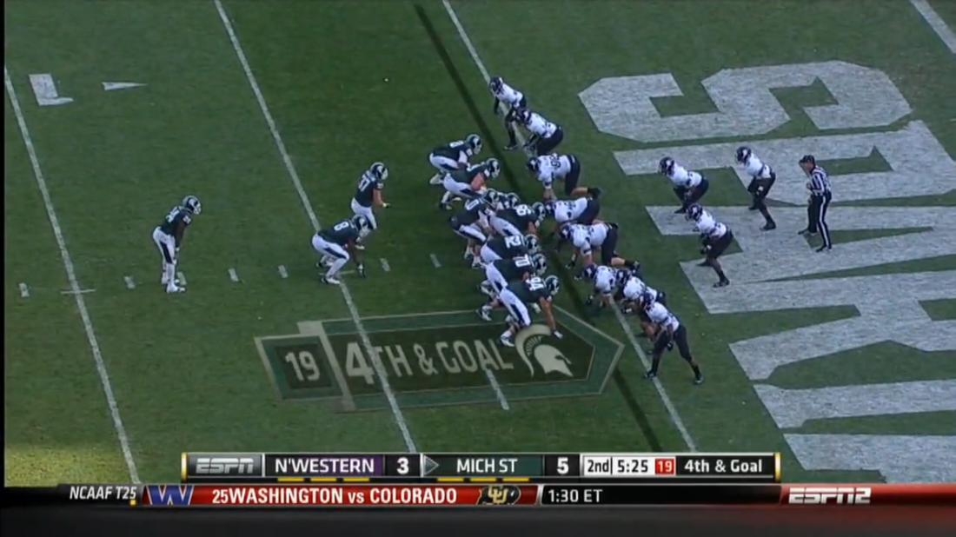
DEFENSIVE LINE
LINEBACKERS
SECONDARY
GOAL LINE DEFENSE

Slide 2
DEFENSIVE LINE

Slide 3
