Slide 1
ANNUAL HOMEOWNERS’ MEETING August 25, 2022, at 5:00 pm RVR Ranch House Conference Room & Zoom

Slide 2
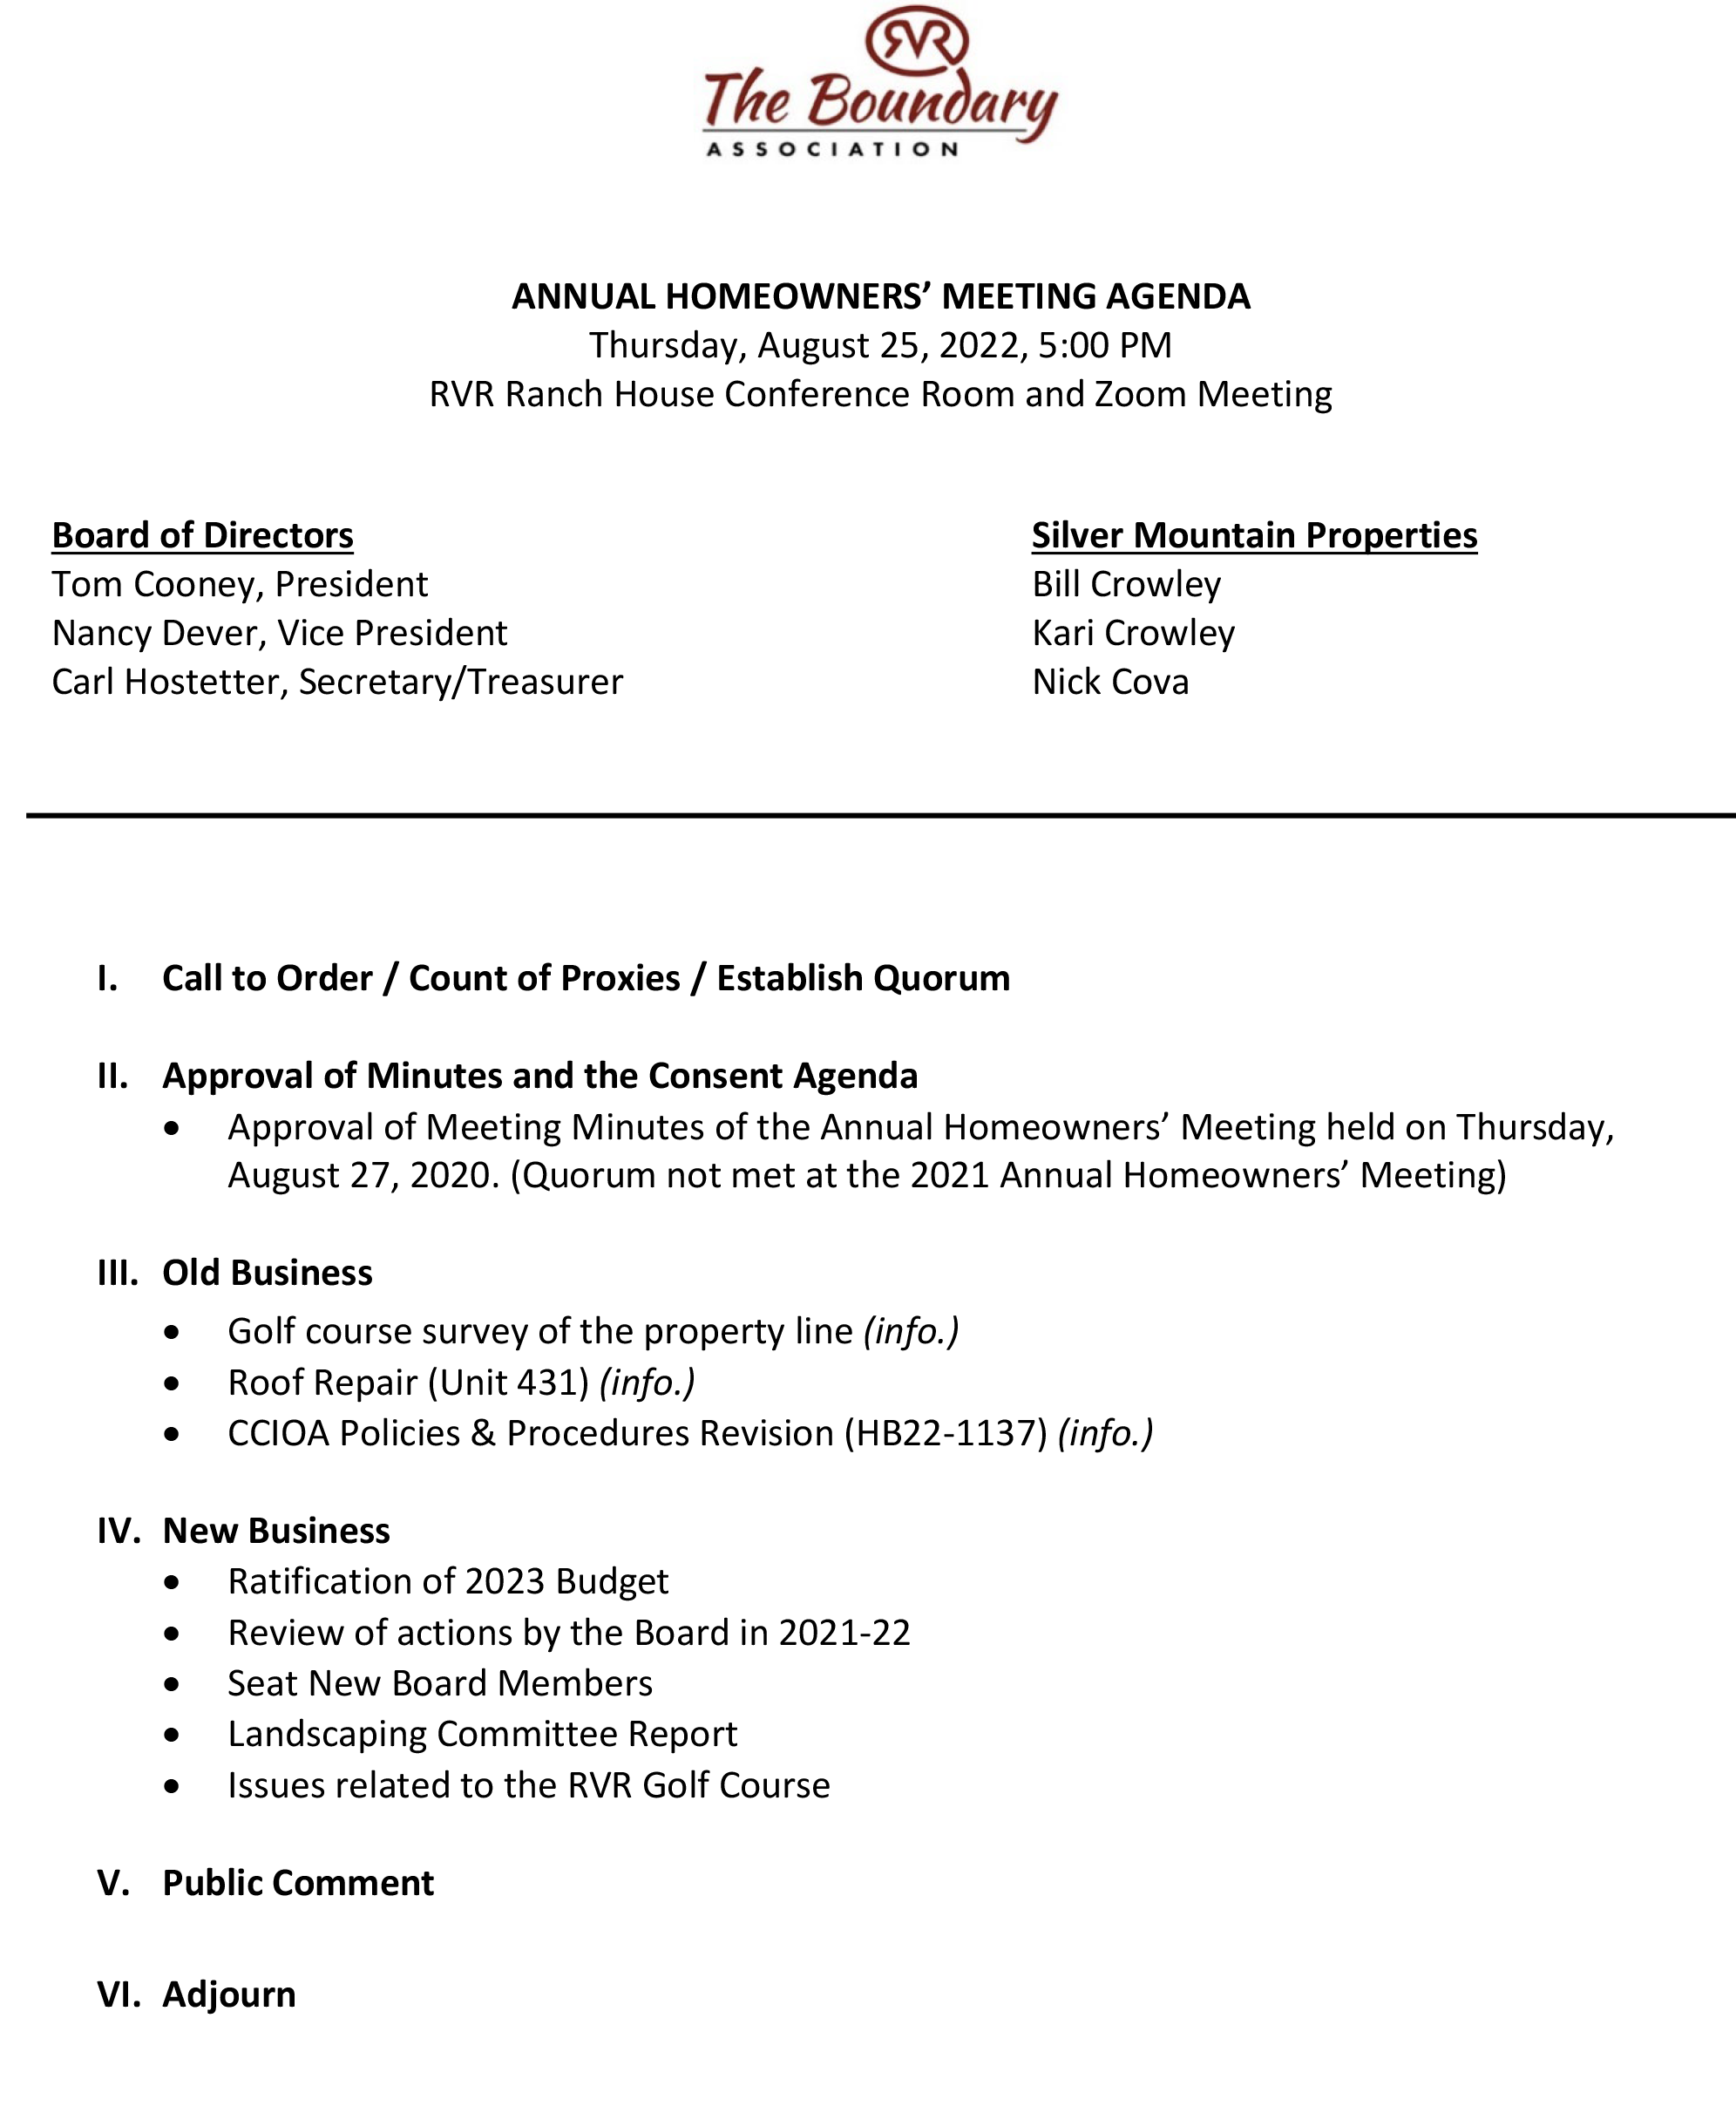

Slide 4
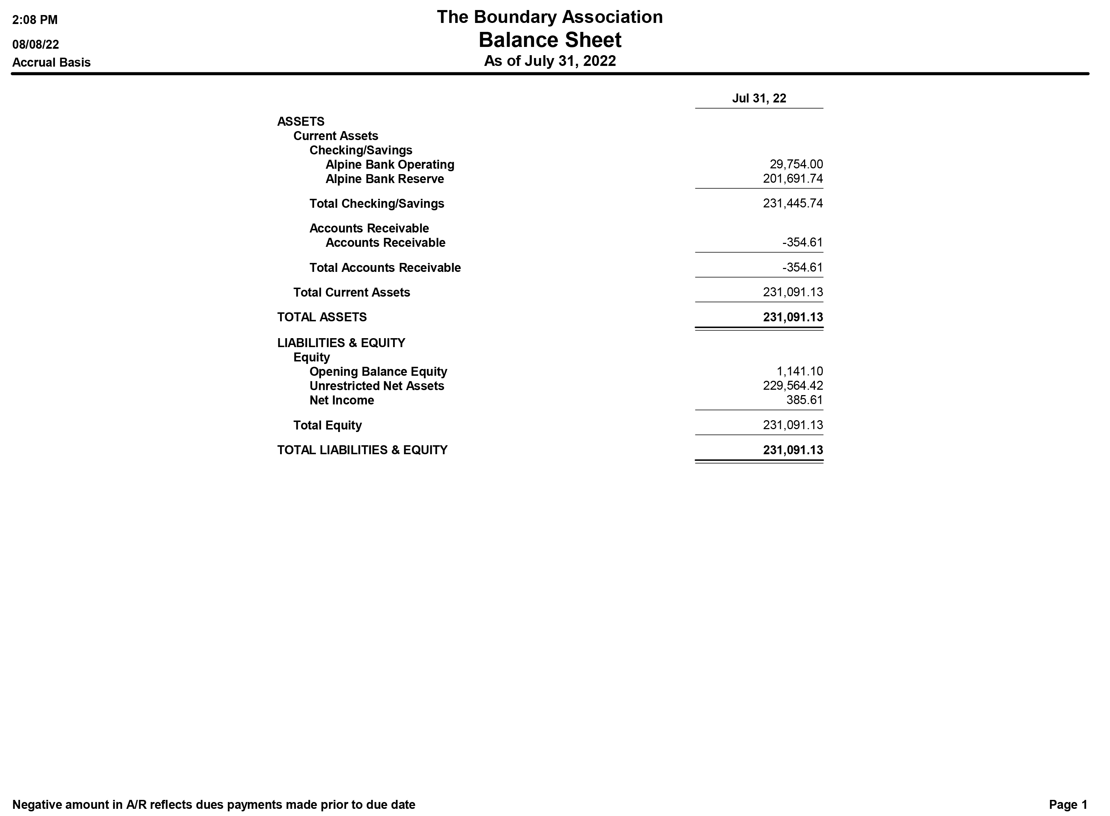

Slide 6
The Year In Review

Slide 7
IMPROVED BOARD TRANSPARENCY
Open Board Meetings
New Website (www.theboundary.org)
Monthly Bulletin
Meeting Minutes published as soon as possible
Full disclosure of financial information

Slide 8
New Property Manager
In April 2021, the Board chose the Silver Mountain Properties team to replace Integrated Mountain Management as our property manager.

Slide 9
Fire Risk Assessment
The deputy chief from the Carbondale Fire Department walked our community and gave us some fire protection tips such as tree and shrub spacing, grass height, location of mulch and firewood, and dead vegetation removal.

Slide 10
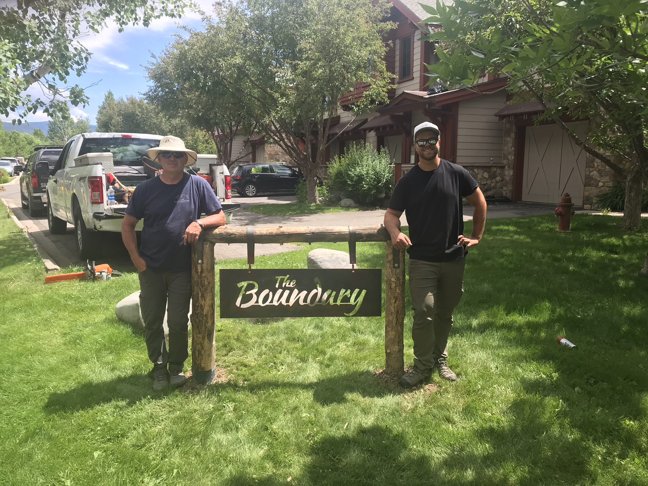
Entrance Signs
Our entrance sign project led by owners Steve Chase and Polly Whitcomb was completed in July 2022.

Slide 11
Street Signs
Two new Boundary street signs were installed by the RVRMA in September 2021.

Slide 12
Pedestrian Path Repair
In response to our safety concerns, the Town of Carbondale repaved the path boarding our community.
The Town also recently repaired bumps in the new paving caused by tree roots.

Slide 13
Tree Removal
In October 2021, we removed thirteen Cottonwood and Aspen trees from our common area. The Aspens were diseased, and the invasive roots of the Cottonwoods are damaging our roadways.

Slide 14
Build-out Complete
In November 2021, the two buildings on Lot #3 were constructed. The Boundary is now complete with 33 units.

Slide 15
Capital Replenishment
Based on a professional reserve study completed in October 2021, we held a special homeowners’ meeting to propose a $140,000 capital reserve replenishment program along with a yearly 4% increase in Reserve Assessments.

Slide 16
Reallocation Amendment
On March 21, 2022, the "Second Amendment to Amended and Restated Declaration for the Boundary" was approved by 75.76% of The Boundary owners.
This Amendment corrected deficiencies in our Governing Documents and changed the Common Expense liability for each Unit as a percentage calculated by dividing the gross livable area square feet of said Unit into the total gross livable area square feet of all The Boundary Units.
The Amendment also preserved voting rights in the Association of one (1) vote allocated to each Unit.

Slide 17
Roof Replacement Program
We approved a program to replace the cedar shake roofs on buildings 1, 2, 4, 5, 6, and 8 with asphalt shingles. In July 2022, ICM Services completed buildings 1, 2, 4, and 5.
Buildings 6 and 8 will be re-roofed in the future.

Slide 18
Painting Project
Mid Valley Painting recently completed the exterior painting of buildings 5 and 6. All 11 Boundary buildings now have the same color scheme.

Slide 19
Colorado HB22-1137
Our Attorney, Ben Johnston, revised “The Boundary Association Responsible Governance Policies and Procedures” to bring us into compliance with the legislation passed on June 3, 2022.
The document, adopted by the Board effective August 5, 2022, is posted on our website under the Governing Documents tab.

Slide 20
EXTERIOR IMPROVEMENTS
The Boundary Association Exterior Improvements Policy and Procedure was approved by the Board 0n July 14, 2022.

Slide 21
Board of Directors
Carl Hostetter Term Expires 2023
Tom Cooney Term Expires 2024
Nancy Dever Term Expires 2024
Jay Cofield Term Expires 2025
Jim McAtavey Term Expires 2025
Board expanded to five members

Slide 22
The Year Ahead
Pre-Existing Improvement & Maintenance Agreement Program
Continue to manage operating expenses
Capital reserve replenishment program
Revitalize common entrances and islands
Evaluate the need for additional trees
Evaluate landscape condition along Golf at RVR property line

Slide 23
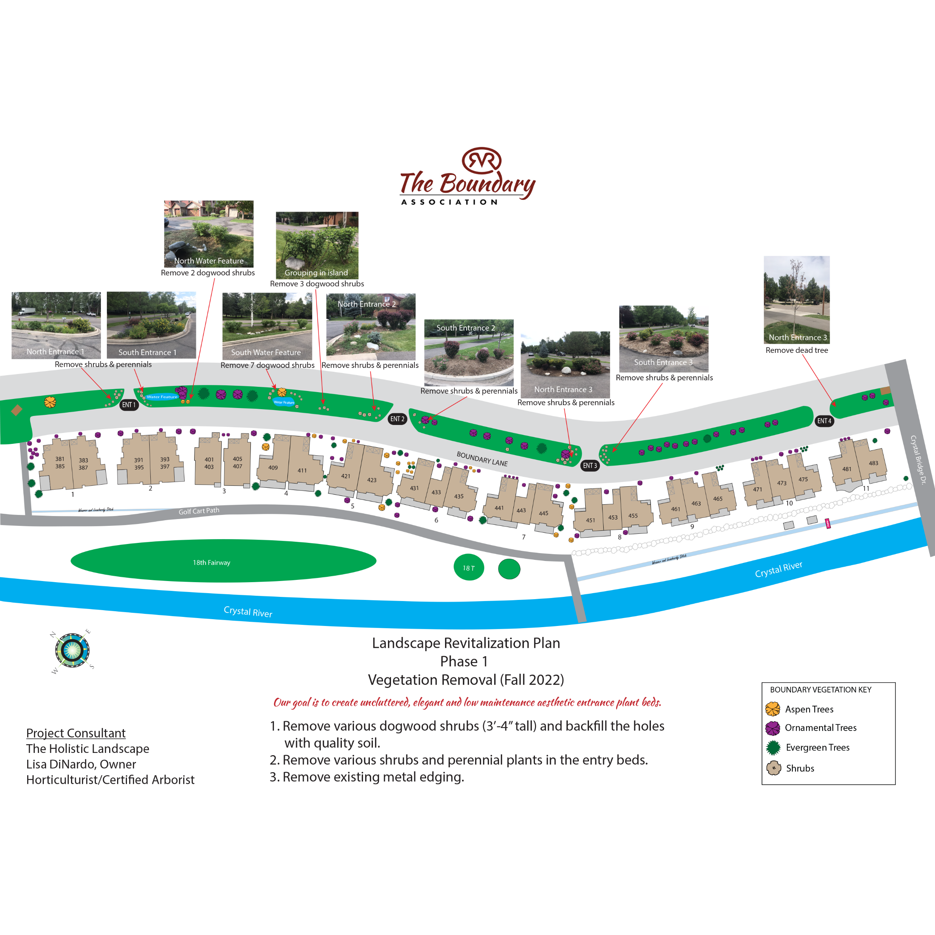

Slide 24
Update on Golf at RVR Property Line
Lawn care is restricted to the area within The Boundary property line.
Golf at RVR will maintain noxious weeds within its property line.
The condition of areas no longer maintained by The Boundary will be re-evaluated this Fall.
Boundary residents are advised not to trespass on Golf at RVR property.
Exceptions for special events require advance approval by Golf at RVR.
Golf at RVR will not install a fence.
Golf at RVR will remove the survey stakes when the property line is documented.

Slide 27
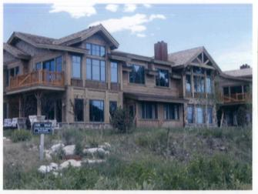
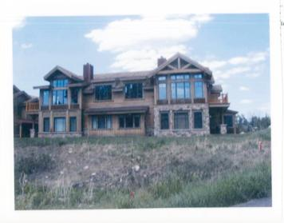
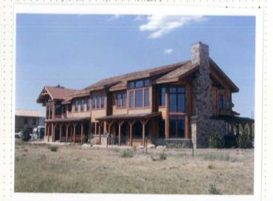
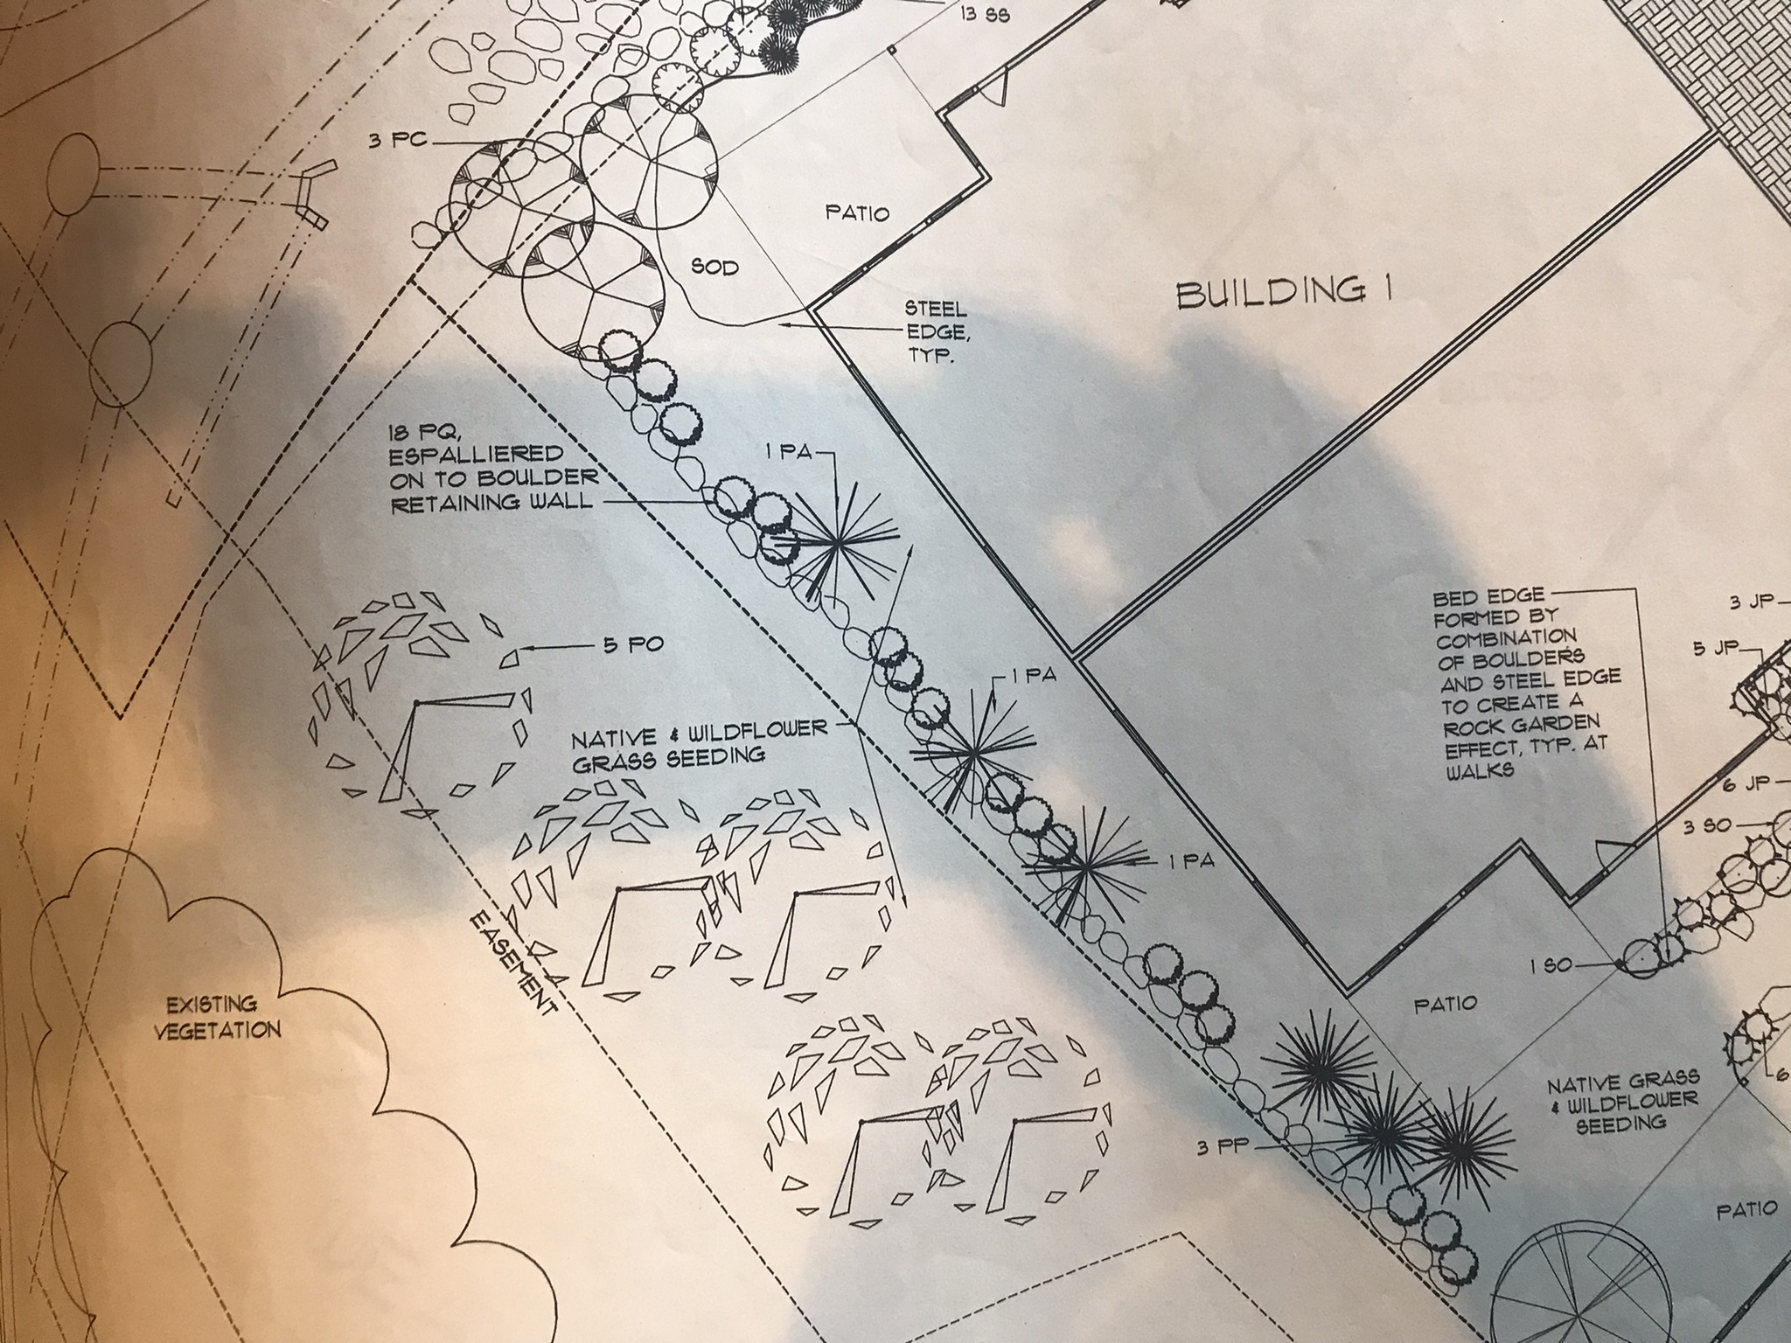
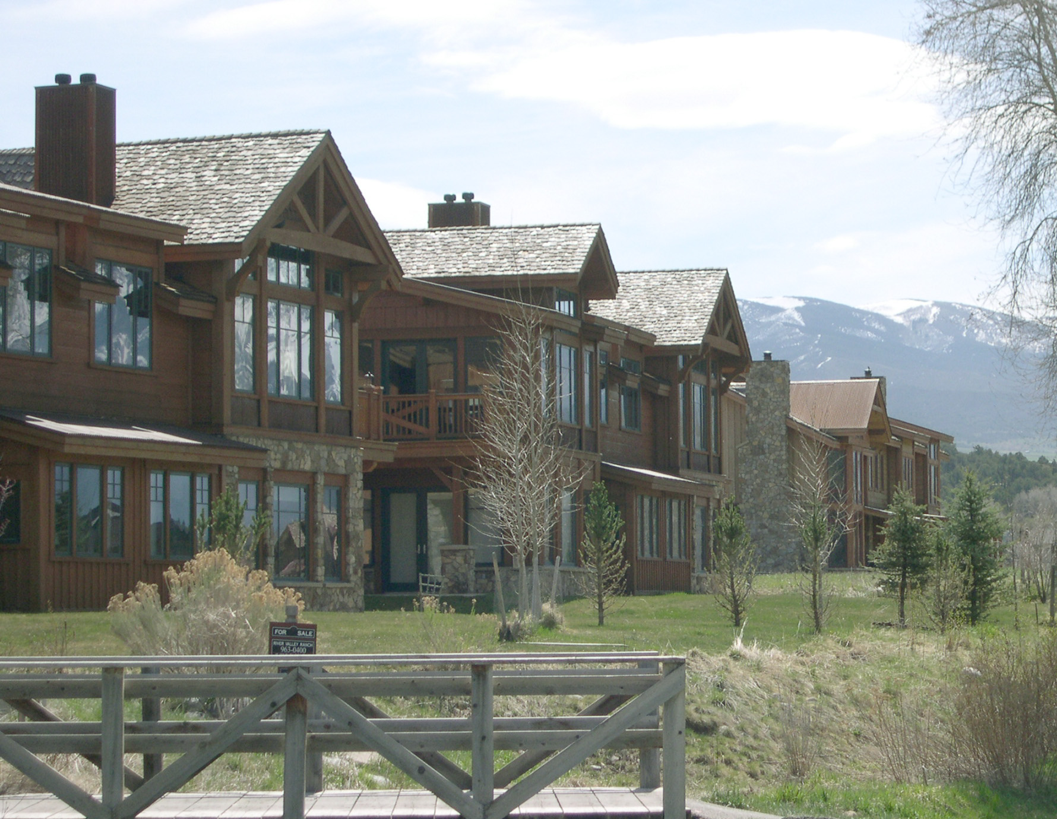
Building #1
Building #2
Building #4
Buildings #1 & #2 Photo from 2005
Building #1 Original Landscape Plan

Slide 28
Adverse Possession
Colorado law requires the occupier (or "squatter") to openly be in possession of the property for 18 years, or after seven years of consistent payment of property taxes and color of title. The term color of title refers to some written document that shows a good faith belief that the possessor is legally entitled to the land, even if it fails to carry the necessary legal authority to do so.
Building # | Year Built | Age
1 2 3 4 5 6 7 8 9 10 11 | 2001 2002 2021 2001 2007 2008 2019 2011 2019 2020 2020 | 21 20 1 21 15 14 3 11 3 2 2
Buildings 1, 2, and 4 are over 18 years old, but we have no proof of when we started maintaining the encroached areas. In addition, we have never paid property taxes on the encroached areas.

Slide 29
Five Elements Required for an Adverse Possession Claim
Continuous
It fails because we only maintain the area six months out of the year.
Hostile to the interests of the owner of record (i.e., without permission)
It applies because our possession infringes on the rights of the golf course owner.
Open and notorious
It applies because the lawn area we maintained was evident to anyone.
Actual (i.e., physically present on the property)
It fails because we do not have a physical structure on the property (i.e., a fence)
Exclusive (one claimant for the entire statutory period)
It fails because we share the area.

Slide 30
Legal Research by Ben Johnston, Partner,
What is the statute of limitations to bring an adverse possession claim? 18 years is the statute of limitations for bringing a claim of adverse possession after the right to bring such action has first accrued (i.e., 18 years from the date one can establish an adverse possession claim). See C.R.S. §§ 38-41-10 and § 13-80-108; San Juan Basin Consortium, Ltd. v. EnerVest San Juan Acquisition Ltd. P'ship, 67 F.Supp. 2d 1213, 1225 (D. Colo. 1999); Childers v. Quartz Creek Land Co., 946 P.2d 534, 537 (Colo. App. 1997).
Can you bring a claim for adverse possession after a gap in possession? You can, if you have already established a valid claim for adverse possession (e.g., actual, adverse, hostile, under claim of right, exclusive, and uninterrupted for the 18-year statutory period). Title to property vests after 18 years of adverse possession, and title to property is not divested by “cessation of occupancy or by the acknowledgement of the former title owner.” Hunter v. Mansell, 240 P.3d 469,475 (Colo. App. 2010). Thus, in this instance, the properties that have adversely possessed the golf course property for 18-year can still bring a claim.
If you have not yet established a claim for adverse possession (i.e., the 18-year statutory period has not yet run), the gap likely will extinguish your ability to bring the claim. See generally Hunter v. Mansell, 240 P.3d 469,475 (Colo. App. 2010). This depends on the facts and circumstances of the gap and the reasons such gap. However, in this instance, the decision to stop mowing and irrigating in light of the interaction with Red almost certainly extinguishes the claim. Ocmulgee Properties Inc. v. Jeffery, 53 P.3d 665, 667 (Colo. App. 2001) (“To disrupt the adverse possession claim, the record owner must assert a claim to the land or perform an act that would reinstate him in possession.” Bushey v. Seven Lakes Reservoir Co., 37 Colo.App. 106, 109, 545 P.2d 158, 161 (1975). See also 16 Richard R. Powell, Powell on Real Property § 91.07[2] (1999)(owner can interrupt claimant's adverse possession by obtaining a judgment against claimant or by openly entering the property with intent to take possession and effectively exclude the claimant); 4 Herbert T. Tiffany, The Law of Real Property § 1161 (3d ed. 2000)(adverse possession is interrupted by the owner's entry on the land for the purpose of taking possession or by legal action to recover possession).

Slide 31
questions

