Slide 1

Board of Directors Meeting
January 27, 2022, at 3:30 pm
RVR Ranch house conference Room

Slide 2
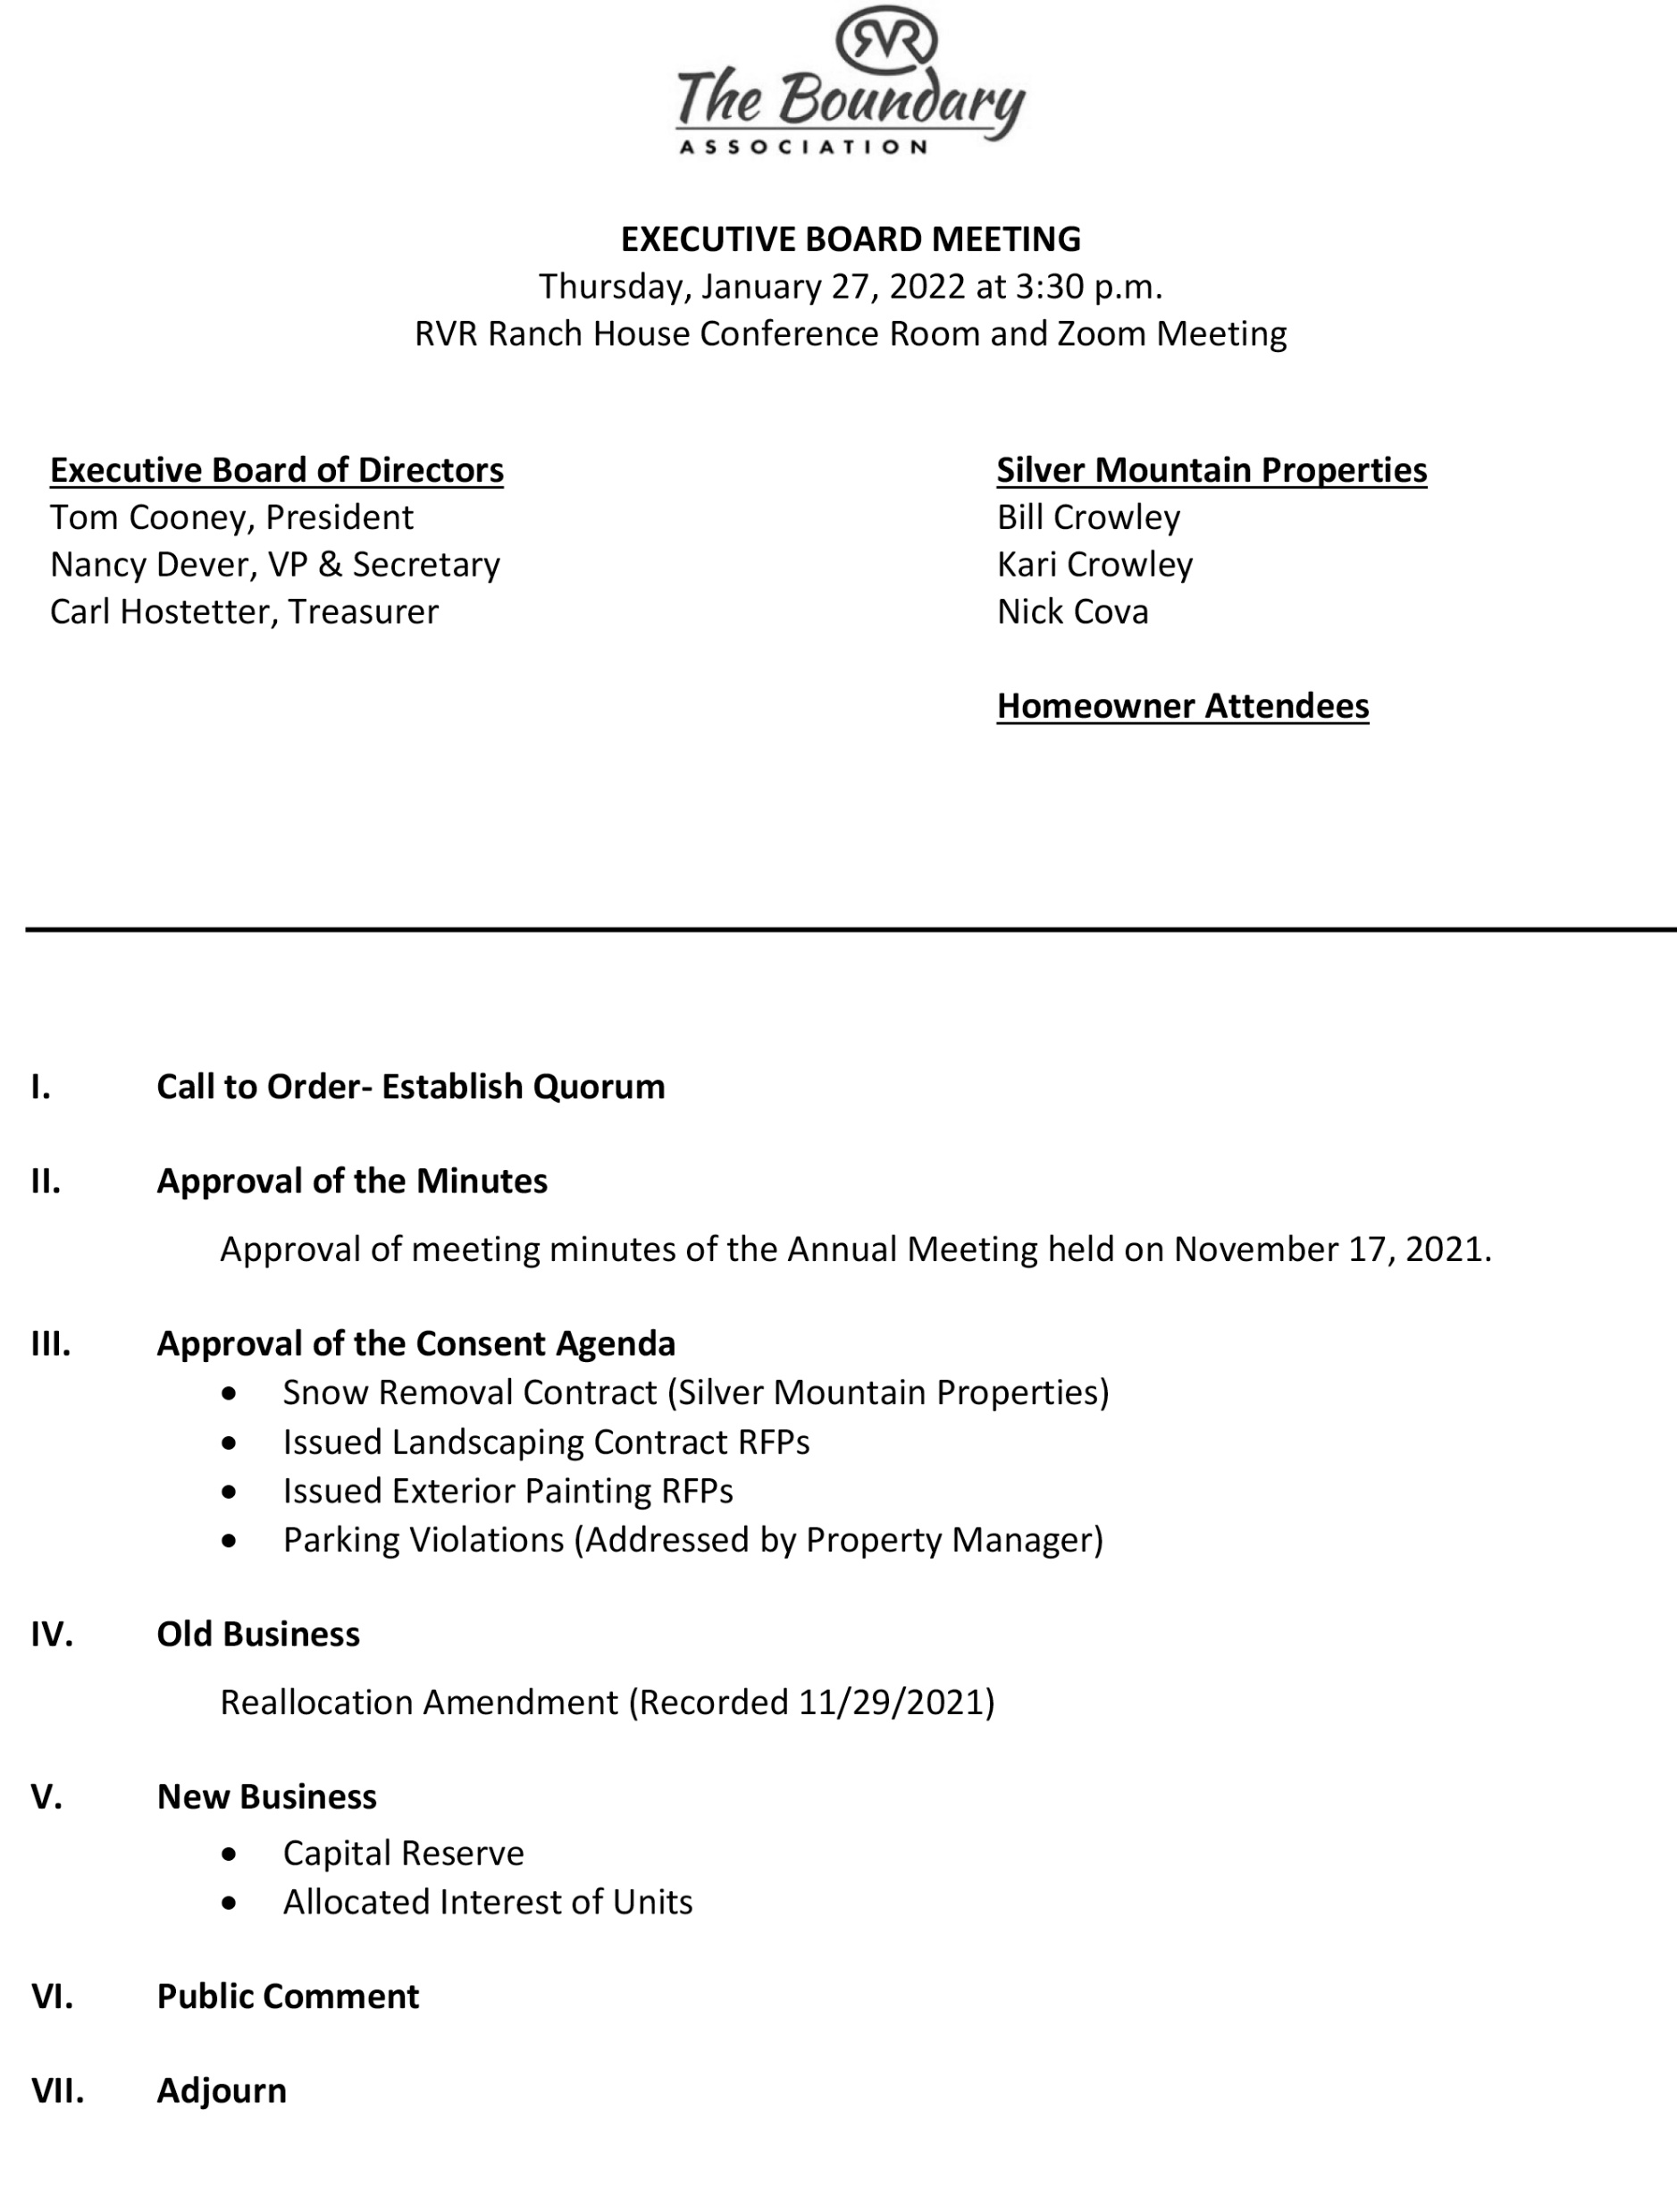

Slide 3
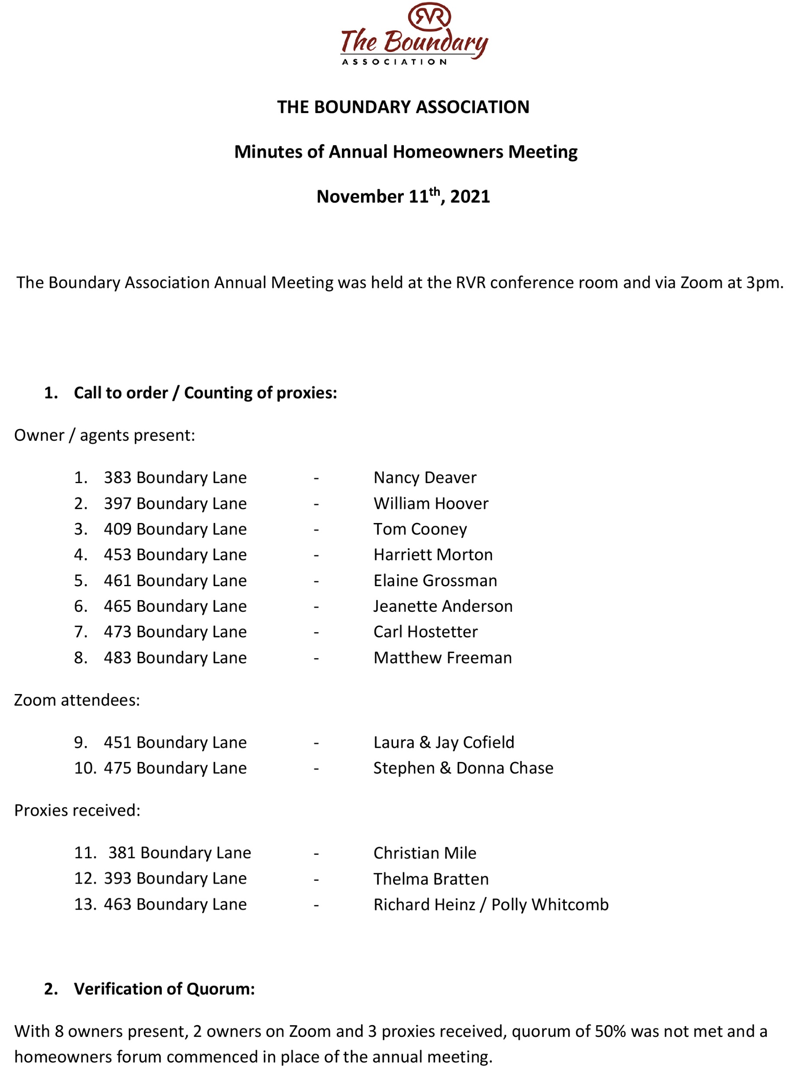

Slide 4
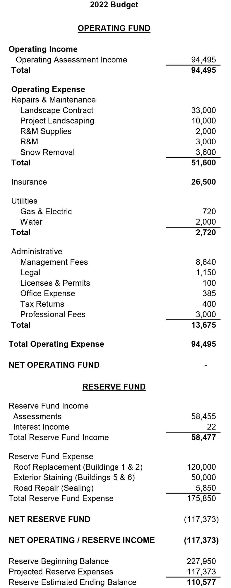
The 2022 Budget of $152,950 was re-formatted to
separate the Operating and Reserve Funds.
Anticipated Reserve Expenses were also added for
the purposes of this presentation.

Slide 5
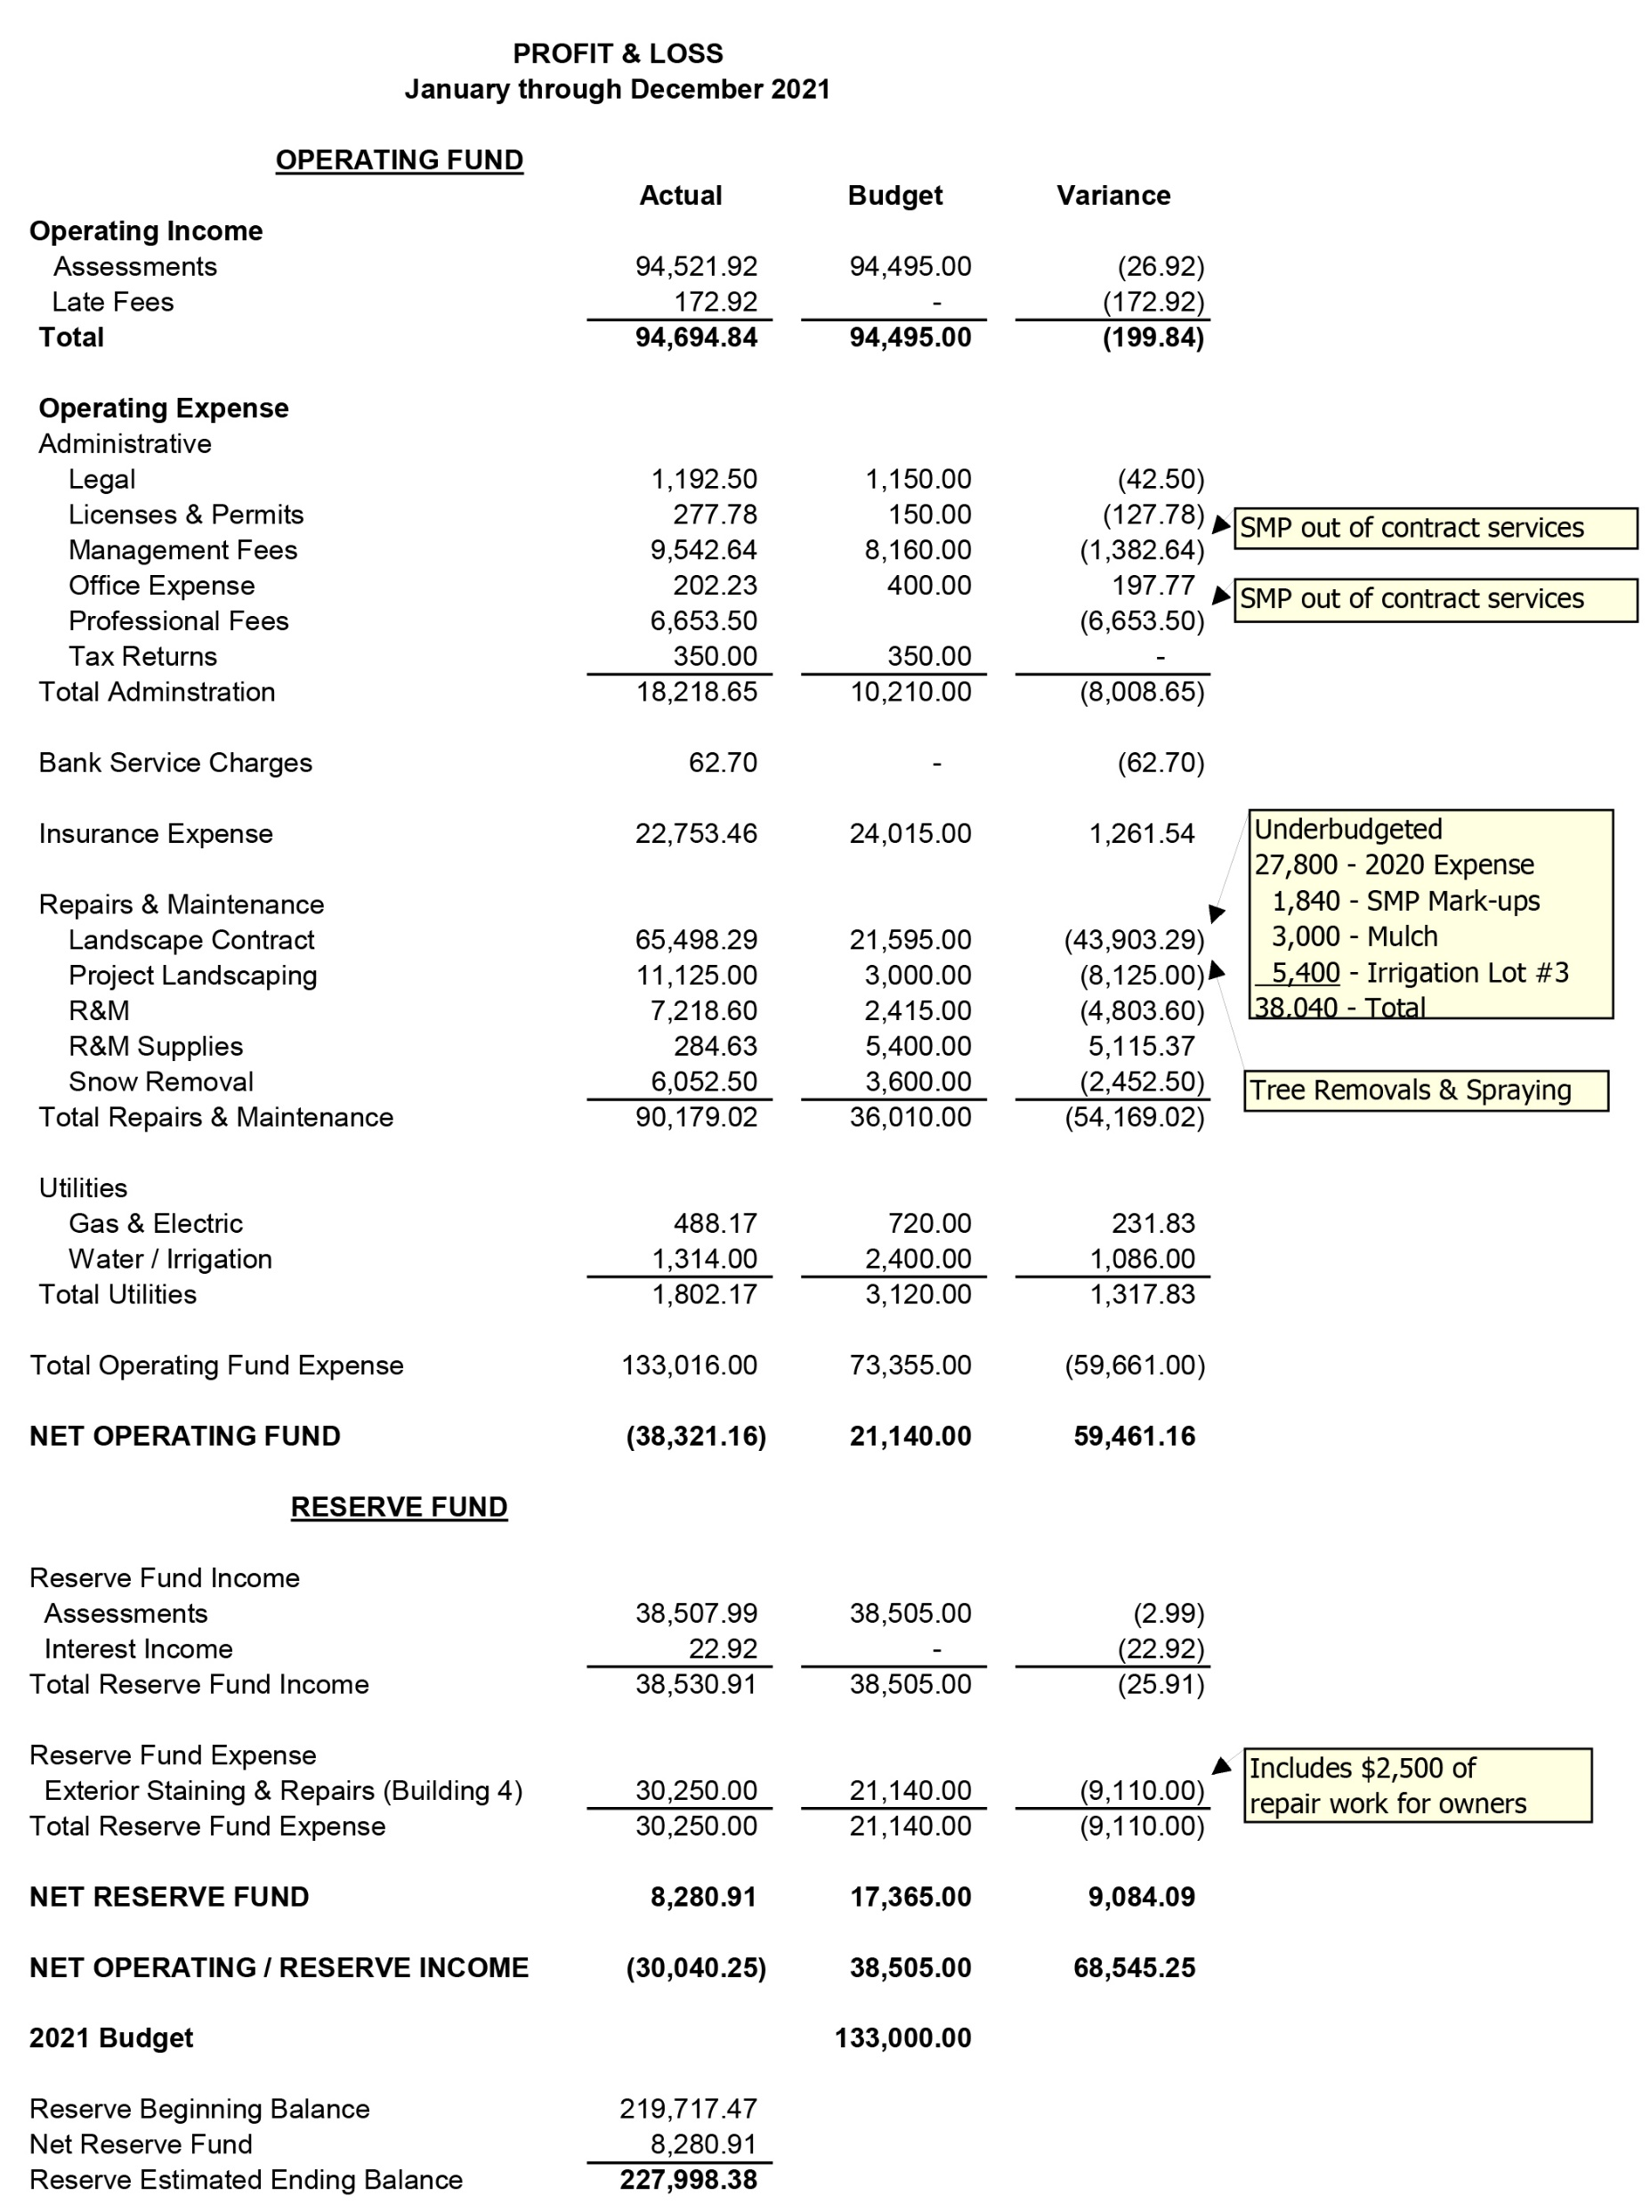

Slide 6
“Getting old is expensive and cannot be avoided. It’s an issue facing every association with common area. Older associations need to get ready for higher expenses, which will likely mean higher reserve
contributions, special assessments, or loan repayments.”— Robert Nordlund, PE, RS

Slide 7
What caused our capital reserve deficit?
Reserve Advisors completed a reserve study in 2011 and recommended a 30-year funding schedule.
The developer, Braeburn Real Estate, stopped paying assessments on five remaining lots in March 2010.
Over time, Braeburn’s past due assessments accumulated to approximately $150,000.
The Association filed liens on the five lots and considered foreclosure in 2018.
Braeburn had no assets to foreclose on, so the Association settled for $25,000 and released the liens.
$20,000 was added to the reserve account, and $5,000 was used for tree maintenance.
The release of liens allowed a new developer to complete The Boundary buildout.
Brian Stowell purchased the five lots (3, 7, 9, 10 & 11) in 2018, began paying assessments, and completed The Boundary.
Association Reserves completed a new reserve study last year that shows a weak and underfunded reserve account.
The reserve study is available on our website. (www.theboundary.org)
2022 Assessments were increased 15% to provide additional reserve funding.

Slide 8
The boundary’s major capital needs
Our big-ticket capital expenditures are roof replacements and painting. We currently have six buildings with cedar shake roofs. Five of those roofs are at the end of their life expectancy. The sixth will be due for replacement in around eight years. The cost of replacing these roofs ranges from $50,000 to 75,000 each. The roofs will be resurfaced with asphalt shingles, which are more fire retardant and longer-lasting.
Our exterior painting schedule calls for painting each building every five years. This means painting two buildings, on average, per year. The cost of painting a building ranges between $15,000 to $25,000.
The following slide focuses on roof replacement, painting, and road repairs. However, keep in mind that the Association is also responsible for maintaining other areas, such as walkways, driveways, patios, and parking areas.

Slide 9
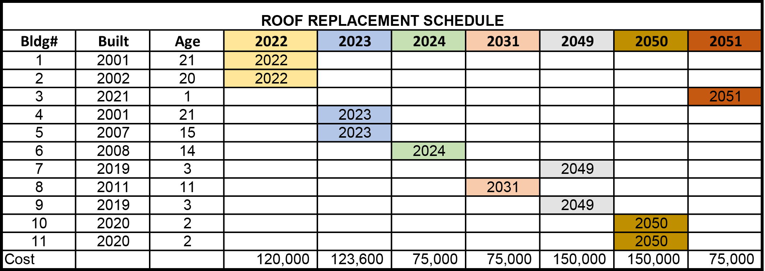

Slide 10
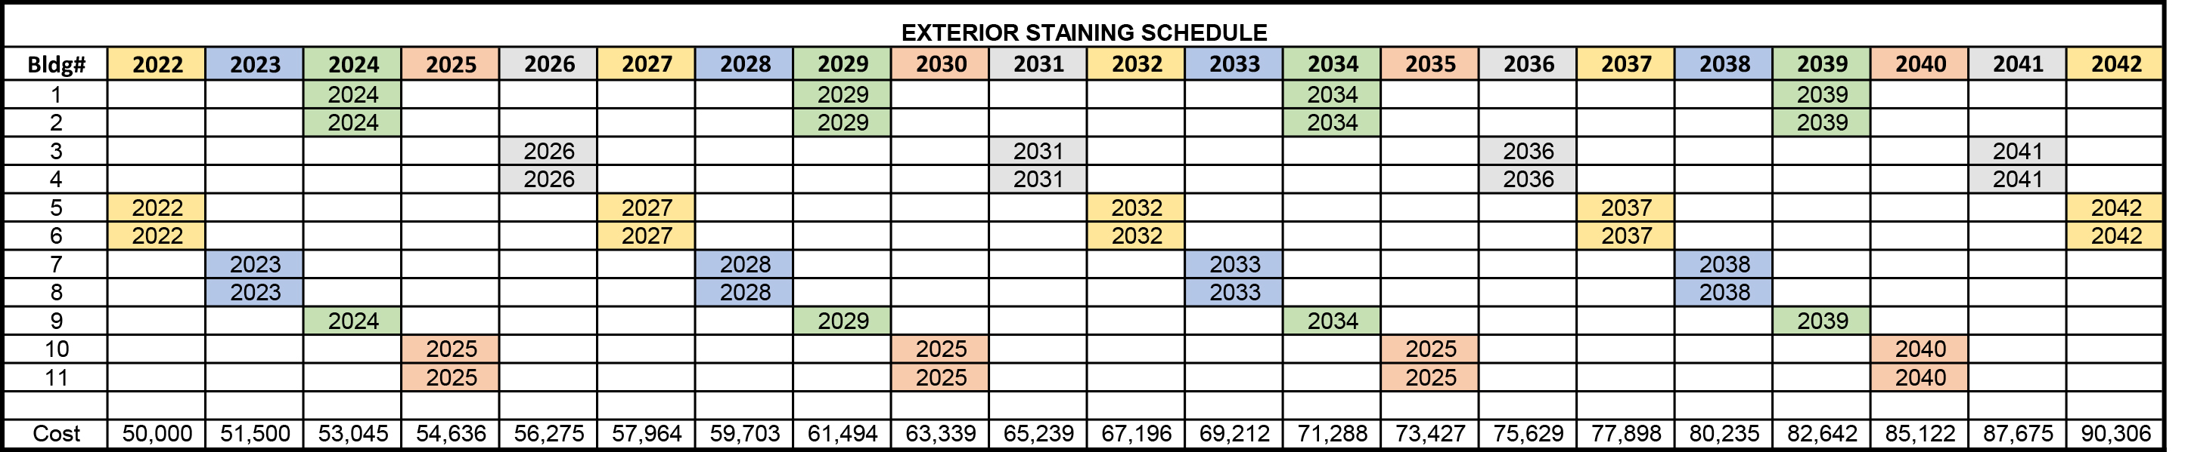

Slide 11
reserve deficit solution options
Increase assessments during the years when shortages occur (Scenario #1 on next slide)
Special assessment (Scenario #2 on next slide)
Level quarterly reserve assessments annually adjusted upward for inflation (Scenario #3 on next slide)
Loans using borrowed capital for major replacement projects

Slide 12
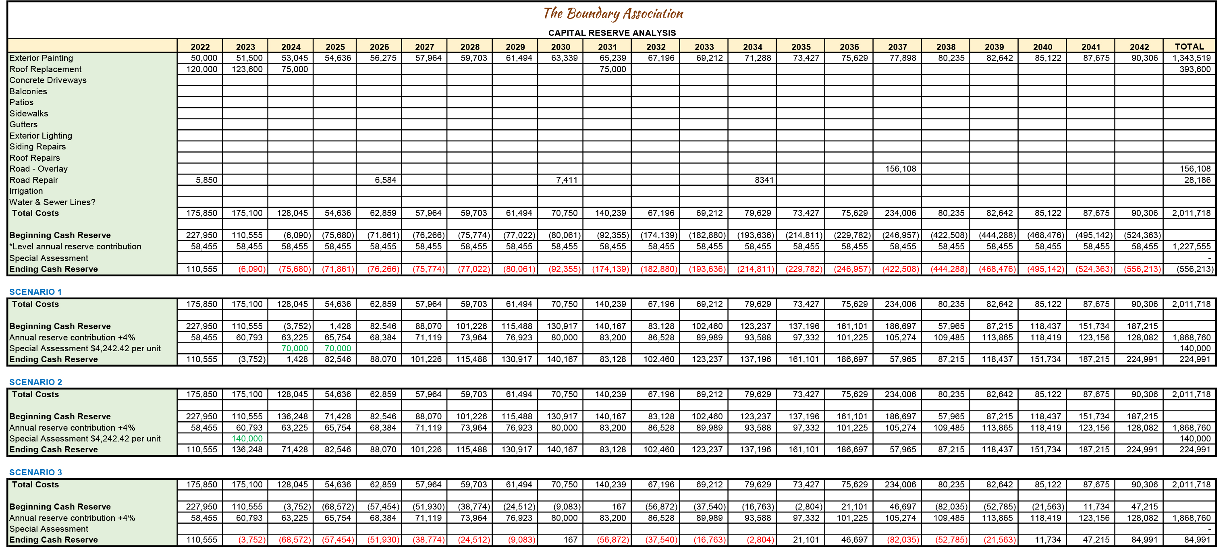

Slide 13
Should we change our current assessment structure?
The Boundary Declaration was recorded on May 13, 1999. This governing document requires that Owner assessments be calculated using the Allocated Interests of each Lot. The premise is that every Lot should pay the same assessment. The Unit owner within each Lot pays their building fraction of livable square feet times (1/11) of the total annual budget. This is demonstrated in the first chart on the next slide.
A Boundary homeowner has challenged the current method of calculating assessments. According to The Boundary Property Manager, the more common form of calculating assessments using square footage is to divide the square footage of each Unit by the square footage total of all Units. This calculation is demonstrated on the second chart on the next slide.
The third chart compares both calculation methods. The last column of that chart shows the quarterly payment difference for each homeowner.
The Board of Directors does not currently have an opinion on which method of assessment calculation is most equitable. However, The Board has engaged an attorney to review our Governing Documents regarding this question, voting rights, maintenance responsibilities, and related matters. Any amendment to our Declaration would require a vote or agreement of Owners holding at least 67% of the votes in the Association.

Slide 14
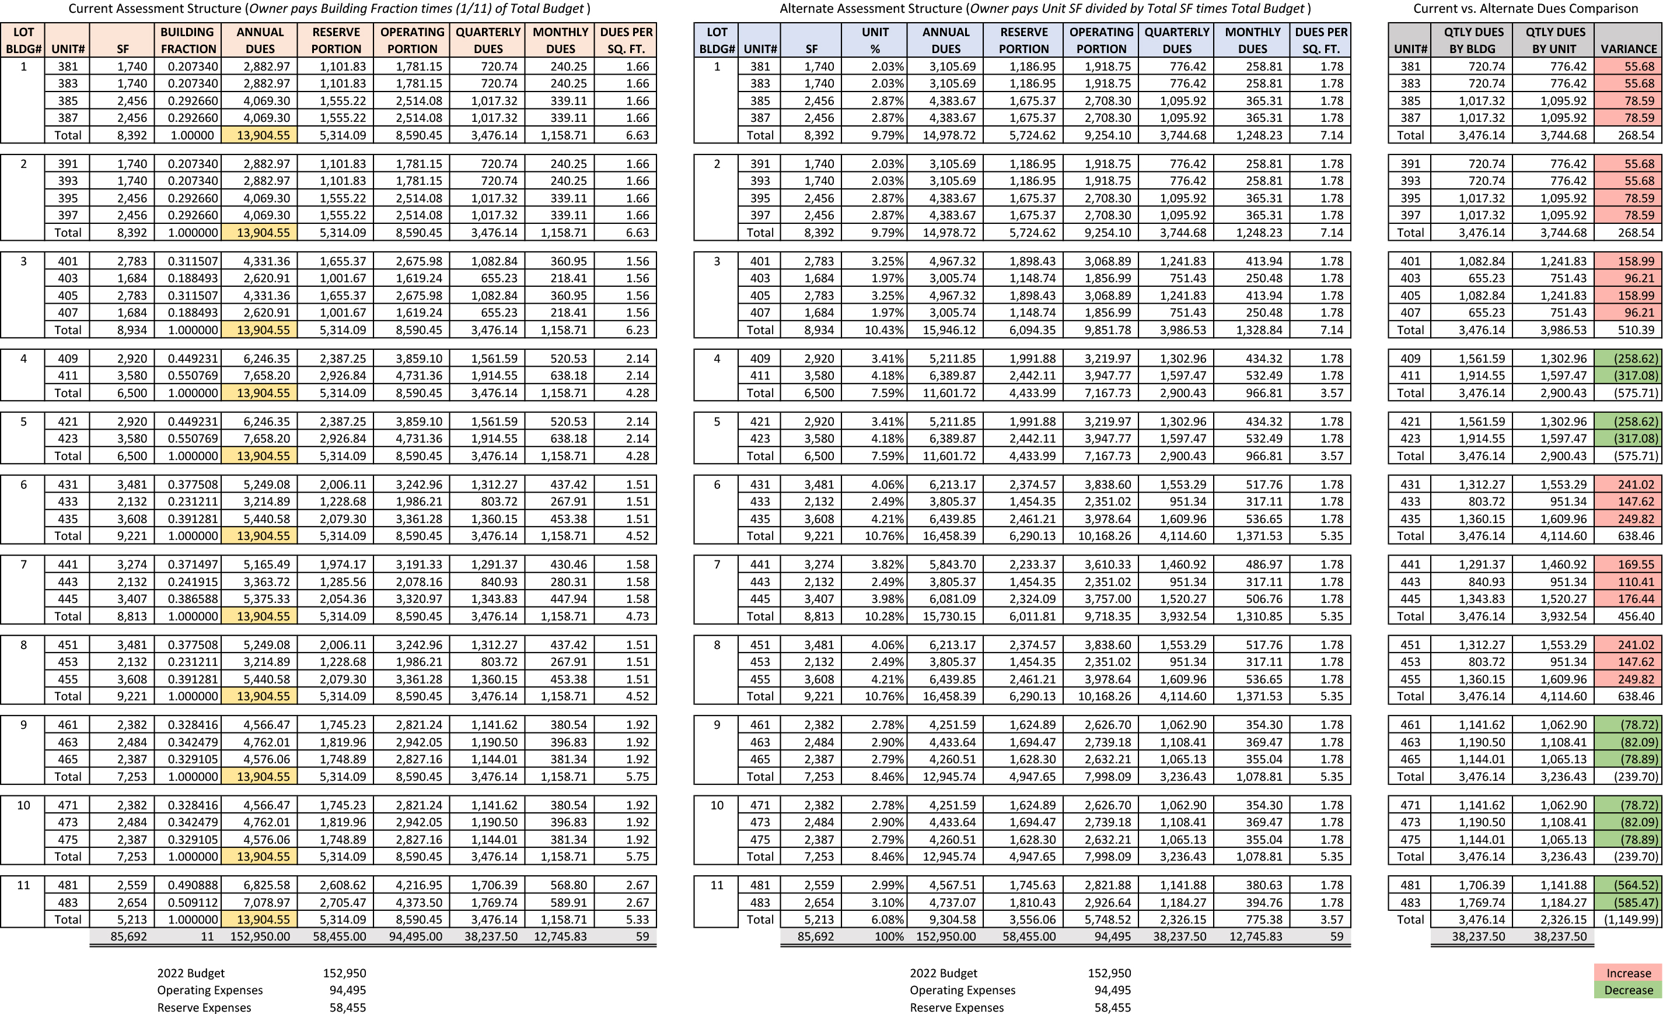

Slide 15
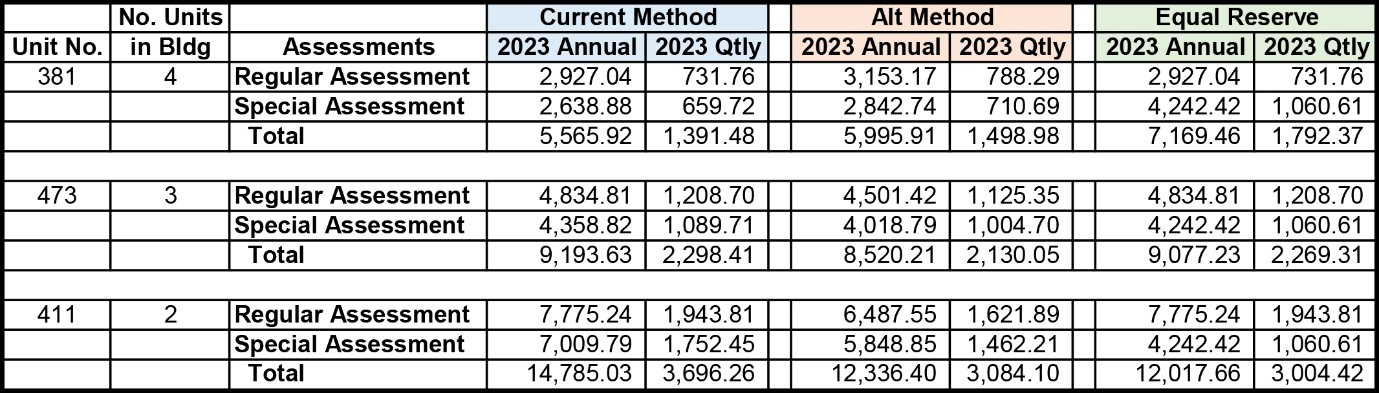
Example of Reserve calculation for units 381, 474 & 411

Slide 16
Assessment calculation summary
Current Assessment Structure |  | Alternative Assessment Structure
Compliant with Governing Documents |  | Requires Declaration Amendment
Algorithm difficult to understand & not commonly used |  | Easier calculation to understand & commonly used
Square Footage per unit irregular |  | Square Footage per unit level

Slide 17
Next steps
After a thorough evaluation of owner feedback and advice from our attorney, the Board will schedule a special meeting of Boundary owners to present a reserve and assessment funding recommendation. The Board is hopeful that this can be done within sixty (60) days. The Board of Directors welcomes your questions and comments. Please feel free to email us at: board@theboundary.org.

Slide 18
questions

Slide 19
Straw Poll
The Assessment calculation should be changed from building fraction to unit percentage?
The Special Assessment should be divided equally between owners?
The Association should continue to maintain building exteriors?

Slide 20
Assessment Formulas
Building (Lot) Fraction SF Calculation
Unit SF Divided by the Sum of all Building Units SF. Example (Unit 381 - 1,740 SF/8,392 = .2073)
Building Fraction Dues Calculation
Building Fraction Times Annual Budget Divided by 11. Example (Unit 381 - .207340 X 152,950/11 = $2,882.97)
Unit Fraction SF Calculation
Unit SF Divided by the Sum of all Boundary Units. Example (Unit 381 - 1,740 SF/85,692 = 2.3%)
Unit Fraction Dues Calculation
Unit Fraction Times Annual Budget. Example (Unit 381 - 2.03% X 152,950 = $3,105.69)

Slide 21
The current Declarations assign assessments to the owners by simply dividing all expenses evenly by the 11 units completed. However, that approach seems to imply that the cost to maintain each unit is the same, though some buildings have 3 units, some have 2 units, and the condos each have 4 units. (though 2 are up and 2 are downstairs.)
This homeowner makes a point that the cost to maintain a 3-unit townhome, with 3 roofs, driveways and garages, 3 patios, 3 front porches, etc will cost more than a building with just 2 of the same, or a condo with shared roof space over just 2 of the 4 total units as an example. For this reason, this homeowner suggests taking a more widely accepted approach of assessments based on square footage.’
Jim Ramsey, Owner

Slide 22
Financial Considerations
Control Operating Expenses
Evaluate Association vs. Homeowner maintenance responsibilities (Walkways, Driveways, Patios, etc.)

Slide 23
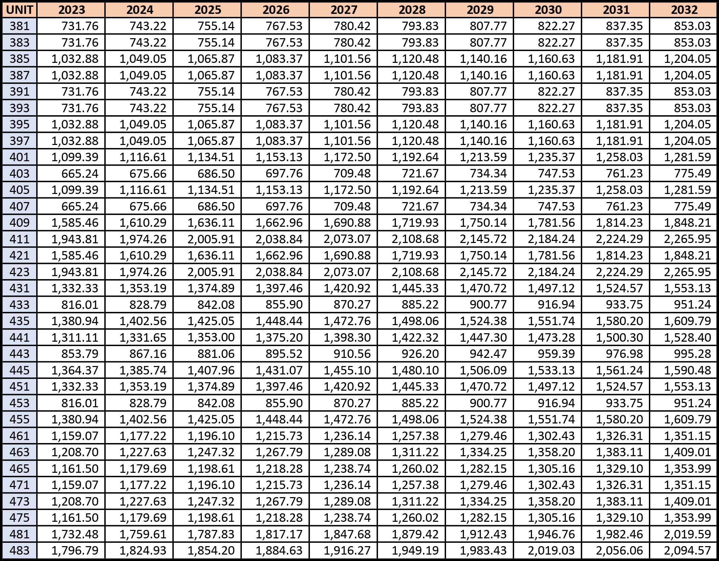
Level quarterly reserve assessments annually adjusted upward AT 4%

Slide 24
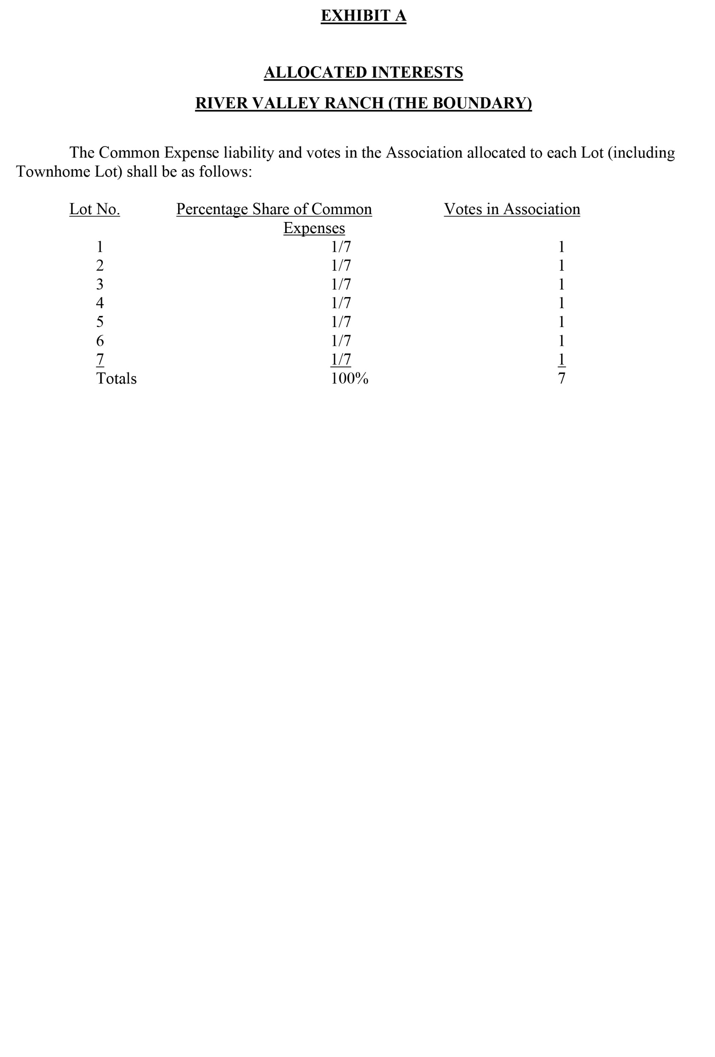

Slide 25
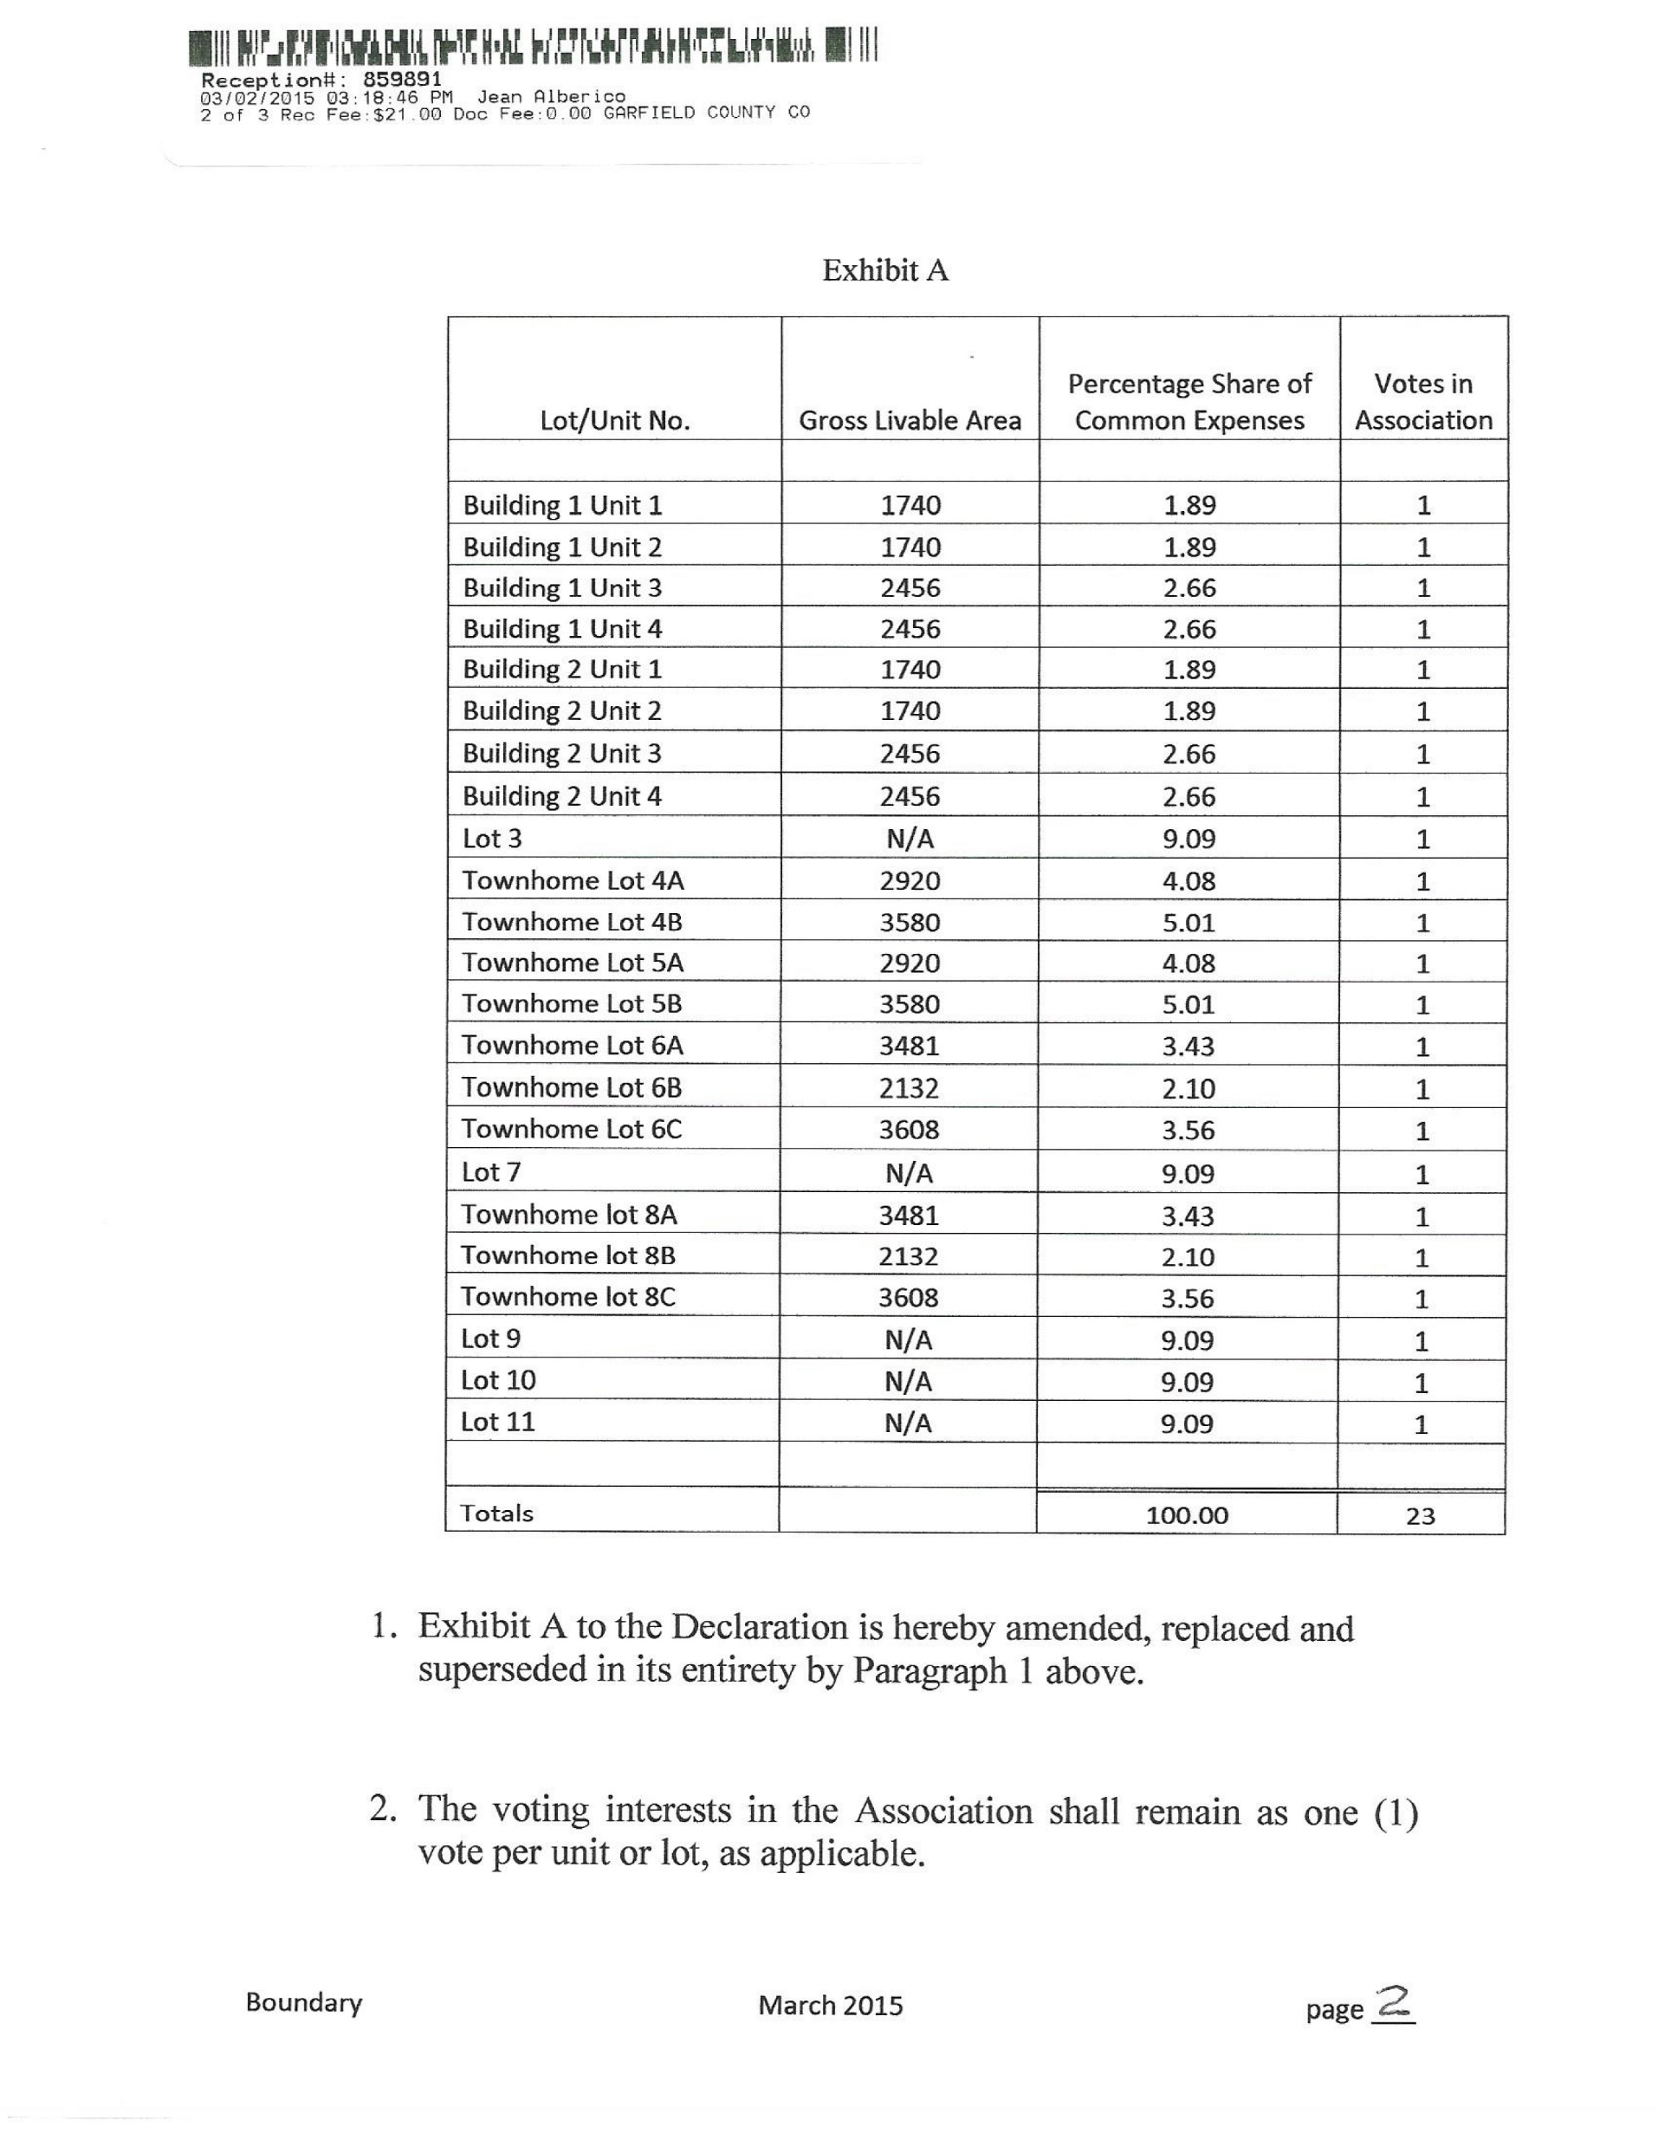

Slide 26
