Slide 1
Board of Directors Meeting April 7, 2022, at 5:00 pm RVR Ranch house conference Room & ZOOM

Slide 5
The boundary’s major capital needs
Our big-ticket capital expenditures are roof replacements and painting. We currently have six buildings with cedar shake roofs. The cost of replacing these roofs ranges from $50,000 to 75,000 each. The roofs will be resurfaced with asphalt shingles, which are more fire retardant and longer-lasting.
Our exterior painting schedule calls for painting each building every five years. This means painting two buildings, on average, per year. The cost of painting a building ranges between $15,000 to $25,000.
The following slide focuses on roof replacement, painting, and road repairs. However, keep in mind that the Association is also responsible for maintaining other areas, such as walkways, driveways, patios, and parking areas.

Slide 11
notice to increase board directors to 5 from 3
BYLAWS
AND RESPONSIBLE GOVERNANCE POLICIES OF THE BOUNDARY ASSOCIATION
ARTICLE VI
BOARD OF DIRECTORS
6.01. Number of Board of Directors. The affairs of this Association shall be managed by a Board of not less than three (3) nor more than five (5) Directors who shall be Members of the Association. The number of the Board of Directors shall be established from time to time by amendment to these Bylaws.

Slide 12
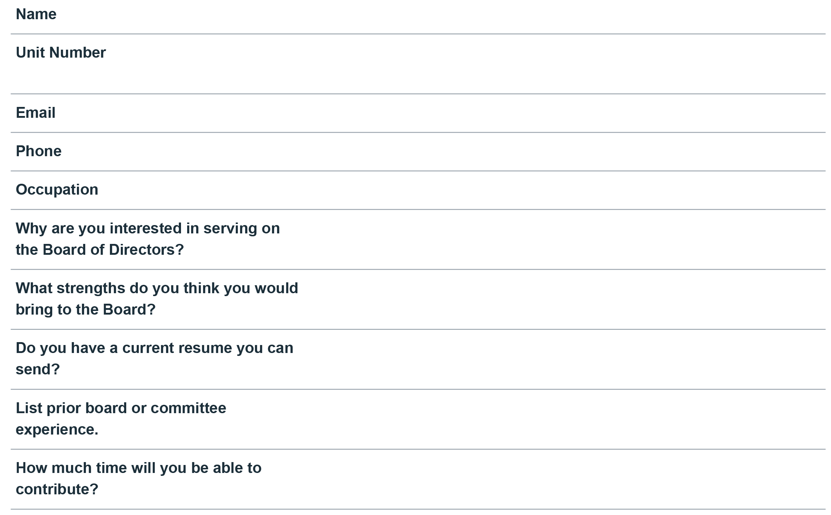
BOARD of Directors application on the website under “resources”

Slide 13
Timeline for the election of new BOARD MEMBERS
Thursday, April 7, 2022, Community notice of Board Election request for candidate declarations
Friday, May 20, 2022, Candidate declaration deadline
Tuesday, June 7, 2022, Electronic ballot to be sent
Friday, June 17, 2022, Voting deadline
July 14, 2022, Election results announced at quarterly Board of Directors Meeting
August 25, 2022, Elected candidates installed at Annual Owner’s Meeting

Slide 14
questions

Slide 15
Events leading up to the amendment vote
January 27, 2022, Special Owners’ Meeting
Explanation of Capital Reserve deficit and funds required to remedy it
Proposal to change allocating expenses to SF from Building Fraction
March 3, 2022, Special Owners’ Meeting (Presentation by Association Attorney)
Inception of The Boundary and review of documents and laws governing the Association
Prior amendments likely invalid without approval by owners
Procedure to change Allocated Interests of an HOA (67% approval of owners)
Recommended that, at a minimum, the Owners need to vote and approve a Reallocation Amendment that allocates the allocated interests among the 33 Townhome Lots and Condominium Units
To be accomplished through “Second Amendment To Amended and Restated Declaration for The Boundary”

Slide 16
March 4, 2022, Board recommends approval of the Amendment
To correct deficiencies in our Governing Documents.
To provide for each unit to have equal voting rights in the Association
To allocate expenses using sq. ft. by Unit creating equal sq. ft. cost for all Units
Most commonly used by homeowner associations across the country
Easiest for owners, prospective owners, and realtors to understand
March 10, 2022, Board solicits votes by electronic ballot
March 21, 2022, voting period ends

Slide 17
Boundary amendment ballot results
Certified by the RVRMA 3/21/22
Jessica Hennessey (Director of Design Review and Admin Services) and Ashley Lynch (General Manager RVRMA)

Slide 18
assessment change Affective THIRD Quarter billing (July 1, 2022)

