Slide 1
Special Meeting of Members March 3, 2022, at 5:00 pm RVR Ranch house conference Room

Slide 2
What documents and laws govern the Boundary?
The Colorado Common Ownership Interest Act (“CCOIA”)
Declaration for the Boundary Association, including any amendments thereto
Bylaws
Policies and Procedures

Slide 3
What are “allocated interests” of an HOA?
CCOIA requires that, through the declaration or bylaws, every HOA must allocate:
Each owner’s fraction or percentage of common expense liability;
The number of votes afforded to each owner; and
Each owner’s fraction or percentage of ownership interest in the common elements of the HOA.
Each owners’ common expense liability, votes afforded, and ownership interest in the common elements are collectively referred to as the “allocated interests.”
C.R.S. § 33-33.3-207

Slide 4
Allocated interests are hard to change
There are only two ways to change the allocated interests of an HOA.
First, the developer of an HOA (aka the “Declarant”), can, in an HOA’s declaration, reserve the right to change the allocated interests as the development progresses and unilaterally file amendments to the declaration to that effect.
Second, the owners of the HOA can, by no less than 67% approval, vote for an amendment to the declaration that changes the allocated interests.
C.R.S. § 33-33.3-217(4)(a)

Slide 5
Inception of the boundary
In 1999, the Boundary was formed by Crystal River Limited Partnership, also known as the “Declarant” of the Boundary Townhome Association
When it was formed, the Boundary was intended to be solely a “Townhome Community,” with a maximum of 33 “Townhome Lots.”
Hence, the initial name of your association was “The Boundary Townhome Association.”
Originally, there were only seven lots in the Boundary and the Original Declaration was tailored to the “Townhome Community,” although the prospect of further development was allowed.

Slide 6
Allocated Interests in The original declaration

Slide 7
Allocated Interests in The original declaration

Slide 8
Early Development of the Boundary
In or around 2001, Crystal River Limited Partnership sold the Boundary and transferred all its development rights to EP Boundary, LLC (“EP”), and, therefore, EP became the new Declarant.
Shortly thereafter, EP recorded an Amended and Restated Declaration that revised the original declaration for the Boundary.
The Amended Declaration, among other things,
Introduced the concept of Condominium Units, in addition to Townhome Lots; and
Changed the name of the association from “The Boundary Townhome Association” to “The Boundary Association.”

Slide 9
Allocated interests in The Amended declaration

Slide 10
Allocated interests in The Amended declaration

Slide 11
Declarant reserved rights in The Amended declaration

Slide 12
EP Reallocation Amendments
As development within the Boundary progressed, EP, pursuant to its reserved Declarant Rights, properly created and recorded a series of “Reallocation Amendments” to reallocate the allocated interests among the owners.
EP recorded reallocation amendments on the following dates:
July 13, 2001
July 26, 2001
November 9, 2001

Slide 13
July 13, 2001 Reallocation amendment

Slide 14
July 26, 2001 Reallocation amendment

Slide 15
November 9, 2001 Reallocation amendment

Slide 16
EP Sells to Braeburn
In or around 2006, EP sold its property to Braeburn Real Estate Development, LLC (“Braeburn”) and transferred its reserved declarant rights to Braeburn.
Braeburn thus became the new Declarant and, by extension, the only entity that could file additional Reallocation Amendments without a vote of the owners of the HOA.
As the Boundary continued to develop, Braeburn never filed another Reallocation Amendment and never formally relinquished its declarant reserved rights to the Association or transferred them to any other entity.
This created a nearly thirteen-year gap between Reallocation Amendments.
From a legal standpoint, Braeburn is still the Declarant and holds the reserved declarant rights.

Slide 17
Subsequent Reallocation Amendments
Beginning in 2014, the Association filed three subsequent Reallocation Amendments:
February 18, 2014
March 2, 2015
November 1, 2021
This was seemingly done under the belief that the Association took over declarant’s Reserved Rights from Braeburn and could unilaterally amend the allocated interests.

Slide 18
February 18, 2014 Reallocation amendment

Slide 19
March 2, 2015 Reallocation amendment

Slide 20
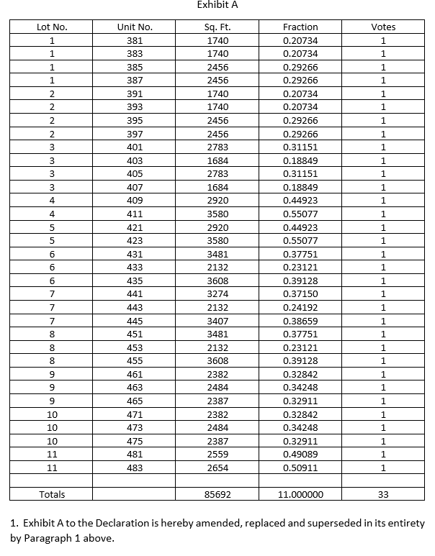
November 1, 2021 Reallocation amendment

Slide 21
Subsequent Reallocation Amendments
From my review of the documents available, it does not appear that Braeburn ever transferred the Declarant’s Reserved Rights to the Association.
It also does not appear that these subsequent Reallocation Amendments were ever voted on or approved by the owners.
Because these Reallocation Amendments were not done pursuant to Declarant Reserved Rights or approved by a vote, they are likely invalid.

Slide 22
Next Steps
At a minimum, the Owners need to vote and approve a Reallocation Amendment that allocates the allocated interests among the 33 Townhome Lots and Condominium Units.
In so doing, the Owners should consider whether the allocation method required by your declaration is still appropriate or whether a new allocation method is more appropriate for the community.
There is no law dictating which allocation method you must select (e.g. total number of lots, square footage, etc.).

Slide 23
questions

