Slide 1
Welcome
April Cove
Maintenance Fund, Inc.
2024
Annual Meeting

Slide 2
AGENDA
Call to order
Agenda Review
Introduction of Members – Establish Quorum
Minutes – 2023 Annual Meeting
Appoint Election Inspectors
Reports from Committees
  ACC – Cheryl Wangrin,
  Maintenance – Mike Harris, Steve Barkley
  Goodwill – Wanda Rollins
Reports from Officers
  Progress Report – Steve Barkley
  Financial Report – Tom Marusa
Budget – Tom Marusa
Old and Unfinished Business
New Business
Elections
Good and Welfare
Adjournment

Slide 3
Architectural Control Committee
1.CONSTRUCTION APPLICATION APPROVALS
Hawthorne (Pelican Point): Timeline extension for home completion & addition of deck (completed)
Landry (Shadow Oaks): New home construction (not started)
Frye (Pelican Point): Retaining wall (completed)
Geisendorff (April Cove): Roof extension over deck & fence (completed)
Mitch/McKahan (Pelican Point): Deck (completed)
Chamberlain (Highview Circle): Fence (not yet begun)
Pending:
Ellington (April Cove @ Pelican Point): New home – Approval pending drainage plan
Landry (Shadow Oaks): Split rail fence
2.CONSTRUCTION INQUIRIES
Jacobs (Highview Circle): Exterior finish of structures, addition of garage, & setback
Wilkinson (Pelican Point): Garage & pergola
Weisburg Pelican Point): Retaining wall/Landscape
3.ACC COMPLIANCE LETTERS
None
4.FUTURE HOME CONSTRUCTION
None
5.CONSTRUCTION REQUIRING ACC APPLICATION APPROVAL
New structures (building, fence, deck, gazebo, carport, etc.)
Additions to existing structures (changing the footprint of any structure, enclosing an exterior space, etc.)
6.PROPOSED NEW CONSTRUCTION MATERIALS
None
7. NEW APPLICATION FORMS
Fence Construction
Retaining Wall Construction
Swimming Pool Construction

Slide 4
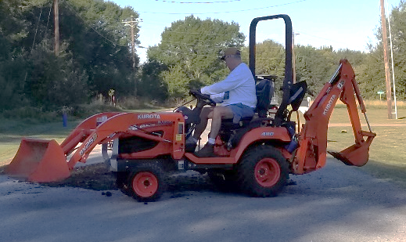
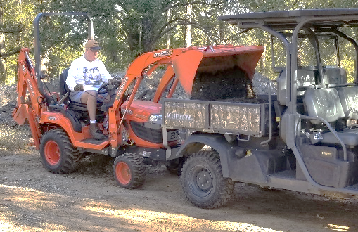
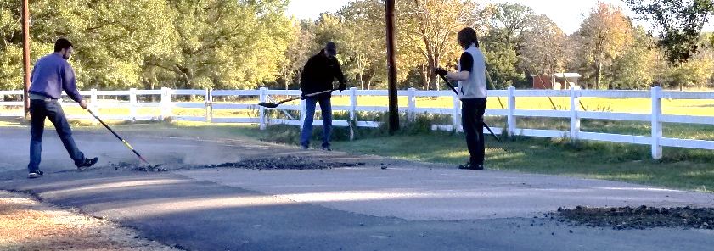
Maintenance Report
Workdays in 2023
  - May 14th
  - Concentrated on the front entrance, storage lot, right of way branch clearing and gravel patching the roadways.
Gravel patching the problem areas ourselves has worked well in keeping the roads passable and minimizing further damage until we can afford to repave large areas of the roadway instead of just patching the smaller sections of the road.
Gravel Patching Process
1) Smooth out torn up areas with the frontend loader.
2) Fill potholes with gravel ground up from previous road work.
3) Rake gravel smooth, remove biggest chunks and pack down.

Slide 5
Maintenance Report
2024 Workdays
  *** Spring, May XXth (Mark your calendars)
  Front entrance clean up, plant and trim
  Storage lot, mow and weed eat. Branch clearing if needed.
  Right of Ways, branch clearing and gravel removal.
  Gravel patch roadways.
  *** Fall, October/November -- TBD
Mowing
Volunteer system is working great!
    Thank you to those who have volunteered!
    Bill Johnson Dennis Stone Donald Walton Rocky Loerch
    Bubba Geisendorff Steve Barkley Bob Rollins Cathi Loerch
We can always use more volunteers, if you want to help contact:
Mike Harris – harrisupt@hotmail.com

Slide 6
Maintenance Report
Workday(continued)
Storage Lot:
Goals
- Encourage Boat and trailer owners to maintain the pads their trailer or boat is parked on. Email reminders.
- Remove junked abandoned boats and trailers.
-Those trailers did get moved to the back of the storage lot and it looks a lot better!
- Add rock to pads. $350/per load, cover 4 pads, 10 loads, total $3,500
Last years question? How do we maintain it until the next workday?
Answer: Volunteers
-Monthly sign-up sheet. 3 volunteers for one day during the month to weed eat and mow.
-Post schedule on Website
Front Entrance:
Same question? How do we maintain it until the next workday?
Answer: Volunteers
- Monthly sign-up sheet. 2 volunteers for one day during the month
- Tasks, weed, weed eat, and maintain systems
- Post schedule on Website

Slide 7
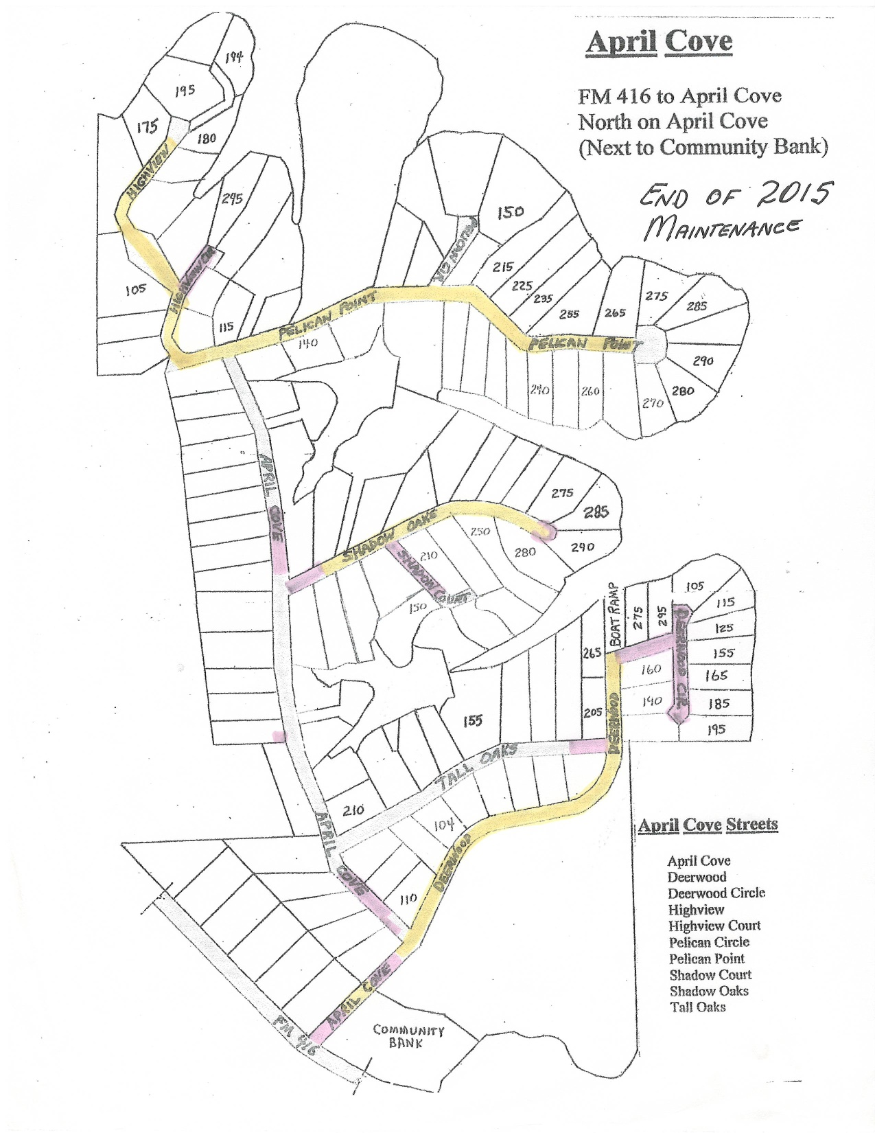
April Cove
Subdivision and Road Maintenance Map
End of 2020
Pelican Cr.
Highview Cr.
HIghview
Pelican Point
Purple -2012-2015 Paving
Red -2016-2020 Paving
Yellow -Seal Coat
April Cove
Shadow Oaks
Boat Ramp
Deerwood Cr.
Tall Oaks
April Cove
Deerwood
April Cove

Slide 8
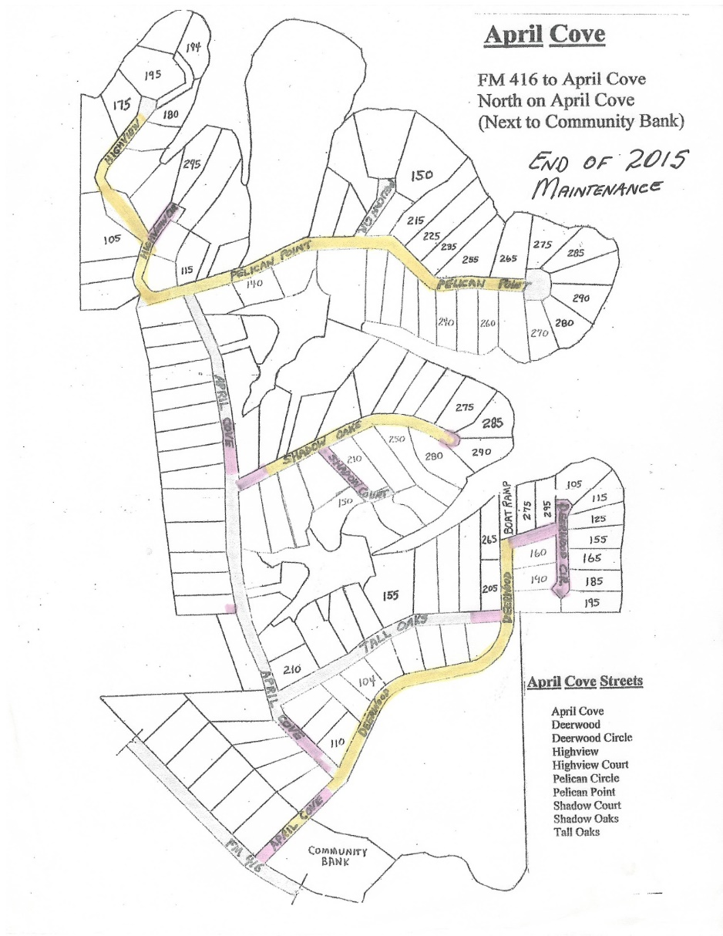
Maintenance Report
Road Maintenance and Repair – 5 Year Plan Options
Road Maintenance Plan | 2021 | 2022 | 2023 | 2024 | 2025 | 2026 | 2027
2023 Update
Deerwood/Deerwood Circle
Sealcoat: Deerwood Circle |  |  |  |  |  | $5,000
Overlay: West Intersection
Intermediate
East Intersection
Sealcoat: Deerwood |  |  |  |  |  | $20,000
Overlay Deerwood
Tall Oaks
Overlay: Walton to McCray |  |  |  | $40,000
Sealcoat: A/C to Walton |  |  |  |  |  |  | $10,000
Grind out / Establish Sub-Grade |  |  | $40,000
Shadow Oak
Sealcoat: A/C to Wangrin
Overlay: Mancha - Cul-de-sac
Overlay: A/C to Mancha
Shadow Court
Overlay: Ashford to Cul-de-sac |  |  | $20,000
Cul-de-sac
Intersection w/ Shadow Oak |  |  |  |  |  |  | $5,000
April Cove
FM 416 to Gate
Crack/Seal Repair
Dig out and replace |  |  |  | $75,000 | $100,000
Highview Circle
Sealcoat: A/C to Cul-de-sac
Overlay: Highview Valley Only |  |  |  |  |  |  | $7,500
Overlay: Highview
Pelican Point
Overlay Cul-de-sac |  |  |  |  |  |  | $20,000
Sealcoat: Pelican Point |  |  |  |  |  | $20,000
Overlay Pelican Point
TOTAL | $0 | $0 | $60,000 | $115,000 | $100,000 | $45,000 | $42,500
April Cove
Subdivision and Road Map
Pelican Cr.
HIghview
Highview Cr.
Pelican Point
Shadow Oaks
April Cove
Tall Oaks
Deerwood Cr.
April Cove
Deerwood
April Cove

Slide 9
ROAD FUND – 5 YEAR PLAN OPTIONS – REVENUE & EXPENSE PROJECTIONS

Slide 10
Maintenance Report
Road Maintenance and Repair
2022 Review:
    2022 - roads gravel patched
    Reduction in construction traffic
    2nd year of gravel patching strategy
    $ -0- spent on roads
Hot Spots: (Jan. 2021 estimate)
    April Cove Rd; $250,000 to replace bad spots
    Tall Oaks; $81,000 to replace (Walton to McCray)
    Highview Valley; Overlay $7,500
    Shadow Court Cul de sac; Overlay: $19,500
Recommendation for 2023:
    Grind & Prep Sub-grade: Non-Repaired Area - Tall Oaks
    Pave Shadow Court Cul-de-sac
    Cold Mix in Smaller Potholes -- Owners
    Continue Gravel Patching Strategy -- Owners
Discussion: Strategy Options
1. Wait / do nothing and continue to build up our funds
2. Start spending – smaller sections / better repairs
3. Raise Capital – Owners Loan Proposal
4. Raise Capital – Increase Road Fee $50/Lot (July ‘23)
4. General Fund $55,000 --- Road Fund $112,000
April Cove
Subdivision and Road Map
Pelican Cr.
HIghview
Highview Cr.
Pelican Point
Shadow Oaks
April Cove
Tall Oaks
Deerwood Cr.
April Cove
Deerwood
April Cove

Slide 11
Maintenance Report
Road Maintenance and Repair
2022 Actual:
- Gravel patching hots spots ourselves; cost $0.
2023 Proposed Plan:
- Approve $60,000 (Tall Oaks & Shadow Court)
- Continue with gravel patching program
- Try cold mix compacted in smaller potholes
Reasons:
    Material costs continue to stay high.
    It is better to dig out and replace large areas of the road than to just overlay smaller patches.
    New home construction has slowed.
    Gravel patching the problem areas ourselves has worked in keeping the roads passable.
April Cove
Subdivision and Road Map
Pelican Cr.
HIghview
Highview Cr.
Pelican Point
Shadow Oaks
April Cove
Tall Oaks
Deerwood Cr.
April Cove
Deerwood
April Cove

Slide 12
GOODWILL COMMITTEE
Wanda Rollins – Chairperson
Cathi Loerch
Debbee Nyman
Susan Barkley
Your Name Goes Here

Slide 13
Progress Report
April Cove Properties
  144 Lots in April Cove (voting & billable)
  86 Property Owners
  50 Completed Homes
  55% of Owners (47) Have Homes in April Cove
  16 Property Transactions (involving 22 Lots) in 2021
  15 Property Transactions (involving 25 Lots) in 2022
Compliance Letters from Board (travel/utility trailers, property, cattle)
Front Entrance Lighting (Repaired twice in 2023 incd. New Timer)

Slide 14
WEBSITE
APRILCOVE.ORG
Andy Cordina
FACEBOOK PAGE
April Cove at Richland Chambers Lake
Cheryl Wangrin & Board Discussion

Slide 15
April Cove Maintenance Fund End of 2021 Financial Summary
ACMF - Expense Budget |  | Proposed 2022 |  |  | Actual 2022 |  |  | Approved 2023
 |  | General | Road |  | General | Road |  | General | Road
Metro Sanitation |  | 5,600 | 0 |  | 5,850 | 0 |  | 6,400 | 0
Navarro Electric |  | 800 | 0 |  | 740 | 0 |  | 800 | 0
Southern Oaks Water |  | 350 | 0 |  | 285 | 0 |  | 300 | 0
TRWD |  | 50 | 0 |  | 50 | 0 |  | 50 | 0
Annual Meeting |  | 50 | 0 |  | 50 | 0 |  | 50 | 0
Insurance |  | 2,750 | 0 |  | 2,575 | 0 |  | 2,750 | 0
Road Repairs |  | 0 | 30,000 |  | 0 | 0 |  | 0 | 40,000
Mowing Expense |  | 500 | 0 |  | 135 | 0 |  | 500 | 0
SOVFD |  | 500 | 0 |  | 0 | 0 |  | 500 | 0
Tractor Maintenance |  | 1,500 | 0 |  | 435 | 0 |  | 500 | 0
Gen. Repairs/Maint |  | 1,500 | 0 |  | 420 | 0 |  | 500 | 0
Goodwill Committee |  | 500 | 0 |  | 75 | 0 |  | 500 | 0
Postage / Supplies |  | 100 | 0 |  | 97 | 0 |  | 200 | 0
Banking/Payment Fees |  | 500 | 0 |  | 1,930 | 0 |  | 2,000 | 0
Legal & Professional |  | 0 | 0 |  | 0 | 0 |  | 0 | 0
Total Expenses |  | $14,700 | $30,000 |  | $12,640 | $0 |  | $15,050 | $40,000

Slide 16
April Cove Maintenance Fund
Balance Sheet
As of December 31, 2021
ASSETS
Current Assets
Bank Accounts
ACMF General Fund 41,175.42
ACMF Road Fund 37,809.36
Main WF 14,589.71
Road WF Acct 24,839.51
Total Bank Accounts $118,414.00
Accounts Receivable
Accounts Receivable 26,439.01
Total Accounts Receivable $26,439.01
Other Current Assets
Deferred Income 0.00
Undeposited Funds 0.00
Total Other Current Assets $0.00
Total Current Assets $144,853.01
Fixed Assets
Entrance Gate 10,550.00
Entrance Gate - Depreciation -8,196.00
Total Fixed Assets $2,354.00
TOTAL ASSETS $147,207.01
LIABILITIES AND EQUITY
Liabilities
Current Liabilities
Accounts Payable
Accounts Payable 0.00
Total Accounts Payable $0.00
Total Current Liabilities $0.00
Total Liabilities $0.00
Equity
Opening Balance Equity 35,596.25
Retained Earnings 65,617.36
Net Income 45,993.40
Total Equity $147,207.01
TOTAL LIABILITIES AND EQUITY $147,207.01
April Cove Maintenance Fund
Balance Sheet
As of December 31, 2022
ASSETS
Current Assets
Bank Accounts
ACMF General Fund 0.00
ACMF Road Fund 0.00
Main WF 55,219.85
Road WF Acct 111,890.69
Total Bank Accounts $167,110.54
Accounts Receivable
Accounts Receivable 25,139.01
Total Accounts Receivable $25,139.01
Other Current Assets
Deferred Income 0.00
Undeposited Funds 235.00
Total Other Current Assets $235.00
Total Current Assets $192,484.55
Fixed Assets
Entrance Gate 10,550.00
Entrance Gate - Depreciation -8,196.00
Total Fixed Assets $2,354.00
TOTAL ASSETS $194,838.55
LIABILITIES AND EQUITY
Liabilities
Current Liabilities
Accounts Payable
Accounts Payable 0.00
Total Accounts Payable $0.00
Total Current Liabilities $0.00
Total Liabilities $0.00
Equity
Opening Balance Equity 35,596.25
Retained Earnings 110,36076
Net Income 48,881.54
Total Equity $194,838.55
TOTAL LIABILITIES AND EQUITY $194,838.55

Slide 17
Old Business
New Business

Slide 18
GOOD & WELFARE
LAKE LEVELS : 313.00’ ( -2.00’ )
SOVFD -- CHILI SUPPER & CAKE SALE: FEB 25TH
  Major Fundraiser for our Volunteer Fire Dept.
  Consider a Donation if You Miss the Chili Supper & Cake Sale
  Consider Becoming a Member of our Fire Dept.
PLEASE SUPPORT OUR LOCAL BUSINESSES
  Richland Chambers Hardware
  Family Dollar
  Spanky’s Grill
  Lighthouse Café
  Joe’s Pizza
NEW MEMBERS / MEMBERSHIP DIRECTORIES

