Slide 1
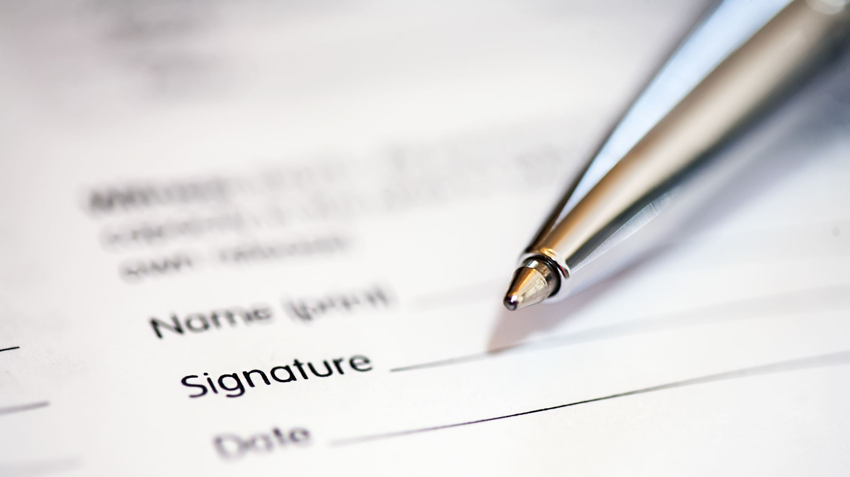

Writing: Words, Sentences, Paragraphs

Slide 2
What is writing?
Writing refers to joining words together in a meaningful way with a specific purpose.
There are many ways to write.
These include:
Imaginative – stories, poems
Informative – newspaper articles, information reports
Persuasive – expositions
Discursive – discussions
Reflective – recounts
Analytical – analysing texts

Slide 3
Four basic parts of speech
Grammar helps us write because grammar teaches us the rules to put words together to make meaningful and purposeful sentences.
Four basic parts of speech:
Nouns: Words that name a person, place, thing, or idea
Verbs: Words that show action or a state of being
Adjectives: Words that describe nouns
Adverbs: Words that describe verbs, adjectives or other adverbs – often ending in –ly but not all the time.

Slide 4
Writing Sentences
Nouns | Verbs | Adjectives | Adverbs
Cat School Teacher City Book Computer Garden Park Gallery Child | Run – ran – running Jump – jumped – jumping Dance, danced, dancing Write, wrote, writing Read, read, reading Speak, spoke, speaking Listen, listened, listening Eat, eaten, eating Visit, visited, visiting Play, played, playing | Happy Beautiful Tall Bright Soft Delicious Brave Calm Friendly Scary | Quickly Slowly Happily Silently Loudly Brightly Easily Carefully Gracefully Sadly
Compose as many sentences using a noun, verb, adjective and adverb.
Example: The happy cat ran quickly.

Slide 5
Building sentences
In addition to nouns, verbs, adjectives, and adverbs, constructing sentences involves other essential parts of speech, including:
Pronouns: words that replace nouns
Examples: he, she, it, they, who, which
Prepositions: Words that show relationships between a noun/pronoun and other words in a sentence, often indicating direction, place, time or method.
Examples: in, on, at, between, under, over
Example: The book is on the table.
Conjunctions: Words that connect words, phrases or clauses
Examples: and, but, or, because, although
Example: I wanted to go for a walk, but it started raining.

Slide 6
Using Pronoun, Prepositions, Conjunctions
Pronouns | Prepositions | Conjunctions
I You He She It We They Me Him Her Us Them Your His Our Myself | At By For From In Of To With After Before Between During Under Over Into Through Across Against Among | And But Or Nor For So Yet Although Because Since Unless While When Where Though
In each sentence, you must have:
noun/pronoun
Verb
Adjective
Adverb
Preposition
Conjunction
Example:
The tall boy ran quickly to the park because he wanted to play basketball.

Slide 7

Sentence Functions and Types
Declarative sentence
Exclamatory sentence
Interrogative sentence
Imperative sentence
Conditional sentence
Interrogative-Declarative sentence
Rhetorical sentence
Optative sentence
Declarative-exclamatory sentence
Negative sentence
Compound sentence
Complex sentence
Simple sentence
Cleft sentence
Balanced sentence
Periodic sentence
Loose 9cumulative sentence
Interrogative tag sentence
Expletive sentence
Parenthetical sentence
Inverted Sentence
Declarative-rhetorical sentence
Elliptical sentence
Nominal sentence
Truncated sentence

