Slide 1
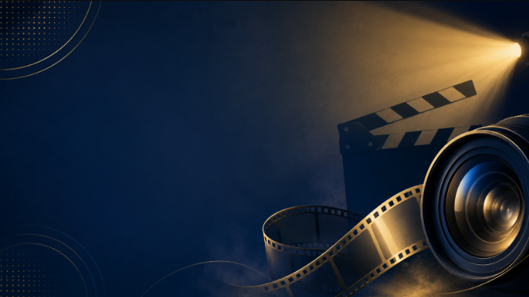
Film
How to analyse films

Slide 2
Common Film Conventions
Films, like all texts, use common conventions to communicate ideas and shape audience responses.
Conventions are the techniques and features that films commonly use, regardless of genre.
Genre refers to the category or type of film, such as horror, action, comedy, drama or science fiction. Some films can also have a hybrid genre, meaning they combine two or more genres, such as action and science fiction.
Common film conventions include:
  Mise-en-scène
  Cinematography
  Sound
  Editing
  Dialogue
  Narrative structure

Slide 3
Mise-en-scène
Mise-en-scène is a French term that refers to everything we can see within the cinematic frame.
This includes:
  Lighting: the use of light, shadow and darkness, including where the light comes from and how it affects the mood.
  Acting: the way characters behave, move, speak and respond to others.
  Costumes: the clothing, accessories and appearance of characters.
  Setting: the location and time of the scene, including props and objects placed within the setting.
Everything we see in a film has been deliberately chosen to create meaning. When analysing mise-en-scène, we need to consider the purpose of what is shown and how it shapes the audience’s understanding of characters, ideas and emotions.

Slide 4
Cinematography
Cinematography refers to how the film is captured on camera.
This includes:
  Camera distance: the space between the camera and the subject or character. Common examples include close-up shots, medium shots and long shots.
  Camera angle: where the camera is positioned in relation to the subject or character. Common examples include low-angle shots, straight-on shots and high-angle shots.
  Camera movement: how the camera moves while capturing a shot. Common examples include pan, tilt, dolly, tracking and rolling shots.
All camera shots are deliberately chosen to create meaning and shape the audience’s response.
When analysing cinematography, we must explain the purpose of the camera technique and the meaning it creates.

Slide 5
Sound
Sound refers to everything we hear in a film.
There are two main types of sound:
  Diegetic sound: sound that comes from within the world of the film. The characters can usually hear it.
  Examples: dialogue, footsteps, a door closing, music playing from a radio.
  Non-diegetic sound: sound that is added for the audience. The characters cannot hear it.
  Examples: background music, voice-over narration, dramatic sound effects.
Other important sound techniques include:
  Sound motif: a repeated sound that appears throughout a film to represent an idea, character, emotion or theme.
  Sound bridge: a sound that continues across two shots or scenes, helping to create a smooth transition or connection.
All sounds are deliberately chosen to create meaning and influence the audience.
When analysing sound, we must explain its purpose and the meaning it creates.

Slide 6
Editing
Editing refers to how different shots are selected, arranged and joined together to create a film.
Editing controls what the audience sees, when they see it, and how they move from one shot or scene to the next.
The most common editing technique is the cut, where one shot changes directly to another.
Other editing techniques include:
  Wipe: one shot is replaced by another using a visible movement across the screen.
  Fade in: an image gradually appears from a dark or blank screen.
  Fade out: an image gradually disappears into a dark or blank screen.
Editing affects the pace, rhythm and emotional tone of a film. It helps the audience process information, build tension and experience the world of the story.
Each editing choice has a purpose and creates meaning. When analysing editing, we must explain how the editing technique shapes the audience’s understanding and response.

Slide 7
Dialogue
Dialogue refers to the words spoken by characters in a film.
Dialogue is important because it helps reveal character, develop relationships, build conflict and communicate key ideas.
Dialogue contains language, and language often includes techniques such as:
  Tone: how a character sounds when speaking, such as angry, nervous, confident or calm.
  Word choice: the specific words a character uses, which can reveal their personality, emotions, values or attitude.
  Repetition: when words or phrases are repeated to emphasise an idea or emotion.
  Questions: used to create tension, show uncertainty or challenge another character.
  Commands: used to show authority, power, control or urgency.
  Silence or pauses: moments where a character does not speak, which can create tension, discomfort or emotional meaning.
Dialogue is deliberately written to create meaning and shape the audience’s understanding of characters, relationships and themes.
When analysing dialogue, we must explain the purpose of the language and the meaning it creates.

Slide 8
Narrative Structure
Narrative structure refers to the way a film’s story is organised and developed.
All films tell stories. These stories usually include characters, events, complications, conflict and resolutions.
Important features of narrative structure include:
Plot: the sequence of events that happen in the story.
  Protagonist: the main character the audience usually follows.
  Antagonist: the character, force or problem that opposes the protagonist.
  Complication: a problem or challenge that disrupts the story and creates tension.
  Conflict: the struggle between characters, ideas, values or forces.
  Climax: the most intense or important moment in the story, where the main conflict reaches its peak.
  Resolution: the ending of the story, where problems are solved or the audience is shown the final outcome.
  Themes: the important ideas, messages or lessons explored through the story.
Narrative structure helps the audience understand the journey of the characters and the meaning of the film.
When analysing narrative structure, we must explain how the story is organised and how this creates meaning, tension and emotional impact.

Slide 9
Writing an analysis
When writing film analysis, you need to explain how the director uses language and film techniques to create meaning.
A strong analysis should:
  Start with a quote from the film.
  Identify and analyse at least ONE language technique.
  Identify and analyse at least ONE film technique.
  Explain the purpose of these techniques.
  Explain the meaning created for the audience.
Language techniques may include dialogue, tone, word choice, repetition, questions, commands, symbolism or contrast.
Film techniques may include mise-en-scène, cinematography, sound, editing, lighting, costuming, camera angles, camera distance or camera movement.
A strong analysis does not just identify techniques. It explains how the techniques work together to shape the audience’s understanding of characters, ideas and themes.

