Slide 1
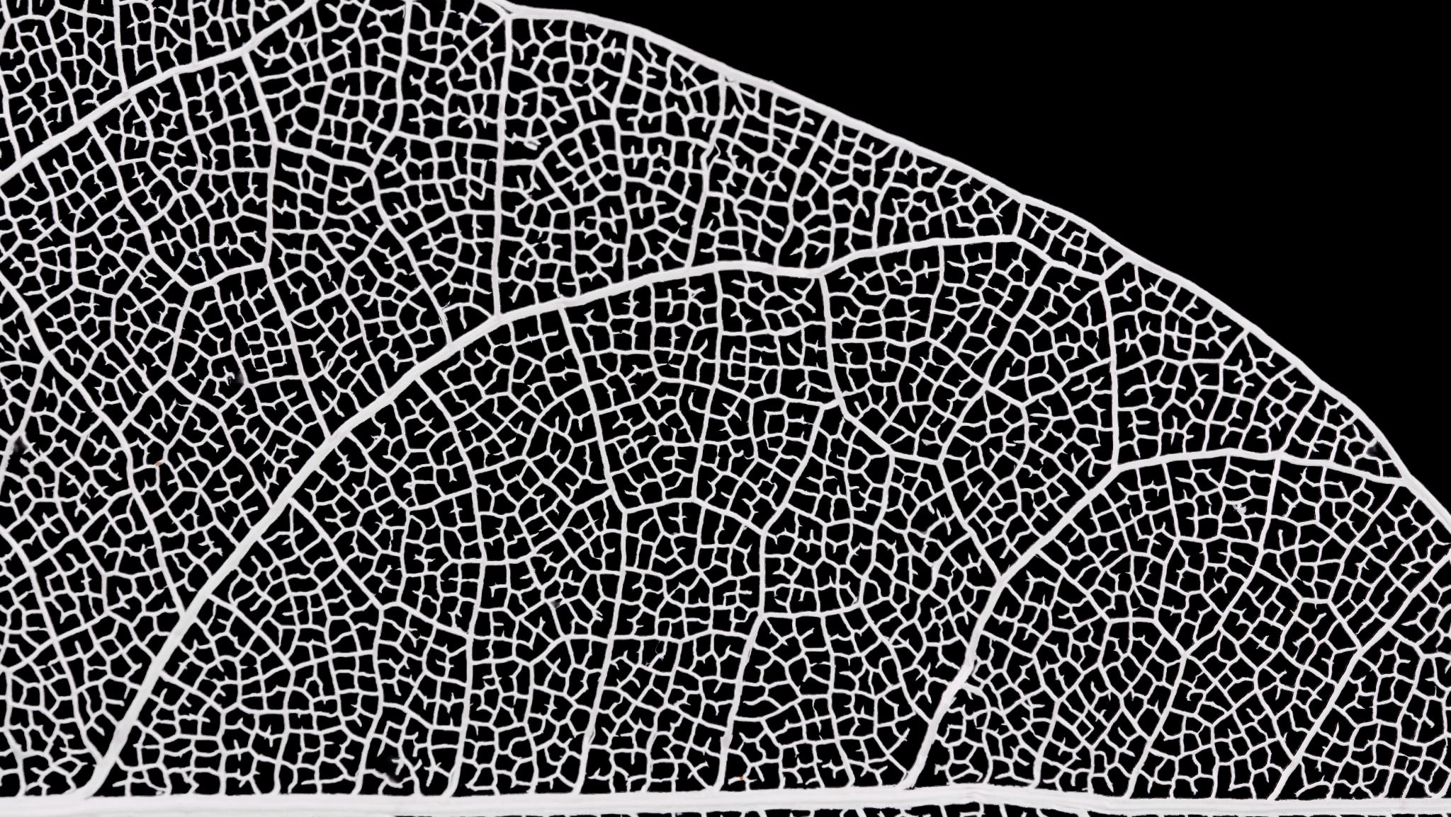
PEEL
Writing Analytical Paragraphs

Slide 2
PEEL
P = Point sentence: in this sentence you answer the question
E = Example/Evidence: a quote from the text you are studying that supports your point sentence
E = Explanation: identify a technique/s in the quote and explain how the technique supports the answer in your point sentence
L = Linking: in this sentence you ensure that your explanation addresses the question directly.

Slide 3
Analysis
In high school English, we emphasise analysis, which means we focus on how language techniques shape meaning. For instance, techniques, such as, metaphors, similes, repetition, descriptive language and many more.
Different text types have different techniques. For example, the book “A Monster Calls” uses both language and visual techniques.

Slide 4
Modelled Example
Question: How does the book “A Monster Calls” utilise language to create fear?
Skill – how you write | Idea – what you about | Requirement – what you need to include in your answer
How – analysis – show analysis through PEEL | Language to create fear | book “A Monster Calls”

Slide 5
Modelled Example
Question: How does the book “A Monster Calls” utilise language to create fear?
P = The book “A Monster Calls” utilises repetition and contrast to create fear, which creates an interesting story.
E = For example, the narrator stated, “He’d had a nightmare. Well, not a nightmare. The nightmare.”
E = Here, the narrator has used repetition of the word “nightmare”, which creates fear because nightmares contain experiences and visions that are unfamiliar and threatening. This is reinforced through the contrast between the indefinite article “a” and the definite article “the”, which amplifies the fear by specifically indicating a nightmare that has haunted Conor for a while.
L = Evidently, this use of language evokes a sense of fear, which encourages the reader to continue the story.

Slide 6
Joint Construction
Question: How does the book “A Monster Calls” utilise language to create fear?
P = The book “A Monster Calls” utilises anaphora and listing to create fear, which creates an interesting story.
E = For example, the narrator stated, “The one he’d been having a lot lately. The one with the darkness and the wind and the screaming.”
E = Here, the narrator has used anaphora of the words “the one”, which creates fear because nightmares contain experiences and visions that are unfamiliar and threatening. This is reinforced through the listing of the words “darkness…wind…screaming”, which amplifies the fear by illustrating how nightmares create fear through the unknown, the powerful and the terrifying.
L = Evidently, this use of language evokes a sense of fear, which encourages the reader to continue the story.

