Slide 1
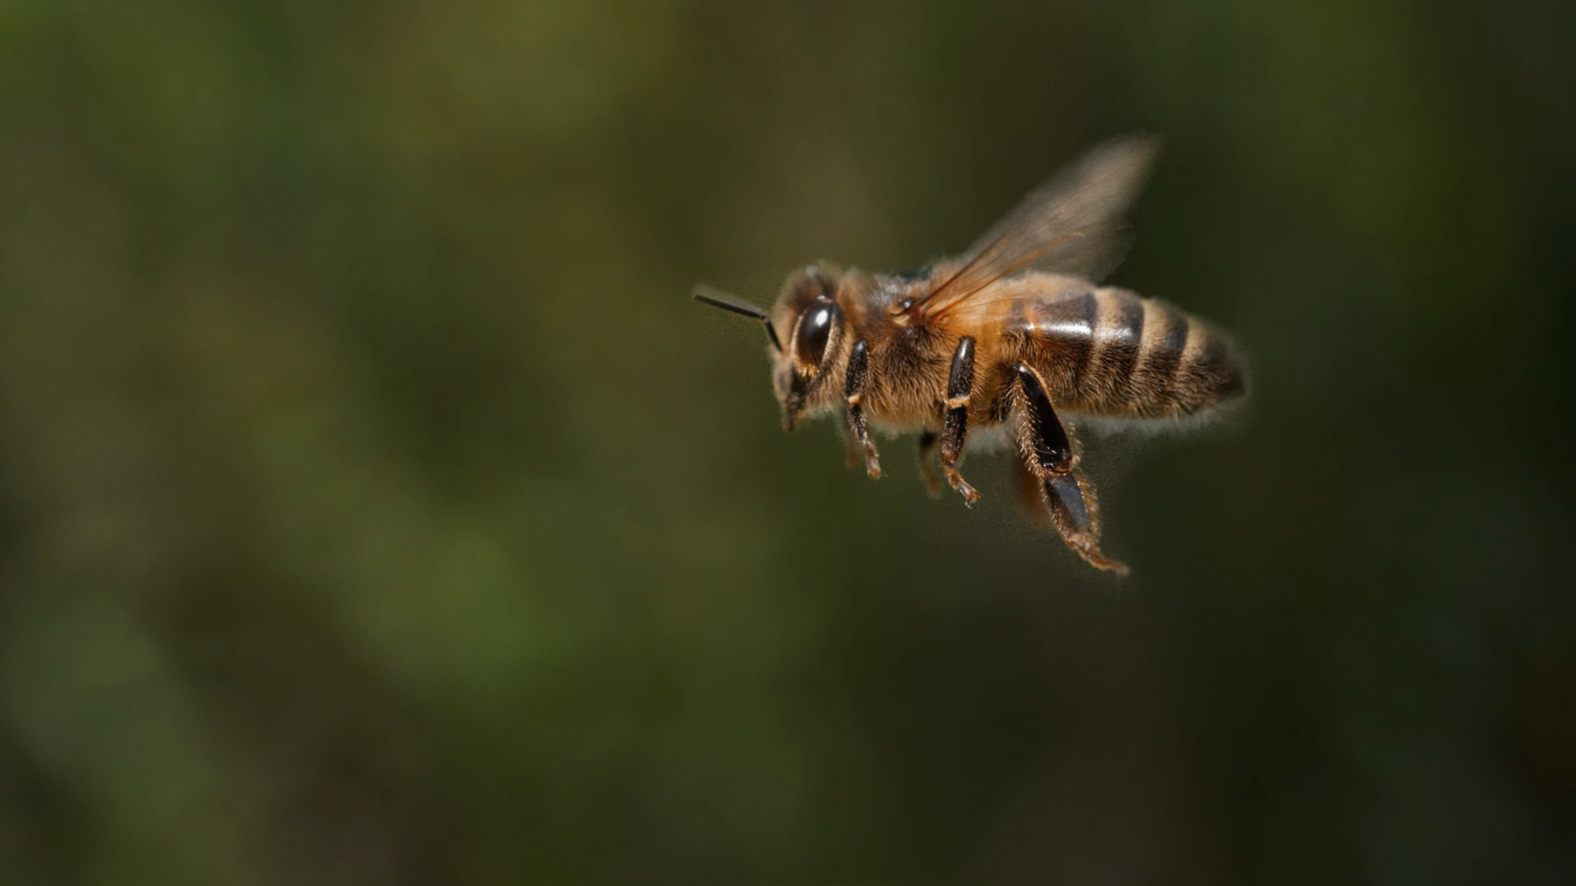
The Life Cycle of a Bee
Getting Writing Right:
Explanation

Slide 2
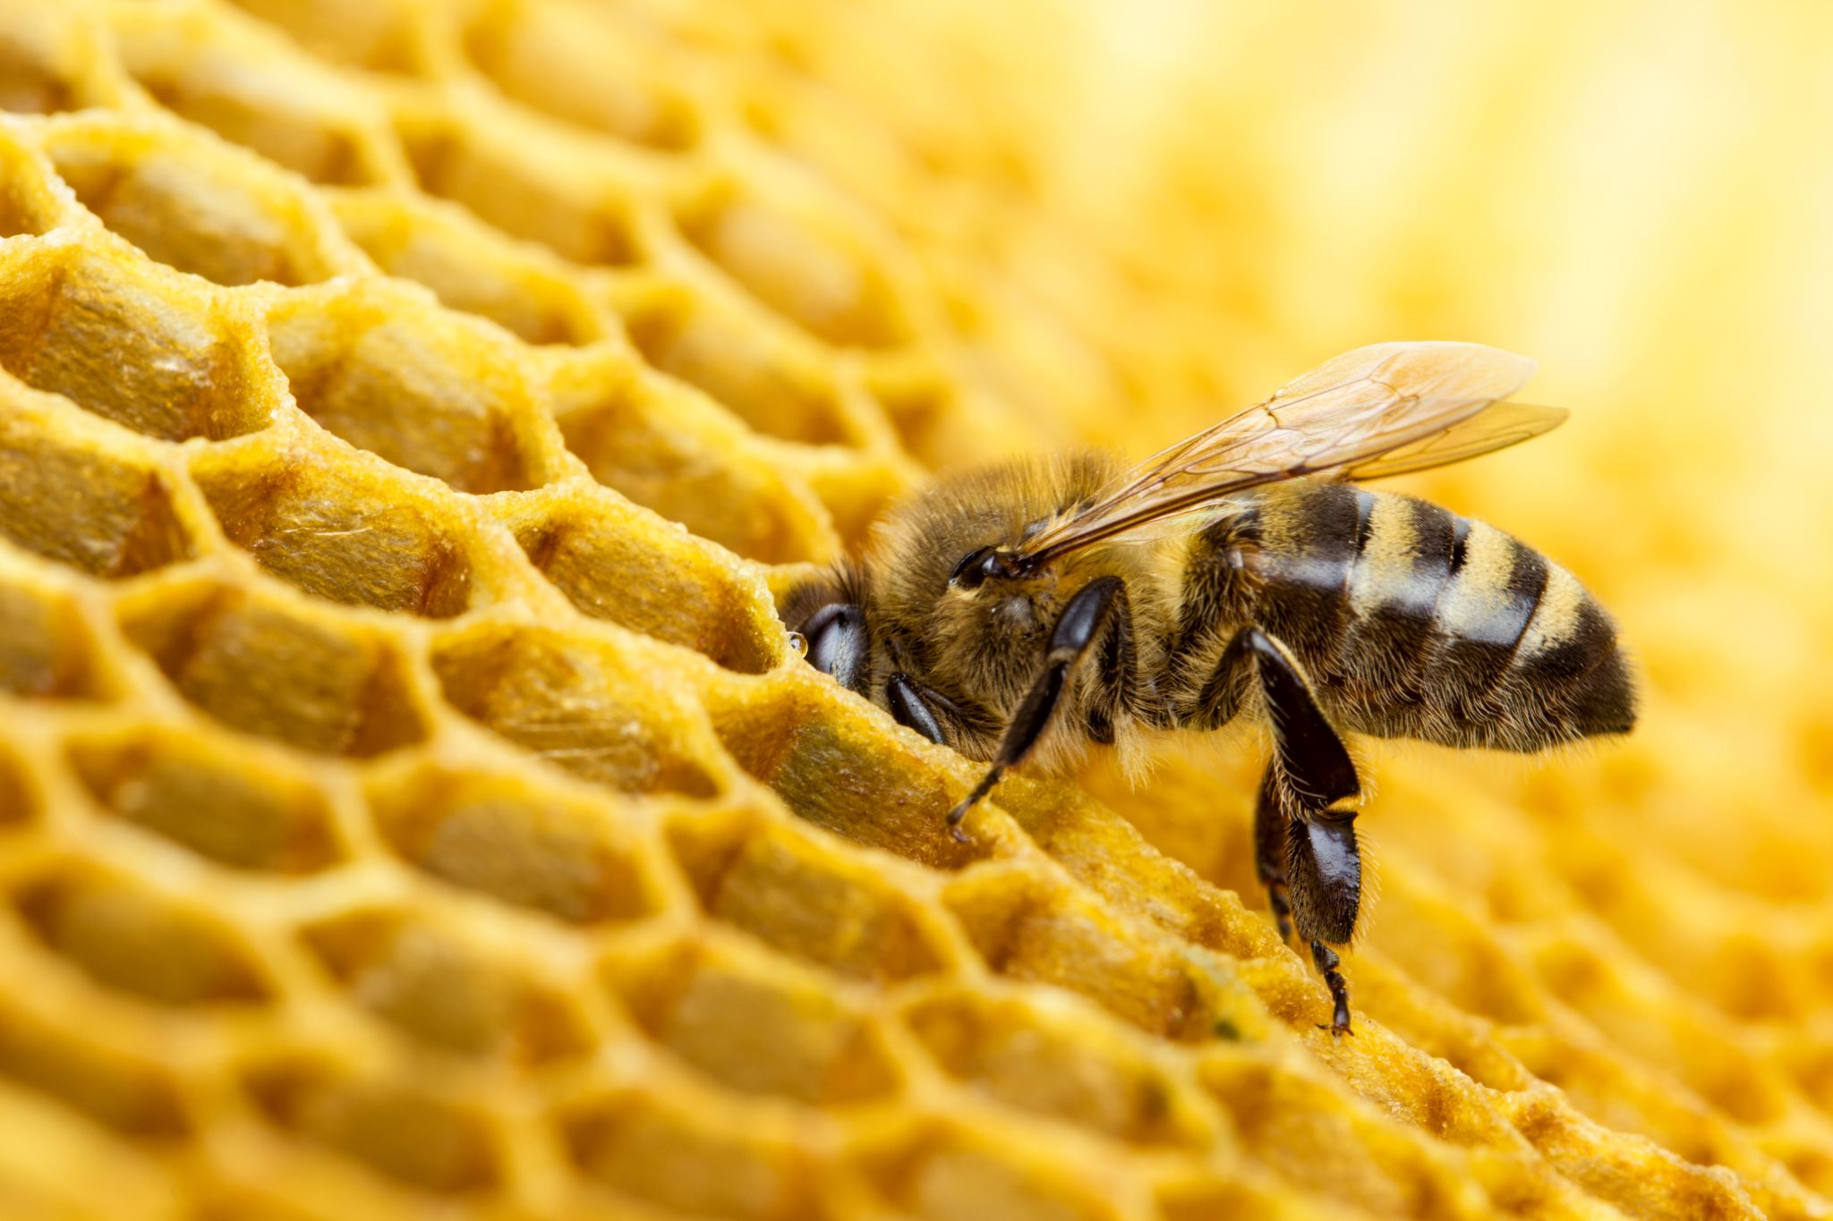
Video https://www.youtube.com/watch?v=xQpolPycuxQ

Slide 3
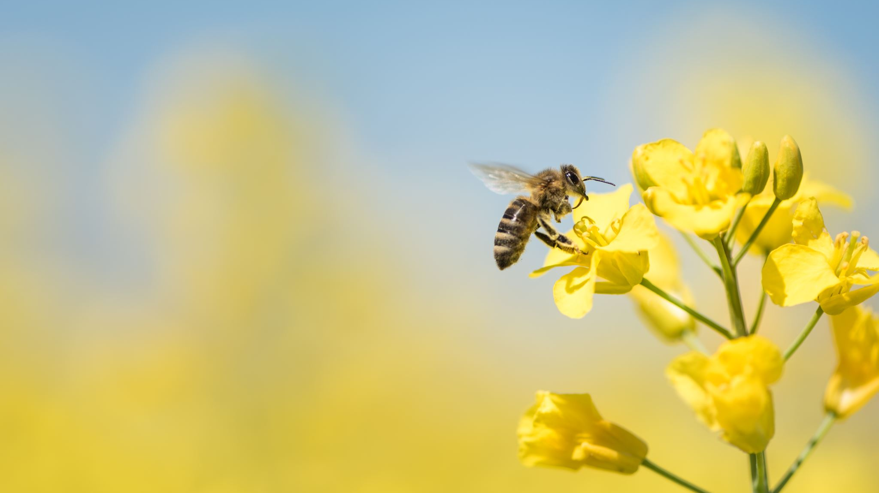
Structure
Opening Statement:
Introduce the topic
Series of Events:
Explain the steps or events in order
Conclusion:
finish by summing up your explanation

Slide 4
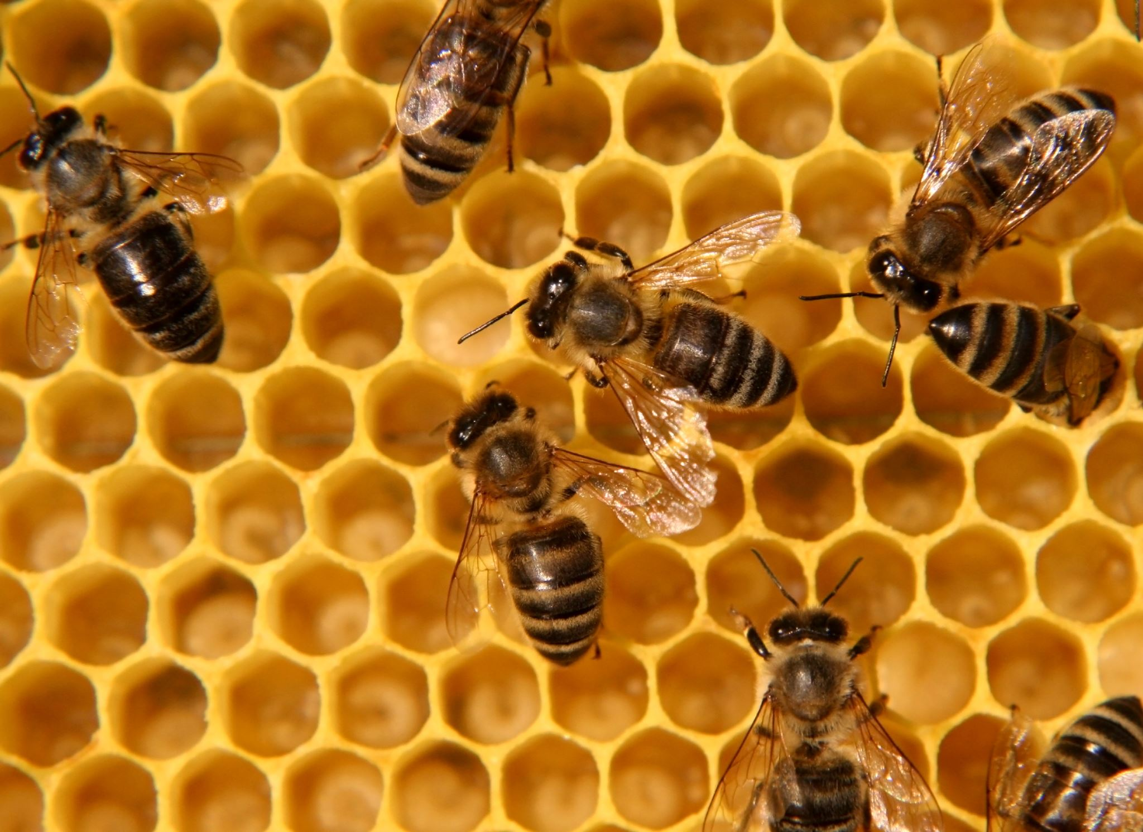
Opening Statement
Introduce the topic
Bees go through a life cycle.
A life cycle means the stages a living thing goes through as it grows.
A bee begins as an egg.
It slowly changes into an adult bee.
Bees live in a hive.
In a hive, there are three types of bees:
  queen bee
  worker bee
  drone bee

Slide 5
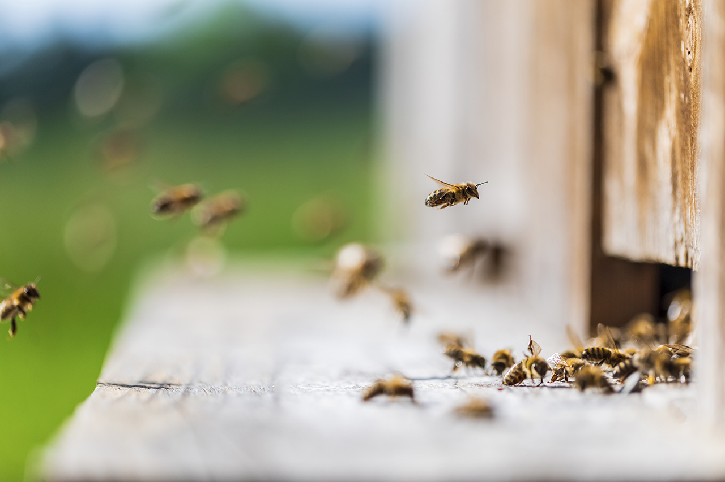
Series of Events
Explain the steps or events in order
1. First step or event: The Egg
First, the queen bee lays one egg.
The egg is laid inside a cell in the honeycomb.
A cell is a small hole in the honeycomb.
The honeycomb is made by worker bees.
The egg is:
  long
  thin
  white
This is the first stage of the bee’s life cycle.
Useful words to use:
first
queen bee
lays
egg
honeycomb
cell

Slide 6
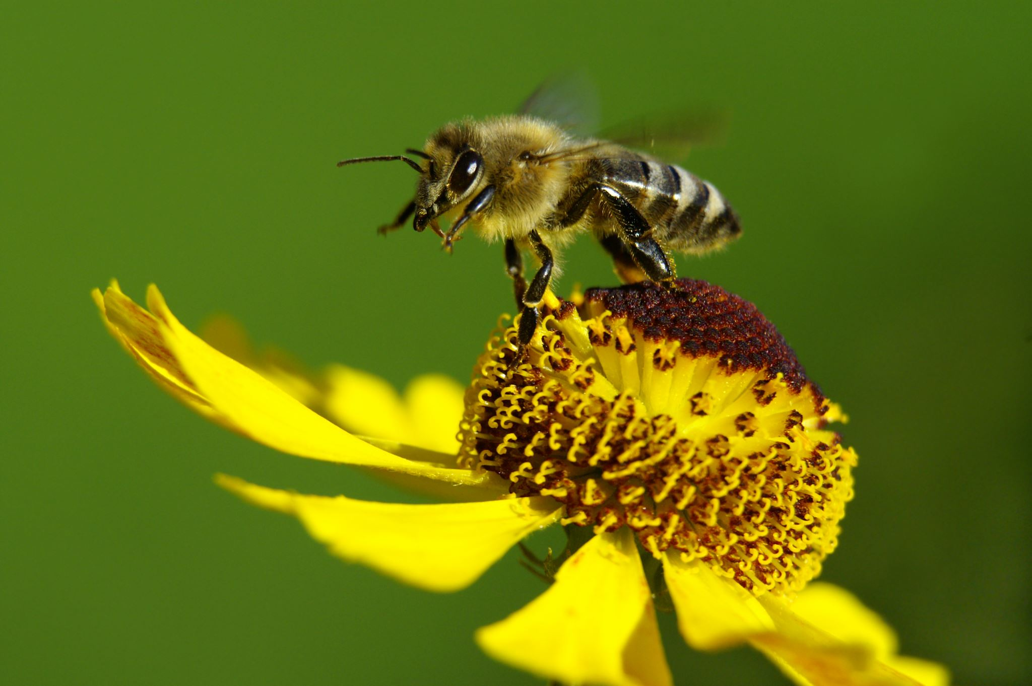
Series of Events
2. Next step or event: The Larva
Next, after about three days, the egg hatches.
It hatches into a larva.
A larva looks like a small white worm.
Worker bees feed the larva.
At first, the larva is fed royal jelly.
Royal jelly is a white liquid made by worker bees.
Then, the larva is fed bee bread.
Bee bread is made from:
  honey
  pollen
The larva keeps growing.
Useful words to use:
next
after three days
hatches
larva
white worm
royal jelly
bee bread
honey
pollen

Slide 7
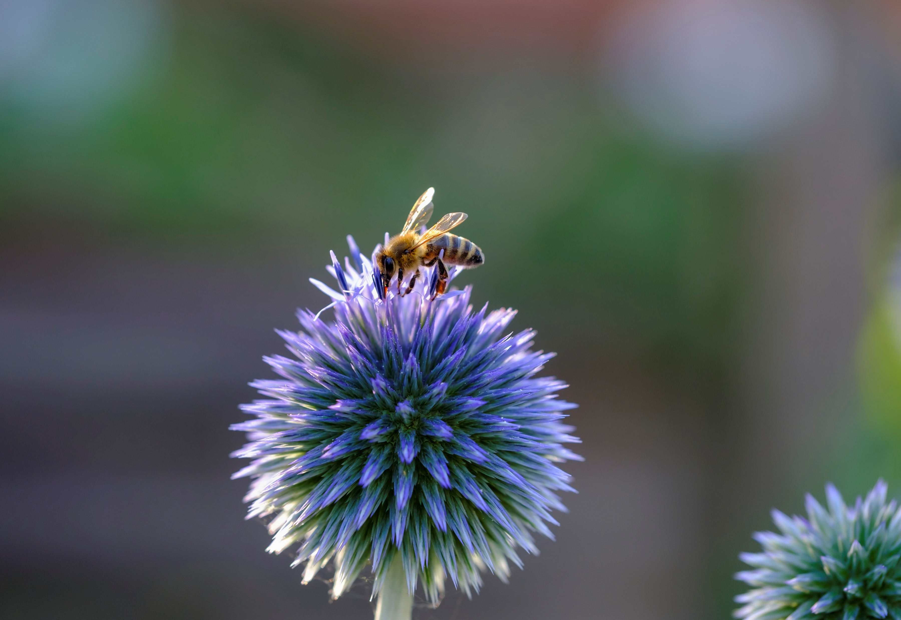
Series of Events
3. Next step or event: The Pupa
Then, worker bees seal the cell.
They use a lid of wax to close the cell.
This is called the pupa stage.
The pupa is no longer fed.
The pupa spins a cocoon.
Inside the cocoon, the bee begins to change.
The bee starts growing its:
  legs
  eyes
  wings
This stage helps the bee turn into an adult.
Useful words to use:
then
worker bees
seal
wax lid
pupa
cocoon
change
legs
eyes
wings

Slide 8
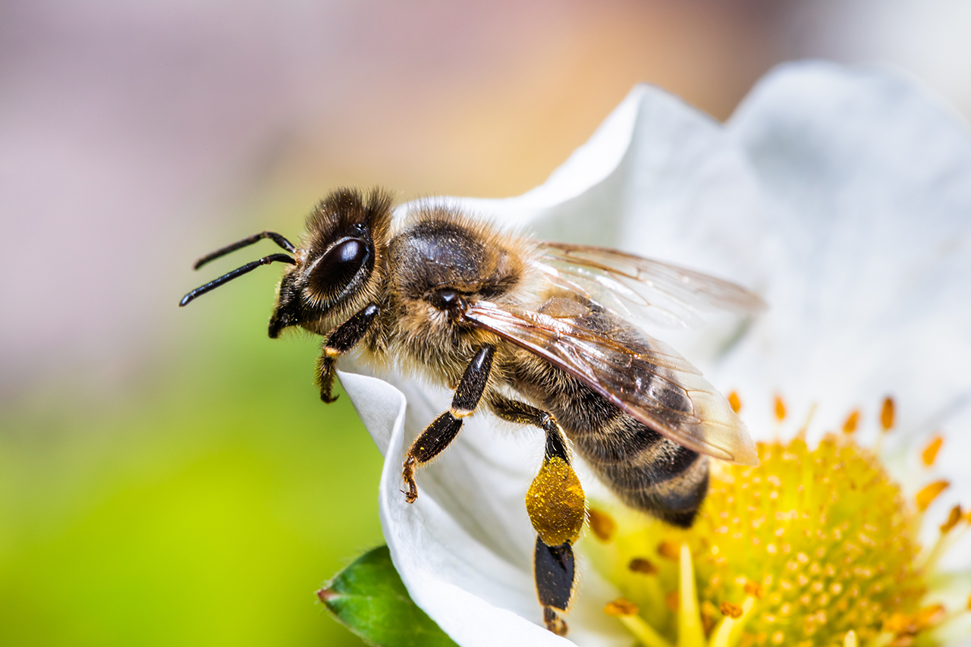
Series of Events
4. Last step or event: The Adult Bee
Finally, after 21 days from being an egg, the bee becomes an adult.
The adult bee bites the wax lid off the cell.
The bee climbs out of the honeycomb cell.
At first, the adult bee is a light grey colour.
The bee stays in the hive for 21 days.
At 22 days old, the bee becomes a forager bee.
A forager bee flies to flowers.
It looks for pollen.
An adult bee can live for up to six weeks in summer.
Useful words to use:
finally
after 21 days
adult bee
bites
climbs out
hive
forager bee
flowers
pollen
six weeks

Slide 9
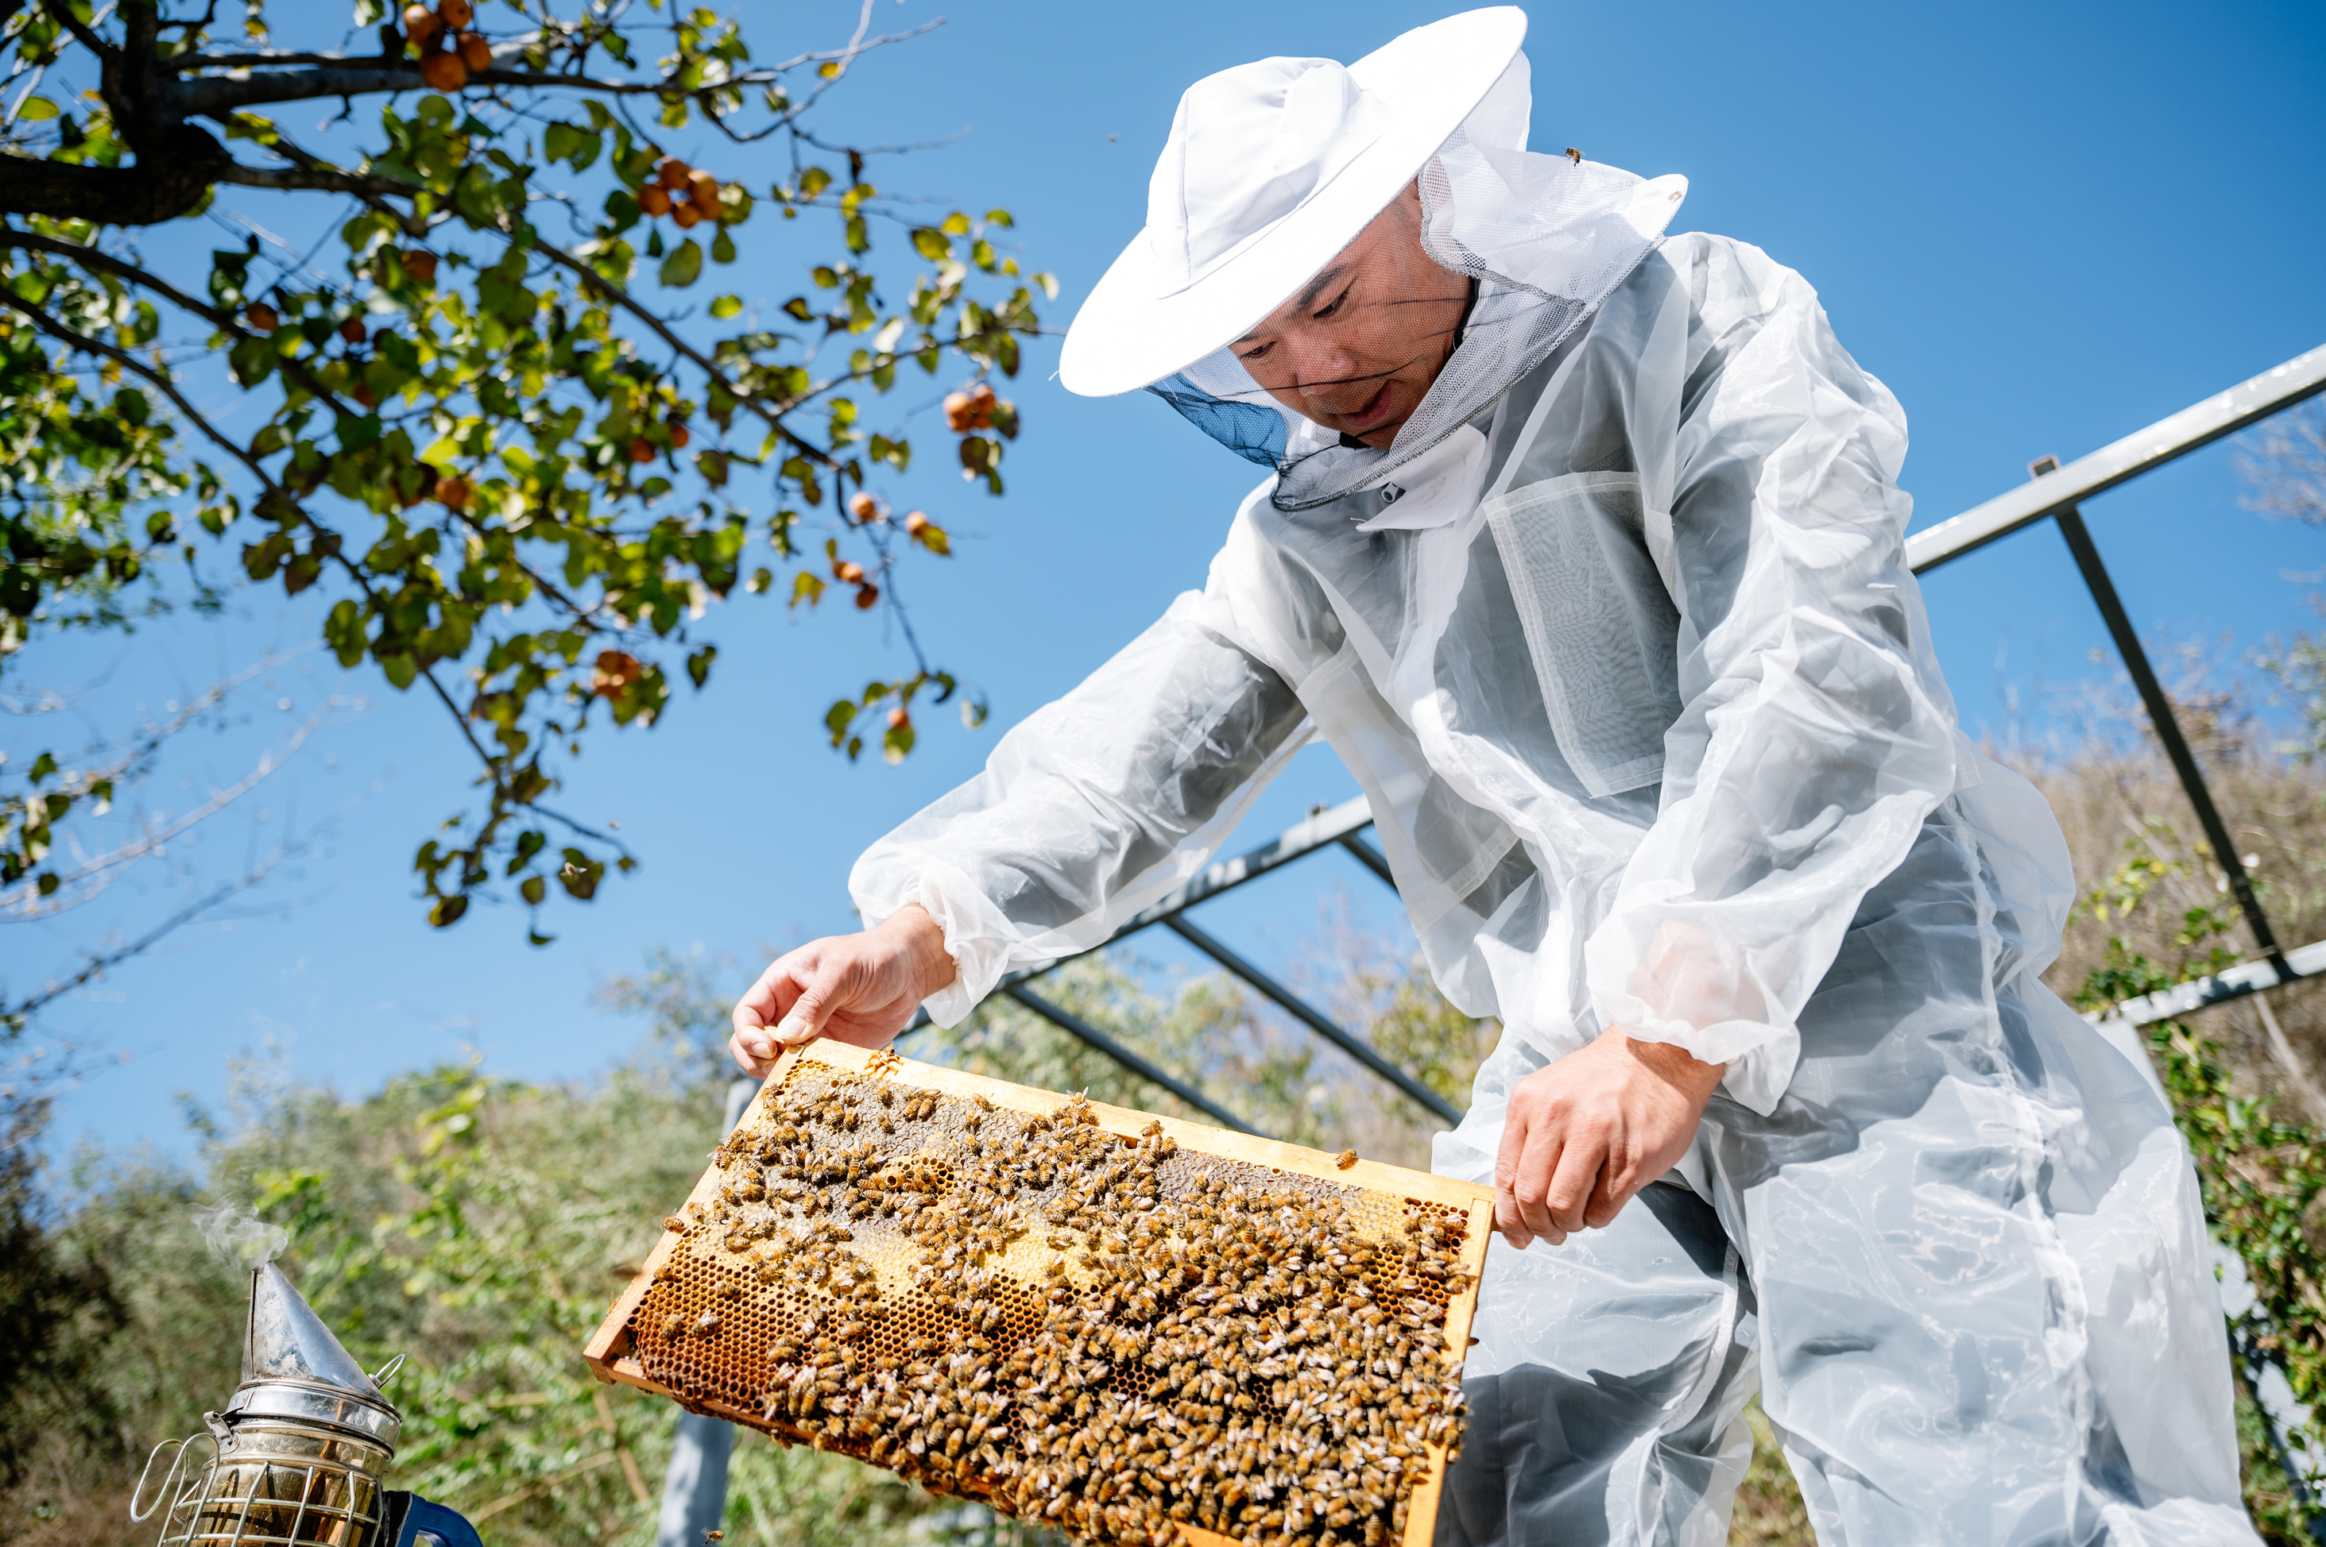
Conclusion
Finish by summing up your explanation
The bee life cycle has four main stages.
These stages are:
  egg
  larva
  pupa
  adult bee
Each stage helps the bee grow and change.
The life cycle shows how a tiny egg becomes an adult bee.
Adult bees can help the hive by collecting pollen.

Slide 10
Modelled Example

Slide 11
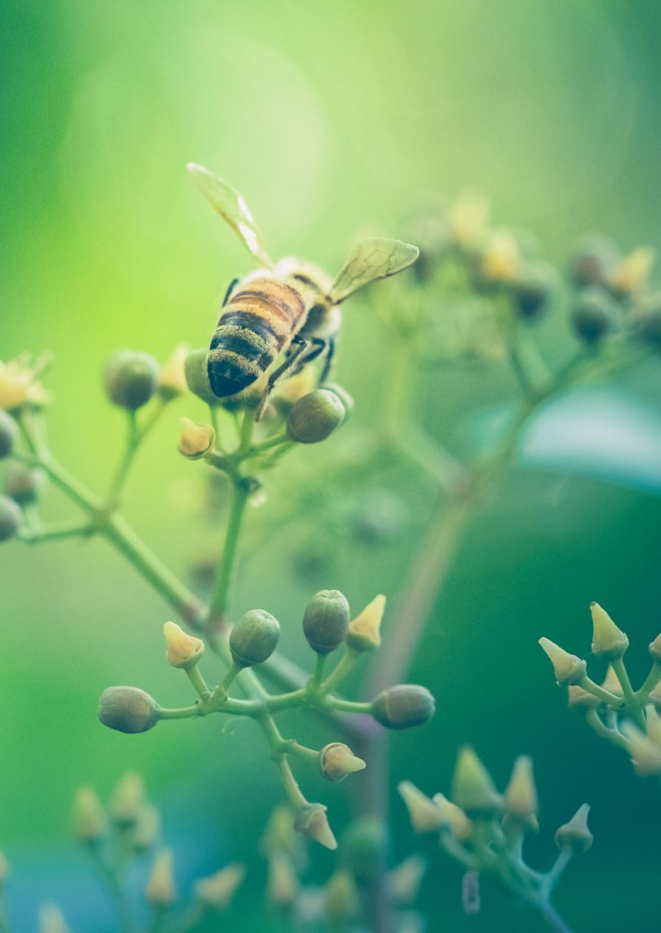
Title:
The Life Cycle of a Bee

Slide 12
Opening Statement
Bees go through a life cycle as they grow and change. A life cycle means the stages a living thing goes through during its life. A bee begins as a tiny egg and slowly changes into an adult bee. Bees live together in a hive. In a hive, there are queen bees, worker bees and drone bees. Each bee has a special job to help the hive.

Slide 13
First
First, the queen bee lays one egg in a cell of the honeycomb. A cell is a small hole in the honeycomb where the egg can stay safe. The honeycomb is made by the worker bees. The egg is long, thin and white. This is the first stage of the bee’s life cycle because every bee begins as an egg.

Slide 14
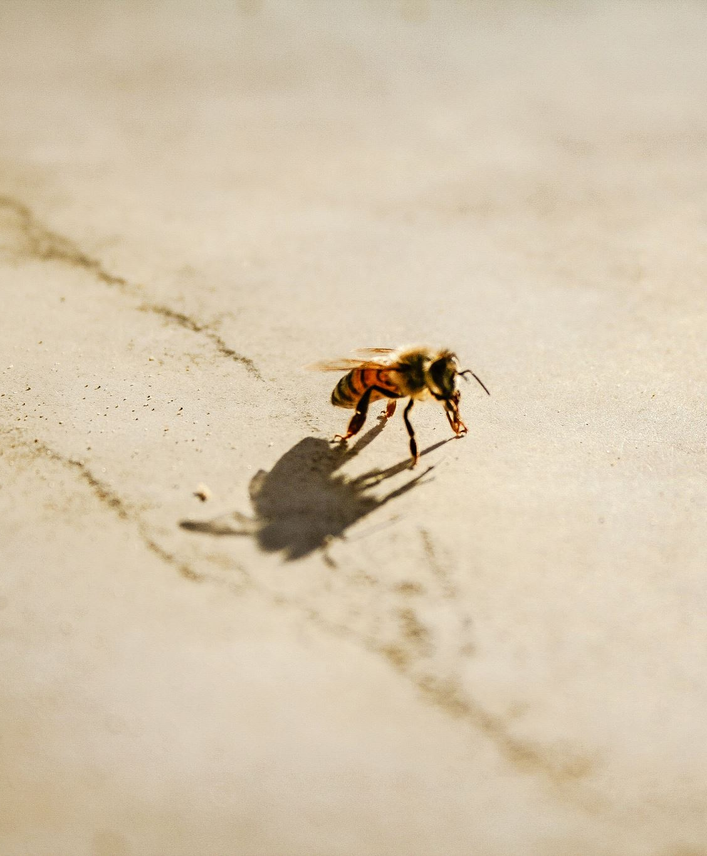
Next
Next, after about three days, the egg hatches into a larva. A larva looks like a small white worm. It cannot fly yet because it does not have wings. The worker bees look after the larva and feed it. First, they feed it royal jelly, which is a white liquid made by worker bees. Then, they feed it bee bread. Bee bread is made from honey and pollen. This food helps the larva grow bigger and stronger.

Slide 15
Then
Then, after a few days, the worker bees seal the cell with a lid of wax. This means they close the cell so the bee can keep growing safely inside. This is called the pupa stage. The pupa is no longer fed by the worker bees. Inside the cell, the pupa spins a cocoon and begins to change. Its legs, eyes and wings start to grow. This is an important stage because the bee is changing from a larva into an adult bee.

Slide 16
Finally
Finally, after 21 days from being a new egg, the pupa has become an adult bee. The fully grown bee bites the wax lid off the cell and climbs out. At first, the adult bee is a light grey colour. It stays inside the hive for 21 days. When it is 22 days old, it becomes a forager bee. This means it flies to flowers and looks for pollen. An adult bee can live for up to six weeks in summer.

Slide 17
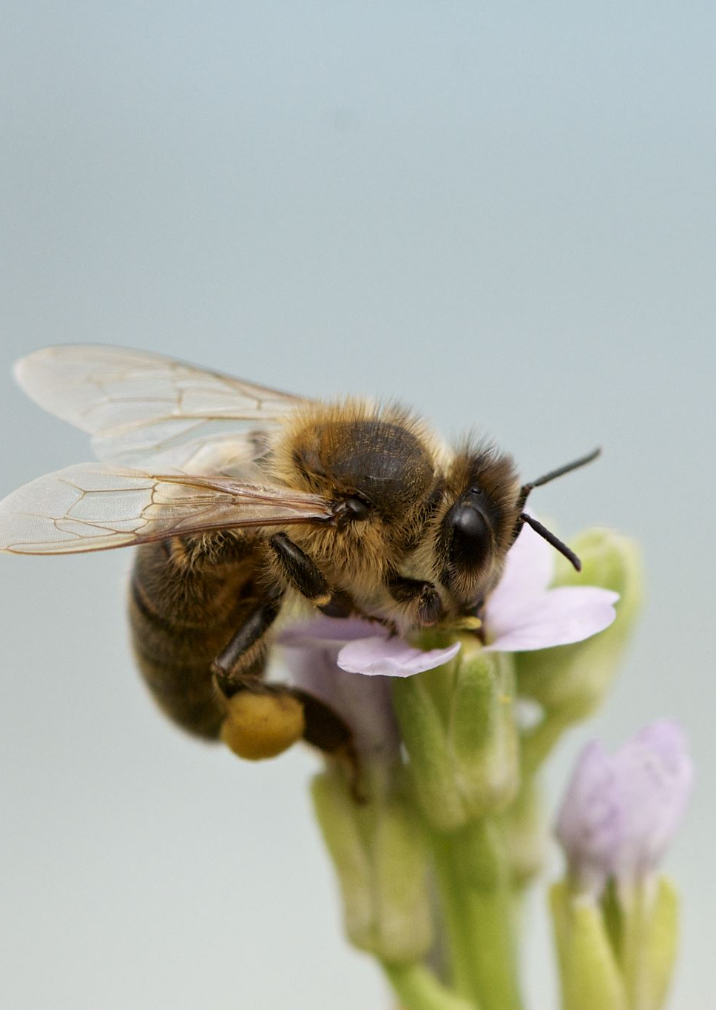
Conclusion
The life cycle of a bee has four main stages. These stages are egg, larva, pupa and adult bee. Each stage helps the bee grow and change. The life cycle shows how a tiny egg can become an adult bee that flies to flowers and helps the hive.

