Slide 1
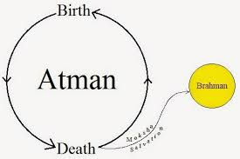
Basic Vedic Metaphysics
History of the Self
Roger K. Green
2024

Slide 2
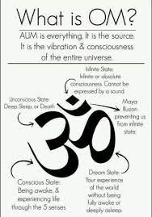
OM / AUM Brahman The Universal Principle The Primordial Sound Sanskrit: ब्रह्मन् Three Parts: A-U-M Trumurti: Creation Preservation Destruction Shruti (Sound)

Slide 3
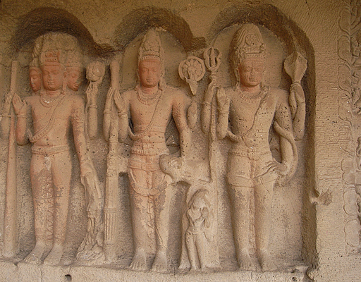
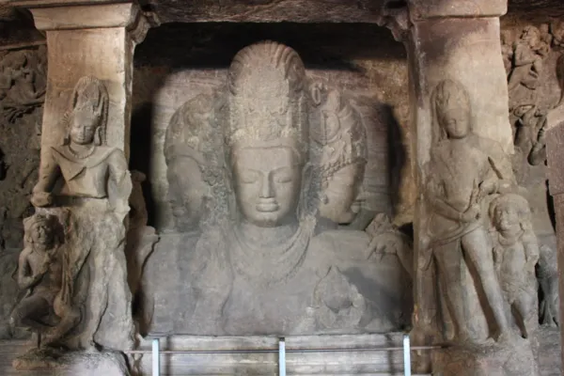
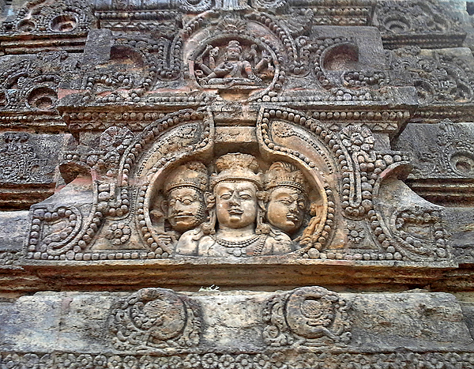
Trimurti

Slide 4
All of these gods and most ancient deities have consorts of the opposite sex -- yes, even Yahweh had one (Asharah)

Slide 5
Shakti: Universal Power
Generally, gods are in their full power when combined with their feminine, creative consorts
Dvandva = “pair” in Sanskrit, or an “agglomerated” noun compound. We see dual pairing in various languages around the world
I.e., brothersister = siblings, father-mother = parents, huband-wife = married couple
Radha-Krishna – unity of Krishna with feminine creative powers
Mitra-Varuna

Slide 6
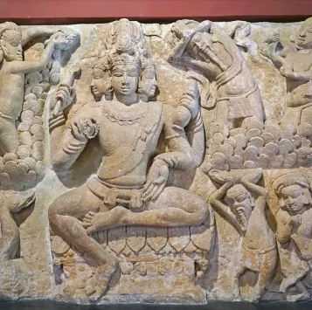
Brahma: The Creator
Female Consort Saraswati
Earlier Vedic deity, Prajapati
Often depicted on top of a swan

Slide 7
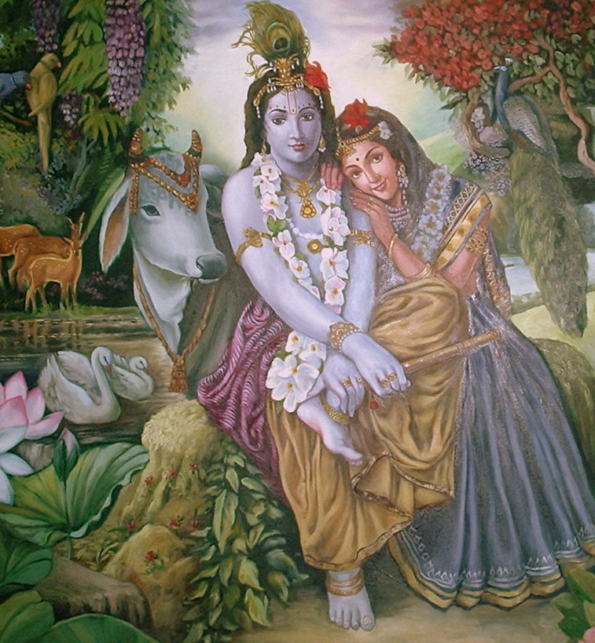
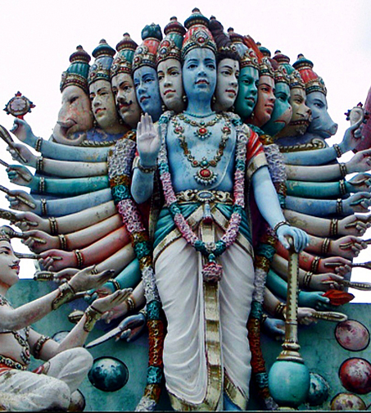
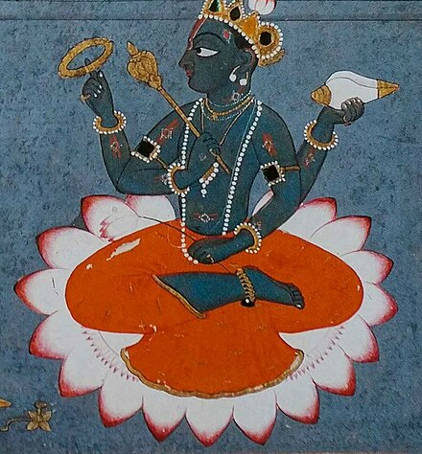
Vishnu: The Preserver, bestower of karma
Female Consort: Lakshmi
Krishna is considered the 8th avatar of Vishnu. Consort is Rhada
Avatar literally means “descent” and the word doesn’t appear in the Vedic texts but does in later Puranic texts and the Bhagavad Gita

Slide 8
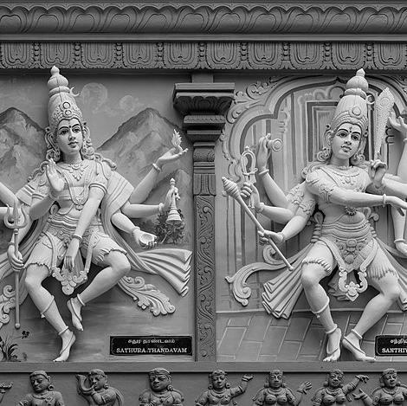
Shiva – The Destroyer / Liberator
Female Consort: Parvati or Devi in Shakta tradition where Shiva amalgamates the Trimurti into one being
Often depicted as dancing (lila / play)
Shiva is older than the Vedas and is an amalgamation of deities including Rudra

Slide 9
Rig Veda: 33 Devas (12 Adityas, 11 Rudras, 8 Vasus (material elements), 2 Ashvins
Many Adityas amalgamate into others in later times

Slide 10
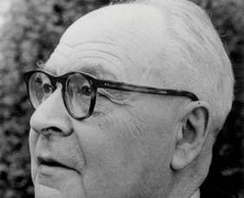
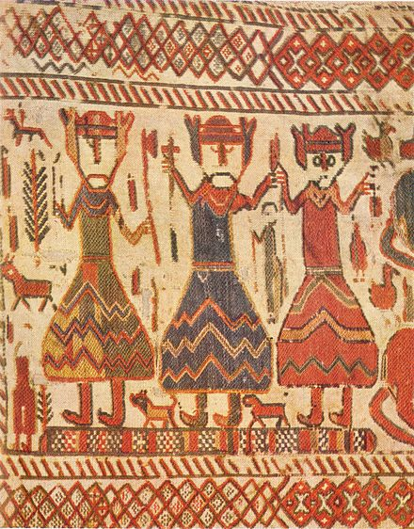
George Dumézil’s Trifunctionalism or Tripartite division in Proto-Indo-European Societies
Sovereignty with implicit dualisms: for example, war leader and priestly (ex. Mitra-Varuna; Indo-Iranian, Romulus-Numa; Latin), Holy Roman Emperor and Pope (eurochristian). Another dualism is “worldly priest” / juridical-lawmaker and “unworldly” and unpredictable priest rooted in the supernatural world (ex. Pentheus versus Dionysus in Euripides Bakkhai.
Military: soldiers
Producers: herding, farming, craft-makers. For example, Odin-Thor-Freyr trifunctional relationship in Icelandic mythology)

Slide 11
More Examples of Trifunctional Division
Ancient India castes (jāti – “birth”): Brahmins (priests)-Kshatriyas (warriors)-Vaishya (agriculturalists) with Shudras as peasants who apparently don’t count. Later four in the Laws of Manu “occupational caste division” (varnas- “colors”) place Vaishyas as merchants and Shudras as artisans with Dalits (“scattered”) or “untouchables” and Adavasis (Indigenous peoples) beneath them. Dalits and Adavasi Peoples are not considered varnas.
Plato’s Republic – Guardians or “philosopher kings”; auxiliaries or soldiers; producers / laborers
In Karl Marx and Friedrich Engels – Aristocracy; Bourgeoisie; Proletarians (and later Lumpenproletariat)
Later: Freud: Superego-Ego-Id

Slide 12
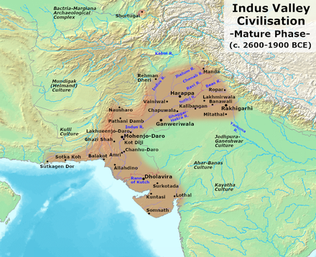
Indus Valley Civilization (3300-1300 BCE)
Possibly Dravidian Language but not yet decoded
250 million Dravidian language speakers today, “Tamil” is the Sanskrit word for Dravidian
Split occurs 2000-1600 BCE
Vedic Peoples (Wusun as Chinese describe them) enter India around 1500 BCE. Soma sacrifice is Vedic. Invasive warrior culture
Eventual split with early Iranians

Slide 13
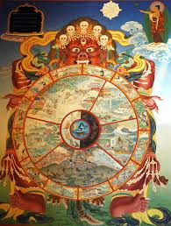
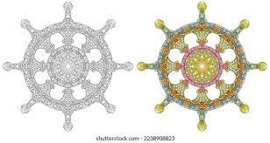
Karma, Dharma, Moksha
Karma = Action
Dharma = Duty or “right action” (etymology of Dharma shows in Prakrit “to hold firm or support”; in Iranian “dara” – holding; in Greek “throne / seat”; Latin, “firm”
Moksha = liberation (implicitly from karmic wheel)

Slide 14
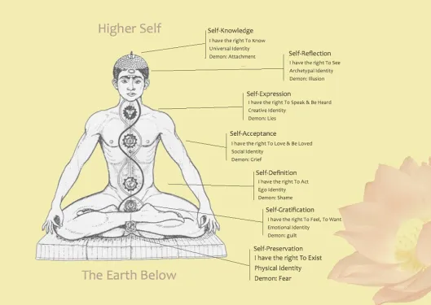
Chakras “wheels”

Slide 15
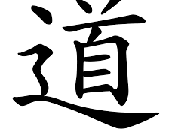
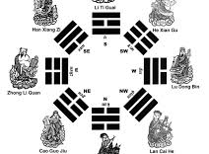
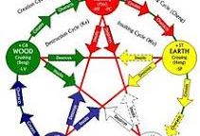
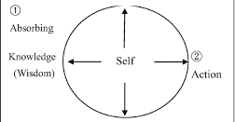
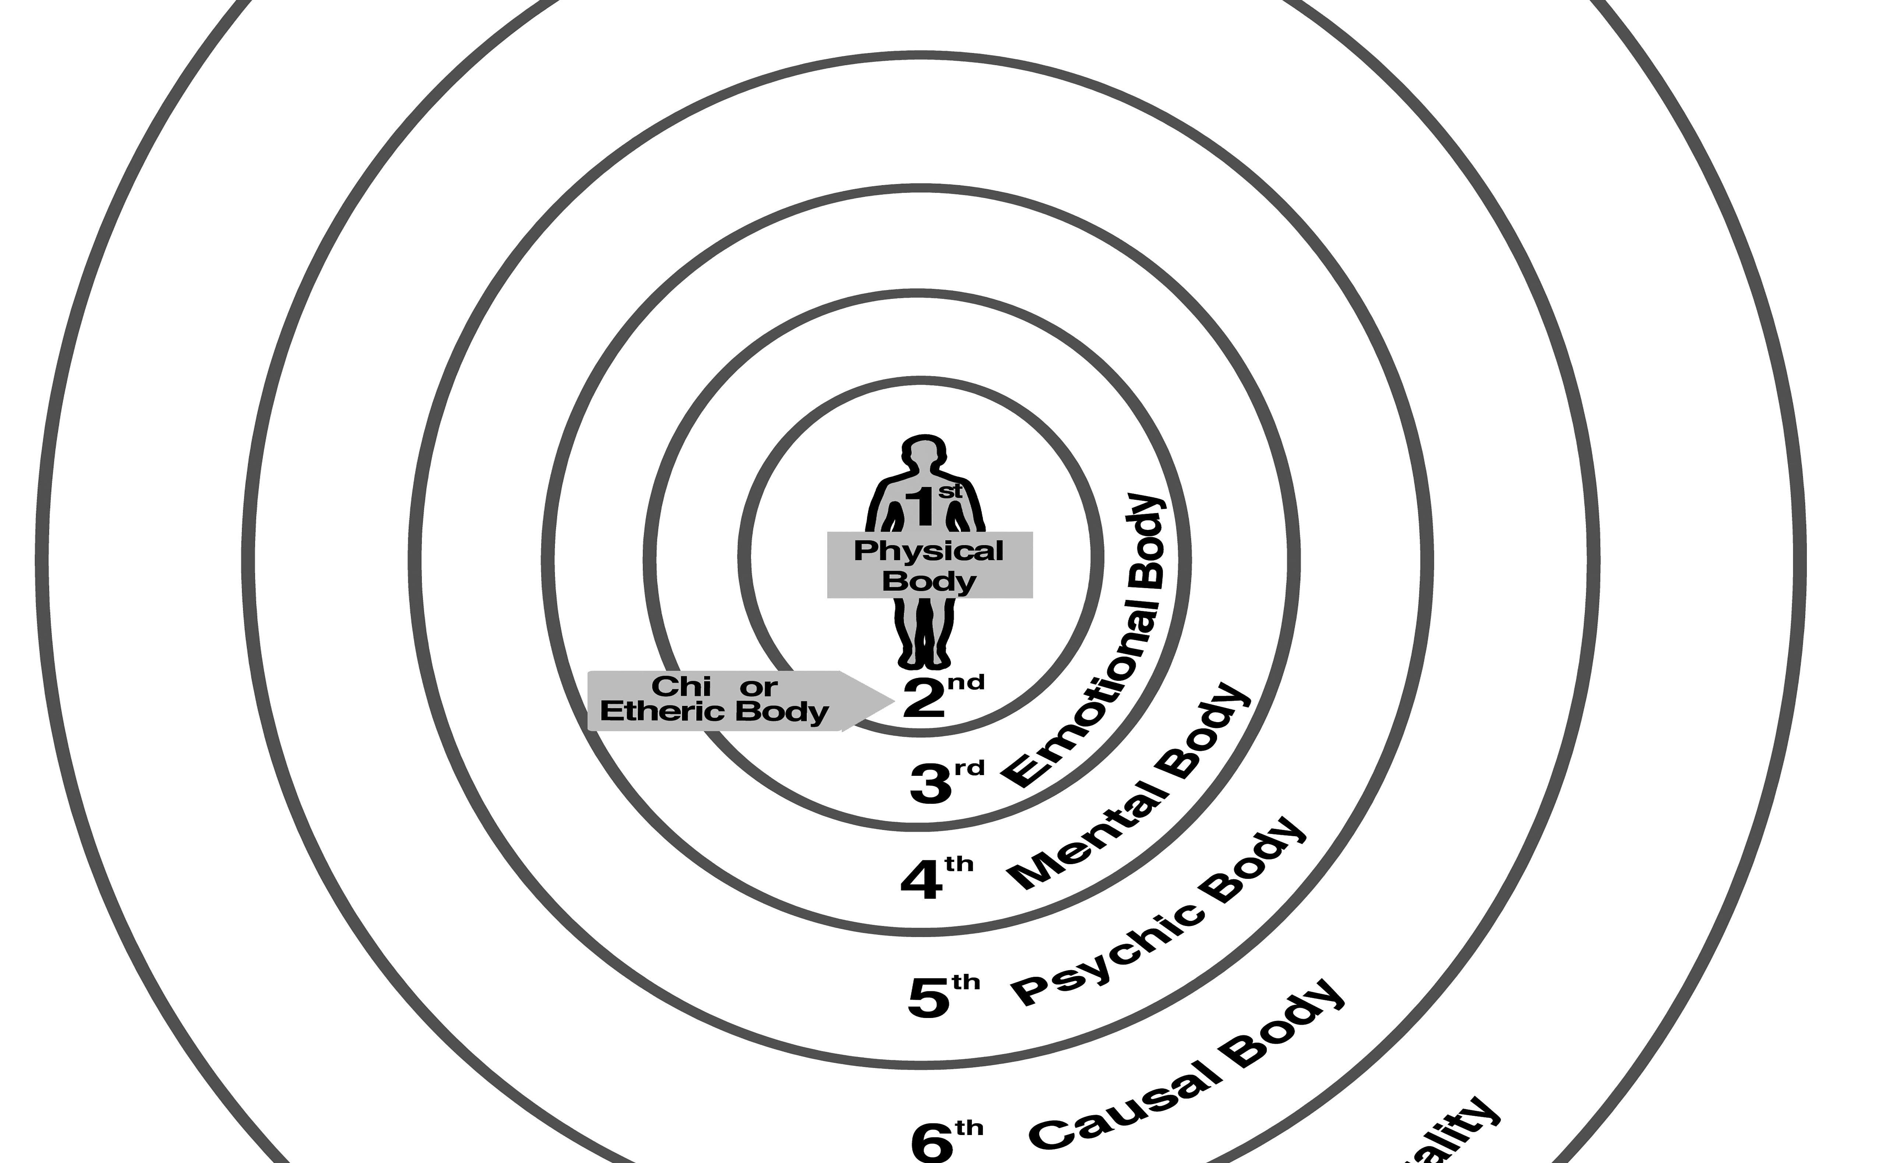
Taoist Concepts
8 Bodies
Physical
Chi – etheric body
Emotional
Mental
Psychic
Causal
Body of Individuality
Body of Tao --Boundlessness

Slide 16
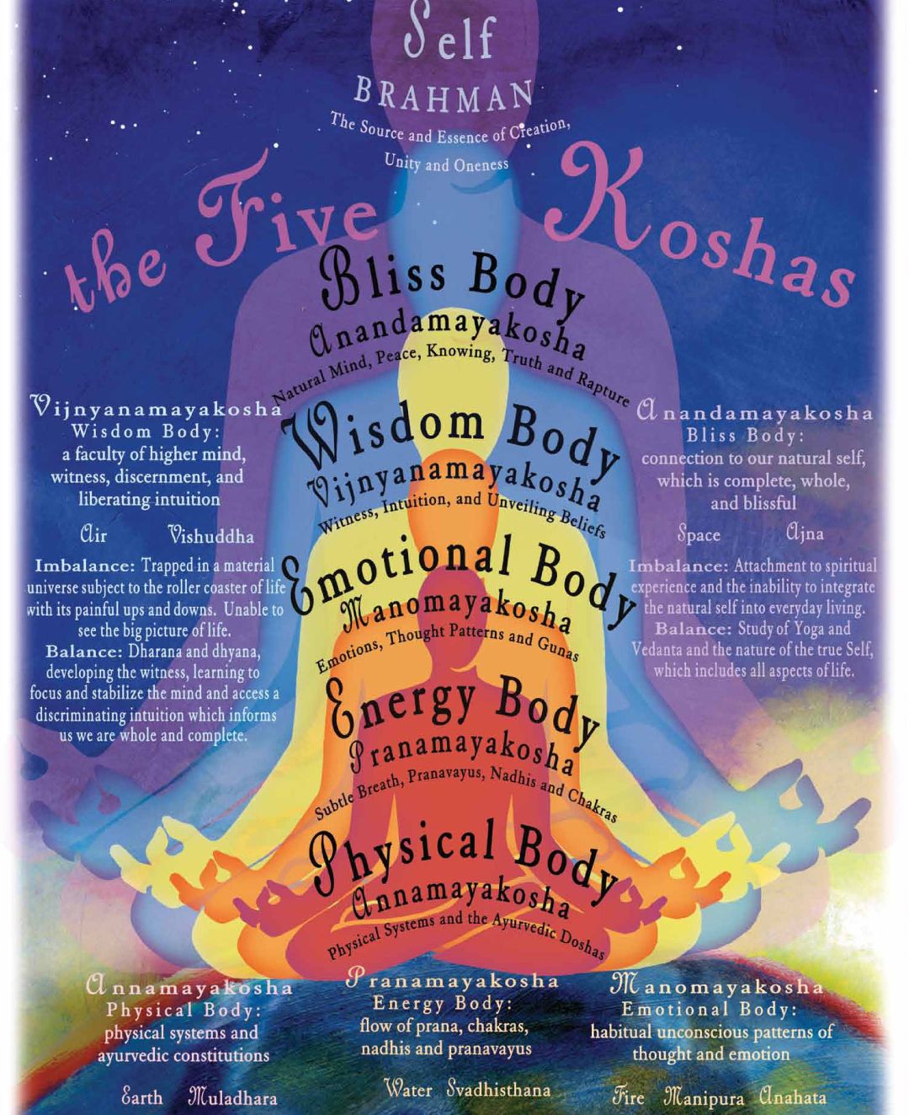
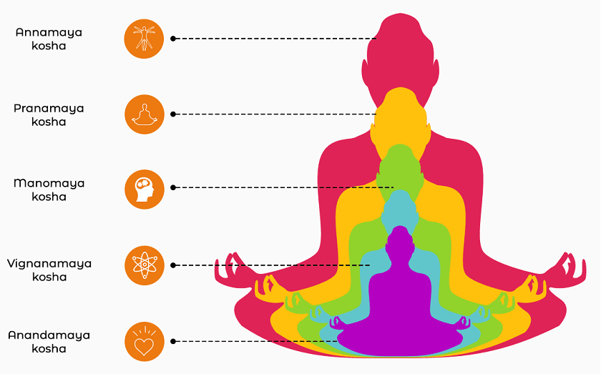
Yogic Layers of Self (Atman)
Koshas or “sheaths”

Slide 17
Canaanite Gods

