Slide 1
Lacan’s Mirror Stage

Slide 2
Mirror
I (ego) (Gap) Me (imago)
(Desire)

Slide 3
Identity = At least two
Identity
Object
Subject

Slide 4
Identity Gap / Desire
Objective “Me”
Subjective “I” / Ego

Slide 5
With the development of the Ego, “I” becomes separate from itself. This makes linguistic representation possible.
Identity Gap / Desire
Objective “Me”
Subjective “I” / Ego

Slide 6

While the “I” becomes separate from itself, it also becomes separate or “other” from the world.

Slide 7
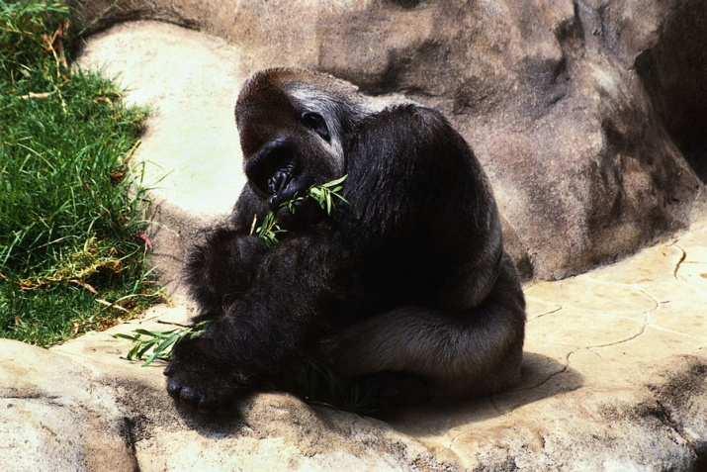

It also allows us to make the world “other.”

Slide 8
Humans come to define themselves through the ways they use technology and tools to shape their world.
Language is a technology.

Slide 9
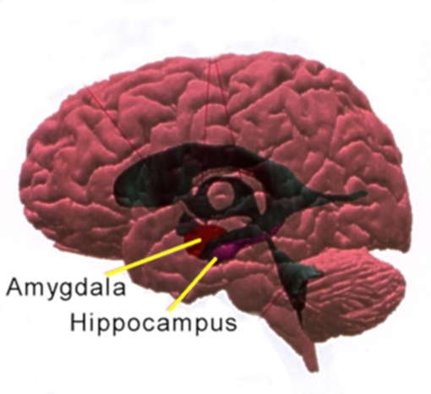
There is biological bases for the development of our ability to perceive others’ feelings in the most recently evolved parts of the human brain. Lacan was only partially aware of this, but he referred to certain animal studies that require mimicking other members of their species for development. He cites scientists who successfully used mirrors with female pigeons’ gonad maturation when another pigeon was not present (“The Mirror Stage as Formative Function of the I as Revealed in Pschoanalytic Experience” 992). More recently, brain science makes these arguments with respect to humans.

Slide 10
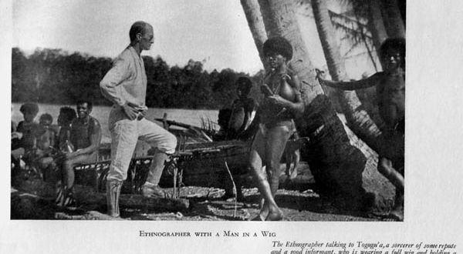
The “I” also becomes an object in the world, potentially harmed or loved by others. Lacan says the baby understands itself as the “object of its mother’s affection.” Quickly, the baby learns it has competition.

Slide 11
“The mirror stage is a drama whose internal thrust is precipitated from insufficiency to anticipation.” –Lacan
The separation necessary in the mirror stage introduces the ability to represent in terms of language and also the ability to perceive and eventually narrate time.

Slide 12
In children’s literature, we see the fundamental building blocks of narrative, which requires anticipation.
Knock knock…
Who’s there?
Children often delight in the narrative game even when they don’t get the joke.

Slide 13

Children quickly become aware of unfulfilled anticipation. We even call a time after the mirror stage “the terrible twos.”

Slide 14
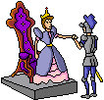

Need vs. Lack
For Lacan, we can physically get what we need, but psychically we are never able to fill our desire. We live a perpetually unfulfilled existence driven by desire for something “Other” to give us meaning.

Slide 15






So, meaning tends to be elusive and related to desire. In some ways it’s subjective, but there are clearly desires many people share.

Slide 16
And yet in many ways we keep striving. Many pine for marriage only to feel unfulfilled.

Slide 17
Loss eventually plays a part in our lives. We often turn toward an invisible “Other” when this occurs.

Slide 18
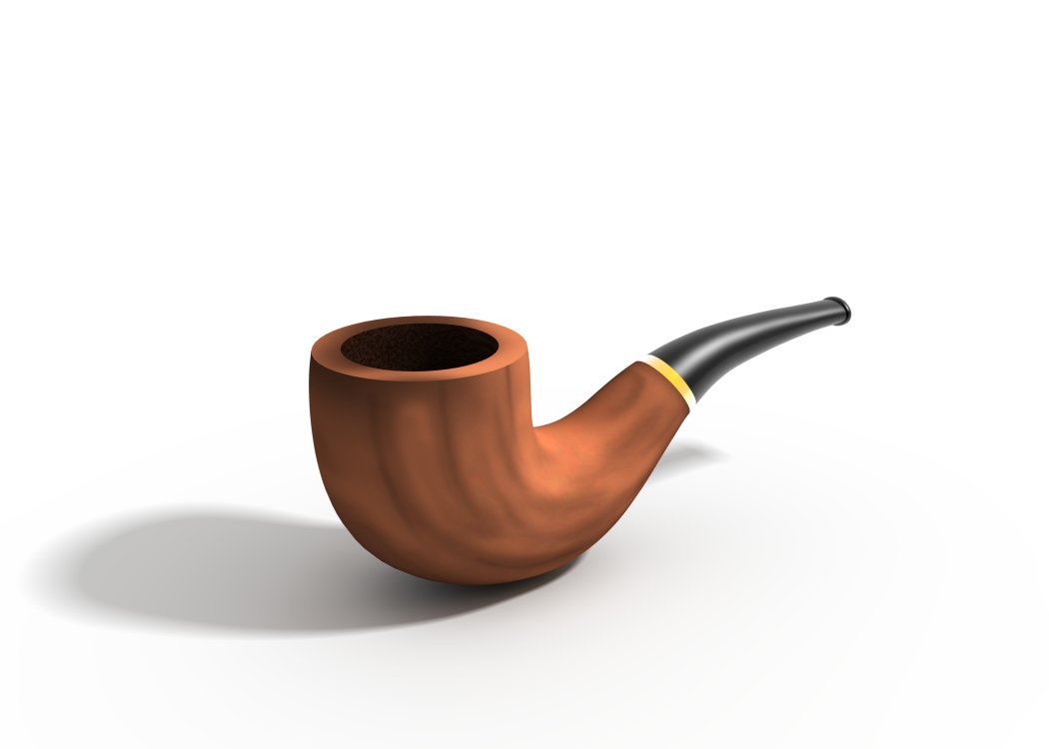
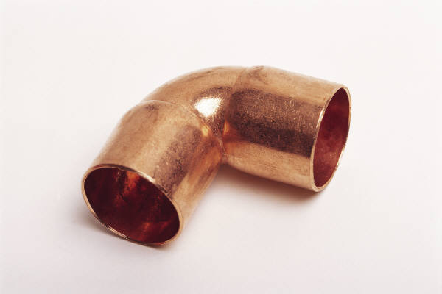
This is not a pipe…and neither is this
…nor is P-I-P-E
All language is representation.

Slide 19
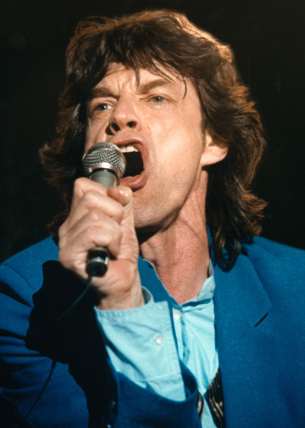
As Professor Paul Fry says, for Lacan unlike Mick Jagger, “You can never get what you want, but if you try…and you must at least try, you might get what you need.”

Slide 20
What is Literature?
The study of literature is about the study of meaning, not just how we determine meaning but how meaning plays a social function in our lives.
Literature is about the social ways we use language to encode and memorialize desire.
Just as language precedes us, just as no one in the room has 100% knowledge of English but is nevertheless proficient, the field of literature is an open system.

Slide 21

play
Literary and writing study consciously avows language play, which involves both substitution (metaphor) and absence (elision or omission).
Literary interpretation articulates and imagines the extensions or exteriority of closure.
We fill in gaps all the time.

Slide 22
Lacan is interested in two specific kinds of substitution.
Metaphor: carrying –over or transfer.
Example: “Your love is a beacon of hope.”
Metonymy: A particular kind of metaphor where we take a part for a whole.
Example: Have you read Shakespeare?

Slide 23
S
S
The Signifier is always different from what is Signified. Like the necessary gap in a sparkplug, meaning “sparks” between the sign and the signified.
Example: Shakespeare
William Shakespeare –English author-the collected writings of…

Slide 24
With literature
Studying Literature means we are attentive to the way language and meaning are created through the “sparks” that connect the gap.
That’s one major difference between plot-based reading and identity-affirming reading (book club or consumer criticism)

Slide 25
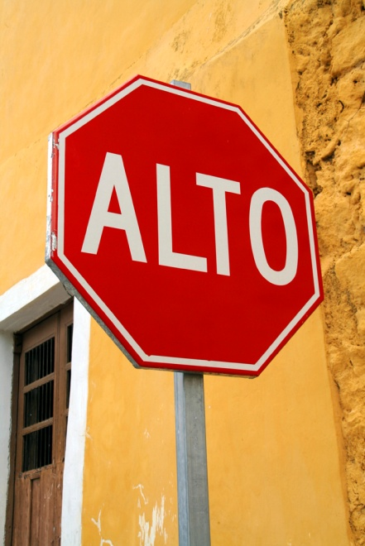

Symbols v. metaphors
While symbols tend to have more socially fixed meaning,
metaphors may require more reflection.

Slide 26
In the statement “I am Roger” I = Roger and at the same time I ≠ Roger.
“What one ought to say is: I am not wherever I am the plaything of my thought; I think of what I am where I do not think to think” (Lacan 1058).

Slide 27
“Who, then, is the other to whom I am more attached than to myself, since, at the heart of my assent to my own identity it is still he who agitates me?” (Lacan 1062).

Slide 28
“I am Roger”
Both the “I” and “Roger” are substitutes for an absent-presence (an elision of the signified).
“I” is a metonym for all of my identity’s potential.
“Roger” is a metaphorical sound / image for both others and myself to locate me at present.

Slide 29
Literature and Writing vs. Communication
While communication is necessary, a need fulfilled through its process, “literature” and literary writing signifies desire and open potentiality. We don’t know where it ends, but in exploring it we track what our capabilities are.
I say “we” because language exists prior to and among people.

Slide 30
silence
Like the first letter in Hebrew, א (Aleph), which is silent, we do not have access to the origin of language.

Slide 31
Desire in Literature and Writing
Desire, a lack that exceeds need, in literature is perhaps at its most basic level accomplished by narrative. So much of literature is based on stories of journeys and returns.
But something exceeds the communication of “what happens.”
To put it in Roland Barthes’ terms: We may indeed get pleasure out of a plot, but we return to some plots again and again because they exceed pleasure and become bliss.

Slide 32
Desire in Psychoanalysis
Desire in psychoanalysis relates to Freud’s popularization of the term “libido” for instinctual drives.
Unsurprisingly, the term often goes through linguistic broadening to characterize sexual drives alone, but just as one sexual act does not extinguish the desire of love (but may function as a procreative need), what Freud calls “eros” (love) signifies an inexhaustible perpetuity.

Slide 33
To reduce language to a purely communicative function, to ignore the literary, is to remove (or at least diminish) the both the possibility for developmental growth necessarily engaged by a subject (a child perhaps) interacting with a linguistic environment, but it is to simultaneously remove or diminish a capacity for love, compassion and understanding…the very qualities that are biologically the most evolved aspect of the human brain.

Slide 34
Literary competence is not to be judged at one particular instance of a human life, since to do so would necessarily set a limit to desire, to eros, to human capability.

Slide 35
To those highly invested in the potential for literature to express desire and potentiality, generic or surface engagements with literature as only “pleasure” and not “bliss” seem backwards or ignorant.

