Slide 1
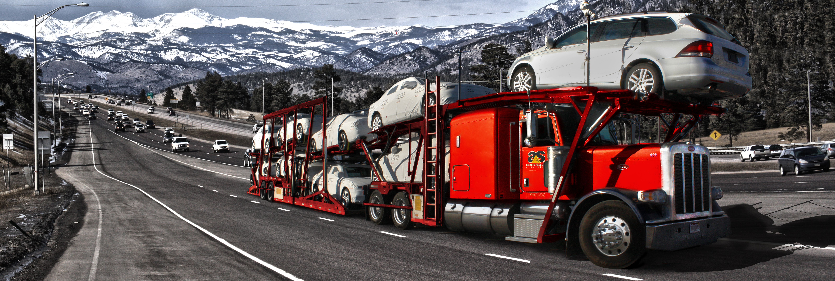
Successful owner Operators Guide
ACCELERATED SERVICES AUTO Transporters

Slide 2

MILES
Average Miles: Drivers must average 350-450 miles per day. (including days off)
While running local/short mile loads; multiple loads must be completed per day. (30-mile load= 4 trips per day)
Days Per Week: Our most successful drivers are driving 5-6 days per week and maximizing their hours while taking strategic resets.
Home Time: We strive to get drivers home when requested but sometimes it is simply not possible due to inventory levels and/or available freight. Driving home empty every weekend will deduct from all the loaded miles that you've worked hard to complete and reduce your revenue.
Loaded Miles: While loaded miles helps to raise revenue, driving past available freight is very costly to the OO and company. Not all our freight is bid as "turn able" traffic so you must use the Network synergies to improve RPM and reduce empty miles.
Out of Route Miles: Keep to a minimum. The extra fuel and wear/tear on the truck adds up quickly and will quickly reduce your revenue.

Slide 3
Maximize YOUR hours
On Duty Hours: Strive to use all available ON DUTY HOURS (70 hrs weekly/14 hrs daily). When you maximize your hours it will help you be more efficient and productive which will increase your revenue. But be sure to always stay in compliance with all DOT rules and regulations regarding Hours of Service.
Plan and Communicate: Plan out the upcoming week as best as possible. Communicate with dispatch if you have an appointment or something to attend. If you need to be home on a Friday, you should start working the Saturday/Sunday before to maximize your full time available prior to when you need to be home. Maximize your hours!
Have a Clear Game Plan: Check dealer/yard hours of availability to best plan out your route and your week. If you need to drive longer to make sure you can get units delivered before a facility closes, then you must plan for that. If you need to be empty in time to reload at a certain time, then you must strategize for that. There will be issues along the way, but the more you have a plan or goal each day the more productive you will be. Our top earners have a clear game plan at the start of each week and make sure to hit certain goals throughout the week.
Extended Time Off: If you plan to take extended time off then it is best to plan so that you are splitting pay periods. This will help not have all the time off hitting in one pay period. It will help to spread your revenue out throughout the month.
Seasonality Take advantage of high revenue periods when possible i.e. end of month, end of year, holidays etc. taking time off prior to or after these periods can substantially increase revenue..

Slide 4
Load Factor
Maximize Load Capacity: It is crucial that you maximize your truck and trailer to full capacity with freight as much as possible . At times it might be easier not to reload or switch vehicles around and just leave a unit off, but the loss in revenue can be substantial. See example below:
  One $350 unit added to each week. $350 X 52 weeks= $18,200 yearly additional revenue
  One $500 unit added to each week. $500 X 52 weeks= $26,000 yearly additional revenue
Plan Out The Load: Sit down after being dispatched and plan out the load. Ask yourself these 2 simple questions:
  “What is the most efficient and safest way to load?”
  “Can I load it a different way to gain another unit?”
Driver Network: Ask fellow drivers about different ways to load the trailer. Tap into your fellow driver network for tips and advice.
Do not fuel prior to loading (when possible) to help avoid overweight situations.

Slide 5
Damages
Reduction in Claims = Increase in Revenue: Keeping damage claims down is one of the most important parts of being a successful owner operator. Damage claims quickly reduce any profit that you have worked so hard for.
Use All Your Tools: Use all necessary tools to ensure that you are damage free for each load. https://safeaccelerated.com/ has all OEM vehicle load restrictions and other important OEM related information. You can visit this anytime for reference.
  Use height sticks to ensure units are secured below 13’6”
  Make sure to weigh your truck so you know what it weighs empty. This will allow you to fully maximize your load weight without causing any damage while hauling too big of a load. This also reduces extra wear and tear on truck and trailer.
  Make sure all units are properly secured using soft tie straps. Each tire and wheel needs to be safely secured.
  Double check that all decks are lowered before putting truck in motion. It's easy to forget to lower your deck after stopping at a dealer to unload a unit. This is how bridge hits happen.
  Tape your fuel doors and mirror caps for all units that you load backwards. This is a self-inflicted claim that can be prevented by a simple use of painter's tape.

Slide 6

Dispatch
Trust your dispatch team as they have the big picture and want to maximize your revenue.
Communication is key with dispatch. Giving accurate ETA’s , down time, shop time, hours of service feedback will help dispatch plan-ahead and maximize your time.
Update dispatch when you will be delayed more than two hours regardless of reason.
Give as much advance notice as possible when special request are needed. (vacations, graduations, weddings)
Give positive feedback to dispatch so we can help you be successful.

Slide 7
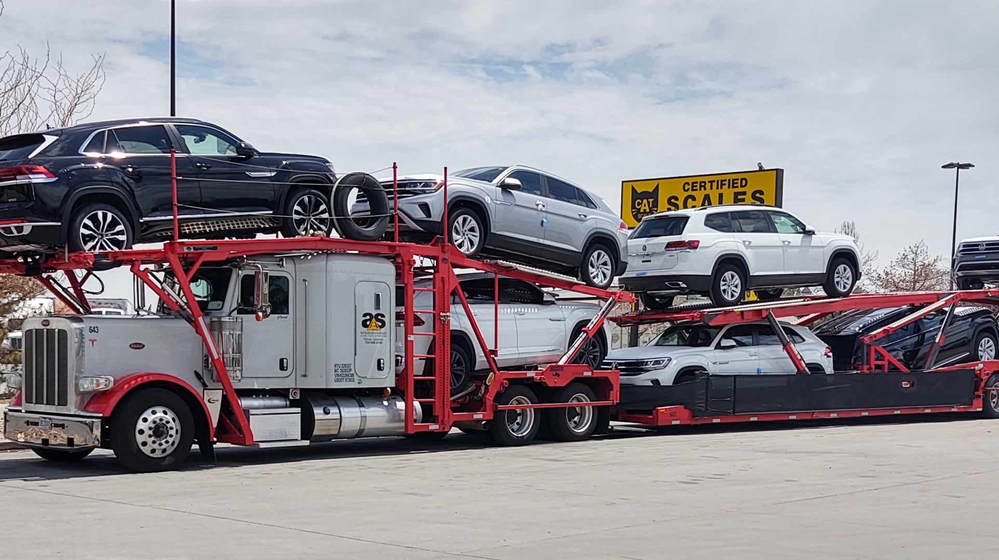
Truck Maintenance Checklist
Check all permits to make sure you have them all (permit book)
Do DOT (lights, tire pressure, tiedown bar, height stick, straps etc.)
Check all fluids (oil, water, hydraulic)
Oil Change every 18K-20K miles
Make sure to grease every 8K-10K miles.
  Drop trailer grease- 5th wheel plate
Every 250K miles change oil in Trans and change Air Filters. This will help keep warranty up to date.
500K miles- extended warranty
Yearly- service, new batteries, Hydraulic filter, shocks

Slide 8
Truck Maintenance Checklist (Winter Preparation)
Hydraulic Fluid (Skydrol or high viscosity fluid) in lines during winter months.
Drain air tanks
Dope fuel when temp is below freezing
Insure tire chains or socks on truck and in good shape
Carry heavy duty jumper cables and general tools on truck
Emergency road side kit and fire extinguisher
Stay on top of warranty requirements and purchase extended program before 500K miles

Slide 9
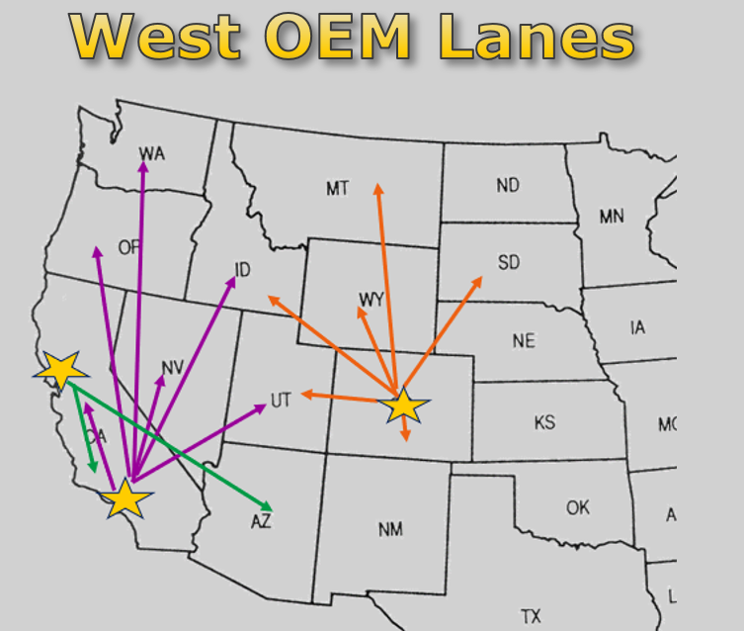

Slide 10
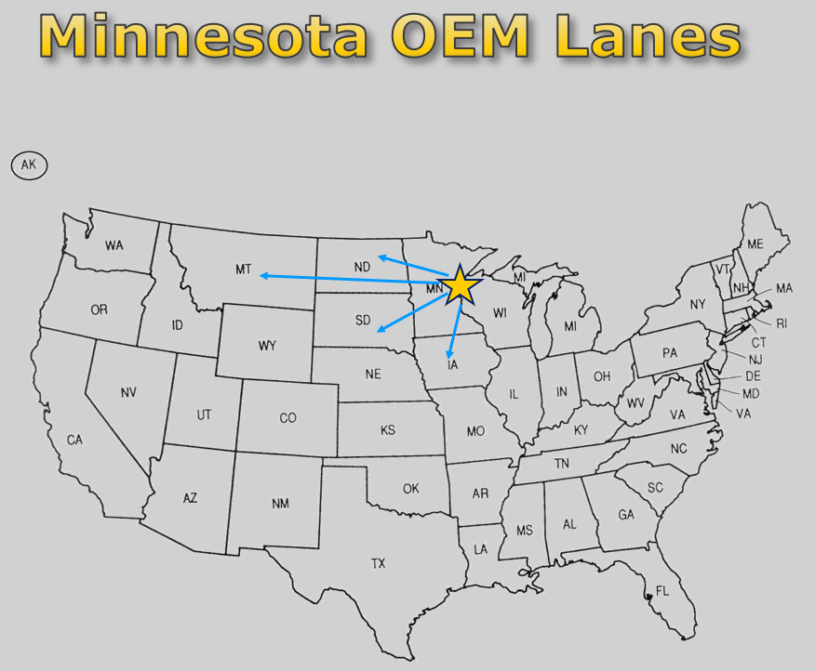

Slide 11
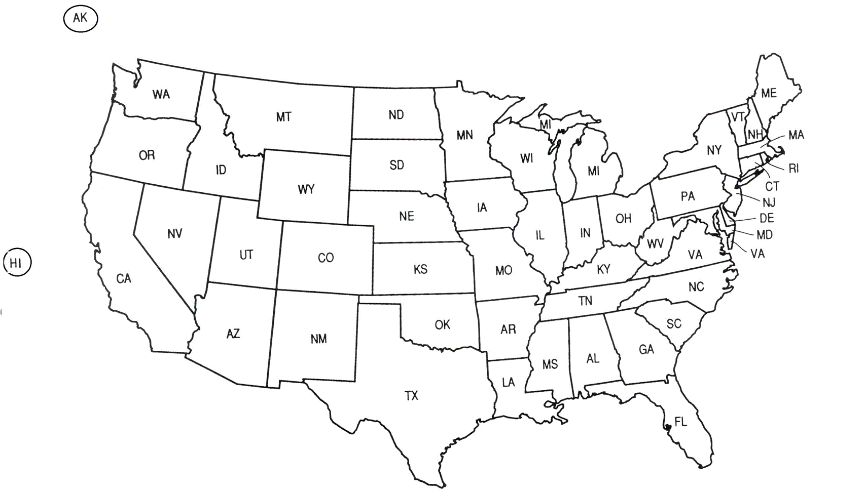
Midwest OEM Lanes

Slide 12
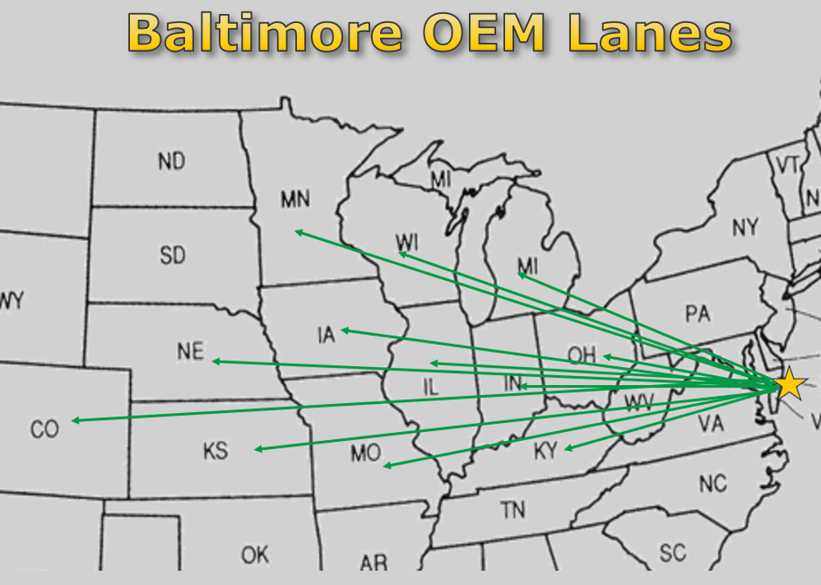
Baltimore

Slide 13
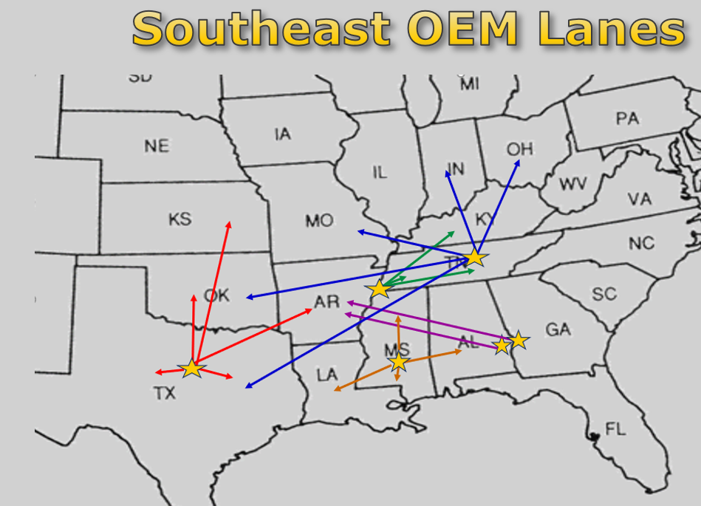

Slide 14
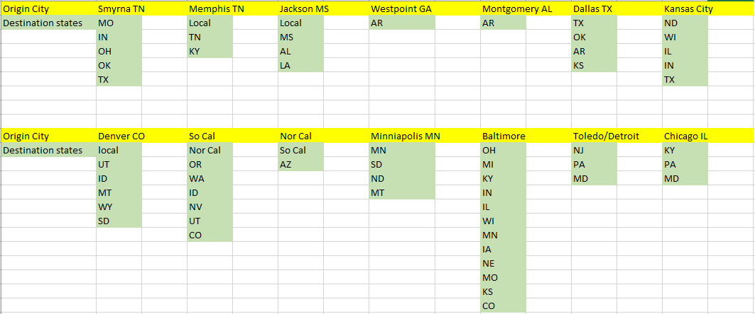

Slide 15
Some Numbers
A driver need to earn around $15K per settlement period (2 weeks) to be a successful owner operator. $30k per month. $360K per year.
10K miles ran per month @ $3 rpm = $30K per month in revenue. This is very obtainable with our Network synergies and long-haul miles at Accelerated. See breakdown below.
  10,000 miles per month = 2500 miles per week (4 weeks)
  2500 miles per week = 357 miles per day
  357 miles per day at average of 68mph = 5.25 hours of driving each day

Slide 16
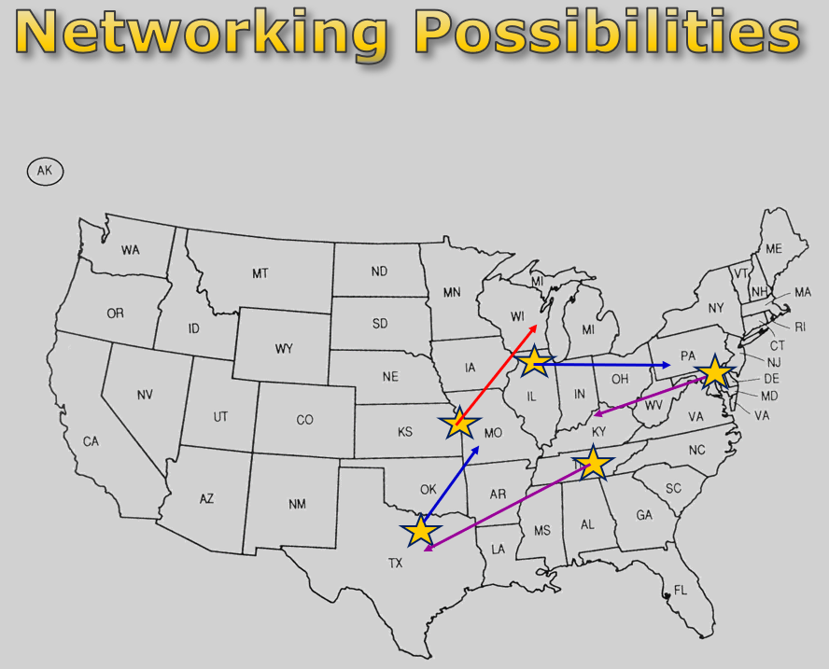

Slide 17
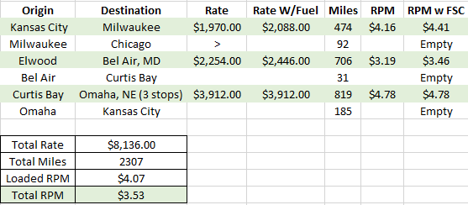
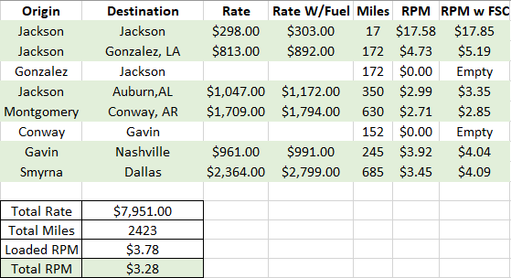
Trip Tour Examples From Across the network

Slide 18
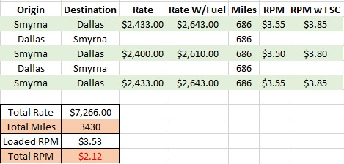
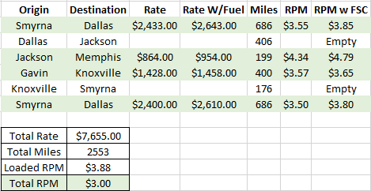
Why Networking is important
Out and Back- would need 7 days and average driving 500 miles per day
Running the Network- done in 6 days

