Slide 1
EQS Logistics Kickoff Meeting
November 1, 2021

Slide 2
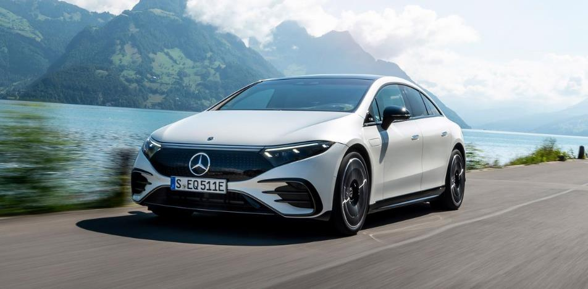
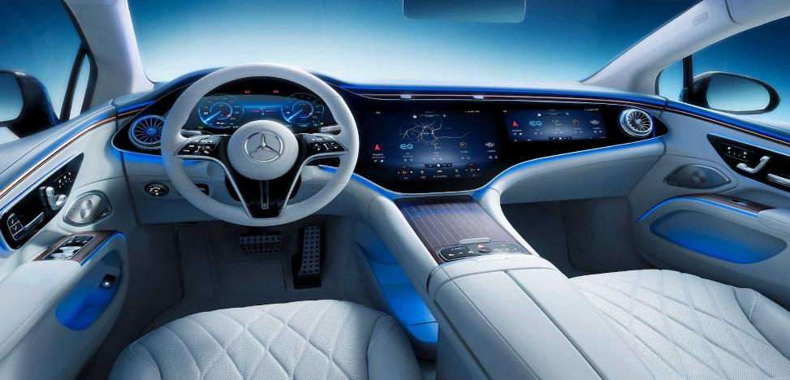
Weights & Dimensions

Slide 3
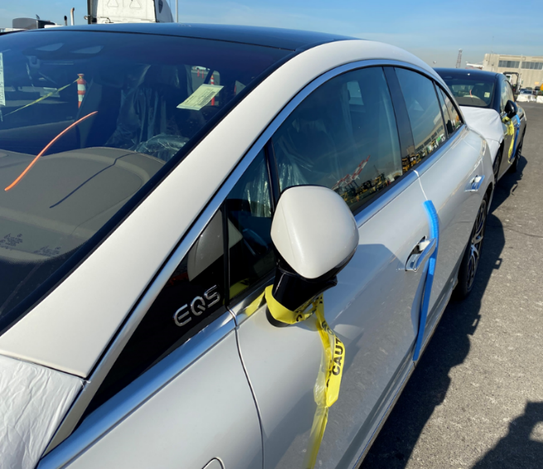
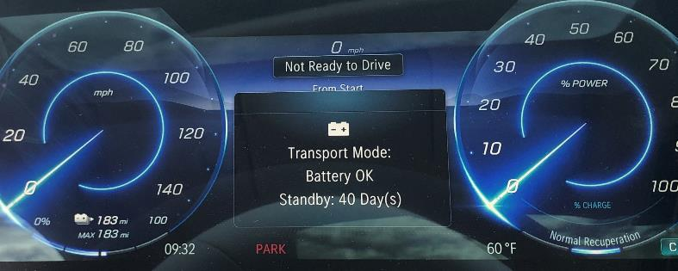
Transport Mode on the EQS
Do not load any EQS that is out of transport mode.
Transport mode raises the suspension of this vehicle to load height. Extra ~2” clearance.
Transport mode locks the 3 passenger doors and trunk and extends only the exterior driver’s door handle
Transport mode is indicated on the driver’s display.
If the vehicle is not in Transport Mode, please alert an MBUSA representative to switch the car into TM mode before loading.

Slide 4
Loading Restrictions on the EQS
The clearance over the tandem is too tight to allow loading on the forward position on the lower level.

Slide 5
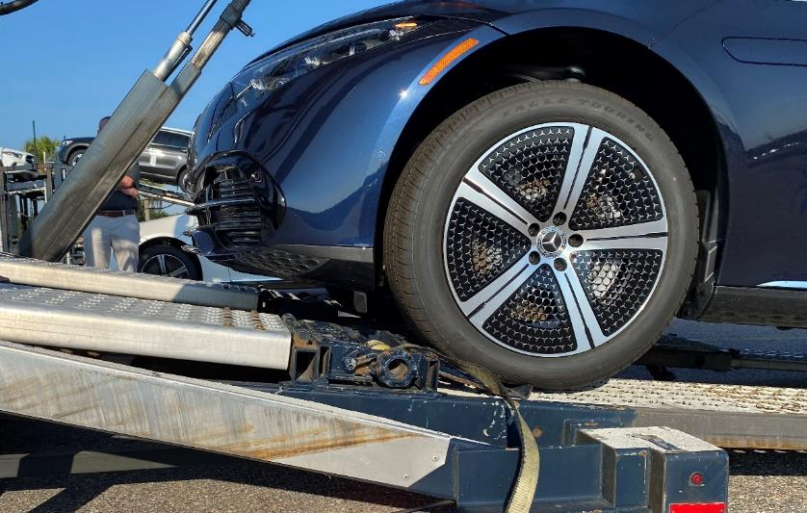
Loading Restrictions on the EQS
The back bottom slide and the loading skid needs to be all the way out and the air bag valves for the tandem need to be dropped when loading.
Preferred load: Not in position 1 (above cab of truck) with no more than 3 on the top deck, and 1 on the bottom deck (back position).
NOTE: recommended to load NO more than 4 EQS units per truck.
×
✓
✓
✓
✓
×
×
×
✓

Slide 6
Special Features on the EQS
The EQS is equipped with door handles that retract into the door of the car. The door handles extend when the doors are unlocked. If you approach a car and the door handles are retracted push on the lower forward corner (1) and gently pry the handle out from the opposite end (2) with your other hand.
1
2

Slide 7
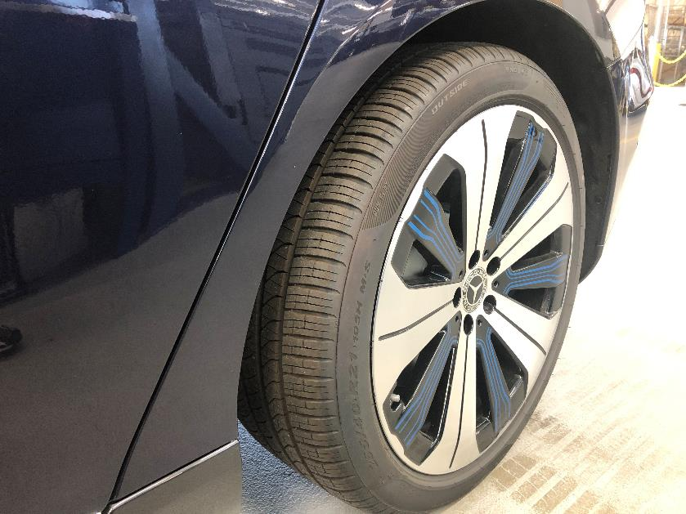
Special Features on the EQS
The EQS has 4-wheel steering. In tight places, be aware that the back of the car will steer. The back wheels can turn 10 degrees at slow speeds.
“Feathering” the accelerator to inch the car forward or backward is more sensitive on an electric car. Be aware when entering/exiting ramps.
*Example: Rear Wheel at max 10 degree angle

