Slide 1

Evangelism
Mark 16:15
Then He said to them, “Go into all the world and preach the gospel to the whole creation.

Slide 2
How do we effectively Evangelize ?
The easiest place to start would be to understand what the gospel is. GOSPEL=Good news of Jesus Christ. His birth, life, death and resurrection. A lot of time we tend to as believers especially leaders to over think and over complicate things. Jesus entire purpose for coming was to save the lost. (Luke 5:32) I have not come to call the righteous, but sinners to repentance.” To the lord it wasn’t complicated it was the foundation, the very base of what it means to be a Christian. I think luke 15 is a great place to explain Jesus heart for his people. Most have heard the parable of the 99 sheep, read Luke 15 for clarity. For this leason we will paraphrase. The good sheperd had 99 sheep hearded saftley were they belonged, and one lost sheep. He leaves the 99 to chase the lost sheep. A picture of the true heart of the gospel. Jesus had and still has his heart focused on the lost. Not that the other 99 are not important, but they already have the comfort, love, and direction of the good sheperd. The sheperd finds the lost sheep rejoices and brings it into the flock. Then Jesus says this; " I tell you, in the same way, there will be more joy in heaven over one sinner who repents than over 99 righteous people who don’t need repentance. Our hearts should be for the lost, for we have already been given our reward (our savior). It reminds me of the prodigal son. The end of the story results in the son who squandered his fathers inheritence and prostituted himself to the world returning to the love of the father, not as a slave but as a child! The focus then shifts to the older brother who is angered because he never was given such rejoicing and he never left the father. He is then told, we must rejoice my son has come home! See the older brother had not realized that although he had done nothing wrong he did not have the right focus. His reward he was living! Each and everyday he had opportunity to be in the presence, love and, intimacy of the father. What was he lacking? Jesus was trying to show his disciples his focus is on those who are not yet his! We must also shift our focus to being trained and equipped to get the lost sheep back to the good sheperd.
So lets get into it. Who, what, when, were, and why of preaching the gospel. The first question we will answer in our understanding evangelizm is the WHO!

Slide 3
The WHO of Evangelism.
This at first sounds like it should be an easy one to answer right? The lost. Well that is the truth, but is the truth actually happening? Record numbers of "Christian" people are leaving the faith each year, and statistically the number of professing "Christians" is declining each year. I will not address this issue right now, check the calltoarms website for videos on the matter. What I will say is; the church is NOT doing its job. We sermonize our fellow believers and beat them down with repentance messages. Our fervor and drive had become lax. We rarely do anything to make us un-comfortable. Instead we invite them to a building we call "Church" and hope our pastors preach good so they get saved??? Are you kidding me this is not the gospel.
Who is it that we should be evangelizing? The lost; the ones who have not accepted Jesus. Be pro-active and go out to the world to preach the gospel. We do NOT evangelize the Church. We do NOT evangelize believers who have strayed away to their sinful nature. WE EVANGELIZE THE LOST!
Romans 10:10-17
For with the heart one believes and is justified, and with the mouth one confesses and is saved. For the Scripture says, “Everyone who believes in him will not be put to shame.” For there is no distinction between Jew and Greek; for the same Lord is Lord of all, bestowing his riches on all who call on him. For “everyone who calls on the name of the Lord will be saved.” How then will they call on him in whom they have not believed? And how are they to believe in him of whom they have never heard? And how are they to hear without someone preaching? ...

Slide 4
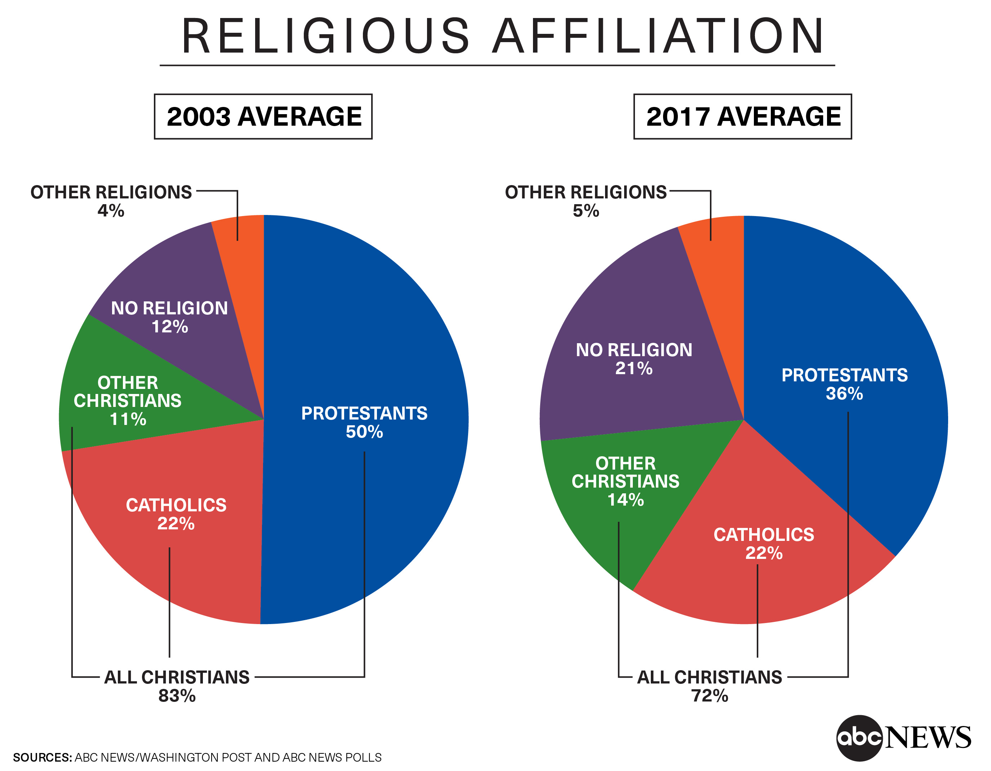
Continued
We cannot allow our agenda stop the spread of Jesus word throughout the nations. False conversions, false religions, religions claiming to be Christ followers all have flooded the world. All the while the true Church who has the very means to save them stays silent.
Part 2 of the who is; who is supposed to or can evangelize? This is simple and won't require much response. All who have the word of truth the gospel of our salvation MUST! Each and every one of us are required and mandated by God to go into the world and preach the gospel.

Slide 5

WHAT?
What is the best method to evangelize? What do you say? What do you do? Is there a right or wrong way?
Step 1: I would for starters like to make a very important distinction before getting too into it.
When you evangelize your method and approach may change depending on the person. If it’s a person you know and are personal with it will become easier. If it is a complete stranger it may be a lot harder.

Slide 6
Do you know Jesus as your Lord and savior? The truth doesn’t change but the method MUST! 1Cor 9:19 Become all things to all men.
Method
Examples
Open Air preaching-
Confrontational
Analytical/Sophisticated
Emotional/Personal
This is the method the disciples often. In the markets, fields, shore. Wherever they went they just began to speak allowed Christ love. In all these methods you must find common ground. Be quick to listen slow to speak. Remember you may be the planter, you may water, you may do both BUT GOD gives the growth. Don’t be disappointed if you don’t see it yourself.
https://youtu.be/nfQjvuU_aT0
https://youtu.be/QsboZ0XmsvQ
https://youtu.be/i_Bt3S-Y1ug
Each of these are rooted in the persons individual gifts God has given them. Do what is best for you with the ability God has given you. What is most important is that you follow Holy spirit and trust he will lead you.

Slide 7
What do we preach?
1 Cor 1:23- Preach Christ and him crucified.
John 8:32- Preach the truth, it will set them free. (Not your agenda)
Matthew 3:2- Preach Repentance, It’s the way to salvation.
Remember again you may plant a seed, you may water someone else seed, but rely on God for growth. Always your method should be rooted in the love of Jesus. How he loves them and what he did on their behalf. Not with intent to win an argument, look smart, or fulfill your Christian "duty".
St. Francis reportedly said, "Preach Jesus, and if necessary use words." Witness for Christ each day, and if necessary use words.

Slide 8
When do we evangelize?
Don’t worry not a lot of reading on this one.
ALL THE TIME!
Be holy spirit led, and always be willing to give an account of those who ask of you the hope of your salvation. 1 Peter 3:15
PLEASE hear this! NEVER EVER EVER EVER!!!!!!!EVER brush off someone who comes to you seeking the lord or asking about the lord. Those are moments that persons heart is ready to receive and willing to listen. It is an opportunity for harvest.
I was always understanding of the scripture in REV that says in the last days the harvest will be plenty but the laborers few. Not until recently in my walk has it really clicked and opened my heart to its meaning. It's not that there will not be many Christians during the harvest, it's that those Christians will not be willing to LABOR! Let's get off our lazy pew warmers and Labor.

Slide 9

Where do you evangelize?
Again this should be simple, but has some aspects that should be observed.
Use wisdom, take a partner with you when evangelizing.
Don’t go to places that are pathways to temptation (Bars/Strip club.....ect)
Be prayed up and listen to were God leads you.
Don’t over think, you are where you are because Jesus has placed you there for such a time as this.
Try and be in places where people feel comfortable. Walls are always the hardest to overcome. Un-comfortability will not help that.

Slide 10
Why? Why evangelize?
What is more important than the eternity of those we know, meet and love?
Jesus died so that none would perish. We cannot treat His death on the cross as some historical event with no personal value. The creator of the universe died so we may live.
If you do not, and they do not, and we do not. No one will. Don’t be the reason someone didn’t get to have personal relationship with Jesus!
God commanded us Go into the world and preach the gospel. We are saved through faith alone YES, but without action to our faith. Faith without works is DEAD.

